Slide 1
Comparison of IVUS-guided vs. Angiography-guided Angioplasty for the Outcomes of DCB
in the Treatment of Femoropopliteal Artery Disease
Young-Guk Ko, MD.
on behalf of IVUS-DCB Investigators
Professor, Division of Cardiology Severance Cardiovascular Hospital Yonsei University, Seoul, Korea

Slide 4
To compare the outcomes of IVUS-guided DCB angioplasty with those of
angiography-guided DCB angioplasty in the treatment of femoropopliteal artery disease.

Slide 5
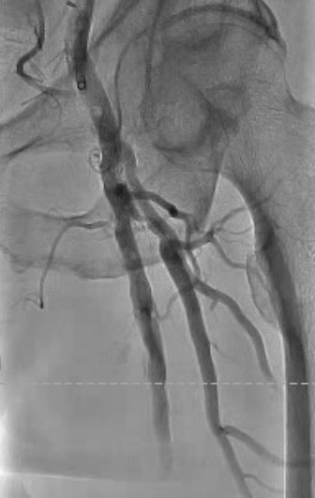
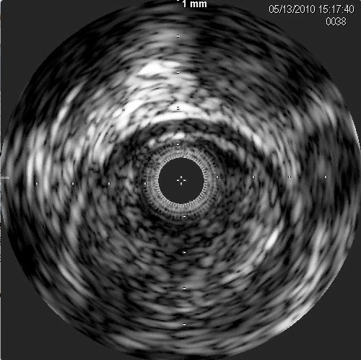
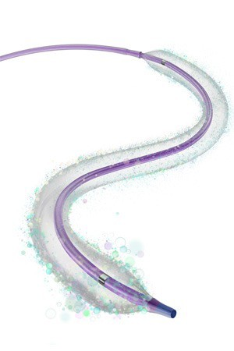
Patients with symptomatic femoropopliteal artery disease
IIT
Multicenter RCT
Rutherford category 2~5
N = 237 from 7 centers in Korea
1:1 randomization
IVUS Guidance (n=119) |  |  |  | Angiography Guidance (n=118)
 | Angioplasty using DCBs (IN.PACT, Medtronic)
Primary endpoint: Primary patency at 12 months

Slide 6
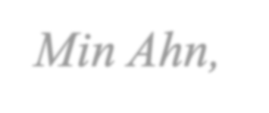
Severance Hospital, Seoul, Korea
Young-Guk Ko, Seung-Jun Lee, Chul-Min Ahn, Donghoon Choi
NHIS Ilsan Hospital, Goyang, Korea
Ji Yong Jang
Sejong General Hospital, Incheon, Korea
Tae-Hoon Kim, Ha-Wook Park
Chungnam National University Hospital, Daejeon, Korea
Jae-Hwan Lee, Jae-Hyeong Park
Busan Veterans Hospital, Busan, Korea
Su Hong Kim
Yongin Severance Hospital, Yongin, Korea
Eui Im
Soonchunhyang University Cheonan Hospital, Cheonan, Korea
Sang-Ho park

Slide 7
 | IVUS Guidance | Angiography Guidance
 | (n=119) | (n=118) | P value
Age, years | 69.0 ± 9.1 | 70.2 ± 8.6 | 0.31
Men | 102 (85.7) | 100 (84.7) | 0.98
Body mass index, kg/m² | 23.8 ± 3.4 | 23.4 ± 3.1 | 0.32
Hypertension | 94 (78.0) | 99 (83.8) | 0.44
Diabetes mellitus | 71 (59.7) | 79 (67.5) | 0.26
Dyslipidemia | 84 (70.6) | 86 (72.9) | 0.80
Chronic kidney disease | 29 (24.4) | 19 (16.1) | 0.16
End-stage kidney disease on dialysis | 14 (11.8) | 8 (6.8) | 0.27
Current smoker | 37 (31.1) | 41 (34.7) | 0.76
CAD | 45 (37.8) | 31 (26.3) | 0.08
Prior stroke | 14 (11.8) | 14 (11.9) | 0.99
Prior peripheral revascularisation | 18 (15.1) | 18 (15.3) | 0.99
Prior limb amputation Clinical presentation | 5 (4.2) | 4 (3.4) | 0.99
Claudication | 89 (74.8) | 86 (72.9) | 0.66
CLTI | 39 (25.2) | 32 (27.1)
Pre-procedural ABI | 0.64 ± 0.21 | 0.63 ± 0.21 | 0.74

Slide 8
IVUS Guidance |  | Angiography Guidance
(n=119) |  | (n=118) | P value
TASC II lesion type
A/B | 39 (32.8) | 40 (33.9)
C/D | 80 (67.2) | 78 (66.1)
Lesion length, mm | 204.9 ± 103.1 | 214.5 ± 102.9 | 0.48
Reference vessel diameter, mm | 5.0 ± 0.7 | 5.0 ± 0.7 | 0.79
Minimal lumen diameter, mm | 0.36 ± 0.65 | 0.47 ± 0.68 | 0.20
Total occlusion | 78 (66.7) | 68 (58.1) | 0.23
Severe calcification (PACCS grade 4) | 38 (31.9) | 30 (25.4) | 0.34
Popliteal involvement | 11 (9.2) | 10 (8.5) | >0.99
Poor distal runoff (0 or 1 vessel) | 30 (25.2) | 36 (30.5) | 0.44
0.96

Slide 9
IVUS
Guidance (n=119)
Angiography Guidance (n=118)
P value
Subintimal approach Atherectomy
31 (26.5)
41 (35.0)
31 (26.5)
38 (32.5)
>0.99
0.78
Pre-balloon diameter, mm
5.0 ± 0.9
4.5 ± 1.1
<0.001
Pre-balloon length, mm
122.3 ± 57.5
119.1 ± 62.8
0.69
Pre-balloon maximal pressure, mmHg
11.8 ± 3.6
8.9 ± 2.7
<0.001
Total number of DCBs Maximal DCB diameter, mm Mean DCB diameter, mm
2.0 ± 0.8
5.8 ± 0.7
5.4 ± 0.6
2.0 ± 0.8
5.8 ± 0.7
5.4 ± 0.6
0.75
0.95
0.92
Adjuvant post-dilatation
31 (26.1)
16 (13.6)
0.03
Maximal post-balloon pressure, mmHg
13.7 ± 2.9
9.6 ± 4.0
0.001
Bailout stenting
24 (20.5)
17 (14.5)
0.30
Post-procedural minimal lumen diameter, mm Post-procedural diameter stenosis, %
3.90 ± 0.59
21.5 ± 12.0
3.71 ± 0.73
25.4 ± 13.3
0.03
0.02

Slide 10
 | IVUS Guidance | Angiography Guidance | P value
 | (n=119) | (n=118)
Technical success* | 91 (76.5) | 72 (61.0) | 0.02
Procedural success† | 88 (73.9) | 71 (60.2) | 0.03
Dissection type | 70 (59.8) | 68 (58.1) | 0.67
A | 8 (10.7) | 15 (20.3)
B | 35 (46.7) | 29 (39.2)
C | 20 (26.7) | 18 (24.3)
D | 5 (6.7) | 5 (6.8)
E | 2 (2.7) | 1 (1.4)
Distal embolisation | 0 | 0 | –
Target lesion perforation | 1 (0.9) | 1 (0.9) | >0.99
Access site complications | 2 (1.7) | 2 (1.7) | >0.99
Post-procedure ABI | 0.99 ± 0.13 | 0.93 ± 0.15 | 0.001
*defined as residual stenosis of <30% without flow compromise; †defined as technical success without any acute complications

Slide 11
83.8%
100
IVUS
80
Primary patency (%)
Angiography
60
70.1%
40
HR, 0.46; 95% CI, 0.25-0.85
Log-rank P = 0.01
20
0
0
90 180 270
Days since Randomization
360
No. at Risk
IVUS Guidance 99
Angio Guidance 97
99
93
98
90
94
76
69
57

Slide 12
Freedom from TLR
Sustained clinical improvement
100
IVUS
92.4%
IVUS
100
89.1%
Proportion of patients free from target lesion revascularization (%)
80
Proportion of patients with primary patency (%)
Angiography
80
83.0%
Angiography
60
60
76.3%
HR, 0.41; 95% CI, 0.19-0.90
Log-rank P = 0.03
HR, 0.45; 95% CI, 0.23-0.86
Log-rank P = 0.02
40
40
20
20
0
0
0
90 180 270
Days since Randomization
360
0
90 180 270
Days since Randomization
360
No. at Risk
No. at Risk
IVUS Guidance | 119 | 119 | 116 | 110 | 90 | IVUS Guidance | 119 | 119 | 116 | 108 | 74
Angio Guidance | 118 | 113 | 106 | 94 | 77 | Angio Guidance | 118 | 113 | 105 | 89 | 66

Slide 13
TASC-II type A/B
TASC-II type C/D
IVUS
96.9%
IVUS
100
100
84.8%
Angiography
94.1%
Primary patency (%)
80
Primary patency (%)
80
60
60
Angiography
58.7%
40
HR, 0.62; 95% CI, 0.15-2.58
Log-rank P = 0.52
40
HR, 0.33; 95% CI, 0.17-0.67
Log-rank P = 0.002
20
20
0
0
0
90 180 270
Days since Randomization
360
0
90 180 270
Days since Randomization
360
No. at Risk
No. at Risk
IVUS Guidance | 32 | 32 | 32 | 31 | 21 | IVUS Guidance | 67 | 67 | 66 | 62 | 48
Angio Guidance | 34 | 34 | 32 | 31 | 24 | Angio Guidance | 63 | 59 | 58 | 45 | 31

Slide 14
 | Univariate |  | Model 1 | Multivariate Model 2
 | HR (95% CI) | P-value | HR (95% CI) | P-value | HR (95% CI) | P-value
Lesion length ≥200 mm | 2.96 (1.50-5.87) | 0.002 | 2.36 (1.14-4.91) | 0.02 | 2.15 (1.07-4.34) | 0.03
Total occlusion | 2.32 (1.12-4.84) | 0.02 | 1.43 (0.62-3.29) | 0.40 | 1.59 (0.69-3.70) | 0.28
Subintimal recanalization | 2.57 (1.42-4.64) | 0.001 | 1.91 (1.02-3.60) | 0.04 | 1.43 (0.73-2.80) | 0.30
Use of IVUS | 0.46 (0.25-0.85) | 0.01 | 0.40 (0.21-0.75) | 0.004 | - | -
Post-procedural MLD (per 0.1 mm decrease) | 1.14 (1.09-1.20) | <0.001 | - | - | 1.13 (1.07-1.18) | <0.001

