Slide 1
A Selective Aldose Reductase Inhibitor for the Treatment of Diabetic Cardiomyopathy
Primary Results of the Phase 3 Randomized Controlled ARISE-HF Study
James L. Januzzi Jr, MDª, Javed Butler, MD, MPH, MBA^{b,c}, Stefano Del Prato, MD^{d}, Justin A. Ezekowitz, MB, BCh^{e}, Nasrien E. Ibrahim, MD, MPH^{f}, Carolyn S.P. Lam MBBS, PhD^{g}, Gregory D. Lewis, MD^{h}, Thomas H. Marwick, MBBS, PhD, MPH^{i} , Riccardo Perfetti, MD, PhD^{j}, Julio Rosenstock, MD^{k} , Scott D. Solomon MD^{f},
W.H. Wilson Tang, MD^{l}, Faiez Zannad, MD, PhD^{m}
ªCardiology division, Massachusetts General Hospital, Baim Institute for Clinical Research and Harvard Medical School, Boston, MA, USA; ^{b}University of Mississippi Medical Center, Jackson, MS, USA; ^{c}Baylor Scott and White Institute, Dallas, TX, USA; ^{d}Interdisciplinary Center “Health Sciences”, Sant’Anna School of Advanced Studies, Pisa, Italy; ^{e}Division of Cardiology, University of Alberta, Canada; ^{f}Brigham and Women’s Hospital, Harvard Medical School, Boston, MA, USA; ^{g}National Heart Centre Singapore and Duke-National University of Singapore, Singapore, Baim Institute for Clinical Research, Boston, MA, USA; ^{h}Cardiology Division, Massachusetts General Hospital, Harvard Medical School, Boston, MA, USA; ^{i}Baker Heart and Diabetes Institute, Melbourne, Australia; ^{j}Applied Therapeutics, New York, NY, USA; ^{k}Velocity Clinical Research Center at Medical City, Dallas, TX, USA; ^{l}Heart, Vascular and Thoracic Institute, Cleveland Clinic, Cleveland, OH, USA; ^{m}Université de Lorraine, Inserm CIC and CHRU, Nancy, France.
Harvard Medical School

Slide 2
Disclosures
Dr. Januzzi:
Board member ACC, Imbria Pharma
Grant support from Abbott, Applied Therapeutics, AstraZeneca, BMS, Novartis Pharmaceuticals
Consulting income from Abbott Diagnostics, Beckman-Coulter, Jana Care, Janssen, Novartis, Prevencio, Quidel, and Roche Diagnostics
Clinical endpoint committees/data safety monitoring boards for Abbott, AbbVie, Amgen, CVRx, Medtronic, Pfizer, and Roche Diagnostics
The ARISE-HF Trial was sponsored by Applied Therapeutics, Inc

Slide 3
Introduction
Heart failure (HF) is a major cardiovascular complication among individuals with diabetes mellitus (DM)
Persons with DM have 2X risk for HF development
HF onset is often heralded by decline in exercise capacity
Risk for HF persists even when adjusting for presence of classical risk HF risk factors
DM itself may result in heart muscle disease, known as diabetic cardiomyopathy (DbCM)

Slide 4
Pathogenesis of DbCM & Hyperactivation of Polyol Pathway^{1,2}
Glucose
Hexokinase
Glucose-6- Phosphate
Glycolitic Pathway
Normal (Krebs Cycle)
Hyperglycemia / Ischemia (Polyol Pathway Activated)
Aldose Reductase
Sorbitol
Osmotic stress
CELL DEATH
Sorbitol Dehydrogenase
Redox Imbalance ROS Formation Advanced Glycation
PKC, NF-kB* Activation
CELL DEATH
Fructose
1. Brownlee M. Diabetes Care. 2005;54(6):1615-1625. 2. Miki T, et al. Heart Fail Rev. 2013;18(2):149-166.

Slide 5
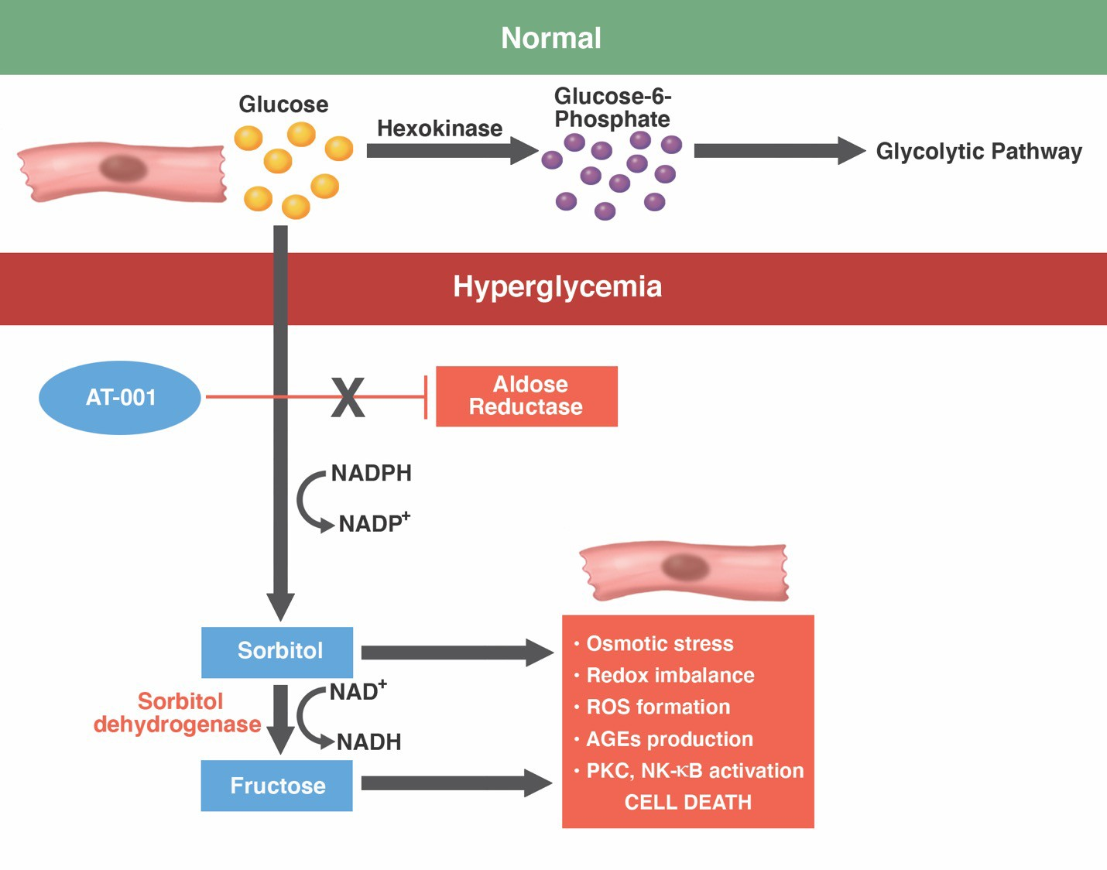
Blocking aldose reductase in DBCM
Aldose reductase inhibitors (ARIs) had previously been developed for treatment of microvascular complications
Most 1st generation ARIs were low potency and poorly tolerated due to side effects
AT-001 is a highly potent and well-tolerated ARI
Januzzi JL Jr, Butler J, Del Prato S, et al Am Heart J. 2023 Feb;256:25-36.

Slide 6
Hypothesis
Treatment of individuals with DbCM and reduced exercise capacity at high risk for HF with an Aldose Reductase Inhibitor (AT-001) would limit progression of DbCM reflected in stabilization of peak VO₂
Januzzi JL Jr, Butler J, Del Prato S, et al Am Heart J. 2023 Feb;256:25-36.

Slide 7
Key Inclusion/Exclusion Criteria
To be included, participants had T2DM and:
Stage B HF
Reduced exercise capacity
No known ASCVD, valvular heart disease, or arrhythmia
Study participants were required to have:
Controlled blood pressure
HbA1c <8.5%
Inclusion | Exclusion
Diagnosis of T2DM On stable glucose lowering and RAS inhibition Age ≥ 60 years or Age ≥ 40 to < 60 years and either duration of T2DM ≥ 10 years or eGFR< 60 mL/min DbCM/Stage B HF with at least 1: GLS < 16% Increased LVMi LAVi > 34 mL/m2 E/E’ ≥ 13 RVSP> 35 mmHg NT-proBNP ≥ 50 ng/L hs-cTnT ≥ 6 ng/L Peak VO₂ < 75% of predicted RER ≥1.05 | Known or suspected Stage C HF Loop diuretic use BP > 140/> 90 mmHg HbA1c >8.5% Prior ACS Severe CAD Prior CABG or PCI Severe valvular heart disease Clinically significant arrhythmia including permanent AF or PAF requiring hospitalization Prior stroke BMI≥ 45 kg/m²
Januzzi JL Jr, Butler J, Del Prato S, et al Am Heart J. 2023 Feb;256:25-36.

Slide 8
Study Design
Screening
Study completion: 15 months
AT-001 1500 mg
CPET
A sample size of 181 patients per treatment group was calculated to provide the analysis >90% power to detect a difference in peak VO₂ of 1.2 mL/kg/min
CPET
AT-001 1000 mg
R
Placebo
Twice-daily oral dosing
Inclusion stratified by region, baseline CPET result, and use of SGLT2 inhibitor or GLP-1RA
Owing to COVID-19 related delays, a planned extension to 27 months if the primary endpoint was neutral at 15 months was removed
CPET denotes: cardiopulmonary exercise test; SGLT2 denotes: sodium/glucose cotransporter 2; GLP-1RA denotes: glucagon like peptide receptor agonist-1
Januzzi JL Jr, Butler J, Del Prato S, et al Am Heart J. 2023 Feb;256:25-36.

Slide 9
Endpoints
Primary endpoint: change in peak VO₂ from baseline to 15 months between placebo and high dose AT-001
Prespecified sub-groups:
Region of enrollment
Sex
CPET parameters (peak VO₂, RER)
Hemoglobin A1c
Baseline NT-proBNP and/or hs-cTnT
Baseline use versus non-use of SGLT2 inhibitor and/or GLP-1 RA
Januzzi JL Jr, Butler J, Del Prato S, et al Am Heart J. 2023 Feb;256:25-36.

Slide 10
Endpoints
Key secondary endpoints:
Percentage of study participants with ≥6% decrease in peak VO₂
Change in NT-proBNP concentration
Change in Kansas City Cardiomyopathy Questionnaire (KCCQ) score
Change in activity using the Physical Activity Scale for the Elderly (PASE)
Progression to symptomatic HF events
Composite of CV death, HF hospitalization or development of signs/symptoms of HF
Based on adjudicated endpoints plus adverse event reporting using Medical Dictionary for Regulatory Activities (MedDRA) preferred terms
Januzzi JL Jr, Butler J, Del Prato S, et al Am Heart J. 2023 Feb;256:25-36.

Slide 11
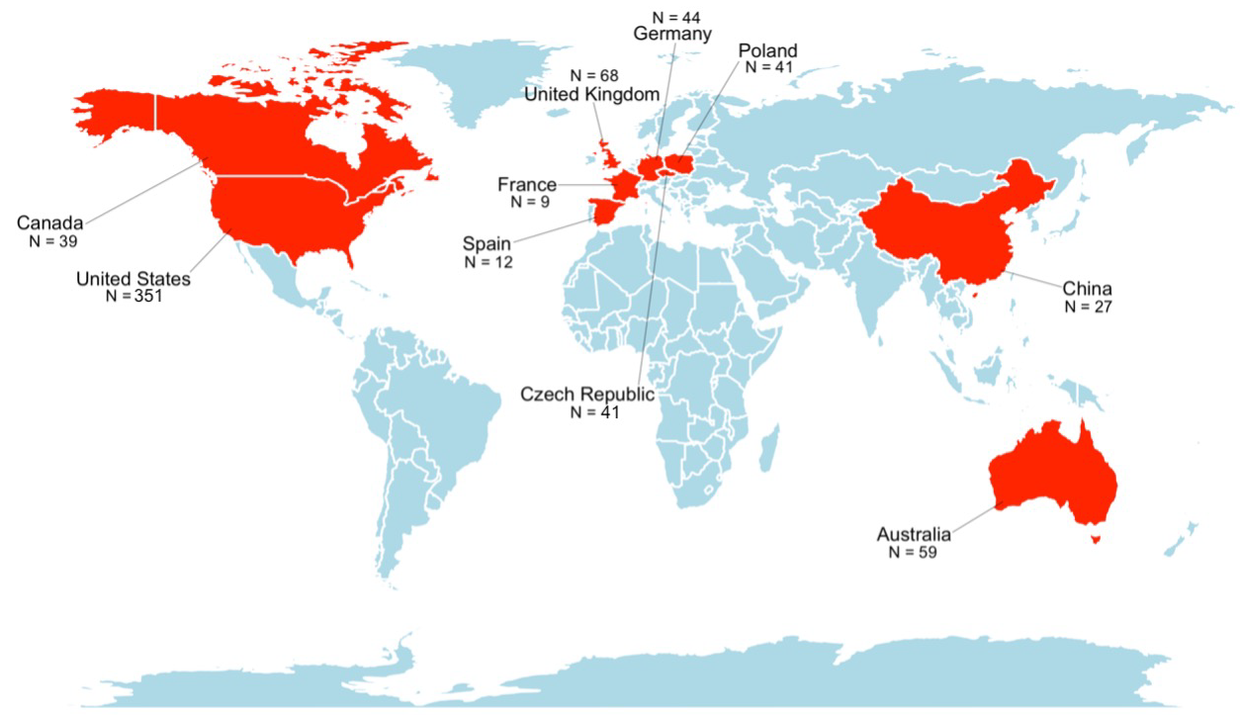
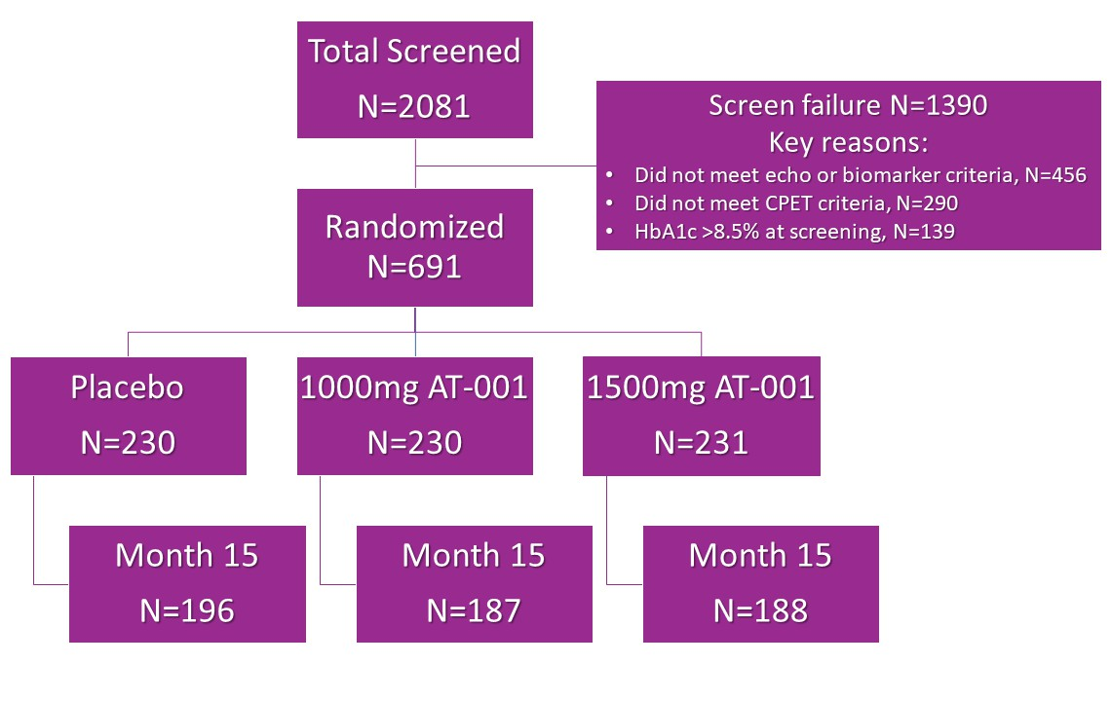
Sites/enrollment: 62 sites

Slide 12
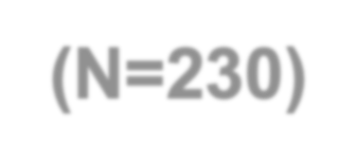
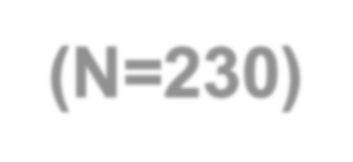
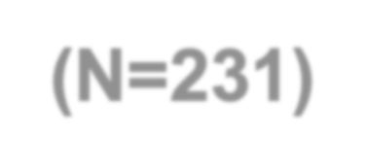
Baseline characteristics
 | Placebo (N=230) | AT-001 1000 mg (N=230) | AT-001 1500 mg (N=231)
Age, years | 68.2 ± 6.7 | 67.4 ± 7.8 | 66.9 ± 7.0
Female, n (%) | 124 (53.9) | 107 (46.5) | 117 (50.6)
Race, n (%)
White | 195 (84.8) | 191 (83.0) | 184 (79.7)
Black | 14 (6.1) | 13 (5.7) | 23 (10.0)
Hispanic ethnicity, n (%) | 44 (19.1) | 48 (20.9) | 59 (25.5)
Body-mass index, kg/m² | 30.9 ± 4.8 | 30.4 ± 4.6 | 30.5 ± 4.4
SBP, mmHg | 131 ± 17 | 132 ± 17 | 131 ± 16
Medical history, n (%)
Hypertension | 179 (77.8) | 179 (77.8) | 165 (71.4)
Dyslipidemia | 45 (19.6) | 36 (15.7) | 35 (15.2)
Duration of T2DM, years | 14.4 ± 9.2 | 14.6 ± 9.2 | 14.4 ± 9.0
SGLT2i or GLP-1RA, n (%) | 86 (37.4) | 89 (38.7) | 88 (38.1)
Average age of 68 years
Female predominant (50.4%)
Race and ethnicity reflective of international enrollment
Medical evaluation included a BMI of 31 but well-controlled blood pressure
Long-standing history of T2DM
62% were not receiving an SGLT2i or GLP-1RA at baseline
SD denotes: standard deviation; kg denotes: kilogram; m² denotes: square meter; SBP denotes: systolic blood pressure; SGLT2i denotes: sodium/glucose cotransporter 2 inhibitor; GLP1-RA denotes: glucagon-like peptide-1 receptor agonist

Slide 13
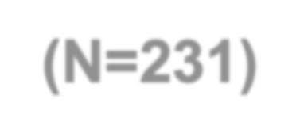
Baseline characteristics, objective results
Parameter | Placebo (N=230) | AT-001 1000 mg (N=230) | AT-001 1500 mg (N=231)
Hemoglobin A1c, % | 6.96±0.74 | 7.04±0.81 | 6.98±0.80
eGFR, mL/min/1.73m² | 81±16 | 81±16 | 80±17
NT-proBNP, ng/L, median (Q1,Q3) | 76 (42,145) | 74 (39,137) | 63 (27,114)
hs-cTnT, ng/L, median (Q1,Q3) | 8 (6,13) | 9 (6,12) | 9 (6,12)
PASE Score | 159 ± 94 | 150 ± 90 | 157 ± 87
KCCQ Overall Summary Score | 90 ± 16 | 90 ± 15 | 91 ± 13
KCCQ Clinical Summary Score | 90 ± 15 | 91 ± 14 | 91 ± 13
KCCQ Total Symptom Score | 92 ± 15 | 92 ± 15 | 94 ± 13
Baseline RER ≥1.15, n (%) | 132 (57.4) | 131 (57) | 131 (56.7)
Baseline peak VO₂, mL/kg/min | 15.6 ± 3.8 | 15.7 ± 3.8 | 16 ± 3.9
Well-controlled T2DM
Preserved kidney function
~25% with high-risk NT- proBNP or hs-cTnT
PASE consistent with reduced activity but with well-preserved KCCQ scores
Impairment in exercise capacity with average peak VO₂ of 15.7 mL/kg/min
Results are mean ± standard deviation unless otherwise specified
eGFR denotes: estimated glomerular filtration rate; mL denotes: milliliters; min denotes: minute; NT-proBNP denotes: N-terminal pro-B type natriuretic peptide; ng/L denotes: nanograms/liter; hs-cTnT denotes: high sensitivity cardiac troponin T; PASE denotes: Physical Activity Scale for the Elderly; SD denotes: standard deviation; KCCQ denotes: Kansas City Cardiomyopathy Questionnaire; RER denotes: respiratory exchange ratio; VO₂ denotes: oxygen consumption

Slide 14
Change in Peak VO₂ by 15 months
0.4
0.2
0.0
-0.2
-0.4
-0.6
-0.8
Adjusted Peak VO2 Mean Change from Baseline +/- SE
Baseline peak VO₂ = 15.7± 3.8
-1.0
Baseline
Month 15

Slide 15
Change in Peak VO₂ by 15 months
0.4
0.2
Adjusted Peak VO2 Mean Change from Baseline +/- SE
Change AT-001 1500 mg: -0.01 (SE=0.18)
P =.21 compared to baseline
0.0
-0.2
-0.4
-0.6
-0.8
AT-001 1500 mg twice daily
Baseline peak VO₂ = 15.7± 3.8
-1.0
Baseline
Month 15

Slide 16
Change in Peak VO₂ by 15 months
0.4
0.2
Adjusted Peak VO2 Mean Change from Baseline +/- SE
Change AT-001 1500 mg: -0.01 (SE=0.18)
P =.21 compared to baseline
0.0
-0.2
Change Placebo: -0.31 (SE=0.18)
P =.005 compared to baseline
-0.4
-0.6
-0.8
AT-001 1500 mg twice daily
Placebo twice daily
Baseline peak VO₂ = 15.7± 3.8
-1.0
Baseline
Month 15

Slide 17
Change in Peak VO₂ by 15 months
0.4
0.2
0.0
Adjusted Peak VO2 Mean Change from Baseline +/- SE
LS-mean difference of change AT-001 vs Placebo = 0.30 (0.23)
P =.19
-0.2
-0.4
-0.6
-0.8
AT-001 1500 mg twice daily
Placebo twice daily
Baseline peak VO₂ = 15.7± 3.8
-1.0
Baseline
Month 15

Slide 18
Change in Peak VO₂ in those not receiving SGLT2 inhibitors or GLP1-RA*
*Prespecified subgroup and study
0.4
participants stratified on enrollment
Adjusted Peak VO2 Mean Change from Baseline +/- SE
0.2
Change AT-001 1500 mg: +0.08 (SE=0.22)
0.0
LS-mean difference of change AT-001 vs Placebo =0.62 (0.30)
P =.04
-0.2
-0.4
Change Placebo: -0.54 (0.21)
-0.6
-0.8
AT-001 1500 mg twice daily
Placebo twice daily
Baseline peak VO₂ = 15.7± 3.8
-1.0
Baseline
Month 15

Slide 19
Secondary endpoints
A ≥6% decline in peak VO₂ was observed in 41.8% of placebo-treated patients and 36.2% of those treated with high dose AT-001 (OR=0.80, 95% CI=0.52, 1.21; P
=.29)
Among non-users of SGLT2 inhibitors or GLP-1RA: 46.0% versus 32.7% (OR=0.56; 95% CI=0.33, 0.96; P =.04)
No significant differences in change of NT-proBNP, KCCQ domains or PASE results were observed

Slide 20
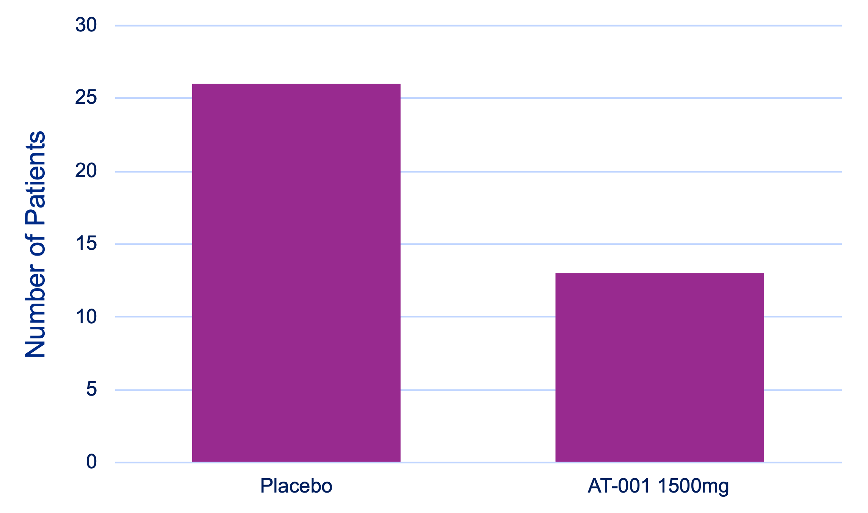
Development of HF symptoms or signs
26 study participants in the placebo group vs 13 patients in the high dose AT-001 group developed symptoms or signs of HF (Chi-squared P =.03)

Slide 21
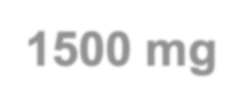
Safety, adverse events occurring in >5%
Characteristic | Overall | Placebo | AT-001 1000 mg | AT-001 1500 mg
COVID-19 | 131 (19.0) | 44 (19.1) | 53 (23.2) | 34 (14.7)
UTI | 96 (13.9) | 25 (10.9) | 34 (14.9) | 37 (16)
Constipation | 49 (7.1) | 11 (4.8) | 17 (7.5) | 21 (9.1)
Nausea | 51 (7.4) | 13 (5.7) | 20 (8.8) | 18 (7.8)
Decrease in eGFR | 39 (5.7) | 2 (0.9) | 16 (7) | 21 (9.1)
Diarrhea | 58 (8.4) | 23 (10) | 20 (8.8) | 15 (6.5)
Fatigue | 54 (7.8) | 22 (9.6) | 12 (5.3) | 20 (8.7)
Back pain | 40 (5.8) | 9 (3.9) | 14 (6.1) | 17 (7.4)
Nasopharyngitis | 45 (6.5) | 15 (6.5) | 19 (8.3) | 11 (4.8)
Dizziness | 37 (5.4) | 10 (4.3) | 5 (2.2) | 22 (9.5)
Arthralgia | 42 (6.1) | 16 (7) | 11 (4.8) | 15 (6.5)
Headache | 35 (5.1) | 11 (4.8) | 10 (4.4) | 14 (6.1)
URI | 37 (5.4) | 13 (5.7) | 12 (5.3) | 12 (5.2)
Fall | 37 (5.4) | 14 (6.1) | 7 (3.1) | 16 (6.9)
Peripheral edema | 36 (5.2) | 14 (6.1) | 10 (4.4) | 12 (5.2)
AT-001 was generally well-tolerated
Treatment with AT-001 was not associated with any evidence of significant liver injury
Rise in serum creatinine at any time during the trial was infrequent and transient
v There was no imbalance in drug discontinuation due to deterioration of kidney function
All results n (%); UTI denotes: urinary tract infection; eGFR denotes: estimated glomerular filtration rate; URI denotes: upper respiratory tract infection

Slide 22
Conclusions
Treatment with AT-001 was safe and well-tolerated but did not result in a statistically significant difference in peak VO₂ among persons with DbCM and reduced exercise capacity
The study participants in ARISE-HF had very well-controlled T2DM (A1c=6.98%), which may not reflect persons with DbCM more generally
A longer study duration might have been necessary
More investigation is needed regarding the potential role of AT-001 to improve cardiovascular outcomes in this high-risk population
Future studies should evaluate longer treatment with AT-001 in a more generalizable population of DbCM
The finding of superior outcomes in those not receiving SGLT2 inhibitors or GLP-1RA is exploratory in nature but bears further study

Slide 23
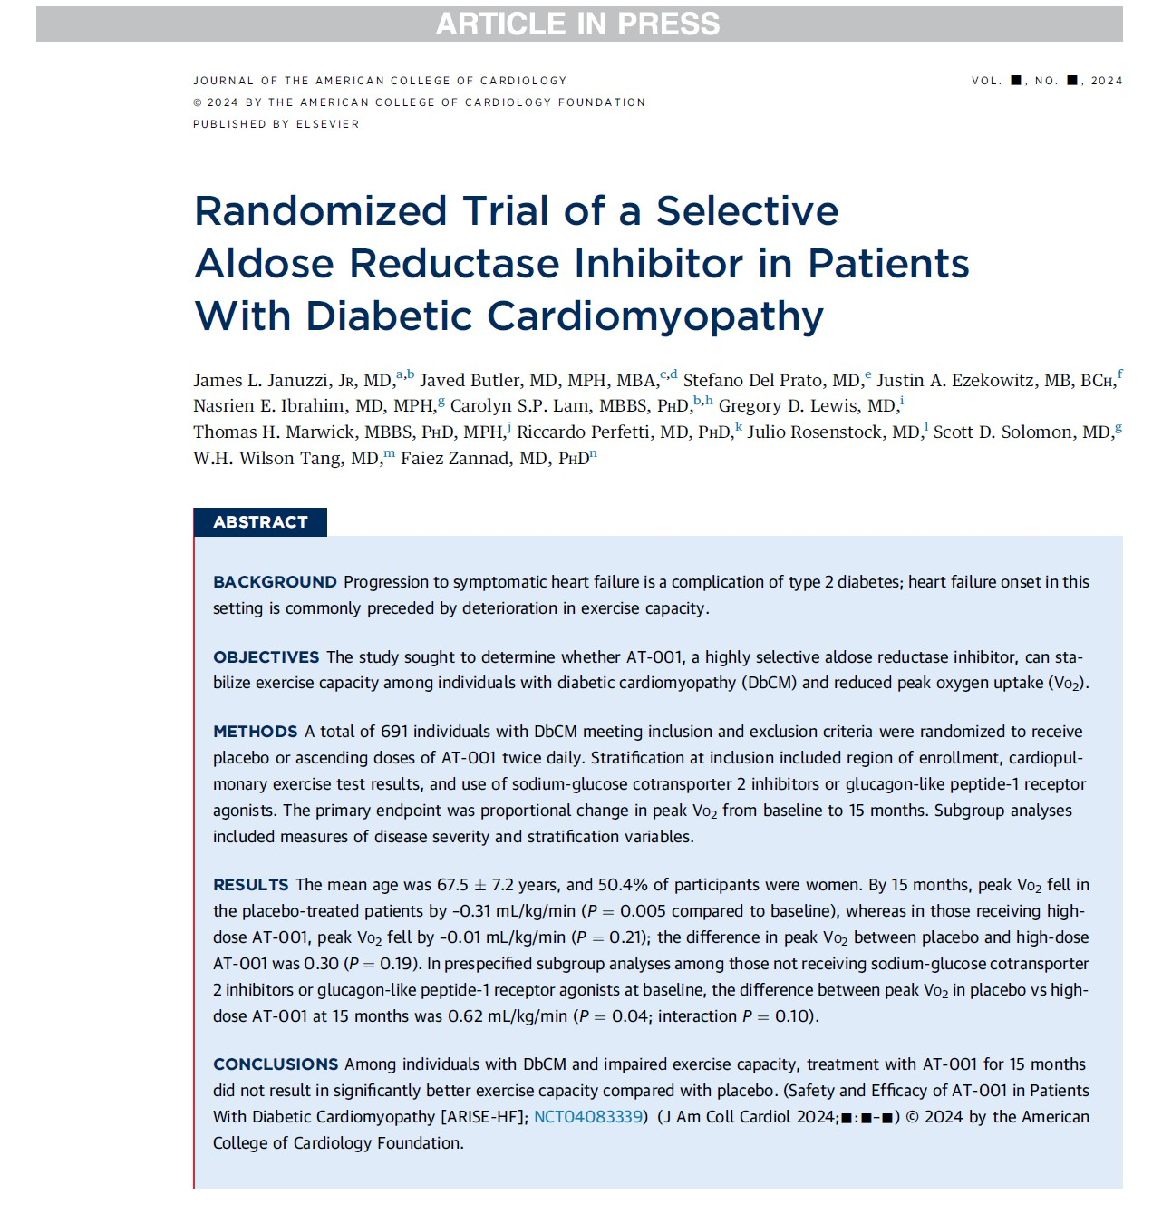
Conclusions
The investigators wish to thank our sites, investigators, and especially the patients for their participation in the ARISE-HF Trial
ARISE-HF is online now at
Available at: https://www.jacc.org/doi/10.1016/j.jacc.2024.03.380

