Slide 1
Transseptal vs. Retrograde Aortic Ventricular Entry to Reduce Systemic Emboli
Gregory M. Marcus, MD, MAS, Roderick Tung, MD, Trisha F. Hue, PhD, MPH, Feng Lin, MS, J. Peter Weiss, MD, Wendy Tzou, MD, Henry Hsia, MD, Ashkan Ehdaie, MD, Daniel Cooper, MD, T. Jared Bunch, MD, Jeffrey Arkles, MD, Babak Nazer, MD, Adam Lee, MBBS, Alexios Hadjis, MD, Duy Nguyen, MD, Mihail Chelu, MD, PhD, Joshua Moss, MD, Jonathan Hsu, MD, Miguel Valderrábano, MD, Prashant Bhave, MD, Andrew Beaser, MD, Arvindh Kanagasundram, MD, Oussama Wazni, MD, Jason Bradfield, MD, Grace Wall, Kathleen Chang, Michelle Yang, Gabrielle Montenegro, Sabrina Jarrott, Joel Kramer, PsyD, Anthony Kim, MD, MS, Edward P. Gerstenfeld, MD, MS, William Dillon, MD

Slide 2
Catheter Ablation for Ventricular Arrhythmias
Class 1 recommendation for recurrent VT and PVCs per AHA/ ACC/ HRS guidelines¹
Utilization of ablation for ventricular arrhythmias has increased 5-fold in recent years²
Al-Khatib et al. Circulation 2017
Palaniswamy et al. Heart Rhythm 2014
2

Slide 3
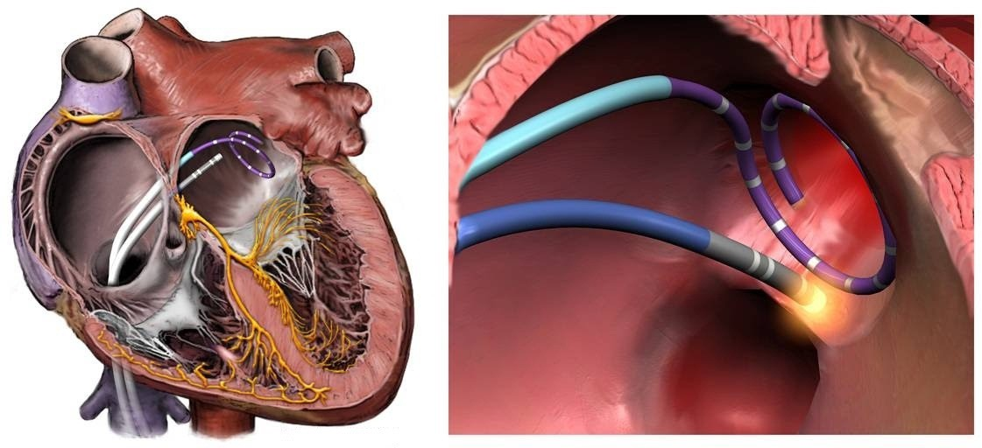
Catheter Ablation and the Brain?
Multiple studies have demonstrated new brain emboli on MRI after ablation for atrial fibrillation in about 15%-25% of cases¹⁻⁴
WHY?
Cardioversions
Large number of burns
Long catheter dwell times
Low flow chamber
AF itself (clot in LAA)
Gaita et al. Circulation 2010
Schrikel Europace 2010
Herrara J Am Coll Cardiol 2011
Deneke J Cardiovasc Electrophys 2015
3

Slide 4
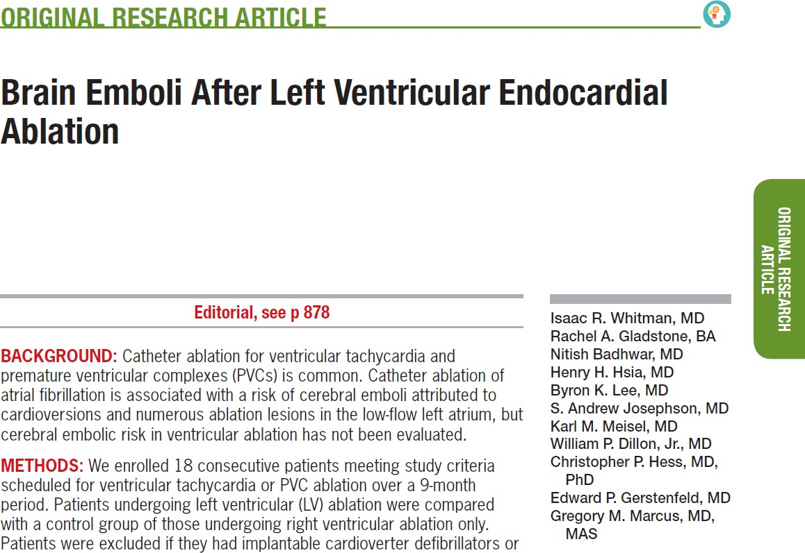
Cerebral Emboli after LV Ablation

Slide 5
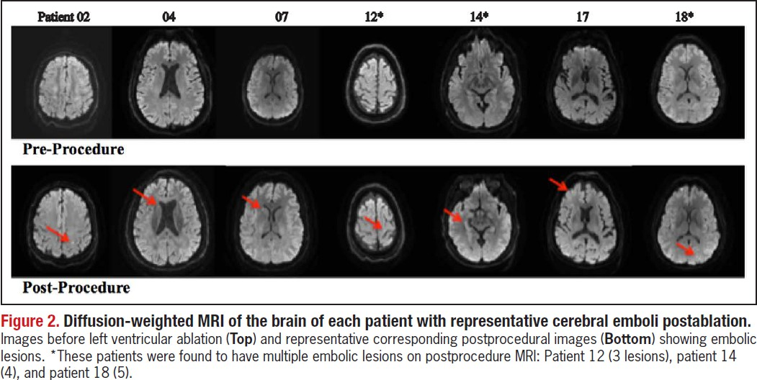
Cerebral Emboli after LV Ablation
None of those undergoing RV ablation experienced a cerebral embolism
7 (58% of all LV or 64% of all retrograde aortic cases) had a new brain embolism

Slide 6
Cerebral Emboli and other LV Procedures
Diagnostic aortic valve studies carry a ~20% risk of cerebral emboli¹
Diagnostic coronary angiography carries a ~20% risk of cerebral emboli²
Omran et al. Lancet 2003
Kim et al. int J Cardiol 2011

Slide 7
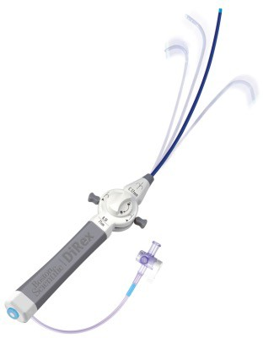
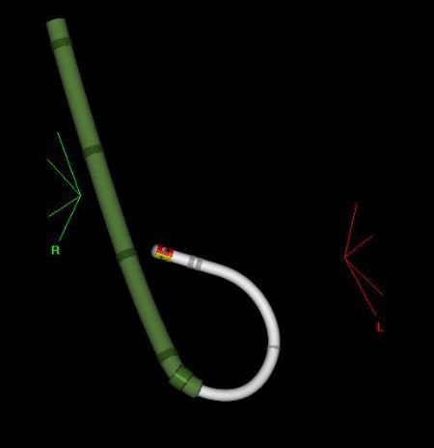
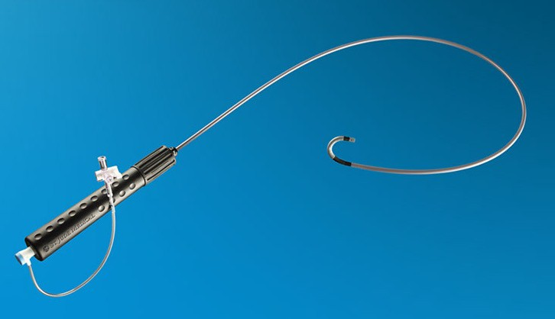
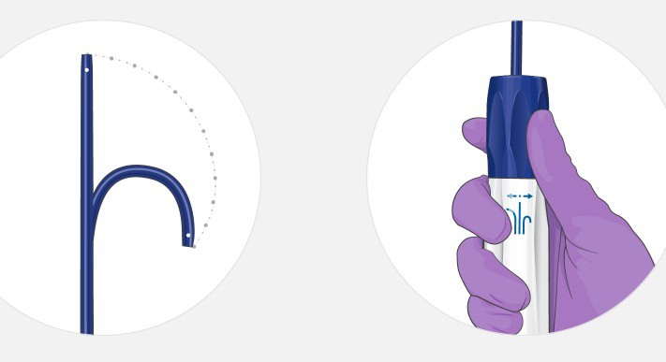
Transseptal Approach Common, Easier with Deflectable Sheaths

Slide 8
We Sought Funding from PCORI to Conduct A Randomized Trial
Aim 1: (PRIMARY OUTCOME) To test the hypothesis that a transseptal approach to left ventricular ablation results in a substantial reduction in cerebral emboli compared to a retrograde aortic approach.
Aim 2: To test the hypothesis that a transseptal approach to left ventricular ablation mitigates neurocognitive decline compared to a retrograde aortic approach.

Slide 9
Key Inclusion Criteria
Age ≥ 18 years
Planned/scheduled endocardial ventricular tachycardia (VT) or premature ventricular contraction (PVC) catheter ablation procedure
Plan is to pursue an ablation target in the left ventricular endocardium that can be accessed by either a transseptal or retrograde aortic approach

Slide 10
Key Exclusion Criteria
Any contraindication to MRI (as defined by the institution performing the MRI)
Clinical contraindication to a retrograde aortic approach as determined by the treating physician, including:
Severe Aortic stenosis
Mechanical aortic valve
Clinical contraindication to a transseptal puncture as determined by the treating physician , including:
Severe Mitral valve stenosis
Mechanical Mitral valve
ASD or PFO closure device that would preclude a transseptal puncture
Mitralclip or Alifieri mitral valve repair that would preclude a transseptal puncture
Planned or known need to perform either a retrograde aortic approach or transseptal approach

Slide 11
Study Flow
Screening
Initial inclusion/exclusion evaluation
Informed consent
Initial Screening Measures
Medical history, including utilization of clinically available ECG and ambulatory ECG monitoring
Medication inventory
Final Screening/Enrollment Measures
Brain MRI ¹
Neurocognitive function testing ^{1,2}
NIH Stroke Scale evaluation ¹
hrQOL/Physical Activity (PA) questionnaire ¹
1: must be performed within 30 days prior to study treatment 2: must be performed >24 hours free of sedating medications
Baseline Visit (V1c)
Anthropometry, Vital signs ³
Study Enrollment (Randomization)
Study Ablation Treatment
AE/SAE evaluation
3: may be performed within 30 days prior to study treatment

Slide 12
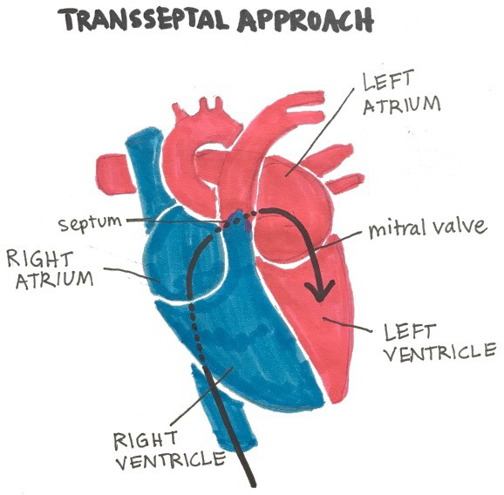
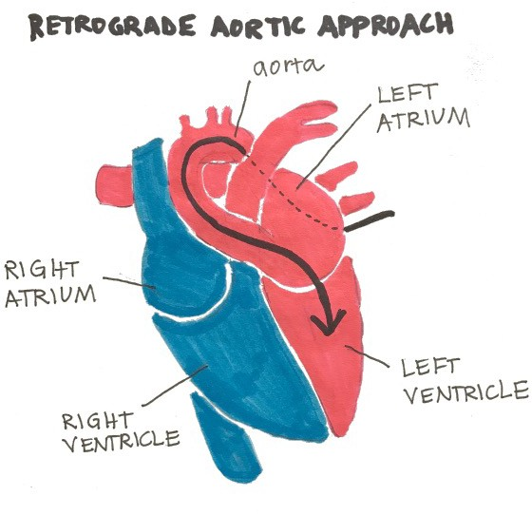
Randomized 1:1 in blocks by site

Slide 13
Study Flow
Day 1 Post-Ablation Visit (V2)
Brain MRI
NIH Stroke Scale evaluation
Discharge summary/Medication inventory
AE/SAE evaluation
Month 1 Visit (V3)
Medical care utilization/Medication inventory
Documentation of results of ECGs and any ambulatory ECG monitoring obtained for clinical purposes, if available
hrQOL/PA questionnaire
AE/SAE evaluation
Month 6 Visit (V4)
Neurocognitive function testing
Medical care utilization/Medication inventory
Documentation of results of ECGs and any ambulatory ECG monitoring obtained for clinical purposes, if available
hrQOL/PA questionnaire
Vital signs, Weight
AE/SAE evaluation

Slide 14
Response to COVID-19 Challenges
Abbreviated neurocognitive function exam that can be administered via Zoom
Includes 5/7 tests in the full exam (other 2 are dependent on reaction time)
Studies have shown that remote neuropsychological testing is a valid and reliable alternative to traditional face-to-face assessment (Brearly et al., 2017; Collum et al., 2014; Wadsworth et al., 2018)
Waiver for pre-ablation brain MRI so ppt will only be required to have the Day 1 post-ablation MRI
Post-ablation MRI will be performed using FLAIR imaging in the axial and coronal planes DWI-MRI
Dr. William Dillon (neuroradiologist) and Dr. Anthony Kim (neurologist) agree that DWI signal will identify the acute post-ablation lesions

Slide 15
Power Calculations
Assumptions:
60% incidence of cerebral emboli (we observed 64% in retrograde aortic approach) in the retrograde aortic approach
20% incidence of cerebral emboli in the transseptal group (based on the AF ablation literature)
A 10% cross-over rate
A 25% loss to follow-up or post-randomization exclusion
150 participants will provide >95% power to detect a statistically significant difference

Slide 16
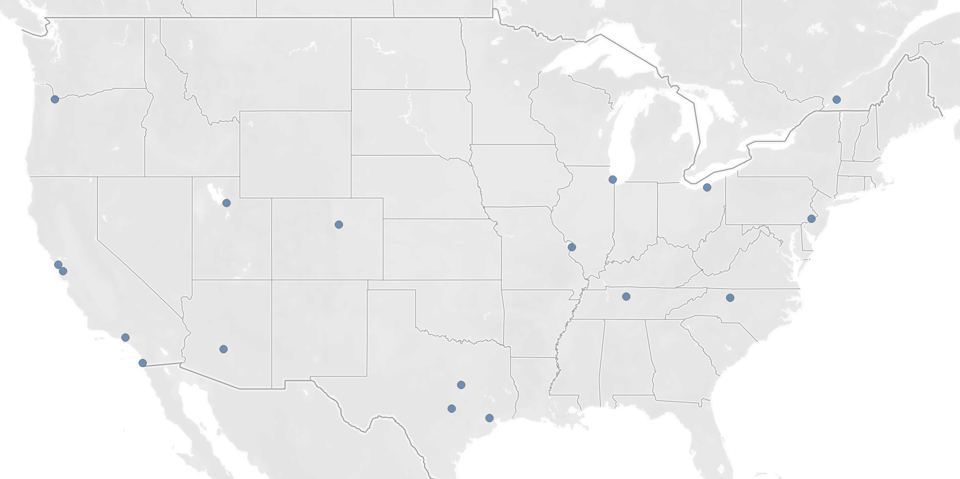
University of Montreal
Oregon Health and Science University
University of Chicago
Cleveland Clinic
University of Utah
University of California, San Francisco
University of Colorado
San Francisco Veterans Affairs
Washington University
University of Pennsylvania
Stanford University
Wake Forest University
Vanderbilt University
University of California, Los Angeles
Banner Health
Baylor University
University of
California,
San Diego
Houston Methodist
Texas Cardiac Arrhythmia Research Foundation

Slide 17
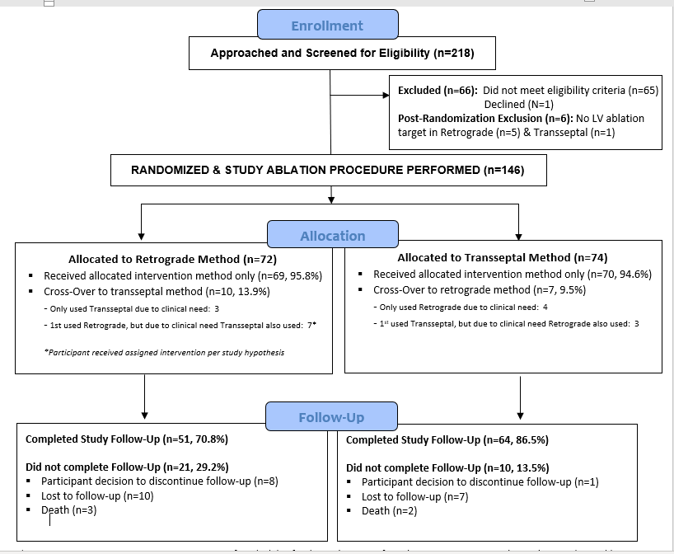

Slide 18
Baseline Characteristics
 | Retrograde Aortic (n=72) | Transseptal (n=74)
Age | 63.2 ± 12.5 | 65.3 ±11.3
Female | 12 (17%) | 18 (24%)
White | 60 (83%) | 67 (91%)
Black | 5 (7%) | 2 (3%)
Asian/ Pacific Islander | 5 (7%) | 2 (2%)
Native American | 1 (1%) | 0
Other | 1 (1%) | 3 (4%)
Hispanic | 4 (6%) | 4 (5%)
BMI (kg.m²) | 31 ± 7 | 30 ± 8
Diabetes | 13 (18%) | 16 (22%)
Hypertension | 26 (36%) | 28 (38%)
Coronary Disease | 40 (56%) | 34 (46%)
Heart Failure | 39 (54%) | 32 (43%)
Stroke | 2 (3%) | 5 (7%)

Slide 19
Baseline Characteristics
 | Retrograde Aortic (n=72) | Transseptal (n=74)
Aortic Vascular Disease | 0 | 1 (1%)
Congenital Heart Disease | 1 (1%) | 5 (5%)
History of DVT | 5 (6%) | 6 (8%)
Hypercoagulable syndrome | 1 (1%) | 1 (%)
Pulmonary embolism | 5 (7%) | 5 (7%)
CABG | 8 (11%) | 9 (12%)
Median Pack years smoked (IQR) | 0 (0-13.5) | 0 (0-9.25)
Atrial Fibrillation | 22 (31%) | 30 (40%)
Sustained VT | 31 (43%) | 34 (46%)
Polymorphic VT | 0 (0%) | 3 (4%)
VF | 1 (1%) | 2 (3%)
PVCs | 49 (68%) | 46 (62%)
Creatinine | 1.08 ± 0.32 | 1.12 ± 0.45

Slide 20
Procedural Characteristics
 | Retrograde Aortic (n=72) | Transseptal (n=74) | P value
Underwent retrograde aortic approach only | 62 (86%) | 4 (5%)
Transseptal only | 3 (4%) | 67 (91%)
Both, started with retrograde aortic | 7 (10%) | 0 (0%)
Both, started with transseptal | 0 (0%) | 3 (4%)
Maximum BP | 154 ± 32 | 160 ± 34 | 0.31
Minimum BP | 83 ± 25 | 86 ± 29 | 0.43
Electrical cardioversion/ defibrillation | 17 (24%) | 19 (27%) | 0.85
Mean ACT | 296 ± 42 | 298 ± 64 | 0.86
Target location |  |  | 0.42
Near mitral annulus | 9 (15%) | 5 (9%)
Near conduction system | 8 (13%) | 5 (9%)
Papillary muscles | 12 (20%) | 19 (35%)
Other | 20 (33%) | 18 (33%)

Slide 21
Procedural Characteristics
 | Retrograde Aortic (n=72) | Transseptal (n=74) | P value
Median ablation time (minutes) | 18 (7-32) | 15 (7-32) | 0.07
Average power (watts) | 42 ± 16 | 42 ± 14 | 0.88
Maximum power (watts) | 44 ± 7 | 44 ± 11 | 0.68
Left heart time (minutes) | 154 ± 86 | 140 ± 79 | 0.29
Median fluoroscopy time (minutes) | 6.6 (0.4-12.1) | 9.5 (2.4-21.7) | 0.014
Procedure time (minutes) | 238 ± 116 | 237 ± 104 | 0.98
Total fluids in (ml) | 1,406 ± 938 | 1,702 ± 1,545 | 0.17
Net fluids in versus out | 881 ± 802 | 932 ± 783 | 0.71

Slide 22
Complications within 30 days
 | Retrograde Aortic (n=72) | Transseptal (n=74) | P value
Total hospital days (median, IQR) | 1 (1-2) | 1 (1-3) | 0.44
Total ICU days (median, IQR) | 0 (0-0) | 0 (0-0) | 0.39
Pericardial effusion | 0 | 4 | 0.12
Vascular injury (AV fistula, pseudoaneurysm) | 2 (3%) | 0 | 0.24
Myocardial infarction | 0 | 0
Stroke/ TIA
Pneumothorax/ hemothorax | 0 | 0
Bleeding requiring surgical intervention or transfusion | 0 | 4 | 0.12
Peripheral infarct | 0 | 0
Other cardiovascular disease-related complication | 5 (7%) | 3 (4%) | 0.72
Death | 0 | 0

Slide 23
Efficacy
 | Retrograde Aortic (n=72) | Transseptal (n=74) | P value
Intra-procedural success |  |  | 0.66
Unable to ablate | 3 (5%) | 4 (6%)
Reduced burden/ inducibility | 17 (26%) | 22 (33%)
Complete success | 46 (70%) | 41 (61%)
1 month visit (median 39 days)
Eradication of target | 35 (58%) | 40 (64%) | 0.29
Sustained VT observed | 1 (2%) | 2 (3%) | 1.0
Appropriate ICD shocks | 2 (3%) | 1 (1%) | 1.0
Improved symptoms | 45 (63%) | 53 (72%) | 0.61
6 month visit (median 198 days)
Eradication of target | 31 (59%) | 40 (64%) | 0.94
Sustained VT observed | 4 (7%) | 2 (3%) | 0.41
Appropriate ICD shocks | 3 (4%) | 1 (1%) | 0.30
Improved symptoms | 41 (55%) | 55 (74%) | 0.66

Slide 24
PVC Burden Pre and Post Ablation
40
p= 0.039
50
N= 80
p= 0.0012
p< 0.0001
p= 0.0007
30
Retrograde Group Transseptal Group
(n=72)
(n=74)
40
N= 80
Retrograde Group
(n=72)
(n=74)
PVC Burden (%)
PVC Burden (%)
Transseptal Group
30
20
N= 24
N= 36
N= 24
20
p= 0.43
N= 36
10
10
p= 0.62
0
0
Baseline
1 Month Follow-Up
6 Month Follow-Up
Baseline
1 Month Follow-Up
6 Month Follow-Up

Slide 25
Pre-procedure MRIs
Seventy participants (35 in each initial randomization group; among the modified intention to treat group, 34 in the transseptal group and 31 in the retrograde aortic group)
None had an acute diffusion abnormality indicative of an acute brain embolism
131 (90%) of all participants had a post-operative day #1 MRI
62 (86%) in the retrograde aortic group and 69 (92%) in the transseptal group

Slide 26
Primary Outcome

Slide 27
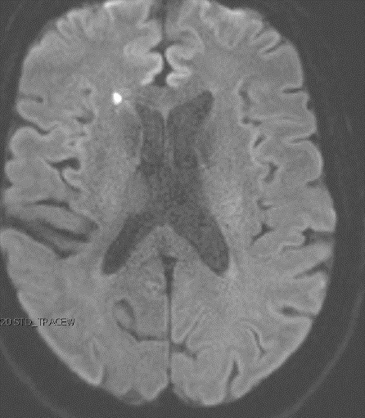
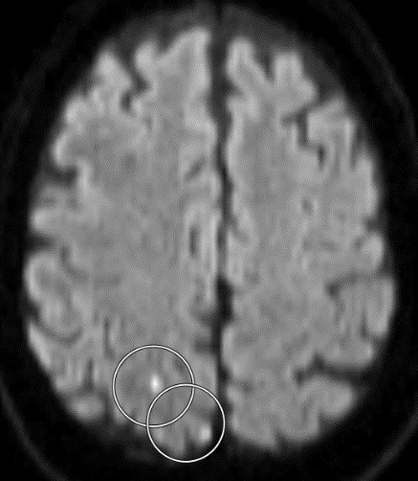
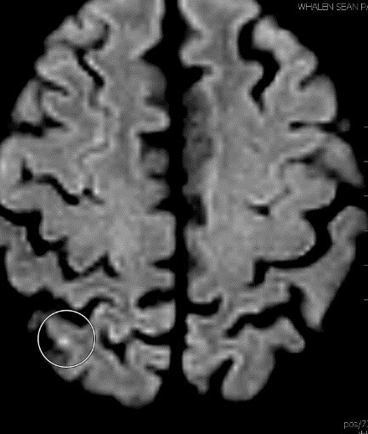
Intention-to-Treat
60
50
Number of Participants
40
p=0.036
30
20
45%
10
28%
0
Acute Emboli
No Acute Emboli
Acute Emboli
No Acute Emboli
Transseptal
Retrograde Aortic
Transseptal
Retrograde Aortic

Slide 28
As-treated
60
50
Number of Participants
40
p=0.0016
30
20
49%
10
23%
0
Acute No Acute
Acute No Acute
Emboli Emboli
Emboli Emboli
Only Transseptal
Any Retrograde Aortic
Transseptal
Retrograde Aortic

Slide 29
Intention−to−Treat
As−Treated
13
14
13
12
11
10
9
8
7
6
5
4
3
2
1
0
12
11
10
Number of Participants
9
8
Number of Participants
7
6
p=0.029
p=0.0010
5
4
Transseptal
Transseptal
3
Retrograde
Retrograde
2
1
0
0 1 2 3 4 5 6 7 8 9 10 11 12 13
Number of Brain Emboli
0 1 2 3 4 5 6 7 8 9 10 11 12 13
Number of Brain Emboli

Slide 30
Cognitive Composite Score
Intention-to-Treat Analysis
Baseline
Month 6
4
p=0.53
2
p=0.33
0
−2
−4
−6
−8
Transseptal
N=49 (66%)
Retrograde
N=46 (64%)
Transseptal
N=36 (49%)
Retrograde
N=30 (42%)

Slide 31
Likelihood of Cognitive Impairment
Intention-to-Treat Analysis
Baseline
Month 6
p=0.022
30
25
Number of Participants
25
p=0.69
Number of Participants
20
20
15
15
10
10
5
5
0
Low Medium High
Transseptal N=49 (66%)
Low Medium High
Retrograde
N=46 (64%)
0
Low Medium High
Transseptal
N=36 (49%)
Low Medium High
Retrograde
N=30 (42%)

Slide 32
Limitations
The study may have been insufficiently powered to detect differences in efficacy and complications
There was substantial loss of follow-up for the 6 month neurocognitive assessment
The brain emboli may be the “canary in the coalmine” that we can see
We did not assess potential impacts of emboli to other organs that may have occurred
The presence of these infarcts does not necessarily detract from the overall benefit of the procedure, but rather may point to the optimal approach

Slide 33
Conclusions
A transseptal approach to endocardial left ventricular catheter ablation results in significantly less frequent acute brain emboli compared to a retrograde aortic approach
The transseptal approach may mitigate against neurocognitive decline after these procedures, although missing data at 6 months precludes confident conclusions
These data suggest that a transseptal approach to other transcutaneous
left ventricular (or perhaps aortic root) procedures may be beneficial
These data may also suggest that emboli affecting other organs may more often occur with retrograde aortic access

Slide 34
Thank You

Slide 35
BACK UP SLIDES:

Slide 36
Cognitive Composite Score
As-Treated Analysis
Baseline
Month 6
4
p=0.42
p=0.079
2
0
−2
−4
−6
−8
Transseptal
N=49 (66%)
Retrograde
N=46 (64%)
Transseptal
N=36 (49%)
Retrograde
N=30 (42%)

Slide 37
p=0.11
Baseline with Paired Follow Up
18
16
14
12
10
8
6
4
2
0
Likelihood of Cognitive Impairment
As-Treated Analysis
Number of Participants
Low Medium High
Transseptal
Month 6
Low Medium High
Retrograde
Baseline
30
25
p=0.013
Number of Participants
25
p=0.25
Number of Participants
20
20
15
15
10
10
5
5
0
Low Medium High
Transseptal N=49 (66%)
Low Medium High
Retrograde N=46 (64%)
0
Low Medium High
Transseptal N=36 (49%)
Low Medium High
Retrograde N=30 (42%)

Slide 38
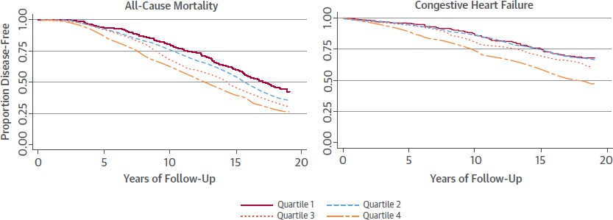
Might Catheter Ablation for Ventricular Arrhythmias Expand?

Slide 39
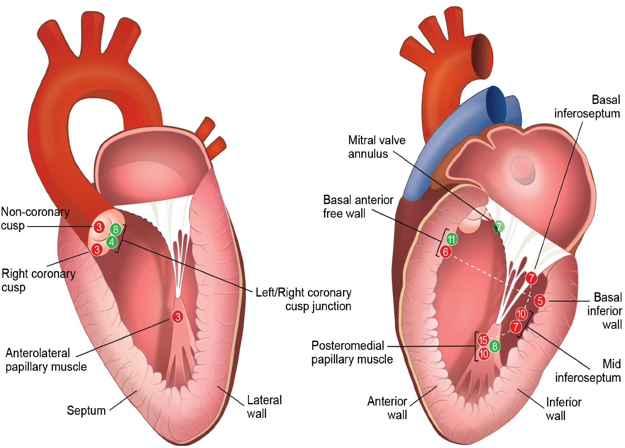
Cerebral Emboli after LV Ablation
WHY IN ATRIAL FIBRILLATION ?
Cardioversions
Large number of burns
Long catheter dwell times
Low flow chamber
AF itself (clot in LAA)

Slide 40
Cerebral Emboli after LV Ablation
No relationships between emboli and:
Any patient characteristic
ACTs
Intraop BP
Long sheath or not (trended the OTHER way)
Number of ablations
Smokers had LESS emboli (p=0.01)
So WHY? And why so much higher than AF?

Slide 41
What do these “Asymptomatic” Brain Emboli Mean?
We don’t really know
Some studies have shown they resolve one month after they are first observed¹
On the other hand, neurocognitive testing may actually be more sensitive to detect brain lesions/ pathology than MRI²⁻⁴
And even small deficits in neurocognitive function may lead to worsening functioning down the road⁵
Deneke Heart Rhythm 2011
Mungas et al. Neuropsychology 2003
Carey et al. Stroke 2008
Kramer et al. Neuropsychology 2007
Hugo et al. Clin Geriatr Med 2014
41

Slide 42
UCSF CC Cores
Neurology Anthony Kim, MD
Neuroimaging William Dillon, MD
Neuropsychology Joel Kramer, PsyD
Katherine Possin, PhD Melanie Stephens, PhD
Sabrina Erlhoff Michelle You
Investigator
Investigator
Investigator Neuropsychologist Neuropsychologist
Clinical Research Coodinator Clinical Research Coodinator
42

Slide 43
Other predictors of acute emboli
 | No acute emboli (n=47) | Acute emboli (n=84) | P value
Mean age (years) | 67.9 ± 9.8 | 62.3 ± 12.3 | 0.009
Intra-procedural coronary angiogram | 3 (6%) | 0 | 0.044
Average Power across all targets (Watts) | 40.6 ± 7.2 | 37.3 ± 6.8 | 0.032
Race |  |  | 0.083
American Indian/ Alaskan Native | 0 | 1 (1%)
Black | 0 | 6 (7%)
Asian | 3 (6%) | 2 (2%)
Native Hawaiian/ Pacific Islander | 1 (2%) | 0
White | 41 (87%) | 75 (88%)
Other | 2 (4%) | 1 (1%)
Hispanic Ethnicity | 0 | 7 (8%) | 0.049
Cardiomyopathy | 34 (72%) | 41 (49%) | 0.010
Sustained polymorphic VT | 5 (11%) | 1 (1%) | 0.0008

Slide 44
Multivariable adjusted predictors of acute emboli*
 | Odds Ratio | 95% CI | P value
INTENTION TO TREAT retrograde v transseptal | 4.98 | 1.72-14.46 | 0.0031
Mean age (per year) | 1.06 | 1.002-1.13 | 0.042
Average Power across all targets (per Watt) | 1.08 | 1.001-1.163 | 0.047
Non-Hispanic White | 1.23 | 0.27-5.65 | 0.79
Cardiomyopathy | 1.83 | 0.64-5.28 | 0.26
Sustained polymorphic VT | 15.36 | 1.58-148.90 | 0.018
AS TREATED retrograde v transseptal | 9.50 | 2.82-31.98 | 0.0003
Mean age (per year) | 1.07 | 1.005-1.142 | 0.035
Average Power across all targets (per Watt) | 1.09 | 1.008-1.185 | 0.032
Non-Hispanic White | 1.11 | 0.22-5.56 | 0.90
Cardiomyopathy | 2.15 | 0.71-6.54 | 0.18
Sustained polymorphic VT | 17.82 | 1.63-195.29 | 0.018
*Unable to include intra-procedural coronary angiogram because, of 3, all had emboli

Slide 45
p=0.34
Baseline with Paired Follow Up
20
18
16
14
12
10
8
6
4
2
0
Likelihood of Cognitive Impairment
Intention-to-Treat Analysis
Number of Participants
Low Medium High
Low Medium High
Retrograde
Baseline
Transseptal
Month 6
30
25
p=0.022
Number of Participants
25
p=0.69
Number of Participants
20
20
15
15
10
10
5
5
0
Low Medium High
Transseptal N=49 (66%)
Low Medium High
Retrograde
N=46 (64%)
0
Low Medium High
Transseptal
N=36 (49%)
Low Medium High
Retrograde
N=30 (42%)

Slide 46
Neurocognitive Testing
The second neurocognitive test was performed a median 202 days (IQR 180- 252 days) after the procedure
In the transseptal group: 206 days ( IQR 187-245 days)
In the retrograde aortic group: 195 days (IQR 169-279 days), p=0.44 versus transeptal
46

