Slide 1

Frequency, timing, and causes of 30- day mortality after noncardiac surgery: Impact of CV complications
Jessica Spence, MD, PhD(c) On behalf of VISION investigators

Slide 2
Declaration of interest
- I have nothing to declare
• •
ESC Congress
Munich 2018 •

Slide 3
Disclosures
>60 grants
Roche Diagnostics provided biomarkers and some financial support

Slide 4
Background
Globally >230 million surgeries annually
  surgery less invasive but older, sicker population
Contemporary risk and timing of 30-day mortality after noncardiac surgery is uncertain
Limited understanding of incidence of postoperative complications and relationship with perioperative mortality
We undertook large international cohort study to inform these issues

Slide 5
VISION design and methods
Prospective, international, cohort study
Eligibility criteria
  ≥45 yrs undergoing inpatient noncardiac surgery
Sampling method
  representative sample
27 centres in 14 countries
  North and South America, Europe, Asia, Africa, Australia
Participants actively followed for complications and mortality until 30 days after surgery
  perioperative Troponin T measurements

Slide 6
Objectives
Determine among adults undergoing inpatient noncardiac surgery followed for 30 days
  incidence of death
  timing and location of death
  incidence of major complications
    MINS, CHF, new AF, stroke, VTE, major bleeding, AKI with dialysis, sepsis, non-sepsis infection
  relationship between complications and death

Slide 7
Baseline characteristics (N=40,004)
Age in years
45-64 | 55%
65-74 | 25%
≥75 | 19%
Women | 50%
History of Hypertension | 51%
Active cancer | 24%
Diabetes | 21%
CAD | 13%
PAD | 8%
COPD | 8%
Stroke | 4%
CHF | 4%
AF | 3%

Slide 8
Type of surgeries
Type of Surgery
General | 20%
Orthopedic | 17%
Urology/Gynecology | 12%
Vascular | 7%
Neurosurgery | 6%
Thoracic | 3%
Low-risk | 36%
Urgent or emergent surgery
11%

Slide 9
Mortality at 30-days
Regions | # of participants | # of deaths | Mortality (95% CI)
Total | 40,004 | 715 | 1.8% (1.8-1.9)
Western | 22,447 | 253 | 1.1% (1.0-1.3)
Asia | 10,005 | 197 | 2.0% (1.7-2.3)
South America | 6063 | 169 | 2.8% (2.4-3.2)
Africa | 1489 | 96 | 6.4% (5.3-7.8)

Slide 10
Timing and location of mortality
Timing and location of death | # of | Percentage
 | deaths | (95% CI)
Operating room | 4 | 0.6% (0.2-1.0)
Index hospitalization post surgery | 505 | 71% (67-74)
After discharge home | 210 | 29% (26-33)
Mortality after discharge home by | region
Western | 79/253 | 29% (24-35)
Asia | 74/197 | 37% (31-44)
South America | 45/169 | 26% (21-34)
Africa | 18/96 | 19% (12-28)

Slide 11
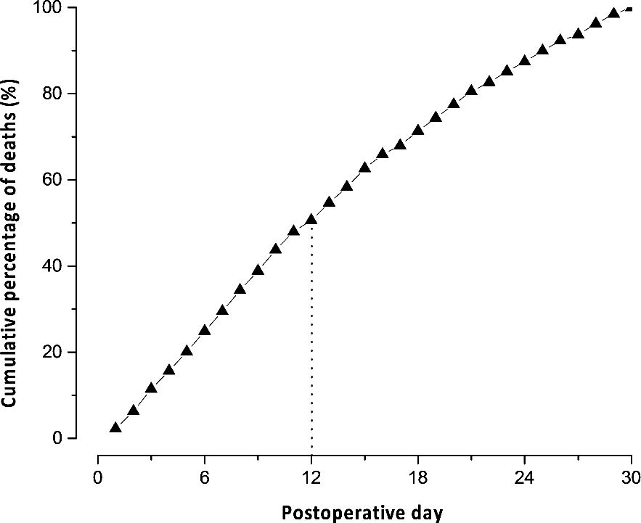
Timing of death during 30 day follow-up

Slide 12
30-day mortality by type of surgery
Surgery | Number of | Percentage
General | deaths 240 | (95% CI) 3.0% (2.7-3.4)
Vascular | 73 | 2.8% (2.2-3.5)
Neurosurgery | 62 | 2.6% (2.1-3.4)
Orthopedic | 124 | 1.8% (1.5-2.1)
Thoracic | 20 | 1.7% (1.1-2.6)
Low risk surgery | 177 | 1.2% (1.1-1.4)
Urology/Gynecology | 24 | 0.5% (0.3-0.7)

Slide 13
Complications with highest attributable fraction
Complication Incidence | Adjusted HR | Attributable
(%) | (95% CI) | fraction (95% CI)
Major bleeding 6238 (16%) | 2.7 (2.3-3.2) | 37.5 (17.5-56.0)
MINS 5191 (13%) | 2.3 (2.0-2.7) | 28.1 (14.6-45.8)
Sepsis 1783 (5%) | 6.2 (5.1-7.5) | 23.9 (12.3-43.2)

Slide 14
Other complications
Complication | Incidence (%) | Adjusted HR (95% CI) | Attributable fraction (95% CI)
Non-sepsis infection | 2171 (5.4%) | 2.4 (1.7-3.2) | 5.9 (3.4-9.3)
Stroke | 132 (0.3%) | 1.8 (1.4-2.2) | 4.8 (2.5-10.0)
VTE | 320 (0.8%) | 2.2 (1.3-3.7) | <1
CHF | 372 (0.9%) | 2.6 (1.9-3.6) | <1
AKI resulting in dialysis | 118 (0.3%) | 4.2 (3.0-5.8) | <1

Slide 15
No Bleeding, Sepsis, or MINS
Sepsis
N=1793 (4.5%)
Mortality: 12.0%
N=29706 (74.3%)
Mortality: 0.57%
N=691 (1.7%)
Mortality: 5.8%
N=597 (1.5%)
M: 13.4%
N=158 (0.5%)
M: 21.5%
N=337 (0.8%)
M: 18.1%
N=3819 (9.6%)
Mortality: 2.9%
N=3211 (8.0%)
Mortality: 3.5%
N=1485 (3.7%)
Mortality: 7.3%
Bleeding
N=6238 (15.6%)
Mortality: 5.8%
MINS
N=5191 (13.0%)
Mortality: 6.0%

Slide 16
Conclusions
1.8% of adults died within 30 days of noncardiac surgery
  0.6% of deaths occurred in operating room (OR)
  29% of deaths occurred after discharge
Majority of death after noncardiac surgery secondary to complications
  major bleeding, MINS, and sepsis account for 89.5% of AF
  CV complications were among most common complications and accounted for >60% of deaths explained by our model

Slide 17
Implications
Perioperative death is major public health issue
  >1.5 million adults die within 30-days of noncardiac surgery annually
Death overwhelmingly occurs outside of OR
  need to focus on early identification and management of postoperative complications
  extend monitoring into ward and home
Focus on prevention and management of perioperative MINS, bleeding, and sepsis
  substantial potential to reduce perioperative mortality
  role for CV physicians

