Slide 1
Impact of MAC on Patient Selection, Procedural Success and 1-Year Outcomes in a Real-World Patient Population Evaluated for TMVI:
Results from the CHOICE-MI MAC Study
Walid Ben Ali MD PhD FRCSC
on Behalf of the CHOICE-MI Investigators

Slide 2
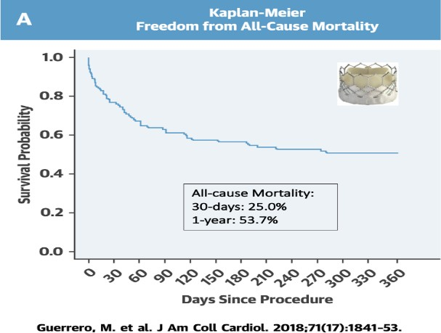
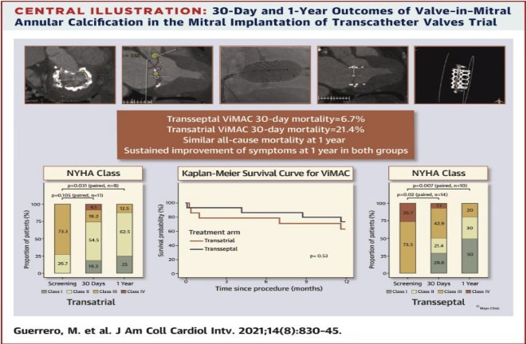
BACKGROUND
•
Mitral Annular
Calcification
(MAC) is
outcomes in
associated to poor patients
clinical
undergoing
mitral
valve
interventions.
The
impact of MAC on patient selection,
and long-term clinical
procedural success
outcomes is still unclear in the high-risk group of patients evaluated for TMVI.

Slide 3
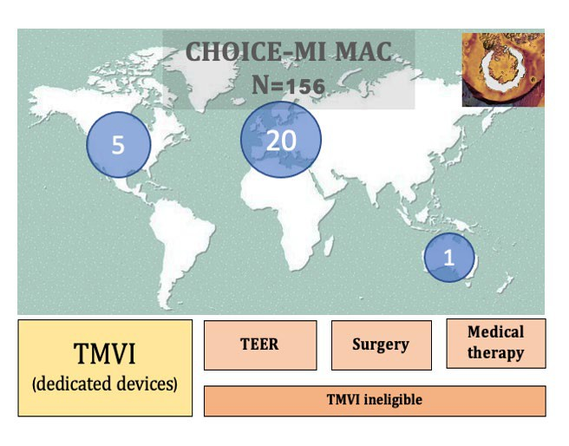
AIM
The CHOICE-MI registry is an investigator- initiated, multicentric registry currently enrolling patients screened for TMVI in 26 centers worldwide (NCT04688190).
The CHOICE-MI MAC study aims to compare the clinical features, procedural and clinical outcomes of moderate-to-severe MAC (MAC group) to those with mild or less MAC (Non-MAC group) irrespective of the final treatment decision.

Slide 4
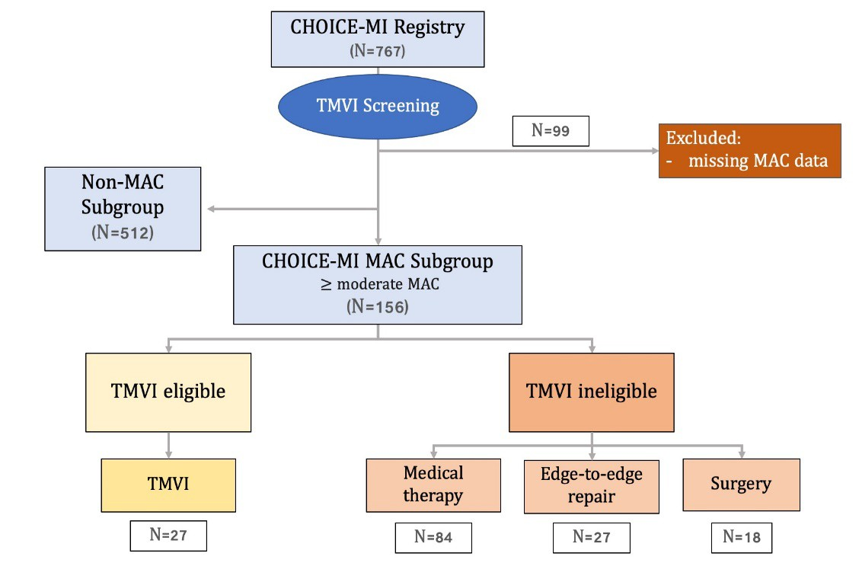
STUDY DESIGN
Primary Outcome:
All-cause death or HF rehospitalisation at 1 year
Secondary Outcomes:
All-cause and CV mortality at 1 year
Residual MR at discharge and 1 year
NYHA functional class at discharge and 1 year

Slide 5
Baseline Characteristics Demographic
 | MAC (156) | Non-MAC (512) | p Value
Age (years) | 80 (75.4, 84) | 78 (71, 82) | 0.003
Female (%) | 92 (62.8) | 209 (40.8) | 0.001
STS PROM (%) | 6.6 (3.6, 9.7) | 4.8 (3, 7.5) | 0.028
EuroSCORE II (%) | 5.5 (3.3, 11) | 4.8 (2.9, 10.2) | 0.71
NYHA III/IV (%) | 127 (82.4) | 414 (81.4) | 0.21
HF hospitalization the last year | 1 (0,1) | 1 (0,1) | 0.84
Previous CABG (%) | 32 (20.6) | 135 (26.4) | 0.18
Previous TAVR (%) | 39 (25.2) | 37 (7.2) | 0.001
Hypoalbuminemia (%) | 30 (31.6) | 65 (16.7) | 0.001

Slide 6
Baseline Characteristics TTE – CT SCAN
 | MAC (156) | Non-MAC (512) | p Value
TTE
Ejection Fraction (%) | 58 (47.5, 62.2) | 47 (35.4, 60) | 0.001
Left Ventricular End Diastolic Volume (ml) | 114.9 (80.7, 150.3) | 136 (99.9, 176) | 0.046
Severe MR (%) | 88 (56.4) | 340 (66.4) | 0.12
Secondary MR (%) | 24 (15.8) | 240 (47.3) | 0.001
Mean Mitral Gradient (mm Hg) | 5 (3, 7.4) | 2.3 (2, 4) | 0.001
Tricuspid Regurgitation > 2+ (%) | 69 (44.2) | 260 (50.9) | 0.17
Systolic Pulmonary Artery Pressure (mm Hg) | 51 (40, 63.3) | 48 (38, 58) | 0.006
CT SCAN
Inter-Commissural Diameter (mm) | 38.2 (34.3, 44.2) | 41.1 (38, 44.6) | 0.019
Systolic Mitral Annular Perimeter (mm) | 121.1 (116.3, 134.2) | 131.4 (118.2, 140.8) | 0.047

Slide 7
Device and Procedural Characteristics
TMVI
 | MAC (27) | Non-MAC (183) | p Value
Transapical access (%) | 23 (85.2) | 160 (90.4) | 0.62
Technical success (%) | 26 (96.3) | 173 (95.1) | 1
Procedural Mortality (%) | 0 | 4 (2.2) | 0.98
LVOT Obstruction (%) | 2 (7.4) | 5 (2.8) | 0.5
Valve Migration (%) | 2 (7.4) | 2 (1.1) | 0.14
Conversion to surgery (%) | 1 (3.8) | 4 (2.2) | 1
Access Site Complication (%) | 6 (22.2) | 12 (6.7) | 0.021

Slide 8
Device and Procedural Characteristics
TEER
 | MAC (27) | Non-MAC (150) | p Value
More than 1 Clip (%) | 5 (18.5) | 73 (50) | 0.005
NT size (%) | 70.8 | 64.1 | 0.69
Technical success (%) | 20 (74.1) | 133 (89.9) | 0.05
Procedural Mortality (%) | 0 | 0
SLDA | 1 (3.7) | 2 (1.6) | 0.48
Conversion to surgery (%) | 0 | 1 (0.7) | 1
Access Site Complication (%) | 1 (3.7) | 6 (4.1) | 1
Surgery
 | MAC (18) | Non-MAC (32) | p Value
Mitral Valve Repair (%) | 2 (13.3) | 9 (32.1) | 0.33
MIS (%) | 1 (5.9) | 4 (18.2) | 0.51
Median Cross Clamp time (min) | 92 (71, 122) | 92 (77, 120) | 0.87
Procedural Mortality (%) | 1 (5.6) | 0 | 0.81

Slide 9
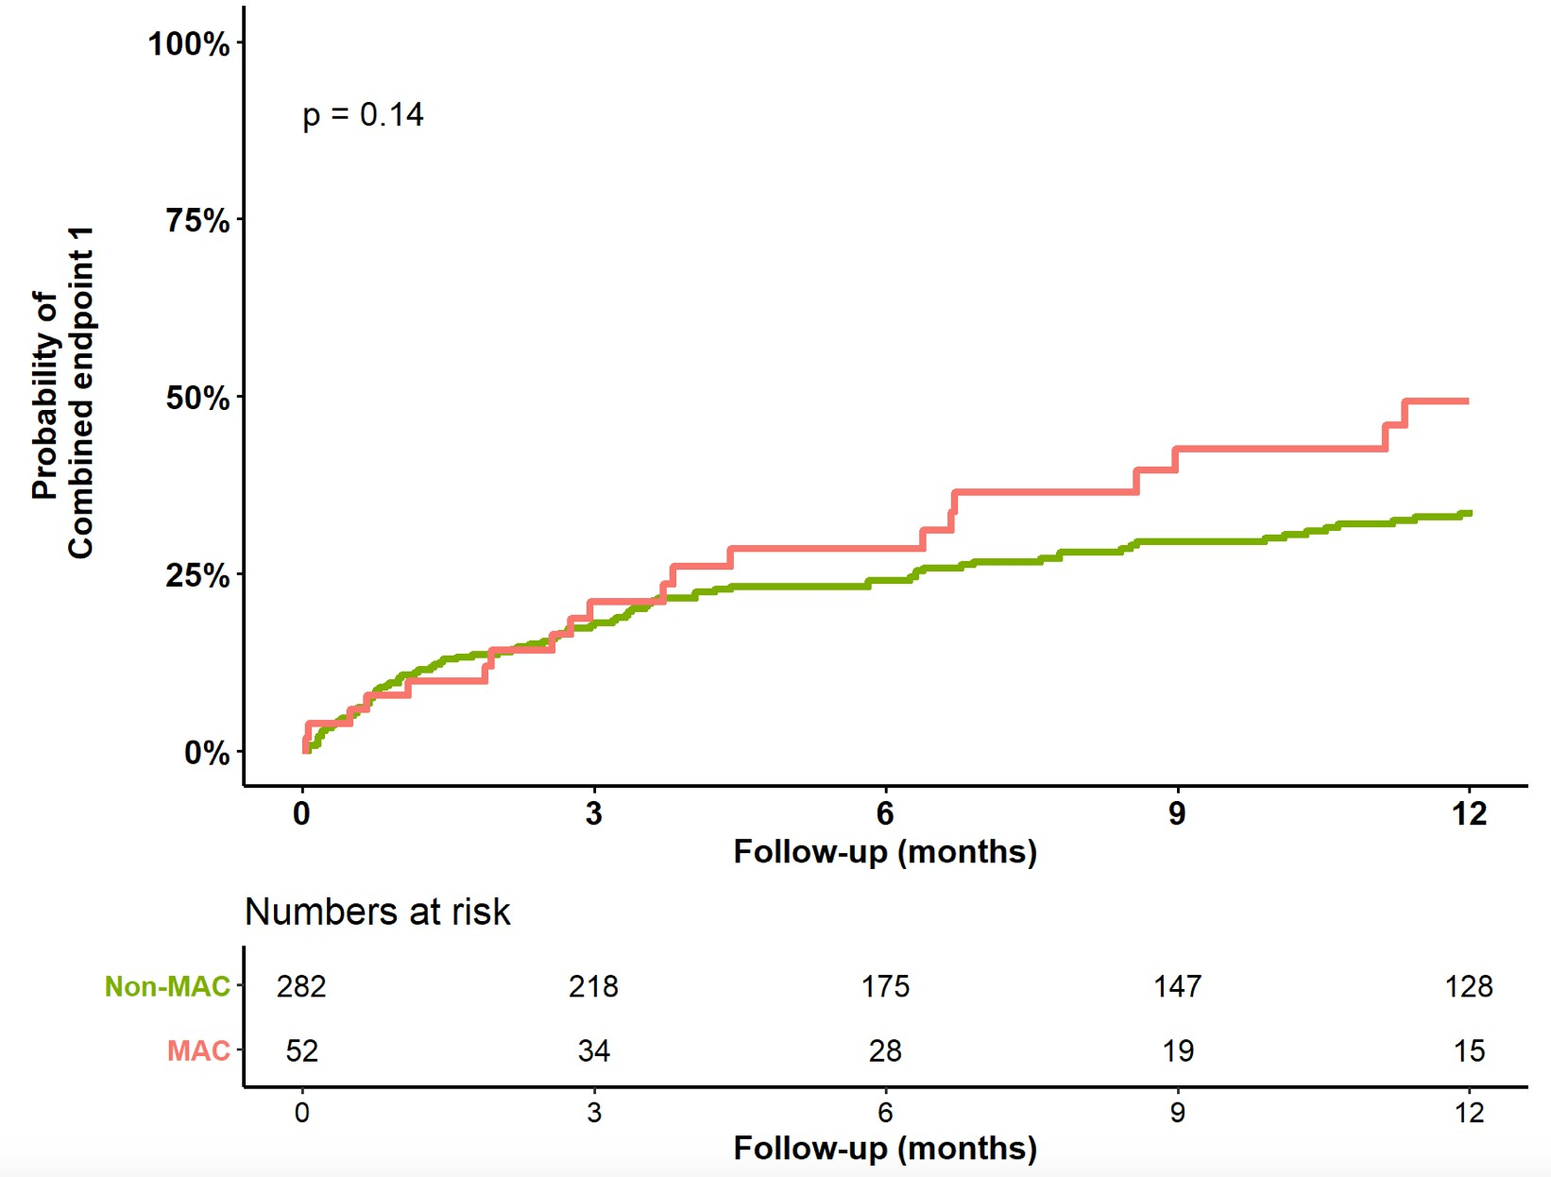
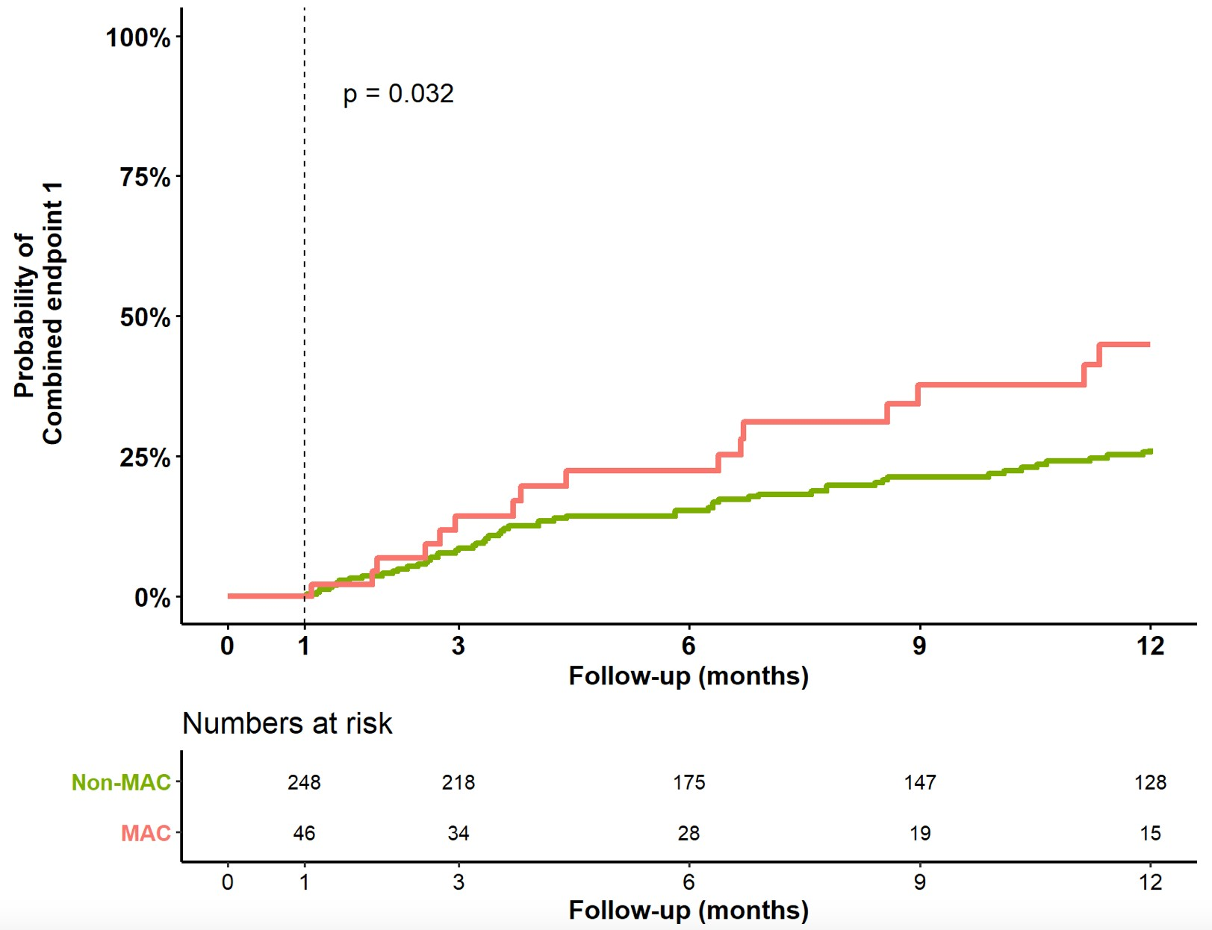
PRIMARY OUTCOME
All-cause mortality or HF hospitalization
49.3%
45%
34%
26.4%

Slide 10
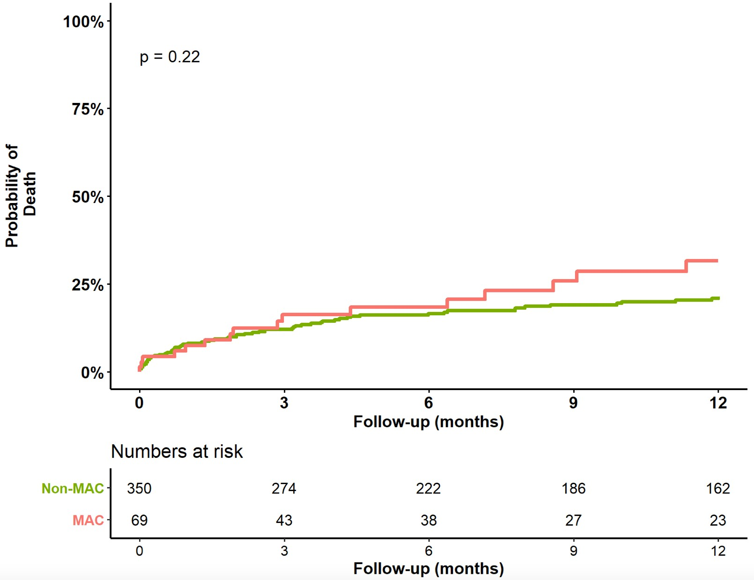
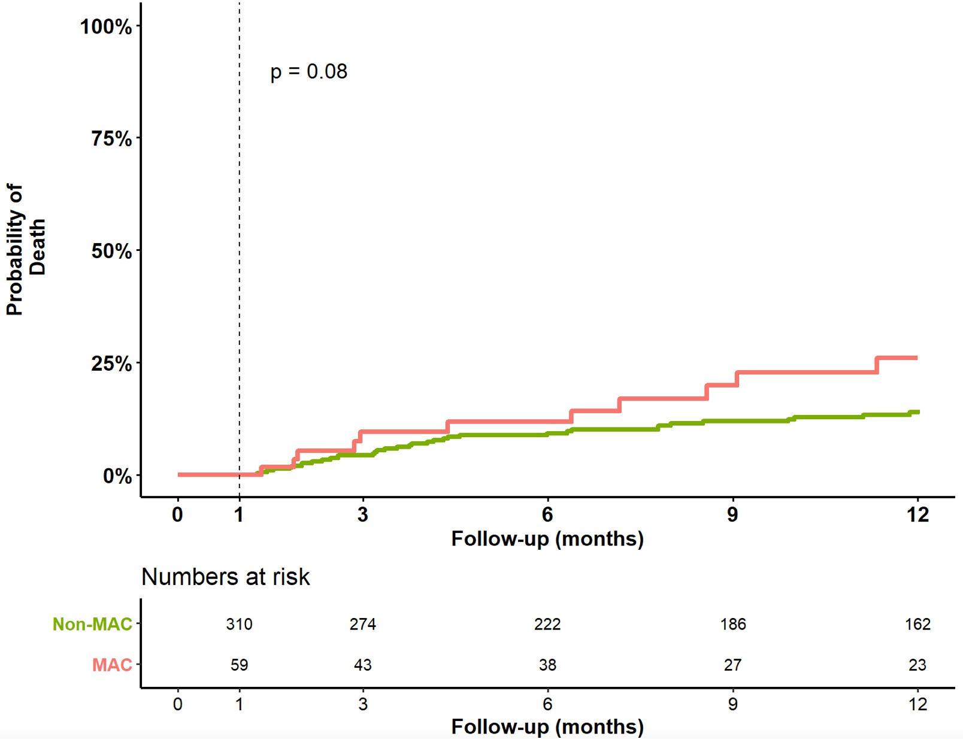
ALL-CAUSE MORTALITY
31.6%
21.4%
26.1%
14.4%

Slide 11
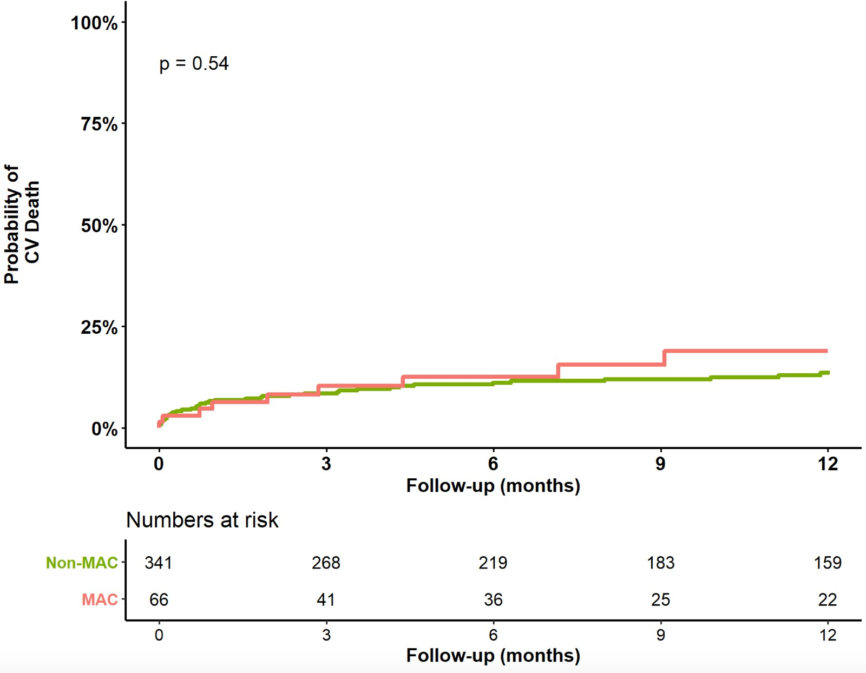
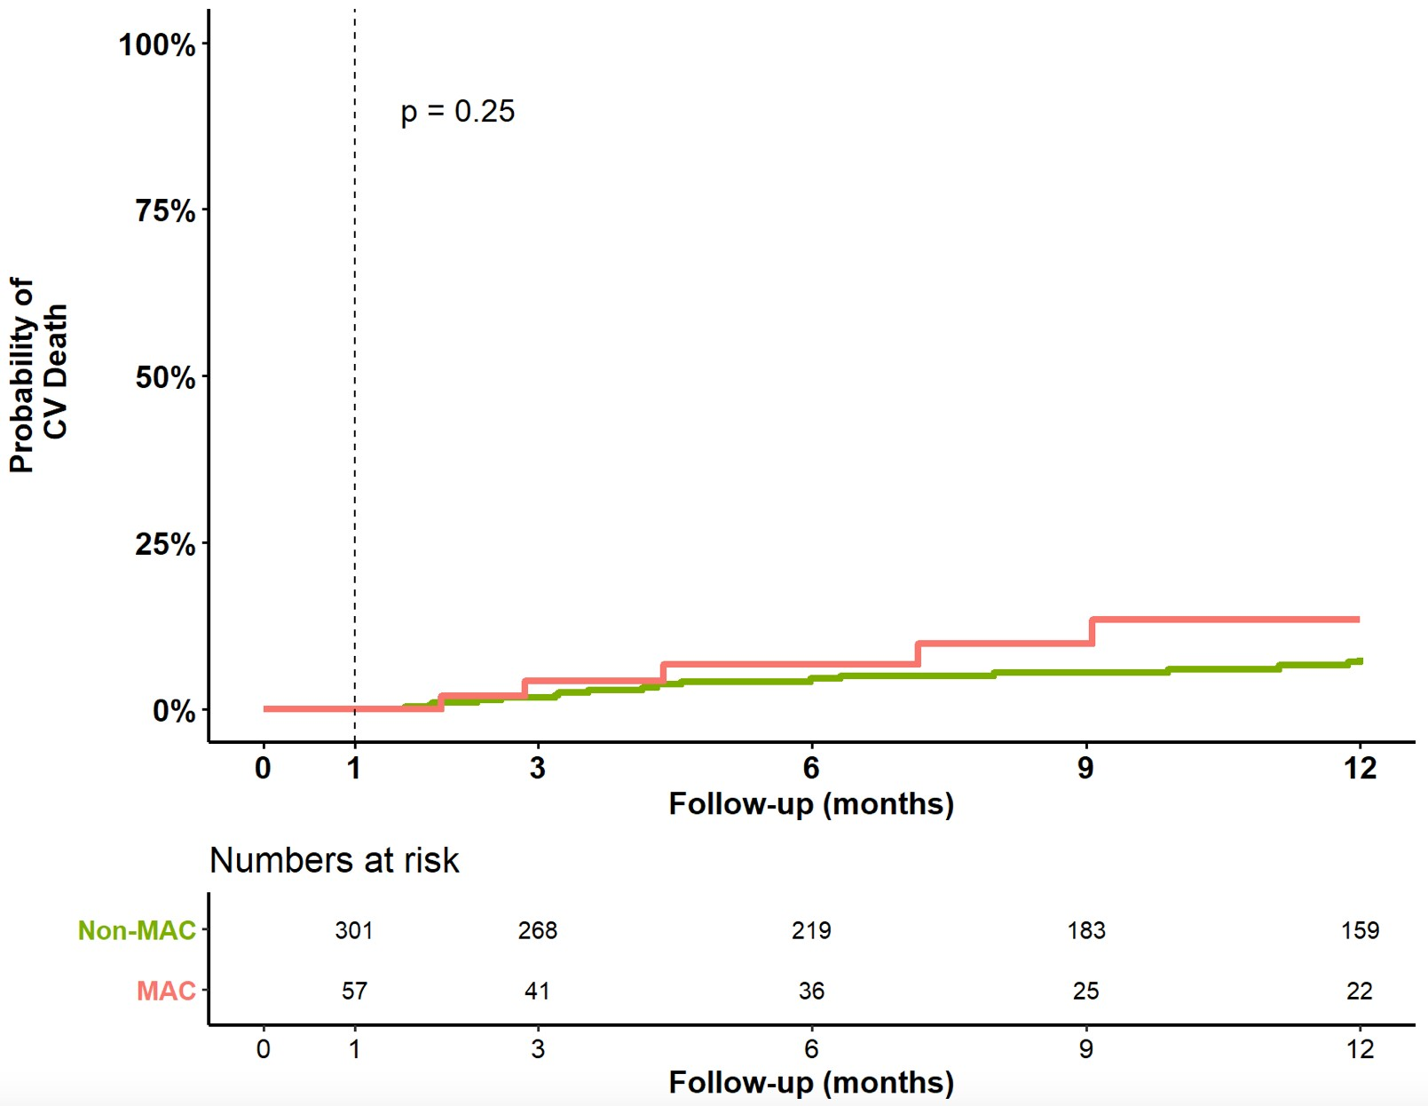
CV MORTALITY
18.9%
14.1%
13.4%
7.7%

Slide 12
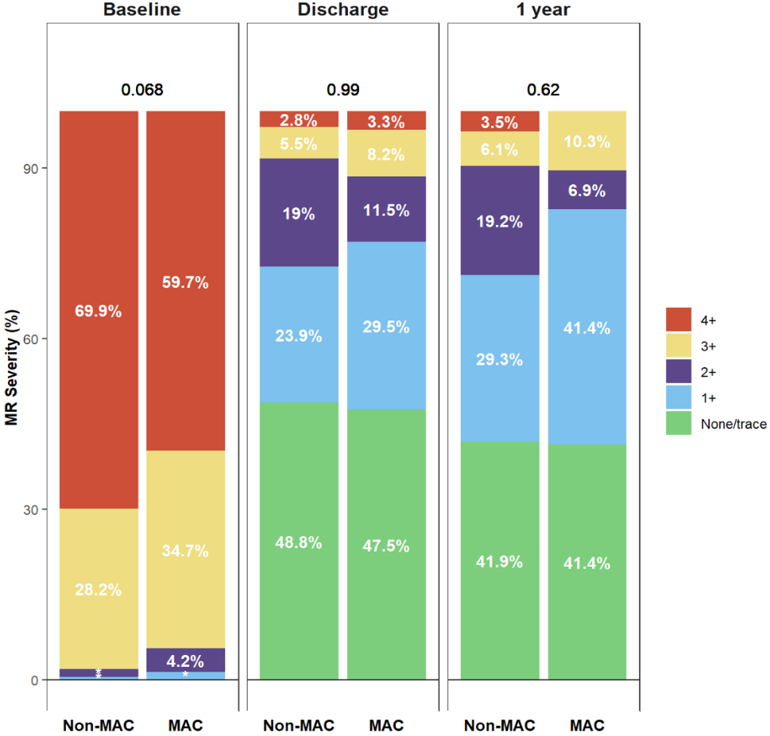
Residual MR

Slide 13
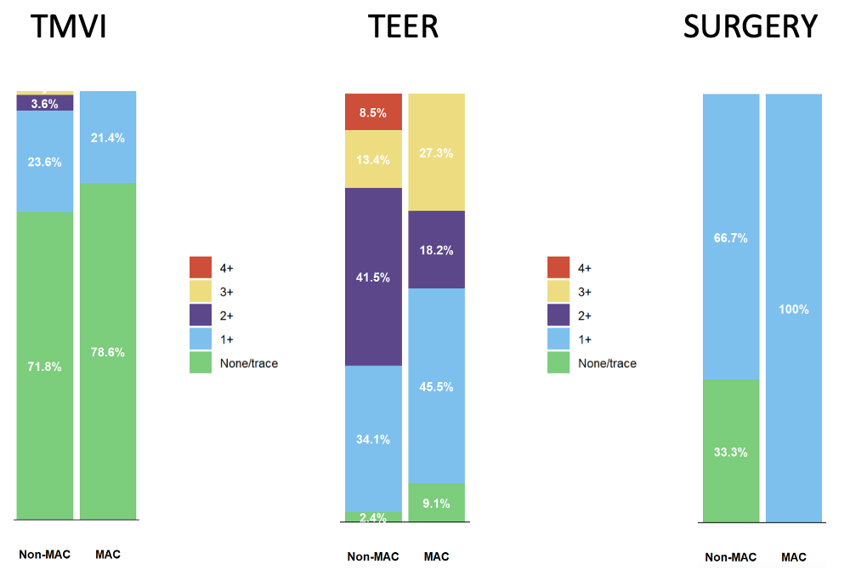
Residual MR at 1 Year
MVPG
(mmHg)
3(2, 4) 5 (3.4, 7.8) *
3.8 (3 , 5) 6 (3.4, 6.5)
3.7 (2.6 , 4) 4.4 (3, 6.2)

Slide 14
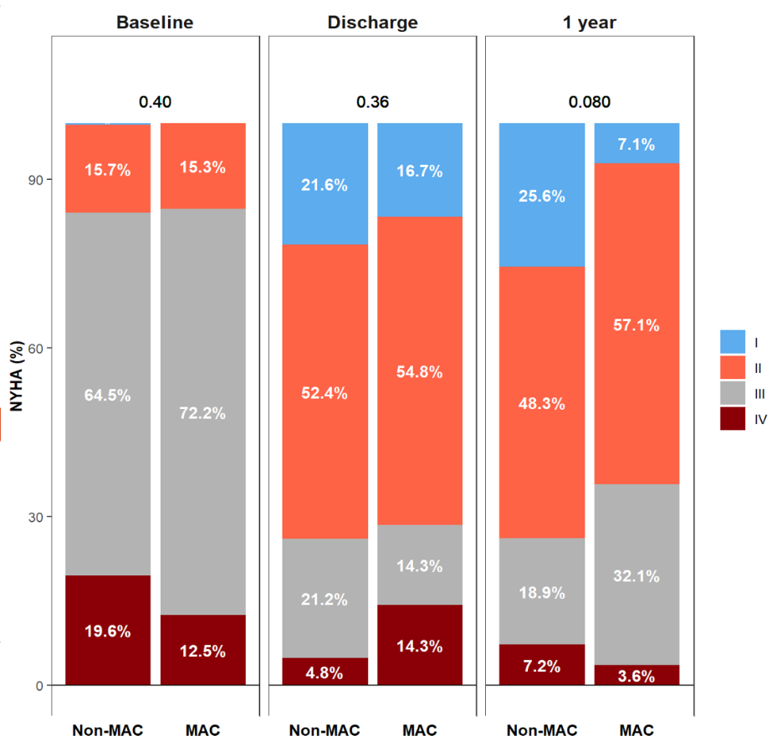
NYHA FUNCTIONAL CLASS

Slide 15
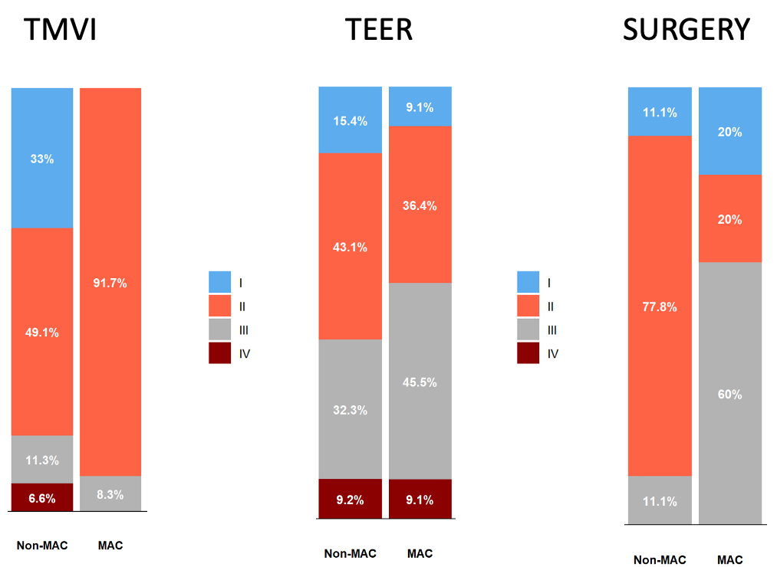
NYHA Class at 1 Year

Slide 16
CONCLUSIONS
Patients with moderate to severe MAC display unique anatomical and clinical characteristics.
More than half of MAC patients are still rejected for interventional or surgical therapies.
The presence of MAC is associated with worse peri-procedural outcomes that extend beyond 30 days, irrespective of the transcatheter-based treatments.
TMVI appears to provide better technical and clinical outcomes compared to other transcatheter-based techniques.

Slide 17
CHOICE-MI Investigators
Alberto Pozzoli | John G. Webb | Paolo Denti
Alison Duncan | Jörg Hausleiter | Raj Makkar
Allessandra Sala | Jörg Kempfert | Ralph Stephan von Bardeleben
Anthony Chuang | Juan Granada | Rüdiger Lange
Augustin Coisne | Lars Sondergaard | Sabine Bleiziffer
Axel Unbehaun | Lenard Conradi | Sachin Goel
Christoph Klein | Marcel Weber | Sebastian Ludwig
Daniel Kalbacher | Markus Kofler | Simon Redwood
David Muller | Matti Adam | Stefan Blankenberg
Didier Tchétché | Maurizio Taramasso | Stephan Baldus
Edith Lubos | Michael Reardon | Sung-Han Yoon
Felix Kreidel | Michele Flagiello | Tanja Rudolph
Georg Nickenig | Mirjam Wild | Tetsu Tanaka
Gilbert Tang | Moritz Wyler von Ballmoos | Thomas Modine
Gry Dahle | Myriam Akodad | Thomas Walther
Hendrik Ruge | Neil Fam | Walid Ben Ali
Hendrik Treede | Nicolas Dumonteil | Yoshi Kaneko
Jean Francois Obadia | Omar Chehab

