Slide 1


Administration of Ticagrelor in the cath Lab or in the Ambulance for New ST elevation myocardial Infarction to open the Coronary artery
ATLANTIC
G. Montalescot, A.W. van’t Hof, F. Lapostolle, J Silvain, J.F. Lassen, L. Bolognese,
W.J. Cantor, A. Cequier, M. Chettibi, S.G. Goodman, C.J. Hammett, K. Huber, M. Janzon,
B. Merkely, R.F. Storey, U. Zeymer, O. Stibbe, P. Ecollan, W.M.J.M. Heutz, E. Swahn,
J.P. Collet, F.F. Willems, C. Baradat, M. Licour, A. Tsatsaris, E. Vicaut, C.W. Hamm,
for the ATLANTIC investigators
G. Montalescot, COI are available at www.action-coeur.org

Slide 2
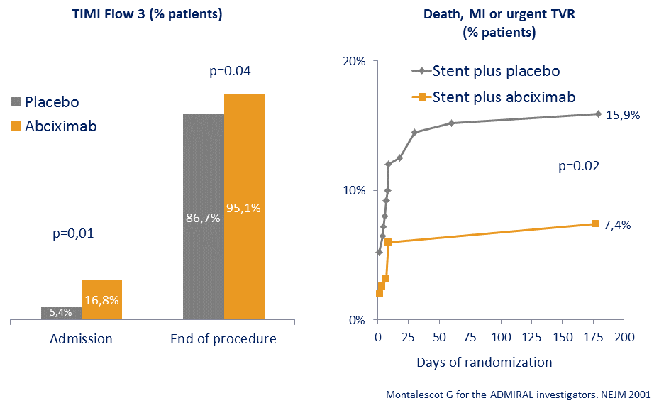
Pre-hospital GPIIbIIIa inhibitors
Primary PCI of STEMI

Slide 3
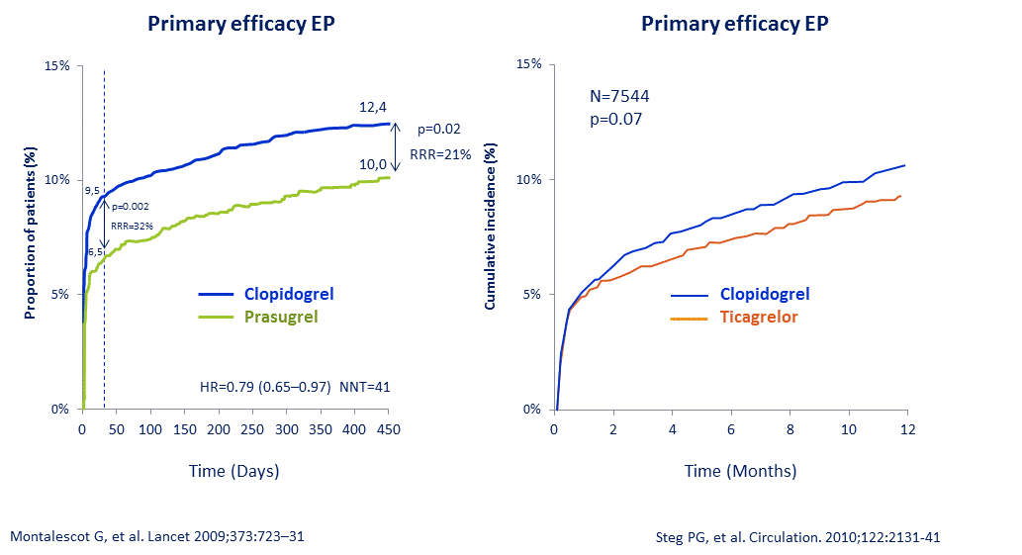
In-hospital new oral P2Y12 antagonists
Primary PCI of STEMI

Slide 4
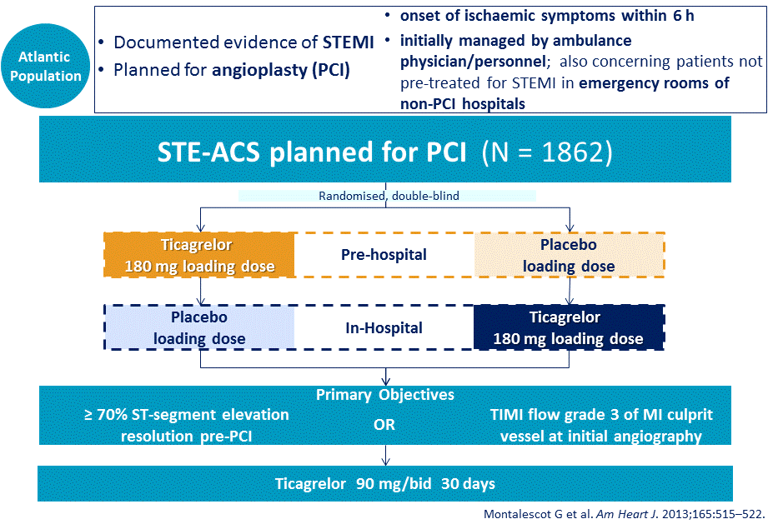
Study population and design

Slide 5
Pre-specified clinical 2° endpoints
Composite of death, MI, stent thrombosis, stroke or urgent revascularization at 30 days
Definite stent thrombosis at 30 days
Thrombotic bailout with GPIIb/IIIa inhibitors

Slide 6
Safety objectives
Bleeding (excluding CABG related events)
  PLATO definition
  TIMI, STEEPLE, GUSTO, ISTH and BARC definitions
  Within first 48h and during 30 days of treatment
Other safety events within 30 days of study treatment

Slide 7
Trial Conduct
Coordinating Center: ACTION Study Group - Institute of Cardiology, Pitié-Salpêtrière University Hospital, Paris, France
Sponsor: AstraZeneca
Global Trial Operations: Worldwide Clinical Trials (UK)
External Academic Statistical Center : ACTION Study Group
Executive Committee: Gilles Montalescot (France), Arnoud W van’t Hof (The Netherlands), Christian W Hamm (Germany), Frédéric Lapostolle (France), Jens Flensted Lassen (Denmark)
Endpoint adjudication Committee: Robert Wilcox (UK); David Gray (UK); William Smith (UK), Timothy Taylor (UK)
Data Safety Monitoring Board: Stuart Pocock (UK), Gabriel Steg (France), Angeles Alonso Garcia (Spain)

Slide 8
Baseline patient characteristics
 |  | Ticagrelor pre-hospital (n=909) | Ticagrelor in-hospital (n=953)
Age, years; mean ± SD |  | 60.6 ± 12.4 | 61.0 ± 12.5
≥75 years; % |  | 15.8 | 16.8
Female, % |  | 19.0 | 20.6
Weight, kg; mean ± SD |  | 80.4 ± 15.9 | 79.7 ± 15.6
BMI ≥30 kg/m², % |  | 19.5 | 18.7
Diabetes mellitus, % |  | 12.7 | 14.5
TIMI risk score group, % | 0–2 | 60.7 | 60.1
 | 3–6 | 37.1 | 38.3
 | >6 | 2.2 | 1.6
Killip class I, % |  | 90.1 | 90.5
BMI, body mass index; SD, standard deviation

Slide 9
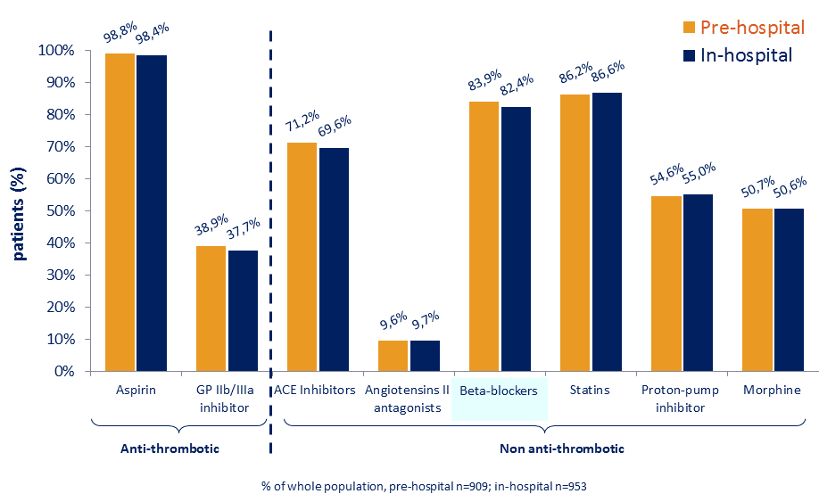
Concomitant medications

Slide 10
Procedural characteristics
Values are % | Ticagrelor pre-hospital (n=909) | Ticagrelor in-hospital (n=953)
Coronary Angiography | 97.7 | 98.3
Arterial access (% of those undergoing coronary angiography)
Femoral | 31.5 | 33.0
Radial | 67.9 | 66.7
Thrombo-aspiration | 51.8 | 49.3
PCI | 88.0 | 87.1
With stent | 83.6 | 81.4
DES | 51.4 | 50.3
BMS | 33.6 | 32.7
Without stent | 4.4 | 5.7
CABG | 1.1 | 1.6
No PCI or CABG | 10.9 | 11.3
BMS, bare metal stents; DES, drug-eluting stents

Slide 11
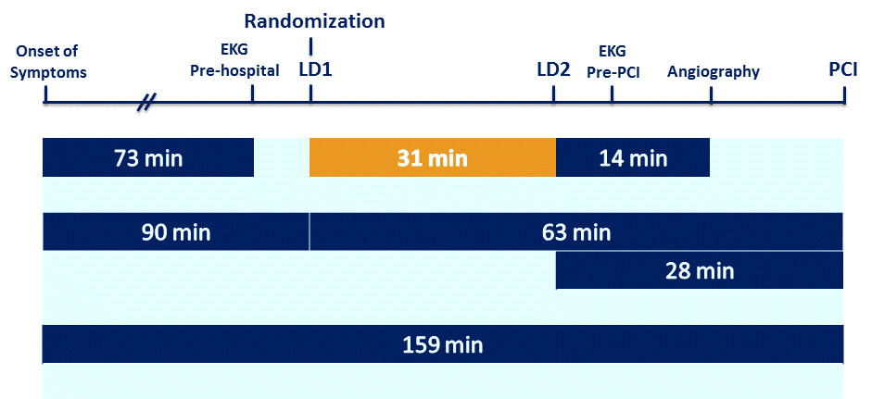
Median times to pre- and in-hospital steps

Slide 12
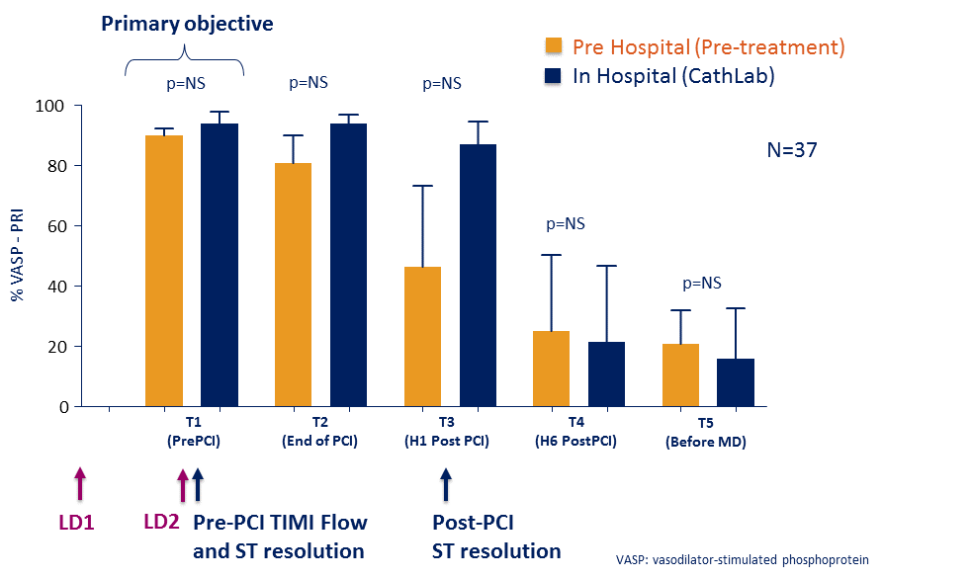
Ticagrelor pre-hospital vs. in-hospital for VASP-PRI

Slide 13
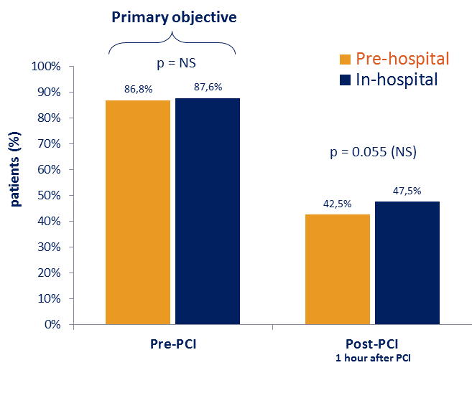
1st Co-primary endpoint
No ST-segment resolution (≥70%)

Slide 14
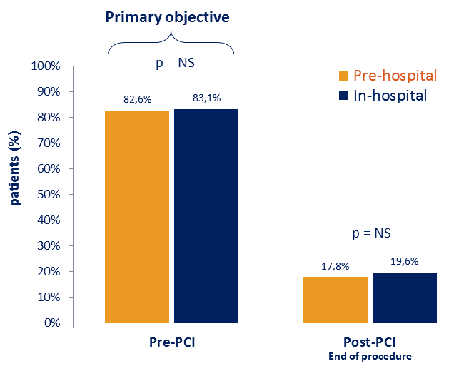
2nd Co-primary endpoint
No TIMI 3 flow in infarct-related artery

Slide 15
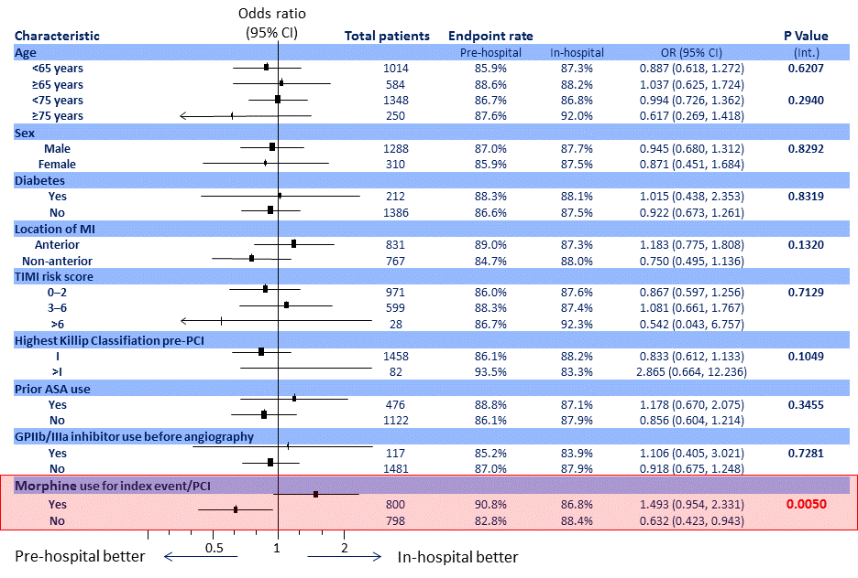
Absence of ST-segment resolution by patient characteristics

Slide 16
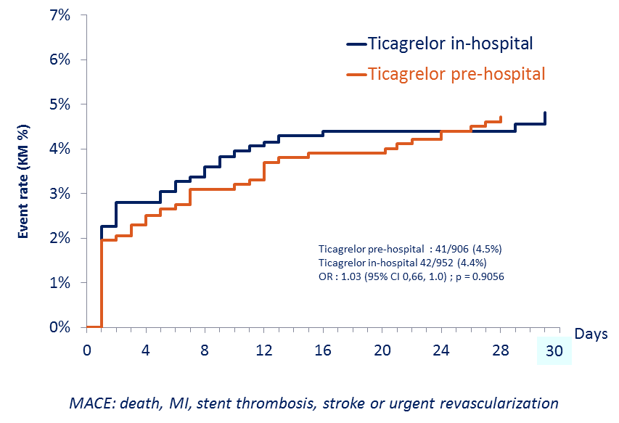
Major adverse CV events up to 30 days

Slide 17
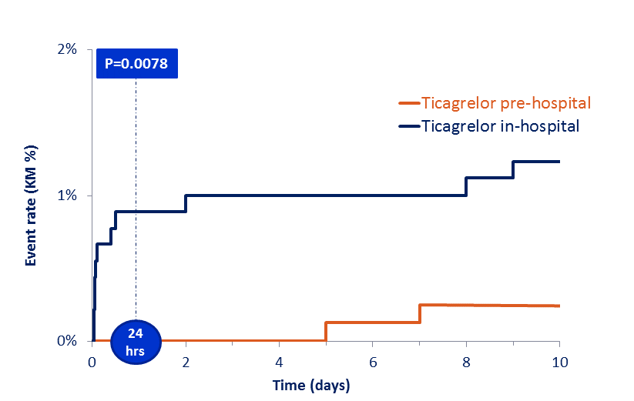
Definite stent thrombosis up to 10 days

Slide 18
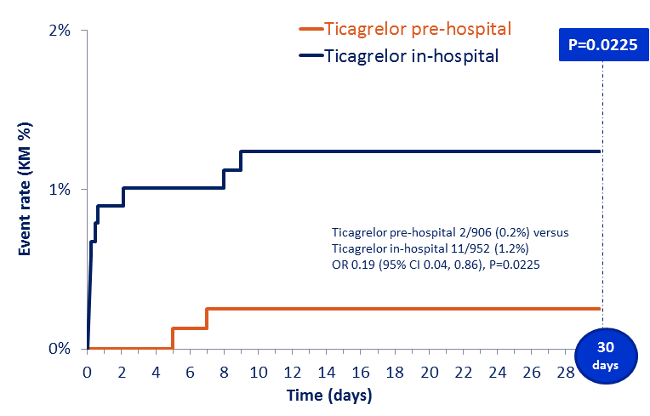
Definite stent thrombosis up to 30 days

Slide 19
Clinical endpoints at 30 days
Values are % | Ticagrelor pre-hosp (n=906) | Ticagrelor in-hosp (n=952) | Odds ratio (95% CI) | p-value
Death (all-cause) | 3.3 | 2.0 | 1.68 (0.94, 3.01) | 0.08
MI | 0.8 | 1.1 | 0.73 (0.28, 1.94) | 0.53
Stroke | 0.4 | 0.2 | 2.11 (0.39, 11.53) | 0.39
TIA | 0 | 0.1 |  | Not estimable
Urgent coronary revascularization | 0.6 | 0.8 | 0.66 (0.21, 2.01) | 0.46
Bail-out GP IIb/IIIa inhibitors | 8.6 | 10.5 | 0.80 (0.59, 1.10) | 0.17

Slide 20
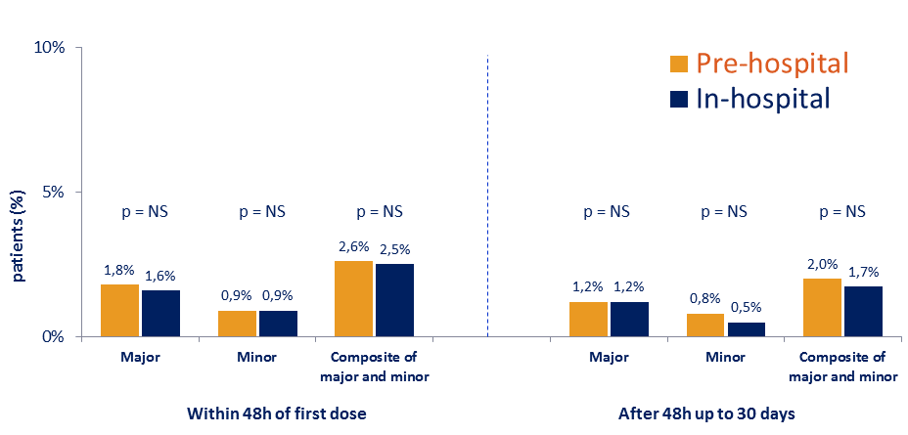
Non-CABG-related bleeding events
(PLATO definitions) - Safety population

Slide 21
Conclusion
Pre-hospital ticagrelor administration a short time before PCI in patients with ongoing STEMI is safe but does not improve pre-PCI coronary reperfusion. It may, however, reduce the risk of post-PCI stent thrombosis.
Notes:
ATLANTIC was an international, multicenter, randomized, double-blind study in 1862 patients with ongoing STEMI of less than 6 hours, comparing pre-hospital (in-ambulance) versus in-hospital (in-catheterization laboratory) treatment with ticagrelor or placebo.
Median time from randomization to angiography was 48 min and median time difference between the two treatment strategies was 31 min
The two co-primary endpoints, analyzing reperfusion before PCI, did not differ between the pre- and in-hospital ticagrelor groups.
Post-PCI ST-segment elevation resolution ≥70% was numerically better with pre-hospital administration of ticagrelor (p=0.055) and was better in patients not receiving morphine.
MACE were not different between the two groups but definite stent thrombosis occurred less frequently in the pre-hospital arm (0% versus 0.8% in the first 24 hours, p=0.0078); 0.2% versus 1.2% at 30 days, p=0.0225).
Major bleeding event rates at 48 h and 30 days were low and identical between the two study groups whichever bleeding

Slide 22
Algeria: Rachid Bougherbal (Algiers), Mohamed Tahar Bouafia (Algiers), Mohamed Chettibi (Algiers), Djamaleddine Nibouche (Medea), Abdelkader Moklati (Tipaza), Ahmed Benalia (Algiers), Omar Kaid (Blida), Messaad Krim (Blida).
Australia: Christopher Hammett (Herston, QLD), Paul Garraby (Woolloogabba, QLD), Rohan Jayasinghe (Southport, QLD), Stephen Rashford (Kedron, QLD).
Austria: Kurt Huber (Vienna), Thomas Neunteufl (Vienna), Helmut Brussee (Graz), Hannes Alber (Innsbruk), Franz Weidinger (Vienna), Michael Brunner (Vienna), Johann Sipoetz (Vienna), Gerhard Prause (Graz), Michael Baubin (Innsbruk), Dieter Sebald (Vienna).
Canada: Warren Cantor (Newmarket, ON),, Ram Vijayaraghavan (Scarborough, ON), Iqbal Bata (Halifax, NS), Andrea Lavoie (Regina, SK).
Denmark: Jens Flensted Lassen (Aarhus), Jan Ravkilde (Aalborg), Lisette Okkels Jensen (Odense C), Alf Møl Christensen (Aarhus), Marianne Toftegaard (Aalborg), Dennis Köhler (Odense C).
France: Gilles Montalescot (Paris), Gregory Ducrocq (Paris), Nicolas Danchin (Paris), Patrick Henry (Paris), Bernard Livarek (Le Chesnay), Romain Berthier (Corbeil Essonnes), Thomas Hovasse (Massy), Philippe Garot (Quincy sous Sénart), Laurent Payot (Montreuil), Hakim Benamer (Aubervilliers), Jean Baptiste Esteve (Montfermeil), Simon Elhadad (Lagny sur Marne), Emmanuel Teiger (Creteil), Jean Louis Bonnet (Marseille), Franck Paganelli (Marseille), Yves Cottin (Dijon), François Schiele (Besançon), Christophe Thuaire (Le Coudray), Guillaume Cayla (Nîmes), Pierre Coste (Pessac), Patrick Ohlmann (Strasbourg), Eric Bonnefoy Cudraz (Bron), Pierre Lantelme (Lyon), Thibault Perret (Lyon), Christophe Tron (Rouen), Axel De Labriolle (Montauban), Edouardo Aptecar (Melun), Olivier Beliard (Neuilly sur Seine), Olivier Varenne (Paris), Rami El Mahmoud (Boulogne Billancourt), Emmanuelle Filippi-Codaccioni (Vannes), Denis Angoulvant (Tours), Patrick Peycher (Tours), Olivier Poitrineau (Chateauroux), Xavier Tabone (Bourges), Patrick Ecollan (Paris), Claire Broche (Paris), Yves Lambert (Chesnay), Nicolas Briole (Corbeil Essonnes), Arielle Beruben (Montfermeil), Nicolas Porcher (Lagny sur Marne), Jean-Pierre Auffray (Marseille), Marc Freysz (Dijon), Franck Depardieu (Besançon), David Poubel (Chartres), Jean-Emmanuel De La Cousaye (Nîmes), Jean-Claude Bartier (Strasbourg), Benoît Jardel (Rouen), Bertrand Boulanger (Vannes), Hervé Labourel (Chambray-les-Tours), Louis-Christophe Soulat (Chateauroux), Frédéric Lapostolle (Bobigny), Véronique Julie (Dreux), Michel Thicoipe (Bordeaux), Olivier Capel (Lyon), Olivier Stibbe (Paris), Pierre Carli (Paris), Karim Tazarourte (Melun), Fabrice Alcouffe (Montauban), David Aboucaya (Clichy), Gaële Aubert (Juvisy sur Orge), Gérald Kierzek (Paris), Séverine Cahun-Giraud (Garches).
Germany: Uwe Zeymer (Ludwigshafen), Christian Hamm (Bad Nauheim), Thomas Dengler (Bad Friedrichshall), Roland Prondzinsky (Mersebourg), Paul Marc Biever (Freiburg), Andreas Schäfer (Hannover), Melchior Seyfarth (Wuppertal), Bernd Lemke (Lüdenscheid), Gerald Werner (Darmstadt), Holger Nef (Gießen), Holger Steiger (Darmstadt), Matthias Leschke (Esslingen), Thomas Münzel (Mainz), Marco Campo Dell Orto (Hessen), Christian Loges (Bad Friedrichshall), Monika Schinke (Merseburg), Frank Koberne (Freiberg), Hans Peter Reiffen (Hannover), Klaus Tiroch (Wuppertal), Dirk Wierich (Lüdenscheidt), Michael Kneussel (Darmstadt), Simon Little (Gießen), Hartmut Sauer (Esslingen), Rita Laufenberg-Feldmann (Mainz).
Hungary: Béla Merkely (Budapest), Imre Ungi (Szeged), Iván Horváth (Pécs), István Édes (Debrecen), István Mártai (Markó).
Italy: Leonardo Bolognese (Arezzo), Sergio Berti (Massa), Francesco Chiarella (Genova), Paolo Calabria (Grosseto), Massimo Fineschi (Siena), Marcello Galvani (Forli), Marco Valgimigli (Cona), Luciano Moretti (Ascoli Piceno), Maurizio Tespili (Seriate), Massimo Mandó (Arezzo), Francesco Bermano (Genova), Robusto Biagioni (Grosseto), Andrea Fabbri (Forli), Adelina Ricciardelli (Ferrara), Maria Romana Petroni (Ascoli Piceno), Umberto Roberto Vatteroni (Massa Carrara), Francesco Palumbo (Siena).
Netherlands: Frank F. Willems (Arnhem), Amar Al mafragi (Terneuzen), Ton A.A.C.M. Heestermans (Alkmaar), Martijn J. Van Eck (Den Bosch), Wim M.J.M. Heutz (Arnhem), H.H. Meppelder (Goes), Anika Roukema-de Jong (Alkmaar), Harm Van de Pas (Den Bosch).
Spain: Ángel Cequier Fillat (Barcelona), Manel Sabaté Tenas (Barcelona), Josepa Mauri Ferrer (Badalona), Antoni Serra Peñaranda (Barcelona), Joan Ángel Ferrer (Barcelona), Bruno García Del Blanco (Barcelona), Faustino Miranda Guardiola (Barcelona), Juan Miguel Ruiz Nodar (Alicante), Andrés Íñiguez Romo (Vigo), Nicolás Vázquez González (A Coruña), Ramiro Trillo Nouche (A Coruña), Luis Díaz De La Llera (Sevilla), José María Hernández García (Málaga), Fernando Rivero-Crespo (Madrid), Felipe Hernández Hernández (Madrid), José Luis Zamorano Gómez (Madrid), Xavier Jiménez Fárega (Barcelona), Gilberto Alonso Fernández (Barcelona), José Luis Toboso (Badalona), Mercedes Carrasco (Alicante), Victoria Barreiro ( A Coruña), José Antonio Iglesias Vázquez (A Coruña), María del Mar Ruiz Montero (Málaga), Fernando Rosell Ortiz (Málaga), Guillermo Garcia Escudero (Málaga), Vicente Sánchez-Brunete Ingelmo (Madrid), Antonio Lara García (Madrid).
Sweden: Magnus Janzon (Linköping), , Jonas Oldgren (Uppsala), Fredrik Calais (Örebro), Robert Kastberg (Gävle), Per-Adolf Bergsten (Linköping), Hans Blomberg (Uppsala),Kristian Thörn (Örebro), Gunnar Skoog (Gävle).
United Kingdom: Robert F. Storey (Sheffield), Azfar Zaman (Newcastle upon Tyne), Robert Gerber (Eastbourne and Hastings), Alisdair Ryding (Norwich), Mark Spence (Belfast), Neil Swanson (Middlesborough), Martin Been (Coventry), Konrad Grosser (Ashford, Kent), Peter Schofield (Cambridge), David Mackin (York), Paul Fell (Newcastle upon Tyne), Tom Quinn (Guildford), Teresa Foster (Cambridge), David McManus (Belfast),

Slide 23
