Slide 1
ACST-2: Randomised trial of stenting vs surgery for asymptomatic severe carotid artery stenosis Alison Halliday Nuffield Department of Population Health (NDPH) University of Oxford, UK for the ACST-2 collaborators

Slide 3
ACST-2 is published online in The Lancet on 29 Aug 2021, with immediate open access All authors declare no conflicts of interest

Slide 4
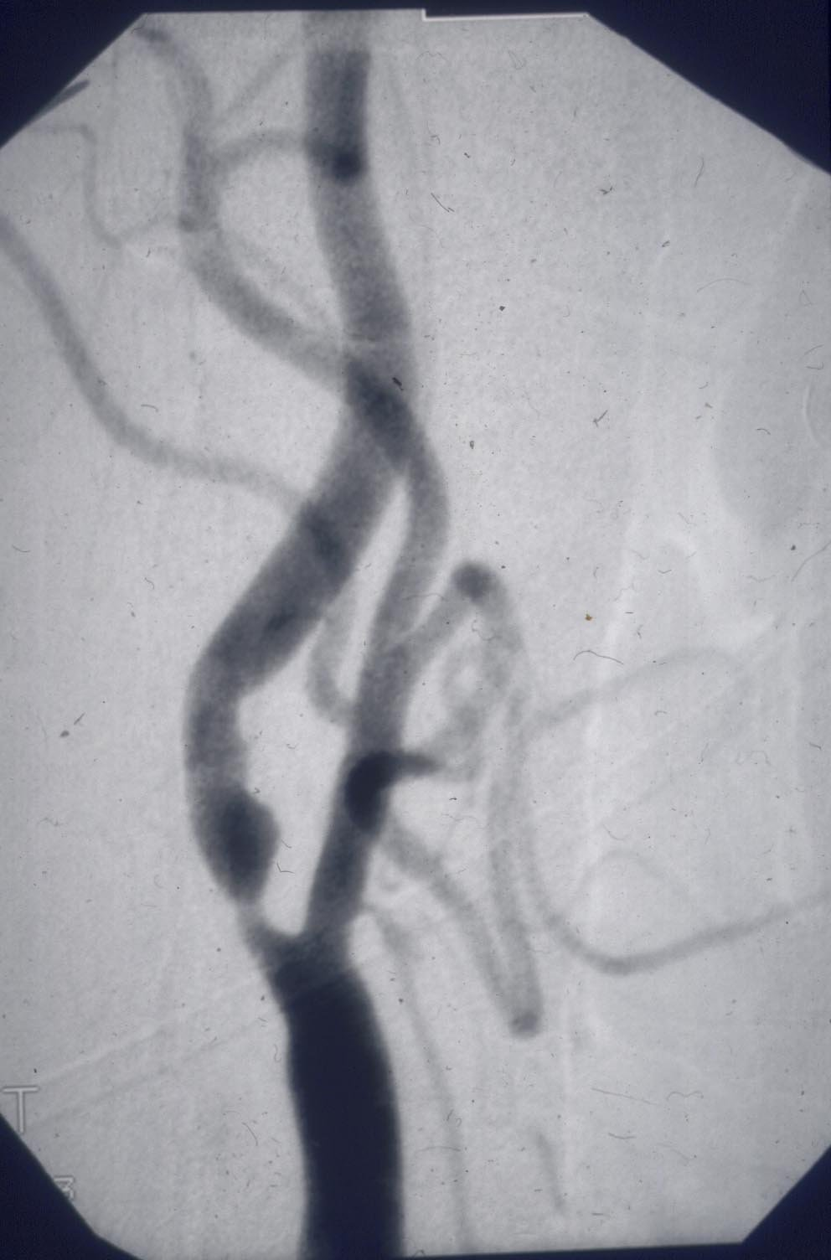
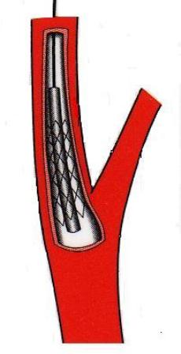
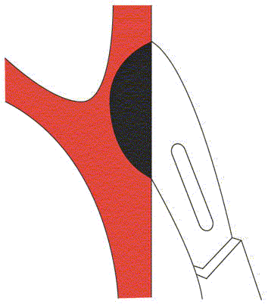
ACST-2: trial in 3625 patients of carotid artery stenting (CAS) vs carotid artery surgery (CEA: “endarterectomy”)

Slide 5
ACST-2: trial of carotid stenting (CAS) vs surgery (CEA)
Background on asymptomatic patients
with severe carotid stenosis
Surgery restores patency, and trials show it ~halves later stroke rates.
But, modern medical therapy also ~halves long-term stroke rates.
Stenting also restores patency, and in recent nationwide registry data
CAS and CEA each have ~1% risk of causing disabling stroke or death.

Slide 6
2014-19 German mandatory nationwide registry of in-hospital* CAS/CEA risks in asymptomatic patients Stenting Surgery 18,000 CAS 86,000 CEA Disabling stroke or death: 0.7% 0.7% Any stroke or death: 1.8% 1.4% NB In-hospital stroke risks were not affected by gender, or by age. * Median 4-5 days to discharge; 30-day risks would be higher. Source: https://iqtig.org/qs-verfahren/qs-karotis

Slide 7
ACST-2: carotid stenting (CAS) vs surgery (CEA)
CAS vs CEA: why do we also need randomised evidence?
Large, representative registries can assess procedural hazards,
and determine reliably whether they depend on gender or age.
But, registries cannot reliably compare long-term non-procedural
stroke rates; for this, large-scale randomised evidence is required.

Slide 8
ACST-2: carotid stenting (CAS) vs surgery (CEA)
Randomised trial in 130 hospitals (mostly European), each with a collaborating vascular surgeon, interventionist, and stroke doctor
Collaborators used their normal procedures, with, for stenting, any CE-approved devices and double anti-platelet therapy.

Slide 9
ACST-2: carotid stenting (CAS) vs surgery (CEA)
Severe carotid artery stenosis (≥60% on ultrasound), with no recent ipsilateral stroke or other symptoms from it
Thought to need a carotid procedure (stenting or surgery), but substantially uncertain whether to prefer CAS or CEA

Slide 10
ACST-2: carotid stenting (CAS) vs surgery (CEA)
3625 patients randomised, half to stenting and half to surgery (70% male, 30% diabetic, mean age 70, mean follow-up 5 years)
Both groups got good long-term medical treatment, 80-90% with lipid-lowering, anti-thrombotic and anti-hypertensive therapy.
Strokes were classified by residual disability 6 months afterwards (defining a “disabling” stroke as modified Rankin Score [mRS] 3-5).

Slide 11
ACST-2: carotid stenting (CAS) vs surgery (CEA)
5-year risk of procedural death, or of disabling or fatal stroke
Left: Including procedural risks, Right: Excluding procedural risks
4
4
1811 CAS vs 1814 CEA
3.5% CEA
%
Long-term stroke rate ratio, CAS vs CEA, 0.98 (0.64-1.48)
%
3.4% CAS
3
3
2.5% CEA
2.5% CAS
2
2
1
~1% procedural risk
1
0
0
0
1
2
3
4
5
years
0
1
2
3
4
5
years

Slide 12
ACST-2: carotid stenting (CAS) vs surgery (CEA)
Severity of worst procedural event & worst non-procedural stroke
 | Procedural (<30 days) stroke or death |  |  | Non-procedural stroke (with mean 5-year FU)
 | Allocated CAS n=1811 | Allocated CEA n=1814 |  | Allocated CAS n=1748* | Allocated CEA n=1767*
Disabling or fatal | 15 (0.9%)† | 18 (1.0%)† |  | 44 (2.5%) | 45 (2.5%)
Non-disabling | 48 (2.7%) | 29 (1.6%) |  | 47 (2.7%) | 34 (1.9%)
* Excludes the 63 CAS vs 47 CEA patients who had a procedural stroke or death † Includes the 2 CAS vs 6 CEA procedural deaths not involving a stroke

Slide 13
ACST-2: carotid stenting (CAS) vs surgery (CEA)
Severity of worst procedural event, and worst non-procedural stroke
 | Procedural (<30 days) stroke or death |  |  | Non-procedural stroke (with mean 5-year FU)
 | Allocated CAS n=1811 | Allocated CEA n=1814 |  | Allocated CAS n=1748 | Allocated CEA n=1767
Disabling or fatal | 15 | 18 |  | 44 | 45
Non-disabling:
mRS score 2 | 9 | 9 |  | 9 | 5
mRS score 1 | 23 | 15 |  | 23 | 17
mRS score 0 | 16 | 5 |  | 15 | 12

Slide 14
ACST-2: carotid stenting (CAS) vs surgery (CEA)
Any procedural death or any stroke at any time, by severity
 | Allocated CAS n=1811 | Allocated CEA n=1814
mRS >1: Fatal, disabling, or unable to carry out some previously usual activities | 77 | 77
mRS 0-1: Non-disabling, and still able to carry out all previously usual activities | 77 (4.2%) | 49 (2.7%)

Slide 15
ACST-2: carotid stenting (CAS) vs surgery (CEA)
3625 patients with severe stenosis but no recent ipsilateral symptoms,
half allocated CAS, half CEA; good compliance, and good medical therapy.
Summary of results
1% 30-day risk, in each group, of procedural death or disabling stroke;
2.5% 5-year risk, in each group, of non-procedural disabling/fatal stroke.
But, with stenting, there was a 1-2% excess risk of non-disabling stroke
that left patients still able to carry out all their previously usual activities.

Slide 16
Stenting vs surgery: ACST-2 results plus other evidence
Procedural strokes: An excess of non-disabling procedural strokes from stenting
is consistent with large, recent, nationally representative registry data.
Non-procedural strokes: To compare the effects of CAS vs CEA,
ACST-2 should be considered along with all other major trials.
8 major trials of CAS vs CEA, 4 in asymptomatic and 4 in symptomatic patients, have been reported. A formal meta-analysis can combine their findings.

Slide 17
Non-procedural stroke incidence in the 8 major trials of CAS vs CEA

Slide 18
Conclusions from the German national registry and from ACST-2 and the other major trials of CAS vs CEA
Competent CAS and CEA involve ~1% procedural death or disabling stroke,
then have similar effects on long-term rates of fatal or disabling stroke.
For asymptomatic patients with severe stenosis, previous trials showed that,
even if good medical treatment is given, CEA ~halves long-term stroke rate.
If so, then in ACST-2, where 0.5% per year had a fatal or disabling stroke with
either CAS or CEA, with neither procedure ~1% per year would have done so.

Slide 19
ACST-2 is published online in The Lancet on
29 Aug 2021 with immediate open access
The chief acknowledgements are to the patients who agreed to participate;
the collaborating doctors at 130 hospitals in 33 countries who randomised
them from 2008-20 and are continuing follow-up until 2026, and trial staff.
ACST-2 has for some years been hosted and funded by Oxford University’s
Nuffield Department of Population Health (NDPH; Prof Rory Collins).
Current funding is from the MRC/BHF/CRUK core support for the NDPH.
Until 2013, funding was from the UK NIHR HTA and BUPA Foundation.

