Slide 1



A multicenter prospective registry of a novel tapered sirolimus-eluting stent for long coronary lesions
Dr. Pierfrancesco Agostoni, MD, PhD
Interventional Cardiologist
HartCentrum, Ziekenhuis Netwerk Antwerpen (ZNA) Middelheim, Belgium
On Behalf of Morpheus-Global Investigators

Slide 2
Disclosure Statement of Financial Interest
I do have a financial interest/arrangement or affiliation with one or more organizations that could be perceived as a real or apparent conflict of interest in the context of the subject of this presentation, they are:
Affiliation/Financial Interest: | Name of Organization:
Grant/ Research support | Meril Life Sciences Pvt. Ltd.

Slide 3
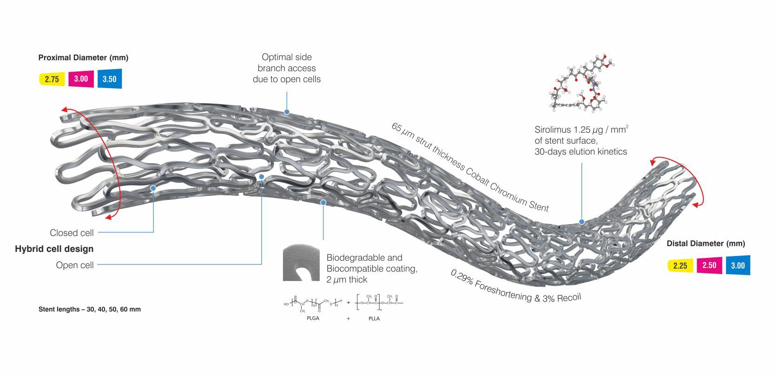

Mimic the Natural Artery Tapering and Avoid Stent Overlap
World’s First and only Tapered Coronary Drug-eluting Stent System
Stent lengths:
30-40-50-60 mm

Slide 4
Rationale Behind Tapered DES
Despite the advancement in stent platform, polymer and techniques, treatment of very long coronary lesions remains a challenge even with DES
The biomechanical interaction between the stent and the coronary artery is a significant concern due to the complex geometric feature of the artery, especially when arterial diameter changes to a significant degree over the length of the stent (tapering). This is mainly observed in long diffused coronary vessels
Multiple short stents with variable diameters are often implanted (overlapping) to match adequately the size of long tapered lesions
The purpose of a long tapered stent system is to “fill the gap” in this setting

Slide 5
Morpheus-Global Registry
NCT02901353
Study Objective:
Purpose of this registry is to evaluate safety and performance of the BioMime™ Morph sirolimus-eluting coronary
stent system in very long (length up to 56mm) coronary lesions in native coronary arteries with reference vessel diameter of 2.25mm to 3.50mm
Primary Outcome Measure:
Freedom from target lesion failure (TLF: cardiac death, vessel related-MI, TLR) at 6 months and up to 24 months
Secondary Outcome Measures:
MACE (TLF) at 1, 6, 12 and 24 months; “Defined as a composite of cardiac death, myocardial infarction attributed to the target vessel or ischemia-driven TLR”
Target vessel failure at 1, 6, 12 and 24 months; “Defined as cardiac death, myocardial infarction attributed to the
target vessel, or target vessel revascularization”
Academic Research Consortium defined stent thrombosis at 1, 6, 12 and 24 months; “Definite, probable and possible stent thrombosis during acute, subacute, late and very late phase”

Slide 6
Study Design
Prospective, single-arm, multi-centre, observational, real-world registry
Approximately 500 patients to be enrolled from The Netherlands, UK, Italy, Finland, Hungary, Bulgaria, Slovakia, Saudi Arabia, Jordan, South Africa, Indonesia and Malaysia
Baseline assessment, Informed Consent Process and Eligibility Testing
Index Procedure for the target lesion (length ≤ 56mm) Clinical Follow-up at 1 Month, 6 Months, 12 Months, and 24 Months
Freedom from target lesion failure (TLF) at 6 months and up to 24 months
MACE (TLF) and
ARC defined stent thrombosis
at 1, 6, 12, and 24 months
Other Outcomes Measured: Device and Procedure Success

Slide 7
Key Eligibility Criteria
Inclusion criteria | Exclusion Criteria
The patient must be at least 18 years old Significant native coronary artery stenosis (>50% by visual estimate) with lesion length of ≤56mm The patient or guardian agrees to the protocol requirements and the schedule of follow-up and provides informed written consent, as approved by the appropriate Institutional Review Board/Ethical Committee of the respective clinical site | Patients contraindicated to any of the following medications: aspirin, heparin, clopidogrel or other antiplatelet agents, cobalt-chromium, contrast agents and sirolimus An elective surgical procedure is planned that would necessitate interruption of antiplatelet drugs during the first 6 months post enrolment Patients who are actively participating in another drug or device investigational study

Slide 8
Investigating Sites
Investigating Site | Country | Investigator | # Enrolled
St.Antonius Nieuwegein | The Netherlands | Dr. P. Agostoni | 118
VUmc Research BV | The Netherlands | Dr. Paul Knaapen | 72
Specialised Hospital of active treatment in cardiology- Yambol | Bulgaria | Dr. Farhat Fouladvand | 71
Ospedale Maria Paterrno Arezzo | Italy | Dr. Antonino Nicosia | 60
Oulu University Hospital | Finland | Dr. Kari Kervinen | 27
Stredoslovenski ristav srdcovfch a ceivnych chorôb, a.s. (SÚSCCH) | Slovakia | Dr. Martin Hudec | 21
University Malaya Medical Centre (UMMC) | Malaysia | Dr. Ramesh Singh Arjan Singh | 18
Queen Elizabeth Hospital- II (Queen-2) | Malaysia | Dr. Liew Houng Bang | 14
University of Semmelweis | Hungary | Prof. Dr. Bela Merkely | 13
Panorama MediClinic | South Africa | Dr. Clive Corbett | 10
Vincent Pallotti Hospital | South Africa | Dr. Saleem Dawood | 10
Investigating Site | Country | Investigator | # Enrolled
UHW, Cardiff Centre, UK | UK | Dr Anirban Choudhury | 8
Azienda Ospedaliera Cannizaro | Italy | Dr. Salvatore Tomasello | 7
Freeman Hospital, Newcastle | UK | Prof. Azfar Zaman | 6
Life Flora Hospital | South Africa | Dr. Anthony Becker | 6
King Fehad Military Medical Complex | Saudi Arabia | Dr. Khalid Al Faraidy | 6
Derriford Hospital, Plymouth | UK | Dr Girish Vishwanathan | 5
University of Debrecen | Hungary | Dr. Szűk Tibor & Dr. Vajda | 3
Mediwest Research Center Oy | Finland | Dr. Jussi Sia | 2
Linksfield Park Medical Centre | South Africa | Dr. Riaz Garda | 2
Netcare Union Hospital | South Africa | Dr. C. Zambakides | 1
Gateway Hospital, Umhlanga, KZN | South Africa | Dr. Daivd Gillmer | 1
Jordan Hospital | Jordan | Dr. Imad Al Haddad | 1

Slide 9
Baseline Demographics
Cardiac Status
Characteristics | n = 482
Age, Years, (Mean±SD) | 65.35± 10.49
Male, n(%) | 365 (75.73)
Diabetes mellitus, n (%) | 153 (31.74)
Current smokers, n (%) | 109 (22.61)
Hypertension,n (%) | 339 (70.33)
Hyperlipidaemia, n (%) | 322 (66.80)
Renal insufficiency, n (%) | 34 (7.05)
3%
5%
Stable angina
Unstable angina STEMI
Non-STEMI
Silent Ischemia Asymptomatic
19%
44%
13%
16%

Slide 10
Lesion Characteristics
Lesion characteristics | n=484
Total no. of lesion treated with study device, n | 484
Total occlusion, n (%) | 198 (40.91)
Stenosis, n (%)
De novo | 458 (94.63)
In-stent | 19 (3.93)
Lesion Type, n (%)
Severely calcified | 116 (23.97)
CTO | 169 (34.92)
Diffuse | 152 (31.40)
Long (≥ 46mm) | 330 (68.18)
Thrombus | 41 (8.47)
Other (Critical, Discrete, Tandem) | 17 (3.51)
Lesion Location
LM RCA LAD LCx
0.41 %
12.60 %
40.08 %
46.90 %

Slide 11
Lesion and Stent Characteristics
AHA/ACC Lesion Classification Stent Length (mm)
A B1 B2 C 30mm 40mm 50mm
4.75 %
60mm
11.39 %
12.81 %
39.87 %
11.78 %
23.21 %
70.66 %
25.53 %

Slide 12
Clinical Outcomes
Events n (%) | In-hospital (n = 482) | 1-month FU (n = 470)* | 6-month FU (n = 350)*
All cause death | 0 (0.0) | 3 (0.64) | 7 (2.00)
Cardiac death | 0 (0.0) | 2 (0.43) | 4 (1.14)
Non-cardiac death | 0 (0.0) | 1 (0.21) | 3 (0.86)
MI | 1 (0.21) | 2 (0.43) | 3 (0.86)
Q-Wave | 0 (0.0) | 1 (0.21) | 1 (0.29)
Non Q-Wave | 1 (0.21) | 1 (0.21) | 2(0.57)
ID-TLR | 0 (0.0) | 2 (0.43) | 7 (2.00)
Definite ST | 0 (0.0) | 2 (0.43) | 2 (0.57)
MACE | 1 (0.21) | 6 (1.28) | 14 (4.00)
Freedom from TLF | 481 (99.79) | 464 (98.72) | 336 (96.00)
* Follow-up ongoing
Device Success | 98.34% (474 out of 482 subjects)
Procedure Success | 98.96% (477 out of 482 subjects)

Slide 13
Conclusions
This study shows that BioMime Morph seems safe and effective in very long (length up to 56 mm)
coronary lesions in native coronary arteries with reference vessel diameter 2.25 mm to 3.50 mm
A single long tapered BioMime Morph system is often enough for treating long diffused lesions in tapered arteries, and therefore the arterial wall can be saved from over-exposure to drug/metal (due to overlap) and its related adverse events such as delayed healing, peri-procedural myocardial infarction, risk of target lesion revascularization and very late stent thrombosis, due to the use of multiple stents
The cumulative MACE rate was 1.28% at 1-month follow-up and 4% at 6-month follow-up
The freedom from TLF was reported in 98.72% and 96% of patients at 1-month and 6-month
follow-up, respectively
Long-tapered DES can be considered as an extremely interesting alternative for long diffused de novo coronary lesions with tapered anatomy in routine clinical practice, provided these preliminary data are confirmed at completion of the study

Slide 14
THANK YOU

Slide 15
BACK UP SLIDES

Slide 16
Study Status
Patients enrolled
n=482
1-month FU
n=470
6-month FU
n=350
12-month FU
n=210

Slide 17
Site reported reasons for device failure in 8 patients:
1. Balloon of the stent rupture at 10 ATM during deployment, with incomplete stent expansion requiring post dilatation (balloon 3.0 x 12 NC). Good final result.
2. No BioMime Morph stent placed. Long stent could not cross the lesion to distal RCA
3. Calcified vessel, BioMime Morph couldn't pass lesion
4. Due to calcification not possible to place BioMime Morph stent
5. Unable to pass lesion with stent, when retrieving in guide-wire stent gets stuck, one strut was bend, other stent was placed instead
6. Primary attempt with BioMime Morph stent but stent does not pass in mid-segment and when retrieving the stent also strut visible proximally. Stent not placed.
7. Stent was placed subintimal
8. The study device did not cross the lesion; another type of DES was use to achieve procedure success

Slide 18
Site reported reasons for procedure failure in 5 patients:
1. No BioMime Morph stent placed. Long stent could not cross the lesion to distal RCA
2. Due to calcification, not possible to place BioMime Morph stent
3. Unable to pass lesion with stent, when retrieving in guide-wire stent gets stuck, one strut was bend
4. Primary attempt with BioMime Morph stent but stent does not pass in mid-segment and when retrieving the stent also strut visible proximally. Stent not placed.
5. Stent was placed subintimal

