Slide 1
TRILUMINATE Pivotal
A Randomized Trial for Tricuspid Regurgitation
Paul Sorajja, MD
On behalf of the TRILUMINATE Pivotal investigators
TRILUMINATE Pivotal is sponsored by Abbott

Slide 2
Potential Conflicts of Interest
Consultant to 4C Medical, Abbott Structural, Anteris, Boston Scientific, Edwards LifeSciences, Foldax, HighLife, Medtronic, Shifamed, Shockwave, vDyne, WL Gore
National Co-P.I. for TRILUMINATE Pivotal

Slide 3
Study Design for TRILUMINATE Pivotal RCT
BACKGROUND
TRILUMINATE Pivotal RCT is the first randomized, controlled study for the treatment of tricuspid regurgitation (TR).
SCIENTIFIC OBJECTIVE
To evaluate the safety and effectiveness of the TriClip System in symptomatic patients with severe TR.
PRIMARY ENDPOINT
A composite of mortality or tricuspid valve surgery, heart failure hospitalizations, and qualityrofrlife improvement ≥15 points assessed using the Kansas City Cardiomyopathy Questionnaire (KCCQ), evaluated at 12 months in a hierarchical fashion using the Finkelstein-Schoenfeld methodology.
30 days: TR reduction to moderate or less; freedom from major adverse events
12 months: Change in KCCQ and 6MWD
24 months: Recurrent HF hospitalizations; freedom from all-cause mortality, tricuspid valve surgery, and tricuspid valve intervention
SECONDARY ENDPOINTS
Inclusion Criteria:
Symptomatic with severe TR despite medical therapy
≥ Intermediate risk of mortality/morbidity with tricuspid valve surgery
KEY INCLUSION/ EXCLUSION CRITERIA
Exclusion Criteria:
Indication for other valve disease intervention
Anatomy not suitable for TriClip therapy

Slide 4
Study Design for TRILUMINATE Pivotal RCT
Subject Selection
Subject has symptomatic, severe TR and is at intermediate or greater risk for mortality or morbidity with TV surgery
Yes
Subject meets inclusion/exclusion criteria?
No
Yes
Echo Core Lab TR Severity Confirmed? |  | No
 | Yes
Screen Failure
Eligibility Committee Confirm optimized medical therapy and valve anatomy clippable |  | No
 | Yes
Baseline Visit
Yes
Ability to reduce TR to Moderate or less?
No
Randomize 1:1
Single-Arm
TriClip Device (N=175)
Medical Therapy (N=175)
TriClip Device

Slide 5
Efficacy and Safety
TR Severity
Baseline 1-year
Adverse Events† (30 Days)
Major Adverse Events (n=172) 3 (1.7%)
Cardiovascular mortality Endocarditis requiring surgery New-onset renal failure
Non-elective CV Surgery, TVRS for device-related AE
Any-cause mortality Major bleeding#
Single leaflet device attachment (SLDA)*
Stroke
Myocardial infarction Device embolization*
Device thrombosis
New CRT/CRT-D/ICD/perm. pacemaker^
1 (0.6%)
0 (0%)
2 (1.2%)
100%
11.1
80%
38.2
0 (0%)
60%
1 (0.6%)
8 (4.7%)
12 (7.0%)
1 (0.6%)
0 (0%)
0 (0%)
0 (0%)
1 (0.6%)
97.1
98.4
89%
moderate or less
94.4
40%
20%
50.7
2.4
3.2
0%
2.9
1.6
Device (n=136)
Control (n=125)
Device (n=136)
Control (n=125)
Severe/Massive/Torrential Moderate
Trace/Mild
†Attempted procedure population (3 subjects randomized to Device withdrew consent prior to
index procedure)
#Defined as bleeding ≥ Type 3 based on a modified Bleeding Academic Research Consortium
(BARC) definition
*SLDA and embolization evaluated through 30-day follow-up
^Assessed through adverse event reporting

Slide 6
Primary Endpoint Results
Win ratio, 1.48
(1.06, 2.13), p=0.02
11348
TriClip™ therapy demonstrated superiority to medical therapy, driven by improvement in KCCQ
12000
10000
8000
7643
p<0.0001
6516
6000
p=0.75
2644
p=0.41
2871
4000
2884
1948
2128
2000
0
Total
Death or TV Surgery
HF hospitalization
KCCQ change ≥15 pts
Device Wins
Control Wins

Slide 7
A Deeper Dive into the Baseline Characteristics of Patients Enrolled in TRILUMINATE Pivotal RCT

Slide 8
Baseline Characteristics for RCT Cohort
Variable N=350
Variable, continued N=350
Age, mean (years) 78 ± 7
Female 55%
Hypertension 81%
Atrial fibrillation 90%
Diabetes 16%
Renal disease 35%
Prior Aortic or Mitral Intervention 37%
Prior Aortic Intervention Surgical replacement Percutaneous replacement Surgical repair Percutaneous repair
15%
11%
3%
1%
0%
Prior Mitral Intervention Surgical replacement Percutaneous replacement Surgical repair Percutaneous repair
25%
5%
0%
7%
11%
TR Severity Severe Massive Torrential
Prior CABG
19%
28%
20%
51%
Prior PCI
14%
Etiology
Primary/mixed Secondary
Prior CRT/CRT-D/ICD/Pacemaker
15%
6%
94%
HFH within previous 1 year
25%

Slide 9
Baseline Symptoms and Quality of Life
NYHA
KCCQ
100%
2%
35%
Mean KCCQ:
55.1 ± 23.8
33%
30%
30%
80%
25%
55%
25%
(%)
60%
Subjects (%)
20%
Subjects
40%
15%
11%
10%
20%
43%
5%
0%
0%
0-24
Very poor to poor
25-49
Poor to fair
50-74
Fair to good
75-100
Good to very good
Baseline (N=350)
NYHA I NYHA II NYHA III NYHA IV

Slide 10
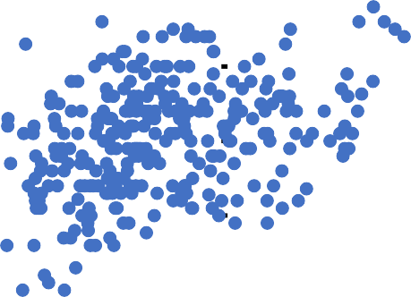
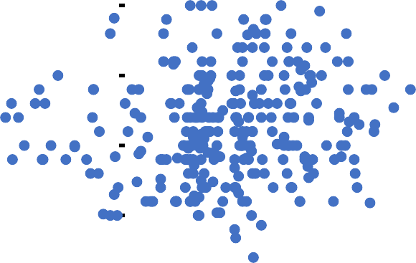
Baseline Cardiac Chambers
LV and RV Size
RVEDD (base)
LV and RV Function
 |  | TAPSE
LV dysfunction RV normal _{3.5} 4% 3 2.5 LVEF ² |  |  | LV normal RV normal 42%
20 30 | 40 | 1.5 ⁵⁰ | 60 |  | 70 80 LV normal RV dysfunction 45%
 |  | 1
LV dysfunction |  | 0.5
RV dysfunction
9% |  | 0
LV normal |  |  | 9 | LV dilated RV dilated 28%
RV dilated
61% |  |  | 8
 |  |  | 7
 |  |  | 6
LVEDVi |  |  | 5
0 | 20 | 40 | 4 | 60 80 100 LV dilated RV normal 1%
 |  |  | 3
 |  |  | 2
LV normal RV normal |  |  | 1
10% |  |  | 0
4
Mean RVEDD (base): 5.1 ± 0.8 cm Mean LVEDVi: 44 ± 17 mL/m²
Mean TAPSE: 1.6 ± 0.4 cm
Mean LVEF: 59 ± 10 %

Slide 11
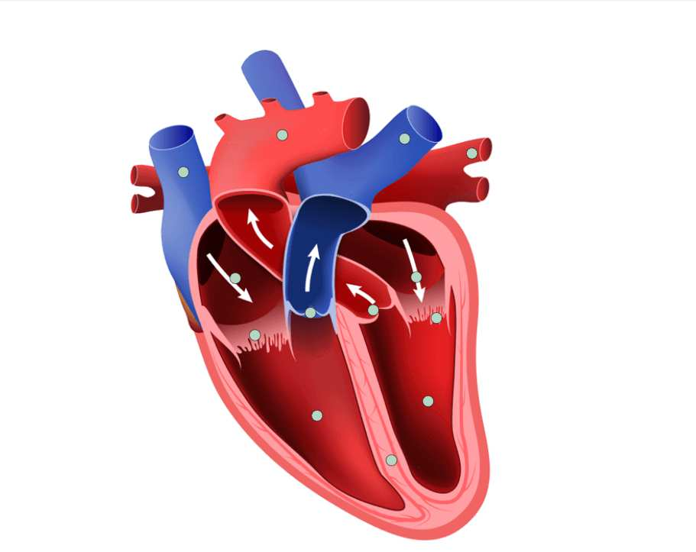
Invasive Hemodynamic Data at Baseline
Right Atrial Pressure (n=192)
75
PCWP: 14.9 ± 4.4 mmHg
Mean PAP: 25.5 ± 6.1 mmHg
65
55
PVR: 2.5 ±1.1 WU
Number of Subjects
45
35
Right atrial pressure:
11.0 ± 5.0 mmHg
25
15
5
RVEDP: 8.5 ± 6.2 mmHg
-5
[1, 6]
[6, 11] [11, 16] [16, 21] [21, 26]
Right Atrial Pressure (mmHg)
[26, 31]
86% of subjects had pulmonary artery systolic pressure <50 mmHg

Slide 12
Baseline Organ Function
CARDIAC (NT PRO-BNP)
KIDNEY (GFR)
LIVER (GGT)
4%
17%
7%
40%
33%
40%
>2000
55%
dysfunction
31%
67% > 40
56%
67%
45%
< 400
400-2000
2000
< 30 (severe dysfunction)
30-45 (moderate dysfunction)
45-60 (mild dysfunction)
60 (normal)
N = 332
< 40 (normal)
40 (elevated)
N = 133
N = 232

Slide 13
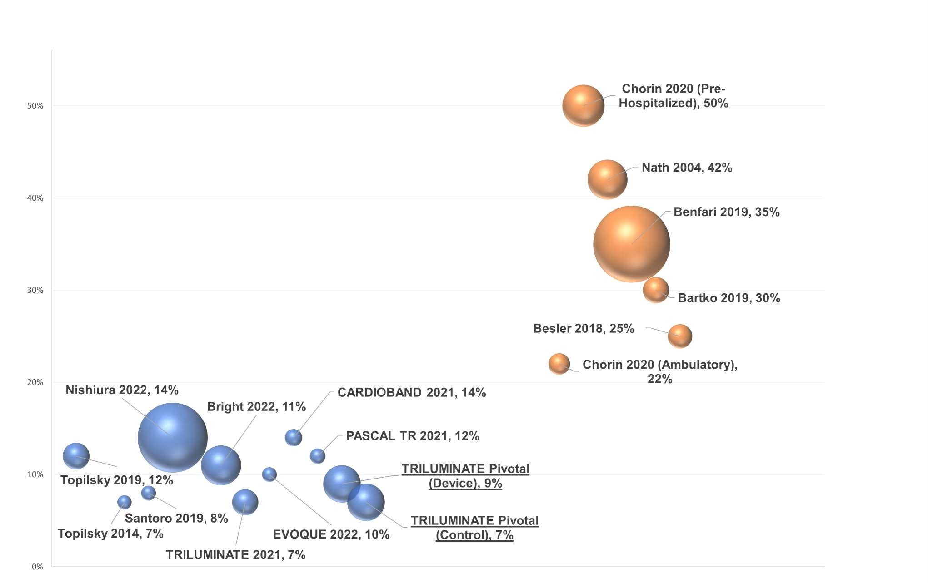
1-Year Mortality Compared to Other Studies
1-year Mortality Range
No concomitant valve disease: 7% to 14% Untreated concomitant valve disease: 22% to 50%
1-Year Mortality
Note: Size of data point represents relative study sample size.

Slide 14
Change in QOL Compared to Prior Studies
30
Range: 3-12 months
26.3
25
22
KCCQ Change
20
17
15.2
15
13.5
12
10
6
6.1
5
-2.99
73
67
68
56
36
52 38 53
53
0
Baseline KCCQ score shown at bottom of bar
-5
PARADIGM-HF DEFINE-HF
DAPA-HF
FAIR-HF
PCDM
TRILUMINATE
Pivotal
COAPT
PARTNER-2
PAL-HF

Slide 15
Conclusions
TRILUMINATE Pivotal is the first RCT to examine the effects of TR reduction with TriClip therapy; the trial demonstrated safety of the TriClip system and significant reduction in TR, associated with QOL benefit.
The findings were observed in patients who predominantly had:
Preserved LV size/function;
Mild RV dysfunction and moderate RV enlargement;
Severe symptoms and moderate impairment of QOL at baseline;
Moderate right atrial pressure elevation, mild elevation in PCWP, and moderate pulmonary hypertension;
No untreated left-sided VHD.
One-year mortality was 8%, comparable in device and medical arms, and in line with studies of TR patients without untreated VHD.
QOL improvement was comparable to or better than prior trials of established therapies.

Slide 16
PCRonline.com

