Slide 1


Intravascular Lithotripsy And/Or Mechanical Debulking Multicenter Registry For The Treatment Of Complex Calcified Coronary Arteries
The Multicenter Prospective
Registry
Enrico Cerrato, MD, Ph.D
Interventional Cardiology Unit
San Luigi Gonzaga University Hospital, Turin, Italy
Rivoli Infermi Hospital, Turin, Italy
On behalf of Rolling Stone investigators

Slide 2
Enrico CERRATO MD, PhD
  Lectures fee from Biotronik, Abbott Vascular, Medtronic, Boston Scientific
  My institutions received research grants from Shockwave medical and Abbott vascular

Slide 3
Background
Intravascular Lithotripsy (IVL) demonstrated its safety and effectiveness for modification of severely calcified coronary lesions to achieve optimal stent expansion in select patients and lesion population
Different specific subsets of patients have not been evaluated in clinical trials
Unprotected LM
Ostial Location
In-stent restenosis
Bailout IVL after stenting
True Bifurcations
Acute MI
Severe CKD
Severe LV impairment
Comparative data on different calcium debulking techniques are lacking
Cerrato E.

Slide 4
Primary Objective
The primary objective of the ROLLING-STONE trial was to compare the performance of IVL vs atherectomy device (AT, rotational and orbital atherectomy) during PCI in a real-life all-comers population.
Inclusion criteria
De novo lesions, in-stent restenosis (ISR) or under-expanded stent treatment
Moderate-severe calcifications (Mintz classification) at the lesion site by angiography or imaging
Exclusion criteria
Inability to sign informed consent
Life expectancy less than 1y
Investigator initiated
Prospective (2022-2023), multicentre registry
Debulking technique used at operator’s discretion
Independent core lab and AE committee (Cagliari University)
Indipendent statistical analysis (Turin University)
NCT05016726

Slide 5

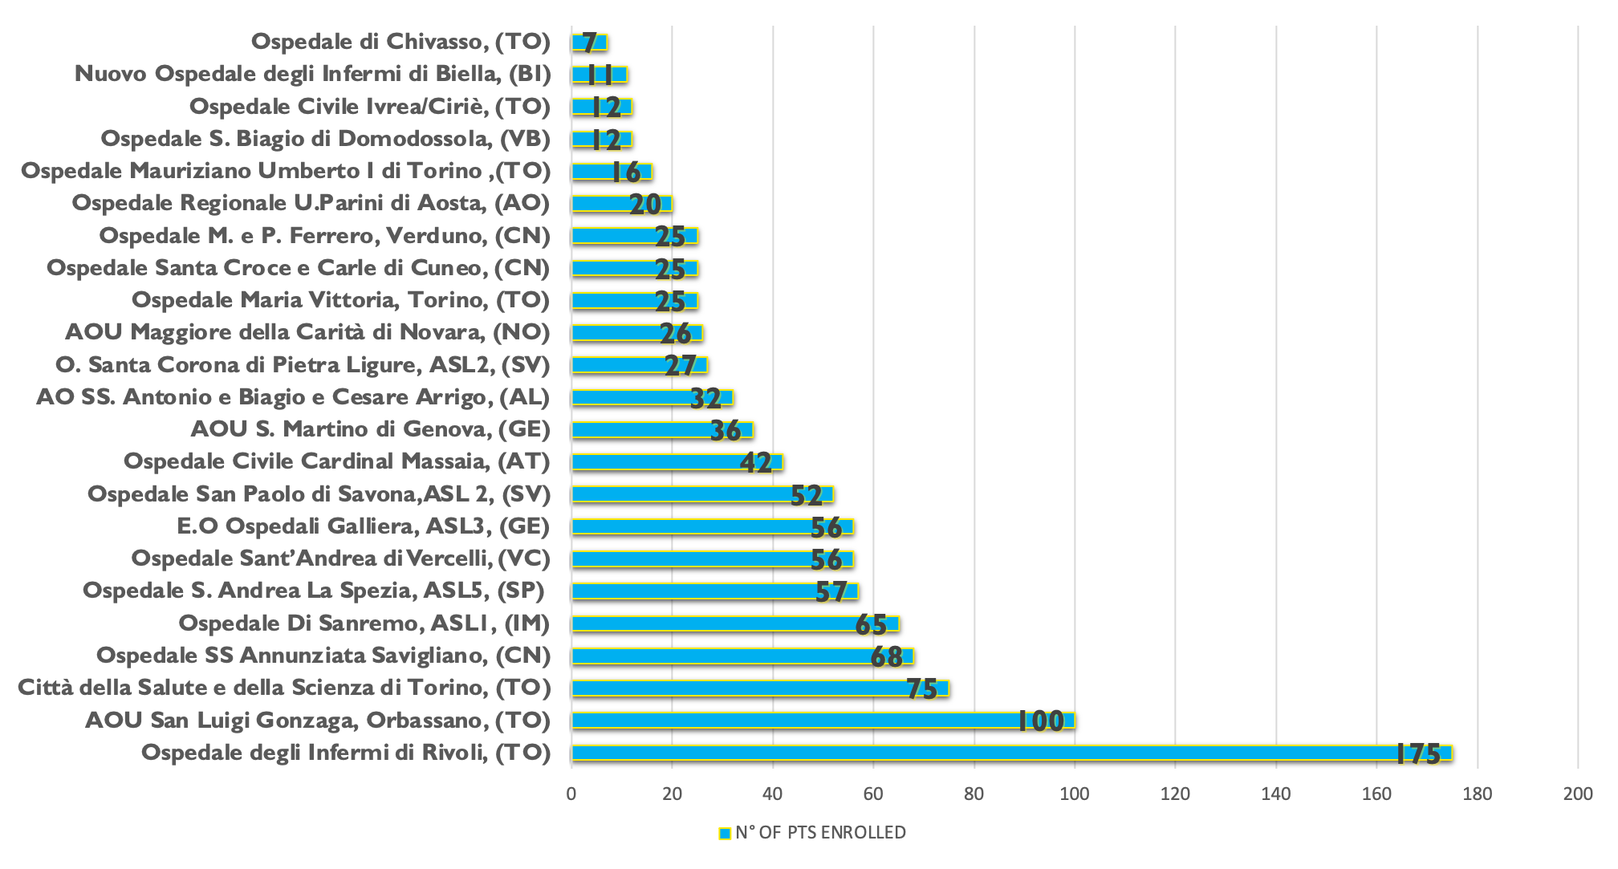
23 Enrolling sites
500 – 1300 PCI/year per center
Only 5 out 23 sites with
Cardiac Surgery Backup on site

Slide 6
Study Endpoints
Primary effectiveness endpoint
Procedural success: stent delivery with residual stenosis <30%, and absence of in-hospital major adverse cardiovascular events
[MACE: cardiac death, myocardial infarction (MI), or target vessel revascularization]
Primary safety endpoint
Freedom from MACE at 30 days
Secondary safety endpoint
Freedom from MACE at 12 months
Elegibility criteria
Propensity score (PS) matching, and Inverse Probability Weighting (IPW) were performed to compare 30 days and 12 months safety endpoints
in IVL vs. AT group

Slide 7
Study Flow Chart
Elegibility criteria
1y FUP available:97%

Slide 8
Clinical Characteristics
Characteristic | Overall (N 924) | AT (N 380) | IVL (N 544) | p-value
Age (years) | 74 ± 9 | 76 (70 - 82) | 75 (68 – 81) | 0.031
Female | 167 (21) | 91 (25) | 76 (18) | 0.008
Hypertension | 781 (85) | 319 (84) | 462 (85) | 0.70
Dyslipidemia | 703 (77) | 275 (74) | 428 (79) | 0.043
Current and former smokers | 442 (48) | 168 (45) | 274 (51)
Diabetes | 381 (42) | 157 (42) | 224 (41) | 0.89
Previous MI | 265 (29) | 80 (21) | 185 (34) | <0.001
Previous PCI | 348 (38) | 94 (25) | 254 (47) | <0.001
Atrial Fibrillation | 148 (16) | 57 (15) | 91 (17) | 0.50
Peripheral arterial disease | 241 (26) | 98 (26) | 143 (26) | 0.90
Previous stroke | 74 (8.1) | 29 (7.7) | 45 (8.4) | 0.70
Previous bleeding | 35 (3.8) | 12 (3.2) | 23 (4.3) | 0.39
Chronic Renal Failure | 204 (22) | 94 (25) | 110 (20) | 0.10
Dialysis | 35 (3.8) | 15 (4.0) | 20 (3.7) | 0.85
LVEF < 35%, | 129 (14) | 53 (14) | 76 (14) | 0.96
Haemoglobin | 12.62 ± 1.69 | 12.50 ± 1.69 | 12.71 ± 1.69 | 0.056
Clinical presentation |  |  |  | 0.18
- Stable CAD | 409 (44) | 168 (44) | 241 (44)
ACS | 515 (56) | 212 (56) | 303 (56) | 0.98
Cardiac arrest | 6 (0.7) | 1 (0.3) | 5 (0.9) | 0.41
Cardiogenic shock | 15 (1.6) | 8 (2.1) | 7 (1.3) | 0.35
AT
IVL

Slide 9
Procedural Characteristics
IVL Plan n=544
AT Plan n=380
IVL balloon diameter | 3.39 ± 0.69
N* of pulses | 78 ± 8.9
IVL to more than 1 segment | 161 (29.6)
Need for second balloon | 29 (5.3)
RA maximum burr size | 1.63 ± 0.27
Need for second burr | 54 (18.6)
OA speed use
Low only High only Both | 37 (42.6) 5 (5.7) 45 (51.7)

Slide 10
Procedural Characteristics
Characteristic | Overall (N 924) | AT (N 380) | IVL (N 544) | p-value
Multivessel disease | 723 (78) | 321 (84) | 402 (74) | p<0.01
Chronic total occlusion | 226 (25) | 95 (26) | 131 (24) | 0.57
Left main disease | 208 (23) | 81 (22) | 127 (24) | 0.49
Left main debulking | 110 (12) | 41 (11) | 69 (13) | 0.38
Stenting
Number of stents used | 1.58 ± 0.92 | 1.96 ± 0.91 | 1.32 ± 0.83 | <0.001
Total stent length* | 40 (26 – 56) | 50 (33 – 70) | 33 (23 – 47) | <0.001
Max stent diam | 3.41 ± 0.83 | 3.21 ± 0.94 | 3.55 ± 0.67 | <0.001
Stent postdilation
Non-compliant balloon | 631 (77) | 291 (83) | 340 (73) | 0.001
Intravascular imaging use | 302 (34) | 103 (28) | 199 (38) | 0.003
Radial access only | 719 (81) | 266 (74) | 453 (85) | <0.001

Slide 11
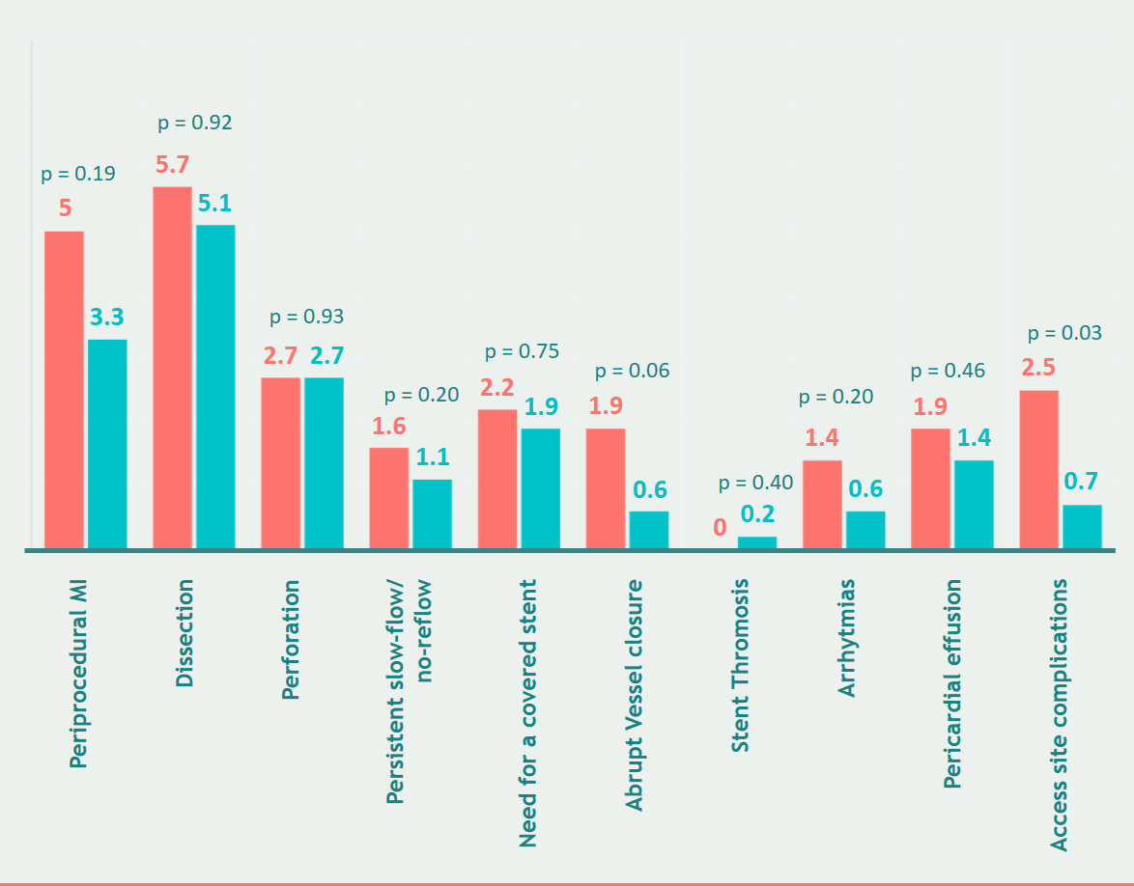
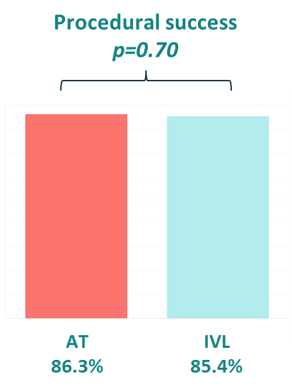
Primary effectiveness endpoint
Procedural success
Intraprocedural Complications

Slide 12
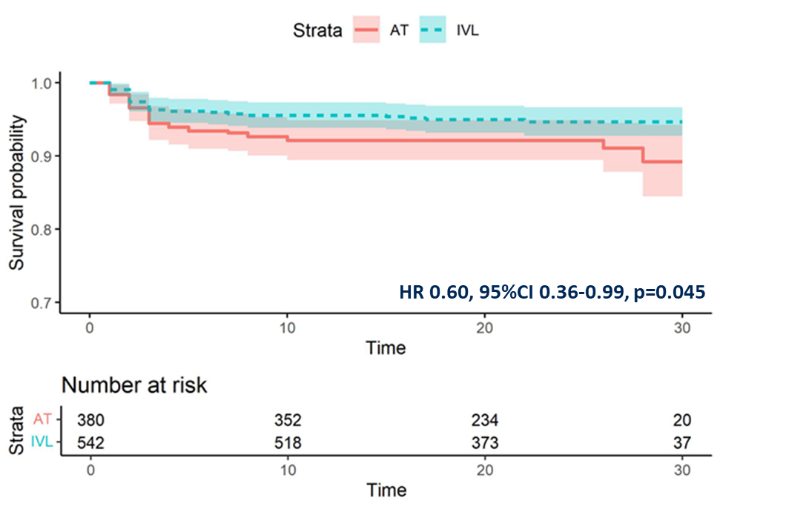
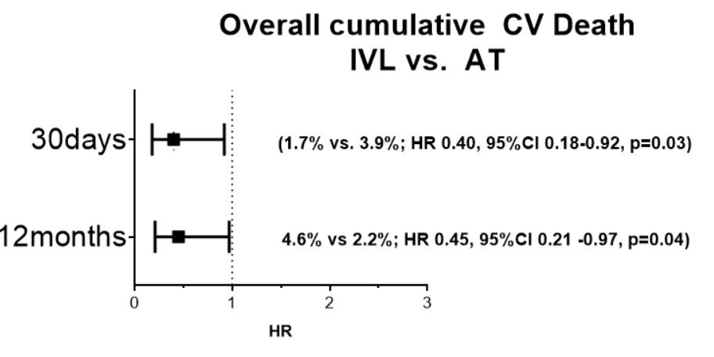
Primary Safety Endpoints
MACE at 30days
Composite of cardiac death, myocardial infarction or target vessel revascularization
5.7% vs. 8.6% HR 0.60, 95%CI 0.36-0.99, p=0.045
CV death resulted lower in IVL vs. AT
(1.7% vs 3.9%, HR 0.40 95%CI 0.18 - 0.92, p=0.03)

Slide 13
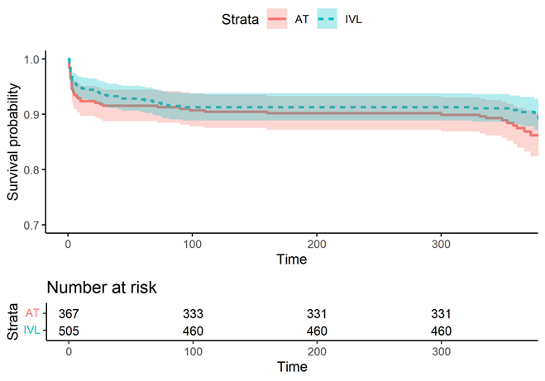
Secondary Safety Endpoints
MACE at 1 year
Composite of cardiac death, myocardial infarction or target vessel revascularization
11% vs 14% HR 0.71, 95%CI 0.49 -1.04, p=0.079
CV death resulted lower in IVL vs. AT
(2.2% vs 4.6%, HR 0.45, 95%CI 0.21 -0.97, p=0.04)

Slide 14
PSM and IPW analysis
Only de novo stenosis included
Adjustment for baseline differences
  Propensity Score (PS) Matching
    Nearest-neighbor method with a caliper of 0.1
    Standardized Mean Difference (SMD) with a threshold of 0.1 deemed acceptable
  Inverse Probability Weighting (IPW)
    Including all patients
 | After matching
Characteristic | N | AT N = 161 | IVL N = 161 | SMD: AT vs. IVL
Female, n (%) | 322 | 42 (26) | 40 (25) | 0.03
Age (years), Median (IQR) | 322 | 76 (69 – 82) | 74 (68 – 81) | 0.06
History of smoking, n (%) | 322 |  |  | 0.01
Current and former smoker |  | 82 (51) | 81 (50) | 0.01
No Smoker |  | 79 (49) | 80 (50) | -0.01
Previous PCI, n (%) | 322 |  | 54 (34) | -0.07
Myocardial infaction, n (%) | 322 | 35 (22) | 37 (23) | -0.03
Number of vessels disease, n (%) | 322 |  |  | 0.11
One-vessel disease |  | 30 (19) | 24 (15) | 0.10
Three-vessels disease |  | 87 (54) | 87 (54) | 0.00
Two-vessels disease |  | 44 (27) | 50 (31) | -0.08
Intravascular imaging, n (%) | 322 | 52 (32) | 51 (32) | 0.01
Other vessels not subjected to debulking, n (%) | 322 | 48 (30) | 48 (30) | 0.00
Timing IVL at clinical presentation, n (%) | 322 | 113 (70) | 111 (69) | 0.03
Only radial access site, n (%) | 322 | 133 (83) | 134 (83) | -0.02
Stent lenght (mm), Median (IQR) | 322 | 45 (29 – 60) | 40 (28 – 56) | 0.04
Elegibility criteria
After PS matching, a cohort of 322 patients were identified.

Slide 15
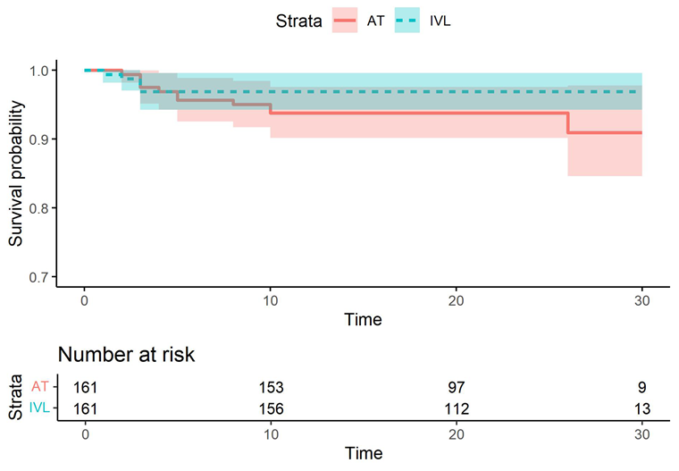
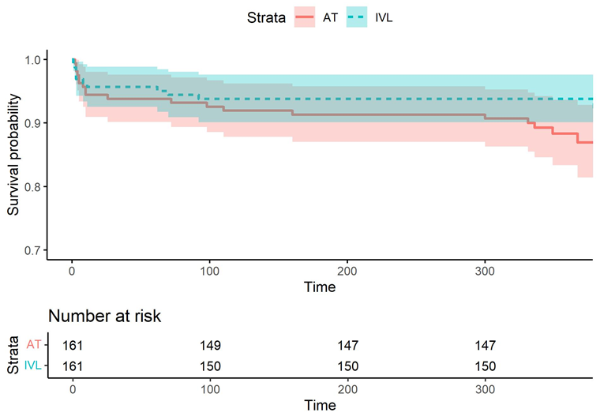
SAFETY ENDPOINTS IN PSM COHORT
MACE at 30 days after PSM
MACE at 1 year after PSM
HR 0.44, 95%CI 0.15 -1.27, p=0.13
HR 0.44, 95%CI 0.21 -0.90, p=0.024
IPW analysis including 534 subject in the model, confirmed the same findings
MACE at 12 months HR 0.44, 95%CI 0.22 -0.90p= 0.025)

Slide 16
LIMITATIONS
Not all debulking devices included (i.e. laser, cutting/scoring balloons alone)
Combination of multiple debulking devices was captured in the registry but excluded for the purpose of the present analysis
Patients/lesions differ among groups
Despite PS model, this is not a randomized trial
Intracoronary imaging in only one-third of cases

Slide 17



CONCLUSIONS
ROLLING-STONE stands as the largest prospective investigator initiated multicenter registry including >1000 all-comers patients treated with different debulking devices.
The study confirms the feasibility, high safety and efficacy of both IVL and AT in an unselected population, demonstrating similar procedural success rate and a lower incidence of 30-days MACE and cardiovascular death in IVL group
After propensity matching, IVL seems to have a better 12 months safety outcome compared to AT in our registry
Further real-world data are needed to determine the optimal treatment strategy for severe coronary calcifications across different patients subsets

