Slide 1
Dawn Bardot, PhD
Vice President, Technology Innovation
February 2017
A Public-Private Partnership
collaborating on Regulatory Science
to make patient access to new medical
device technologies faster, safer and
more cost-effective

Slide 2

Disclosure Statement of Financial Interest
I, Dawn Bardot, DO NOT have a financial interest/arrangement or affiliation with one or more organizations that could be perceived as a real or apparent conflict of interest in the context of the subject of this presentation.

Slide 3
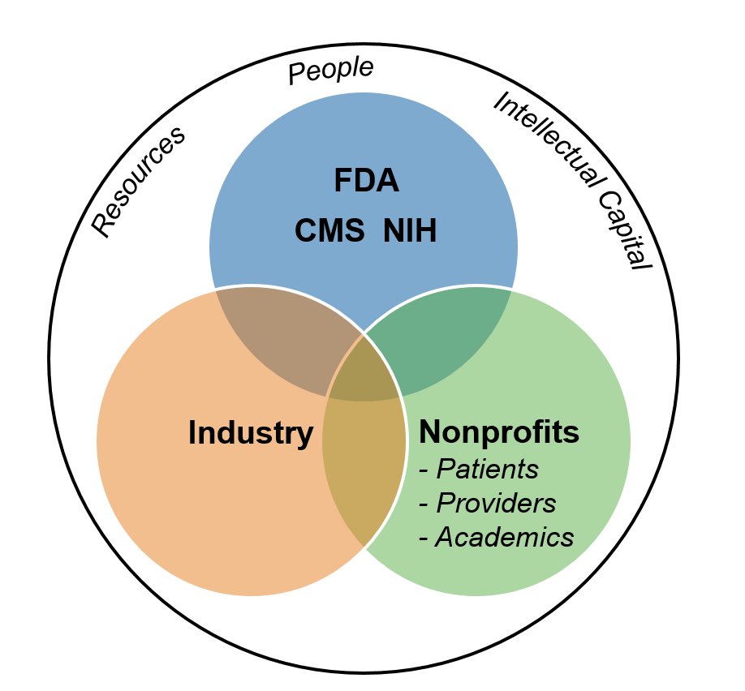

MDIC Highlights
58 Members
6 Projects
Leading resource on issues important to the Medtech innovation ecosystem
Congressional testimony on modernizing clinical trials
Over $4.4m funding from grants and contracts for Program initiatives.
A 501(c)3 - Public-Private Partnership collaborating on Regulatory Science
to make patient access to new medical device technologies faster, safer, and more cost-effective
WORKING COOPERATIVELY
to re-engineer pre-competitive technology innovation
Align Resources
REDUCING TIME
and resources needed for new technology development, assessment, and review
Accelerate Progress
HELPING PATIENTS
gain access to new medical technologies sooner
Achieve Results
www.MDIC.org

Slide 4
Project Initiatives
Clinical Trial Sciences
Goal: Advance regulatory science through innovations in medical device clinical trial efficiency and cost-effectiveness.
Virtual Patient: Forward leverage existing information into prospective clinical studies to reduce sample size and timelines; thereby accelerating patient and provider access to new medical technologies.
Early Feasibility Study (EFS): (A) Identify EFS Administrative challenges, such as Contracting and IRB Review. (B) Develop tools and processes to overcome the identified challenges.
Reimbursement Support: Support and de-risk participation in FDA’s program providing private payer reimbursement considerations parallel to the IDE process.
MDIC: FDA:
Board Champion| Chip Hance Primary Contact | Owen P. Faris, PhD | Clinical Trials Director |
Former CEO | Creganna Medical Office of Device Evaluation (ODE) | CDRH
Acting Program Manager | Dan Schwartz | MDIC Primary Contact | Ken Skodacek | Office of Device Evaluation (ODE) | CDRH
Computer Modeling & Simulation
Goal: Increase confidence in safety and efficacy, reduce clinical trial size and accelerate
device review through regulatory grade computer models & simulations.
MDIC: FDA:
Board Champion| Randy Schiestl Primary Contact | Kyle J. Myers, PhD | Director (Acting) |
VP, Global Operations & Technology | Boston Scientific Office of Science & Engineering Laboratories (OSEL) | CDRH
Senior Program Manager | Dawn Bardot, PhD | MDIC

Slide 5
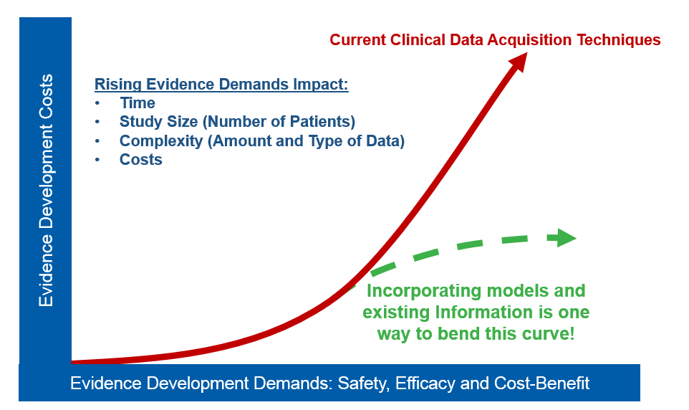
Innovation in Clinical Trial Design:
Pressures Impacting Clinical Research

Slide 6

Innovation in Clinical Trial Design:
Repetition in Clinical Studies
First-in-Human
CE Mark
US Pivotal
Japan/
China

Slide 7
Specifics aim
Combing evidence to inform clinical trials: Virtual Patients
Virtual patients describe a concept that represents a continuum of information that can be exchangeable for real patient outcomes in a clinical study.
Information sources can include:
Clinical data collected in different countries
Predicate device data
Postmarket data
Engineering model data
Human evidence replaced by virtual patients
The concept, graphically
100%
Build on:
  FDA Document: Guidance for the Use of Bayesian Statistics in Medical Device Clinical Trials
Integrate the virtual patient in clinical design
Augment using Bayesian methods
Maintain clinical endpoints with reduced prospective sample size
Clinical Evidence
0%
Exchangeability

Slide 8
Innovation in Clinical Trial Design:
Retrospective Project Results
Therapeutic Area | Study Type | Enrollment Total (N) | Virtual Patients | Study Savings
Diagnostic | Single-arm (vs. OPC) | 150 | 75 | 50%
Vascular | Two-arm (Test & Control*) | *131 | *21 | *16%
Orthopedic #1 | Single-arm (vs. OPC) | 90 | 32 | 36%
Orthopedic #2 | Single-arm (vs. Historical) | 306 | 36 | 12%
*Two-arm example was conducted using one Loss Function applied to both Control and Test arms. Opportunity: Use two distinct Loss Functions, one for each arm. This Two-arm data is representative of only the Control arm (current best fit). Loss Function development for the Test arm is in-progress.

Slide 9
Virtual Patient Statistical Framework Journal Publication
Journal of Biopharmaceutical Statistics (accepted)
Incorporation of stochastic engineering models as prior information in Bayesian medical device trials
Membership of Medical Device Innovation Consortium Clinical Trials Powered by Bench and
Simulation Working group
Marc Horner, ANSYS
Anita Bestlemeyer, BD
Valentin Parvu, BD
Dan Cooke, Boston Scientific
Ken Merdan, Boston Scientific
Randy Schiestl, Boston Scientific
Kristian Debus, CD-adapco
Bill Wheeler, CD-adapco
Sumesh Zingde, Conformis
Jeffrey Dunne, Covidien
Susan Roweton, Covidien
Frederic Turquier, Covidien
Shivkumar Sabesan, Cyberonics
Scott Stubbs, Cyberonics
Tom Battisti, Dassault Systemes SIMULIA
Cheryl Liu, Stryker
Payman Asfshari, DePuy Synthes
Sharon Starowicz, DePuy Synthes
Aldo Badano, FDA
Kenneth Cavanaugh, FDA
James Coburn, FDA
Erin Cutts, FDA
Telba Irony, FDA
Robert Kazmierski, FDA
Donna Lochner, FDA
Orlando Lopez, FDA
Konstantinos Makrodimitris, FDA
Tina Morrison, FDA
Rajesh Nair, FDA
William Pritchard, FDA
David Pudwill, FDA
Mitchell Shein, FDA
Laura Thompson, FDA
Quirino Balzano, IT'IS
Esra Neufeld, IT'IS
Dawn Bardot, MDIC
Bill Murray, MDIC
Brian Choules, MED Institute
Wei Gan, Medtronic
Tarek Haddad, Medtronic
Adam Himes, Medtronic
Mark Palmer, Medtronic
Richard Thomas, Medtronic
Russ Klehn, St. Jude Medical
John Murphy, St. Jude Medical
Kristin Ruffner, St. Jude Medical
Lydia Telep, St. Jude Medical
Sean Zhang, St. Jude Medical
Christine Scotti, WL Gore
Lisa Wells, WL Gore
More at mdic.org/computer-modeling/virtual-patient

Slide 10
Spectrum of Clinical Trial Methods, Means, and Approaches
More traditional Newer
Frequentist
for example RCT and OPC trials
Post Market Studies
Leverage Retrospective Information into Prospective Studies
Real World Evidence
(RWE)
for example
RCT from EHR
Bayesian
Adaptive Trials
Computer Models
Large Simple Trials
IDEs Inside a Registries
MDIC works across this spectrum

Slide 11
Spectrum of Clinical Trial Methods, Means, and Approaches
More traditional Newer
Frequentist
for example RCT and OPC trials
Post Market Studies
Leverage Retrospective Information into Prospective Studies
Real World Evidence
(RWE)
for example
RCT from EHR
Bayesian
Adaptive Trials
Computer Models
Virtual Patient Historical Data Retrospective
Large Simple Trials
IDEs Inside a Registries
Virtual Patient Engineering Model Mock Submission
MDIC works across this spectrum

