Slide 1
Lutonix® Paclitaxel-Coated Balloon to Treat Obstructive Lesions in the Superficial Femoral and Popliteal Arteries 12-Month Results from the SAFE-DCB Study
Nicolas W. Shammas, MD, MS and Edward Y. Woo, MD
for the SAFE-DCB Investigators

Slide 2
Nicolas W Shammas, MD, MS, FACC, FSCAI, FSVM
Research and Educational Grants
Bard
Boston Scientific
Intact Vascular
VentureMed Group
Advisory Board/Consultant
Intact Vascular
Speaker Bureau
Boston Scientific
Janssen
Boehringer Ingelheim
Novartis
Intact Vascular
Bard

Slide 3
SAFE-DCB Registry
Objective: To Assess the Lutonix® Drug-Coated Balloon (DCB) to Treat Obstructive Lesions in the Superficial Femoral and Popliteal Arteries in a “Real World” US Patient Population
Prospective, single arm, multicenter registry
Enrolled 1005 patients in 74 U.S. centers
First patient enrolled: April 2015
Last patient enrolled: September 2016
Oversight committee and medical monitor reviewed safety events
12-month outcomes are being presented today.
Primary endpoint analysis at 12 months
Ongoing follow up through 3 years

Slide 4
Endpoint Definitions
Primary Effectiveness: Freedom from target lesion revascularization (TLR) at 12 months defined as the first revascularization procedure (e.g., PTA, stent) after the initial study procedure
Primary Composite Safety: Freedom from device- or procedure-related perioperative death (< 30 days), target limb major amputation (above the ankle), and target vessel revascularization

Slide 5
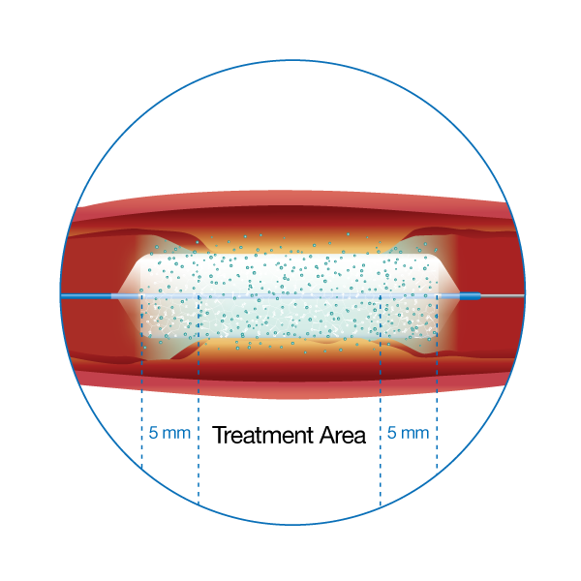
SAFE-DCB Recommended Procedure Steps
Adequately prepare the vessel (determined by the treating physician)
Recommended Procedural Step:
Transit time < 30 seconds
Inflation time ≥ 120 seconds
Pressure > 7 atm
Final Residual Stenosis < 20%
Dual antiplatelet therapy:
Pre-Procedure: According to current medical standards
After Procedure: Minimum of 4 weeks
Prolonged antiplatelet therapy (at the discretion of the physician)

Slide 6
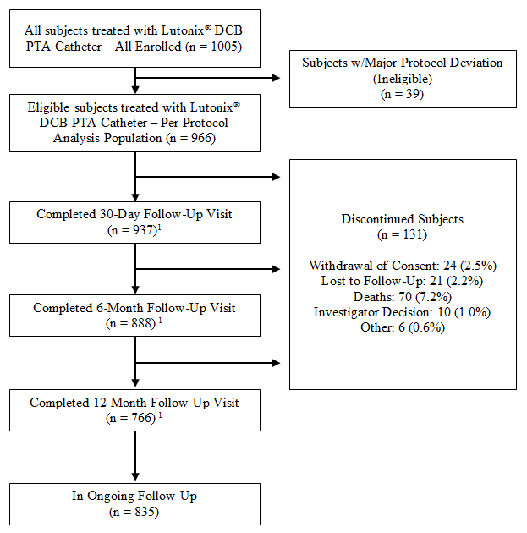
Subject Disposition
 | n
All Enrolled Population | 1005
Per-Protocol Population | 966
Reached 12M Visit (In Ongoing Follow-Up) | 835
Completed 12M Visit | 766
¹Does not include subjects that did not complete the follow-up visit but remained in ongoing follow-up.

Slide 7
Demographics
 | N = 966
Age (Years)
Mean (SD) | 69.1 (9.79)
Sex
Female | 418 (43.3)
Race | n (%)
American Indian or Alaska Native | 2 (0.2)
Asian | 14 (1.4)
Black or African American | 192 (19.9)
Native Hawaiian or Other Pacific Islander | 3 (0.3)
White | 735 (76.1)
Other | 20 (2.1)

Slide 8
Clinical History
Risk Factors |  |  | N = 966 n (%)
Subjects With At Least One Risk Factor |  |  | 960 (99.4)
 | Cigarette Smoking |  | 722 (74.7)
 | Diabetes |  | 523 (54.1)
 | Dyslipidemia |  | 743 (76.9)
 | Hypertension |  | 828 (85.7)
 | Renal Insufficiency (Serum Creatinine ≥ 2.5 mg/dL) |  | 43 (4.5%)
Subjects With At Least One Type of Cardiovascular Disease |  |  | 688 (71.2)
 | Aortic Disease |  | 44 (4.6)
 | Congestive Heart Failure (CHF) |  | 125 (12.9)
 | Coronary Artery Disease (CAD) |  | 506 (52.4)
 | Deep Vein Thrombosis (DVT) |  | 26 (2.7)
 | Myocardial Infarction (MI) |  | 146 (15.1)
 | Stroke |  | 95 (9.8)
 | Transient Ischemic Attack (TIA) |  | 50 (5.2)
 | Valvular Heart Disease |  | 63 (6.5)
 | Other |  | 282 (29.2)
Critical Limb Ischemia | RB 4-6 |  | 340 (35.1)

Slide 9
Angiographic Variables
Number of Target Lesions | 1237
Type of Lesion
Occlusion | 313 (25.3)
De Novo Lesion?
Yes | 1154 (93.3)
No | 83 (6.7)
Degree of Calcification
None | 142 (11.5)
Mild | 348 (28.1)
Moderate | 383 (31.0)
Severe | 359 (29.0)
Target Lesion Length (mm)
N | 1237
Mean (SD) | 75.0 (43.93)
Reference Vessel Diameter (mm)
N | 1235
Mean (SD) | 5.26 (0.703)
Target Lesion Stenosis (pre-intervention) (%)
N | 1235
Mean (SD) | 86.70 (12.50)

Slide 10
Summary of Index Procedure
# of Target Lesions that Underwent Pre-DCB Adjunctive Treatment | 1237 (%)
Number of Target Lesions that Underwent Pre-Dilatation | 955 (77.2)
Atherectomy | 614 (49.6)
Cutting/Scoring Balloon(s) | 151 (12.2)
MAJOR Flow Limiting Dissection During the Procedure | n (%)
Yes (D and E grades) | 18 (1.9)
Acute Procedural Success n/N (%) (< 30% residual with no complications) | 897/965 (93)
Residual stenosis Mean (SD) % | 11.54 (13.96)
Transit balloon time Mean (SD) seconds | 35.4 (40.47)
Maximum pressure of balloon inflation Mean (SD) atm | 8.05 (2.22)
Total duration of inflation Mean (SD) seconds | 152.7 (53.95)
Post-DCB Stent | 134 (13.9)
Bailout¹ | 16 (1.7)
Non-Bailout¹ | 118 (12.2)
¹Bailout stenting is defined as stenting deemed necessary during the index procedure as a result of a major flow-limiting dissection (Grades D-F), a procedural complication, adverse event, or due to significant post-DCB residual stenosis ≥30%. All other stenting procedures are considered Non-Bailout. The determination of whether or not stenting met the definition of Bailout or Non-Bailout was ultimately made by the site Investigators.

Slide 11
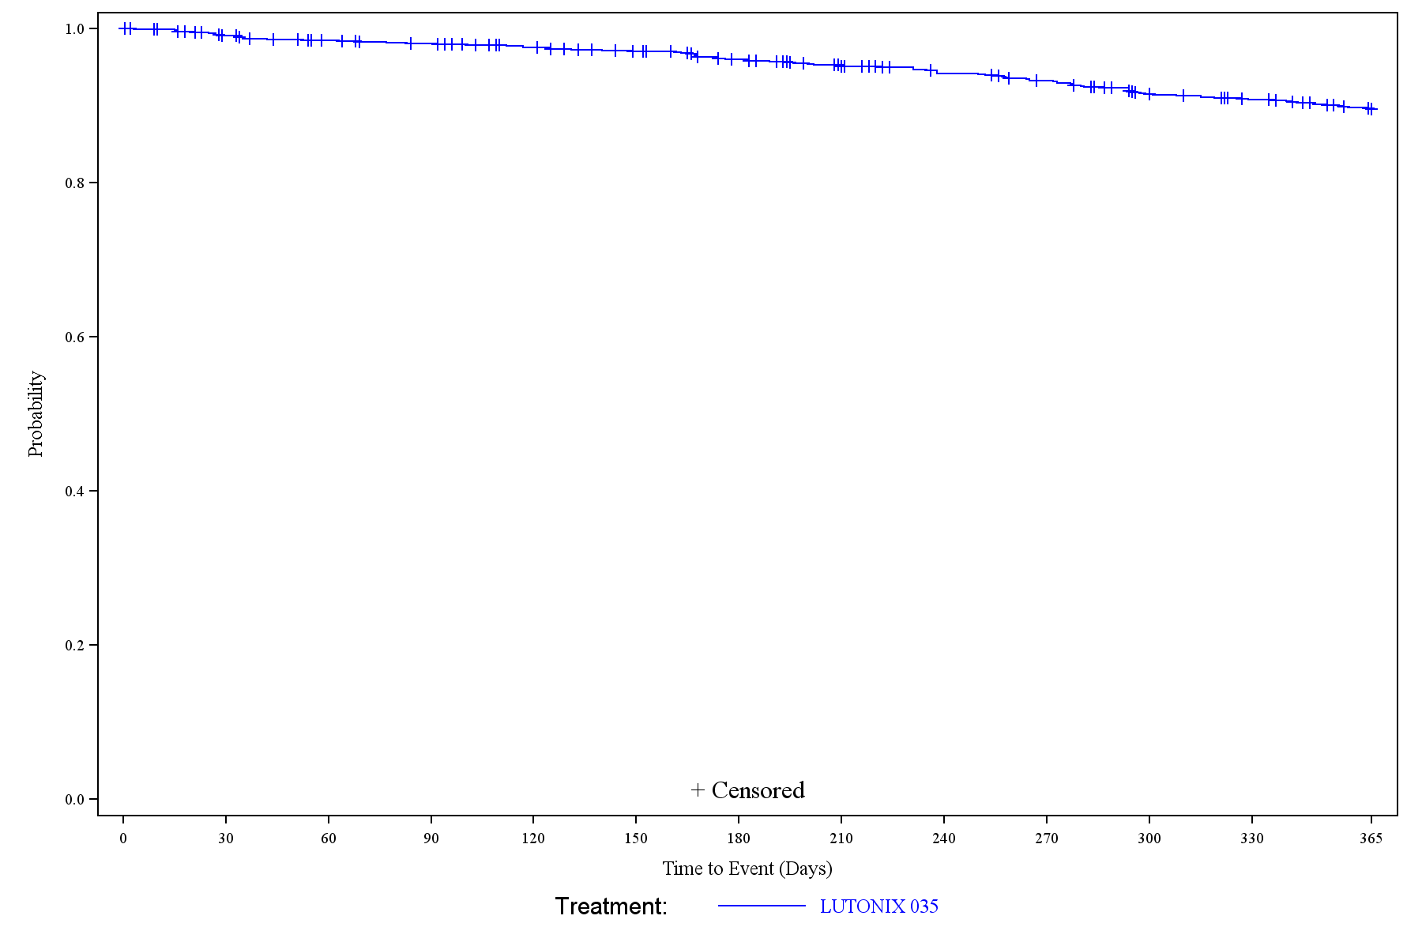
Primary Effectiveness (Kaplan-Meier)
89.5%
Time Point | # of Subjects with TLR | # of Subjects Censored | # of Subjects Left | K-M Estimates of Subjects Free from TLR | 95% CI
Day 0 | 0 | 0 | 966 | 100.0% | (100.0%, 100.0%)
Day 30 | 9 | 14 | 943 | 99.1% | (98.2%, 99.5%)
Day 180 | 38 | 52 | 876 | 95.9% | (94.5%, 97.0%)
Day 365 | 95 | 106 | 765 | 89.5% | (87.3%, 91.3%)
Day 395 | 104 | 862 | 0 | 88.4% | (86.2%, 90.4%)

Slide 12
Primary Effectiveness (Proportional)
Primary Effectiveness Endpoint | Proportion n/N (%) | 95% CI
Freedom from TLR through 12 months (Day 365) | 765/860 (89.0) | (86.7%, 91.0%)
Reason for Re-intervention
Clinically Driven TLR | 88/860 (10.2)
Subjects whose symptoms were a determining factor in performing the re-intervention were considered to have a Clinically Driven re-intervention

Slide 13
Primary Effectiveness by Subgroups (Kaplan-Meier)
Kaplan-Meier Analysis of Freedom from Target Lesion Revascularization at 12 Months by Subgroups
Subgroup | K-M Estimates of Subjects Free from TLR | 95% CI
Male Subjects | 91.4% | (88.7%, 93.6%)
Female Subjects | 86.9% | (83.2%, 89.9%)
CTO | 85.1% | (80.1%, 89.0%)
Non-CTO | 91.2% | (88.7%, 93.1%)
Long Lesion(≥140 mm) | 87.8% | (80.9%, 92.3%)
Pre-Dilatation Only | 93.4% | (89.5%, 95.8%)
Pre-DCB Cutting/Scoring Balloons Only | 92.0% | (77.3%, 97.4%)
Pre-DCB Atherectomy Only | 92.9% | (82.2% , 97.3%)
All Stenting | 86.2% | (79.0%, 91.1%)
Proper Technique | 92.5% | (88.0%, 95.3%)
Not Proper Technique | 88.7% | (86.1%, 90.9%)
Diabetic | 89.2% | (86.1%, 91.7%)
Non-Diabetic | 89.8% | (86.5%, 92.3%)

Slide 14
Primary Safety (Kaplan-Meier)
The primary safety endpoint is defined as freedom from composite of device and/or procedure-related perioperative (≤30 days) death, target limb major amputation (above the ankle) and target vessel revascularization.
Kaplan-Meier Analysis of the Primary Safety Endpoint (Per-Protocol Population)
Time Point | # of Subjects With Events | # of Subjects Censored | # of Subjects Left | K-M Estimates of Subjects Free from Events | 95% CI
Day 0 | 3 | 0 | 963 | 99.7% | (99.0%, 99.9%)
Day 30 | 17 | 949 | 0 | 98.2% | (97.2%, 98.9%)

Slide 15
1-Year Mortality in SAFE DCB
71 deaths (71/1005;7.1%; 95% CI 5.6%, 8.8%)
Most common causes:
Cardiac arrest with or without respiratory failure (n = 11)
Myocardial infarction and respiratory failure (n=5)
Sepsis/septic shock (n=9)
Unknown or unreported (n=10)

Slide 16
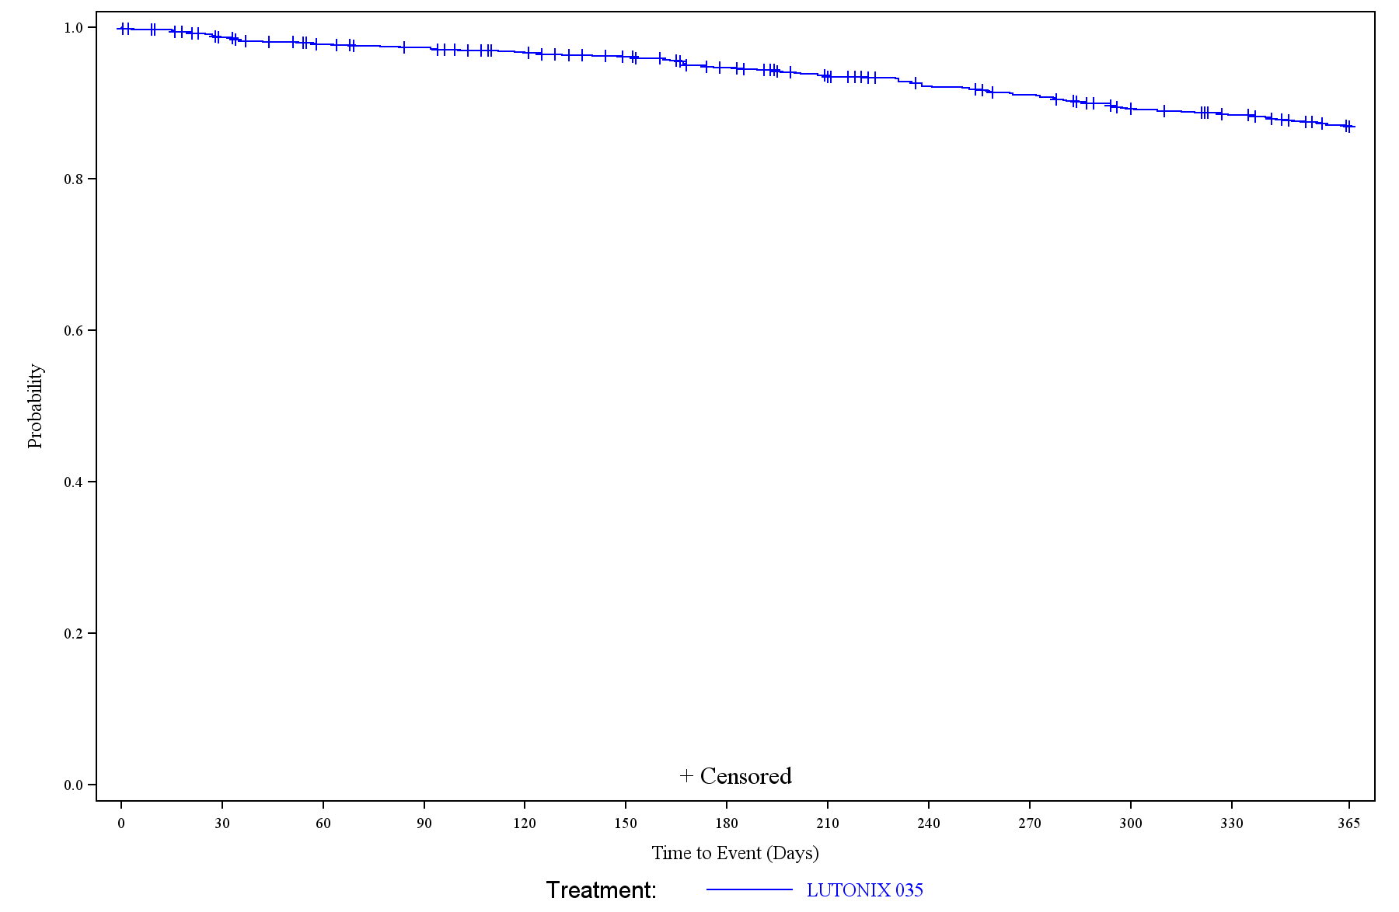
Freedom from TVR (Kaplan-Meier)
86.9%
Time Point | # of Subjects Failed | # of Subjects Censored | # of Subjects Left | K-M Estimates of Subjects Successful | 95% CI of Subjects Successful
Day 0 | 2 | 0 | 964 | 99.8% | (99.2%, 99.9%)
Day 30 | 13 | 14 | 939 | 98.6% | (97.7%, 99.2%)
Day 180 | 50 | 51 | 865 | 94.7% | (93.0%, 95.9%)
Day 365 | 119 | 847 | 0 | 86.9% | (84.5%, 88.9%)

Slide 18
Conclusion
The SAFE DCB trial demonstrated a high fTLR (89.5%) in treating femoropopliteal arteries in a real world setting despite:
54.1 % Diabetic
29% Severe Ca
35.1% CLI
25.3% CTO
Freedom from composite of device and/or procedure-related perioperative (≤30 days) death, target limb major amputation (above the ankle) and target vessel revascularization was 98.2%
The SAFE DCB data are consistent with already published studies demonstrating excellent safety and 1-year freedom from TLR

Slide 19
THANK YOU

