Slide 1
efficAcy and safety of Trimetazidine in Patients having been treated by Percutaneous Coronary Interventions (PCI)
Roberto Ferrari, Nicolas Danchin, Ian Ford, Kim Fox, Michal Tendera and Petr Widimsky on behalf of the investigators
Study supported by

Slide 2
Previous studies show that angina pectoris might re-occur despite successful PCI
There are no contemporary data on prognostic benefits of anti-anginal drugs in Post-PCI patients
ATPCI assesses the efficacy and safety of Trimetazidine added to optimal medical therapy in patients who had a recent successful PCI for stable angina or a non-ST elevated myocardial infarction (NSTEMI)
ATPCI tested the value of metabolic therapy as Trimetazidine is the only anti-anginal drug devoid of haemodynamic effects improving metabolism of ischaemic myocardium

Slide 3
A total of 6007 patients from 27 countries after successful PCI (elective or urgent) and receiving optimal medical treatment were randomised and followed for 5 years
Primary endpoint: cardiac death, hospitalisation for cardiac events, recurrent/persistent angina leading to adding, switching or increasing the dose of anti-anginal therapies or to coronary angiography

Slide 4
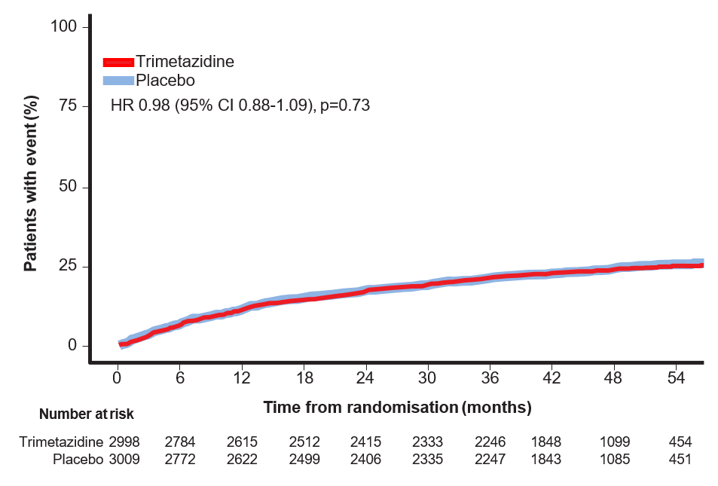
Primary endpoint Efficacy analysis set (N=6007)

Slide 5
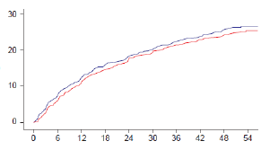
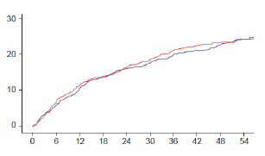
Primary endpoint: Analysis by index PCI Efficacy analysis set (N=6007)
Elective PCI
Urgent PCI
HR 0.94 (95% CI 0.82-1.08)
HR 1.04 (95% CI 0.88-1.22)
Patients with events%
Patients with events%
Time from randomization (months)
Time from randomization (months)

Slide 6
The event rate in the ATPCI population was lower than expected and required an extension of the follow-up to 5 years
The prophylactic use of the anti-anginal-metabolic agent Trimetazidine, added to recommended medical therapy, did not improve the outcome of the ATPCI population after a successful elective or urgent PCI
No Trimetazidine-related safety issues were identified

Slide 7
Take Home Messages
Patients with stable angina and NSTEMI receiving optimised medical therapy combined with successful PCI have low events and no re-occurrence of angina
Improvement of cardiac metabolism with Trimetazidine did not improve outcome and is not necessary
Patients with CCS disease should:
Control their risk factors
Take the available preventive and anti-anginal drugs and, if symptoms persist, angioplasty will improve them without any re-occurrence

