Slide 1
Safety and performance of the third-generation drug-eluting resorbable coronary magnesium scaffold system in the treatment of subjects with de novo coronary artery lesions: 6-month results of the prospective, multicenter BIOMAG-I first-in-human study
Michael Haude, MD, PhD
On behalf of the BIOMAG-I investigators

Slide 2
Michael Haude, MD, PhD
Grant/Research Support:
Biotronik
Cardiac Dimensions
Orbus Neich
Philips
Consult/Honoraria:
Biotronik
Cardiac Dimensions
Orbus Neich

Slide 3
Background
Bioresorbable scaffolds have been developed to^{1, 2}
Provide temporary mechanical support
While controlling neointimal proliferation over the vascular healing period
Prevent long-term stent-related adverse events
Resorbable Magnesium Scaffolds emerged as promising technology:
The CE-marked 2nd generation Drug-Eluting Resorbable Magnesium Scaffold (DREAMS 2G, commercial name Magmaris) showed low target lesion failure and scaffold thrombosis rates in multiple trials ^{3, 4, 5}
But in-scaffold Late Lumen Loss (LLL) was not comparable to LLL values observed with historical PLLA-based scaffolds⁶ or contemporary DES⁷
1: Neumann et al. ESS-EACTS Guidelines, EuroIntervention 2019: 14: 1435-1534; 2 Galli et al., SICI-GISE Position Paper, CRM 2022; 34: 11-16;; 3: Galli S et al; 2-Year Follow up of Magmaris Multicenter Italian Registry, CRM 2022; 41: 69-75; 4: Verhey et al; BIOSOLVE-IV registry - 12 Months Outcomes of the First Cohort of 1075 Patients, CCI 2021;98:E1–E8; 5: Haude et al; Pooled 12months Outcomes of BIOSOLVE-II and BIOSOLVE-III , CCI 2018; 92:E502-E511; 6: Serruys PW et al, Evaluation of the 2nd Generation of a Bioresorbalbe Everolimus Drug Eluting Scaffold , 6 month - Clinical and Imaging Outcomes, Circulation 2010; 122: 2301-2312; 7: Byrne et al, ESC report - Task Force on the Evaluation of Coronary Stents in Europe, Eur Heart J 2015; 36: 2608-2620.

Slide 4
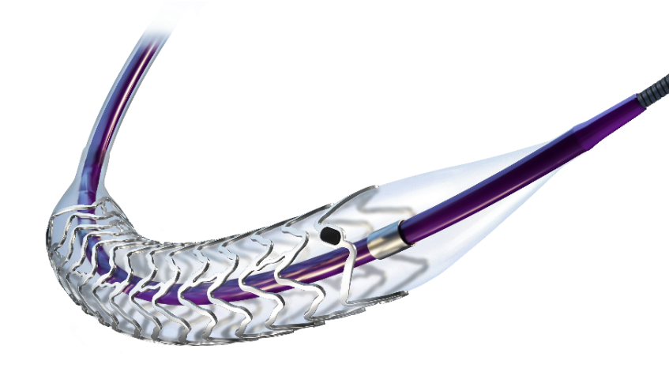
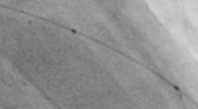
Improvements of DREAMS 3G – Next Generation RMS
1. Increased durability of radial support while maintaining resorption time of 12 months
3. Improved radiopacity²
New marker concept
BIOmagTM, Backbone
proprietary Magnesium alloy
improved mechanical properties
BIOluteTM Coating
Sirolimus drug & PLLA
2. Reduced strut thickness¹
4. Increased size portfolio
ø 2.5 mm | 99 µm
ø 3.0 & 3.5 mm | 117 µm
ø 4.0 mm | 147 µm
DREAMS 3G size matrix
mm | ø 2.5 | ø 3.0 | ø 3.5 | ø 4.0
13 | X | X | X | X
22 | X | X | X | X
30 | _ | X | X | _
1.BIOTRONIK data on file, compared to Magmaris; 2. BIOTRONIK data on file, BIOMAG-I case angiogram, courtesy of Prof. M. Haude, Rheinland Klinikum, Neuss, Germany 2021. BIOmag and BIOlute are a trademark or registered trademark of the BIOTRONIK Group of Companies, DREAMS 3G is the project name, the product is not CE marked.

Slide 5
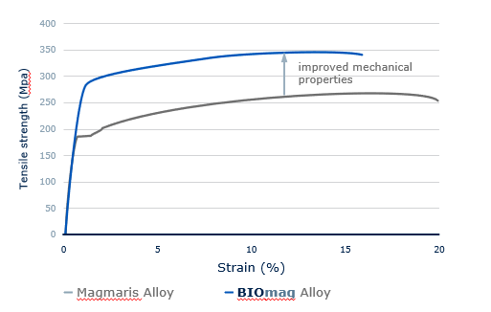
Improved scaffolding performance of DREAMS 3G compared to DREAMS 2G
Increased stability and radial strength of scaffold
Source: M. Seguchi, 2023: Preclinical evaluation of the degradation kinetics of third-generation resorbable magnesium scaffolds, EuroIntervention 2023;18-online publish-ahead-of-print January 2023
BIOmag and Magmaris are trademarks or registered trademarks of the BIOTRONIK Group of Companies, DREAMS 3G is the project name, the product is not CE marked

Slide 6
BIOMAG-I: Study Design
Up to 116 subjects with
de novo coronary artery stenosis
Study objective
Assessment of angiographic, clinical and safety performance of
DREAMS 3G in patients with de novo coronary artery lesions
Primary endpoint
In-scaffold late lumen loss (LLL) at 6-month post-procedure
Clinical endpoints at 1, 6, 12, 24, 36, 48 and 60 months
Target Lesion Failure (TLF*)
Cardiac death
Target vessel MI **
Clinically driven target lesion revascularization
Clinically driven target vessel revascularization
Definite/probable scaffold thrombosis (ARC-2 def.)
1-month Clinical F/U
6-month
Clinical and angiographic F/U (mandatory)
IVUS & OCT
12-month
Clinical and angiographic FUP
IVUS & OCT
Vasomotion (if applicable and if subject consents)
2-year Clinical F/U
3-year Clinical F/U
4-year Clinical F/U
5-year Clinical F/U
* composite of cardiac death, target vessel myocardial infarction, and clinically driven target lesion revascularization
** peri-procedural target vessel MI according to SCAI definition and non-peri-procedural target vessel MI according to extended historical definition

Slide 7
BIOMAG-I: Clinical Sites
Germany
Rheinlandklinikum-Lukaskrankenhaus, Neuss; M. Haude, CCI
Deutsches Herzzentrum München, München; M. Joner
Segeberg Kliniken Herzzentrum, Bad Segeberg; R. Tölg
Herz- und Gefäßzentrum Oberallgäu-Kempten; J. Torzewski
Johannes Wesling Klinikum Minden, Minden; M. Wiemer
Poland
Miedziowe Centrum Zdrowia SA, Lubin; A. Wlodarczak
Netherlands
OLVG, Amsterdam; R. J. van der Schaaf
Belgium
Ziekenhuis Oost Limburg (ZOL), Genk; B. Ferdinande
UZ Gasthuisberg, Leuven; J. Bennett
ZNA Middelheim, Antwerpen; S. Verheye
Switzerland
HUG, Geneva; J. F. Iglesias
Sweden
Skane University Hospital, Lund; G. Olivecrona
Austria
Med. Uni Hospital, Graz; G. Toth Gayor
Spain
Hospital Clinico San Carlos, Madrid; J. Escaned

Slide 8
Inclusion and Exclusion Criteria
Inclusion Criteria*
Exclusion Criteria*
n Criteria*
Maximum of up to two single de novo lesions in two separate coronary arteries
Target RVD by visual estimation between 2.5-4.2 mm
Target lesion length by visual estimation ≤ 28 mm
Target lesion stenosis by visual estimation ≥ 50% - < 100%
Subjects with stable or unstable angina pectoris or documented silent ischemia or hemodynamically stable NSTEMI patients without angiographic evidence of thrombus at target lesion
Evidence of STEMI within 72 hours prior to index procedure
LVEF <30%
Thrombus in the target vessel (visualized by QCA)
Heavily calcification lesion
Three-vessels with coronary artery disease requiring treatment at time of procedure
Additional coronary lesion in the same vessel, which requires treatment
Totally occluded coronary artery (TIMI flow 0)
Target lesion involves a side branch > 2.0 mm in diameter
Ostial lesions
Unsuccessful pre-dilatation, residual stenosis more than 20%
*list truncated

Slide 9
Patient Flow
Baseline
N = 116 patients
N = 117 lesions
IVUS N = 103 lesions
OCT N = 113 lesions
1 month
Clinical F/U N = 116
N=1 missed visit*
6 month
Clinical F/U N = 115 patients
Angiographic F/U N = 110 patients
Angio N = 111 lesions
IVUS N = 103 lesions
OCT N = 106 lesions
F/U Compliance
Clinical F/U = 99.1%
Angiographic F/U = 95.7%
F/U: follow up; IVUS: intravascular ultrasound; OCT: optical coherence tomography
*Patient refused to be contacted for follow-up visit

Slide 10
Baseline and Lesion Characteristics
Baseline Characteristics (N=116) | N (%)
Age (mean ± SD) | 61.0 ± 9.0
Male | 90 (77.6)
Hypertension | 86 (74.1)
Hypercholesterolemia | 72 (62.1)
Smoking history | 75 (64.7)
Diabetes mellitus | 32 (27.6)
Insulin-dependent diabetes | 6 (5.2)
History of MI | 39 (33.6)
NSTEMI | 24 (20.7)
Lesion Location* (N=117) | N (%)
LAD | 53 (45.3)
LCx | 22 (18.8)
RCA | 40 (34.2)
Intermediate Branch | 2 (1.7)
Lesion Characteristics* (N=117) | N (%)
Lesion Length (mm ± SD) | 12.3 ± 5.1
RVD (mm ± SD) | 2.7 ± 0.5
AHA/ACC Lesion Class B2/C | 90 (76.9)
Bifurcation | 25 (21.4)
* Lesion location and lesion characteristics data are based on core lab analysis

Slide 11
Primary Endpoint In-Scaffold Late Lumen Loss (LLL) at 6 months
Mean In-scaffold LLL = 0.21 ± 0.31mm, 95% CI [0.16; 0.27]
Mean In-scaffold LLL = 0.44 ± 0.36mm,
95% CI [0.37; 0.50]¹
BIOMAG-I
-52%
BIOSOLVE-II¹
Post hoc superiority analysis: weighted mean 0.44; superiority margin 0.11; calculated power 93.6%; p<0.000193.6%;
Data are shown as mean ± SD; CI = confidence interval
¹ Haude et al. Safety and performance of the second-generation drug-eluting absorbable metal scaffold in patients (BIOSOLVE-II): 6 month results of a prospective, multicentre, non-randomised, first-in-man trial. Lancet 2016;387: 31–39.

Slide 12
Secondary Endpoint In-segment Late Lumen Loss (LLL) at 6 months
Mean In-segment LLL= 0.05±0.36mm
95% CI [-0.014, 0.12]
Mean In-segment LLL= 0.27±0.37mm
95% CI [0.20; 0.37]¹
-81%
BIOMAG-I
BIOSOLVE-II¹
Post hoc superiority analysis: weighted mean 0.44; superiority margin 0.0675; calculated power 99.5%; p<0.0001
Data are shown as mean ± SD; CI = confidence interval
¹ Haude et al. Safety and performance of the second-generation drug-eluting absorbable metal scaffold in patients (BIOSOLVE-II): 6 month results of a prospective, multicentre, non-randomised, first-in-man trial. Lancet 2016;387: 31–39.

Slide 13
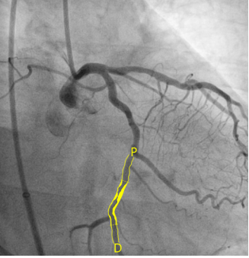
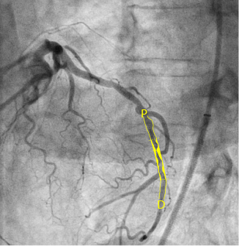
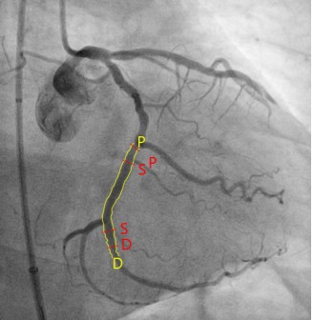
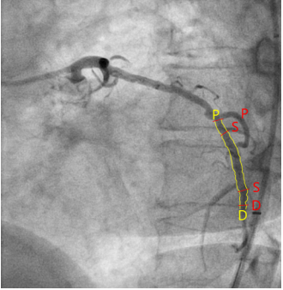
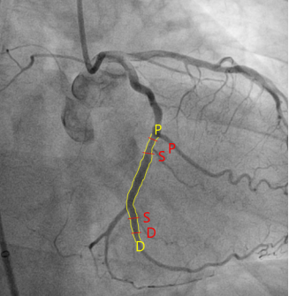
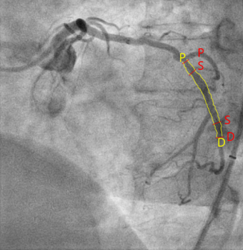
Serial Angiographic Data Analysis at 6-month F/U
Pre-procedure
Post-procedure
6m F/U
 | Pre-procedure | Post-procedure | 6 months | ∆ post-procedure – 6 months | p-value post-procedure vs 6 months
Angiography | N=111 | N=111 | N=111 | N=111
Reference vessel diameter (mm) In-scaffold In-segment | NA 2.73 (0.46) | 2.85 (0.46) 2.75 (0.50) | 2.84 (0.49) 2.79 (0.51) | -0.01 (0.26) 0.05 (0.33) | 0.73 0.14
Minimum lumen diameter (mm) In-scaffold In-segment | NA 1.07 (0.39) | 2.60 (0.43) 2.31 (0.44) | 2.39 (0.54) 2.26 (0.49) | -0.21 (0.31) -0.05 (0.36) | < 0.0001 0.12
Diameter stenosis (%) In-scaffold In-segment | NA 60.8 (12.9) | 8.4 (5.4) 15.6 (8.2) | 16.0 (11.6) 19.0 (11.6) | 7.5 (11.0) 3.3 (13.3) | <0.0001 0.01
Data are mean (SD)
Notes:
Images are from GER443-012

Slide 14
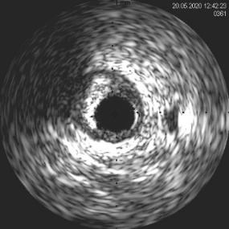
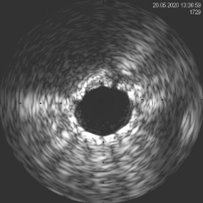
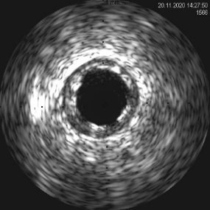
Serial IVUS Data Analysis at 6-month F/U
 | Pre-procedure | Post-procedure | 6 months | ∆ post-procedure – 6 months | p-value post-procedure vs 6 months
Intravascular ultrasound | N=87 | N=87 | N=87 | N=87
Mean vessel area (mm²) | 12.59 (4.48) | 14.90 (4.62) | 14.67 (4.82) | -0.23 (1.45) | 0.15
Mean scaffold area (mm²) | NA | 7.59 (2.21) | 6.96 (2.48) | -0.62 (1.05) | <0.0001
Mean lumen area (mm²) | 5.93 (2.23) | 7.61 (2.26) | 6.97 (2.50) | -0.65 (1.05) | <0.0001
Mean plaque area (mm²) | 6.63 (3.19) | 7.24 (2.86) | 7.72 (2.75) | 0.48 (1.14) | 0.0002
Total incomplete strut apposition area (mm²) | NA | 0.03 (0.10) | 0.02 (0.05) | 0.00 (0.10) | 0.68
Total tissue protrusion/ neointimal area (mm²) | NA | 0.00 (0.00) | 0.02 (0.11) | 0.02 (0.11) | 0.05
Data are mean (SD),
Notes:
Images are from GER443-009

Slide 15
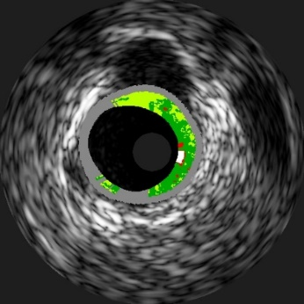
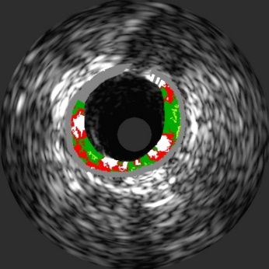
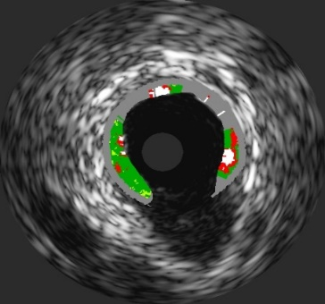
Serial IVUS-VH Data Analysis at 6-month F/U
Fibrous
Fibrous Fatty
Necrotic core
Calcium
 | Pre-procedure | Post-procedure | 6 months | ∆ post-procedure – 6 months | p-value post-procedure vs 6 months
Virtual histology | N=19 | N=19 | N=19 | N=19
Dense calcium (%) | 7.22 (7.58) | 28.17 (13.88) | 23.28 (7.83) | -4.89 (14.16) | 0.15
Data are mean (SD)
Notes:
Images are from GER175-004

Slide 16
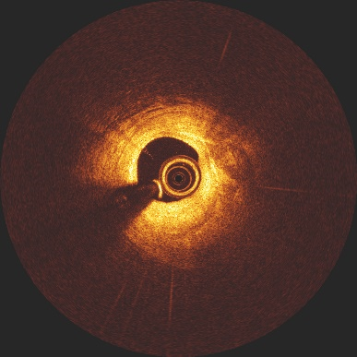
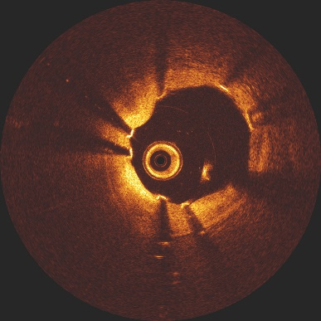
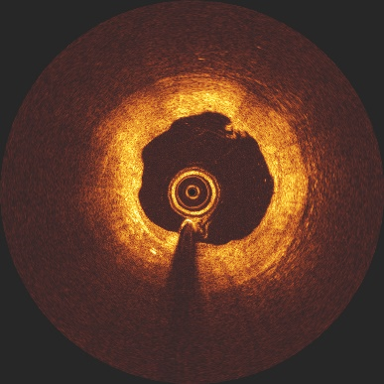
Serial OCT Data Analysis at 6-month F/U
Pre-procedure
Post-procedure
6m F/U
Malapposed* struts %: 4.40 ± 4.54
Total incomplete strut apposition area mm²: 0.08 ± 0.11
Struts hardly discernable
Data are mean ±SD
* Definition of malapposition: if the distance between outer contour of the strut and vessel wall is more than the individual strut thickness
Notes:
Images are from GER443-009
OCT analysis are on patient level

Slide 17
Clinical Results at 6-month F/U
 | N=115 | % | 95% CI
Target Lesion Failure* | 1 | 0.9 | 0.1 - 6.2
Cardiac Death | 0 | 0.0 | 0.0 - 0.0
Target Vessel MI** | 0 | 0.0 | 0.0 - 0.0
Clinically driven TLR | 1^{ƚ} | 0.9 | 0.1 - 6.2
Scaffold Thrombosis definite or probable | 0 | 0.0 | 0.0 - 0.0
^{ƚ :} The patient was asymptomatic, but at follow-up angiography, a 63% diameter stenosis (by core laboratory assessment) with an IFR of 0.51 was detected that was successfully treated with an Orsiro DES on post procedure day 166.
* composite of cardiac death, target vessel myocardial infarction, and clinically driven target lesion revascularization
** peri-procedural target vessel MI according to SCAI definition and non-peri-procedural target vessel MI according to extended historical definition

Slide 18
Conclusion (1)
DREAMS 3G demonstrates significantly lower in-scaffold LLL (mean 0.21 mm, median 0.13 mm) compared to its precursor device DREAMS 2G at 6-month follow-up¹ which is now on the level of contemporary DES²
Very good safety and efficacy profile up to 6-month follow-up:
Very low TLF (0.9%) and clinically-driven TLR rate (0.9%)
No definite or probable scaffold thrombosis
No myocardial infarction
¹ Haude et al. Safety and performance of the second-generation drug-eluting absorbable metal scaffold in patients (BIOSOLVE-II): 6 month results of a prospective, multicentre, non-randomised, first-in-man trial. Lancet 2016;387: 31–39.
² Byrne et al, ESC report - Task Force on the Evaluation of Coronary Stents in Europe, Eur Heart J 2015; 36: 2608-2620

Slide 19
Conclusion (2)
IVUS assessment showed preservation of the scaffold area from post-procedure up to six months with a low mean neointimal area.
OCT revealed that struts were well embedded in the vessel wall with a low proportion of mal-apposed struts, which were no longer discernable at six months.
In the serial Virtual Histology IVUS analysis, the white colour coding (a surrogate parameter for scaffold struts) was reduced at six months compared to post-procedure, documenting device resorption.

