Slide 1
The PROVE registry
A prospective multi-center multi-national post-market safety and performance surveillance of a short-frame supra-annular transcatheter aortic valve
Holger Thiele – Heart Center Leipzig
on behalf of the PROVE Investigators

Slide 2
Potential conflicts of interest
Speaker's name : Holger Thiele
☑ I do not have any potential conflict of interest to declare

Slide 3
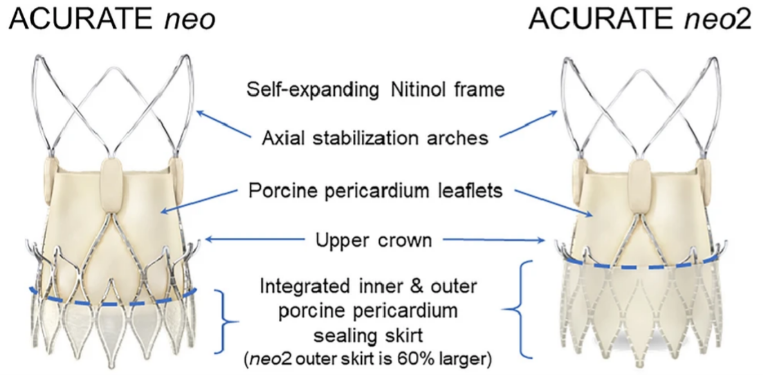
Background
Improved design targeting more predictable deployment and improved sealing
Möllmann et al. Clin Res Cardiol 2021; 110:1912-20

Slide 4
Background
Main ACURATE neo2 studies | Study population | In-hospital or 30 day all-cause mortality
Möllmann H (2021), Multicenter | 120 | 3.3%
Kim WK (2022), Single-center | 448 | 2.4%
Post-market surveillance study (2023), Multicenter | 250 | 0.8%
NeoAlign (2023), Single-center | 170 | 1.8%
Early neo2 (2023), Multicenter | 554 | 1.3%
ITAL-neo (2022), Multicenter | 205 | 1.5%
PREDICT PVL (2022), Single-center | 30 | 0.0%
Kim WK (2022), Multicenter | 810 | 3.3%
Miyashita H (2023), Single-center | 100 | 2.0%
NEOPRO-2 (2022), Multicenter | 763 | 2.9%
Rheude T (2023), Multicenter | 155 | -
Pellegrini C (2023), Multicenter | 608 | 1.8%
Encouraging outcomes

Slide 5
Background
Main ACURATE neo2 studies | Study population | In-hospital or 30 day all-cause mortality
Möllmann H (2021), Multicenter | 120 | 3.3%
Kim WK (2022), Single-center | 448 | 2.4%
Post-market surveillance study (2023), Multicenter | 250 | 0.8%
NeoAlign (2023), Single-center | 170 | 1.8%
Early neo2 (2023), Multicenter | 554 | 1.3%
ITAL-neo (2022), Multicenter | 205 | 1.5%
PREDICT PVL (2022), Single-center | 30 | 0.0%
Kim WK (2022), Multicenter | 810 | 3.3%
Miyashita H (2023), Single-center | 100 | 2.0%
NEOPRO-2 (2022), Multicenter | 763 | 2.9%
Rheude T (2023), Multicenter | 155 | -
Pellegrini C (2023), Multicenter | 608 | 1.8%
Multicenter _{ü}
Prospective
All-comer population
Core lab analysis of all images

Slide 6
Background
Main ACURATE neo2 studies | Study population | In-hospital or 30 day all-cause mortality
Möllmann H (2021), Multicenter | 120 | 3.3%
Kim WK (2022), Single-center | 448 | 2.4%
Post-market surveillance study (2023), Multicenter | 250 | 0.8%
NeoAlign (2023), Single-center | 170 | 1.8%
Early neo2 (2023), Multicenter | 554 | 1.3%
ITAL-neo (2022), Multicenter | 205 | 1.5%
PREDICT PVL (2022), Single-center | 30 | 0.0%
Kim WK (2022), Multicenter | 810 | 3.3%
Miyashita H (2023), Single-center | 100 | 2.0%
NEOPRO-2 (2022), Multicenter | 763 | 2.9%
Rheude T (2023), Multicenter | 155 | -
Pellegrini C (2023), Multicenter | 608 | 1.8%
✓
✓
Multicenter
Prospective
All-comer population
Core lab analysis of all images

Slide 7
Background
Main ACURATE neo2 studies | Study population | In-hospital or 30 day all-cause mortality
Möllmann H (2021), Multicenter | 120 | 3.3%
Kim WK (2022), Single-center | 448 | 2.4%
Post-market surveillance study (2023), Multicenter | 250 | 0.8%
NeoAlign (2023), Single-center | 170 | 1.8%
Early neo2 (2023), Multicenter | 554 | 1.3%
ITAL-neo (2022), Multicenter | 205 | 1.5%
PREDICT PVL (2022), Single-center | 30 | 0.0%
Kim WK (2022), Multicenter | 810 | 3.3%
Miyashita H (2023), Single-center | 100 | 2.0%
NEOPRO-2 (2022), Multicenter | 763 | 2.9%
Rheude T (2023), Multicenter | 155 | -
Pellegrini C (2023), Multicenter | 608 | 1.8%
✓
✓
✓
Multicenter
Prospective
All-comer population
Core lab analysis of all images

Slide 8
Background
Main ACURATE neo2 studies | Study population | In-hospital or 30 day all-cause mortality
Möllmann H (2021), Multicenter | 120 | 3.3%
Kim WK (2022), Single-center | 448 | 2.4%
Post-market surveillance study (2023), Multicenter | 250 | 0.8%
NeoAlign (2023), Single-center | 170 | 1.8%
Early neo2 (2023), Multicenter | 554 | 1.3%
ITAL-neo (2022), Multicenter | 205 | 1.5%
PREDICT PVL (2022), Single-center | 30 | 0.0%
Kim WK (2022), Multicenter | 810 | 3.3%
Miyashita H (2023), Single-center | 100 | 2.0%
NEOPRO-2 (2022), Multicenter | 763 | 2.9%
Rheude T (2023), Multicenter | 155 | -
Pellegrini C (2023), Multicenter | 608 | 1.8%
✓
✓
✓
Multicenter
Prospective
All-comer population
Core lab analysis of all images
✓

Slide 9
Background
Objectives of PROVE:
I. To evaluate the safety, efficacy performance of the ACURATE neo2.
✓
✓
✓
Multicenter
and device
Prospective
All-comer population
II. To do this in a prospective, multicenter, all-comer population, with a core lab analysis of all images and an independent endpoint adjudication.
Core lab analysis of all images
✓

Slide 10
Study design
Investigator-initiated, prospective, single arm, study
Aiming to enroll at least 1000 patients at 27 European sites
Endpoints
Primary endpoint: all-cause mortality up-to 12 months
Additional endpoints according to VARC-3: technical success, device success, early safety, clinical efficacy (at one year) and several clinical endpoints
Study administration
Steering committee: Holger Thiele, Mohamed Abdel-Wahab, Helge Möllmann
Clinical event commitee: Karl-Heinz Kuck, Andreas Zeiher, Karl Georg Häusler
Central image analysis: Osama Soliman, CORRIB Core Lab (Galway, Ireland)
Sponsor: Leipzig University
Funding: unrestricted grant from Boston Scientific International S.A.

Slide 11
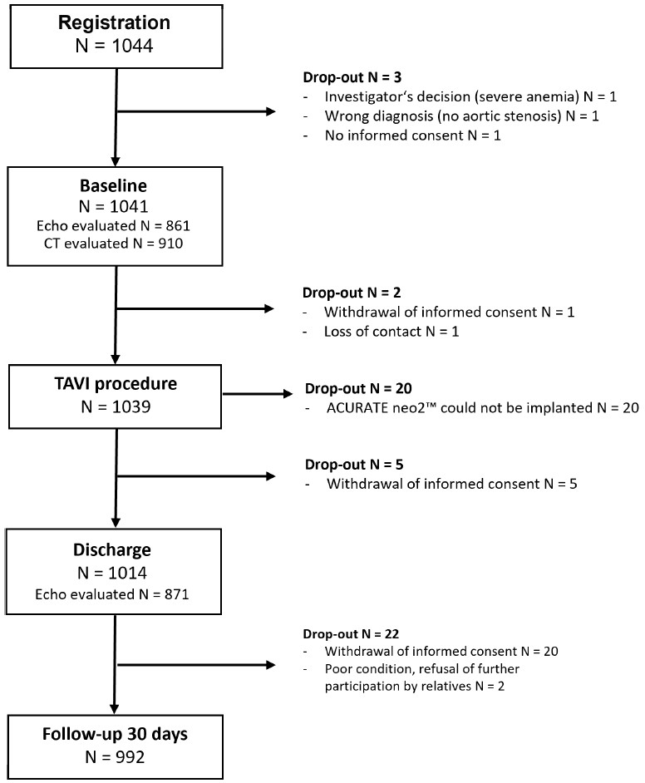
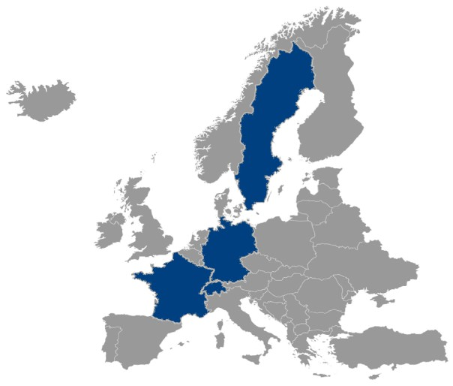
Trial flow

Slide 12
Recruiting study sites
Center | Principal investigator | n
Herzzentrum Leipzig | H. Thiele, M. Abdel-Wahab | 173
St.-Johannes Klinik, Dortmund | H. Möllmann | 119
Kerkoff-Klinik, Bad Nauheim | W.-K. Kim | 105
HDZ NRW, Bad Oeynhausen | T. Rudolph, S. Bleiziffer | 97
Herz und Gefäßzentrum, Frankfurt | T. Walter | 90
Elisabeth Krankenhaus, Essen | T. Schmitz | 79
DHZB, Berlin | C. Klein | 77
Zentralklinik Bad Berka | P. Lauten | 62
Universitätsklinikum Hamburg-Eppendorf | A. Schäfer | 44
Augustinum Klinik, München | O. Husser | 38
Universitätsspital Basel | T. Nestelberger | 25
Universitätsspital Zürich | J. Michel | 21
Herzzentrum Dresden | N. Mangner | 21
Center | Principal investigator | n
Universitätsklinikum Düsseldorf | T. Zeus | 16
Herzzentrum Freiburg-Bad Krozingen | J. Rothe | 15
Herzzentrum der Universität zu Köln | M. Adam | 11
Hôpital Privé Jacques Cartier, Massy | S. Champagne | 10
Schüchtermann Kliniken, Bad Rothenfelde | N. Doll | 8
Luzerner Kantonsspital | S. Toggweiler | 8
Centre Cardiologique du Nord, Saint-Denis | M. Nejjari | 7
Universitätsklinikum Tübingen | T. Geisler | 6
Universitätsklinikum Augsburg | S. Elvinger | 4
DHZ München | M. Joner | 3
Rhön-Klinikum AG Campus Bad Neustadt | W. Reents | 2
Universitätsklinikum Regensburg | M. Hilker | 2
Skånes Universitetssjukhus Lund | M. Gotberg | 1

Slide 13
Baseline characteristics
Patient characteristics | n = 1041
Age (years) | 82.6 ± 5.6
Female sex | 65% (677/1041)
Body mass index (kg/m²) | 26.9 ± 4.9
Diabetes mellitus | 27.4% (285/1041)
Coronary artery disease | 52.4% (545/1041)
History of stroke | 9.7% (101/1041)
History of atrial fibrillation/flutter | 38.8% (404/1041)
Prior pacemaker | 10.7% (111/1019)
EuroScore II | 3.1 (1.9 - 5.2)
STS Score | 4.3 (2.7 - 7.4)
Prior TAVI | 0.1% (1/1041)
Prior SAVR | 0.3% (3/1041)
ECHO characteristics | n = 861*
Left ventricular ejection fraction (%) | 55.3 ± 10.0
Aortic valve area (cm²) | 0.8 ± 0.2
Aortic valve mean gradient (mmHg) | 30.1 ± 11.6
Severe aortic regurgitation | 0.8% (7/857)
CT characteristics* | n = 910*
Bicuspid aortic valve morphology | 2.5% (23/909)
Mean annulus diameter (mm) | 23.4 ± 1.8
Mean annulus area (mm²) | 424.0 ± 65.4
Annulus perimeter (mm) | 74.4 ± 5.6
Severe aortic valve calcification | 45.6% (415/909)
Severe LVOT calcification | 4.7% (43/909)
* only Core Lab analysed patients

Slide 14
Procedural data
Procedural data | n = 1039
General anesthesia | 11.0% (113/1031)
Transfemoral vascular access | 99.9% (1033/1034)
Cerebral embolic protection system used | 2.0% (21/1035)
Predilatation | 96.4% (999/1036)
Postdilatation | 27.1% (281/1035)
No rapid pacing | 12.8% (132/1032)
ACURATE neo 2 could not be implanted | 1.8% (19/1039)
Second valve implanted | 1.0% (10/1019)
Conversion to open surgery | 0.4% (4/1019)
Amount of contrast agent (ml) | 102.5 ± 51.3
Procedure time (min) | 52.1 ± 21.8
ACURATE neo2 size
L
27.5% (n=280/1017)
S
30.8% (n=313/1017)
M
41.7% (n=424/1017)

Slide 15
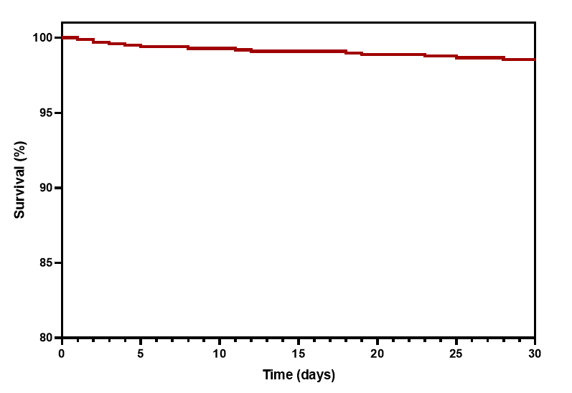
Cause of death
Unknown n=1 (7.1%)
Primary endpoint at 30 days
1.4%
All-cause mortality at 30 days
Non - Cardiovascular
n=5 (35.7%)
Cardiovascular n=8 (57.1%)
Number at Risk 1019
985
967
960
948
924
818

Slide 16
Key clinical endpoints at 30 days
9.3% (n=85)
10
93.9%
88.0%
79.4%
8
5.8%
(n=59)
Technical
Device
Early
6
Success
Success
Safety
4
2.6% (n=26)
2.2% (n=22)
1.6%
2
1.0%
(n=16)
0.1%
(n=10)
(n=1)
0
All Stroke
Myocardial infarction
Major vascular complications
Severe bleeding (type 3 and 4)
Any acute kidney injury
New Pacemaker*
Re- hospitalization
* among pacemaker naive patients (n=911)

Slide 17
Valve performance parameters
3.4%
35
2,5
 | 29.5% | Severe
 |  | Modera
 |  | Mild
 | 67.1% | None/Tr
30.1 ± 11.6
(n=791)
2.1 ± 0.6
(n=710)
30
Mean effective orifice area (cm²)
2
Mean AV Gradient (mmHg)
25
te
20
1,5
15
1
0.8 ± 0.2
(n=721)
ace
10
6.8 ± 3.2
(n=810)
0,5
5
0
0
Baseline
Discharge
Paravalvular Leak
(n = 854)

Slide 18
The ACURATE neo2 PROVE registry demonstrated in a large, European, all-comer population:
Conclusions
1.4%
88.0%
6.8±3.2
3.4%
9.3%
All-cause mortality at 30 days
Device Success
Transvalvular gradient at discharge (mmHg)
More than mild PVL
at discharge
New pacemaker Implantation

Slide 19
PCRonline.com

