Slide 1
Zilebesiran in Combination with a Standard-of-care Antihypertensive in Patients with Inadequately Controlled Hypertension: Primary Results from the Phase 2
KARDIA-2 Study
George L Bakris¹, Akshay S Desai², Ahmad Aswad³, Jolita Badariene⁴, Farhana Kazi⁵, Adam D Karns⁶, Joel M Neutel⁷, Wansu Park⁸, Daniel Stiglitz⁸, Nune Makarova⁸, Andrea Havasi⁸, Dion Zappe⁸, Manish Saxena^{9,10}
¹University of Chicago Medicine, Chicago, IL, USA; ²Brigham and Women’s Hospital, Boston, MA, USA; ³Gonzalez MD and Aswad MD Health Care Services, Miami, FL, USA; ⁴Medical Faculty, Vilnius University, Vilnius, Lithuania; ⁵Prime Revival Research Institute LLC, Coppell, TX, USA; ⁶Entertainment Medical Group, Beverly Hills, CA, USA; ⁷Orange County Research Center, Tustin, CA, USA; ⁸Alnylam Pharmaceuticals, Cambridge, MA, USA; ⁹Barts Health NHS Trust, London, UK; ¹⁰Queen Mary University of London, London, UK
Presented at the the American College of Cardiology Annual Scientific Session & Expo, April 6–8, 2024, Atlanta, GA, USA

Slide 2
Hypertension and Zilebesiran
Despite the availability of effective therapy, many patients with hypertension do not meet guideline-recommended BP targets, leaving them with unattended risk for CV events
Poor adherence to complex, multidrug oral regimens may contribute to inadequate BP control
Zilebesiran siRNA
Liver-targeting ligand
Even in those who are treated, residual BP variability and lack of nighttime dipping may further increase cardiovascular risk
AGT
Renin
Zilebesiran, an investigational, subcutaneously administered RNA interference therapeutic targeting hepatic synthesis of AGT, the most upstream precursor to all angiotensin peptides, may offer an alternative treatment approach for hypertension
Des(Ang1)AGT
Angiotensin peptides
AGT, angiotensinogen; des(Ang1)AGT, des(Ang1)angiotensinogen; GalNAc, N-acetylgalactosamine; siRNA, small interfering ribonucleic acid.
Million Hearts Foundation. Estimated hypertension prevalence, treatment, and control among US adults: tables. https://millionhearts.hhs.gov/files/Estimated-Hypertension-Prevalence-tables-508.pdf (Accessed March 19, 2024); Desai AS et al. N Engl J Med 2023;389:228–38

Slide 3
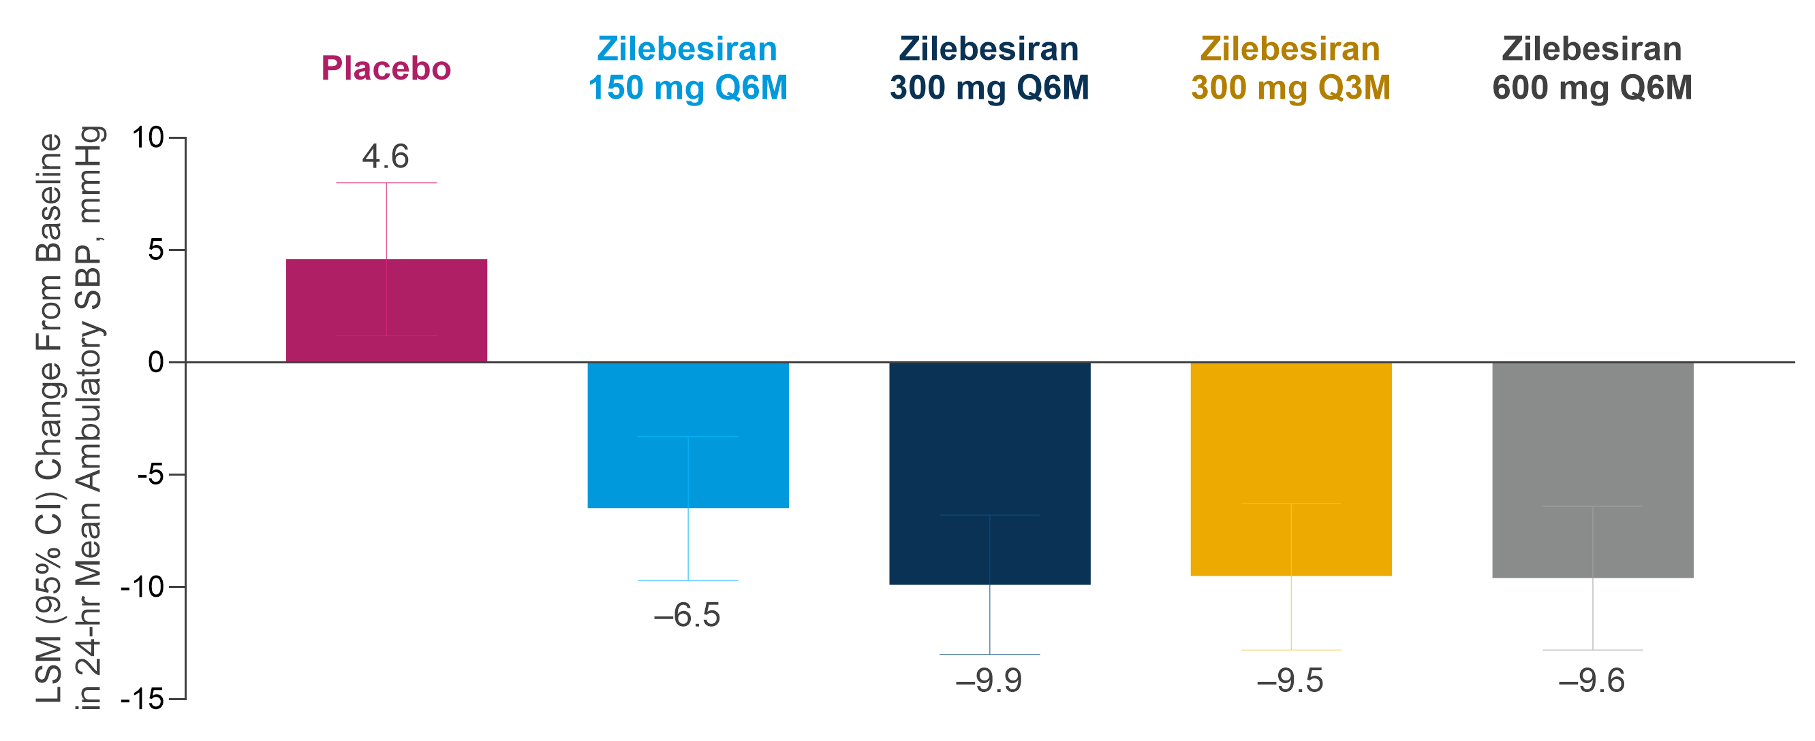
: Significant SBP Reductions Sustained to Month 6 in Patients with Mild-to-Moderate Hypertension
LSMD vs placebo, mmHg (95% CI) | −11.1 (−15.8, −6.4) | −14.5 (−19.1, −9.9) | −14.1 (−18.9, −9.4) | −14.2 (−18.9, −9.5)
What is the efficacy, safety, and tolerability of zilebesiran when added to a standard-of-care antihypertensive in patients with inadequately controlled hypertension?
NCT04936035. Bakris GL et al. JAMA 2024;331:740–9. AGT, angiotensinogen; CI, confidence interval; LSM, least-squares mean; LSMD, LSM difference; Q3M, every 3 months; Q6M, every 6 months.

Slide 4
: Phase 2, Randomized, Double-Blind, Placebo-Controlled Study to Evaluate the Efficacy and Safety of Zilebesiran as an Add-on Therapy in Patients with Uncontrolled Hypertension
Open-label run-in period (≥4 weeks)
6-month double-blind period Indapamide +
Zilebesiran 600 mg SC x1
OR
Indapamide +
Placebo SC
Primary Endpoint
Change from baseline at Month 3 in 24-hr mean ambulatory SBP
Patient Population
Indapamide
2.5 mg daily
R
After run-in period
24-hr mean ambulatory SBP
≥130–160 mmHg
Select Secondary Endpoints
Aged 18 to 75 yrs
Untreated HTN: Seated office SBP
≥155–180 mmHg
4:7:10 Randomization for Run-In
Change in serum AGT
Change from baseline at Month 3 in office SBP
Time-adjusted change from baseline at Month 6 in 24-hr mean ambulatory SBP
Time-adjusted change from baseline at Month 6 in office SBP
Proportion of patients achieving SBP response at Month 6 without rescue medication
OR
Amlodipine +
Zilebesiran 600 mg SC x1
OR
Amlodipine +
Placebo SC
Amlodipine 5 mg daily
R
or
≥80% adherence to protocol-specified
Treated HTN with 1– 2 antihypertensives: Seated office SBP
≥145–180 mmHg
OR
background antihypertensive therapy
Olmesartan +
Zilebesiran 600 mg SC x1
OR
Olmesartan +
Placebo SC
Olmesartan 40 mgª daily
R
Stratification
Safety Endpoint
Race (Black vs all others);
Baseline 24-hr mean SBP (< vs ≥145 mmHg);
Screening eGFR
(< vs ≥60 mL/min/1.73 m²)
0
3
6
Frequency of AEs
Rescue medication permitted
Baseline
Primary
Endpoint
NCT05103332. ª20 mg daily for patients with creatinine clearance ≤60 mL/min at screening enrolled outside of US, consistent with local labeling. AE, adverse event; AGT, angiotensinogen; R, randomization; SBP, systolic blood pressure.

Slide 5
Patient Disposition
Screened N=4481
Screen failure N=2981, 66.5%
Randomized to run-in period N=1500, 33.5%
Indapamide N=273
Randomized to DB period N=130, 47.6%
Amlodipine N=475
Olmesartan N=752
Randomized to DB period N=301, 40.0%
Randomized to DB period N=241, 50.7%
Placebo N=65
Dosed N=64
Completed 6-month DB period N=63, 96.9%
Zilebesiran N=65
Dosed N=63
Completed 6-month DB period N=59, 90.8%
Placebo N=121
Dosed N=121
Completed 6-month DB period N=115, 95.0%
Zilebesiran N=120
Dosed N=118
Completed 6-month DB period N=115, 95.8%
Placebo N=152
Dosed N=152
Completed 6-month DB period N=149, 98.0%
Zilebesiran N=149
Dosed N=149
Completed 6-month DB period N=140, 94.0%
DB, double-blind.

Slide 6
Baseline Demographics Across Cohorts
 | Background Medication
 | Indapamide | Amlodipine | Olmesartan
 | Placebo or Zilebesiran (N=127) | Placebo or Zilebesiran (N=239) | Placebo or Zilebesiran (N=301)
Mean age, years (SD) | 59.2 (10.5) | 58.0 (10.0) | 58.5 (10.4)
Male, % | 56.7 | 56.5 | 57.1
Enrolled in the United States, % | 82.7 | 80.3 | 80.7
Race, %
White | 70.1 | 61.1 | 68.8
Black or African American | 23.6 | 33.5 | 25.6
24-hr mean ambulatory SBP, mmHg (SD) | 143.3 (8.4) | 142.9 (8.0) | 143.8 (8.2)
24-hr mean ambulatory SBP ≥145 mmHg, % | 46.5 | 39.3 | 45.5
Mean office SBP, mmHg (SD) | 144.7 (11.8) | 143.5 (11.5) | 145.2 (12.9)
BMI ≥30 kg/m², % | 66.9 | 61.9 | 56.1
eGFR <60 mL/min/1.73 m², % | 15.7 | 5.4 | 11.6
Diabetes, % | 21.3 | 22.6 | 25.2
Percentages in the table are based on number of patients randomized and dosed.

Slide 7
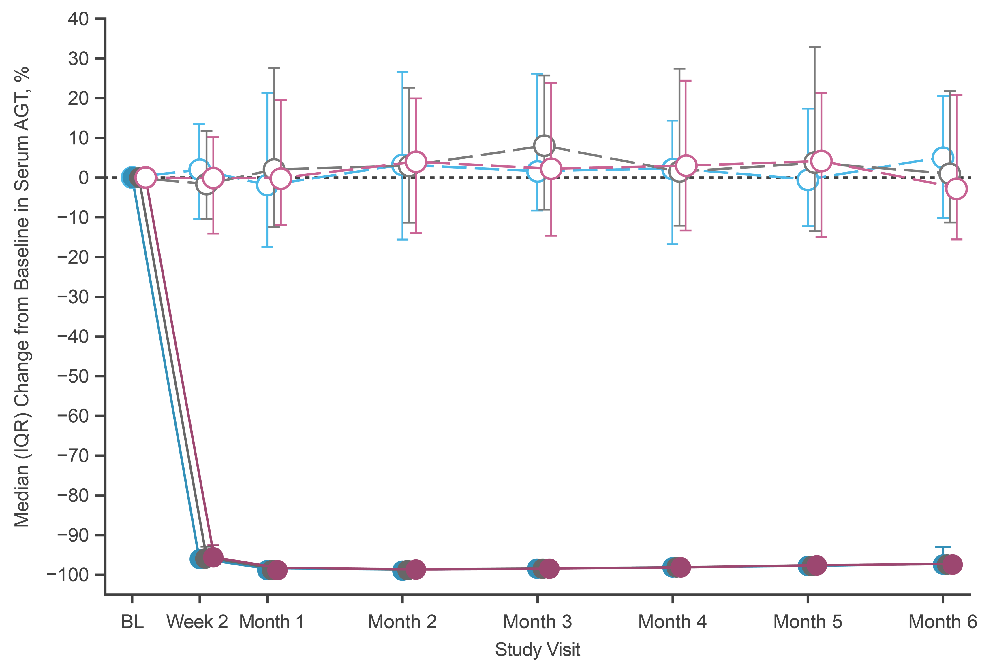
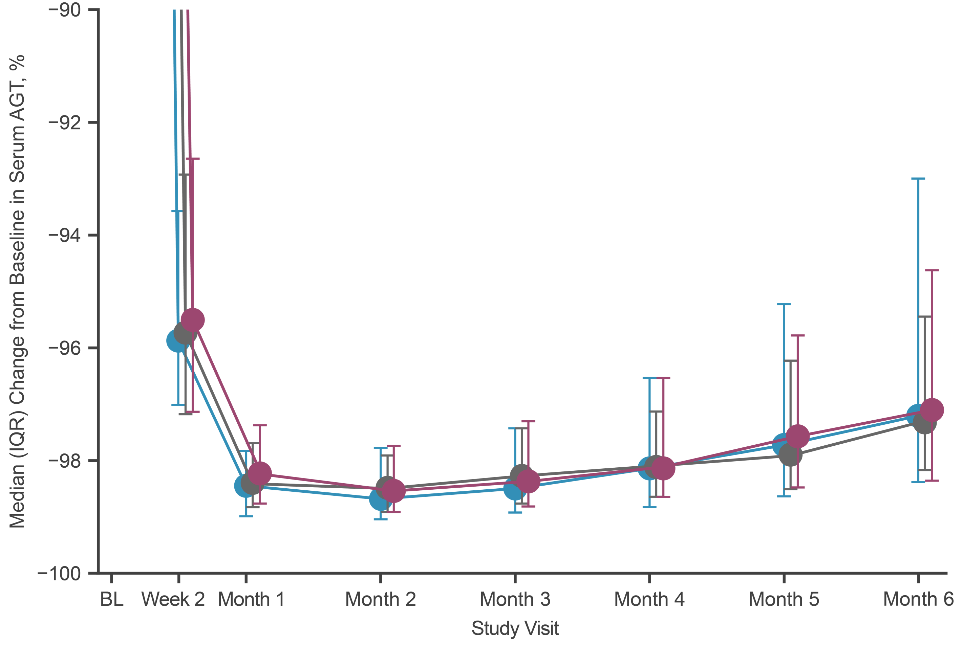
Change From Baseline in Serum AGT
Rapid median reductions in serum AGT >95% sustained through Month 6 with zilebesiran
AGT, angiotensinogen; BL, baseline; IQR, interquartile range.

Slide 8
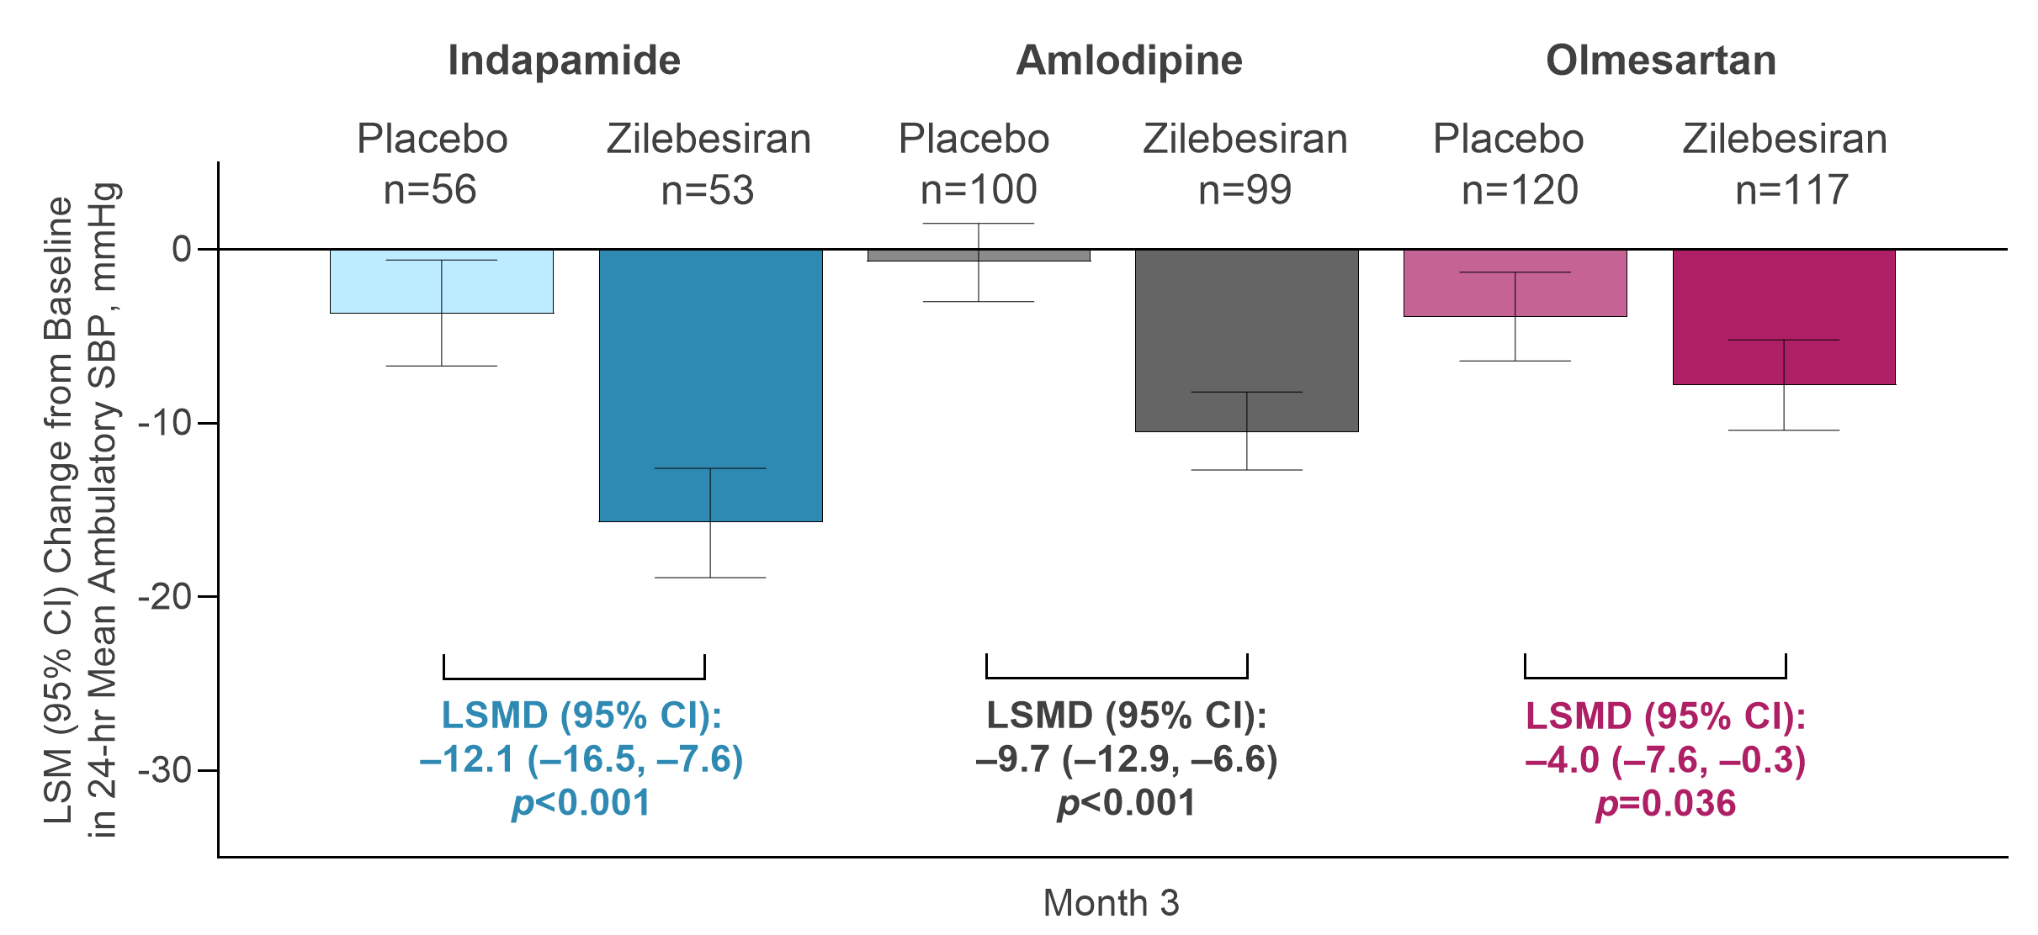
Primary Endpoint: Change from Baseline to Month 3 in 24-hr Mean Ambulatory SBP
Ambulatory blood pressure assessed while patients were receiving or within 2 weeks of stopping any rescue medication is censored.
CI, confidence interval; LSM, least-squares mean; LSMD, LSM difference.

Slide 9
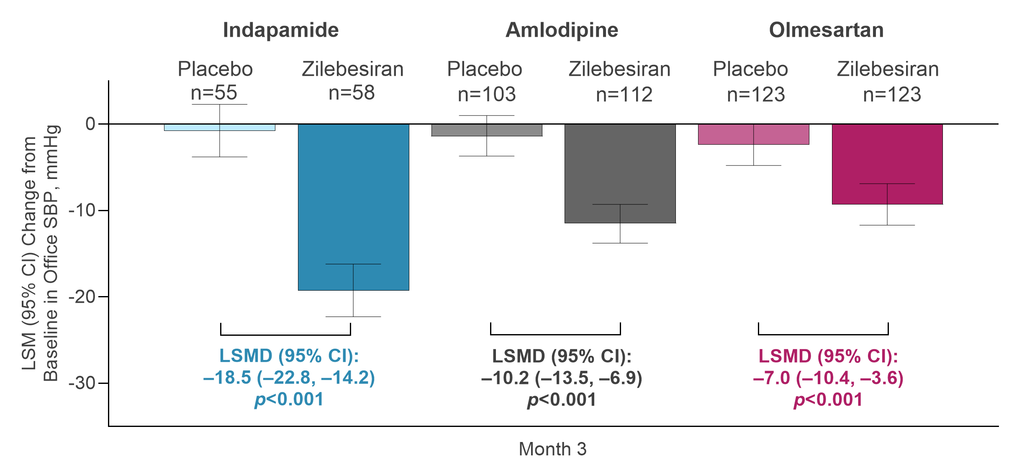
Secondary Endpoint: Change from Baseline to Month 3 in Office SBP
Office blood pressure assessed while patients were receiving or within 2 weeks of stopping any rescue medication is censored.
CI, confidence interval; LSM, least-squares mean; LSMD, LSM difference.

Slide 10
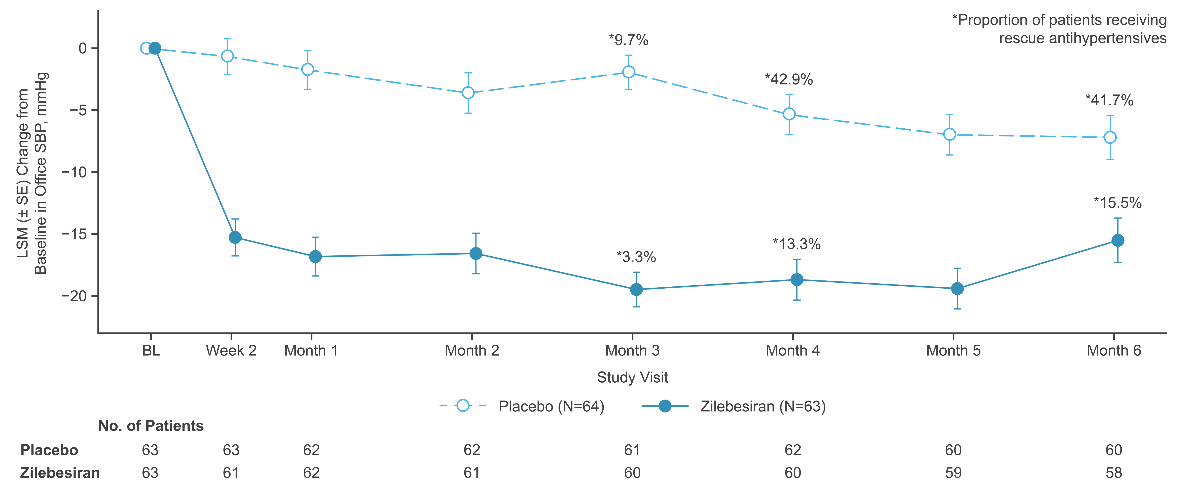
Secondary Endpoint: Change From Baseline Through Month 6 in Office SBP
Indapamide Cohort
*9.7%
*42.9%
*41.7%
*15.5%
*3.3%
*13.3%
 | Time-Adjusted 24-hr Mean Ambulatory SBP | Time-Adjusted Office SBP
LSMD vs placebo, mmHg (95% CI) | −11.0 (−14.7, −7.3), p<0.001 | −13.6 (−16.9, −10.3), p<0.001
BL, baseline; CI, confidence interval; LSM, least-squares mean; LSMD, least-squares mean difference; SE, standard error.

Slide 11
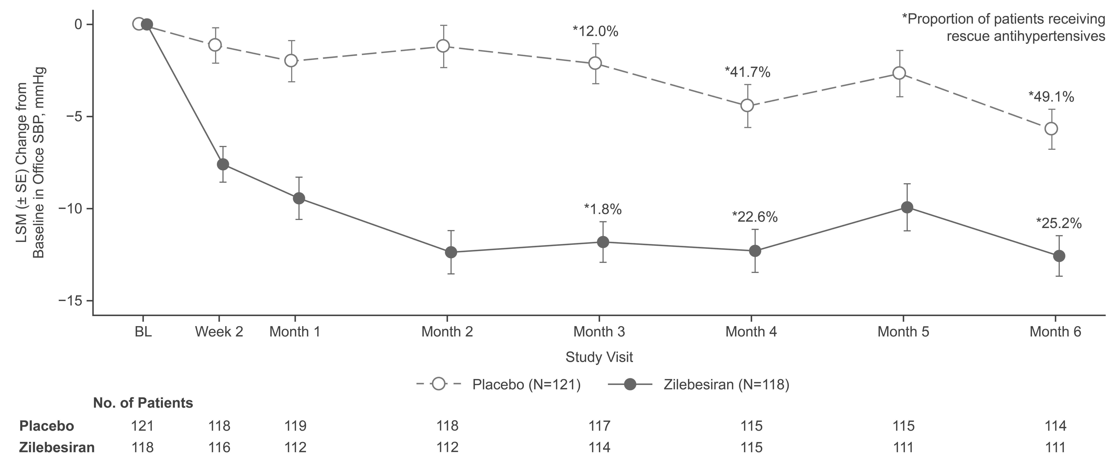
Secondary Endpoint: Change From Baseline Through Month 6 in Office SBP
Amlodipine Cohort
*12.0%
*41.7%
*49.1%
*1.8%
*22.6%
*25.2%
 | Time-Adjusted 24-hr Mean Ambulatory SBP | Time-Adjusted Office SBP
LSMD vs placebo, mmHg (95% CI) | −7.9 (−10.6, −5.3), p<0.001 | −8.6 (−10.9, −6.3), p<0.001
BL, baseline; CI, confidence interval; LSM, least-squares mean; LSMD, least-squares mean difference; SE, standard error.

Slide 12
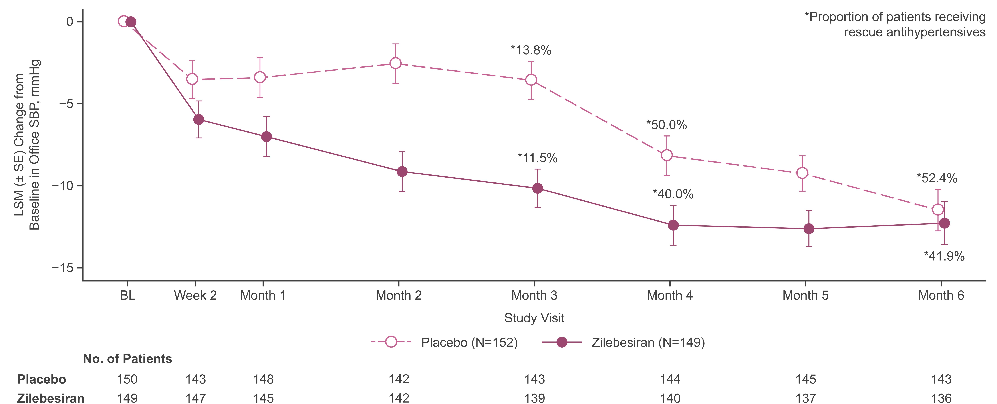
Secondary Endpoint: Change From Baseline Through Month 6 in Office SBP
Olmesartan Cohort
*13.8%
*50.0%
*11.5%
*52.4%
*40.0%
*41.9%
 | Time-Adjusted 24-hr Mean Ambulatory SBP | Time-Adjusted Office SBP
LSMD vs placebo, mmHg (95% CI) | −1.6 (−4.4, 1.2), p=0.26 | −4.6 (−6.8, −2.4), p<0.001
BL, baseline; CI, confidence interval; LSM, least-squares mean; LSMD, least-squares mean difference; SE, standard error.

Slide 13
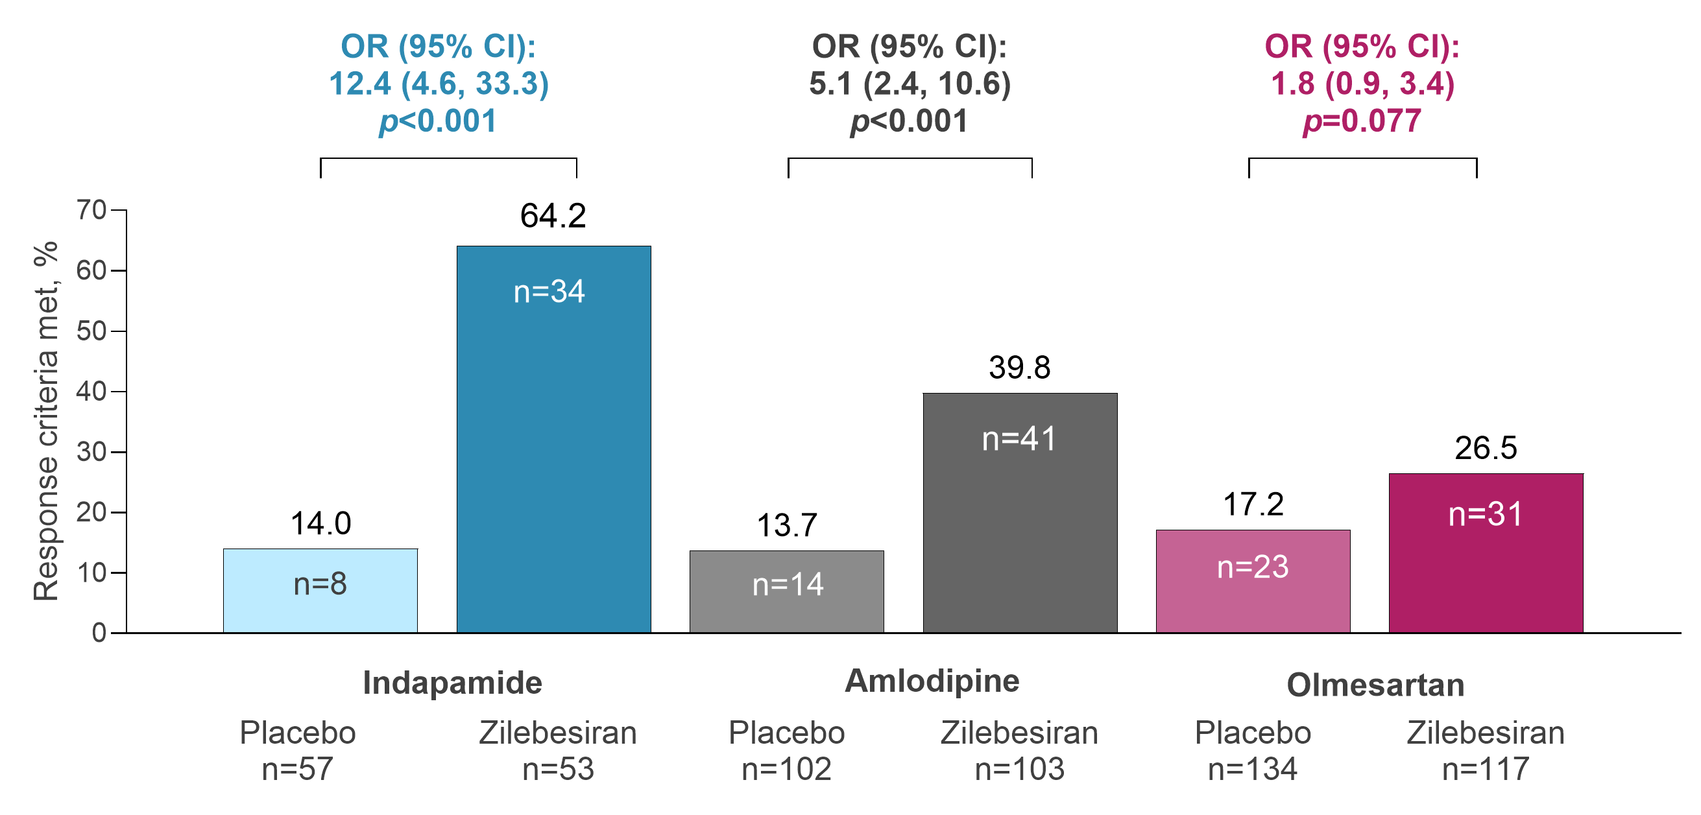
Secondary Endpoint: Proportion of Patients Achieving SBP Response at Month 6 Without Rescue Medication
Response Criterion: 24-hr mean ambulatory SBP <130 mmHg and/or reduction ≥20 mmHg without additional antihypertensives
OR, odds ratio.

Slide 14
Safety Profile Through Month 6
n (%) | Background Medication
 | Indapamide |  | Amlodipine |  | Olmesartan
 | Placebo (N=64) | Zilebesiran (N=63) | Placebo (N=121) | Zilebesiran (N=118) | Placebo (N=152) | Zilebesiran (N=149)
At least 1 AE | 25 (39.1) | 31 (49.2) | 57 (47.1) | 64 (54.2) | 73 (48) | 87 (58.4)
At least 1 serious AE | 2 (3.1) | 0 | 1 (0.8) | 3 (2.5) | 4 (2.6) | 4 (2.7)
Hypotension/orthostatic hypotension AE | 0 | 0 | 4 (3.8) | 7 (5.9) | 3 (2.0) | 7 (4.7)
Potassium >5.5 nmol/L | 0 | 2 (3.2) | 1 (0.8) | 8 (6.8) | 3 (2.0) | 10 (6.7)
Confirmed by repeat measure | 0 | 1 (1.6) | 0 | 2 (1.7) | 0 | 1 (1.3)
≥30% decrease from baseline in eGFR (mL/min/1.73m²) | 1 (1.6) | 8 (12.7) | 5 (4.1) | 10 (8.5) | 4 (2.6) | 10 (6.7)
Confirmed by repeat measure | 0 | 3 (4.8) | 2 (1.7) | 1 (0.8) | 1 (0.6) | 4 (2.7)
>2x increase from baseline in creatinine (umol/L) | 0 | 0 | 0 | 0 | 0 | 3 (2.0)
Confirmed by repeat measure | 0 | 0 | 0 | 0 | 0 | 1 (0.7)
There were no deaths or no AEs leading to study discontinuation
Majority of hypotension AEs were transient and resolved without intervention
Majority of laboratory abnormalities of interest were mild, resolved upon repeat measurement without intervention, and occurred in the first 3 months
Adverse event definitions are based on MedDRA terminology. AE, adverse event.

Slide 15
: Summary
For US HCPs Only
Scan to View Congress Material Presented
Treatment with a single subcutaneous dose of zilebesiran 600 mg was associated with clinically significant reductions in 24-hr mean ambulatory and office SBP compared with placebo at Month 3 when added to a diuretic, CCB, or maximum-dose ARB
– These differences were sustained to Month 6 in the indapamide and amlodipine cohorts despite add-on antihypertensive therapy
Add-on treatment with zilebesiran was associated with increased rates of mild hyperkalemia, hypotension, and eGFR decline >30%, but most episodes were non-serious, transient, and resolved without intervention
Though the trial was not adequately powered to ensure long-term safety, these results support the potential for combining biannual dosing of zilebesiran with standard-of care antihypertensives to achieve additive blood pressure reductions
The Phase 2 KARDIA-3 study (NCT06272487) has been initiated and will evaluate patients with hypertension uncontrolled by 2-4 standard-of-care antihypertensives who have high cardiovascular risk or advanced chronic kidney disease
Thank you to the patients, their families, investigators, study staff, and collaborators for their participation in the KARDIA-2 study
ARB, angiotensin receptor blocker; CCB, calcium channel blocker.

