Slide 1
COMPARE-ABSORB
1 year results
Pieter C. Smits, MD
&
Robert-Jan van Geuns, MD
On behalf of the COMPARE-ABSORB investigators

Slide 2
Disclosure Statement of Financial Interest
I, Pieter Smits,
Have received institutional research grants from Abbott Vascular, St. Jude Medical, Terumo.
Have received speakers/consulting fees from Abbott Vascular, St. Jude Medical, Terumo and Astra Zeneca
All TCT 2018 faculty disclosures are listed online and on the App.

Slide 3
COMPARE-ABSORB trial
Investigator initiated, prospective, single blind, multicenter
randomized controlled trial comparing
Xience versus Absorb
in a high-risk patient and/or complex lesion population

Slide 4
Objectives
To show non-inferiority between Absorb and Xience on TLF at 1 year
Secondary objective is to show superiority of Absorb on TLF between 1 and 5 years in a landmark analysis
Tertiary objective is to show superiority of Absorb on TLF from start to 5 year

Slide 5
COMPARE-ABSORB
Inclusion criteria
Patients with at least one of the following:
High-risk characteristics for restenosis
Known diabetes and/or multivessel disease of which more than one de-novo target lesion to be treated with the study scaffold/stent
Complex de-novo target lesion
Lesion length >28 mm
Small vessels: RVD between 2.25-2.75 mm
Lesion with pre-existing total occlusion
Bifurcation with single device strategy

Slide 6
Key features of COMPARE-ABSORB
Specific patient population and implantation technique
To study a patient population which potentially might benefit the most by the vascular restoration therapy concept on the long term
Selection of specific patients and complex lesions not investigated in previous RCT’s like: STEMI, acute non-STEMI, bifurcations and long lesions and CTO’s
PSP implantation technique from the start

Slide 7
Key features of COMPARE-ABSORB
PSP protocol for ABSORB implantation from the start
Pre-dilatation mandatory with 1:1 balloon-artery ratio
Treatment of target vessels < 2.75 mm QCA, IVUS or OCT highly recommended
High pressure (>16 Atm) post-dilatation is mandatory
Post-dilatation with NC balloons up to 0.5 mm larger than the scaffold is recommended

Slide 8
Trial design (original)
Original protocol April 2015
1Y
5Y
1st analysis:
N on-inferiority in TLF at 1Y
2nd analysis: Superiority in TLF betw een 1 and 5
years
45 sites across Europe
AB SOR B
3rd analysis:
Cum ulative
superiority in TLF at 5Y (or 7Y )
Em ergent/ Elective P CI 2100 pts
R
R andom ization after successful w iring first target
X ience
lesion
TLF 1yr in X ience: 8.5%
N on-inferiority m argin: 4.5%
Alpha = 0.05
P ow er= 90%
Sam ple size: 808 x 2 = 1616 pts
TLF 1-5yr in X ience: 10.5%
TLF 1-5yr in AB SOR B 6.3%
P ow er= 90%
Sam ple size: 1004 x 2 = 2008 pts
Sam ple size 5% attr. = 2100 pts

Slide 9
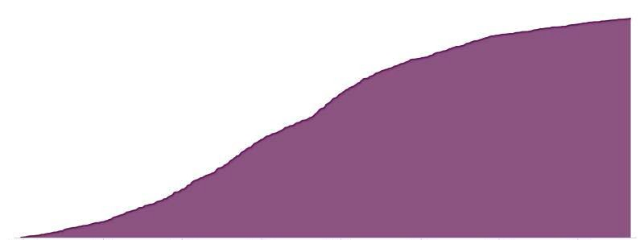
Study flow
AIDA NEJM 2017
FDA warning letter
ABSORB III 2 yr results
1670
Patients enrolled
 | 1200 Patients enrolled
ABSORB II 3 yr results
First Initiated site 28 Sep 2015
First Patient enrolled 28 Sep 2015 Maassstad Hospital
31 August DSMB letter Trial put on hold
 | 8 September Commercial stop on ABSORB
600 Patients enrolled
Start regulatory submission
100 Patients enrolled
July 2015
Sep. 2015
Dec. 2015
May 2016
Oct. 2016
Nov. 2016
March 2017
Aug. & Sept.
2017
Sept. 2018
Study Start-up period | Enrollment period | Follow-up period

Slide 10
Study Flow and Follow-up
Randomized 1:1 N=1670 (ITT)
Absorb N=848
Xience N=822
N = 13 no contact
N = 13 withdrew consent
N = 11 no contact
N = 11 withdrew consent
Absorb N=822
96.9% Complete
Xience N=800
97.3% Complete
1-Year Follow-up

Slide 11
Characteristics
Baseline characteristics, indication, treatment | ABSORB 848 patients 1242 target lesions 962 procedures | XIENCE 822 patients 1213 target lesions 904 procedures | P value
Diabetes mellitus | 34.6% (293) | 36.1% (296) | 0.57
Acute coronary syndrome (ACS) | 52.1% (442) | 48.7% (400) | 0.17
STEMI | 13.0% (110) | 12.5% (103) | 0.88
Non-STEMI treatment < 72 hours | 13.3% (113) | 12.4% (102) | 0.57
Pre-dilatation | 96.5% (1198) | 78.6% (1213) | <0.001
Non-compliant balloon used | 67.9% (814) | 52.9% (504) | <0.001
Mean study devices used | 1.3 ± 0.7 | 1.3 ± 0.6 | 0.07
Post-dilatation | 90.7% (1497) | 58.3% (906) | <0.001
Non-compliant balloon used | 93.0% (1392) | 85.5% (775) | <0.001
Max. pressure ≧ 16 Atm | 79.7% (1193) | 79.5% (720) | 0.92

Slide 12
Primary endpoint
1 year TLF non-inferiority analysis
Assumed difference between Xience and Absorb : 0 %
Non inferiority margin : 4.5 %
One sided 2.5% significance level
TLF rate Xience 4.2%
TLF rate Absorb 5.1%
Δ Prim. EP: Absorb - Xience = 0.9 % (95% CI: -1.2 – 3.0 %)
Absorb not inferior
Δ Prim EP %
- 5 - 4
-3 -2 -1 0 1 2 3
Absorb is non-inferior compared to Xience
4
5
P < 0.001

Slide 13
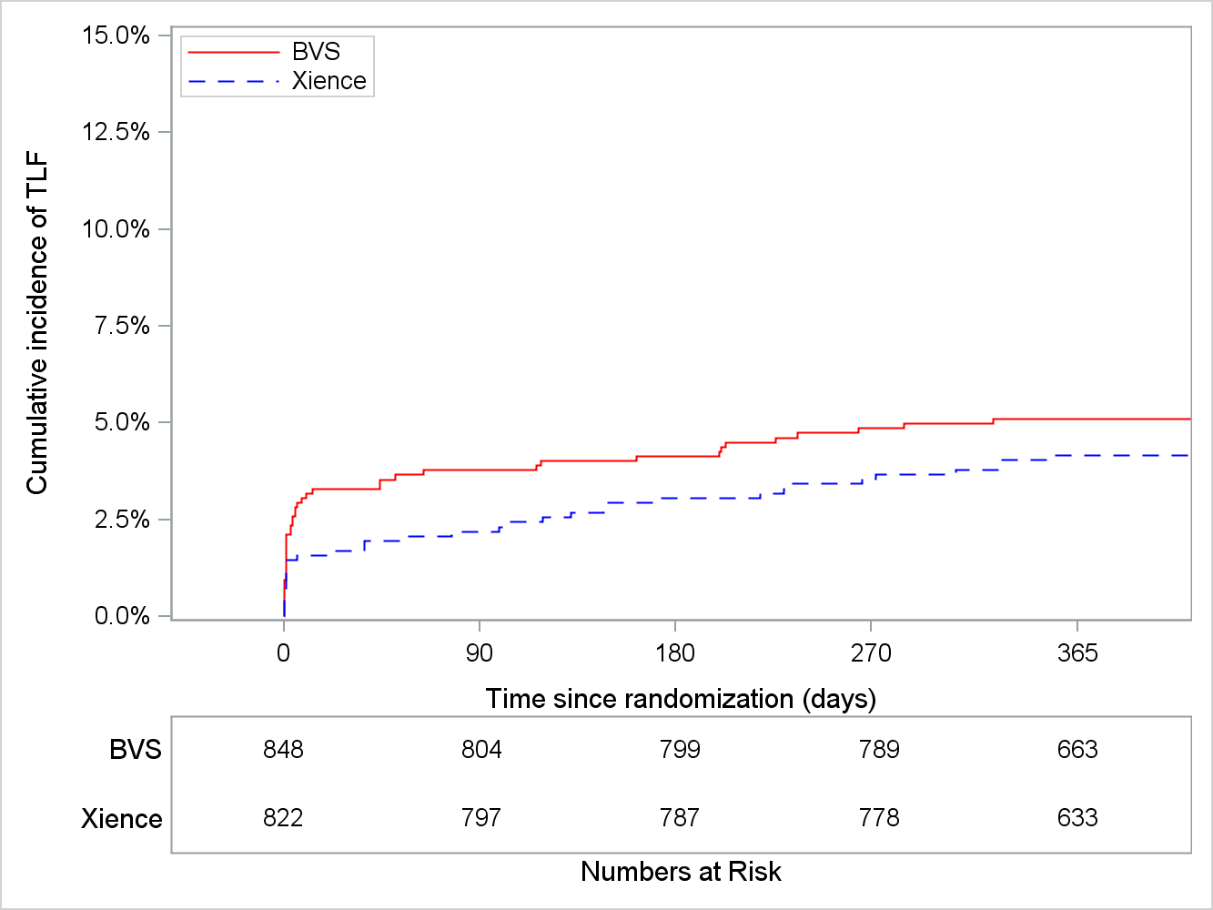
TLF @ 1 year
Cardiac death, target vessel myocardial infarction, clinically-indicated target lesion revascularization
HR 1.24 (0.79 - 1.94)
^{P}logrank ^{= 0.35}
5.1%
4.2%

Slide 14
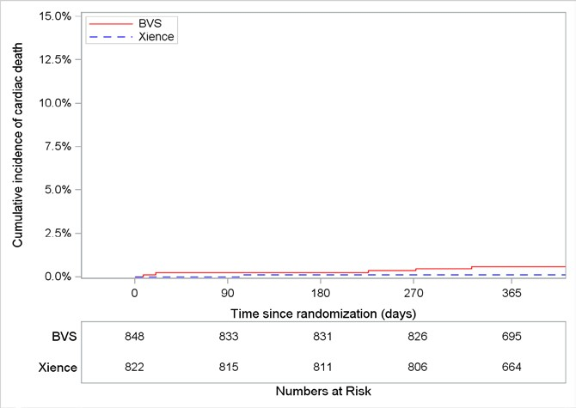
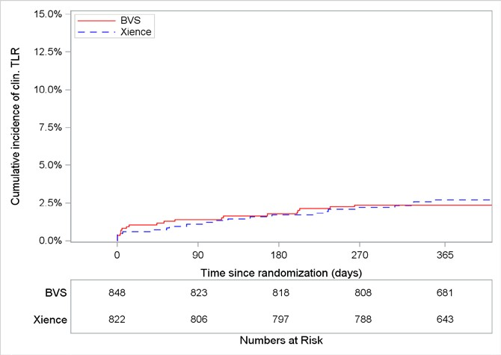
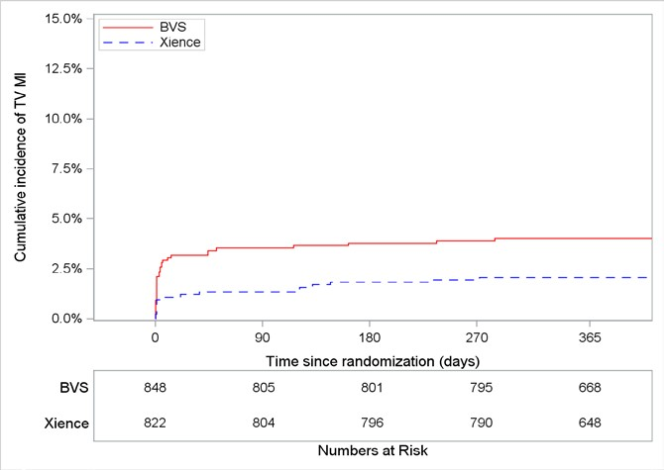
Components of TLF
Cardiac death
Clinically indicated target vessel revascularization
HR 4.87 (0.57 - 41.70)
^{P}logrank ^{= 0.11}
HR 0.89 (0.48 - 1.62)
^{P}logrank ^{= 0.69}
0.6%
0.1%
2.7%
2.4%
Target vessel myocardial infarction
HR 1.96 (1.10 - 3.51)
^{P}logrank ^{= 0.02}
4.0%
MI definition:
SCAI (peri-procedural)
TUD (spontaneous)
2.1%

Slide 15
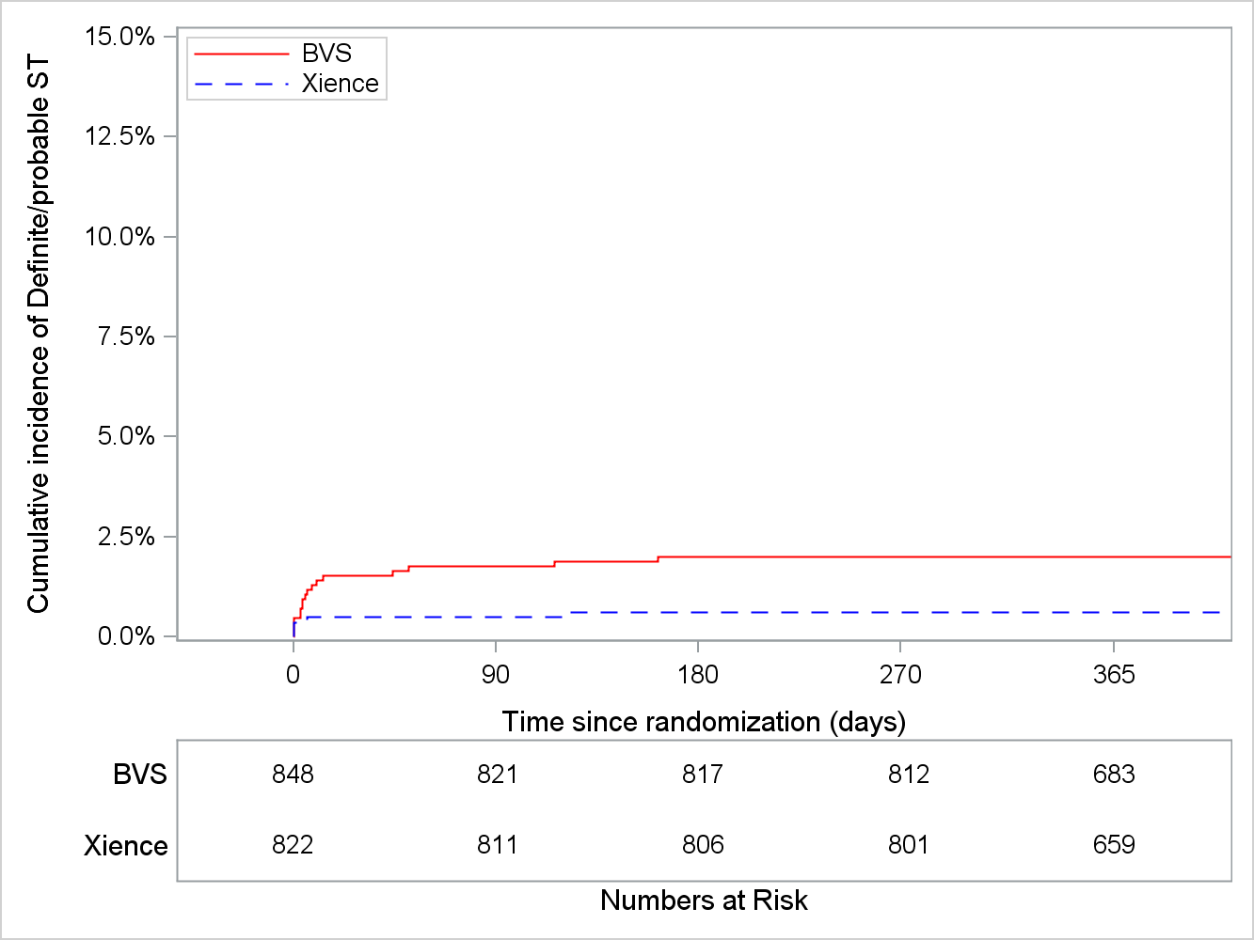
Stent/Scaffold Thrombosis @ 1 year
Definite and Probable Stent/Scaffold Thrombosis (ARC definition)
HR 3.32 (1.22 - 8.99)
^{P}logrank^{=0.01}
2.0%
0.6%

Slide 16
Scaffold thrombosis
9 / 16 (56%) of the definite Scaffold Thrombosis occurred in RVD of ≦ 2.75 by QCA
13 /17 (76%) def/prob scaffold thrombosis occurred within 10 days post procedure
Only in 1 case a relationship with DAPT cessation was observed

Slide 17
Conclusions
In a high risk population for restenosis the primary endpoint of non-inferiority between Absorb and Xience for target lesion failure at 1 year was met
The target lesion failure rate in this high risk population was for both devices impressively good, potentially due to the applied implantation protocol

Slide 18
Conclusions
Although non-inferiority was met, scaffold thrombosis and myocardial infarction rate for Absorb was significantly higher compared to Xience, despite applied PSP protocol
COMPARE-ABSORB will have a 7 year follow-up to investigate the potential benefit of Absorb in a high risk population

