Slide 1
The Randomized Exploratory Study of Exercise Training in Hypertrophic Cardiomyopathy
RESET-HCM
Sara Saberi, MD, MS

Slide 2
Background: Current exercise guidelines are controversial
No data to inform recreational exercise recommendations
US and European guidelines do not agree on safety of moderate intensity exercise^{1,2}
Concern: Does exercise trigger ventricular arrhythmias?
In clinical practice, patients with HCM are often discouraged from participating in physical activity
Patients with HCM are less active than the general U.S. population³
60% believe exercise restrictions negatively impact emotional well-being
Maron BJ et al. Circulation. 2004;109:2807-16.
Pelliccia A. et al. Eur J Cardiovasc Prev Rehabil. 2006;13:876-885.
Reineck E. et all. Am J Cardiol. 213;111:1034-39

Slide 3
Objective
In patients with HCM, can moderate-intensity aerobic training improve exercise capacity without causing harm?

Slide 4
Methods: Design, Setting and Participants
Randomized clinical trial
April 2010 – October 2015
728 Individuals screened for
eligibility
592 Excluded
386 Declined to participate
206 Did not meet inclusion/
exclusion criteria
136 Randomized
69 Assigned to usual activity
group
67 Assigned to exercise training
group
10 Lost to follow up
3 Discontinued intervention
7 Lost to follow up
3 Discontinued intervention
56 Completed the study
57 Completed the study
Notes:
54% of those that did not meet inclusion/exclusion criteria had recent septal reduction procedure/ICD or low EF.
There was no difference in the attrition rate between groups.

Slide 5
Methods: Inclusion/Exclusion Criteria
Inclusions
HCM: presence of unexplained LVH ≥ 15 mm in any wall segment
18-80 years old
Exclusions
H/o exercise-associated ventricular arrhythmias/syncope
Recent (< 3 mo) or planned septal reduction procedure or ICD implantation
Hypotensive BP response (> 20 mm Hg drop in SBP) on prior exercise testing
EF < 55%
NYHA class IV
Unwilling to refrain from competitive sports

Slide 6
Methods: Intervention
Study Enrollment & Randomization
Randomized 1:1 to 16 weeks of moderate intensity exercise training or usual activity
Stratified by age, sex, and presence of LVOT obstruction at rest
Initial Testing Day
CPET, Echo, CMR, 24-hour Holter, QOL
Exercise physiology consultation for Exercise Training group
16 Weeks Home-Based Exercise Training vs Usual Activity
Arrhythmia detection monitor for 1st month
Daily activity log
Weekly phone follow-up
End of Study Visit & Testing Day
CPET, Echo, CMR, 24-hour Holter, QOL
Exercise physiology consultation for Usual Activity group

Slide 7
Methods: Design, Setting and Participants
Usual Activity: No exercise guidance
Exercise Training:
Structured, home-based exercise program individually prescribed based on heart rate reserve derived from baseline CPET
Recommended modes: walking, jogging, cycling, elliptical
Week 1
3 sessions
20 min/session
60% heart rate reserve
Borg 11-14
Weeks 2-4
4-7 sessions/week
25-60 min/session
70% heart rate reserve
Borg 11-14
Weeks 5-16
Maintain exercise regimen

Slide 8
Methods: Outcomes
Primary outcome measure:
Change in peak VO2 from baseline to 16 weeks
Secondary outcomes:
Left ventricular hypertrophy and function
Scar volume on CMR
BNP
Degree of LVOT obstruction
Quality of life measures (SF-36v2, QIDS-SR₁₆, MLHF)

Slide 9
Results: Demographic and Clinical Characteristics at Baseline
All but 1 of the patients who completed the study protocol underwent genetic testing.
Groups were similar in baseline characteristics.
Variable | Usual Activity (n=69) | Exercise (n=67)
Age, mean (SD), y | 50.0 (13.5) | 50.5 (13.2)
Female, No. (%) | 28 (40.6) | 29 (43.3)
Peak VO2, mean (SD), mL/kg/min | 22.5 (7.2) | 21.3 (6.3)
Maximal wall thickness, mean (SD), mm | 21 (6) | 21 (5)
No Testing
Pathogenic
VUS

Slide 10
Results: Demographic and Clinical Characteristics at Baseline
Notes:
Clinical characteristics at baseline were similar between the two study groups. Of particular note, these groups would NOT be considered low risk based on the presence of LVOTO in ~17%, prior septal reduction in 26%, prior ICD implantation in 34%, and prior history of VT/VF/aborted sudden death in ~4%, and atrial fibrillation in 16%. 1/3 of patients reported NYHA Class II-III symptoms.

Slide 11
Results: Intervention Participation
Prior to enrollment
41% of Usual-Activity Group reported no habitual exercise
28% of non-exercisers in Usual-Activity Group exercised regularly
Study Protocol
Most Common Modes of Exercise
Walking
Cycling
Jogging/Running
Elliptical
Aerobics
Stair Climbing
45% of Exercise Training Group reported no habitual exercise
93% of non-exercisers in Exercise Training Group exercised regularly
Study Protocol

Slide 12
Results: Intervention Participation
+ 1.5
+ 106
+ 9.4
P < 0.001
P < 0.001
P < 0.001
Notes:
Physical activity data was tabulated into metabolic equivalents using the 2011 Compendium of Physical Activities. MET-hours of activity were calculated by multiplying METs of each activity by time spent in hours.

Slide 13
Primary Endpoint Peak VO2 is Improved by Exercise Training in HCM
Adjusting for baseline peak VO2, genetic status and study site did not attenuate the difference in peak VO2.
Sensitivity analysis using multiple imputation including all 136 participants did not attenuate the effect.
Between Group Difference in Mean Change 1.27 mL/kg/min, P = 0.02
(95% CI, 0.17 – 2.37)
Absolute increase in peak VO2 of 6%

Slide 14
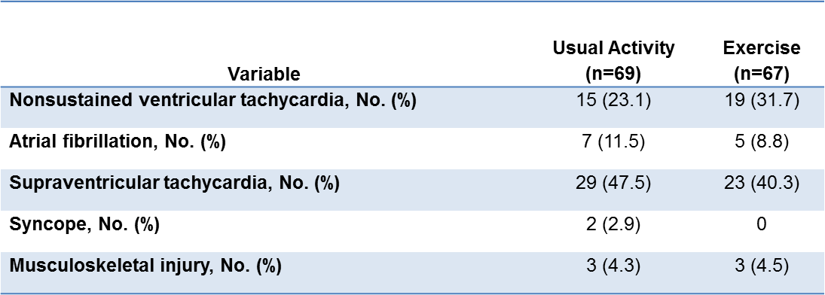
Results: Adverse Events
No major adverse events in either group.
(death, aborted sudden cardiac death, appropriate ICD therapies, or sustained ventricular tachycardia)
Minor Adverse Events:

Slide 15
Results: Secondary Outcomes
No significant changes in left ventricular hypertrophy or function, scar volume or BNP.
Significant improvement in the Physical Functioning scale of SF-36v2 (between group difference 8.2, [95% CI 2.6 to 13.7]; P = 0.004).

Slide 16
Limitations
Study was subject to potential sampling bias
Effect size of exercise training was relatively modest
No major adverse events and no signal for harm, but study not powered to assess safety
Not possible to blind patients to treatment assignment
Exercise prescription only incorporated moderate-intensity aerobic exercise in adult patients. This study does not address higher intensity recreational exercise or competitive sports participation.
Notes:
1. Clinical characteristics of study participants similar to those of patients cared for at our institutions and published series

Slide 17
Conclusions
Moderate-intensity exercise compared with usual activity resulted in a significant increase in exercise capacity at 16 weeks – absolute increase in peak VO2 of 6%.
No major adverse events.
No difference between groups in nonfatal arrhythmias or cardiac remodeling.
Improvements in QOL in the exercise group.

Slide 18
Implications and Future Directions
No clinical trial has previously implemented an exercise intervention in patients with HCM.
Trial supports moderate-intensity exercise as an intervention for improving exercise capacity in patients with HCM.
HF-ACTION⁴: exercise intervention absolute increase in peak VO2 of 0.6 mL/kg/min, or 4%.
HF-ACTION⁵: every 6% increase in peak VO2 8% lower risk for CV mortality or HF hospitalizations
Future studies to address more vigorous aerobic exercise, isometric activities, and participation in competitive sports in both adult and pediatric patients with HCM
Future studies with longer follow-up to assess the clinical importance of these findings and any potential influence of exercise on disease progression
4. O’Connor CM et al. JAMA. 2009;301:1439-50.
5. Swank AM et al. Circ Heart Fail. 2012;5:579-85.

Slide 19
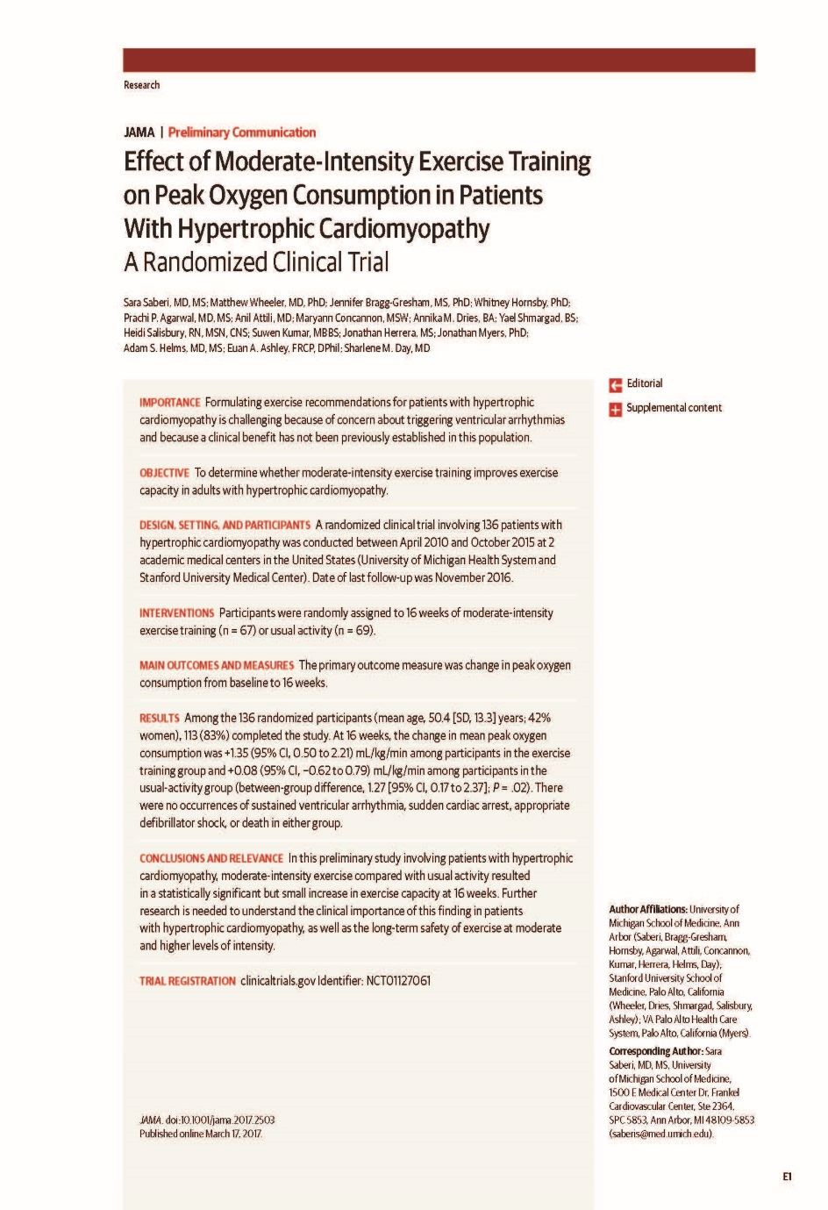
S Saberi et al.
Effect of Moderate-Intensity Exercise Training on Peak Oxygen Consumption in Patients With Hypertrophic Cardiomyopathy: A Randomized Clinical Trial
Published online March 17, 2017

Slide 20
Acknowledgements
Inherited Cardiomyopathy Program at University of Michigan
Sharlene M. Day, MD
Adam S. Helms, MD, MS
Maryann Concannon, MSW
Linda C. Baty, MSN, RN, NP-C
Stanford Center for Inherited Cardiovascular Disease
Euan A. Ashley, FRCP, Dphil
Matthew Wheeler, MD, PhD
Heidi Salisbury, RN, MSN
Annika M. Dries, BA
Yael Shmargad, BS
University of Michigan School of Medicine
Jennifer Bragg-Gresham, MS, PhD
Whitney Hornsby, PhD
Prachi P. Agarwal, MD, MS
Anil Attili, MD
Suwen Kumar, MBBS
Jonathan Herrera, MS
Brice Rolston, MD, MBA
VA Palo Alto Health Care System
Jonathan Myers PhD
Scott Baty
Wendi Schumacher
Matthew Kolevar, BSE
Sonya Clark
Jacob Sitzman, BS, RCEP, CCES
Kara Eggerbrecht, BS, CEP
Jennifer Richichi, BS, CEP

