Slide 1
Cybersecurity: FDA Approach
Matthew Hazelett
CRT 2019 - FDA Luncheon Symposium:
Healthcare Reform and its Impact on Innovation
Notes:
Good Afternoon,
I’m Matthew Hazelett, I’m a reviewer in the Division of Cardiovascular Devices at the FDA and am going to talk with you today about FDA’s approach to Cybersecurity for Medical Devices.

Slide 2
Disclosures
I have no disclosures to report
Notes:
I have no disclosures to report

Slide 3
Medical Device Cybersecurity
Connected medical devices, like all other computer systems, incorporate software that are vulnerable to threats
We are aware of cybersecurity vulnerabilities and incidents that could directly impact medical devices or hospital network operations
When medical device vulnerabilities are not addressed and remediated, they can be exploited which can result in patient harm as well as serve as access points for entry into hospital/health care facility networks
May lead to compromise of data confidentiality, integrity, and availability
Notes:
The health care and public health critical infrastructure sector represents a significantly large attack surface for national security today.
Devices have capitalized on technological advances to become increasingly interconnected. With these connections, the hardware and software that enables them are vulnerable to cybersecurity threats. This technology is just like that used in any other computer system, like your smart phone.
Over the past several years, we have all become aware of cybersecurity vulnerabilities and incidents that could directly impact medical devices or hospital network operations.
When vulnerabilities are not addressed and remediated, they can be exploited, which can result in patient harm and serve as access points for entry into hospital and health care facility networks. One of the most notable exploits was the WannaCry ransomware attack which was enabled by unpatched Windows operating systems.
Breaches into devices can compromise device and data confidentiality, integrity, and availability. These breaches can result in release of patient health information, changing device settings or information, and denial of service attacks.

Slide 4
Shared Responsibility
Manufacturer
NCCIC
Researchers
FDA
Health Care
Facilities
Clinicians
Patients
Professional Societies
ISAOs
Notes:
The responsibility of cybersecurity does not rest on any single entity. While the core design and maintenance is primarily the responsibility of the device manufacturer and their suppliers, cybersecurity is a shared responsibility between all the stakeholders who review and interact with devices.
This includes Patients and Clinicians who are responsible for updating their devices to ensure they have the most recent security patches.
Health care facilities work to secure their networks and assess the impact of the devices they purchase on their overall network security.
Information Sharing and Analysis Organizations, or ISAOs, work to share information between manufacturers and stakeholders.
And the National Cybersecurity and Communications Integration Center (or NCCIC), which is the segment of the Department of Homeland Security serves to evaluate cybersecurity vulnerabilities and facilitates information sharing between security researchers and manufacturers.

Slide 5
FDA Approach to Cybersecurity
Premarket Guidance
Content of Premarket Submissions for Management of Cybersecurity in Medical Devices
Postmarket Guidance
Postmarket Management of
Cybersecurity in Medical Devices
Total Product Lifecycle Evaluation
Apply postmarket experience and learnings to premarket review of devices
Notes:
How has FDA approached the growing cybersecurity risks?
FDA has developed and released two final Guidance Documents regarding medical device cybersecurity. The premarket guidance was finalized in 2014 and the postmarket guidance was finalized in 2016. They serve to describe FDA’s current expectations for security in medical devices and fit into the Center’s Total Product Lifecycle Evaluation of devices where the postmarket experience and learnings are increasingly being used to inform premarket reviews.

Slide 6
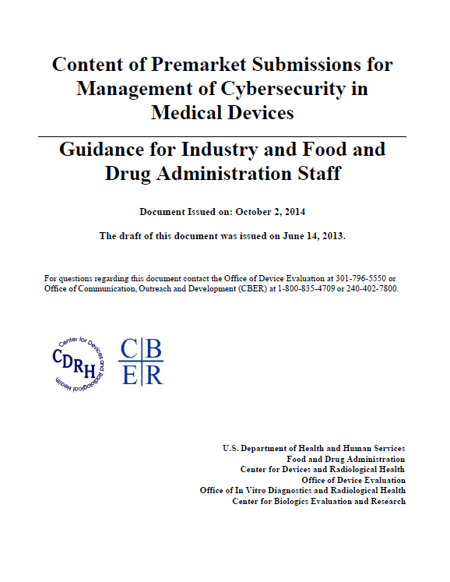
FDA Premarket Guidance: 2014
Shared responsibility between stakeholders
Address cybersecurity during the design and development of the medical device
Establish design inputs for device related to cybersecurity
Establish a cybersecurity vulnerability and management approach
Content of Premarket Submissions for Management of Cybersecurity in Medical Devices, Guidance for Industry and Food and Drug Administration Staff (Oct. 2, 2014), available at https://www.fda.gov/downloads/medicaldevices/deviceregulationandguidance/guidancedocuments/ucm356190.pdf.
Notes:
In the premarket guidance, the FDA emphasized the shared responsibility between stakeholders, as I mentioned earlier.
It describes how addressing cybersecurity during the design and development of the medical device could result in more robust and efficient mitigation of patient risks.
It also recommends that manufacturers establish design inputs for devices related to cybersecurity around the five core principles from the National Institute of Standards and Technology, or NIST, voluntary Cybersecurity Framework . These principles are to:
Identify,
Protect,
Detect,
Respond to,
and Recover from
cybersecurity vulnerabilities.
And it stresses the importance of a cybersecurity vulnerability and management approach to ensure that potential cybersecurity risks are being monitored and addressed.

Slide 7
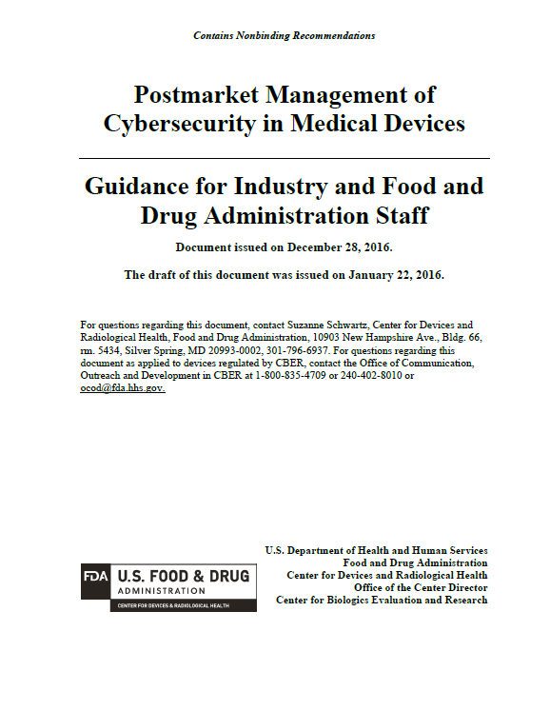
FDA Postmarket Guidance: 2016
Use a risk-based framework to assure risks to public health are addressed in a continual and timely fashion
Articulate manufacturer responsibilities
Foster a collaborative and coordinated approach to information sharing and risk assessment
Incentivize the “right” behavior
Postmarket Management of Cybersecurity in Medical Devices, Guidance for Industry and Food and Drug Administration Staff (Dec. 28, 2016), available at
https://www.fda.gov/downloads/medicaldevices/deviceregulationandguidance/guidancedocuments/ucm482022.pdf.
Notes:
The Postmarket Guidance expanded upon the premarket guidance to detail expectations primarily pertaining to considerations after initial device release.
In the guidance, we recommend a risk-based framework is used to assure risks to public health are addressed in a continual and timely fashion
It articulates manufacturer responsibilities for cybersecurity within the context of the Quality System Regulations
It stresses the need to foster a collaborative and coordinated approach to information sharing and risk assessment
And it aims to incentivize the “right” behavior by describing how some cybersecurity changes can be implemented and deployed without requiring FDA premarket review and approval.

Slide 8
Cybersecurity Risk Assessment
What can the device do versus what it was designed to do?
Assessment of impact of cybersecurity risk on safety and essential performance of the medical device based on:
Severity of Patient Harm (if the vulnerability were to be exploited)
Exploitability
Notes:
If there was one key takeaway that I hope you get from this session, it would be that one of the core differences between the assessment of cybersecurity risks and standard device risks, like component failures, is that assessing cybersecurity risks requires taking into account an active adversary or attacker with either malicious intent or a lack of understanding of the potential consequences of an exploit. It requires an assessment of what can the device do, or more specifically, what can the device be made to do, instead of assessing what the device was designed to do.
Standard device risks are the ones that you are used to discussing everyday with patients and can be assessed based on the likelihood of the failure to occur and the resultant severity of the harm if it were to occur. They are often predictable either in their time to failure and/or their rate of occurrence.
While FDA recommends that cybersecurity risks and vulnerabilities also be assessed based on the Severity of patient harm, FDA recommends that instead of assessing the likelihood of a cybersecurity risk being exploited, that manufacturers assess the exploitability of the cybersecurity risk.

Slide 9
Cybersecurity Risk Assessment
What can the device do versus what it was designed to do?
Assessment of impact of cybersecurity risk on safety and essential performance of the medical device based on:
Severity of Patient Harm (if the vulnerability were to be exploited)
Exploitability
Likelihood
Notes:
Assessing the exploitability of a cybersecurity risk or vulnerability can take into account factors like:
Whether it can be exploited remotely or requires physical access,
The complexity of exploitation,
The Level of User Interaction
The Exploit code maturity, and
Whether compensating controls are available.
A likelihood assessment can lead to a false sense of security where these factors are masked by an underlying assumption that “no one is going to do this”. FDA recognizes that no device will be 100% secure, but we are looking to ensure devices are secure today and securable for the future.

Slide 10
Impact of FDA’s Approach
Premarket
Presubmissions prior to submission
Submissions to enhance security or address vulnerabilities in fielded devices
Deficiencies in submissions
Postmarket
FDA Safety Communications for vulnerabilities and corrections
Recalls to address vulnerabilities
Coordinated Disclosure Policies and ISAO participation
Warning Letter citing cybersecurity concerns
Notes:
Since the implementation of the cybersecurity guidance documents, FDA has seen several improvements in how cybersecurity is being addressed for medical devices.
For example, during premarket reviews:
We have seen an increase in early engagement with FDA on cybersecurity designs and approaches through the presubmission process,
We have seen more submissions to enhance the security of fielded devices or to patch vulnerabilities identified after market release, and
FDA has been increasingly identifying a lack of/or insufficient cybersecurity documentation or mitigations and has been issuing deficiencies to manufacturers
In the postmarket space:
FDA has issued several Safety Communications for identified vulnerabilities and corrections,
Manufacturers have submitted voluntary recalls to address vulnerabilities identified in their products,
Manufacturers are adopting listening systems for researchers, adopting coordinated disclosure policies, and participating in ISAOs, and
FDA has included cybersecurity in manufacturer inspections and it has been cited in a warning letter.

Slide 11
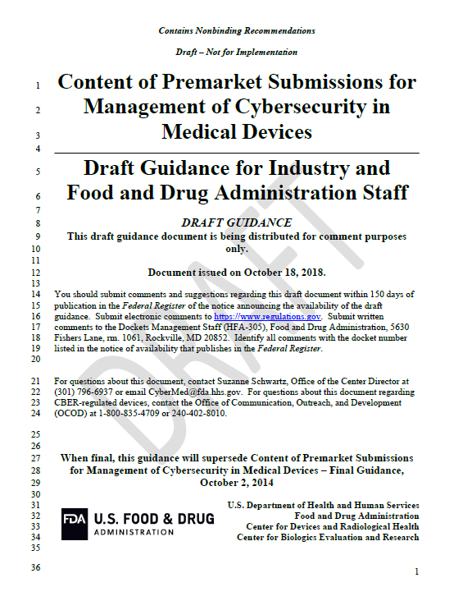
Premarket Guidance: Draft 2018
Draft Premarket Guidance Revision (2018)
Risk-Based Structure
More detailed expectations
Designs
Documentation
Labeling
Cybersecurity Bill of Materials
Content of Premarket Submissions for Management of Cybersecurity in Medical Devices (Oct. 18, 2018), available at https://www.fda.gov/downloads/MedicalDevices/DeviceRegulationandGuidance/GuidanceDocuments/UCM623529.pdf
Notes:
Despite the progress being made over the past several years and the continued evolution of cybersecurity as a review focus at FDA, we recognized that revising the premarket guidance could further improve medical device cybersecurity. The changes were informed by our initial experience with the 2014 Premarket Guidance as well as our learnings from the cybersecurity exploits and vulnerabilities identified since its release.
In the draft revision, FDA proposes a risk-based structure for cybersecurity design controls and reviews.
The draft also provides more detailed expectations for design controls, documentation, and labeling. These recommendations remain aligned with the NIST Cybersecurity Framework and the quality system regulations.
It also defines a cybersecurity bill of materials, or CBOM, to detail all commercial, open source, and off the shelf hardware and software contained in the device.

Slide 12
Future Advances
Routine Update Schedules
Increased collaboration between stakeholders
Increased adoption of Security-by-design into development
Increased reliability during update processes
Improved authentication schemes
Detection mechanisms for breaches
Increased response and rapid mitigation capabilities
Increased innovation
Increased awareness, education, and communication
Notes:
While I won’t address all of the items up here, with the adoption of the practices and principles detailed in the guidance documents, FDA believes that in the near future:
Medical device updates are going to become, more and more, a part of the clinical and user routine and will be performed closer to the frequency we have become accustomed to with smartphone or computer program updates,
collaboration between all stakeholders will continue to increase,
and finally that awareness, education, and communication surrounding cybersecurity will continue to grow in the clinical and patient communities.

Slide 13
Matthew Hazelett
Matthew.Hazelett@fda.hhs.gov
Notes:
And with that, thank you for your time.

