Slide 1



The Minimizing Adverse
Haemorrhagic Events By Transradial Access Site And Systemic Implementation of Angiox-MATRIX
Final 1-Year Results
M. Valgimigli, MD, PhD
Swiss Cardiovascular Center Bern,
Inselspital, Bern, Switzerland
on behalf of the MATRIX Group
NCT01433627

Slide 2
Declaration of Interest
I, Marco Valgimigli,
Served as a speaker, or advisor or consultant for:
The Medicines Company and Terumo

Slide 3




Background
MATRIX −the largest RCT comparing TRA vs TFA in ACS− reported a 30-day net adverse clinical events (NACE) benefit, driven by mortality and bleeding,
in favor of the radial approach
It is unknown whether the short-term benefits of radial access are maintained at longer-term follow-up
Multiple studies reported on longer-term comparative effectiveness of bivalirudin vs UFH±GPI, but results remain controversial and in none of them access site was randomly allocated
No study has so far randomized pts receiving bivalirudin to continue or stop the Tx after PCI

Slide 4







MATRIX Program
NCT01433627
NSTEACS or STEMI with invasive management
Aspirin+P2Y12 blocker
1:1
Trans-Radial Access |  | ACCESS | Trans-Femoral Access
1:1
Bivalirudin
Mono-Tx
Heparin
±GPI
ANTITHROMBIN TYPE
1:1
Stop Infusion
Prolong≥ 4 hs infusion
TREATMENT DURATION
30-day results avaialble at Lancet. 2015; 385(9986):2465-76 and N Engl J Med 2015; 373: 997–1009

Slide 5



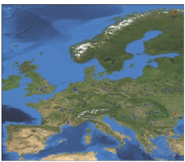











Study Organization and Sites
Sponsor
Italian Society of Interventional Cardiology
Grant suppliers: The Medicines Company and Terumo Principal Investigator: Marco Valgimigli, MD, PhD Study Director: Maria Salomone. MD, PhD
78 Sites across 4 EU countries recruited patients
National Coordinating Investigators and CROs
Paolo Calabrò, MD, PhD, Italy; Trial Form Support
Arnoud W J van‘t Hof, MD, The Netherlands; Trial Form Support Manel Sabate’, MD, PhD, Spain; FLS-Research Support
Elmir Omerovic, MD, PhD, Sweden; Gothia Forum
Clinical Event Committee
Statistical Committee (CTU)
Data Mng
P. Vranckx, Chair
S. Leonardi Co-Chair
P. Tricoci
P.Jüni, MD, Chair
M. Rothenbühler Dik Heg
E. Frigoli, Project Leader

Slide 6

Endpoints
Co-primary outcomes at 30 days for MATRIX Access and MATRIX Antithrombin were:
MACE: composite of death, MI and stroke
NACE: composite of death, MI, stroke and major bleeding (BARC 3 or 5)
The primary outcome at 30 days for MATRIX Treatment Duration was composite of urgent target vessel revascularisation, definite stent thrombosis, or net adverse clinical events ( NACE +)
Secondary outcomes included all primary EPs within 1 year and each component of the composite outcomes

Slide 7




Patient disposition, baseline characteristics and drug adherence
8,404 pts included in the
Access program
96% recieved the allocated Tx
8391
(99.8%)
Complete 1 year data
7,204
(99.9%)
Complete 1 year data
7,213 pts included in the Antithrombin Type Program 96% recieved the allocated Tx
3,606
(99.9%)
Complete 1 year data
3,610 pts included in the Treatment duration Program 95% recieved the allocated Tx
Baseline characteristics were well matched
Adherence to secondary prevention medications was similarly high

Slide 8
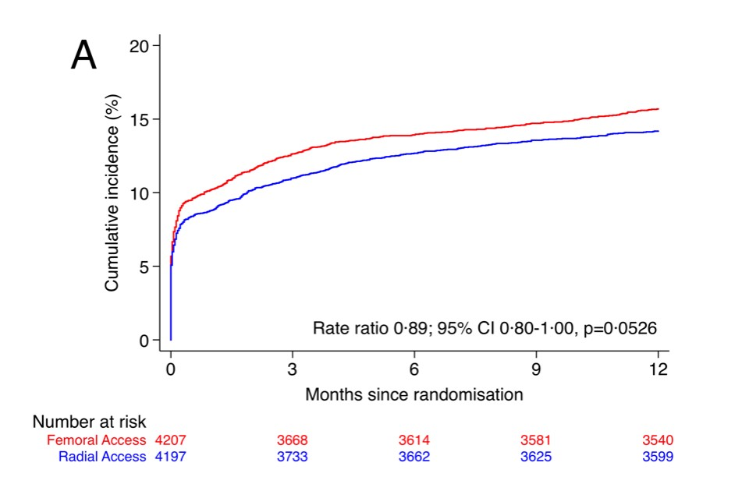
ACCESS
1-Year Major Adverse CV events
Femoral Radial
15.7%
14.2%

Slide 9
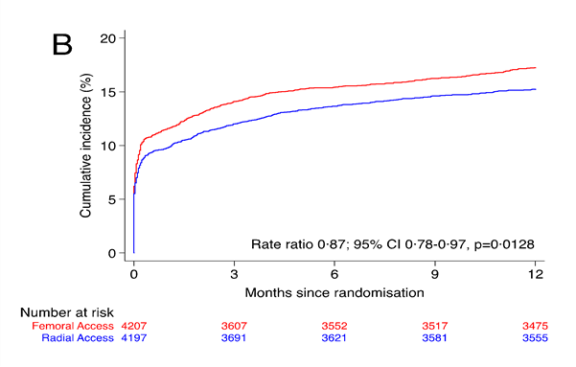
ACCESS
1-Year Net Adverse Clinical Events
Femoral Radial
17.2%
15.2%
NNTB: 50

Slide 10
1 Year NACE Components
ACCESS
(CV) Death, MI, Stroke and BARC 3 or 5
% Radial Femoral
14 P=0.99
11.6
12
10.7
10
0.84
0.68–1.04
P=0.11
4.4
0.71
0.54–0.93
P=0.013
0.92
1.00
0.57–1.74
P=0.99
0.71
0.54–0.93
P=0.014
8
0.71–1.05
P=0.21
6
4
3.7
3.3
3
2.2
2.2
2
0.6 0.6
0
Death
CV Death
MI
Stroke
BARC 3 or 5

Slide 11
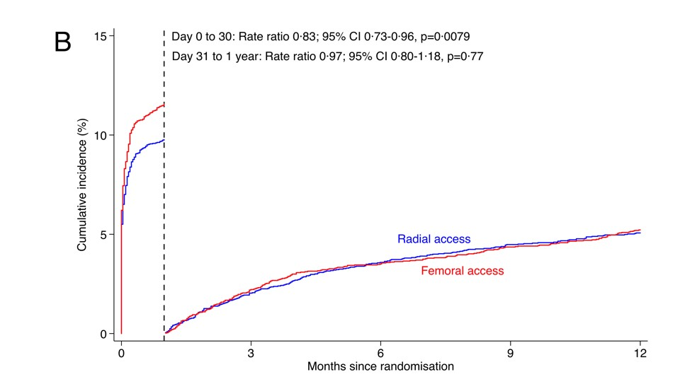
1-Year Net Adverse Clinical Events
Period Analysis
ACCESS
Femoral Radial
17.2%
15.2%
NNTB: 50

Slide 12
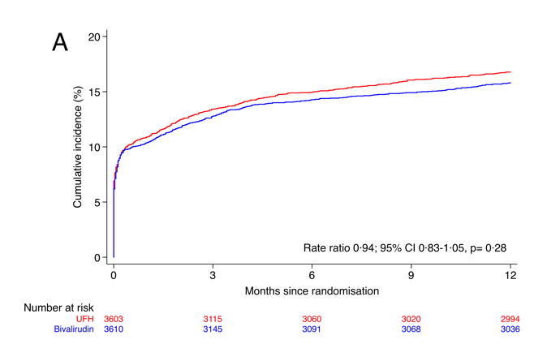
ANTITHROMBIN
1-Year Major Adverse CV Events
UFH
Bivalirudin
16.8%
15.8%

Slide 13
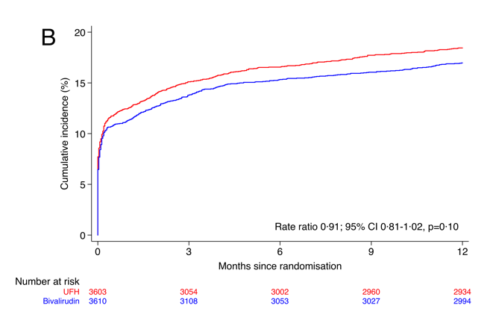
ANTITHROMBIN
1-Year Net Adverse Clinical events
UFH
Bivalirudin
18.4%
17.0%

Slide 14
1 Year NACE Components
ANTITHROMBIN
(CV) Death, MI, Stroke and BARC 3 or 5
% Bivalirudin
14 P=0.99
UFH
12.6
12.4
12
10
0.79
0.63–0.99
P=0.042
4.6
0.74
0.55–0.99
P=0.043
0.98
0.79
0.44–1.43
P=0.44
0.68
0.51–0.91
P=0.008
8
0.86–1.12
P=0.77
6
4
3.6
3
2.9
2.1
2.1
2
0.6
0.7
0
Death
CV Death
MI
Stroke
BARC 3 or 5

Slide 15
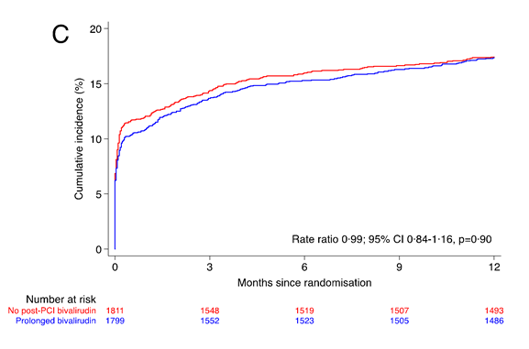
TREATMENT DURATION
1-Year Net Adverse Clinical Events +
Urgent TVR, definite ST, or Net adverse clinical events
No post-PCI bivalirudin Post-PCI bivalirudin
17.4%

Slide 16

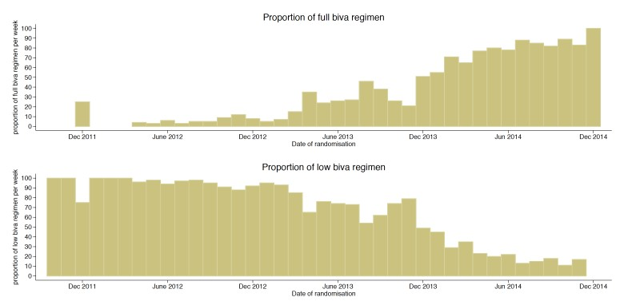


Post-PCI Bivalirudin Rx
Regimens and temporal distribution
Bivalirudin could be administered at*:
the full PCI dose (1.75mg/kg/h) for up to 4 hours
or
the reduced dose of 0.25 mg/Kg/h for at least 6 hours
*: with the choice between those two regimens made at the discretion of the treating physicians
Full PCI regimen
34%
Infusion duration: 264’
Reduced regimen
59%
Infusion duration: 433’
N=119 (6.6%) received no post-PCI bivalirudin in the post-PCI bivalirudin arm

Slide 17
Exploratory Analysis*
TREATMENT DURATION
Efficacy endpoints according to bivalirudin regimen
0.25 Post-PCI Biv
1.75 Post-PCI Biv no Post-PCI Biv
20.3
%
14.7
19.8
20
18.6
17.4
17
15.6
15.7
15
11.8
12.1
11.9
11.3
10
8.5
5
2.4 2.2
1.3
2.1
_{0.2}0.8
0
MACE NACE NACE + CV Death
MI
Definite ST
* The choice of post-PCI bivalirudin regimen was at discretion of the investigator

Slide 18


MATRIX@1 year: Summary
The radial access reduced the 1 year NACE rates, owing to a durable effect on CV death and bleed
The use of bivalirudin did not reduce MACE or NACE rates although its effects on mortality and bleeding persisted at 1 year as compared to UFH±GPI
Post-PCI bivalirudin infusion did not reduce 1 year NACE+ rates compared to no post-PCI bival. However, the post-PCI low regimen was associated to higher and the full dose to lower ischemic risks at exploratory analysis.

