Slide 1

The Current Situation of Mitral Valve Devices in Japan
Shin Iwamoto, PhD
Pharmaceuticals and Medical Devices Agency（PMDA)

Slide 2

Shin Iwamoto, PhD
I have no relevant financial relationships

Slide 3
Agenda
This presentation is based on the review report of MitraClip system by PMDA. Please check the link.
http://www.pmda.go.jp/medical_devices/2017/M20171128001/340733000_22900BZX00358000_A100_1.pdf
Classification and Treatment of Chronic Mitral Regurgitation(MR)
Review Process of MitraClip in Japan
  Efficacy and Safety in the Pivotal Study
  Efficacy and Safety in the Japan Study
  Benefit-Risk Balance Conclusion
  Indication for Use in Japan

Slide 4
Classification and Treatment of
Chronic Mitral Regurgitation(MR)
 | Degenerative MR | Functional MR
Definition | The pathology of ≥1 of the components of the valve causes valve incompetence with systolic regurgitation of blood from the left ventricle (LV) to the LA. | The mitral valve leaflets and chords usually are normal Instead, MR is associated with severe LV dysfunction due to coronary artery disease or idiopathic myocardial disease.
Recommendations for severe MR | Mitral valve surgery is recommended. | ・In principle, treatment for underlying disease is recommended. ・Mitral valve surgery is considered
Severe MR
Prohibitive risk patient
Mitral valve surgery or
Valve replacement
Target patients
for MitraClip
No option

Slide 5
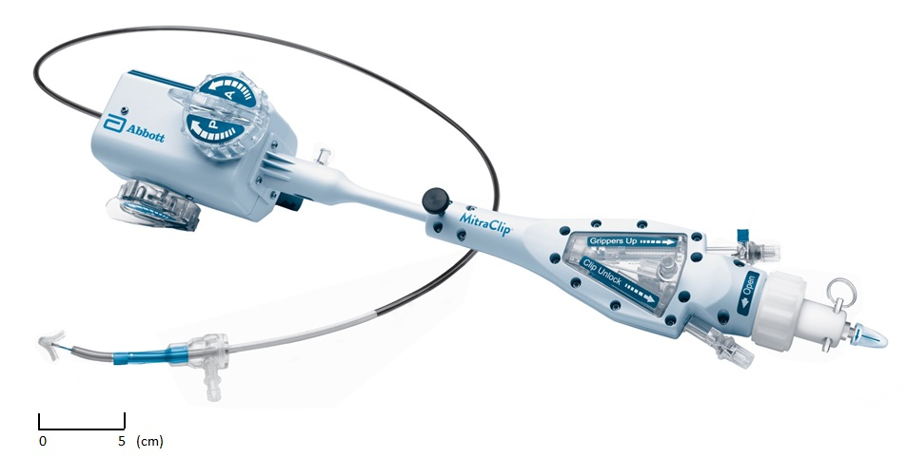
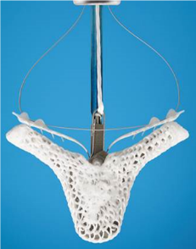
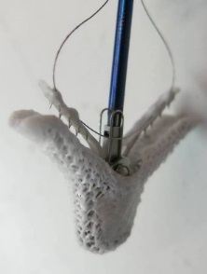
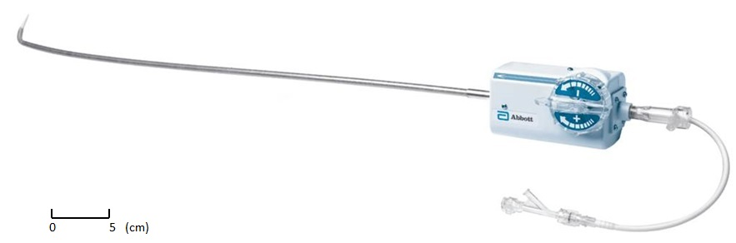
Overview of MitraClip Clip Delivery System
Clip Delivery System
<Date of Approval>
 | Approval Date
EU | December, 2015 (Previous gen. 2008)
US | May, 2016 (Previous gen. 2013)
JP | October, 2017
Steerable Sleeve Handle

Slide 6
MitraClip IFU in US and JP
US | Japan
The device is indicated for the percutaneous reduction of significant symptomatic mitral regurgitation (MR ≥ 3+) due to primary abnormality of the mitral apparatus [degenerative MR] in patients who have been determined to be at prohibitive risk for mitral valve surgery by a heart team, which includes a cardiac surgeon experienced in mitral valve surgery and a cardiologist experienced in mitral valve disease, and in whom existing comorbidities would not preclude the expected benefit from reduction of the mitral regurgitation. | The device is indicated for the percutaneous reduction of significant symptomatic mitral regurgitation (MR ≥ 3+) in patients with LVEF greater than 30%, who have been determined to be at prohibitive risk for mitral valve surgery. (except for blows) FMR patients without best medical therapy according to the Japanese guideline Acute-on-chronic MR Catecholamine dependent Mechanical circulatory assist device dependent
IFU | US | JP
DMR | ○ | ○
FMR | － | ○

Slide 7
Overview of Clinical Data for Patients
with Prohibitive Risk for Valve Surgery
 | Integrated High Risk Cohort^{*1} (EVEREST II HRR and Realism HR trial) |  | Japan Study
Design | Single arm
Target patients | Patients with significant symptomatic mitral regurgitation (MR ≥ 3+) of either FMR or DMR etiology that were determined to be too high risk for surgery.
Patients number | 351 pts (including E II HRR 78pts and Realism HR primary 273pts^{*1}) | 30pts
Age, Mean +SD | 75.7±10.5 | 80.4±7.0
Sites | 41 sites in US and Canada | 6 sites in Japan
*1: EVEREST II HRR and Realism HR trial were single-arm, self-controlled adjunctive studies to evaluate the safety and effectiveness of the MitraClip in high surgical risk patients.

Slide 8
Efficacy in the Integrated High Risk Cohort
<Procedural success: Implantation success and reduction to MR<2 >
Degenerative MR (DMR) | Functional MR(FMR)
79%(83/105) | 85.0%(209/246)
<Severity of mitral regurgitation>
The MitraClip reduced the MR severity in both degenerative MR and functional MR.
The device also has shown benefit at 12 months based on normal and conservative analysis which was handled patients who are dead or missing data as MR > 3 because total 126 pts of these patients, DMR 37pts and FMR 89pts, were found.
The rate of MR severity < 2+ | DMR(105pts) | FMR(246pts)
Baseline | 8.8% (9/102) | 15.7% (37/235)
Discharge | 80.8% (80/99) | 88.1% (199/226)
12-Monthª (Normal analysis) | 85.3% (58/68) | 82.8% (130/157)
12-Month (Conservative analysis) | 55.2% (58/105) -Dead case:25pts -Missing data:12pts | 52.8% (130/246) -Dead case:55pts -Missing data:34pts

Slide 9
Efficacy in the Integrated High Risk Cohort (2)
● NYHA Class and Heart failure hospitalizations
In both DMR and FMR patients,
clinical improvements post 12 months MitraClip treatment are show in NYHA class and the rate of hospitalization for heart failure.
Rate of NYHA < II | DMR (105pts) | FMR (246pts)
Baseline | 18.1% (19/105) | 13.8% (34/246)
12-month post MitraClip treatment | 87.3%(62/71) | 81.0%(132/163)
12-month post MitraClip treatment (conservative analysis) | 59.0% (62/105) | 53.7% (132/246)
Rate of hospitalization for heart failure (per patient-year) | DMR (105pts) | FMR (246pts)
12-month pre-enrollment → post-discharge through 12-month | 0.68 → 0.18 | 0.81 → 0.39

Slide 10
Safety in Integrated High Risk Cohort
Majority of major adverse events are death and transfusion > 2 units.
The major adverse event rate are almost the same between DMR and FMR group.
 | DMR (N = 105) |  | FMR (N = 246)
 | 30-Day | 12-Month | 30-Day | 12-Month
Death | 6.7% (7/105) | 23.8% (25/105) | 4.1% (10/246) | 22.4% (55/246)
Major adverse events ^{*1} | 18.1% (19/105) | 36.2% (38/105) | 19.1% (47/246) | 38.2% (94/246)
Major adverse events (excluding transfusion) | 8.6% (9/105) | 26.7% (28/105) | 9.3% (23/246) | 28.5% (70/246)
*1:MAE defined as combined clinical endpoint of death, myocardial infarction (MI), re-operation for failed surgical repair or replacement, non-elective cardiovascular surgery for adverse events, stroke, renal failure, deep wound infection, ventilation for greater than 48 hours, gastrointestinal (GI) complication requiring surgery, new onset of permanent atrial fibrillation, septicemia, and transfusion of 2 or more units of blood.

Slide 11
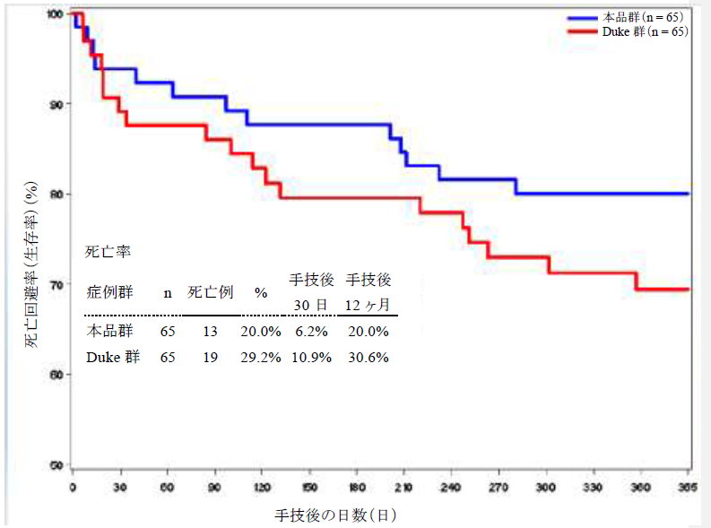
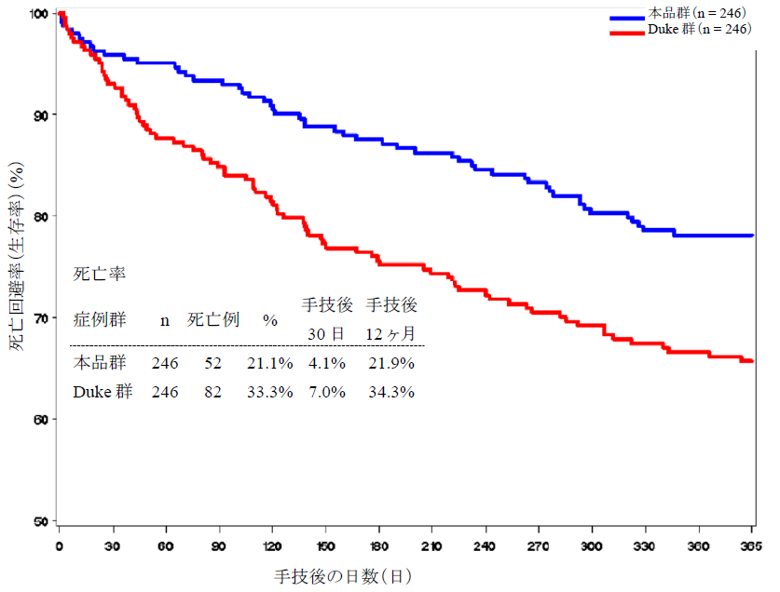
Propensity Score Matching Analysis for Mortality
There are not sufficient clinical data on long-term prognosis of MR patients with prohibitive risk for mitral valve surgery.
Therefore, propensity score matching analysis was performed to compare mortality between the integrated HR cohort and patients with medical treatment from Duke university database.
100
100
DMR
FMR
90
90
80
MitraClip
80
MitraClip
Survival (%)
Survival (%)
70
Medical care
(Duke uni. Database)
70
Medical care
(Duke uni. Database)
60
Cox hazards analysis^{*1}(Adjusted) | HR(95%CI) | P-value
N = 65 Best matched patients | 0.63 (0.25 - 1.61) | 0.3326
60
Cox hazards analysis^{*1}(Adjusted) | HR(95%CI) | P-value
N = 246 Best matched patients | 0.56 (0.38 - 0.82) | 0.0031
50
50
30
180
360
30
180
360
*1:Cox proportional hazards regression analysis
These analyses suggest
The MitraClip procedure dose not increase the risk of mortality in prohibitive risk MR patients.

Slide 12
The Results of Japan Study
Prospective, multi-center, single arm, 30 patients
Primary endpoint:
  Effectiveness: Acute procedural success
  Safety: Major adverse events at 30-days
 | All comers (30pts) | DMR (16pts) | FMR (14pts)
Acute procedural success^{*1} | 86.7% (26/30) | 81.3% (13/16) | 92.9% (13/14)
Major adverse events at 30-days^{*2} (Including death) | 0% (0/30) | 0% (0/16) | 0% (0/14)
*1: Implantation success and reduction to MR<2
*2: MAE defined as combined clinical endpoint of death, myocardial infarction (MI),
renal failure, non-elective cardiovascular surgery for device or procedural related adverse events.
Japan study has shown favorable results with MitraClip in both DMR and FMR patients.

Slide 13
Benefit-Risk Conclusions
<Benefit>
In DMR and FMR patients with prohibitive risk for mitral valve surgery, there were significant clinical improvements in MR grade and other clinical parameters such as NYHA Class and hospitalizations for heart failure.
Based on these improvements, the MitraClip treatment might also improve the mortality in these patients.
<Risk>
Technical support such as training and proctorship could reduce device related complications. However, the probable risks with the MitraClip such as implantation failure, stroke, bleeding, still remain.
In consideration of the facet that there are no effective treatment options for patients with MR at prohibitive risk for valve surgery, the PMDA believes that this device becomes a new option for these patients.

Slide 14
The Reasons for Including Functional MR Indication in JP
IFU | US | JP
DMR | ○ | ○
FMR | － | ○
According to Japanese therapeutic guidelines, the physically improvement of MR is clinically meaningful for both degenerative MR and functional MR patients as long as cardiac function is maintained.
There is no effective treatment option for the functional MR patients who are targeted for this device, so the medical needs are so much high.
The PMDA believes that the device has shown clinical efficacy for functional MR patients, because it is suggested a tendency to improve survival rate and clinical symptoms of functional MR patients in overseas and domestic clinical trial results.

Slide 15
MitraClip IFU in Japan
The MitraClip treatment is not an alternative to medical therapy since benefit-risk balance of this device in patients with controlled heart failure with medications is unclear.
Efficacy and safety of MitraClip in acute-on-chronic MR patients are not assured.
There are no sufficient data of MitraClip in patients with severe heart failure including low LVEF and dependent on catecholamine and/or mechanical circulatory assist device.
<IFU>The device is indicated for the percutaneous reduction of significant symptomatic mitral regurgitation (MR ≥ 3+) in patients with LVEF greater than 30%, who have been determined to be at prohibitive risk for mitral valve surgery.
(except for blows)
FMR patients without best medical therapy according to the Japanese guideline
Acute-on-chronic MR
Catecholamine dependent and/or Mechanical circulatory assist device dependent

Slide 16


Thank you for your kind attention!
Shin Iwamoto, Ph.D.
Office of Medical Devices II
PMDA, Japan
iwamoto-shin@pmda.go.jp
For more information, please visit our website:
URL :http://www.pmda.go.jp/

