Slide 1
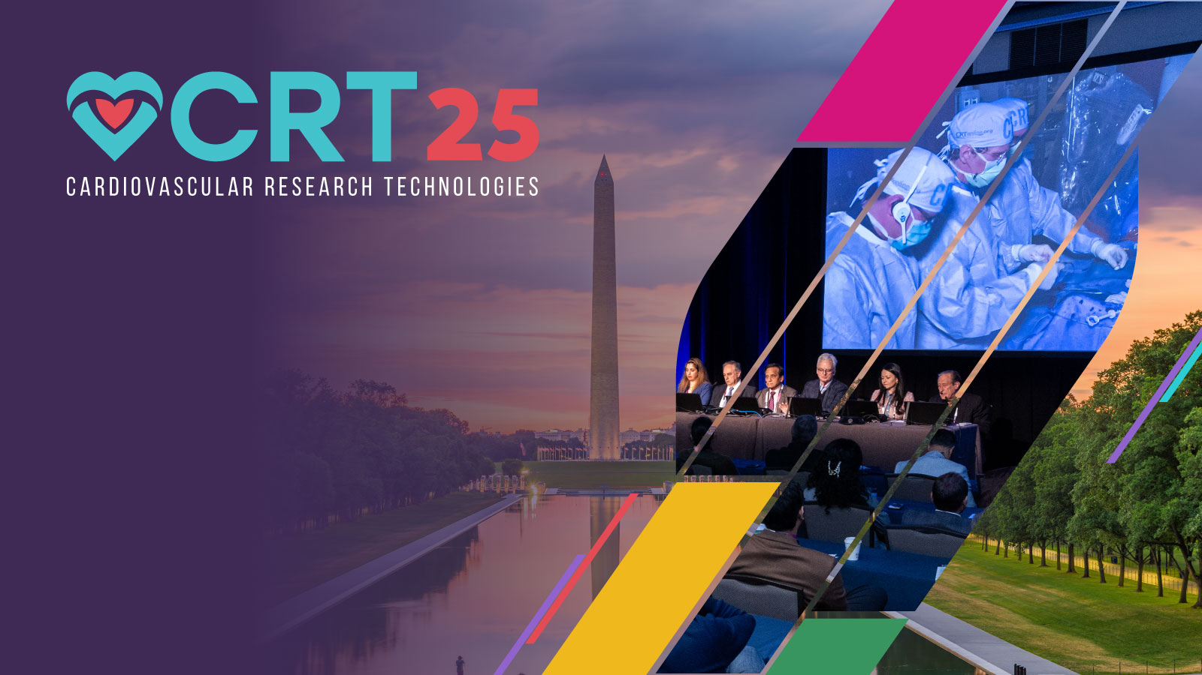
Outcomes for Single Antiplatelet, Dual Antiplatelet, or Oral Anticoagulation after Amulet: Insights from EMERGE LAA Post-Approval Study
Atman P. Shah, MD
James Freeman, MD, Mohamad Alkhouli, MD, Himanshu Agarwal, MD, Megan Coylewright, MD, MPH, Akash Makkar, MD, Xavier Freixa, MD, PhD, Jens Erik Nielsen-Kudsk, MD, DMSc Dhanunjaya Lakkireddy, MD

Slide 2
Atman P. Shah, MD Disclosures
Consultant:
Abbott
Edwards Lifesciences
Proctor:
Abbott
The views or opinions presented in this document are solely those of the authors and do not represent those of the American College of Cardiology, the American College of Cardiology Foundation, or the National Cardiovascular Data Registry.
No funding was provided for this analysis.

Slide 3
Background
Left atrial appendage occlusion (LAAO) reduces stroke in patients with non-valvular AF who cannot tolerate long-term anticoagulation
FDA approved the dual-seal AmplatzerTM AmuletTM LAA occluder in August 2021
Dual antiplatelet therapy is the approved antithrombotic medication regimen for Amulet post-procedure, from hospital discharge through 6 months, followed by single antiplatelet therapy
LAAO patients are often at high risk for bleeding and may benefit from less intensive post-procedure antithrombotic therapy
Limited data is available comparing different antithrombotic medication regimens following Amulet occluder procedures
Notes:
-Trend toward trying to tailor medications to patient specific needs post-LAAO
-Limited data on different post-procedure medications with Amulet in a large scale

Slide 4
EMERGE LAA Post-Approval Study
Learning curve analysis²
2021
2022
2023
2024
2025
2026
2027
2028
1-year outcomes⁴
FDA approval of AmplatzerTM AmuletTM LAA Occluder
Concomitant ablation⁵
Evaluation of EMERGE LAA primary endpoints
Evaluation of EMERGE LAA long-term stroke outcomes
First report of EMERGE LAA data¹
Prior failed LAAO³
Enrollment period for EMERGE LAA
Follow-up in NCDR LAAO Registry
NCDR=National Cardiovascular Data Registry
LAAO=Left atrial appendage occlusion
Follow-up using CMS claims linkage
¹Alkhouli et al. JACC Cardiovasc Interv 2024;17(3)422–434. ²Shah et al. CRT Conference 2024.
³Makkar et al. Heart Rhythm 2024; S1547-5271(24)02541-4. ⁴Shah et al. TCT Conference 2024. ⁵Ellis et al. AF Symposium 2025.
Notes:
-EMERGE LAA post approval study was initiated in August 2021 after Amulet was FDA approved
-Utilizes the NCDR LAAO Registry to capture commercial Amulet cases within the US that are reimbursed
-Procedures are collected through the end of 2023 and patients will be follow for 2 years in the LAAO registry then years 3-5 in through CMS claims linkage
-First data on early experience was presented in early 2024 along with other important topics over the past year

Slide 5
Analysis Design
Purpose | This analysis aims to compare the safety and effectiveness of three different hospital discharge antithrombotic strategies following Amulet implant: dual antiplatelet therapy (DAPT) versus single antiplatelet therapy (SAPT) or oral anticoagulation (OAC).
Analysis Population | Includes all patients with a successful Amulet occluder implant and discharged alive from the hospital between August 14, 2021 and December 15, 2023 and entered into the NCDR LAAO Registry.
Follow-up | Procedural, discharge, 45-day, and 6-month
Analysis Outcomes and Patient Population | Patient characteristics, procedural details, closure assessment, and clinical outcomes through 6 months 11,445 patients analyzed Discharged on DAPT (IFU recommended) – 9355 patients (81.7%) Discharged on SAPT – 606 patients (5.3%) Discharged on OAC – 1484 patients (13.0%) Discharged on DOAC – 1391 patients (12.2%) Discharged on warfarin – 93 patients (0.8%)
Notes:
-This analysis focuses on the comparison of patients discharged on the Amulet IFU recommended DAPT versus alternative SAPT or OAC regimens
-Procedures were taken from patients with a successful Amulet implant and discharged alive from the hospital from initial FDA approval through the end of December
-Follow-up captured through 6 months
-About 11k patients analyzed of which about 9k were discharged on DAPT, 600 on SAPT, and about 1500 on OAC. Of the patients discharged on OAC, almost all were on a DOAC compared to warfarin
Potential questions:
~70% of OAC group were on Apixaban
~6% of OAC group was on warfarin
-OAC group includes those with and without antiplatelet combination. ~50% were on OAC alone and 50% were on OAC in combination with an APT
-About 50% aspirin and 50% clopidogrel
-Amulet IDE had 30% warfarin vs. 70% DOAC. EMERGE has 5% warfarin vs. 95% DOAC
-EMERGE has a 10x larger cohort and more experienced operators now

Slide 6
Endpoints and Outcomes
Composite Endpoint | Composite of all-cause death, stroke, major bleeding, or systemic embolism.¹
Major Adverse Events (MAEs) | Composite of all-cause death, all stroke (ischemic, hemorrhagic, or undetermined stroke), systemic embolization, transient ischemic attack, device embolization, major bleeding, pericardial effusion requiring open cardiac surgery or percutaneous intervention, major vascular complication, myocardial infarction, or cardiac arrest.
Device Closure | Peri-device leak (PDL) is provided post-implant and 45 days.
Adjusted Analysis | Multivariable logistic regression was performed to adjust for baseline characteristics that were significantly different between the medication groups.
¹Coylewright et al. JACC Cardiovasc Interv 2023;16:2708-2718.
Notes:
-Analyzed a composite endpoint used in prior literature as well as major adverse events and key clinical events
-PDL was measured post-implant and at 45 days
-A multivariable regression analysis was performed to adjust for baseline differences between the 3 medication groups

Slide 7
Representative Patient Risk Profile in Real-World
CHARACTERISTIC | DAPT (N=9355) | SAPT (N=606) | OAC (N=1484)
Age (years)* | 77.1 ± 7.7 | 76.9 ± 8.0 | 76.3 ± 7.8
Female | 39.9% | 42.7% | 38.7%
AF classification*
Paroxysmal | 63.6% | 67.5% | 57.5%
Persistent/Permanent | 36.4% | 32.5% | 42.5%
CHA₂DS₂-VASc* | 4.7 ± 1.5 | 4.8 ± 1.5 | 4.6 ± 1.4
Prior stroke | 19.9% | 21.1% | 21.5%
HAS-BLED* | 2.7 ± 1.1 | 2.8 ± 1.1 | 2.5 ± 1.1
Prior bleeding* | 65.4% | 74.3% | 58.8%
*p<0.05 between the medication groups
Patients in SAPT group were at highest stroke and bleeding risk pre-LAAO
Notes:
-Representative patient risk profile we’d expect to see in the real-world with LAAO and similar to what we’ve reported previously
-As expected, patients in the SAPT group were at the highest stroke and bleeding risk pre-LAAO
Potential question:
-EMERGE slightly higher risk than Amulet IDE (75 yr, 4.5 CHA2DS2-VASc)

Slide 8
>99% Clinically Relevant Closure (≤3mm PDL) Regardless of Discharge Medication
 | DAPT (N=9355) | SAPT (N=606) | OAC (N=1484)
Peri-device leak post-implant*
0 mm | 97.8% | 98.5% | 95.6%
>0-3 mm | 1.9% | 1.5% | 3.5%
>3-5 mm | 0.3% | 0.0% | 0.6%
>5 mm | 0.0% | 0.0% | 0.3%
Procedure time (min)* | 83.0 ± 38.2 | 85.5 ± 53.6 | 93.1 ± 52.6
Number of devices used | 1.2 ± 0.4 | 1.2 ± 0.6 | 1.2 ± 0.5
Prior LAAO intervention* | 2.7% | 2.8% | 4.6%
Operator experience*
<10 cases | 15.1% | 16.8% | 19.2%
10-29 cases | 34.0% | 30.0% | 35.1%
≥30 cases | 50.9% | 53.1% | 45.7%
Concomitant ablation* | 0.3% | 0.7% | 9.5%
*p<0.05 between the medication groups
OAC group had more complex procedures (e.g. prior failed LAAO attempts) and early experienced operators
Patients with concomitant ablation were more likely to be discharged on OAC
Notes:
-Over 99% of implants had clinically relevant closure regardless of medication discharged on
-Patients in the OAC group had more complex procedures indicated by more failed prior Watchman attempts and early experienced operators
-Also, in alignment with ablation guidelines to use OAC post-procedure, the OAC group had significantly higher number of these concomitant ablation cases

Slide 9
Majority of Patients Discharged on SAPT Remained on SAPT or No Antithrombotic Through 6 Months
OAC
DAPT
SAPT
No Antithrombotic
Amulet occluder IFU recommends discharging patients on DAPT for 6 months followed by SAPT beyond 6 months at the discretion of the physician. OAC is recommended if residual jet is >5mm at any point.
*129 patients discharged on SAPT transitioned to DAPT or OAC by 6 months: No PDL >5mm, 2 strokes, 4 DRTs, 92 non-Amulet device related secondary procedure, 31 unknown medical reason.
**Ablation guidelines recommend OAC for at least 2 months post-ablation.
Patients discharged on DAPT or OAC transitioned to less intensive antithrombotic medications by 6 months in alignment with IFU recommendations
Notes:
-This tracks the medication regimens at each of the visits from through 6 months for each of the groups
-Majority of patients discharged on SAPT remained on the SAPT regimen or no antithrombotic through 6 months
-Patients that transitioned to a more intense medication in the SAPT group after discharge was primarily from a non-device related secondary procedure such as ablation or other cardiac procedure and not from a PDL or DRT
-In alignment with the IFU recommendations, a majority of patients in the DAPT and OAC groups transitioned to less intense antithrombotic medications by 6 months

Slide 10
Clinically Relevant Closure Achieved in >95% of All Patients at 45 Days
N=3694
N=154
N=483
97.4%
98.1%
95.1%
*indicates p<0.05 between the medication groups
Includes patients with TEE imaging assessment at 45 (+/-14) days
Clinically relevant closure defined as PDL ≤3mm (refs. Price et al. JACC Cardio Int. 2022. 15(21):2127-2138; Samaras et al. European Heart J. 2023.)
Low number of patients on IFU recommended OAC based on PDL size
Notes:
-Great closure results at 45 days with over 95% having clinically relevant closure less than 3mm leak regardless of medication group
-There was a low number of patients on the IFU recommended OAC based off large leaks greater than 5mm

Slide 11
Similar Clinical Event Rates Through 45 Days Regardless of Discharge Medication
DOAC alone (without APT): 0.6%
Adverse events from date of discharge through 45 days post-procedure
p-values adjusted for significant differences in baseline characteristics between discharge medication categories including age, height, AF classification, CHA₂DS₂-VASc score, HAS-BLED score, prior bleeding, baseline LVEF, and increased fall risk (p>0.05 for all clinical events between medication groups)
SAPT achieved similar thromboembolic and DRT rates as DAPT and OAC
DOACs alone had fewest major bleeding events
Notes:
-Similar clinical event rates through 45 days regardless of discharge medication
-SAPT had similar or better outcomes compared to DAPT despite higher patient risk profile pre-LAAO
-DOAC alone had significantly fewer major bleeding rates than with combination of APT or compared to warfarin driving this lower overall outcome
Potential question:
-OAC group with APT had major bleeding rate of 1.8% at 45 days which is significantly higher than the patients with a DOAC alone group
-Warfarin had significantly higher major bleeding rate at 45 days (4.3%) compared to DOACs (1.2%) regardless with combination of APT
-Similar late pericardial effusion rates (>2 days – 45 days) between all medication groups (0.5% - 0.7%; p>0.05)

Slide 12
SAPT and OAC Showed Similar Clinical Event Rates Compared to DAPT Through 6 Months
DOAC alone (without APT): 1.2%
Adverse events from date of discharge through 6 months post-procedure
p-values adjusted for significant differences in baseline characteristics between discharge medication categories including age, height, AF classification, CHA₂DS₂-VASc score, HAS-BLED score, prior bleeding, baseline LVEF, and increased fall risk (p>0.05 for all clinical events between medication groups)
No significant differences observed between medication groups for any outcome after adjusting for baseline characteristic differences
Notes:
-Trend was maintained through 6 months with numerically lower composite endpoint and major adverse events for SAPT and OAC compared to DAPT although not significant after adjusting for baseline differences
Potential question:
-Unlike Amulet, IDE, we saw similar late pericardial effusion rates (>2 days – 6 months) between all medication groups (0.6% - 0.7%; p>0.05). Potential reasons for this include: 1) Operators are gaining experience and following the IFU to not discharge on OAC as often than what we saw in Amulet IDE; 2) Higher use of DOACs and potentially ½ dosages in EMERGE compared to Amulet IDE which have shown better outcomes in recent literature; 3) A lot of patients transitioned off of OACs early on to less intensive antithrombotic medications; 4) There was a significant amount of patients that were discharged on an OAC alone without the combination of an APT.

Slide 13
Limitations and Future Implications
LAAO Registry is a real-world data collection source which has limitations for capturing follow-up data
LAAO Registry relies on site reporting of adverse events
LAAO Registry does not collect OAC dosage (e.g., ½ dose DOAC)
Medication changes throughout 6-month follow-up
PDL and DRT assessments are site reported and operator dependent
Further follow-up >6 months will be tracked to optimize post-implant antithrombotic strategies

Slide 14
Conclusions
Low and similar clinical event rates between the discharge medication groups:
  At 45 days and 6 months, no significant differences in clinical event rates between DAPT versus SAPT or OAC after adjusting for baseline differences
  Patients in the SAPT group achieved similarly low rates of thromboembolic events, major bleeding, DRT, and mortality through 6 months compared to the DAPT group, despite having the highest pre-LAAO stroke and bleeding risk
  Low major bleeding event rates in OAC group driven by DOACs alone
Regardless of discharge medication group, Amulet achieved a high degree of closure both post-implant (>99% PDL ≤3mm) and at 45 days (>95% PDL ≤3mm)
  CONCLUSION
  Discharging patients on an OAC or a reduced antithrombotic regimen such as SAPT following Amulet LAA occluder implantation may be viable alternatives to the current DAPT regimen, allowing for patient-specific optimization without compromising safety or effectiveness
Notes:
-Conclusion points as written with an emphasis on the final point being this analysis showed Amulet allows physician choice of 3 different antithrombotic medication regimens immediately following implant to allow for a more patient tailored approach without compromising safety of effectiveness with the device
Potential question:
Justification for why OAC group was similar or even better in cases than DAPT:
Higher use of NOACs in EMERGE whereas more patients in Amulet IDE used warfarin
Patients may have been on ½ dose NOAC which has shown better outcomes in literature. Do not get dosage info in LAAO registry
Transition off of OACs early to less intensive antithrombotic medications
Use of OAC alone in most cases rather than OAC+APT

