Slide 1


NCDR Left Atrial Appendage Occlusion (LAAO) Registry:
Review Of The First 3 Years
James V. Freeman, MD, MPH, MS Associate Professor, Cardiac Electrophysiology
Director, Yale Atrial Fibrillation Center Yale University School of Medicine

Slide 2
NCDR LAAO Registry
WATCHMAN approved in March 2015
LAAO Registry developed through a collaboration
  American College of Cardiology (ACC)
  Society for Coronary Angiography and Intervention (SCAI)
  U.S. Food and Drug Administration (FDA)
  Centers for Medicare and Medicaid Services (CMS)
  Boston Scientific
LAAO Registry launched late December 2015
Enrollment began in January 2016; mandated for CMS reimbursement
Supports post-market FDA surveillance study

Slide 3
LAAO Registry
Hospitals are encouraged to submit data on all WATCHMAN
  ~90% of hospitals do
  Includes Lariat procedures (lower volume)
Data elements
  220 for index hospitalization
  60 per follow-up visit
  15 to support adverse event (AE) adjudication
Adjudication performed using electronic algorithm and clinical events committee for some events
Active follow-up for AEs and medical therapy
CMS claims for collection of AEs in years 3-4

Slide 4

Patient Enrollment
45000
12/2018=38,158
40000
35000
30000
25000
20000
15000
10000
5000
0
JAN,2016
FEB,2016 MAR,2016 APR,2016 MAY,2016 JUN,2016 JUL,2016
AUG,2016 SEP,2016 OCT,2016 NOV,2016 DEC,2016 JAN,2017 FEB,2017 MAR,2017 APR,2017 MAY,2017 JUN,2017 JULY,2017 AUG,2017 SEP,2017 OCT,2017 NOV,2017 DEC,2017 JAN,2018 FEB,2018 MAR,2018 APR,2018 MAY,2018 JUN,2018 JUL,2018 AUG,2018 SEP,2018 OCT,2018 NOV,2018 DEC,2018
Freeman, JACC, 2020.

Slide 5
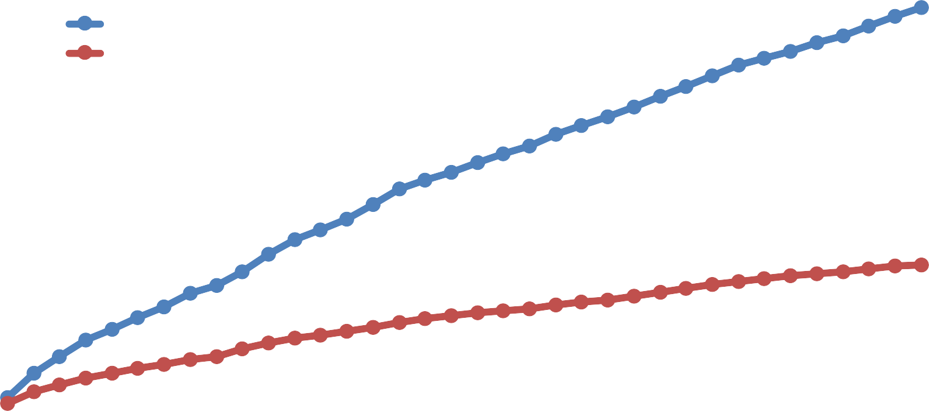
Physician and Hospital Participation
1400
12/2018=1,318
Cumulative Number of Physicians
Cumulative Number of Hospitals
1200
1000
800
12/2018=495
600
400
200
0
JAN,2016
FEB,2016 MAR,2016 APR,2016
MAY,2016
JUN,2016
JUL,2016 AUG,2016 SEP,2016 OCT,2016 NOV,2016 DEC,2016 JAN,2017 FEB,2017 MAR,2017 APR,2017 MAY,2017 JUN,2017 JULY,2017 AUG,2017 SEP,2017 OCT,2017 NOV,2017 DEC,2017 JAN,2018 FEB,2018 MAR,2018 APR,2018 MAY,2018 JUN,2018 JUL,2018 AUG,2018 SEP,2018 OCT,2018 NOV,2018 DEC,2018

Slide 6
Patient Characteristics
Characteristics | LAAO Registry 2016-2018 (N=38,158) | PROTECT AF trial 2005-2008 (N=463 Intervention Arm) | PREVAIL trial 2011-2013 (N=269 Intervention Arm) | EWOLUTION Registry 2013-2015 (N=1025)
Demographics
Age, mean (SD), year | 76.0 (8.1) | 71.7 (8.8) | 74.0 (7.4) | 73.4 (8.9)
Women, N (%) | 15,672 (41.1) | 137 (29.6) | 87 (32.3) | 411 (40.1)
Race, N (%)
White/European | 35,345 (92.6) | 425 (91.8) | 253 (94.1) | NA
Black/African American | 1768 (4.6) | 6 (1.3) | 6 (2.2) | NA
Asian/Pacific Islander | 670 (1.8) | 5 (1.1) | 1 (0.4) | NA
Hispanic ethnicity, N (%) | 138 (0.4) | 25 (5.4) | 6 (2.2) | NA
Medical History
CHA₂DS₂- VASC score, mean (SD) | 4.6 (1.5) | 3.4 (1.5) | 3.8 (1.2) | 4.5 (1.6)
Prior ischemic stroke/transient ischemic attack, N (%) | 10,425 (29.8) | 82 (17.7) | 74 (27.5) | 312 (30.5)
Prior congestive heart failure, N (%) | 14,266 (37.4) | 124 (26.8) | 63 (23.4) | 350 (34.2)
Prior diabetes mellitus, N (%) | 14,396 (37.7) | 113 (24.4) | 91 (33.8) | 304 (29.7)
Prior hypertension, N (%) | 35,148 (92.1) | 413 (89.2) | 238 (88.5) | 885 (86.4)
HAS BLED score, mean (SD) | 3.0 (1.1) | NA | NA | 2.3 (1.2)
Prior intracranial bleeding, N (%) | 4550 (11.9) | NA | NA | 155 (15.1)
Prior clinically relevant bleeding, N (%) | 26,466 (69.4) | NA | NA | 396 (38.7)

Slide 7
LAAO Registry: CHA₂DS₂ VASc Scores
30
Mean CHA₂DS₂ VASc Scores
25
LAAO = 4.6 (SD 1.5)
Percent of Population
PROTECT AF = 3.4 (SD 1.5)
20
PREVAIL = 3.8 (SD 1.2)
15
10
5
0
0
1
2
3 4 5 6
CHA₂DS₂-VASc Risk Score
7
8
9

Slide 8
HAS BLED Score Distribution
40
35
30
25
20
15
10
5
0
Mean 3 (SD 1.1)
Percent of Population
0
1
2
3 4 5
HAS-BLED risk scores
6
7
8

Slide 9
Annual Hospital Volume
120
Median 30 (IQR 4-56)
100
80
60
40
20
0
Number of Hospitals
<10
10 to 19
20 to 29
30 to 39
40 to 49
50 to 59
60 to 69
70 to 79
>=80
Annual Case Volume

Slide 10
Annual Physician Volume
600
Median 12 (IQR 0-24)
500
400
300
200
100
0
Number of Physicians
<10
10 to 19
20 to 29 30 to 39
Annual Case Volume
40 to 49
>=50

Slide 11
Cancelled and Aborted Procedures
Device deployed in 93% of procedures attempted
  3% cancelled prior to venous access
  4% aborted after access but before deploying device
Approximately 50% of cancelled procedures due to LAAO thrombus detected on day of procedure
Rates of major AEs significantly higher among those who had cancelled or aborted procedures

Slide 12
Procedural Success
100
90
80
70
60
50
40
30
20
10
0
95.1%
94.8%
98.5%
98.3 *
94.4%
90.9%
Percent of Procedures
PROTECT-AF CAP PREVAIL CAP2 EWOLUTION LAAO
*Acute procedural success= rate of success among procedures in which a device was deployed.
Among those with an acutely successful procedure 70 (0.2%) had device margin residual leak ≥5mm

Slide 13
Major In-hospital AEs
2.5
2.16%
2.0
Percent of Procedures
1.5
1.39%
1.25%
1.0
0.5
0.24%
0.19%
0.17%
0.15%
0.0
Any Major Complication
Pericardial Effusion Requiring Intervention
Major Bleeding
Cardiac Arrest
Death
Stroke/TIA
Major Vascular Complication
Any Major
Complication*
Major Bleeding

Slide 14
Major In-hospital AEs
Overall | 38158 | 100.00
Adverse Event Type | N | %
Neurologic Events
Ischemic Stroke | 45 | 0.12
Hemorrhagic Stroke | 3 | 0.01
Undetermined stroke | 2 | 0.01
TIA | 16 | 0.04
Intracranial Hemorrhage | 3 | 0.01
Systemic Arterial Embolism | 1 | <0.01
Myocardial Infarction | 14 | 0.04
Device Embolization | 30 | 0.07

Slide 15
Adverse Events Compared with Prior Studies
Major in-hospital AEs lower than those reported in the pivotal trials at 7 days
  PROTECT AF
    Pericardial effusion requiring surgery or pericardiocentesis 4%
    Major bleeding 3.5%
    Procedure-related stroke 1.1%
    Device embolization 0.4%
  PREVAIL
    Pericardial effusion requiring surgery or pericardiocentesis 1.9%
    Procedure-related stroke 0.7%
    Device embolization 0.7%

Slide 16
Adverse Events Compared with Prior Studies
EWOLUTION Registry
  7-day procedure related AEs 2.8%
  1-day procedure related adverse event rates
    Pericardial effusion 0.5%
    Major bleeding 0.7%
    Device embolization 0.2%

Slide 17
Conclusions
NCDR LAAO Registry the largest registry of patients undergoing percutaneous LAAO procedures
Over 38,000 procedures between 2016-2018
Hospital and physician procedure volumes were generally low to moderate but vary substantially

Slide 18
Conclusions
Patients were higher risk for stroke and bleeding than pivotal trials or EWOLUTION registry
Despite this, procedural characteristics and safety compared favorably with the pivotal trials
LAAO Registry demonstrates the value of national registries to evaluate technology as adopted in clinical practice

Slide 19
Thank you

