Slide 1
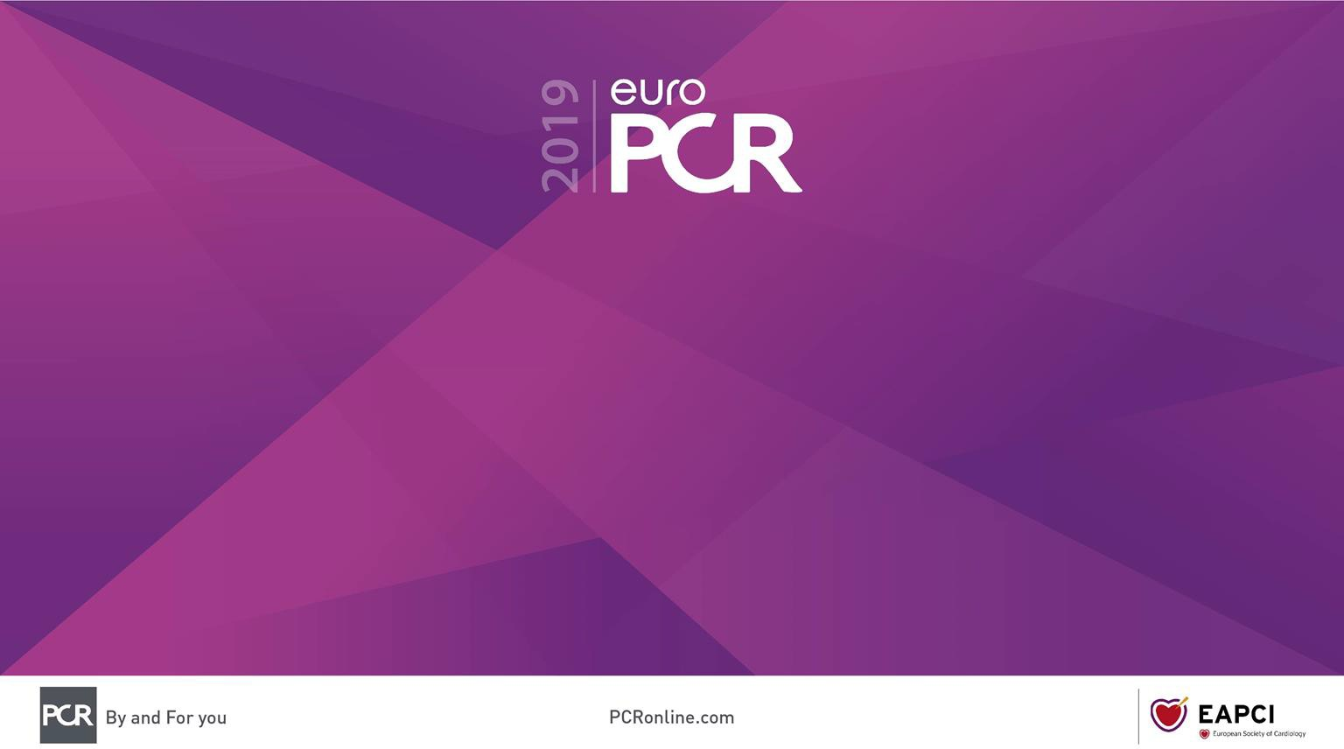
Therapeutic intravascular ultrasound pulmonary artery denervation for the treatment of pulmonary arterial hypertension
TROPHY1: a multicentre, international, open-label trial
A.M.K. Rothman, J-L. Vachiery, L.S. Howard, G.W. Mikhail, I.M. Lang, M. Jonas, D.G. Kiely, D. Shav,
O. Shabtay, A. Avriel, G.D. Lewis, E.B..Rosenzweig, A.J. Kirtane, N.H. Kim, E. Mahmud, V.V.
McLaughlain, S. Chetcuti, M.B. Leon, O. Ben-Yehuda, L.J. Rubin

Slide 2
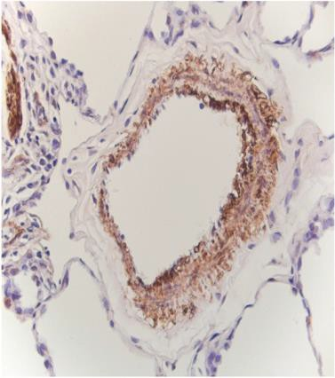
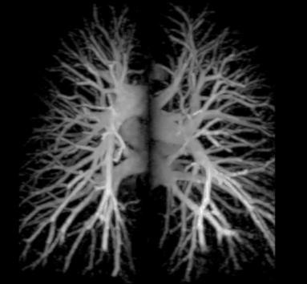
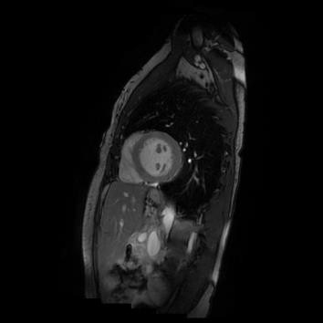

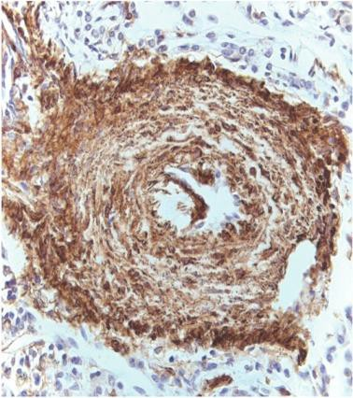
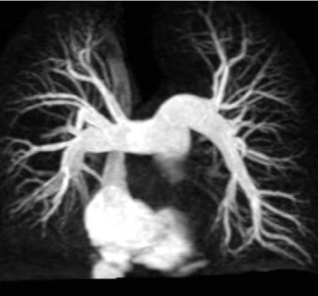
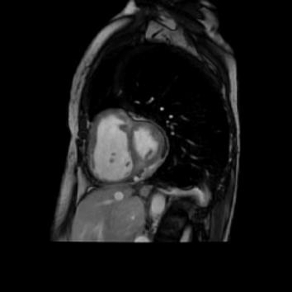

Why this study?
Pulmonary Arterial Hypertension
Survival at 1, 3 and 5 years
is 88%, 72% and 53% on best medical therapy¹
Vascular Constriction And Remodeling
Increased PVR
Right Heart Failure
€15-100 K/year/patient²
Gall, H. et al. J Hear Lung Transplant. 2017;36:957–967.
Hunter S. Commissioning Policy: Targeted Therapies for use in Pulmonary Hypertension in Adults. 2015;1–28.

Slide 3
Why this study?
Patients with pulmonary arterial hypertension manifest signs of sympathetic overdrive¹⁻⁵ that are associated with a poor outcome²⁻⁴
40% of circulating norepinephrine is released from the pulmonary vasculature⁶
Pulmonary artery denervation alters nerve structure and function with evidence of
physiological efficacy in animal models⁷⁻¹⁰ and an early clinical study¹¹
1. Van Albada ME, et. al. Pediatr Res. 2008;63:321–327. 2. Nootens M, et. al. J Am Coll Cardiol. 1995;26:1581–1585. 3. Velez-Rosa S, et. al. Circulation. 2004;110:1308–1312. 4. Ciarka A, et. al. Am J Respir Crit Care Med. 2010;181:1269–1275. 5. de Man FS, et. al. Am J Respir Crit Care Med. 2013;187:14–19. 6. Esler M, et al., 1984. Am J Phys End Met, 247(1), pp.E21–E28. 7. Chen SL, et al. EuroIntervention. 2013;9:269-76. 8. Rothman AMK, et al. Circ Cardiovasc Interv. 2015;8:e002569. 9. Zhou L, et al. JACC Cardiovasc Interv. 2015;8:2013-2023. 10. Rothman AMK, et al. EuroIntervention. doi.org/10.4244/EIJ-D-18-01082 11. Chen SL, et al. J Am Coll Cardiol. 2013;62:1092–1100

Slide 4

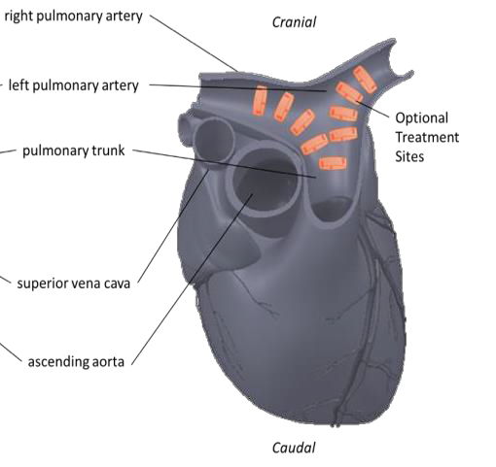
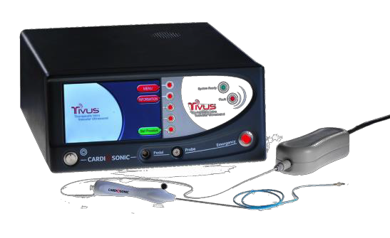
What did we study?
Evaluate the safety and efficacy of percutaneous therapeutic intravascular ultrasound pulmonary artery denervation in patients with pulmonary arterial hypertension on best medical therapy
Rothman AMK, et al. EuroIntervention. doi.org/10.4244/EIJ-D-18-01082

Slide 5
How was the study executed?
23 patients recruited from specialist pulmonary
hypertension centres: 5 in Europe and Israel, and 3 in the USA.
Baseline assessment: right heart catheterization, 6MWD, quality of life, actigraphy and MRI/CT
Inclusion:
Patients meeting haemodynamic criteria for PAH WHO functional class III
Established on dual-oral combination therapy
Pulmonary denervation procedure
Clinical follow-up at 1, 4/6 and 8 months
Exclusion:
Positive vasoreactivity test
Without intravenous prostacyclin
RHC at 4/6 and 12 months*
MRI/CT at 1 and 12 months
Surveillance at 24 and 36m
Independent, blinded analysis was undertaken by the study core lab (Cardiovascular Research Foundation, New York, USA).
*EU/IL – 4 month, USA – 6 month

Slide 6
What are the essential results?
Demographics | Mean
Age, mean (SD), years | 60.0 (11.4)
Female, n (%) | 18 (78)
Race, n (%)
Caucasian | 19 (83)
Black | 1 (4)
Hispanic | 2 (9)
Middle East | 1 (4)
Time from Diagnosis, years | 6.1 (5.7)
Type of PAH, n (%)
Connective tissue Associated | 12 (52)
Associated with Drug use | 3 (13)
Idiopathic PAH | 8 (35)
WHO functional class III, n (%) | 23 (100)
Disease specific therapy, n (%) | Baseline | 4/6-months
ERA and PDE5 | 10 (50) | 10 (50)
ERA and sGCs | 4 (20) | 4 (20)
ERA, sGCs, inhaled Prostacyclin | 3 (15) | 3 (15)
ERA, PDE5, inhaled Prostacyclin | 2 (10) | 2 (10)
ERA, sGCs and oral IP agonist | 1 (5) | 1 (5)
Diuretics, n (%)
None | 3 (15) | 3 (15)
Loop | 7 (35) | 6 (30)
Loop/aldosterone antagonist | 7 (35) | 8 (40)
Loop/aldo/thiazide | 3 (15) | 3 (15)
ERA – endothelin receptor antagonist, PDE5 phosphodiesterase 5 inhibitor, sGCs – soluble guanylate cyclase stimulator

Slide 7
What are the essential results?
No procedure-related serious adverse events were reported
Serious Adverse Events | n
Disease related hospitalization | 11
Non-PAH hospitalization | 3
Death | 1
Adverse Events | n
Anaemia | 2
Cardiac/PAH | 32
Infection | 16
Pain | 10
Procedure related | 7
Renal impairment | 3

Slide 8
What are the essential results?
PAP
PVR
**
RAP
**
CO
PCWP
100
900
14
6.5
6.0
5.5
Pulmonary artery denervation reduced:
*
PVR (dyn·sec/cm⁵)
800
18
16
RAP (mmHg)
12
90
700
CO (L/min)
PCWP (mmHg)
10
14
Pulmonary Artery Pressure (mmHg)
600
5.0
12
10
8
80
8
4.5
4.0
Pulmonary artery pressure
Pulmonary vascular resistance
Right atrial pressure
Pulmonary arterial compliance
500
70
400
6
70
0
0
0
0
60
**
BL
BL
4-6m
BL
4-6m
BL
60
4-6m
4-6m
50
40
SBP
HR
Compliance
SVI
40
30
140
90
**
30
Heart Rate (BPM)
PCa (mL/mmHg)
2.5
45
SBP (mmHg)
130
SVI (mL/m²)
40
20
**
120
80
2.0
35
10
110
1.5
30
100
70
25
0
0
0
0
0
Mean +/- 95% CI
*P<0.05, **P<0.01
BL
4-6m
BL
4-6m
BL
4-6m
BL
4-6m
BL
4-6m

Slide 9
What are the essential results?
6MWT
Actimitry
* *
QoL
450
* *
8000
35
400
Accelerometer Unit (steps) Per Day
EmPHasis-10
30
6MWT (m)
350
6000
25
Pulmonary artery denervation improved:
300
20
250
4000
15
0
0
0
BL
1m
4-6m
8m
BL
4-6m
8m
BL
4-6m
Six-minute walk distance
Daily activity
French invasive (ESC) risk score
NT-proBNP
Risk Score
100
**
Number of low risk criteria met
3 2 1
3500
20
15
NT-proBNP (pg/mL)
3000
Patients (%)
60
25
0
2500
2000
50
40
1500
1000
20
20
0
Mean +/- 95% CI
*P<0.05, **P<0.01
0
BL
BL
1m
4-6m
4-6m

Slide 10
Why is this important?
In patients established on best medical therapy therapeutic intravascular ultrasound pulmonary artery denervation:
Was feasible and safe
Improved pulmonary haemodynamics Improved exercise tolerance

Slide 11
The essentials to remember
Why?
Mortality and morbidity are high in patients with pulmonary arterial hypertension despite best medical therapy
What?
Evaluation of safety and efficacy of therapeutic intravascular ultrasound pulmonary artery denervation
How?
Multicentre, international, open-label, trial of pulmonary artery denervation in addition to best medical therapy
What are the results?
Reduced pulmonary vascular resistance and improved six-minute walk with no procedure-related adverse events
Why is this important?
Pulmonary artery denervation may offer a new therapeutic option for patients with pulmonary arterial hypertension

