Slide 1
Clinical and Quality of Life Outcomes Across the Spectrum of Baseline Kidney Function
Insights from the ISCHEMIA and ISCHEMIA-CKD Trials
Funded by the National Heart, Lung, and Blood Institute
Sripal Bangalore, MD, MHA
NYU Grossman School of Medicine
On behalf of the ISCHEMIA/ISCHEMIA-CKD Research Group

Slide 2
Disclosures
ISCHEMIA/ISCHEMIA-CKD trials were supported by grants from the
NHLBI
Devices used in the trial were donated by Abbott Vascular, Medtronic, St. Jude Medical, Volcano, and Omron Healthcare; medications were provided by Arbor Pharmaceuticals, AstraZeneca Pharmaceuticals, and Merck Sharp & Dohme.

Slide 3


CKD Patients are Under-Represented in Contemporary Revascularization vs. Medicine SIHD Trials
2007 2009 2012
FAME
2 Trial
eGFR <30: 16 Subjects
Subjects with serum Cr
>2 mg/dl excluded
Serum Cr >2 mg/dl: 20 subjects

Slide 4










Study Design
Stable Patient Moderate or severe ischemia
(determined by site; read by core
lab)
Patients with moderate or severe ischemia and eGFR <30 or on dialysis
CCTA not required, e.g., eGFR 30 to <60 or coronary anatomy previously defined
Blinded CCTA
Core lab anatomy eligible?
NO
Screen failure
RANDOMIZE 1:1
YES
RANDOMIZE
INVASIVE Strategy
Optimal Medical Therapy + Cath +
Optimal Revascularization (if suitable)
CONSERVATIVE Strategy
Optimal Medical Therapy alone
Cath and revascularization (if suitable) reserved for Optimal Medical Therapy failure
INVASIVE Strategy
OMT + Cath + Optimal Revascularization
CONSERVATIVE Strategy
OMT alone
Cath reserved for OMT failure
Primary Endpoint: Composite of Death or MI
Maron DJ, et al. Am Heart J. 2018; 201;124-135.
Bangalore S, et al. Am Heart J. 2018; 205:42-52

Slide 5

Study Design
777
5179
0
ESRD
15
30
60
90
130
eGFR (ml/min/1.73m²)

Slide 6
Study Objectives
Evaluate clinical and QoL outcomes across the spectrum of eGFR
Evaluate the impact of treatment strategy on clinical and QoL outcomes across the spectrum of eGFR

Slide 7
Endpoints
Primary Endpoint
Time to death or MI
Major Secondary Endpoints
Time to Death, MI, Hospitalization for Unstable Angina, Heart Failure or Resuscitated Cardiac Arrest
Quality of Life
Safety Outcomes
Procedural complications
Composite of initiation of dialysis or death

Slide 8
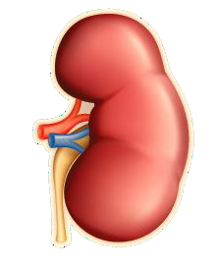
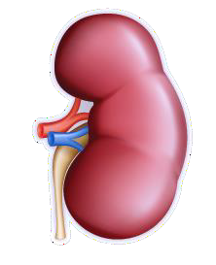
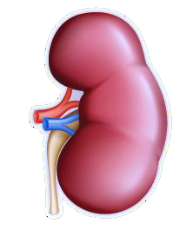
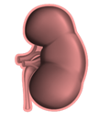

Randomized Participants
Stage 1 N=1889 | Stage 2 N=2551 | Stage 3 N=738 | Stage 4 N=311 | Stage 5/Dialysis N=467
eGFR ≥ 90 | 90> eGFR ≥ 60 | 60> eGFR ≥ 30 | 30> eGFR ≥ 15 | eGFR <15
Normal or high function | Mildly reduced function | Moderately reduced function | Severely reduced function | Kidney failure

Slide 9
CKD Stages and Outcomes
Primary Endpoint
(Death or MI)
Major Secondary Endpoint
(Death/MI/Hosp for UA, HF or RCA)
Cum Incidence Rates (3-year)
50
6
38.01 5 4 3 2 1 0
HR_{adj} (95% CI)
Cum Incidence Rates (3-year)
50
6
5
4
3
2
1
0
P<0.001
P<0.001
40.88
40
34.21
40
36.34
HR_{adj} (95% CI)
30
30
18.42
21.03
20
20
9.52
10.72
10.84
12.19
10
10
0
0
Stage Stage Stage Stage Stage
1 2 3 4 5
Stage Stage Stage Stage Stage 1 2 3 4 5
Bars represents cumulative incidence rates and the black squares represents hazard ratio

Slide 10
CKD Stages and Outcomes
All-Cause Death
Myocardial Infarction
P<0.001 16.74
40
14
12
10
8
6
4
2
0
HR_{adj} (95% CI)
Cum Incidence Rates (3-year)
Cum Incidence Rates (3-year)
20
4
P<0.001
30
28.91
25.37
13.4
3
11.98
HR_{adj} (95% CI)
20
10
7.9
2
6.85
10
8.61
1
3.49
3.64
0
0
0
Stage Stage 1 2
Stage Stage Stage 3 4 5
Stage Stage Stage Stage Stage 1 2 3 4 5
Bars represents cumulative incidence rates and the black squares represents hazard ratio

Slide 11
CKD Stages: Procedural Complications and Bleeding
10
9
8
7.2
6.8
Event Rates
6.2
6
4
3.9
3.3
4
2.4
2.8
_{2.1}2.4
2
1.4
0.50.5^{0.9}
0.8_{0.50.20.6}
0
0.30.2
0 0
0
0
Death
Stroke AKI
Stage 1 Stage 2 Stage 3
Dialysis
Bleeding
Stage 4
Stage 5
Data are for both INV/CON groups combined. Bleeding outcome for the duration of the trial.

Slide 12
CKD Stages: Heterogeneity of Treatment Effect
Primary Endpoint
(Death or MI)
Major Secondary Endpoint
(Death/MI/Hosp for UA, HF or RCA)
^{P}interaction ^{= 0.47}
^{P}interaction ^{= 0.41}
Overall
0.99 (0.87, 1.13)
Overall
1.00 (0.89, 1.14)
CKD Stage 1
1.10 (0.83, 1.45)
CKD Stage 1
1.15 (0.89, 1.50)
CKD Stage 2
0.94 (0.75, 1.17)
CKD Stage 2
0.89 (0.72, 1.10)
CKD Stage 3
0.91 (0.67, 1.25)
CKD Stage 3
1.01 (0.75, 1.36)
CKD Stage 4
1.33 (0.88, 2.01)
CKD Stage 4
1.27 (0.85, 1.88)
CKD Stage 5
0.88 (0.64, 1.20)
CKD Stage 5
0.92 (0.68, 1.25)
0.5
1.0
2
Favors CON
4
0.5
1.0
2
Favors CON
4
Favors INV
Favors INV

Slide 13
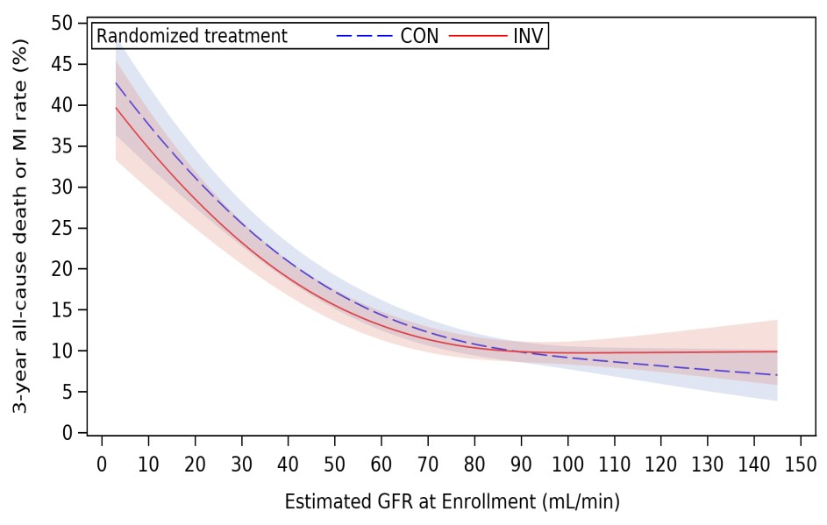
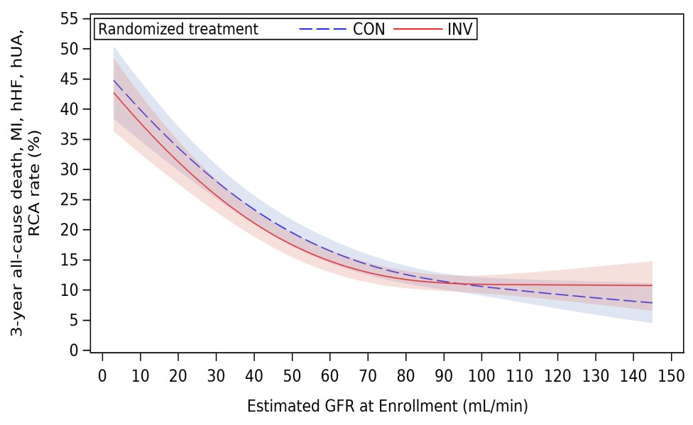
Heterogeneity of Treatment Effect as a Function of eGFR
Primary Endpoint
(Death or MI)
Major Secondary Endpoint
(Death/MI/Hosp for UA, HF or RCA)
^{P}interaction ^{= 0.69}
^{P}interaction ^{= 0.71}

Slide 14
CKD Stages: Heterogeneity of Treatment Effect
All-Cause Death
Myocardial Infarction
^{P}interaction ^{= 0.08}
^{P}interaction ^{= 0.46}
Overall
1.04 (0.87, 1.25)
Overall
0.91 (0.77, 1.08)
CKD Stage 1
1.11 (0.71, 1.71)
CKD Stage 1
1.11 (0.79, 1.56)
CKD Stage 2
0.88 (0.62, 1.26)
CKD Stage 2
0.94 (0.72, 1.22)
CKD Stage 3
1.26 (0.82, 1.94)
CKD Stage 3
0.67 (0.44, 1.01)
CKD Stage 4
1.74 (1.08, 2.82)
CKD Stage 4
0.78 (0.40, 1.54)
CKD Stage 5
0.78 (0.55, 1.12)
CKD Stage 5
0.91 (0.57, 1.47)
0.25
1
4
0.25
1
2 4
Favors CON
8
Favors INV
Favors CON
Favors INV

Slide 15
CKD Stages: Heterogeneity of Treatment Effect
Procedural MI Non Procedural MI
^{P}interaction ^{= 0.74}
^{P}interaction ^{= 0.79}
Overall
2.83 (1.83, 4.36)
Overall
0.68 (0.56, 0.83)
CKD Stage 1
2.49 (1.10, 5.66)
CKD Stage 1
0.79 (0.53, 1.17)
CKD Stage 2
3.89 (1.99, 7.58)
CKD Stage 2
0.63 (0.45, 0.88)
CKD Stage 3
1.87 (0.64, 5.48)
CKD Stage 3
0.59 (0.38, 0.93)
CKD Stage 4
1.93 (0.18, 21.36)
CKD Stage 4
0.61 (0.29, 1.30)
CKD Stage 5
1.84 (0.44, 7.68)
CKD Stage 5
0.82 (0.49, 1.37)
0.25
1
2 4
Favors CON
8
0.25
1
2 4
Favors CON
8
Favors INV
Favors INV

Slide 16
CKD Stages: Heterogeneity of Treatment Effect
Stroke Death or New Dialysis
^{P}interaction ^{= 0.08}
^{P}interaction ^{= 0.29}
Overall
1.60 (1.09, 2.34)
Overall
1.15 (0.95, 1.38)
CKD Stage 1
2.09 (0.85, 5.14)
CKD Stage 1
1.09 (0.70, 1.68)
CKD Stage 2
0.86 (0.46, 1.61)
CKD Stage 2
0.89 (0.62, 1.26)
CKD Stage 3
1.39 (0.59, 3.32)
CKD Stage 3
1.23 (0.82, 1.85)
CKD Stage 4
5.65 (1.23, 25.87)
CKD Stage 4
1.58 (1.08, 2.33)
CKD Stage 5
3.23 (1.04, 10.02)
CKD Stage 5
1.08 (0.51, 2.29)
0.25
1
2 4
Favors CON
8
0.25
1
2 4
Favors CON
8
Favors INV
Favors INV

Slide 17
SAQ-7 Summary Score as a Function of eGFR
Month 3
Month 12 Month 36
100
90
80
70
60
50
Score
Conservative Invasive 15 30 45 60 75 90 105120135
Estimated GFR
15 30 45 60 75 90 105120135
15 30 45 60 75 90 105120135
Treatment Effect on Score
10
5
0
−5
−10
15 30 45 60 75 90 105120135
15 30 45 60 75 90 105 120 135
Estimated GFR
15 30 45 60 75 90 105 120 135

Slide 18
SAQ-7 Angina Frequency Score as a Function of eGFR
Month 3
Month 12 Month 36
100
90
80
70
60
50
Score
Conservative Invasive 15 30 45 60 75 90 105120135
Estimated GFR
15 30 45 60 75 90 105120135
15 30 45 60 75 90 105120135
Treatment Effect on Score
10
5
0
−5
−10
15 30 45 60 75 90 105120135
15 30 45 60 75 90 105 120 135
Estimated GFR
15 30 45 60 75 90 105 120 135

Slide 19
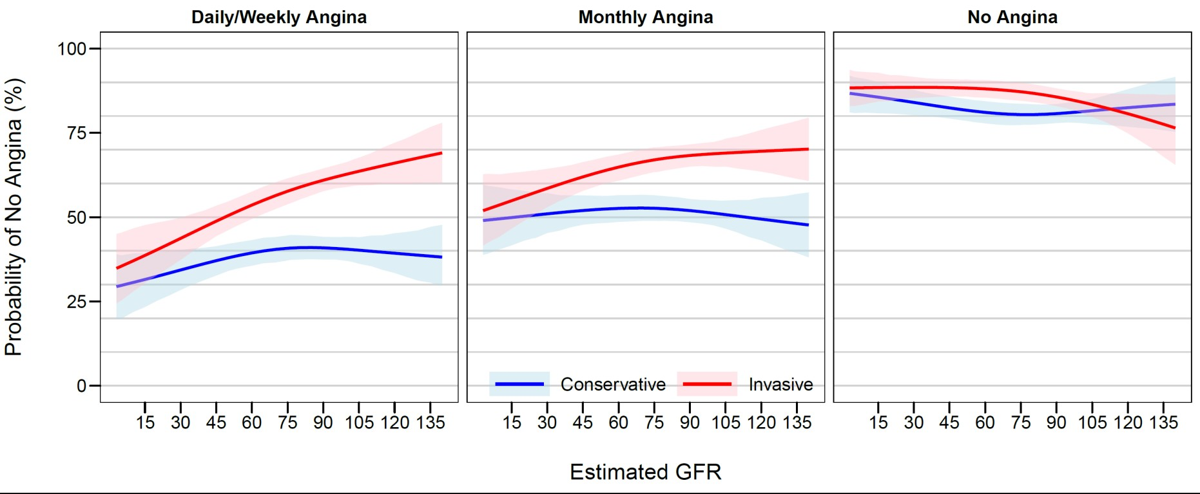
SAQ-7 Angina Frequency Score at 12 months by Baseline Angina Frequency

Slide 20
Conclusions
Exponential increase in cardiovascular events with lower kidney function
Procedure related complications and bleeding increased with lower kidney function
There was no evidence of meaningful heterogeneity of treatment effect for
clinical outcomes across eGFR spectrum
  No difference in INV vs. CON for primary or major secondary outcome
  Increase in procedural MI but decrease in non procedural MI with INV

Slide 21
Conclusions
Nominal heterogeneity of treatment effect such that there was
  Increased risk of death with INV in those with CKD stage 4
  Increased risk of stroke with INV in those with CKD stage 4/5
Significant and durable benefit of INV at improving angina related QoL but the effect attenuated in those with less symptoms and at lower eGFR (below 30- 45)

