Slide 1


Hypertension Treatment in Nigeria: Early Results of a Type 2 Hybrid Effectiveness and Implementation Interrupted Time Series Trial
Dike Ojji, MBBS, PhD | University of Abuja on behalf of the Hypertension Treatment in Nigeria Program Team

Slide 2
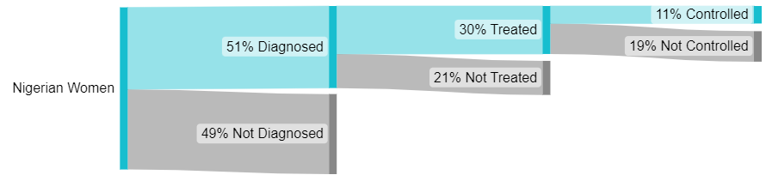
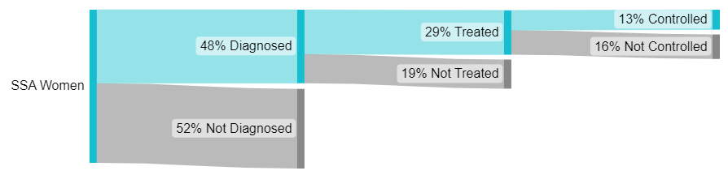
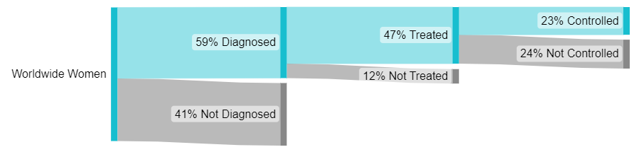
Global hypertension cascade of care
Closing the gap for 1.4 billion adults who have hypertension
Despite the large and growing burden of BP-related diseases, the global hypertension cascade of care, including in Nigeria, is poorly implemented and thus ineffective.
R01HL144708

Slide 3
Hypertension treatment in Nigeria
Multi-level Implementation Package
Based on the WHO HEARTS technical package and Kaiser Permanente’s Northern California model, we are evaluating implementation and effectiveness of a multilevel implementation package in 60 primary care facilities in FCT, Nigeria:
Standard treatment protocol (national policy level)
Patient registration and empanelment (health system level)
Prioritization of fixed-dose combination therapy (health system level)
Team-based care led by community health workers (health worker level)
Home blood pressure monitoring and health coaching (patient-level)
Additional strategies: Free/reduced cost medications (Dec 2020), public health messaging and community mobilization, and quarterly supportive supervision.
R01HL144708

Slide 4
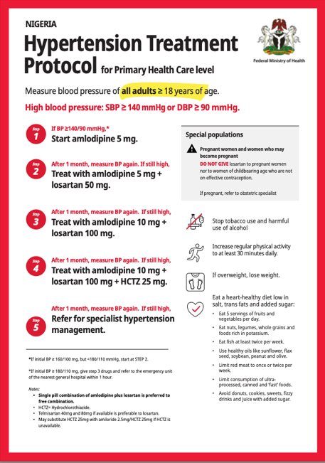
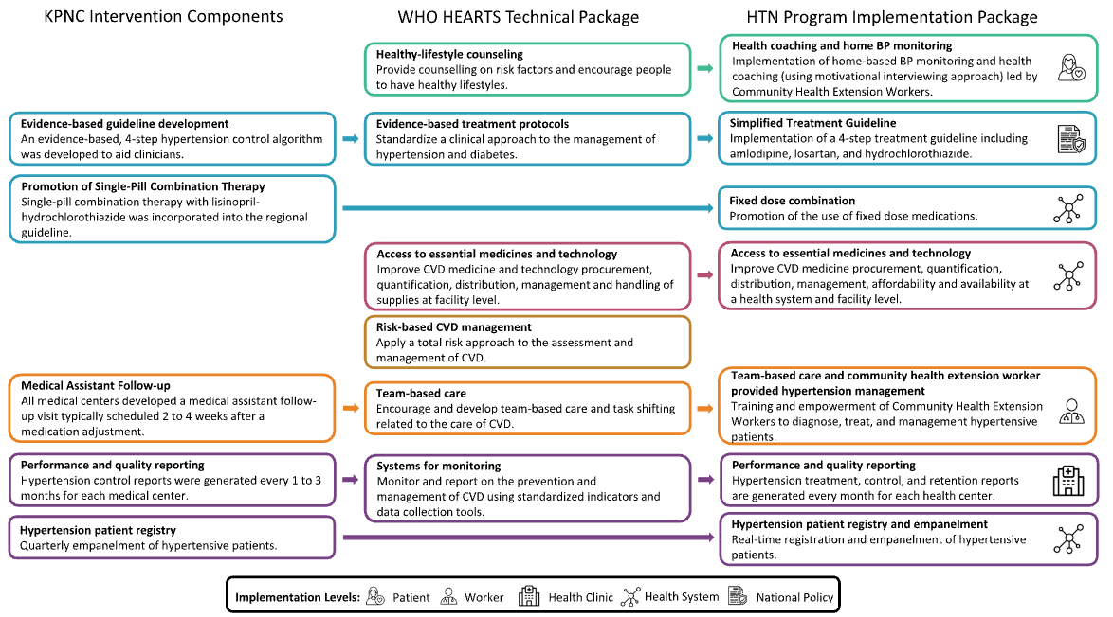
Implementation PACKAGE
R01HL144708

Slide 5
METHODS
Study Design: Single Arm, Type II Hybrid, Interrupted Time Series (NCT04158154)
April 2019 to August 2019 (formative): We conducted quantitative and qualitative research to assess service availability and readiness and acceptability of the implementation package.
January 2020 to November 2020 (pre-implementation): We collected baseline data among sequentially registered patients with hypertension (SBP>140 mm Hg, DBP>90 mmHg, or taking BP lowering medication) presenting to 60 primary care facilities.
January 2021 onward (implementation): We are evaluating the implementation package through ongoing data collection in these facilities.
R01HL144708

Slide 6
METHODS
Study Design: Single Arm, Type II Hybrid, Interrupted Time Series (NCT04158154)
Co-primary effectiveness outcomes: Change in slope of monthly* treatment and control (BP <140/<90 mmHg) rates between pre-implementation and implementation periods.
Secondary effectiveness outcomes: Change in monthly mean systolic and diastolic BP, and rates of multidrug and fixed-dose combination therapy prescription.
Co-primary implementation outcomes: Reach, effectiveness, adoption, implementation, maintenance, acceptability, and cost of the implementation package.
Safety outcomes: Adverse events of special interest (symptoms; changes in serum potassium and serum creatinine), serious adverse events.
*3 month rolling average
R01HL144708

Slide 7
RESULTS
Between January 2020 and October 2023, 21,038 participants were registered, and there were 133,311 unique visits.
 | Pre-Implementation N=5,005 | Implementation N=16,033 | P-value
Mean (SD) Age, years | 48 (13) | 50 (12) | <.0001
Female, % | 66% | 69% | 0.0007
Mean (SD) BMI, kg/m² | 27 (6) | 27 (6) | 0.97
Education: No formal or primary, % | 47% | 46% | 0.009
Secondary, % | 28% | 28%
College or greater, % | 25% | 27%
Mean (SD) SBP, mmHg at enrollment | 154 (20) | 157 (21) | <.0001
Mean (SD) DBP, mmHg at enrollment | 96 (14) | 97 (13) | <.0001
Hypertension patient registry and empanelment (Home BP monitoring)
n=153
Home BP
Ojji DB, et al. J Hypertens. 2022 May 1;40(5):888-896.
R01HL144708

Slide 8
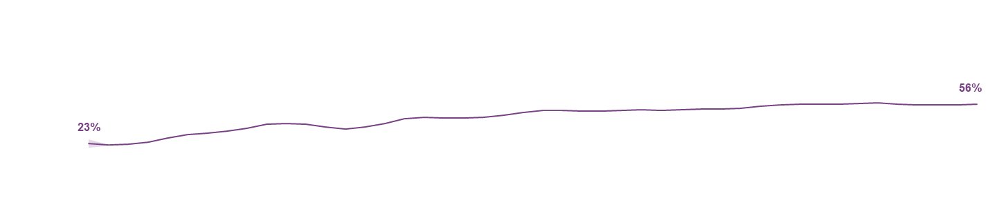
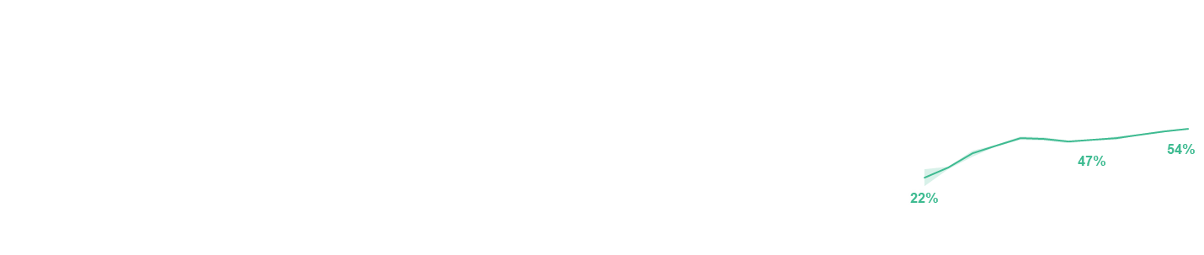
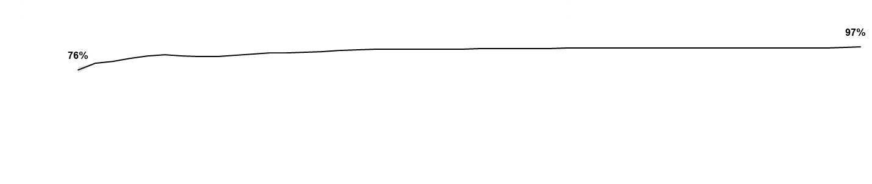

RESULTS
Co-primary outcomes: Change in slope in treatment and control rates
Change in rate per month (β)
 | Baseline | Jan 2021 | Oct 2023 | Pre-Implementation | Implementation
Treatment rate (95% CI) | 76% (73-78%) | 91% (91-91%) | 97% (97-97%) | 1.0% | 0.1%
P-value | <.0001 (non-linear) |  |  | <.0001
Control rate (95% CI) | 23% (20-27%) | 37% (36-37%) | 56% (55-56%) | 1.6% | 0.5%
P-value | <.0001 (non-linear) |  |  | <.01
Hypertension treatment rates for HTN and control rates for HTN & Home BP monitoring
HTN Treatment Rate
HTN Control Rate
Home BP Control Rate
Control rate for Home BP participants prior to enrollment in Home BP monitoring
R01HL144708

Slide 9
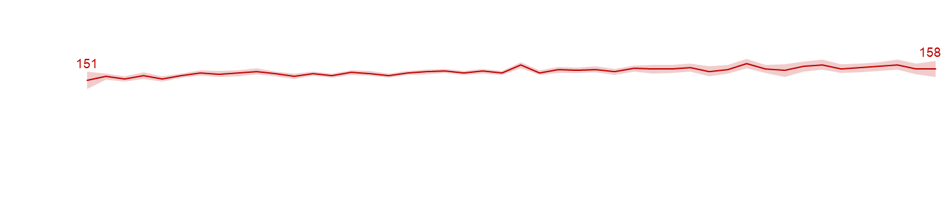
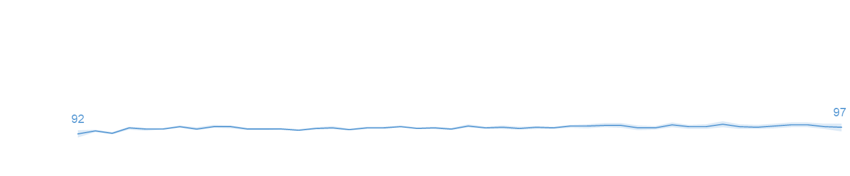
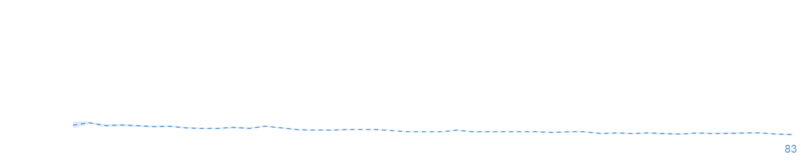
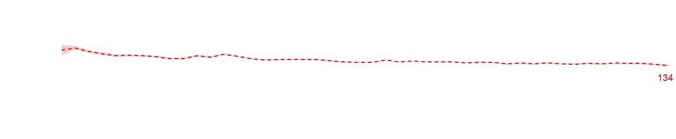
RESULTS
Secondary outcomes: Change in mean systolic and diastolic BP
Change in BP per month (β)
 | Baseline | Jan 2021 | Oct 2023 | Pre-Implementation | Implementation | P value
Mean SBP, enrollment | 151 (145-156) | 155 (154-156) | 158 (153-164) | 0.5 | 0.2 | 0.01
All visits |  | 146 (145-147) | 134 (133-135) | -0.8 | -0.2 | 0.001
Mean DBP, enrollment | 92 (89-95) | 96 (95-97) | 97 (94-100) | 0.5 | 0.1 | 0.0006
All visits |  | 91 (90-91) | 83 (83-84) | -0.4 | -0.2 | 0.002
Systolic & Diastolic Blood Pressure
At enrollment
All visits
At enrollment
All visits
R01HL144708

Slide 10
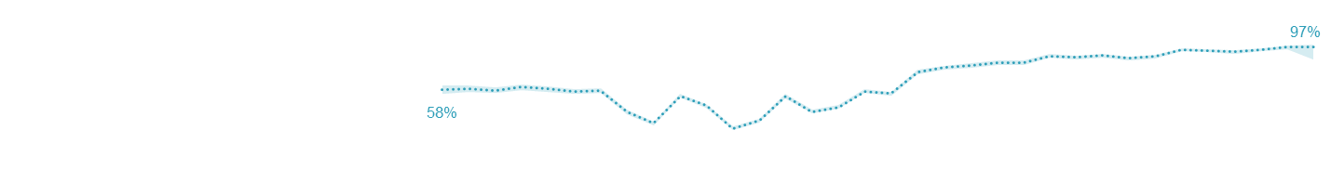
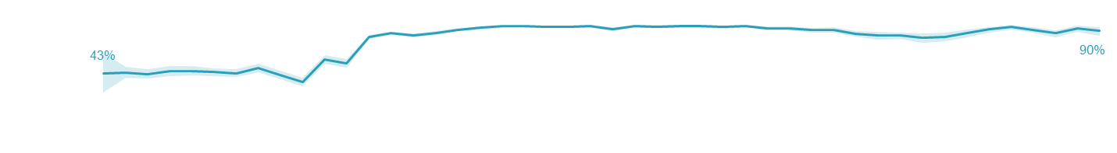
RESULTS
Secondary outcome: Change in mean fixed-dose combination rates
Change in proportion per month (β)
 | Baseline | Jan 2021 | Oct 2023 | Pre-Implementation | Implementation
Proportion of protocol fixed-dose combination medications prescribed (95% CI) | 43% (23-66%) | 83% (81-85%) | 90% (85-94%) | 0.3% | 0.4%
P-Value | 0.003 (non-linear) |  |  | 0.95
 | Step effect p<.0001 | <0.0001 (non-linear)
Fixed dose combination medication protocol
Proportion of protocol fixed dose combination medications prescribed
Multidrug combination medications dispensed as a single pill (Amlodipine+Losartan or Amlodipine+Losartan+HCTZ)
R01HL144708

Slide 11
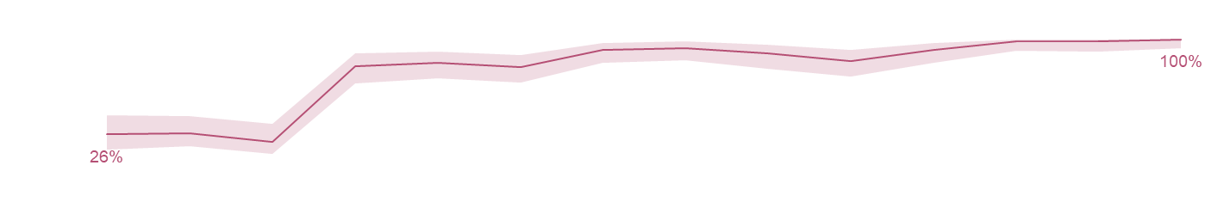
RESULTS
Co-primary implementation outcome: Access to essential medicines
Change in proportion per quarter (β)
 | Baseline | Q1 2021 | Q3 2023 | Pre-Implementation | Implementation
Proportion of PHCs with at least 1 30-day dose of a protocol BP-lowering medication (95% CI) | 26% (14-40%) | 79% (65-89%) | 100% (93-100%) | -2.8% | 2.0%
P-Value | 0.001 (non-linear) |  |  | 0.16
 | Step effect p<.0001 | 0.001
Access to essential medicines and technology
Proportion of PHCs with at least 1 30-day dose of a protocol BP-lowering medication
Medications including Amlodipine, Losartan, HCTZ, Amlodipine+Losartan, or Amlodipine+Losartan+HCTZ
R01HL144708

Slide 12
Discussion
Results in Context
The Hypertension Treatment in Nigeria Program led to significant increase in the 3-month rolling average treatment and control rates from baseline to October 2023, but the changes in slope were greater in the pre-implementation period.
Blood pressures improved significantly and substantially over the study period.
The HTN Program also led to a large increase in availability and use of fixed-dose combination therapy from 43% at baseline to 97% by October 2023.
Limitations included: 1) higher than anticipated baseline treatment and control rates, 2) variable retention in care over the long study period, and 3) interrupted time series study design, which limits causal inference.
R01HL144708

Slide 13
CONCLUSION
A multi-level hypertension program led by community health workers, among the largest hypertension control programs in Africa, was successfully implemented and was associated with improvements in hypertension treatment and control in primary care in Federal Capital Territory, Nigeria.
Mixed methods assessments of implementation, implementation cost, normalization into routine care, and sustainability are ongoing.
Our team now seeks to pursue scale-up of the HTN Program and HEARTS implementation to Nigeria’s 6 geopolitical regions in collaboration with the Federal Ministry of Health and National Primary Care Board Development Agency.
R01HL144708

Slide 14
ACKNOWLEDGMENTS
Patients, HTN Program Team, and Partners: Federal Ministry of Health, National Primary Care Development Agency, FCT Department of Public Health, WHO Nigeria, RTSL
Sponsors: NHLBI (R01HL144708), Northwestern Robert J. Havey MD Institute for Global Health, Resolve to Save Lives
Advisory Board: Dr. Mangai Toma, Mrs. Chiamaka Omoyele, Dr. Nina Ezeigwe, Dr. Ndaeyo Iwot, Dr. Josephine Okechukwu, Dr. Mary Dewan, Mr. Michael Uwazie, Dr. Sunday Goji, PharmD Innocent Uche Nnubia, Dr. Ibrahim Katibi, Dr. Emmanuel Agogo
Data and Safety Monitoring Board: Dr. Brian Rayner, Dr. Amam Mbakwem, Dr. Justine Davies, Dr. James Sheppard, Dr. Patricia Ojiah, Dr. Amanda Thrift, Dr. Adeloye Davies
R01HL144708

Slide 15
Cardiovascular research unit of University OF abuja & university of abuja teaching hospital

Slide 16
THANK YOU

Slide 17
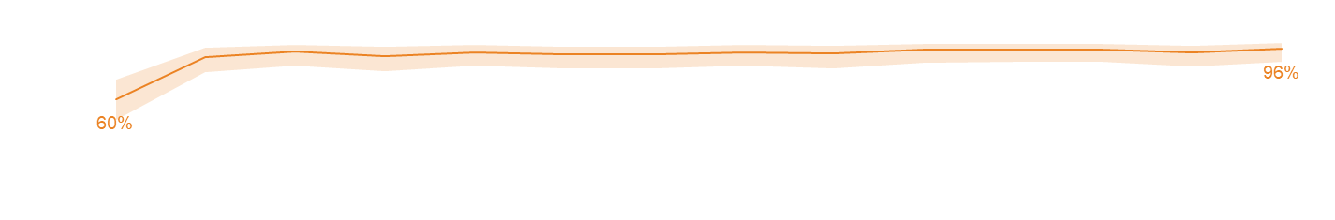
RESULTS
Secondary outcomes: CHEW provided hypertension management
Change in proportion per quarter (β)
 | Baseline | Q1 2021 | Q3 2023 | Pre-Implementation | Implementation
Proportion of PHCs with at least 2 permanent healthcare workers (95% CI) | 60% (44-74%) | 91% (79-97%) | 96% (86-100%) | 17.2% | 0.4%
P-Value | 0.03 (non-linear) |  |  | <0.0001
 | - | 0.005
Team-based care and CHEW provided hypertension management
Proportion of PHCs with at least 2 permanant healthcare workers
Healthcare workers including MD, Nurse, Pharmacist, Lab Tech, CHEW, Junior CHEW, Health Officer
R01HL144708

Slide 18
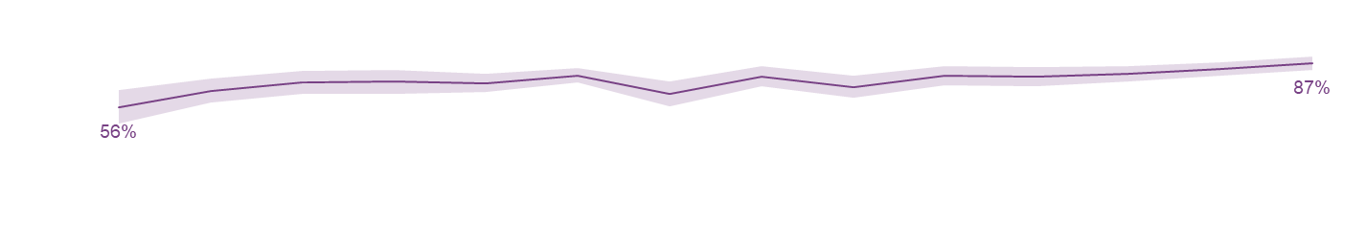
RESULTS
Secondary outcomes: Performance and quality reporting
Change in proportion per quarter (β)
 | Baseline | Q1 2021 | Q3 2023 | Pre-Implementation | Implementation
Proportion of cards without errors (95% CI) | 56% (44-67%) | 73% (65-82%) | 87% (82-91%) | 8.6% | 1.2%
P-Value | 0.02 (non-linear) |  |  | 0.04
 | - | 0.02
Performance and quality reporting
Proportion of cards without errors
R01HL144708

