Slide 1
Pulmonary Embolism: Filling the Evidence Gap
Jay Giri, MD MPH
Assistant Professor of Medicine
Director, Pulmonary Embolism Response Team
Associate Director, Penn Cardiovascular Outcomes, Quality & Evaluative Research Center
University of Pennsylvania

Slide 2
Disclosures
Board of Directors: PERT Consortium, a 501c3 not-for-profit organization

Slide 3
We all know the questions
Lytics vs. Anti-Coag for Intermediate-Risk PE
CDT vs. Systemic Lytics
Novel Catheter Based Therapies vs. Anticoag

Slide 4
Some Other Questions
Who should receive embolectomy?
Who needs hemodynamic support?
How should we dose our lytics?
Best Therapies for Clot in Transit

Slide 5
Current State of Interventional PE Research

Slide 6
FDA
Industry
Societal Leaders

Slide 7
New Technology =
New Opportunity to Advance Scientific Understanding

Slide 8
510K Clearance
For Low and Moderate Risk Devices
Does this apply to interventional PE therapies?
Establish a predicate device that is FDA cleared
Provide data showing substantial equivalence to predicate

Slide 9
EKOS
Classified as Moderate Risk Device
Predicate Devices: Other catheters that can be used for infusion (Swan-Ganz, etc.)
Initial indication: Peripheral Infusion with Warning Stating Lack of Evidence in PE
ULTIMA/SEATTLE II results justified 510k for PE

Slide 10
Incentives
EKOS catheter = $3,000 list price
Most cases – 2 catheters = $6,000
Estimated 300,000 PE hospitalizations
40% intermediate/high-risk
120,000 potential cases
US market: $720M

Slide 11
UlTIMA & SEATTLE II
A 59 patient randomized trial
A 150 patient single-armed trial

Slide 12
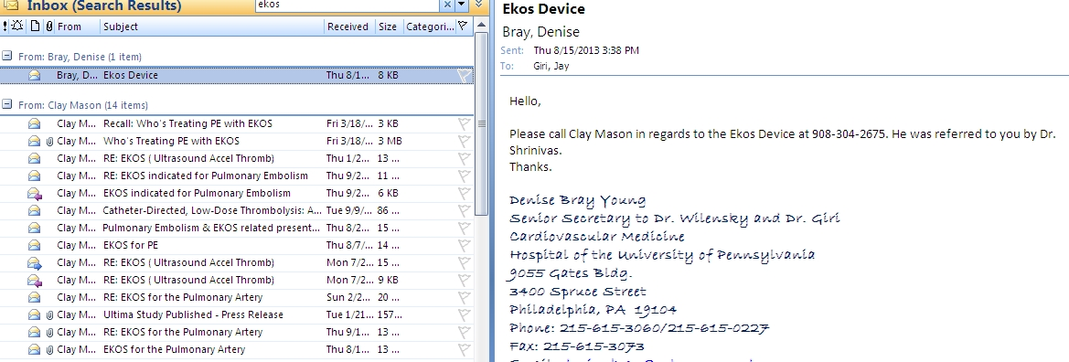
Marketing

Slide 13
Interventional Physician Incentives
Procedure | CPT code | Work RVU - Unilateral | Work RVU - Bilateral
US guided access | 76937 | 0.3 | 0.6
Main PA cath placement | 36013 | 2.52 | 2.52
PA gram | 75743 | 1.33 | 1.66
Selective PA Placement | 36015 | 3.5 | 5.25
Infusion | 37211 | 8 | 12
Cessation | 37214 | 2.74 | 4.11
Total |  | 18.39 | 26.14
Bilateral PE CDT : 26.14 RVU
LHC + PCI : 15.96 RVU
TF TAVR : 15.7 RVU (per operator)
1 hour critical care time: 4.5 RVU

Slide 14
PE Interventional Therapies on the Scale
Technological Advancement
Evidence-Based Regulation

Slide 15
Get Ready for PE Devices without Data
EKOS
Huge Potential Market
510K
Cleared with only 180 total patients studied
$6K per case
Angiovac
No comparative data of any kind
Largest Published Study – 14 patients
$14K per device
Flowtriever
Huge Potential Market
Looking for 510k with 150 patient study (FLARE study)
$5K per device
Indigo System (Penumbra)
510k for removal of thrombus within the periphery
Looking for 510k with 150 patient study

Slide 16
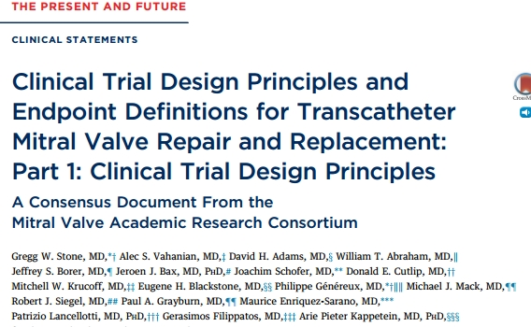
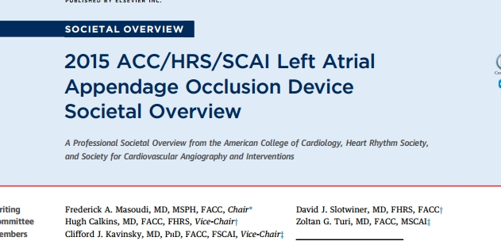
Clinician-Scientists Can Lead Development

Slide 17
Defining the Field
Outcomes Definitions
Design of Studies
Inclusion/Exclusion Criteria
Selection of Control Arm Patients
Operator Training Requirements
Post-Marketing Registries to Assess External Validity Continually

Slide 18
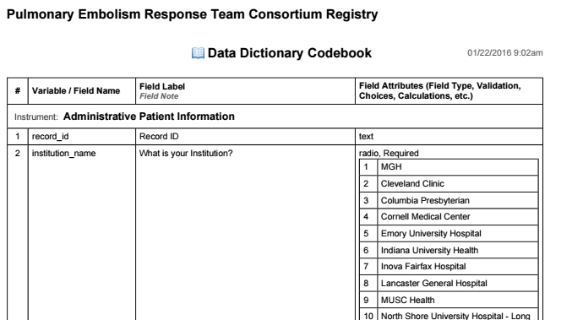
New Opportunities

Slide 19
Thank You
PERT Consortium
Ken Rosenfield - MGH
Victor Tapson – Cedar Sinai
Jana Montgomery – Lahey Clinic
Many Others
Penn Pulmonary Embolism Response Team
Steven Pugliese
Jeremy Mazurek
Barry Fuchs
Prashanth Vallabhajosyula
Tai Kobayashi
PE Research Collaborators
Saurav Chatterjee – U Conn
Ido Weinberg - MGH
Geoffrey Barnes - UMich
Chris Kabhrel - MGH
Ken Rosenfield – MGH
Akhi Sista - NYU
Bram Geller & Srinath Adusumalli - Penn
Emile Mohler, MD
1961 – 2017

Slide 20
All Studies – Major Bleeding Comparison
 | Non-ICH Major Bleed | No Bleeding
Catheter-Directed Lysis | 16 | 164
Systemic Lysis | 83 | 948
P = 0.66
Chatterjee, et al. JAMA 2014.
Kucher, et al. Circulation 2014.
Piazza, et al. JACC Intvn. 2015.

Slide 21
All Studies – ICH Comparison
 | ICH | No ICH
Catheter-Directed Lysis | 0 | 180
Systemic Lysis | 15 | 1009
P = 0.15
Chatterjee, et al. JAMA 2014.
Kucher, et al. Circulation 2014.
Piazza, et al. JACC Intvn. 2015.

Slide 22
What if?
 | ICH | No ICH
Catheter-Directed Lysis | 1 | 180
Systemic Lysis | 15 | 1009
P = 0.49
Chatterjee, et al. JAMA 2014.
Kucher, et al. Circulation 2014.
Piazza, et al. JACC Intvn. 2015.

