Slide 1
Surgical versus transcatheter approach in combined coronary and aortic valve disease
Ignacio J. Amat Santos, MD, PhD, FESC Director, Interventional Cardiology HCU Valladolid - Spain

Slide 2
Potential conflicts of interest
Speaker's name : Ignacio J Amat-Santos
☑ I have the following potential conflicts of interest to declare:
Receipt of honoraria or consultation fees: Boston Scientific, Medtronic, Meril Life, Products & Features

Slide 3
Why this study?
Patients with severe aortic stenosis (AS) present frequently (~50%) with concomitant obstructive coronary artery disease (CAD)
The current guidelines recommend combined surgical aortic valve replacement (SAVR) and coronary artery bypass grafting (CABG) as the preferred treatment in these patients
However combined surgical approach is associated with a higher rate of adverse events
as compared to isolated SAVR or CABG.
Combined transcatheter aortic valve implantation (TAVI) and percutaneous coronary intervention (PCI) have evolved as a valid alternative for SAVR and CABG
We aimed to compare percutaneous versus surgical approach when combined coronary and aortic valve disease exists

Slide 4
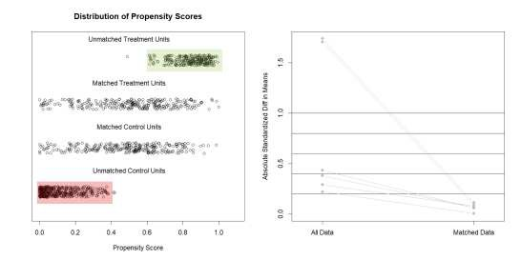
What did we study?
National multicenter (14 centers) retrospective study of all patients with severe AS and CAD
Treated between 2018 and 2021 with either PCI+TAVI or CABG+SAVR and with at least 1-year of follow up
Matched Saencaonlydsarisy etondrpeodinutsce the
impact of baseline differences
Primary endpoint
All-cause mortality and stroke at 1-yr
All-cause mortality, Stroke, MI, AoReg, Re-intervention (CAD/Valve) at 1-y

Slide 5
What are the essential results?
BASELINE CHARACTERISTICS
1342 PATIENTS
4 excluded due to hybrid approach
625 (46.6%) PCI + TAVI
713 (53.1%) CABG + SAVR
Variables | Global population (n=1342) | Unmatched cohort |  |  | Matched cohort
 |  | SAVR+CABG (n=713) | TAVI+PCI (n=625) | p-value | SAVR+CABG (n=254) | TAVI+PCI (n=254) | p-value
Clinical characteristics
Variables | Global population (n=1342) | Unmatched cohort |  |  | Matched cohort
 |  | SAVR+CABG (n=713) | TAVI+PCI (n=625) | p-value | SAVR+CABG (n=254) | TAVI+PCI (n=254) | p-value
Echocardiographic findings
LVEF, % | 56.4±11.8 | 56.5±11.2 | 56.4±12.5 | 0.888 | 57.1±11.0 | 55.2±12.7 | 0.076
AVA, cm² | 0.7±0.2 | 0.8±0.2 | 0.7±0.19 | <0.001 | 0.8±0.2 | 0.7±0.2 | 0.052
Mean transaortic gradient, mmHg | 45.4±14.1 | 44.6±14.4 | 46.3±13.8 | 0.040 | 43.7±13.6 | 45.5±13.7 | 0.192
Three-vessel or left main disease | 27.2 | 33.7 | 19.8 | <0.001 | 38.2 | 23.2 | <0.001
SYNTAX score | 27.4±7.2 | 28.9±8.2 | 26.7±6.9 | 0.031 | 27.2±8.1 | 26.4±7.4 | 0.073
Previous CABG | 2.6 | 0.7 | 4.8 | <0.001 | 0 | 7.5 | 0.653
Previous valve surgery | 2.3 | 1.4 | 3.4 | 0.018 | 1.2 | 6.3 | 0.004
COPD | 11.9 | 10 | 14.1 | 0.020 | 11.0 | 15.4 | 0.161
CKD (eGFR<60ml/min) | 26.9 | 14.9 | 40.6 | <0.001 | 20.1 | 39.0 | <0.001
EuroSCORE II, % | 2.6 [1.7-4.3] | 2.3 [1.6-3.6] | 3.1 [1.9-5.7] | <0.001 | 2.9 [2.1-4.6] | 2.7[1.7-4.7] | 0.662
Age, years
Female sex
Arterial hypertension
76.5±8
33
82.6
72.1±7 81.6±5.8 <0.001
77.4±5.3 77.9±5.7 0.063
23.8
80.5
43.3
85
<0.001
0.032
68.5
80.3
65.4
81.9
0.523
0.738
Dyslipidemia 74.6 75.9 73.1 0.248 76.0 81.9 0.110
Diabetes mellitus
43.6
47
39.7
0.007
44.9
46.5
0.791
NYHA functional class III or IV
39.3
31.7
48
<0.001
36.6
47.2
0.020
Atrial fibrillation
20
14.2
26.7
<0.001
19.3
28.0
0.025

Slide 6
PROCEDURAL OUTCOMES
What are the essential results?
Variables | Global population (n=1342) | Matched cohort
 |  | SAVR+CABG (n=254) | TAVI+PCI (n=254) | p-value
PROCEDURAL OUTCOMES
Number of grafts ≥ 3 | - | 51.7 | - | -
Biological prosthesis |  | 96.5 | 100 | 0.022
Re-intervention | 0.9) | 2.2 | 1.1 | 0.687
Procedural death | 0.7 | 1.2 | 0.4 | 0.625
Technical success | 97.2 | 96.5 | 95.2 | 0.648
IN-HOSPITAL OUTCOMES
New PPI | 10.5 | 9.8 | 12.2 | 0.488
AKI | 11.2 | 20.5 | 7.1 | <0.001
In-hospital death | 3.8 | 6.3 | 2.4 | 0.052
Major vascular complic. | 3.1 | 0.8 | 3.1 | 0.109
Major bleeding | 12.3 | 12.2 | 9.4 | 0.401
Cerebrovascular events | 2.3 | 5.5 | 1.6 | 0.031
MI | 1 | 1.6 | 0.4 | 0.375
New onset AF | 16.3 | 29.9 | 5.9 | <0.001
Stroke + in-hospital death | 5.3 | 10.6 | 3.1 | 0.002

Slide 7
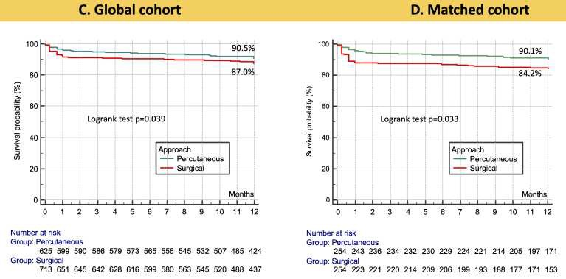
What are the essential results?
FOLLOW UP OUTCOMES
1-year
At 1-year follow up, the primary endpoint of mortality + stroke was higher in the CABG+SAVR group than in the PCI+TAVI cases both, in the matched and the unmatched cohorts
13% vs. 9.5%, p=0.035
15.8% vs. 9.9%, p=0.035
Conversely, the PCI+TAVI group presented higher degree of:
Moderate-severe aortic regurgitation
(12.6 vs. 1.5%, p<0.001) and
New permanent pacemaker
(15 vs. 6.5%, p<0.001)

Slide 8
FOLLOW UP OUTCOMES
What are the essential results?
Variables |  | Unmatched cohort |  |  |  |  |  | Matched cohort
 | SAVR+ CABG | TAVI+ PCI | HR (95% CI) | p-value | SAVR+ CABG (n=254) |  | TAVI+ PCI (n=254) | HR (95% CI) | p-value
Secondary endpoints* |  |  | NO DIFFERENCES IN THE SECONDARY OUTCOMES
Mortality | 10.3 | 7.5 | 1.328 (0.897-1.964) | 0.156 | 12.2 | 8.0 |  | 1.488(0.816-2.714) | 0.195
Need for new revascularization | 1.3 | 1.6 | 0.844 (0.325-2.187) | 0.726 | 0.5 | 2.7 |  | 0.214(0.025-1.835) | 0.160
Myocardial infarction | 4.1 | 2.3 | 1.707 (0.869-3.354) | 0.120 | 3.4 | 3.6 |  | 0.930(0.337-2.566) | 0.889
Stroke | 5.1 | 3.3 | 1.545 (0.861-2.772) | 0.144 | 7.4 | 4.0 |  | 1.789(0.783-4.088) | 0.168

Slide 9
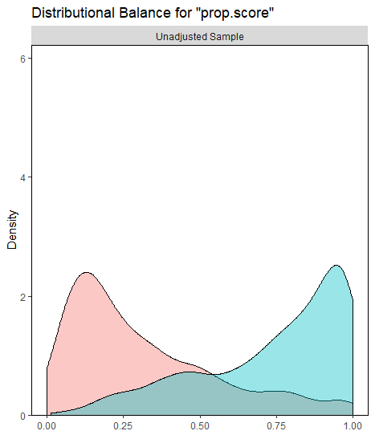
What are the essential results?
Percutaneous Surgical

Slide 10
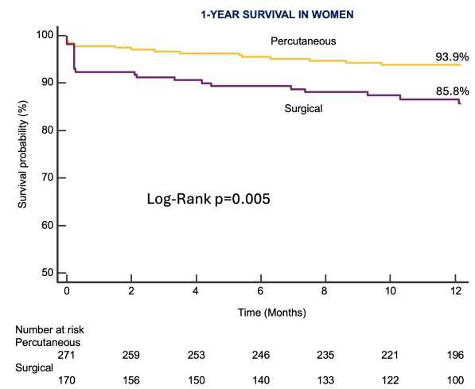
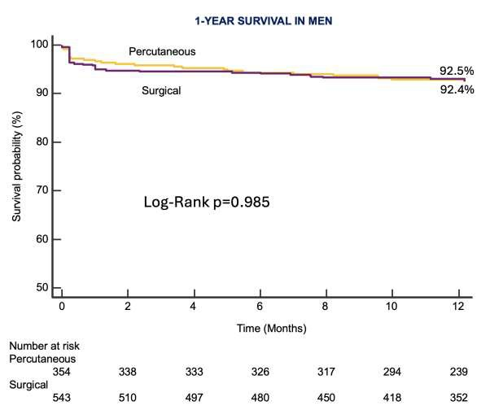
Global population according to gender
1-YEAR +
WOMEN
MEN

Slide 11
The essentials to remember
WHY?
Concomitant severe AS and significant CAD are frecuent. Surgical approach is the guidelines-directed strategy
WHAT?
Patients from 14 institutions with severe AS+CAD who underwent CABG+SAVR vs. PCI+TAVI between 2018 and 2022
HOW?
Primary endpoint: Global mortality + Cerebrovascular events at 1-yr
Secondary endpoint: All-cause mortality, Stroke, MI, AoReg, Re-intervention (CAD/Valve) at 1-yr
WHAT ARE THE RESULTS ?
The rate of Mortality + cerebrovascular events was higher after CABG + SAVR at 1-year
WHY IS IT IMPORTANT?
This highlights the need for a randomized trial in this setting and likely update the Guidelines

Slide 12
PCRonline.com

