Slide 1
Radial vs Femoral Access in ACS Patients
Michael J. Cowley, M.D. MSCAI
Virginia Commonwealth Univ
Richmond, Va
Nothing to disclose

Slide 2
Bleeding* Rates in NCDR PCI Registry
2007-2012 (n=2,820,874); Radial = 178,643 pts
%
* Major or Hgb i > 3 gm
Feldman DN: Circulation 2013;127:2295-2306

Slide 3
Meta-analysis of Radial vs Femoral 23 Studies (n=7,030)
Major bleeding
0.27 (0.16-0.45)
Death
0.74 (0.42-1.30)
Death, MI or stroke
0.71 (0.49-1.01)
Access Failure
1.31 (0.87-1.96)
Radial better
1.0
Femoral better
Jolly SS: Am Heart J 2009;157:132-40
Notes:
3

Slide 4
RIVAL: Radial vs Femoral
ACS, NSTE, or STEMI (n=7,021 pts)
%
p=0.50
p=0.0001
p<0.23
Complication
* Death , MI, CVA, Major Bleed
Jolly SS: Lancet 2011; 377: 1409-1420

Slide 5
R I V A L
Outcomes by STEMI vs NSTEACS
#
%Radial %Femoral
Hazard Ratio (95% CI)
Interaction
Primary Outcome
p-value
NSTE/ACS
5063
3.8
3.5
STEMI
1958
3.1
5.2
0.025
Death, MI or stroke
NSTE/ACS
5063
3.4
2.7
STEMI
1958
2.7
4.6
0.011
Death
NSTE/ACS
5063
1.2
0.8
STEMI
1958
1.3
3.2
0.001
Non CABG Major Bleed
NSTE/ACS
5063
0.6
1.0
STEMI
1958
0.8
0.9
0.56
Major Vascular Complications
NSTE/ACS
5063
1.4
3.8
0.89
STEMI
1958
1.3
3.5
0.25
1.00
4.00
Radial better Femoral better

Slide 6
R I V A L
Results Radial Volume at Centers
*High (>146 radial PCI/year/ median operator); Medium (61-146); Low (≤60)
Tertiles of Radial PCI Centre Volume/yr
HR (95% CI)
p-value
Primary Outcome
Interaction
High
0.021
Medium
Low
Death, MI or stroke
High
0.013
Medium
Low
Non CABG Major Bleed
High
Medium
0.538
Low
Major Vascular Complications
High
0.019
Medium
Low
Access site Cross-over
High
0.003
Medium
Low
0.25
1.00
4.00
16.00
Radial better Femoral better
Notes:
Of note in high volume femoral PCI centres, femoral was not better than radial.
6

Slide 7
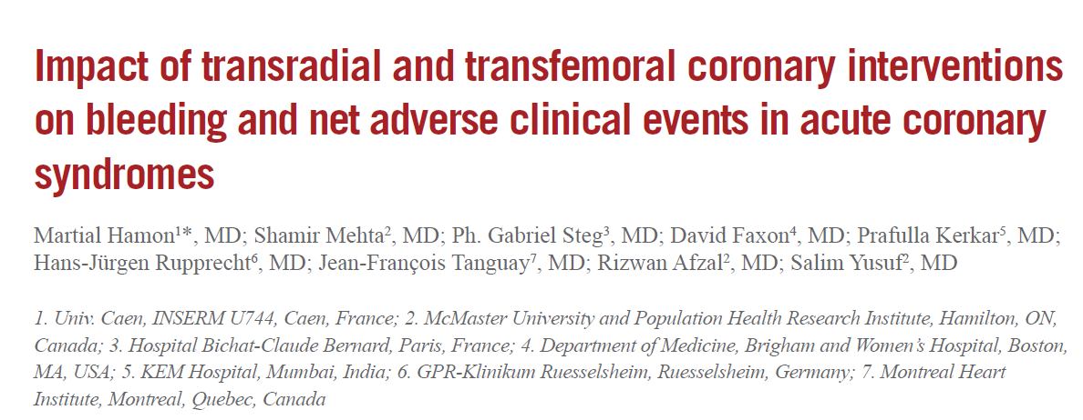
Hamon M : EuroIntervention 2011: 7: 91-97

Slide 8
OASIS Trial
Endpoint Events by Access Site (9 days)
%
p<0.03
p=0.004
Hamon M : EuroIntervention 2011: 7: 91-97

Slide 9
OASIS Trial
Major Bleeding by Access Site (9 days)
%
p<0.03
p=0.004
p<0.05
Hamon M : EuroIntervention 2011: 7: 91-97

Slide 10
ACUITY Access
Endpoint Events by Access Site
%
p=ns
p=ns
p=0.02
Hamon M : TCT 2006

Slide 11
Radial Access for STEMI
NCDR
REAL Registry
Horizons AMI subgroup
RIVAL
RIFLE
RADIAL STEMI

Slide 12
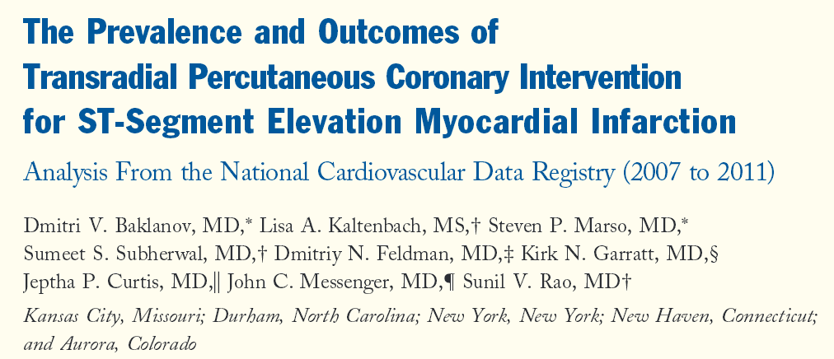
NCDR Registry
1° PCI in 90,879 pts; 6,159 had Radial PCI
Baklanov D: JACC 2013; 420-426

Slide 13
Radial PCI for STEMI
Mortality
Mortality, adjusted
Procedure Success
Procedure Success, adjusted
Bleeding
Bleeding, adjusted
Favors Radial
Favors Femoral
Baklanov D: JACC 2013; 420-426

Slide 14
Radial Access for 1° PCI
RCT, RCT subgroup, or Registry
Study | Outcomes
RIVAL STEMI* | i NACE, MACE, Death, Vasc
RIFLE STEACS* | i NACE, MACE, Bleed, Death
STEMI Radial* | i NACE, Bleed
Horizons AMI | i NACE, MACE, Bleed, Death/MI
Real Registry | i MACE, Death, Vasc, Transfuse
* RCT radial vs femoral

Slide 15
RIVAL: Radial vs Femoral
STEMI (n=1,958 pts)
%
p=0.02
p=0.03
p=0.002
p=0.001
p<0.87
Complication
* Death , MI, CVA, Major Bleed
Jolly SS: Lancet 2011; 377: 1409-1420

Slide 16
HORIZONS: Radial vs Femoral
30 Day Outcomes
%
p<0.001
p=0.03
p=0.02
p=0.02
Généreux P: et al: EuroIntervention 2011; 7: 905-916

Slide 17
HORIZONS: Radial vs Femoral
1 Year Outcomes
%
p<0.001
p<0.01
p=0.05
p=0.02
Généreux P: et al: EuroIntervention 2011; 7: 905-916

Slide 18
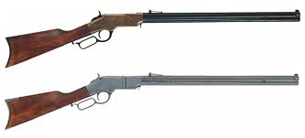
RIFLE STEACS
Adverse Events at 30 days
n= 1,001 pts
%
p = 0.003
p = 0.029
p = 0.026
p = 0.02
NACE: = MACCE + bleeding
MACCE: Cardiac death, MI, TLR, stroke
Romagnoli E, et al: JACC 2012

Slide 19
Radial STEMI
n=707 pts
%
p = 0.0028
p = 0.0001
80%
58%
* Bleeding and Access Site Complications at 30 days
Bernat I: LBCT, TCT 2012

Slide 20
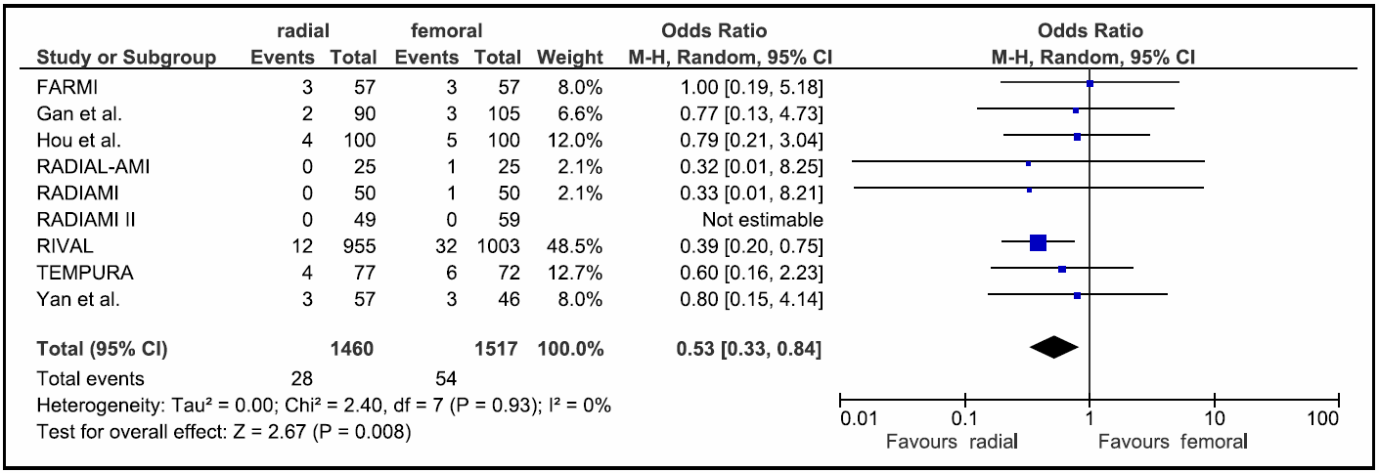
Radial vs Femoral for STEMI
10 RCTs with 3,347 STEMI Patients
Death (30 days)
Joyal et al: Am J Cardiol 2012;109:813- 818

Slide 21
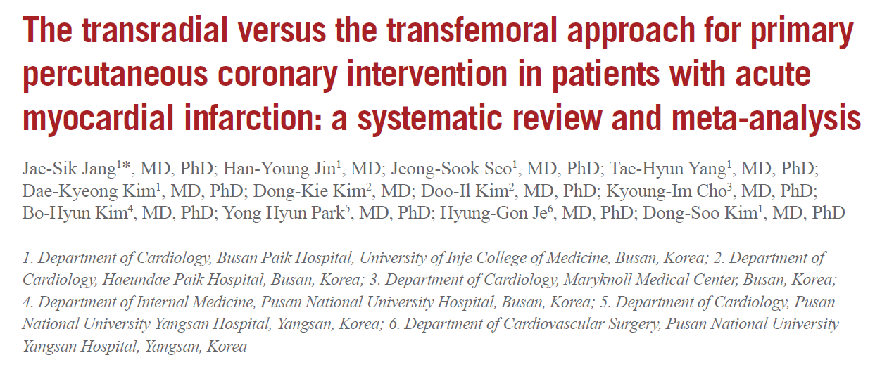
Jang J: EuroIntervention 2012; 8: 501-510

Slide 22
Radial vs Femoral for Primary PCI
21 studies (8 RCT); 8,434 pts
Lower MACE, mortality, bleeding
No difference in D2B, procedure time, fluoro time
Shorter hospital stay with TRA
Jang J: EuroIntervention 2012; 8: 501-510

Slide 23
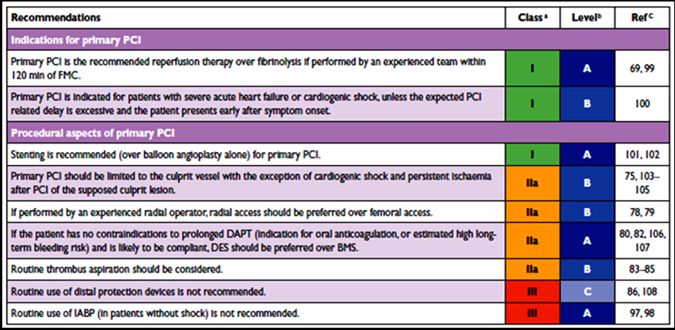
ESC Guidelines
Primary PCI: Indications and procedural aspects
If performed by an experienced radial operator, radial access should be preferred over femoral access (IIa, B)
Steg G: Eur Heart J 2012;33:2569-2619

Slide 24
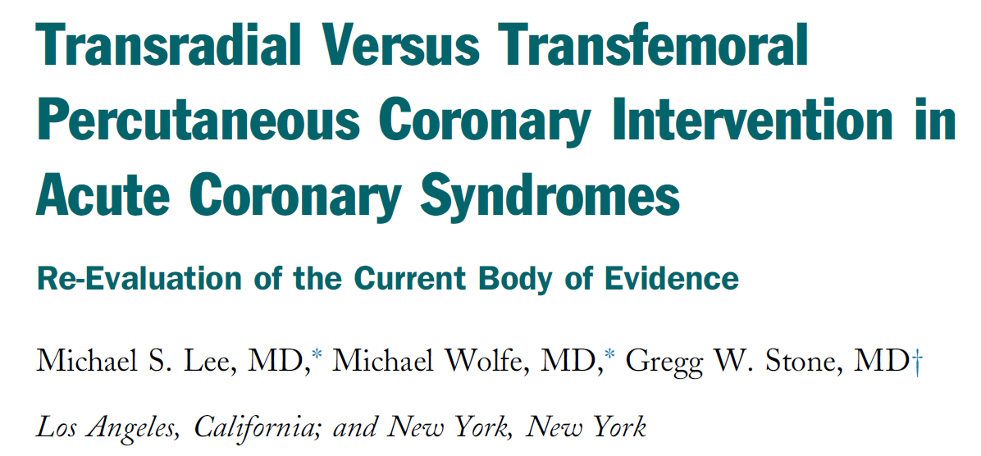
JACC CV Interv 2013; 6: 1149-1152

Slide 25
Radial Superiority for ACS
Criticisms
High volume radial centers
Lower volume operators not better
Suboptimal Antithrombotic Usage
Infrequent bivalirudin (<10%)
High UFH doses (70-100 IU/kg)
Liberal GPI use (25%, 70%, 45%)
Infrequent VCD

Slide 26
Bleeding Avoidance Strategies for PCI
Effect of Radial Access and Bivalirudin
NCDR (n=501,017 pts)
%
p<0.001
2.7
2.5
1.8
Baklanov D: Circ CV Interv 2013; 6: 347-353

Slide 27
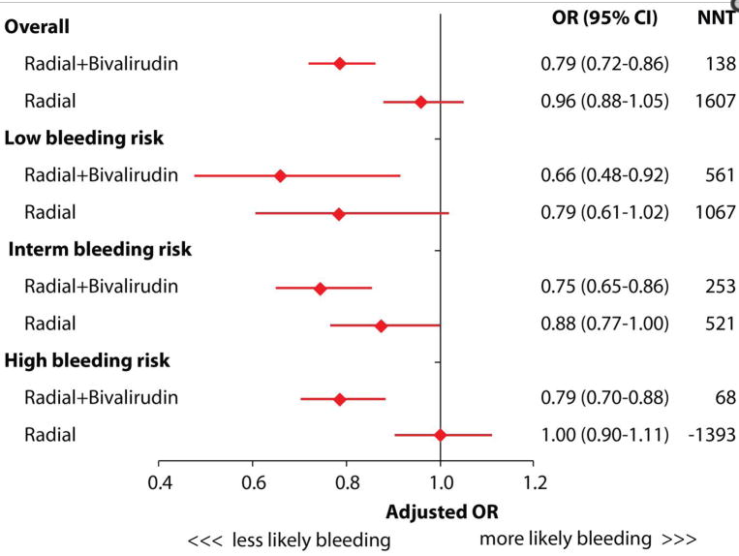
Radial vs Femoral + Bival + VCD
NCDR (n=501,017 pts)
Baklanov D: Circ CV Interv 2013; 6: 347-353

Slide 28
Radial vs Femoral for ACS
Upcoming Bivalirudin Trials
MATRIX Trial
SAFARI-STEMI

Slide 29
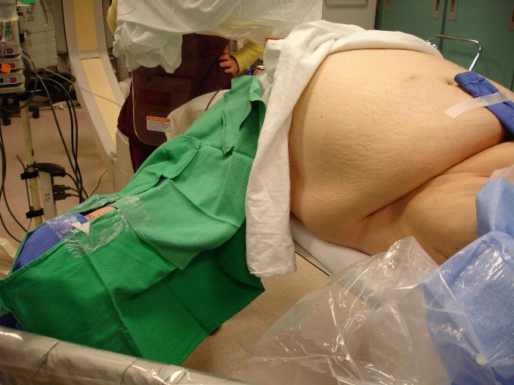
Radial or Femoral For ACS?
You Make the Call !

Slide 30
Radial vs Femoral Access for ACS
Summary
TRA significantly reduces bleeding, MACE, mortality and access complications in ACS pts
Data and guidelines support preferential use of TRA for ACS, and particularly with STEMI pts
Broader TRA expertise should allow better clinical outcomes to a greater number of ACS pts

