Slide 1
TCT Template Title 30 pt Bold Arial
Outcomes for the Full US Cohort of the FLASH FlowTriever Mechanical Thrombectomy Registry in Pulmonary Embolism
Catalin Toma, MD University of Pittsburgh Medical Center, Pittsburgh, PA, USA
John Doe, MD
Subtitle 25 pt Arial Bold Italics

Slide 2
Disclosure Statement of Financial Interest
Within the past 12 months, I or my spouse/partner have had a financial interest/arrangement or affiliation with the organization(s) listed below.
Affiliation/Financial Relationship | Company
Consulting Fees/Honoraria | Medtronic
Consulting Fees/Honoraria | Philips
Faculty disclosure information can be found on the app

Slide 3
Intervention for Pulmonary Embolism
Acute all-cause mortality following PE has remained high (>10%) over 2 decades^{1,2}
Following PE, the 30-day readmission rate is nearly 25%,³ and up to half of patients report persistent dyspnea, exercise intolerance, and/or functional limitations at 3–6 months⁴
Guidelines suggest considering advanced therapies, including mechanical thrombectomy, when thrombolytics fail or are contraindicated, or hemodynamic deterioration occurs⁵
Major bleeding risks with thrombolytic-based treatment strategies remain a concern, and their use is limited by corresponding contraindications and consequent ICU monitoring
Mechanical thrombectomy can rapidly extract thrombus and relieve RV strain without thrombolytics; additional data on the risk-to-benefit ratio could shift the standard of care
Kucher N, et al. Circulation. 2006 (ICOPER)
PERT Consortium Quality Database. Presented by E. Secemsky (October 2021)
PERT Consortium Quality Database. Presented by R. Lookstein (October 2020)
Luijten D, et al. Semin Thromb Hemost. 2022
Konstantinides SV, et al. Eur Heart J. 2020 (ESC Guidelines)

Slide 4
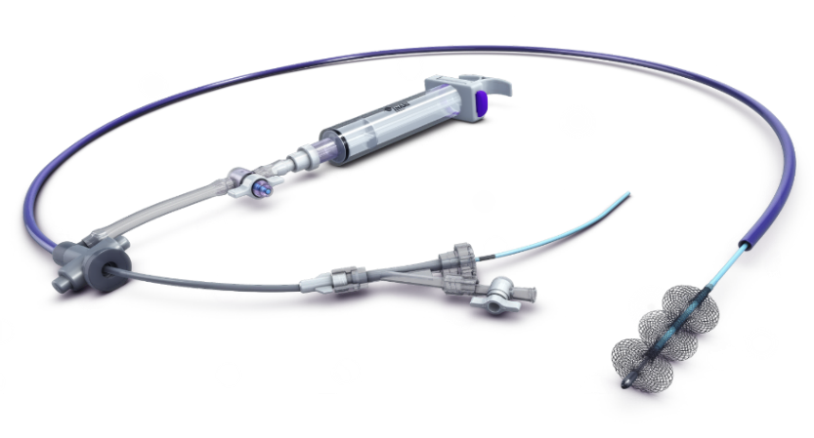
Percutaneous Mechanical Thrombectomy
The FlowTriever System extracts PE thrombus by aspiration and/or mechanical modes without the need for thrombolytics
Large bore (16–24F) aspiration catheter
Nitinol mesh disks for clot disruption
The FlowTriever System is 510(k)-cleared by the US FDA and CE Mark approved for the treatment of PE.

Slide 5
FLASH Registry
Design: Prospective, multicenter, single-arm
Methods: Decision to intervene at the discretion of treating physicians/local PERT
Objective: Evaluate the safety and effectiveness of the FlowTriever System for treatment of PE in an all-comer patient population through 6 months
Primary Endpoint: MAE composite endpoint:
Device-related mortality within 48 hours
Major bleeding within 48 hours
Intraprocedural device- or procedure-related AEs
800 patients enrolled at 50 clinical sites in the United States
Between December 2018 and December 2021
1 patient later found to be ineligible
799 PE patients treated with the FlowTriever System included in analysis
794 (99.4%) at 48-hour visit*
734 (91.9%) at 30-day visit†
558 (69.8%) at 6-month visit‡
+
129 (16.1%) still participating
FLASH is the largest prospective interventional study in PE
*±36 hours. †±15 days. ‡±90 days.

Slide 6
Baseline Characteristics
Characteristic | n (%) or mean ± SD
Age, years | 61.2 ± 14.6
Male sex | 431 (54.0)
History of DVT | 143 (17.9)
History of PE | 85 (10.7)
History of PHTN | 77 (9.7)
Concomitant DVT | 512 (65.0)
Systolic PA pressure ≥70 mmHg | 99 (12.7)
History of cancer | 165 (20.7)
Active cancer | 65 (8.1)
Lytics contraindication | 256 (32.1)
Characteristic | n (%) or mean ± SD
High-risk PE | 63 (7.9)
Intermediate-high risk PE | 611 (76.7)
Intermediate-low risk PE | 59 (7.4)
Intermediate risk PE (unknown) | 64 (8.0)
sPESI | 1.6 ± 1.1
Positive biomarker(s)* | 720 (94.6)
RV/LV ratio (CT or echo) | 1.5 ± 0.5
Saddle PE | 319 (40.0)
Unilateral PE | 68 (8.5)
Bilateral PE | 411 (51.5)
Sample size for each characteristic ranged from 751 to 798 patients.
*Elevated BNP and/or troponin.

Slide 7
Procedure Characteristics and Length of Stay
Characteristic | n (%) or median [IQR]
Femoral or common femoral access | 794 (99.5)
Thrombectomy time, min | 43 [29–62]
Estimated blood loss, mL | 225 [95–400]
With FlowSaver blood return | 100 [50–200]
Without FlowSaver blood return | 250 [100–400]
Adjunctive PE therapy used | 19 (2.4)
Post-procedure ECMO use | 3 (0.4)
Hospital overnights post-procedure | 3 [2–5]
No overnight ICU stay post-procedure | 473 (62.6)
Access sample size is the total number of access sites. Sample size for the remaining characteristics ranged from 721 to 799 patients, except for estimated blood loss with FlowSaver (n=79) and without FlowSaver (n=642).

Slide 8
Safety and Mortality Outcomes
Primary MAE Composite Endpoint: | 1.8% (14/788)
0 device-related deaths: | 0.0%
11 major bleeds*: | 1.4%
3 intraprocedural AEs: | 0.4%
2 clinical deteriorations†
1 cardiac injury‡
0 intraprocedural deaths
All-Cause Mortality:
48-hour visit: | 0.3% (2/794)
30-day visit: | 0.8% (6/734)
6-month visit: | 5.0% (28/558)
*No intracranial hemorrhages. †Not related to the study device. ‡Unknown relationship to the study device.

Slide 9
Immediate Hemodynamic Responses
p < 0.0001
p < 0.0001
p < 0.0001
p values calculated from paired assessments; mean change reported.
*In patients (25.9%) with baseline cardiac index <2.0 L/min/m² .

Slide 10
Acute Clinical Outcomes
p < 0.0001
p < 0.0001
p < 0.0001
Required
None (room air)
87.4% of patients had improvement in supplemental O₂ status at 48 hours
p values calculated from paired assessments.

Slide 11
Echocardiographic Assessments
Severely reduced Moderately reduced | Mildly reduced Normal
p < 0.0001
p < 0.0001
p < 0.0001
p < 0.0001
p < 0.0001
p < 0.0001
p values calculated from paired assessments; mean latest follow-up ranged from 105.2–116.3 days.

Slide 12
Dyspnea and Quality of Life Measures
p < 0.0001
p < 0.0001
p < 0.0001
4
3
2
1
0
p < 0.0001
p < 0.0001
p values calculated from paired assessments; score change is mean change from baseline to 6 months.

Slide 13
Readmissions and Long-Term Sequelae
All-Cause Readmissions at 30-day visit: | 6.2%
Related to PE treatment: | 1.4% (10/711)
Unrelated to PE treatment: | 4.8% (34/714)
Long-Term Sequelae at 6-month visit:
CTEPH: | 1.2% (6/490)
CTED/Post-PE Syndrome: | 2.0% (10/497)

Slide 14
FLASH in Perspective
¹
²
²
³
PERT Consortium Quality Database. Presented by E. Secemsky. (October 2021)
Ismayl M, et al. Am J Cardiol. 2022 (Catheter-directed thrombolysis meta-analysis)
PERT Consortium Quality Database. Presented by R. Lookstein. (October 2020)

Slide 15
Conclusion
FLASH results demonstrate the excellent safety profile of the FlowTriever System with a 1.4% major bleeding rate and 0.4% rate of other MAEs in the largest prospective interventional study population
In a real-world patient population with prevalent baseline predictors of mortality, all-cause mortality was <1% at the 30-day visit
Hemodynamics improved on-table, acute vitals and RV strain normalized, and clinical recovery continued through 6 months
Data from ongoing PEERLESS RCT will provide important evidence regarding the safety and effectiveness of FlowTriever mechanical thrombectomy compared with catheter-directed thrombolysis

Slide 16
Acknowledgements
PRINCIPAL INVESTIGATORS | SITES
Catalin Toma (Global FLASH PI) | University of Pittsburgh Medical Center (Pittsburgh, PA)
Jaber, Wissam | Emory University (Atlanta, GA)
Weinberg, Mitchell | Northwell Health (Manhasset, NY)
Bunte, Matthew; Wible, Brandt | Saint Luke's Hospital of Kansas City (Lee's Summit, MO)
Stegman, Brian | CentraCare Heart & Vascular Center (St. Cloud, MN)
Khandhar, Sameer | University of Pennsylvania (Philadelphia, PA)
Gondi, Sreedevi | Baptist Health Louisville (Louisville, KY)
Chambers, Jeffrey | Metropolitan Heart & Vascular Institute (Minneapolis, MN)
Amin, Rohit | Ascension Sacred Heart (Pensacola, FL)
Leung, Daniel | Christiana Care Health Services (Newark, DE)
Pollak, Jeffrey | Yale University (New Haven, CT)
Kado, Herman | Ascension Providence Hospital (Madison Heights, MI)
Sarosi, Michael | St. Joseph Mercy (Ypsilanti, MI)
Brown, Michael | Missouri Cardiovascular Specialists (Columbia, MO)
Castle, Jordan | Providence Sacred Heart (Spokane, WA)
Bhat, Ambarish | University of Missouri, Columbia (Columbia, MO)
Savin, Michael | Oakland University William Beaumont School of Medicine (Royal Oak, MI)
Siskin, Gary | Albany Medical Center (Albany, NY)
Beam, Daren/Stewart, Lauren Kathryn | Indiana University School of Medicine (Indianapolis, IN)
Brancheau, Daniel | Ascension Genesys Hospital (Grand Blanc, MI)
Ahmed, Mustafa | UAB Division of Cardiovascular Disease (Birmingham, AL)
Rosenberg, Michael; Fanola, Christina | University of Minnesota (Minneapolis, MN)
Elmasri, Fakhir | Lakeland Vascular Institute (Lakeland, FL)
Zlotnik, David | SUNY, The University at Buffalo (Buffalo, NY)
PRINCIPAL INVESTIGATORS | SITES
Bisharat, Mohannad | Memorial Hospital Jacksonville (Jacksonville, FL)
Butros, Paul | Inova Health System (Fairfax, VA)
Koenig, Gerald | Henry Ford Health System (Detroit, MI)
Zybulewski, Adam; *Olivieri, Brandon, *Beasley, Robert | Mount Sinai Medical Center of Florida (Miami, FL)
Angel, Wesley; Roberts, Jon | Methodist Healthcare Foundation (Germantown, TN)
Kerrigan, Jimmy | Ascension St. Thomas West (Nashville, TN)
Li, Jun | University Hospitals Cleveland Medical Center (Cleveland, OH)
Schimmel, Daniel | Northwestern University (Chicago, IL)
Balderman, Joshua | Pima Heart and Vascular (Tucson, AZ)
Patton, Marquand | Palmetto General Hospital (Hialeah, FL)
Walker, Chris | UTMC Knoxville (Knoxville, TN)
Gonsalves, Carin | Thomas Jefferson University (Philadelphia, PA)
Kasmikha, Zaid; *Qaqi, Osama | Ascension Providence Rochester Hospital (Rochester, MI)
Veerina, Kalyan | Opelousas General (Opelousas, LA)
Dexter, David | Sentara (Norfolk, VA)
Lookstein, Robert | Mount Sinai Medical Center (New York, NY)
Lasic, Zoran | Jamaica Hospital/Lenox Hill (New York, NY)
Mahjoobi, Maziar | Texoma Medical Center (Denison, TX)
Paul, Jonathan | University of Chicago (Chicago, IL)
Tumuluri, Ramagopal | Aurora St. Luke’s Medical Center (Milwaukee, WI)
Horowitz, James | NYU Langone Medical Center (New York, NY)
Lee, Justin | Sarasota Memorial (Sarasota, FL)
Leonardi, Robert | Lexington Medical Center (Lexington, KY)
Patel, Mitul | Valley Health (Ridgewood, NJ)
Rothschild, Daniel | Norton Healthcare (Louisville, KY)
Tabriz, David | Rush University Medical Center (Chicago, IL)
*Past Principal Investigators

Slide 17
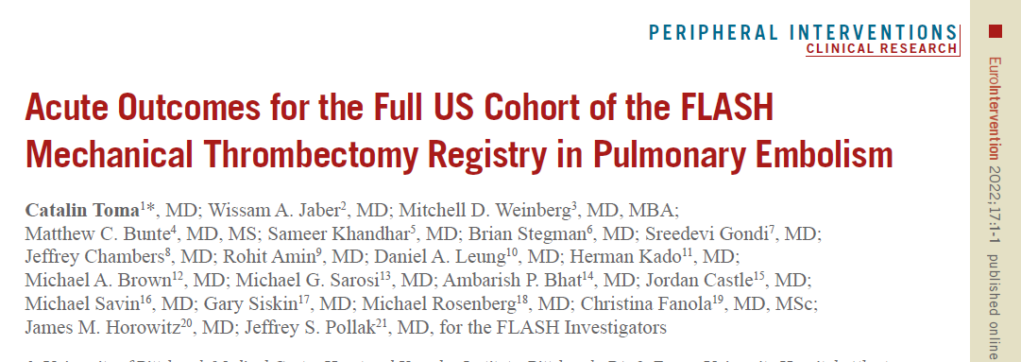
Simultaneous Publication In EuroIntervention

Slide 18
Multiple Linear Regression Models
Absolute Reduction in mPAP
Variable | Effect Estimate | 95% CI | p-value
Baseline mPAP | -0.38 | (-0.44,-0.32) | <.001
Age (per year) | 0.03 | (-0.01, 0.06) | 0.100
Gender (male vs. female) | 0.43 | (-0.53, 1.39) | 0.380
Race (Black vs. White) | 0.57 | (-0.50, 1.64) | 0.297
Race (others/unknown vs. White) | 0.19 | (-2.28, 2.65) | 0.883
BMI (kg/m²) | 0.08 | (0.02, 0.14) | 0.008
Intermediate-high vs. intermediate-low risk | 0.15 | (-1.66, 1.96) | 0.872
High vs. intermediate-low risk | 0.51 | (-1.85, 2.88) | 0.671
PE location (bilateral vs. unilateral) | -1.33 | (-2.51, -0.15) | 0.027
PE location (saddle vs. unilateral) | -1.81 | (-3.18, -0.44) | 0.010
DVT history | 0.00 | (-1.27, 1.27) | 0.999
Variable | Effect Estimate | 95% CI | p-value
Concomitant DVT (distal vs. none) | -0.29 | (-1.38, 0.80) | 0.606
Concomitant DVT (proximal vs. none) | 0.44 | (-0.81, 1.70) | 0.488
Concomitant DVT (both vs. none) | -2.95 | (-4.45, -1.46) | <.001
PE history | 1.26 | (-0.37, 2.88) | 0.130
PHTN history | 0.18 | (-1.38, 1.74) | 0.821
Cancer history | -0.49 | (-1.64, 0.66) | 0.405
Lytics contraindication | -0.18 | (-1.14, 0.79) | 0.721
RV/LV ratio | -0.02 | (-1.01, 0.97) | 0.969
Heart rate (per 10bpm) | -0.19 | (-0.42, 0.05) | 0.127
PE symptom duration (per day) | 0.02 | (-0.04, 0.09) | 0.463
sPAP (≥70 vs. <70 mmHg) | 4.07 | (2.44, 5.69) | <.001

Slide 19
Multiple Linear Regression Models
Absolute Reduction in mMRC Dyspnea Score
Variable | Effect Estimate | 95% CI | p-value
Baseline dyspnea score | -0.79 | (-0.88, -0.70) | <.001
Age (per year) | 0.01 | (0.00, 0.02) | 0.139
Gender (male vs. female) | -0.21 | (-0.47, 0.05) | 0.122
Race (Black vs. White) | 0.05 | (-0.25, 0.34) | 0.758
Race (others/unknown vs. White) | 0.15 | (-0.50, 0.80) | 0.646
BMI (kg/m²) | 0.00 | (-0.01, 0.02) | 0.792
Intermediate-high vs. intermediate-low risk | -0.14 | (-0.65, 0.37) | 0.602
High vs. intermediate-low risk | 0.59 | (-0.06, 1.24) | 0.077
PE location (bilateral vs. unilateral) | -0.23 | (-0.56, 0.09) | 0.165
PE location (saddle vs. unilateral) | -0.29 | (-0.68, 0.11) | 0.157
DVT history | -0.15 | (-0.53, 0.23) | 0.428
Variable | Effect Estimate | 95% CI | p-value
Concomitant DVT (distal vs. none) | -0.14 | (-0.44, 0.17) | 0.375
Concomitant DVT (proximal vs. none) | -0.28 | (-0.62, 0.05) | 0.100
Concomitant DVT (both vs. none) | 0.04 | (-0.41, 0.49) | 0.853
PE history | -0.14 | (-0.64, 0.35) | 0.569
PHTN history | 0.04 | (-0.45, 0.54) | 0.862
Cancer history | 0.28 | (-0.04, 0.60) | 0.085
Lytics contraindication | 0.09 | (-0.18, 0.37) | 0.508
RV/LV ratio | -0.03 | (-0.33, 0.27) | 0.829
Heart rate (per 10bpm) | 0.00 | (-0.07, 0.07) | 0.999
PE symptom duration (per day) | 0.03 | (0.01, 0.06) | 0.007
sPAP (≥70 vs. <70 mmHg) | 0.28 | (-0.11, 0.68) | 0.164

