Slide 1
Real-time catheter-based MVO detection in STEMI
Results from the MOCA I study
Prof. Marco Valgimigli, MD, PhD Deputy Chief of Cardiology Cardiocentro Ticino Institute, EOC Lugano, Switzerland

Slide 2
Potential conflicts of interest
Speaker's name : Marco Valgimigli
I received personal fees from AstraZeneca, grants and personal fees from Terumo,personal fees from Alvimedica/CID, personal fees from Abbott Vascular, personal fees from Daiichi Sankyo, personal fees from Bayer, personal fees from CoreFLOW, personal fees from IDORSIA PHARMACEUTICALS LTD, personal fees from Universität Basel | Dept. Klinische Forschung, personal fees from Bristol Myers Squib SA, personal fees from Medscape, personal fees from Biotronik, personal fees from Novartis, personal fees from Concept Medical.

Slide 3
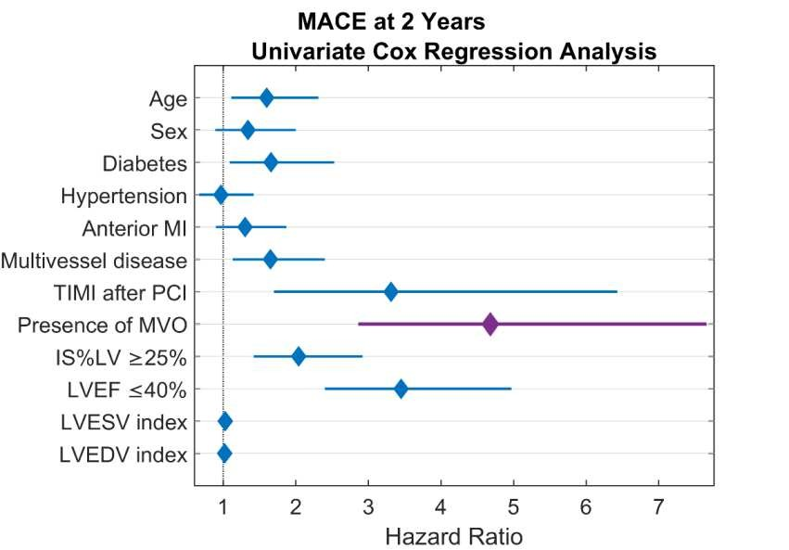
Why this study?
Microvascular Obstruction (MVO)
carries major prognostic implications after STEMI
STEMI patients remain at risk of cardiovascular events after primary PCI (pPCI)
MVO is present in nearly 60% of primary PCI cases
MVO is a major prognostic determinant after STEMI, but is not routinely diagnosed in the cathlab
De Waha S et al., EHJ 2017 ;38:3502-10;
Klug G et al. J Cardiovasc Magn Reson. 14, 46 (2012)
Image data from: Van Kranenburg M et al., JACC Cardiovasc Imaging. 2014 Sep;7(9):930-
9
Diagnosis and treatment of MVO in STEMI patients might become a new treatment opportunity

Slide 4
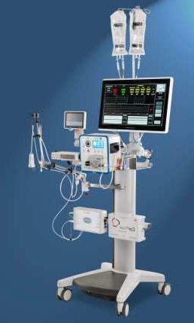
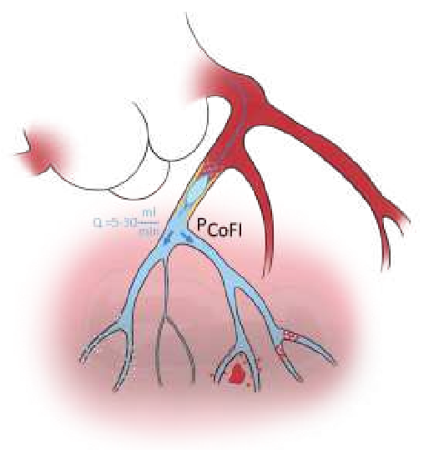
What did we study?
The MOCA I first-in-human study evaluates the safety and feasibility of a novel real-time catheter-based system to detect MVO in the cathlab
CorFlow Controlled Flow Infusion (CoFI) System with new occlusion-infusion catheter, optical pressure-sensing guide wire and console
System outputs a novel pressure parameter (P_{CoFI}) for diagnosis of MVO
→ (Diagnostic Phase of MOCA I)
System also has capability to timely deliver therapeutic intracoronary agents
→ (Therapeutic Phase of MOCA I)

Slide 5
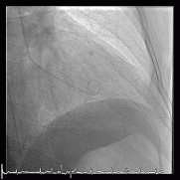
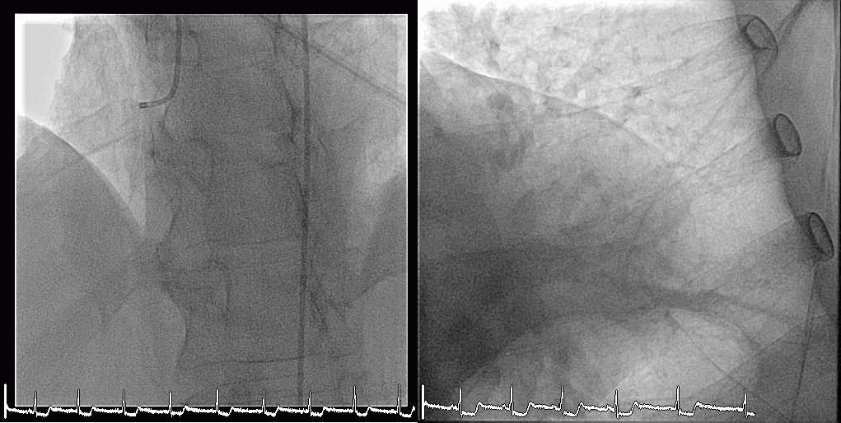
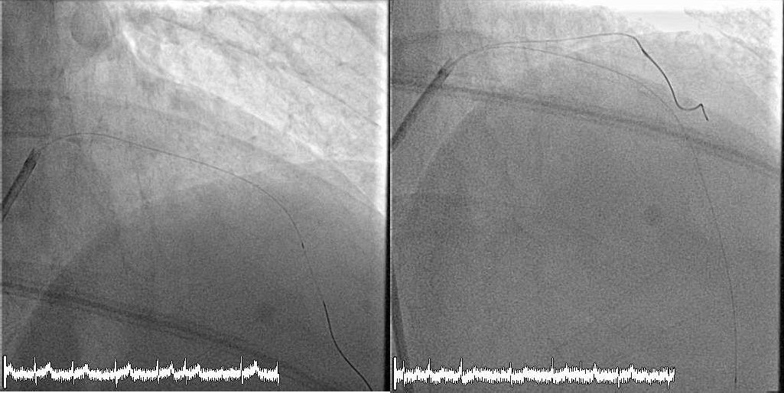
CH001-008
RCA
Prox LAD occlusion
Wiring RIVA
DES 3.0 X 30 mm

Slide 6
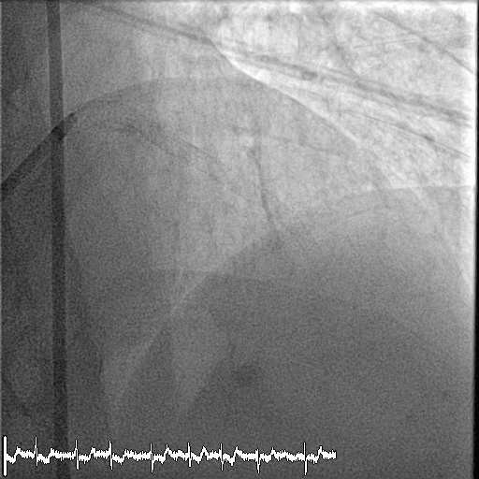
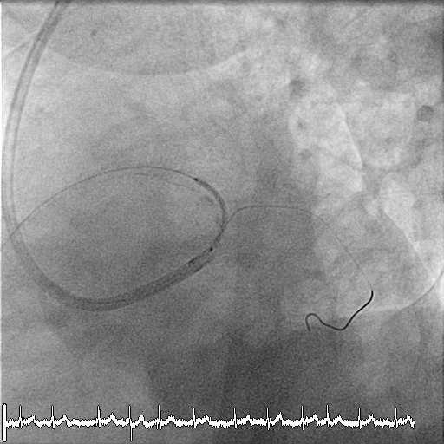
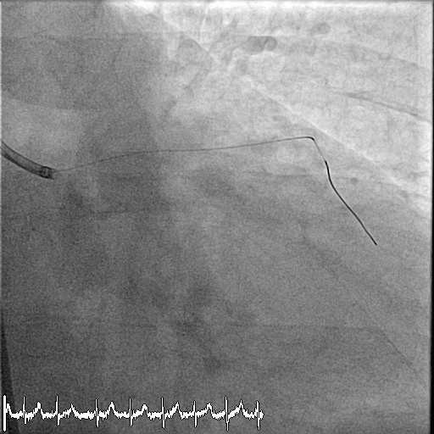
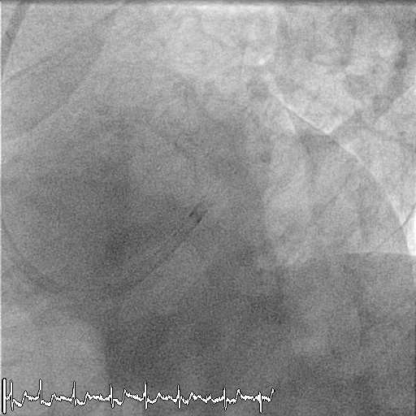
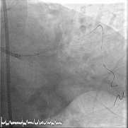
CH001-008
Strut fenestration towards CFX and POT

Slide 7
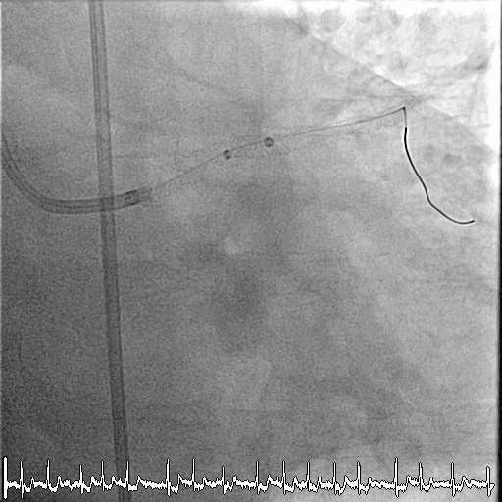
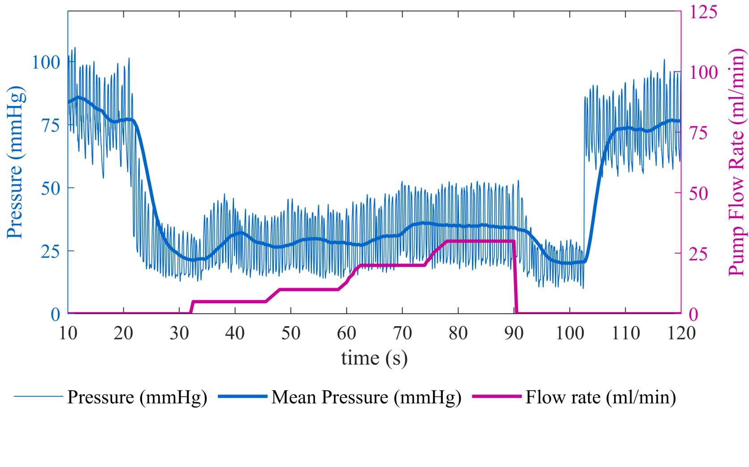
CH001-008

Slide 8
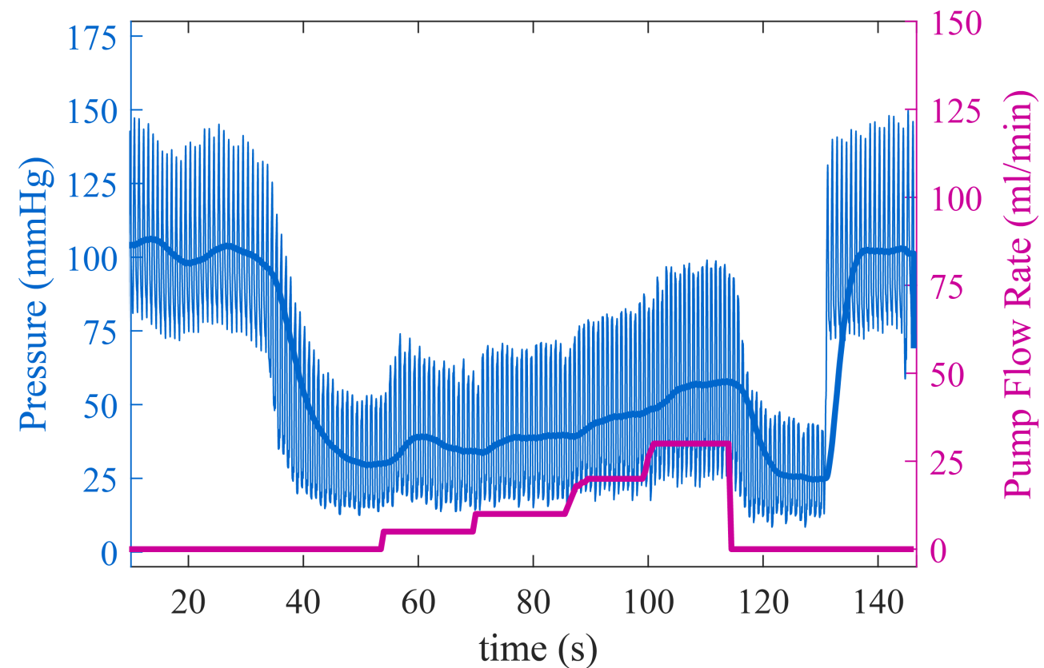
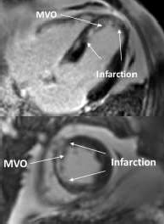
How was the study executed?
MOCA I – Diagnostic Phase Procedure
pPPCI & CoFI Diagnostic Measurement
Day 0
Cardiac MRI**
Day 3-5
1.5 min occlusion sequence
Continuous measurement of pressure distal to occlusion
30 Anterior STEMI*
≤ 6h symptom
onset to balloon
Clinical Follow-up 30 days and
6 months
Ringer’s Lactate infusion
at 5, 10, 20, 30 ml/min
Correlation – of CoFI diagnostic parameters and CMRI
* 8 patients with incomplete data excluded
** Measurements centrally performed by Imacor, Lund, Sweden Core Lab

Slide 9
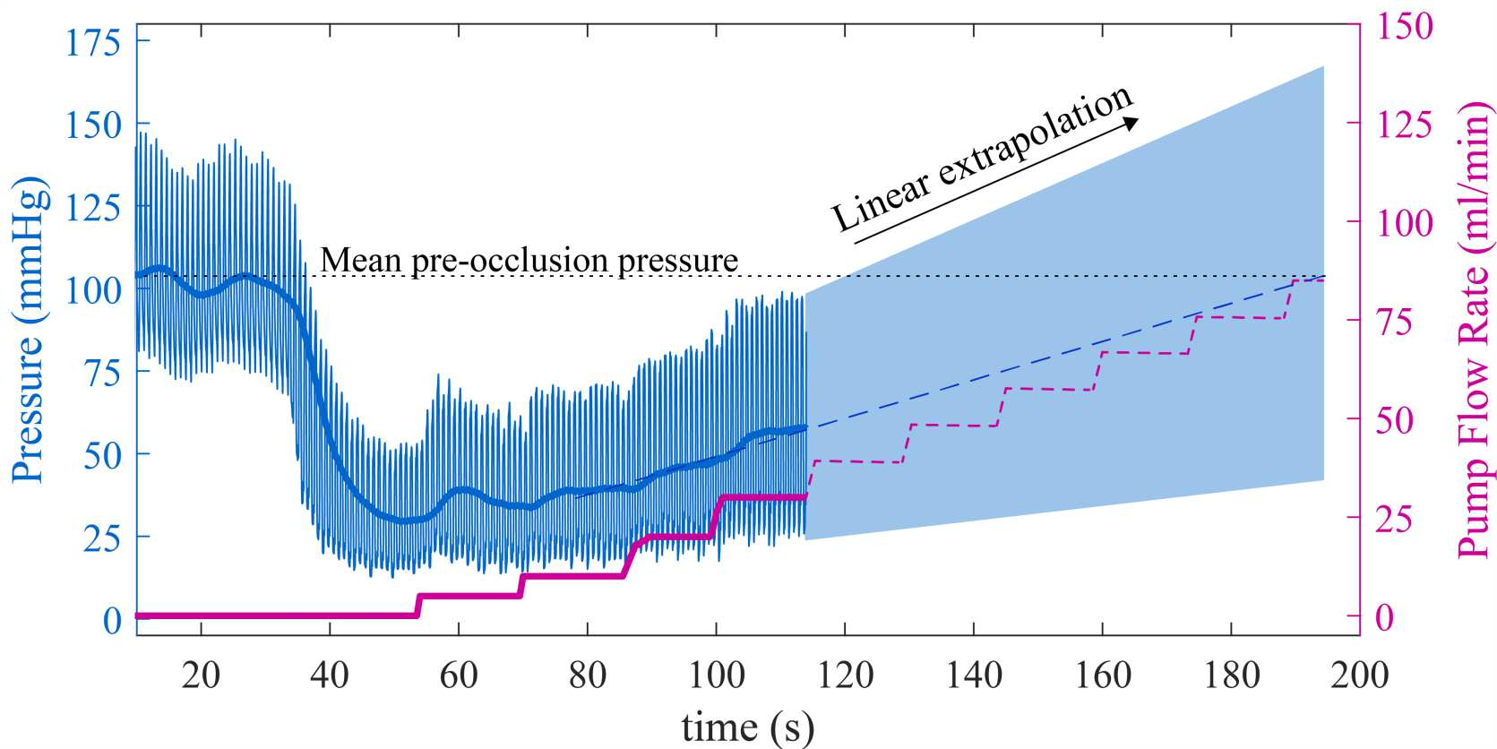
How was the study executed?
MOCA I – Diagnostic Phase Procedure
All patients enrolled by: Inselspital, Bern, Switzerland
Prof. Dr. Lukas Hunziker Munsch
CHUV, Lausanne, Switzerland
Dr. Stéphane Fournier
HUG, Geneva, Switzerland
Dr. Juan F. Iglesias
Cardiocentro Ticino, Switzerland
Dr. Marco Moccetti
Santariskiu Klinikos, Vilnius, Lithuania
Dr. Arvydas Baranauskas
Kauno Klinikos, Kaunas, Lithuania
Prof. Dr. Ramunas Unikas
pPPCI & CoFI Diagnostic Measurement
Day 0
^{P}CoFI
Ringer’s Lactate infusion
at 5, 10, 20, 30 ml/min
30 Anterior STEMI*
≤ 6h symptom
onset to balloon
* 8 patients with incomplete data excluded
** Measurements centrally performed by Imacor, Lund, Sweden Core Lab

Slide 10
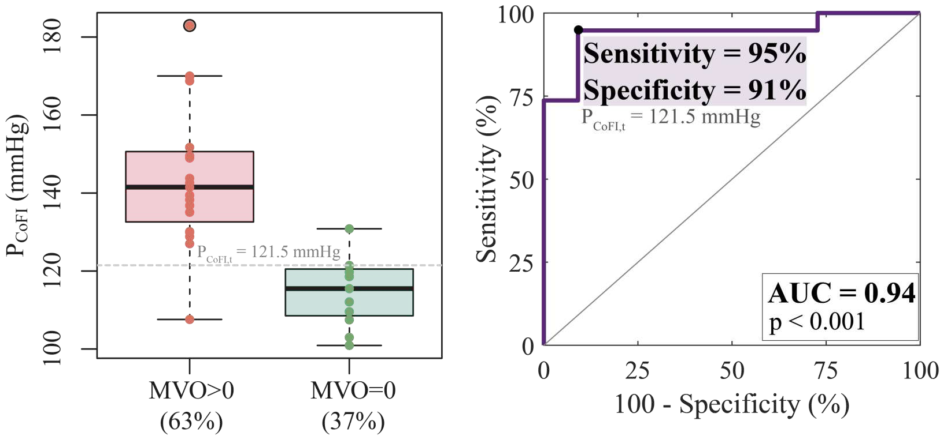
What are the essential results?
The CoFI system detects MVO in the cath lab in STEMI patients
N = 30, MOCA I - phase II, 5 centers
 | CI95%
Sens. | 84.2%-100.0%
Spec. | 72.7%-100.0%
AUC | 0.85-1.00
A P_{CoFI} measurement above 121.5 mmHg has high sensitivity and specificity with MVO detection at day 3-5 CMRI

Slide 11
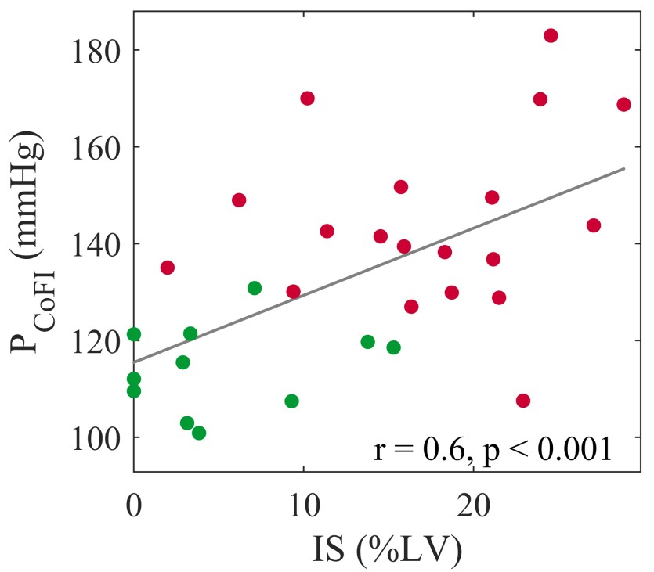
What are the essential results?
CoFI can be useful clinically for more than only MVO detection
N = 30, MOCA I - phase II, 5 centers
Green dots MVO = 0, red dots MVO > 0 in CMRI
 | CMRI Parameter Day 3-5 | Correlation Coefficient* | Significance Level
 | IS (% of LV) | r = 0.6 | <0.001
 | MVO (% of LV) | ρ = 0.7 | <0.001
 | Transmurality | r = 0.5 | 0.007
* Pearson corr.: r, Spearman corr.: ρ
P_{CoFI} shows strong correlation to Infarct Size (IS), MVO extent, and Transmurality in CMRI at day 3-5

Slide 12
The essentials to remember
What are the results?
The CoFI system provides a novel index named P_{COFI} for the detection of MVO in the cath lab with sensitivity and specificity ≥ 90% in a STEMI cohort. The P_{COFI} shows correlation with MVO extent, IS and transmurality.
Recommended future studies?
Addditional validation studies to confirm performance of CoFI system in detecting the presence and the extent of MVO in broader and less selected populations are needed.
Randomized clinical research on targeted therapy approaches post detection.
Why is this important?
The use of the CoFI system may allow cathlab-based MVO detection and, via the same
system, the targeted delivery of therapeutic agents for MVO.

Slide 13
PCRonline.com

Slide 14
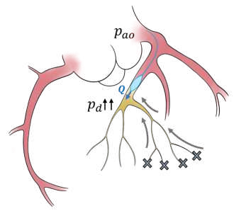
What did we study?
Novel CoFI Pressure Parameter for Detection of MVO (P_{CoFI})
Systolic flow reversal and reduced systolic anterograde flow are typical patterns for MVO ^{1,2}
Distal obstructions impede squeeze of intramyocardial blood into venous circulation during systole ³
In CoFI sequences: the vessel is occluded proximally, and distal infusion is volume-controlled.
In CoFI sequences: Strongest increase in distal pressure during systole in patients with MVO
The CoFI algorithm corrects for interpatient variability in anatomy, lesion location and collateral flow to derive P_{CoFI} by extrapolation of pressure tracings to mean pre-occlusion pressure
¹Bekkers SC et al., J Am Coll Cardiol. e010;55:1649–60 ²Niccoli G et al., Eur Heart J. e016;37:10e4–33 ³Yamamoto K et al, J Am Coll Cardiol. e001;38:1383–9

Slide 15
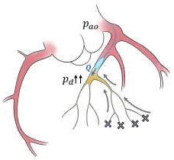
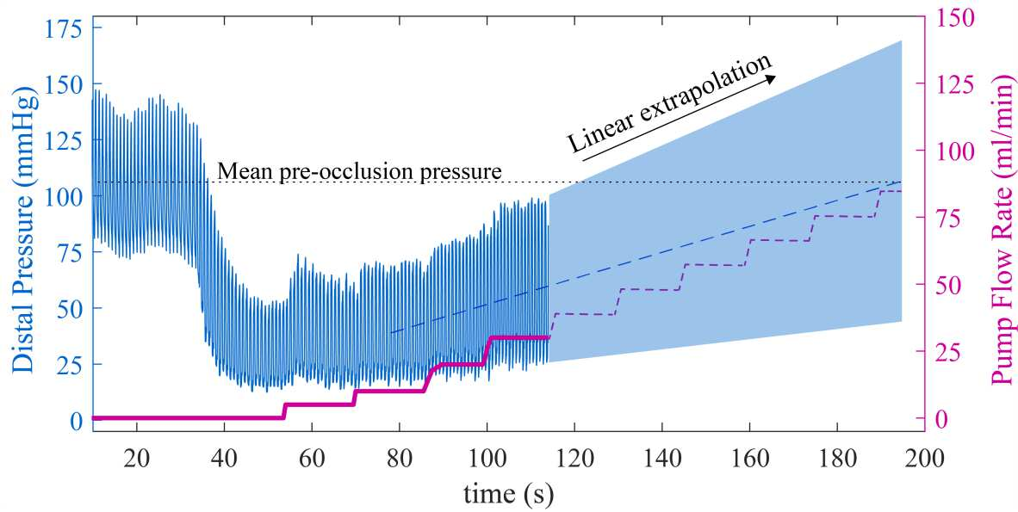
What did we study?
Novel CoFI Pressure Parameter for Detection of MVO (P_{CoFI})
Systolic flow reversal and reduced systolic anterograde flow are typical patterns for MVO ^{1,2}
Distal obstructions impede squeeze of intramyocardial blood into venous circulation during systole ³
In CoFI sequences: the vessel is occluded proximally, and distal infusion is volume-controlled.
In CoFI sequences: Strongest increase in distal pressure during systole in patients with MVO
The CoFI algorithm corrects for interpatient variability in anatomy, lesion location and collateral flow to derive P_{CoFI} by extrapolation of pressure tracings to mean pre- occlusion pressure
¹Bekkers SC et al., J Am Coll Cardiol. e010;55:1649–60 ²Niccoli G et al., Eur Heart J. e016;37:10e4–33 ³Yamamoto K et al, J Am Coll Cardiol. e001;38:1383–9

Slide 16
What did we study?
MOCA I Study Design
Phase II: Diagnostic Phase N=20 LAD STEMI patients / pPCI CMRI @ 3 days post MI
30 day clinical FUP
Phase III: Treatment Phase N=20 LAD STEMI patients / pPCI CMRI @ 3 days post MI
30 day clinical FUP
Phase I: Roll-in Phase Up to 18 NSTEMI patient 30 day clinical FUP
Amended in 2020 to include up to 50 patients to yield 20 subjects with MVO. Currently enrolled: 40/50
Amended in 2022 with additional 30 Day CMRI, updated Secondary Endpoints to reflect derived parameters Currently enrolled: 11/20

