Slide 1
EMBARGOED for 10:50am CT 11-13-20
AFFIRM-AHF Trial:
Ferric Carboxymaltose for Iron Deficiency at Discharge After Acute Heart Failure
Piotr Ponikowski, MD, PhD, FESC on behalf of the AFFIRM-AHF investigators
Center for Heart Diseases, University Hospital
Department of Heart Diseases, Medical University
Wrocław, Poland
Disclosures for the presenter: Abbott Vascular, Amgen, AstraZeneca, Bayer, Berlin Chemie, BMS, Boehringer Ingelheim, Cibiem, Impulse Dynamics, Merck, Novartis, Pfizer, Renal Guard Solution, Servier, and Vifor Pharma.

Slide 2
Background and Rationale
Iron deficiency is common in heart failure (HF) and associated with reduced exercise capacity, poor quality of life, increased risk for hospitalisation, and mortality.
In stable HF patients, treatment of iron deficiency with intravenous ferric carboxymaltose (FCM) improves physical performance and quality of life.
The effects of FCM administered at hospital discharge in stabilised patients with acute HF and concomitant iron deficiency on the outcomes are unknown.

Slide 3
AFFIRM-AHF Study Design
1st dose at discharge
FCM ⁽¹⁾
FCM ⁽²⁾
FCM ⁽²⁾
Clinical stabilisation
Admission due to acute HF
Randomisation 1:1
PL⁽¹⁾
PL⁽²⁾
PL⁽²⁾
TC1 W2
TC2 W4
V3 W6
V4 W12
V5 W24
TC3 W36
V6 W52
Pre-screening (in-hospital)
Screening / Randomisation
Follow-up / Study treatment administration ⁽¹⁾⁽²⁾
Follow-up
¹ The repletion dose of study treatment will be administered based on the iron need assessed at the baseline visit
² Study treatment to be administered only if iron deficiency persisted
PL, placebo; TC, telephone contact; V, visit; W, week.
Ponikowski P, et al. Eur J Heart Fail. 2019;21(12):1651-1658.

Slide 4
Key Eligibility Criteria
Inclusion criteria
Hospitalisation for acute HF confirmed by signs/symptoms of acute HF and elevated natriuretic peptide (BNP or NT-proBNP) levels Iron deficiency: serum ferritin <100 ng/mL OR serum ferritin 100-299 ng/mL and TSAT <20% Left ventricular ejection fraction <50% not older than 12 months prior to randomization
Exclusion criteria
Clinical evidence of ACS, TIA, or stroke within 30 days CABG, PTCA, cardiac device implantation (including CRT) within 30 days Hb <8 g/dLª or >15 g/dL Active infection requiring anti-microbial treatment during an index hospitalisation ESA, i.v. iron or blood transfusion administered in last 3 months and oral iron (>100 mg/day) in previous 4 weeks
ª<10 g/dL for sites in The Netherlands, Spain and Singapore.
ACS, acute coronary syndrome; BNP, B-type natriuretic peptide; CABG, coronary artery bypass grafting; CRT, cardiac resynchronization therapy; ESA, erythropoiesis stimulating agent; Hb, haemoglobin; i.v., intravenous; NT-proBNP, N-terminal-pro hormone BNP; PTCA, Percutaneous transluminal coronary angioplasty; TIA, transient ischemic attack; TSAT, transferrin saturation.
Ponikowski P, et al. Eur J Heart Fail. 2019;21(12):1651-1658.
4

Slide 5
Primary and Secondary Outcomes
Primary
Composite of total HF hospitalisations and CV death up to 52 weeks
Secondary
Total HF hospitalisations
CV death
Time to first HF hospitalisation or CV death
Composite of total CV hospitalisations and CV death
Days lost due to HF hospitalisations or CV death
Safety
Adverse events
CV, cardiovascular.
Ponikowski P, et al. Eur J Heart Fail. 2019;21(12):1651-1658.

Slide 6
Study Treatment Dosing Regimen
Hb 8 to ≤14 g/dL | Hb >14 to ≤15 g/dL
1000 mg FCM / placebo | 500 mg FCM / placebo
Week 0
Hb 8 to ≤10 g/dL |  | Hb 10 to ≤14 g/dL |  | Hb >14 to ≤15 g/dL
<70 kg | ≥70 kg | <70 kg | ≥70 kg
500 mg FCM/ placebo | 1000 mg FCM/ placebo | No dose | 500 mg FCM/ placebo | No dose
Week 6
Only If Iron Deficiency Persisted
500 mg FCM / placebo
Weeks 12 + 24
Ponikowski P, et al. Eur J Heart Fail. 2019;21(12):1651-1658.

Slide 7
Subject Disposition
Screened N=1525
Provided informed consent and were randomised N=1132
FCM N=567
Placebo N=565
9 excluded
8 FCM not started
1 no post-baseline visit
15 excluded
14 placebo not started
1 no post-baseline visit
Included in the modified ITT analysis set N=558
Included in the modified ITT analysis set N=550
ITT, intention-to-treat.

Slide 8
Prespecified Analyses
Modified Intention-To-Treat (mITT) Population
All randomised patients in whom study treatment was started and for whom at least one post-randomisation value was available
Pre-COVID-19 sensitivity analysis
The COVID-19 sensitivity analyses were performed on the mITT population - patient follow-up was censored in each country when the first COVID-19 patient was reported

Slide 9
Baseline Characteristics
Characteristic | FCM (N=558) | Placebo (N=550)
Age, year | 71.2 ± 10.8 | 70.9 ± 11.1
Female, % | 44 | 45
Systolic BP, mm Hg | 120 ± 15 | 120 ± 16
NYHA Class III-IV, % | 52 | 54
LVEF, % | 32.6 ± 9.6 | 32.7 ± 10.0
Ischaemic aetiology of HF, % | 47 | 47
Newly diagnosed HF at index hospitalisation, % | 27 | 30
Comorbidities, % Atrial fibrillation and/or flutter Diabetes mellitus Chronic kidney disease | 56 41 40 | 55 44 41
Results presented as mean ± SD unless otherwise noted.
mITT population.
BP, blood pressure; NYHA, New York Heart Association.

Slide 10
Baseline Pharmacotherapy
Pharmacotherapy, % | FCM (N=558) | Placebo (N=550)
Angiotensin converting enzyme inhibitor | 53 | 51
Angiotensin receptor blocker | 17 | 18
Angiotensin receptor neprilysin inhibitor | 6 | 7
Mineralocorticoid receptor antagonist | 67 | 64
Beta-blocker | 81 | 84
Loop diuretic | 87 | 85
mITT population.

Slide 11
Baseline Laboratory Data
Laboratory test results | FCM (N=558) | Placebo (N=550)
NT-proBNP, pg/mL, median (IQR) | 4743 (2781, 8128) | 4684 (2785, 8695)
BNP, pg/mL, median (IQR) | 1068 (802, 1715) | 1204 (803, 1955)
Haemoglobin, g/dL | 12.3 ± 1.6 | 12.1 ± 1.6
Anaemia, % | 52 | 57
Ferritin, ng/mL | 83.9 ± 62.2 | 88.5 ± 68.6
Ferritin <100 ng/mL, % | 73 | 69
TSAT (%) | 15.2 ± 8.3 | 14.2 ± 7.5
TSAT <20%, % | 82 | 85
eGFR, mL/min/1.73 m² | 55.3 ± 21.3 | 55.7 ± 23.1
eGFR <60 mL/min/1.73 m², % | 52 | 52
Results presented as mean ± SD unless otherwise noted.
mITT population.
eGFR, estimated glomerular filtration rate.

Slide 12
Primary Endpoint: Total HF Hospitalisations and CV Death
100
90
Rate ratio (95% CI): 0.79 (0.62‒1.01); P=0.059
Total Events
80
372
70
60
293
Mean Cumulative Events per 100 Patients
50
40
30
20
Placebo
10
FCM
0
0
4
12
24
36
52
Time since randomisation (weeks)
mITT population.

Slide 13
Component of Primary Endpoint: Total HF Hospitalisations
100
90
Rate ratio (95% CI): 0.74 (0.58‒0.94); P=0.013
80
Total Events
70
60
294
Mean Cumulative Events per 100 Patients
50
217
40
30
20
Placebo
10
FCM
0
0
4
12
24
36
52
Time since randomisation (weeks)
mITT population.

Slide 14
Component of Primary Endpoint: CV Death
1.0
0.9
Hazard ratio (95% CI): 0.96 (0.70‒1.32); P=0.809
0.8
0.7
0.6
Proportion with Event
0.5
0.4
Placebo
FCM
CV Deaths
0.3
0.2
78
0.1
77
0.0
0
4
12
24
36
52
Time since randomisation (weeks)
Number at risk
FCM | 544 | 509 | 483 | 468 | 289
Control | 537 | 511 | 486 | 465 | 285
mITT population.

Slide 15
Secondary Endpoint: First HF Hospitalisation or CV death
1.0
0.9
Hazard ratio (95% CI): 0.80 (0.66‒0.98); P=0.030
0.8
0.7
0.6
First Events
Proportion with Event
0.5
209
0.4
Placebo
181
0.3
FCM
0.2
0.1
0.0
0
4
12
24
36
52
Time since randomisation (weeks)
Number at risk
FCM | 519 | 457 | 416 | 381 | 227
Control | 514 | 446 | 389 | 358 | 209
mITT population.

Slide 16
COVID-19 Sensitivity Analysis
 | mITT Population RR or HR (95% CI) | Pre-COVID sensitivity analysis RR or HR (95% CI)
Total HF Hospitalisations and CV Death | RR: 0.79 (0.62–1.01) P=0.059 | RR: 0.75 (0.59–0.96) P=0.024
Total HF Hospitalisations | RR: 0.74 (0.58–0.94) P=0.013 | RR: 0.70 (0.55–0.90) P=0.005
CV Death | HR: 0.96 (0.70–1.32) P=0.81 | HR: 0.94 (0.68–1.29) P=0.69
First HF Hospitalisation or CV Death | HR: 0.80 (0.66–0.98) P=0.030 | HR: 0.79 (0.65–0.97) P=0.023
Total CV Hospitalisations and CV Death | RR: 0.80 (0.64–1.00) P=0.050 | RR: 0.77 (0.62–0.97) P=0.024
HR, hazard ratio; RR, rate ratio.

Slide 17
Primary Endpoint for Selected Predefined Subgroups
 | FCM | Placebo |  | Rate Ratio (95% CI) |  | P for interaction
 | Events / Patients
Overall | 293 / 558 | 372 / 72.51 | 372 / 550 | 0.79 (0.62–1.01)
Hb level at baseline |  |  |  |  |  | 0.15
<12 g/dL | 136 / 228 | 171 / 236 | 171 / 236 | 0.97 (0.66–1.41)
≥12 g/dL | 156 / 329 | 201 / 314 | 201 / 314 | 0.67 (0.48–0.93)
Heart Failure aetiology |  |  |  |  |  | 0.015
Ischaemic | 149 / 265 | 236 / 257 | 236 / 257 | 0.60 (0.43–0.84)
Non-ischaemic | 140 / 282 | 128 / 275 | 128 / 275 | 1.11 (0.77–1.60)
eGFR tertiles (mL/min per 1.73 m²) at baseline |  |  |  |  |  | 0.94
<42.96 | 115 /157 | 152 / 165 | 152 / 165 | 0.76 (0.50–1.16)
≥42.96 to <64.32 | 76 /166 | 83 / 156 | 83 / 156 | 0.76 (0.48–1.22)
≥64.32 | 56 /164 | 79 / 159 | 79 / 159 | 0.69 (0.42–1.12)
NT-pro BNP (pg/mL) or BNP (pg/mL) at baseline |  |  |  |  |  | 0.88
Lower tertile | 69 / 187 |  | 105 / 177 | 0.71 (0.45–1.11)
Middle tertile | 99 / 191 |  | 115 / 183 | 0.81 (0.53–1.24)
Upper tertile | 125 / 179 |  | 152 / 189 | 0.82 (0.54–1.23)
Left ventricular ejection fraction at baseline |  |  |  |  |  | 0.74
<25% | 84 / 104 |  | 113 / 122 | 0.88 (0.54–1.44)
25% to <40% | 144 / 288 |  | 178 / 243 | 0.71 (0.50–1.01)
40% to <50% | 65 / 166 |  | 80 / 184 | 0.85 (0.52–1.38)
Diagnosis of HF |  |  |  |  |  | 0.11
Documented HF prior to index hospitalisation | 249 / 405 |  | 336 / 385 | 0.72 (0.55–0.95)
Newly diagnosed at index hospitalisation | 44 / 153 |  | 36 / 165 | 1.22 (0.69–2.14)
Favours FCM
Favours placebo

Slide 18
Safety Overview
Adverse events (AE) | FCM (N=558) |  | Placebo (N=550)
 | Patients n (%) | Total Events (n) | Patients n (%) | Total Events (n)
Any AE | 357 (64) | 1246 | 360 (65) | 1314
Serious AE | 250 (45) | 547 | 282 (51) | 632
AE leading to withdrawal of study treatment | 61 (11) | 71 | 79 (14) | 88
AE leading to study discontinuation | 98 (18) | 117 | 96 (17) | 123

Slide 19
Adverse Events of Interest
Adverse events (AE) | FCM (N=558) |  | Placebo (N=550)
 | Patients n (%) | Total Events (n) | Patients n (%) | Total Events (n)
Cardiac disorders | 224 (40.1) | 391 | 244 (44.3) | 453
Infections | 102 (18.2) | 143 | 121 (22.0) | 165
Diarrhea | 17 (3.0) | 19 | 14 (2.5) | 16
Constipation | 10 (1.8) | 10 | 10 (1.8) | 12
Hypophosphataemia | 1 (0.2) | 1 | 1 (0.2) | 1
Bone pain | 0 (0) | 0 | 1 (0.2) | 1
Pruritus | 3 (0.5) | 3 | 3 (0.5) | 3
Rash | 2 (0.4) | 2 | 2 (0.4) | 2
Urticaria | 1 (0.2) | 1 | 1 (0.2) | 1
Neoplasm | 9 (1.6) | 3 | 7 (1.3) | 9
Drug hypersensitivity | 2 (0.4) | 2 | 0 (0) | 0
Hypersensitivity | 0 (0) | 0 | 1 (0.2) | 1

Slide 20
Change in Serum Phosphate
0.00
-0.05
-0.10
-0.15
-0.20
Mean Change in Phosphate (mg/dL)
-0.25
-0.30
-0.35
Placebo
-0.40
FCM
-0.45
-0.50
6
12
24
52
Weeks

Slide 21
Conclusions
In patients stabilised after an episode of acute HF with concomitant iron deficiency, treatment with FCM reduced the risk of HF hospitalisations, with no apparent effect on the risk of CV death.
In this high-risk population, FCM reduced the total number of HF hospitalisations, irrespective of anaemia status.
Statistically significant treatment benefits with FCM were seen on the time to first HF hospitalisation or CV death.
The prespecified COVID-19 sensitivity analyses revealed statistically significant differences in favour of FCM for the primary and secondary outcomes.
Treatment with FCM was safe and well tolerated.

Slide 22
Implications for Clinical Practice
Iron deficiency:
can be easily detected using a simple blood test
should be assessed in patients hospitalised with acute HF
is an important therapeutic target in patients with HF
Administration of FCM in patients with iron deficiency, LVEF≤50%, stabilised after an episode of acute HF reduces the risk of subsequent HF hospitalisations

Slide 23
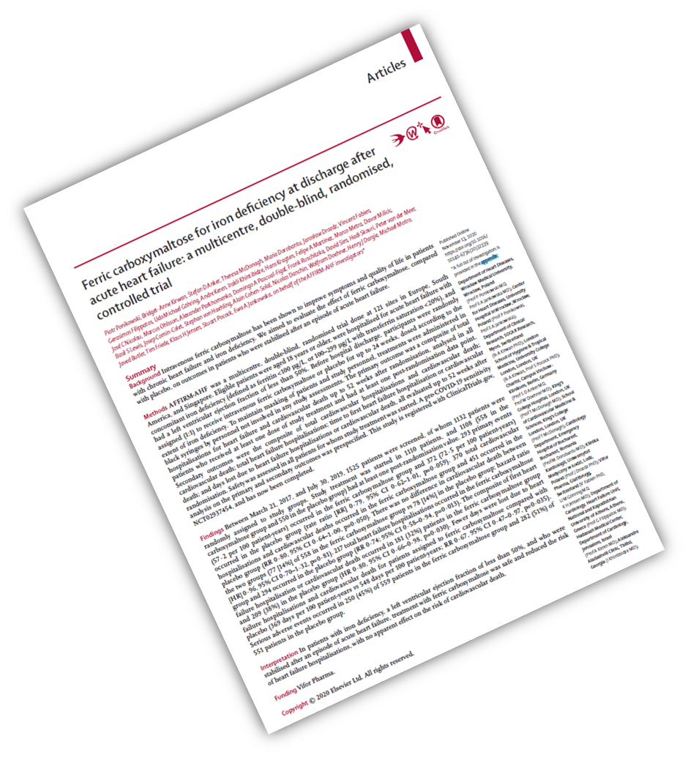
Now Published

Slide 24
Acknowledgements
AFFIRM-AHF Study Group: Piotr Ponikowski, Bridget-Anne Kirwan, Stefan D. Anker, Theresa McDonagh, Maria Dorobantu, Jarosław Drozdz, Vincent Fabien, Gerasimos Filippatos, Udo Michael Göhring, Andre Keren, Irakli Khintibidze, Hans Kragten, Felipe A. Martinez, Marco Metra, Davor Milicic, José C. Nicolau, Marcus Ohlsson, Alexander Parkhomenko, Domingo A. Pascual-Figal, Frank Ruschitzka, David Sim, Hadi Skouri, Peter van der Meer, Basil S. Lewis, Josep Comin-Colet, Stephan von Haehling, Alain Cohen-Solal, Nicolas Danchin, Wolfram Doehner, Henry J. Dargie, Michael Motro, Javed Butler, Tim Friede, Klaus H. Jensen, Stuart Pocock, Ewa A. Jankowska, on behalf of the AFFIRM-AHF Investigators Funded by Vifor Pharma

