Slide 1



EWOLUTION - Efficacy and safety of LAAO in patients with prior ischemic and hemorrhagic stroke
Prof. Dr. Lucas Boersma, MD/PhD/FESC
St. Antonius Hospital, Nieuwegein, The Netherlands AMC/University of Amsterdam, The Netherlands
H. Ince
S. Kische
E. Pokushalov
B. Schmidt
T. Betts
H. Sievert
M. W. Bergmann
Vivantes Klinikum Urban, Berlin, Germany
Vivantes Klinikum im Friedrichshain, Berlin, Germany
State Res Inst of Circ Path. Novosibirsk, Russian Federation Cardiology Centre Bethanien, Frankfurt Am Main, Germany John Radcliffe Hospital, Oxford, United Kingdom CardioVascular Center Frankfurt, Frankfurt, Germany Cardiologicum Hamburg, Hamburg, Germany
on behalf of all the EWOLUTION investigators

Slide 2
Declaration of interest
- Consulting/Royalt ies/ Ow ner / St ockh o,llder of a healthcare co1mp¹ any (¹ B ost on Sci ent ific)
ESC Congress
Munich 2018 •
•

Slide 3
Registry on WATCHMAN Outcomes in Real-Life Utilization: EWOLUTION
Study Objective:
Collect real-world WATCHMAN LAAO experience outside of selected populations in prior RCT
Study Design:
Prospective, single-arm, multi-center registry of the Watchman LAA Closure Technology
Primary Endpoint:
Primary analysis includes procedural success and safety, incidence of stroke, bleeding, and death after 2 yr of FU
Investigator and Medical Safety Group for adjudication
Patient Population:
>1000 patients
Number of Sites:
47 throughout Europe, Russia and Middle East
Enrollment:
Started October 2013 - Completed May 2015
Standard practice at participating centers
Follow-up:
Normally 1-3 months post-procedure
Annually thereafter for a total of 2 years
Boersma et al. Cath Card Int 2015

Slide 4
EWOLUTION – complete 2 year patient flow
Informed consent obtained: N = 1025
Anatomy considered not suitable at prescreening: N = 5
Implant of WATCHMAN:
N = 1020
Study population
End of study < 2 yrs: N = 221
Deceased: N = 161
Withdrawn: N = 18
Lost to FU: N = 42
Patients with successful Watchman implant: N = 1005
pts with FU, no TEE; 118; 12%
Pts with completed 2 yrs FU:
N = 784/1005 (78%)
pts with FU & TEE; 835;
83%
pts without FU; 52; 5%
Total #CT/TEEs:
N = 1145 (avg 1.4/pt)

Slide 5
EWOLUTION – Stroke risk profile in AF patients
CHA₂DS₂-VASc distribution in EWOLUTION
250
200
150
100
50
0
CHA₂DS₂-VASc score ≥ 5 49%
HAS-BLED ≥ 3 40%
Major Bleeding/predisposition bleeding 39% Contra-indication (N)OAC 73%
Nr pts
0
1
2
3
4
5
6 7 8 9
16
14
12
10
8
6
4
2
0
Expected ischemic strokes per 100 PY
based on CHA DS -VASc (Friberg)
14.4
2 2
13.1
12.6
Treated with ASA
11.4
12.2
11.2
10.8
Untreated
9.7
8.4
7.2
5.5
4.8
_{3.2} 3.7
_{2.2} 2.5
0.2 0.2
0.6 0.6
0
1
2
3
4
5
6
7
8
9

Slide 6
EWOLUTION – High risk subgroup characteristics
Post implant medications | N | CHA₂DS₂-VASc | HAS-BLED | (N)OAC | single/ none | DAPT
EWOLUTION all pts | 1020 | 4.5 | 2.3 | 27% | 14% | 60%
Hx Ischemic stroke/TIA | 311 | 5.5 | 2.6 | 35% | 15% | 50%
Hx Hemorrhagic stroke | 153 | 5.4 | 2.8 | 11% | 27%* | 62%
Hx Major Bleed | 318 | 4.8 | 3.2 | 15% | 17% | 67%
* More pts on SAPT/none p<0.001)

Slide 7
EWOLUTION – OAT during Follow-Up
71%
Pts with known medication: N = 998
58%
Pts without FU information: N = 52
60%
Pts with first medication change info: N = 946
14%
26%
27%
7%
8%
8%
8%
6%
7%
2-YR FU FIRST CHANGE
IMPLANT
None
SAPT
DAPT
(N)OAC
After 2 years 85% of pts were on SAPT or nothing

Slide 8
EWOLUTION – OAT during Follow-Up - subgroups
Post-implant
14% 15% _{17%}
27%
_{60%} 50%
67%
62%
_{27%} 35%
_{11%} 15%
ALL Hx IS/TIA Hx HemStk Hx MjBleed OAC DAPT single/none
Study End
_{85%} 83% _{89% 86%}
_{7%} 5%
7% 10%
_{8%} 13% _{5% 4%}
ALL Hx IS/TIA Hx HemStk Hx MjBleed OAC DAPT single/none

Slide 9
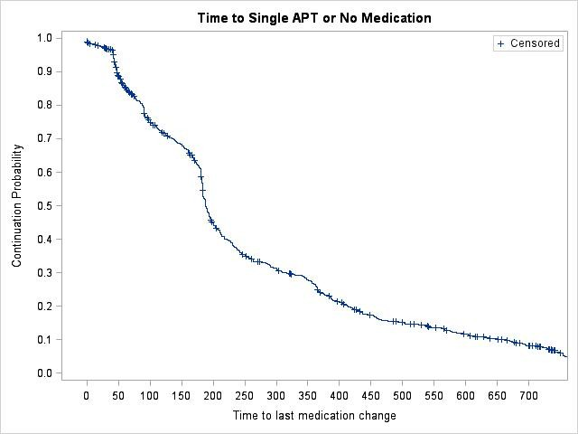
Time to final single APT or nothing
Time | Kaplan-Meier Event Rate
45 Days | 8.3%
3 months | 23.6%
6 months | 45.5%
1 year | 75.0%
2 years | 95.1%

Slide 10
EWOLUTION – Thrombo-embolic event rates
12
expected if untreated observed in EWOLUTION
10.1
Nr thromboembolic events /100 pt-yrs
10
8
7.2
80%
Reduction
6
83%
Reduction
4
2.0
2
1.3
0
Ischemic Stroke
IS/TIA/SE

Slide 11
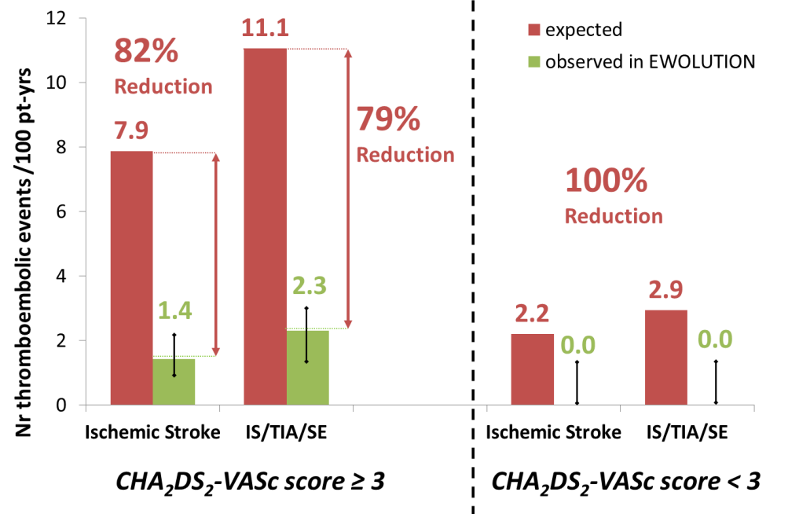
EWOLUTION – No Stroke/TIA/SE in low risk patients
N = 902
N = 118

Slide 12
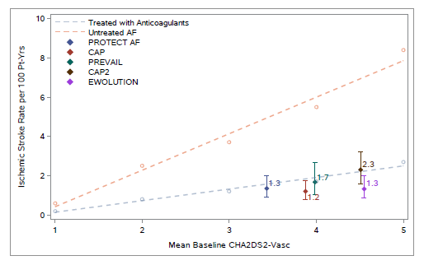
Consistent low stroke rate with WATCHMAN

Slide 13
EWOLUTION – Stroke in high risk subgroups
12
Thromboembolic events /100 pt-
yrs
CHA₂DS₂- VASc
4.5
CHA₂DS₂- VASc
5.5
CHA₂DS₂- VASc
5.4
CHA₂DS₂- VASc
4.8
10
9.5
9.3
8
7.8
7.2
76% RRR
81% RRR
6
85% RRR
83% RRR
4
2
2.3
1.8
1.3
1.2
0
EWOLUTION all (N=1020)
Hx stroke/TIA (N=311)
Hx hemorrhagic stroke (N=153)
Hx Major Bleed (N=318)

Slide 14
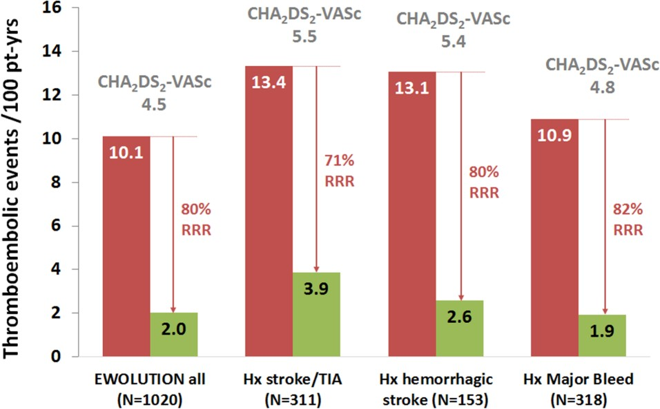
EWOLUTION – Stroke/TIA/SE in high risk subgroups
CHA₂DS₂-
CHA₂DS₂- VASc
5.4
VASc 5.5
CHA₂DS₂- VASc
4.8
CHA₂DS- VASc 4.5

Slide 15
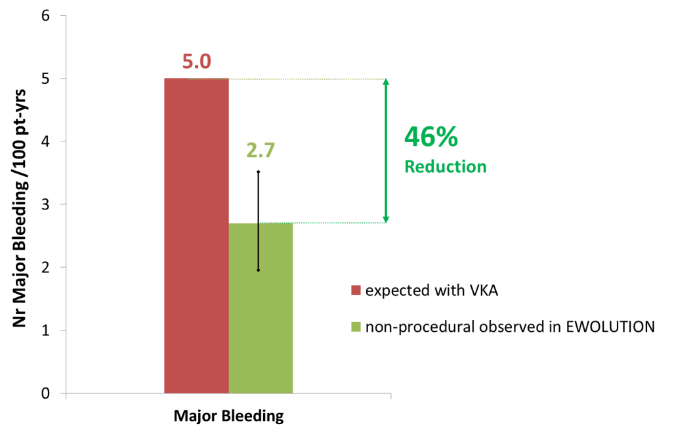
EWOLUTION – Bleeding rates for all pts
N = 1020
Boersma et al. EHRA 2018

Slide 16
EWOLUTION – Bleeding in high risk subgroups
7
HAS-BLED 2.3
HAS-BLED 2.6
HAS-BLED 2.8
HAS-BLED 3.2
6
6.5
30% RRR
Major Bleedings /100 pt-yrs
5.6
5
5.4
5.0
41% RRR
46% RRR
4.5
4
67% RRR
3
3.2
2.7
2
1.8
1
0
EWOLUTION all (N=1020)
Hx stroke/TIA (N=311)
Hx hemorrhagic stroke (N=153)
Hx Major Bleed (N=318)

Slide 17
EWOLUTION - Conclusions
WATCHMAN LAAC was studied in an all-comer prospective registry with >70% of 1020 patients contra-indicated to oral anticoagulation
Risk profile, implant and LAA sealing success exceeded that of prior RCT and registries, with lower procedural adverse event rates¹
During the complete 2 years follow-up:
Reduction of ischemic stroke -83%, reduction of bleeding -46%, low (N)OAC use
Prior Ischemic stroke/TIA: despite much higher risk, the same reduction of stroke and bleeding rates compared to the total cohort
Prior Hemorrhagic stroke: despite much higher risk, the same stroke rate reduction, with impressive bleeding reduction (-67%) by much lower (N)OAC use
Prior major bleed: despite a much higher risk (Hx & HAS-BLED), still marked reduction of bleeding events (-30%), and the same stroke rate reduction
1. Boersma et al. EHJ 2016

Slide 18
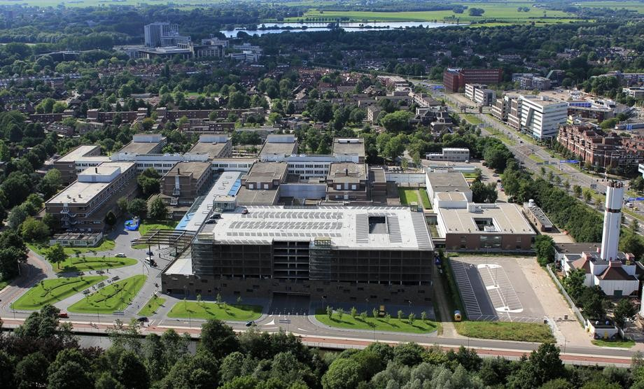
THANK YOU

Slide 19
BACK UP SLIDE

Slide 20
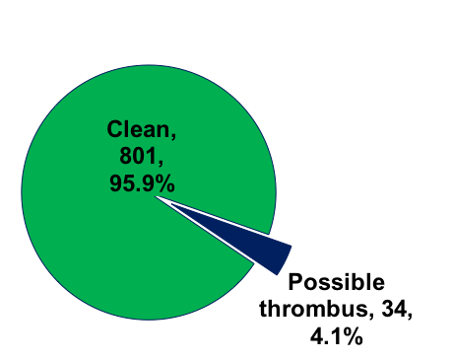
Device thrombus and medication – no relation
P = 0.208
6.0%
4.8%
4.9%
5.0%
4.0%
3.0%
2.0%
1.0%
0.0%
4.5%
2.0%
0.8%
VKA NOAC
DAPT
single APT
None

