Slide 1
Redefining small aortic annulus in patients undergoing TAVI with a self-expanding transcatheter heart valve with intra-annular leaflet position
Michael Reardon, MD Houston Methodist Hospital

Slide 2
Potential conflicts of interest
Speaker's name : Michael Reardon
☑ I have the following potential conflicts of interest to declare:
Participation in a company sponsored speaker's bureau: Boston Scientific, Medtronic, Siemens Healthineers, WL Gore
Receipt of grants / research support: Abbott, Boston Scientific, Medtronic, WL Gore
Receipt of honoraria or consultation fees: Boston Scientific, Medtronic, Siemens Healthineers, WL Gore

Slide 3
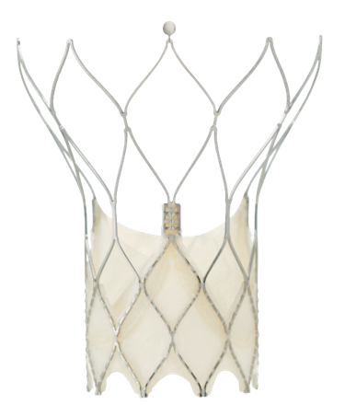
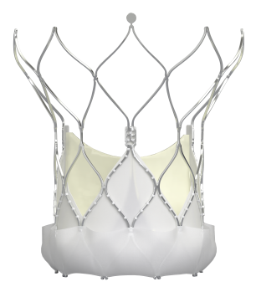
Abbott Transcatheter Heart Valves
First-Gen Abbott TAV Navitor™ Valve
Large cell design
Minimizes coronary obstruction and improves coronary
access and flow^{1,2}
Consistent radial force
Expands, anchors, stabilizes, and seals
Nitinol self-expanding stent
Re-capturable, repositionable, and retrievable until fully deployed
Active sealing cuff
Synchronizes to cardiac cycle to seal and mitigate PVL⁴
Early valve functionality
For hemodynamic stability throughout deployment³
Patient Annulus (mm) |  | 19 |  | 20 | 21 |  | 22 | 23 |  | 24 | 25 |  | 26 | 27
 |  |  | 23 |  |  | 25 |  |  | 27 |  |  | 29
Valve Size (mm)
1. Abbott Data on File. 90664679; 2. Abbott Data on File. 90103707; 3. Möllmann et al. J Am Coll Cardiol Intv. 2017; 10:1538–47
4. Søndergaard, L. 30-day outcomes from a next generation TAVI device with an active sealing cuff. Presented at: EuroPCR conference; May 18-20, 2021.

Slide 4
Study Design and Subject Population
Objective: Evaluate annular threshold for PPM risk when adjusting for body size
Population: subjects with symptomatic severe AS at high or extreme risk for SAVR
Navitor IDE
26 sites (AUS, EUR, US)
PORTICO I
61 sites (AUS, CAN, EUR)
PORTICO IDE
52 sites (AUS, US)
Prospective, multi-center, pre-approval study
N = 260
Prospective, multi-center, post-market study
N = 941
Prospective, multi-center,
randomized clinical trial
N = 375
N = 1576
(subjects with implant attempt)
Follow-Up Visit
30d
1yr
2yr
3yr
4yr
5yr

Slide 5
Background
Patients with small aortic annulus (SAA) are at higher risk for prosthesis-patient mismatch (PPM) after TAVI
PPM increases risk of poor clinical outcomes and impaired valve durability

Slide 6
What did we study and why?
We studied body size-adjusted aortic annulus measurement
How did we do it?
Comparison of:
Perimeter-derived aortic annulus diameter
Indexed perimeter-derived aortic annulus diameter
as predictors of PPM, clinical outcomes, and valve durability.
Why did we do it?
Perimeter-derived annular diameter does not account directly for risk of PPM, whereas indexed annular diameter may predict PPM

Slide 7
Baseline Characteristics
Characteristics | PORTICO I* N=941 | PORTICO IDE N=375 | NAVITOR IDE N=260 | Pooled Analysis N=1576
Age (years) | 82.4 | 83.0 | 83.4 | 82.7
Gender (female) | 65.7% | 51.5% | 57.3% | 60.9%
STS score (mortality) | 5.68% | 6.34% | 3.90% | 5.53%
NYHA class III/IV | 63.9% | 71.2% | 55.0% | 64.2%
Frailty (>1 criteria) | 81.9% | 93.3% | 87.7% | 85.6%
Body surface area (m²) | 1.78 | 1.86 | 1.83 | 1.80
Chronic kidney disease (creatinine >2.0 mg/dL) | 4.6% | 2.7% | 0.0% | 3.4%
Atrial fibrillation | 17.6% | 32.5% | 24.6% | 26.6%
Diabetes | 29.8% | 37.3% | 28.8% | 31.4%
Prior PCI | 22.8% | 29.3% | 30.4% | 25.6%
Prior stroke | 6.3% | 7.5% | 5.4% | 6.4%
Pre-existing pacemaker | 8.6% | 14.7% | 10.8% | 10.4%
*27 and 29 mm valve were not commercially available for first half of enrollment

Slide 8
Aortic Annulus Diameter
Indexed annular diameter: perimeter-derived diameter divided by patient body surface area
Perimeter-Derived Diameter Indexed Perimeter-Derived Diameter
300
400
274
245
332
226
307
292
Number of Subjects
206
Number of Subjects
300
200
182
200
156
92
92
129
100
70
100
82
43
0
0
_<20
21
22
23
(mm)
24
25
26
27
_<10
11
12
13
(mm/m2)
14
15
_>16

Slide 9
Prediction of Prosthesis-Patient Mismatch
Percent of subjects with PPM changes with indexed diameter, but not perimeter-derived diameter
Perimeter-Derived Diameter (mm)
Indexed Perimeter-Derived Diameter (mm/m²)
100%
80%
60%
Subjects (%)
Decreased Risk
40%
Increased Risk
20%
0%
_<20
21
22
23
24 25
Insignificant PPM
26
27
_<10 11
Severe PPM
12
13
14
15
_>16
Moderate PPM

Slide 10
Prediction of Composite Clinical Events
Composite event rate: cardiovascular mortality, disabling stroke, or heart failure hospitalization
Perimeter-Derived Diameter
Indexed Perimeter-Derived Diameter
60%
60%
50,5%
52,1%
50%
N at 5 Years
<23 mm = 119
>23 mm = 150
50%
N at 5 Years
<13 mm/m² = 92
>13 mm/m² = 161
48,4%
40%
40%
44,7%
KM Rate (%)
KM Rate (%)
30%
30%
20%
20%
10%
10%
0%
0%
30 Days
1 Year
2 Years 3 Years 4 Years 5 Years
>23 mm
30 Days 1 Year
<13 mm/m²
2 Years 3 Years 4 Years
>_13 mm/m²
5 Years
_<23 mm

Slide 11
Valve Durability by Annular Measurement
Bioprosthetic Valve Failure¹
Perimeter-Derived Diameter
Indexed Perimeter-Derived Diameter
4%
4%
3,3%
3%
3%
2,8%
KM Rate (%)
KM Rate (%)
2%
2%
2,0%
2,0%
1%
1%
0%
0%
30 Days
1 Year
2 Years 3 Years 4 Years 5 Years
>23 mm
30 Days 1 Year
<13 mm/m²
2 Years 3 Years 4 Years
>_13 mm/m²
5 Years
<_23 mm
1. Adapted from: Capodanno D, et al. Eur Heart J. 2017;38:3382-90; VARC-3 Writing Committee. J Am Coll Cardiol. 2021;77:2717-46

Slide 12
Conclusions
Perimeter-derived annulus diameter adjusted for BSA better- identifies patients at risk for prosthesis-patient mismatch in Abbott THVs compared to unadjusted perimeter-derived diameter
Results did not demonstrate a negative impact of small indexed diameter on clinical outcomes or valve performance
Indexed perimeter-derived diameter <13 mm/m² is a risk factor for prosthesis-patient mismatch

Slide 13
PCRonline.com

