Slide 1




















Effects of Sacubitril/Valsartan on N-Terminal Pro-B-Type Natriuretic Peptide in Heart Failure with Preserved Ejection Fraction
Jonathan W Cunningham, Muthiah Vaduganathan, Brian Claggett, Michael R Zile, Inder S Anand, Milton Packer, Faiez Zannad, Carolyn SP Lam, Stefan Janssens, Pardeep S Jhund, Lars Kober, Jean Rouleau, Sanjiv J Shah, Vijay K Chopra, Victor C Shi, Martin P Lefkowitz, Margaret F Prescott, Marc A Pfeffer, John JV McMurray, Scott D Solomon & the PARAGON-HF Investigators
Brigham & Women’s Hospital, Boston
@JonWCunningham

Slide 2
Speaker’s Disclosures
Jonathan Cunningham has no relationships with industry to disclose.
The PARAGON-HF trial was sponsored by Novartis.

Slide 3




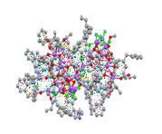











Sacubitril/Valsartan –Angiotensin Receptor Neprilysin Inhibitor –
Simultaneously Inhibits NEP and the RAS
Vasoactive Peptide System
Heart Failure
Renin Angiotensin System
Angiotensinogen
(liver secretion)
pro-BNP
Sacubitril/
Valsartan
NT-pro BNP
Valsartan
^{O} O
Angiotensin I
Sacubitril
ANP
BNP
Adrenomedullin Bradykinin Substance P (angiotensin II)
CNP
N
OH
O
Angiotensin II
X
O HO
HN
OH
N
N
_{N} NH
O
AT₁ receptor
Neprilysin
X
Inactive fragments
Vasodilation
 blood pressure
 sympathetic tone
aldosterone levels
 fibrosis
 hypertrophy Natriuresis/Diuresis
Vasoconstriction
 blood pressure
 sympathetic tone
 aldosterone
 fibrosis
 hypertrophy
Vardeny O. & Solomon SD. JACC HF 2014

Slide 4

PARAGON-HF Study Design
Key Eligibility Criteria
Age ≥50 years
EF ≥45%
Elevated Natriuretic Peptides
Structural Heart Disease
Minimum NT-proBNP for Inclusion
>200 pg/ml with HF hospitalization
>300 pg/ml without hospitalization
3-fold increase in AF
N=4,796
Single-blind active run-in period
Double-blind Treatment period
Sacubitril/Valsartan 97/103 mg BID
Median 27-mo Follow-up
Valsartan
Sac/Val
Valsartan 160mg BID
Screening
1-2 Weeks
2-4 Weeks

Slide 5


PARAGON-HF Study Design
n=4,757
Screening
N=4,796
Single-blind active run-in period
Double-blind Treatment period
Sacubitril/Valsartan 97/103 mg BID
Median 27-mo Follow-up
Valsartan
Sac/Val
Valsartan 160mg BID
Screening
1-2 Weeks
2-4 Weeks

Slide 6
PARAGON-HF Study Design
n=4,757 n=2,774
Screening Pre Run-In
n=2,703
Pre Sac/Val
n=2,730
Randomization
n=2,660
16wks
n=2,502
48wks
N=4,796
Single-blind active run-in period
Double-blind Treatment period
Sacubitril/Valsartan 97/103 mg BID
Median 27-mo Follow-up
Valsartan
Sac/Val
Valsartan 160mg BID
Screening
1-2 Weeks
2-4 Weeks

Slide 7
Objective
To investigate the relationship between NT-proBNP and outcomes in
patients with HFpEF, and the effect of sacubitril/valsartan on NT-proBNP

Slide 8
Baseline Characteristics in Each NT-proBNP Quartile
 | Quartile 1 n=1190 | Quartile 2 n=1189 | Quartile 3 n=1189 | Quartile 4 n=1190 | P-value
NT-proBNP (pg/ml) | <464 | 465-911 | 912-1613 | 1617-31,522
Age (years) | 70.8 ± 8.4 | 72.6 ± 8.4 | 73.3 ± 8.2 | 74.4 ± 8.3 | <0.001
Women | 56% | 53% | 47% | 51% | 0.002
Race |  |  |  |  | 0.85
White | 81% | 80% | 84% | 81%
Asian | 12% | 13% | 12% | 14%
Black | 2% | 3% | 2% | 2%
Other | 5% | 4% | 3% | 4%
Diabetes | 46% | 43% | 42% | 42% | 0.06
Prior HF Hosp | 53% | 53% | 41% | 53% | 0.66
Atrial Fibrillation | 1% | 10% | 55% | 63% | <0.001

Slide 9
Baseline Characteristics in Each NT-proBNP Quartile
 | Quartile 1 n=1190 | Quartile 2 n=1189 | Quartile 3 n=1189 | Quartile 4 n=1190 | P-value
NT-proBNP (pg/ml) | <464 | 465-911 | 912-1613 | 1617-31,522
NYHA FC |  |  |  |  | <0.001
I | 4% | 3% | 2% | 2%
II | 79% | 79% | 78% | 74%
III | 17% | 18% | 20% | 23%
IV | <1% | <1% | <1% | <1%
BMI (kg/m²) | 31.1 ± 5.1 | 30.4 ± 4.9 | 31.1 ± 5.0 | 29.0 ± 4.8 | <0.001
LVEF (%) | 58.9 ± 7.9 | 57.8 ± 7.9 | 57.0 ± 7.6 | 56.3 ± 7.8 | <0.001
eGFR (ml/min/1.73m²) | 67.3 ± 19.8 | 63.0 ± 18.7 | 61.6 ± 18.1 | 58.1 ± 18.4 | <0.001

Slide 10
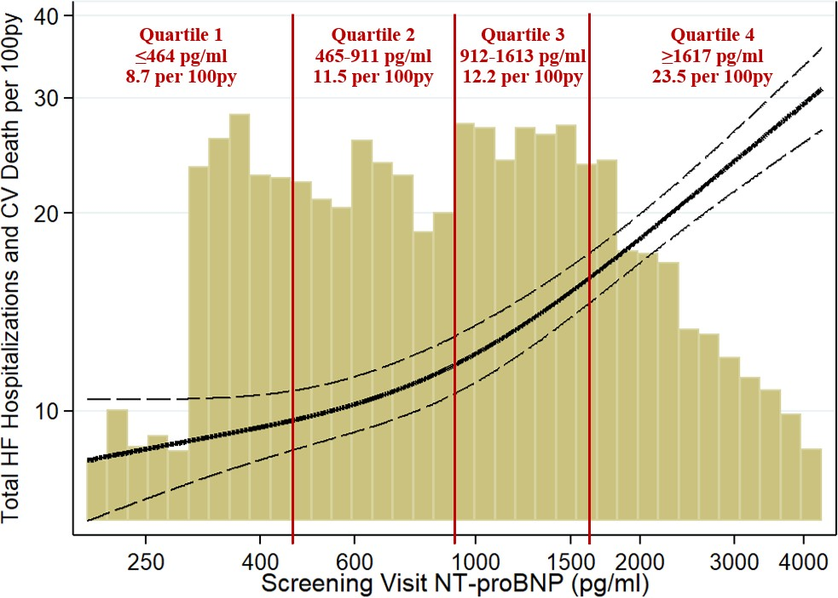
Baseline NT-proBNP strongly predicted total HF hosp & CV death

Slide 11
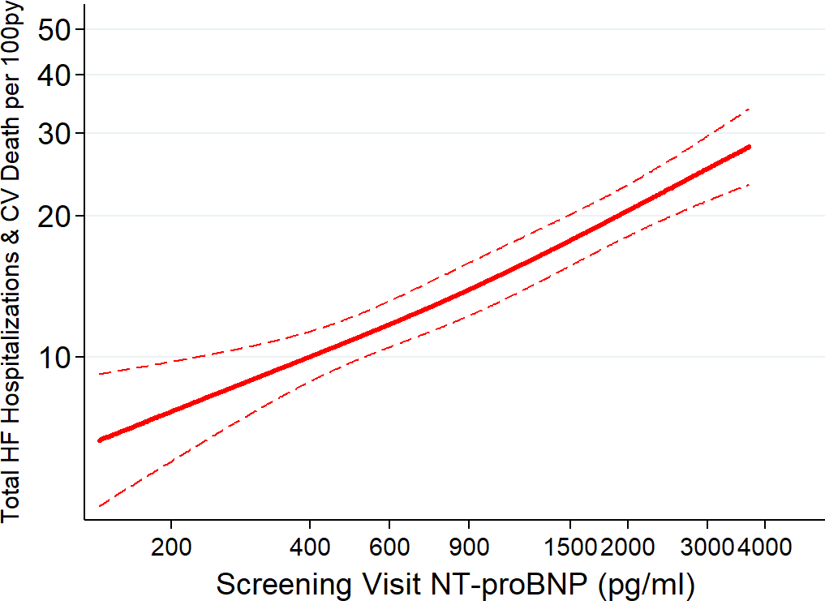
Atrial fibrillation modifies NT-proBNP risk prediction
Primary Endpoint by Screening NT-proBNP
No Atrial Fibrillation

Slide 12
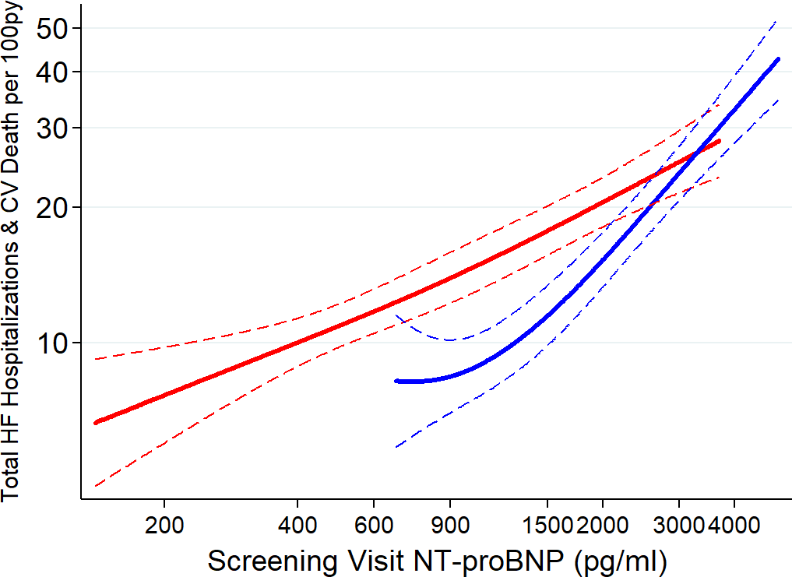
Atrial fibrillation modifies NT-proBNP risk prediction
Primary Endpoint by Screening NT-proBNP
Minimum in AF
& HF Hosp
Minimum in AF &
No HF Hosp
No Atrial Fibrillation
Atrial Fibrillation
P-Interaction <0.001

Slide 13
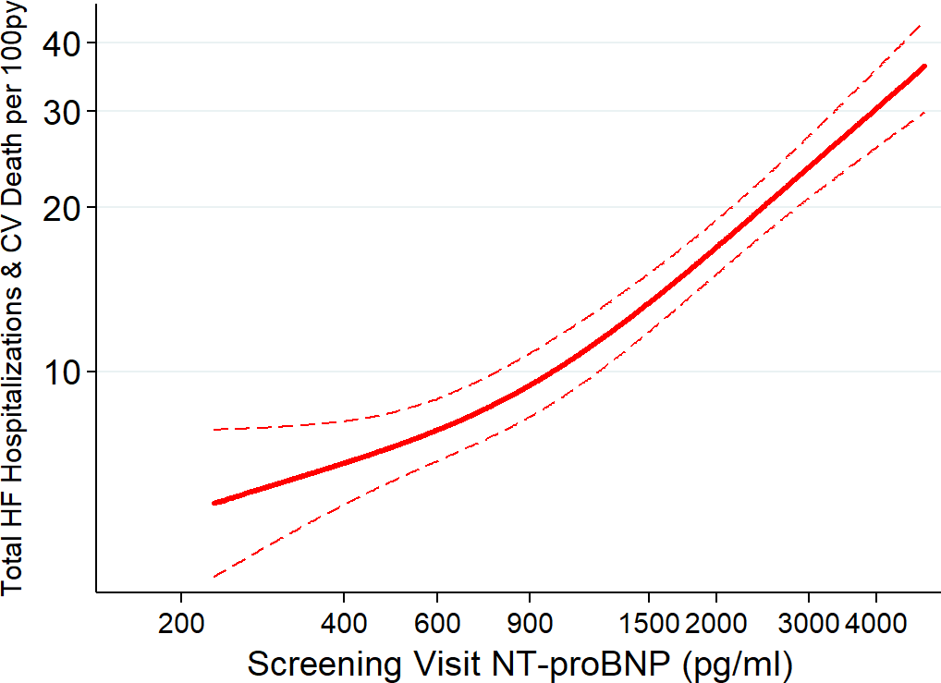
Obese patients with lower NT-proBNP retain moderate risk
Primary Endpoint by Screening NT-proBNP
Non-Obese

Slide 14
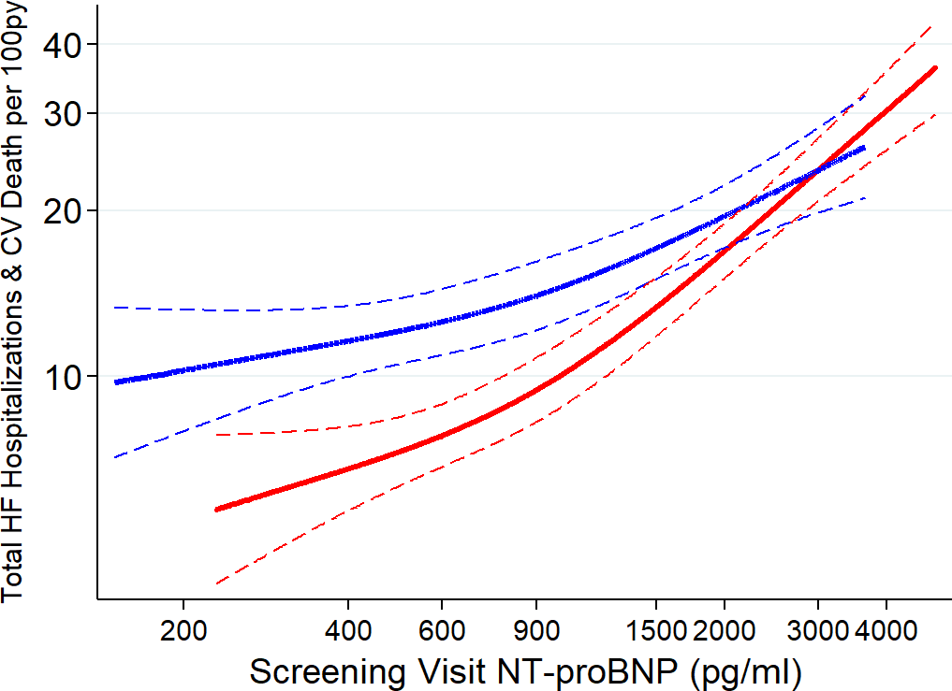
Obese patients with lower NT-proBNP retain moderate risk
Primary Endpoint by Screening NT-proBNP
Obese
Non-Obese
P-Interaction <0.001

Slide 15
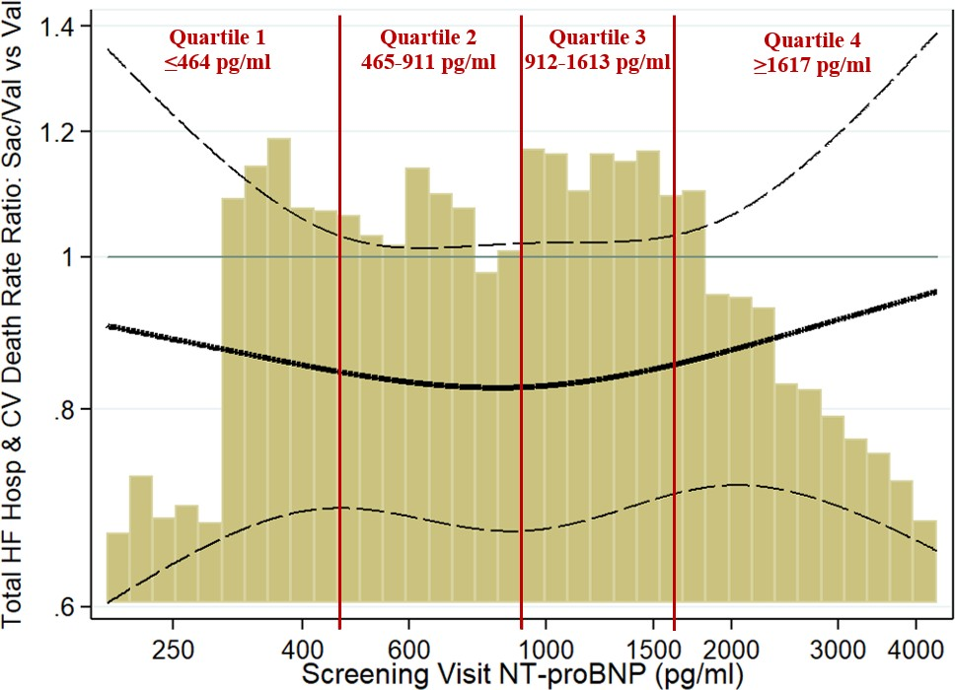
NT-proBNP Did Not Modify Sacubitril/Valsartan Treatment Effect

Slide 16
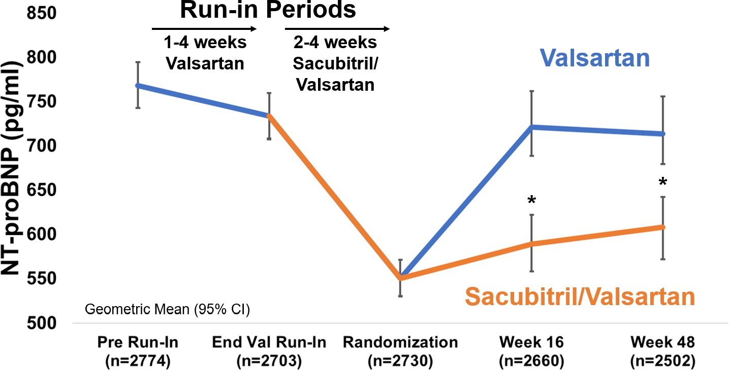
Sacubitril/valsartan reduced NT-proBNP by 19% (vs valsartan)
Change in NT-proBNP over Time

Slide 17
Sacubitril/valsartan reduced NT-proBNP by 19% (vs valsartan)
Change in NT-proBNP over Time

Slide 18
Sacubitril/valsartan reduced NT-proBNP by 19% (vs valsartan)
Change in NT-proBNP over Time
p<0.001
for both

Slide 19
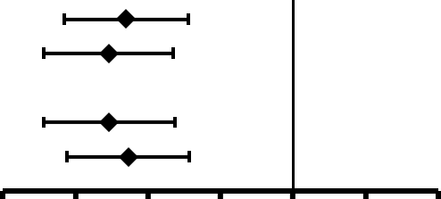
NT-proBNP Reduction Consistent in Key Subgroups
NT-proBNP Reduction with Sac/Val vs Val at 16Wks
Higher LVEF (>57%)
Lower LVEF (≤57%)
Men Women
-23% -16% -8%
Favors Sacubitril/Valsartan
0% +8% +16%
Favors Valsartan
-30%

Slide 20
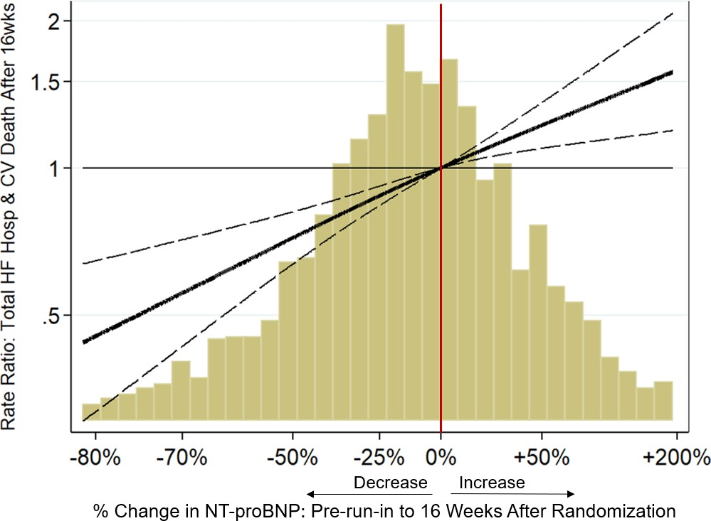
Decreases in NT-proBNP Associated with Lower Event Rate
Association of NT-proBNP Change & Subsequent Events
23% Fewer Events When NT-proBNP Decreased

Slide 21
Conclusions
NT-proBNP Risk Prediction
NT-proBNP strongly predicted events in HFpEF
Risk in atrial fibrilliation is
lower for a given NT-proBNP
Obese patients with low NT-
proBNP retain moderate risk
Effects of Sacubitril/Valsartan
Sacubitril/valsartan reduced NT-proBNP by 19% vs valsartan
NT-proBNP reduction similar in men/women and lower/higher LVEF
NT-proBNP did not identify patients who benefit more from sacubitril/valsartan

Slide 22


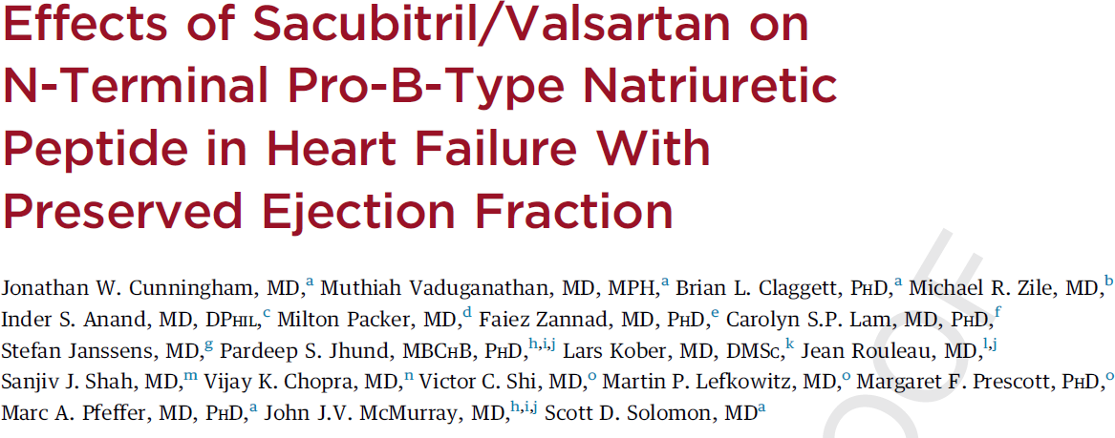
Simultaneous Publication in JACC: Heart Failure
@JonWCunningham
@scottdsolomon

