Slide 1

Two-Year Outcomes of the Five-Year SMART Trial
SMART
Small Annuli Randomized
to Evolut or SAPIEN
Howard C. Herrmann, MD
Roxana Mehran, MD
Didier Tchétché, MD
on behalf of the SMART Trial Investigators

Slide 2
Disclosure of relevant financial relationships
Within the past 12 months, I or my spouse/partner have had a financial interest/arrangement
or affiliation with the organization(s) listed below:
Financial Relationship | Company
Institutional grants/research support | Abbott Vascular, Edwards LifeSciences, Medtronic, Shockwave, Vivasure
Consulting fees/honoraria | Affluent Medical, Caranx, Edwards Lifesciences, Johnson & Johnson, Medtronic, Microinterventional Devices, Wells Fargo
Editorial | Mass Medical Society
Discussion may include unapproved and off-label devices, procedures, and indications

Slide 3
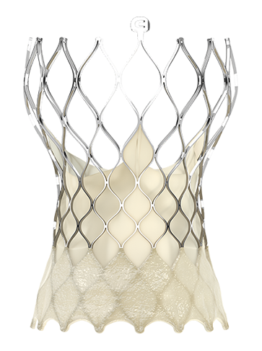
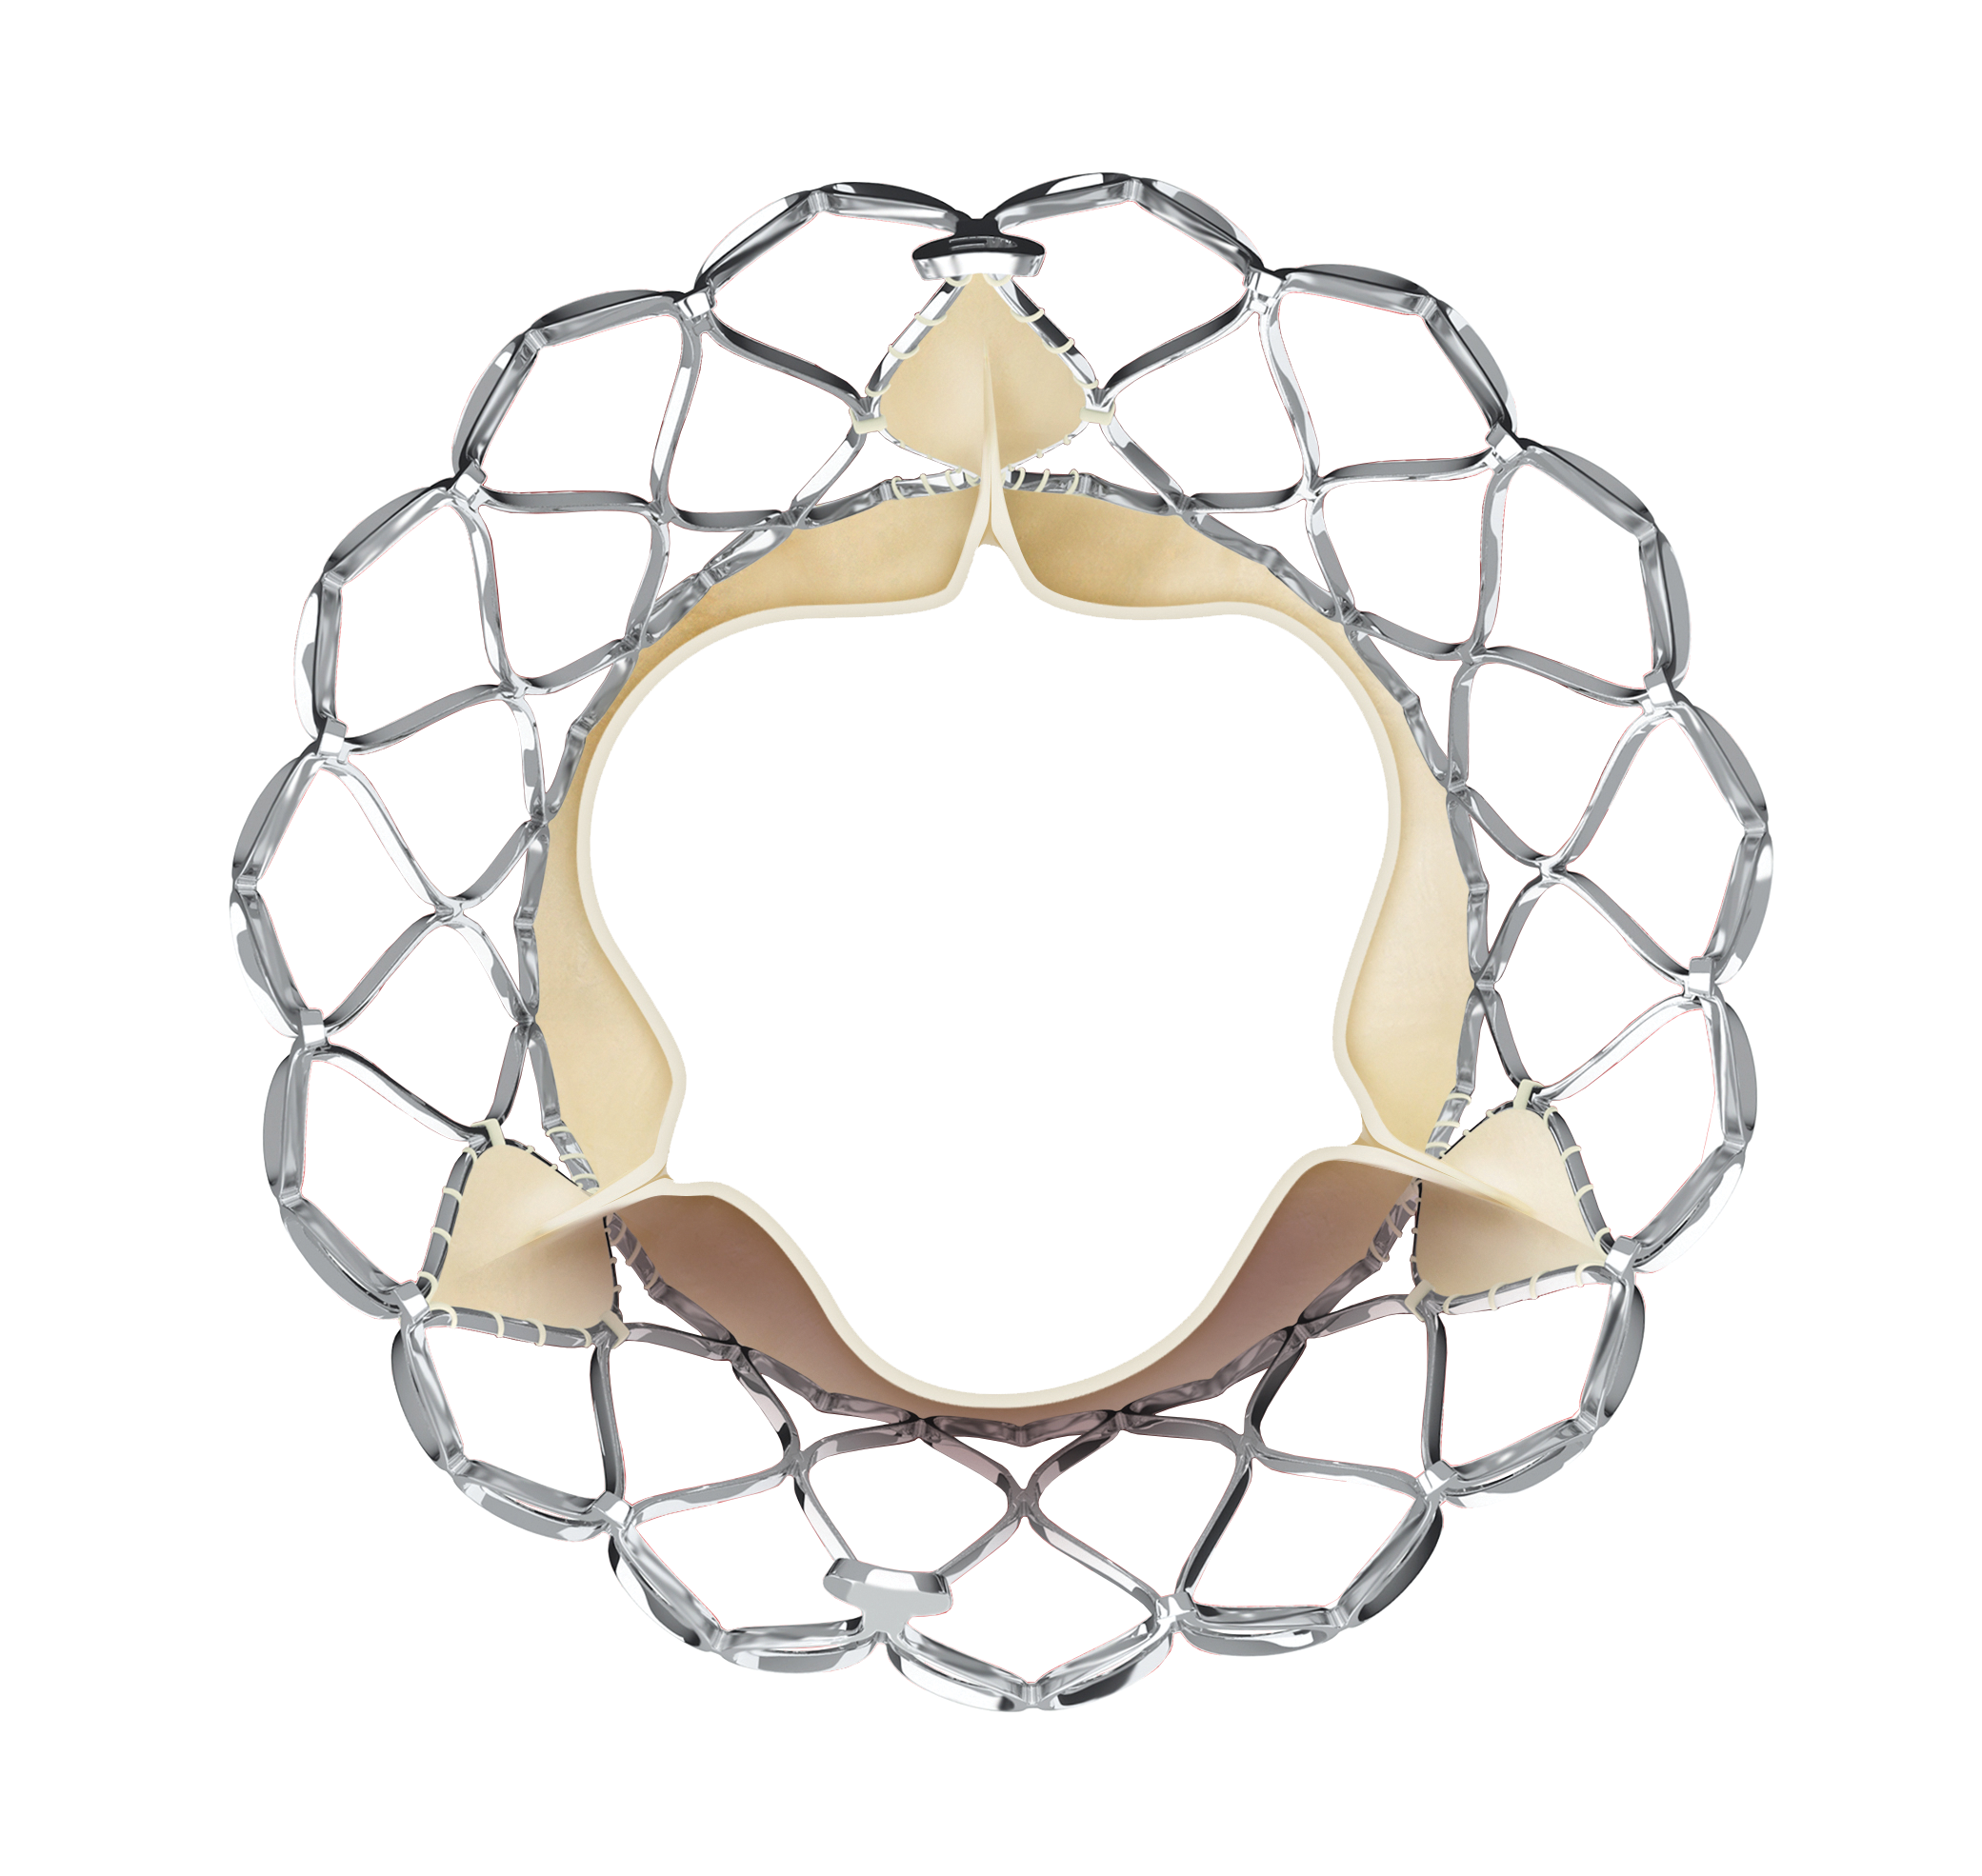
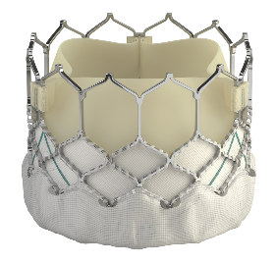
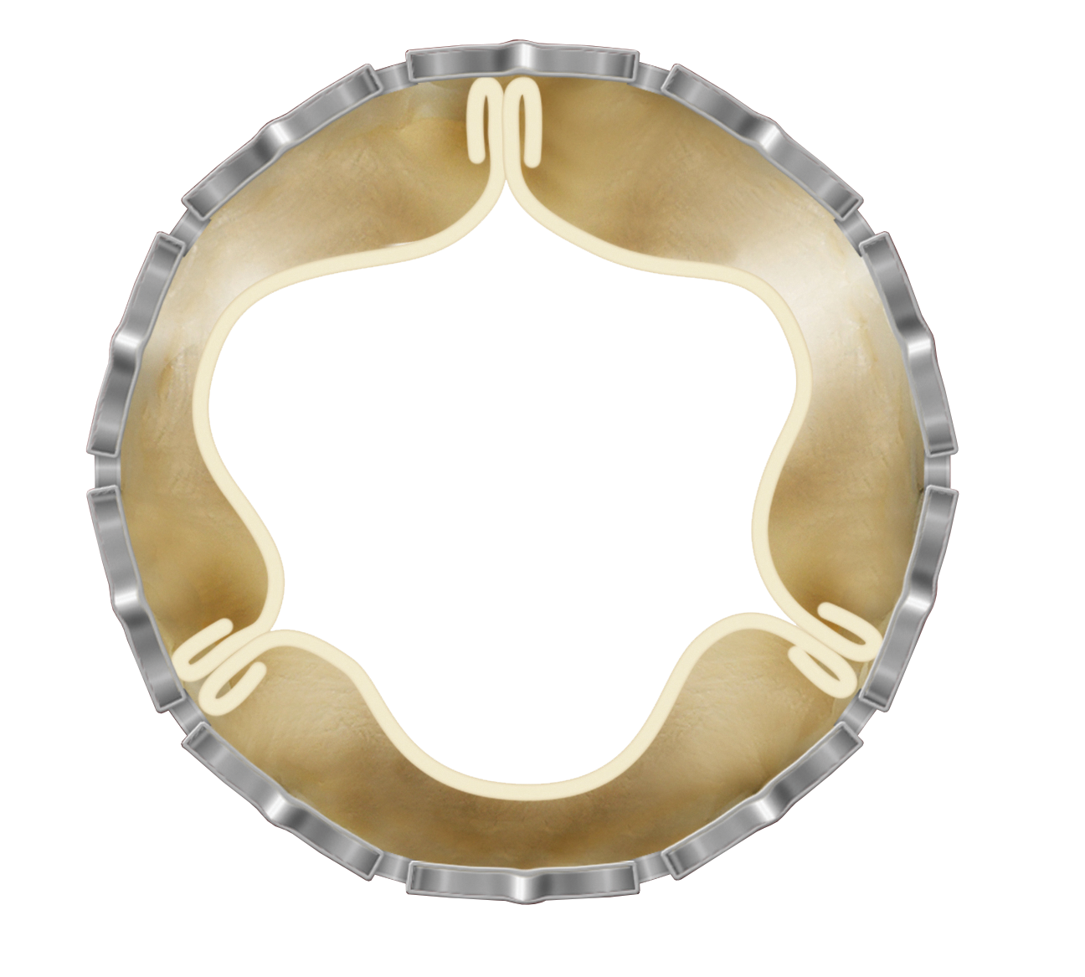
Background
The SMART Trial:
Designed to compare performance for 2 most widely available commercial transcatheter aortic valve replacement (TAVR) devices in patients with severe aortic stenosis and a small aortic valve annulus.¹
Prior Evidence:
Hemodynamics of Evolut valve are superior to those of SAPIEN valve.
Valve Characteristic | Evolut PRO/PRO+/FX | SAPIEN 3/SAPIEN 3 Ultra
Front and top view
Annular Position | Supra-annular | Intra-annular
Platform in SMART | 78.0% Evolut PRO+ | 80.8% SAPIEN 3 Ultra
Annulus Range | 17/18-30 mm | 16-28 mm
Available Valve Sizes | 23, 26, 29, 34 mm | 20, 23, 26, 29 mm
Frame Material | Nitinol (SE) | Cobalt-chromium (BE)
Tissue Material | Porcine | Bovine
Recapturable | Yes | No
Other Features | Designed to retain frame circularity² | Risk for asymmetrical expansion³
Echo core lab derived reference values at 30 days⁴
(2 smallest quintiles of annular dimension)
Mean gradient (mmHg)
SAPIEN
Evolut
SAPIEN
Evolut
SAPIEN
Evolut
284-384 mm² SAPIEN
385-439 mm² SAPIEN
<22.3 mm Evolut
22.3-23.2 mm Evolut
¹Herrmann et al, Am Heart J 2022; 243:92-102. ²Puri et al, JSCAI 2025; 4:102488 (Bench testing may not be indicative of clinical performance). ³Maznyczka et al, JACC CV Interv 2024; 17;2011-2022
⁴Derived from Hahn et al, JACC Imaging 2019; 12:25-34

Slide 4
SMART Trial Design
Prospective, randomized controlled, post-market trial conducted at 83 international sites
All-comer trial with all surgical risk categories including bicuspid patients
716 Patients Treated
Key eligibility
(N=355)
Medtronic Evolut PRO/PRO+/FX
Symptomatic severe AS*
Small aortic annulus (≤430 mm² by MDCT)
Randomization
1:1 stratified by site & sex
Co-primary endpoints powered at 1 year
(N=361)
Edwards SAPIEN 3/SAPIEN 3 Ultra
Co-Primary Endpoint 1: Composite of mortality, disabling stroke, or heart failure rehospitalization through 12 months
Co-Primary Endpoint 2: Bioprosthetic valve dysfunction through 12 months
*AVA ≤1.0 cm² (AVAi ≤0.6 cm²/m²) or mean gradient ≥40 mmHg or max velocity ≥4.0 m/s; 30-day predicted risk of surgical mortality <15% by heart team assessment.

Slide 5
Baseline characteristics
Characteristic | Evolut (N=355) | SAPIEN (N=361)
Age – yr | 80.1 ± 6.3 | 80.3 ± 6.1
Female sex | 87.9% | 85.6%
STS-PROM score – % | 3.3 ± 1.9 | 3.2 ± 1.7
NYHA functional class III/IV | 43.4% | 39.9%
Diabetes | 29.3% | 34.3%
Hypertension | 82.5% | 86.7%
COPD or chronic lung disease | 18.0% | 17.6%
Cerebrovascular disease | 12.0% | 11.4%
Previous CABG | 3.4% | 5.0%
Previous PCI | 17.0% | 23.3%
Previous myocardial infarction | 5.4% | 8.0%
History of RBBB | 5.9% | 6.9%
Coronary artery disease | 35.2% | 41.0%
Pre-existing permanent pacemaker/ICD | 8.5% | 6.9%
Atrial fibrillation / atrial flutter | 19.8% | 18.4%
Bicuspid aortic valve morphology | 3.9% | 4.2%
Data presented as mean ± SD or %

Slide 6
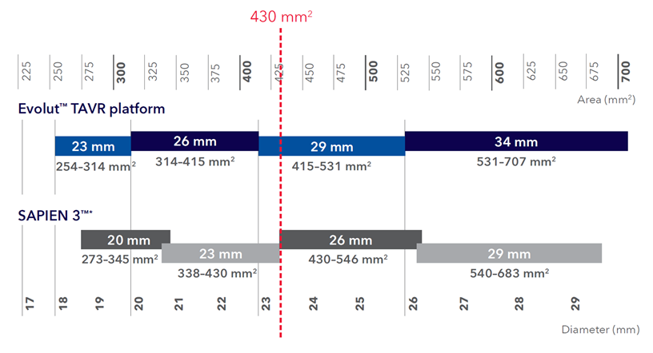
Valve sizing
Aortic annulus size | Evolut (N=355) | SAPIEN (N=361)
Mean area (mm²) | 380.9 ± 34.2 | 382.8 ± 33.9
Mean perimeter (mm) | 70.3 ± 3.2 | 70.4 ± 3.2
SAPIEN
(N=361)
Evolut (N=350)
SAPIEN (N=365)
78.0% Evolut PRO+
80.8% SAPIEN 3 Ultra
Chosen size based on IFU
Device Sizing | Evolut (N=350) | SAPIEN (N=365)
Smaller than recommended | 14 (4.0%) | 6 (1.6%)
Recommended | 309 (88.3%) | 336 (92.1%)
Larger than recommended | 27 (7.7%) | 23 (6.3%)
Valve size (mm)
23
26
29
20
23
26
p=0.11 (Chi-square)

Slide 7
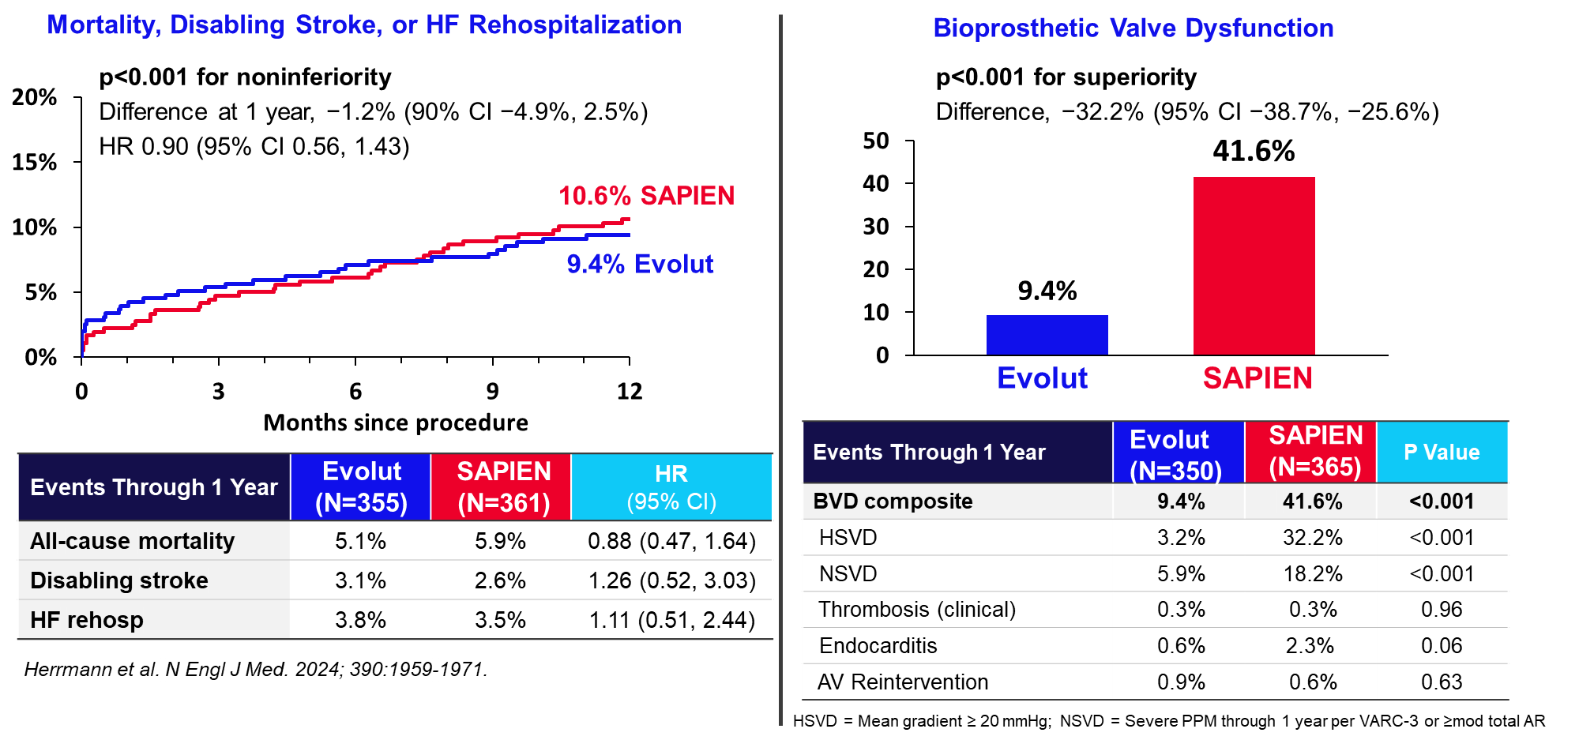
SMART Trial results at 1 year: Co-primary outcomes

Slide 8
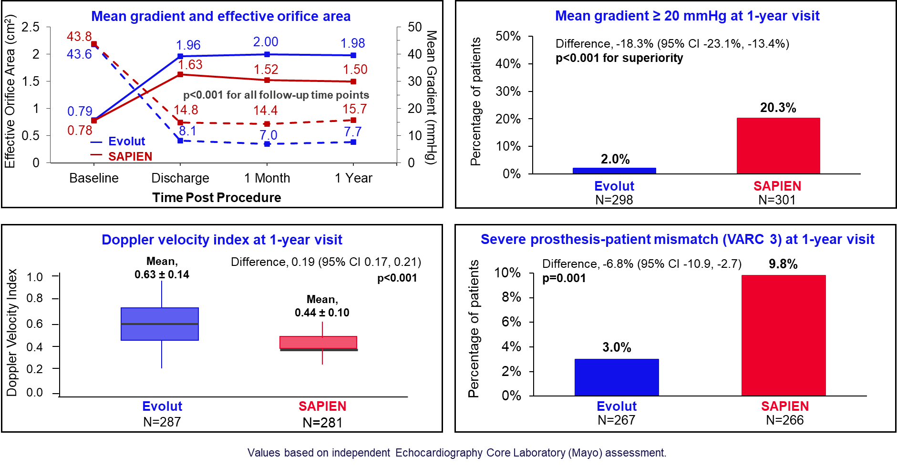
SMART Trial results at 1 year: Hemodynamics

Slide 9
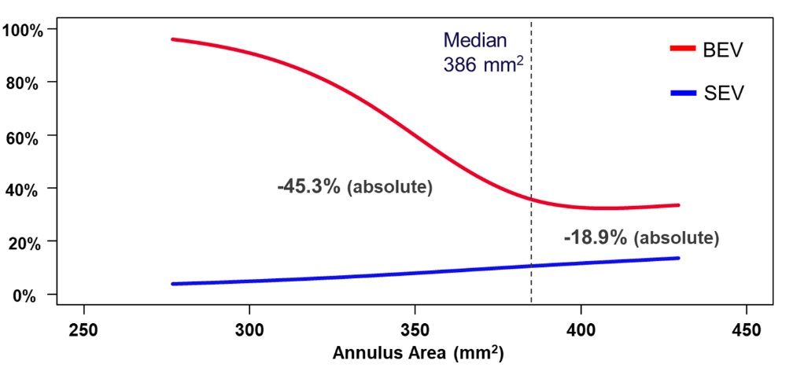
Use of SAPIEN valve was a predictor of BVD
Finding consistent throughout entire range of annulus area in the trial
Incidence of BVD
Multivariable predictors of BVD through 1 Year
SAPIEN
Evolut
Overall Cohort (Evolut + SAPIEN) | Odds Ratio (95% CI) | P Value
SAPIEN (vs Evolut) | 8.21 (5.10-13.23) | <0.001
BSA (per 0.1 m²) | 1.27 (1.13-1.43) | <0.001
Aortic annulus area (per 1 mm²) | 0.99 (0.98-0.99) | <0.001
SPIEN
BVD | Evolut |  | SAPIEN |  | Difference (95% CI) | P Value
Annulus Area <386 mm² | N=171 | 9 (6.1%) | N=187 | 82 (51.4%) | −45.3% (−54.2% , −36.4%) | <0.001
Annulus Area ≥386 mm² | N=179 | 19 (12.7%) | N=178 | 49 (31.6%) | −18.9% (−28.2% , −9.7%) | <0.001
Herrmann et al. Presented at NY Valves 2024, June 5-7, New York, NY

Slide 10
Results at 2 Years

Slide 11
Population and Follow-up Flowchart
As-treated Cohort
N=716
Evolut
N=355
SAPIEN
N=361
12 withdrew
6 withdrew
1-Year Follow-Up
N=343
1-Year Follow-Up
N=355
8 withdrew
6 withdrew
1 explant
2-Year Follow-Up
N=335
2-Year Follow-Up
N=348
2-year follow-up:
Data available for 95% of patients
Echo compliance >87%

Slide 12
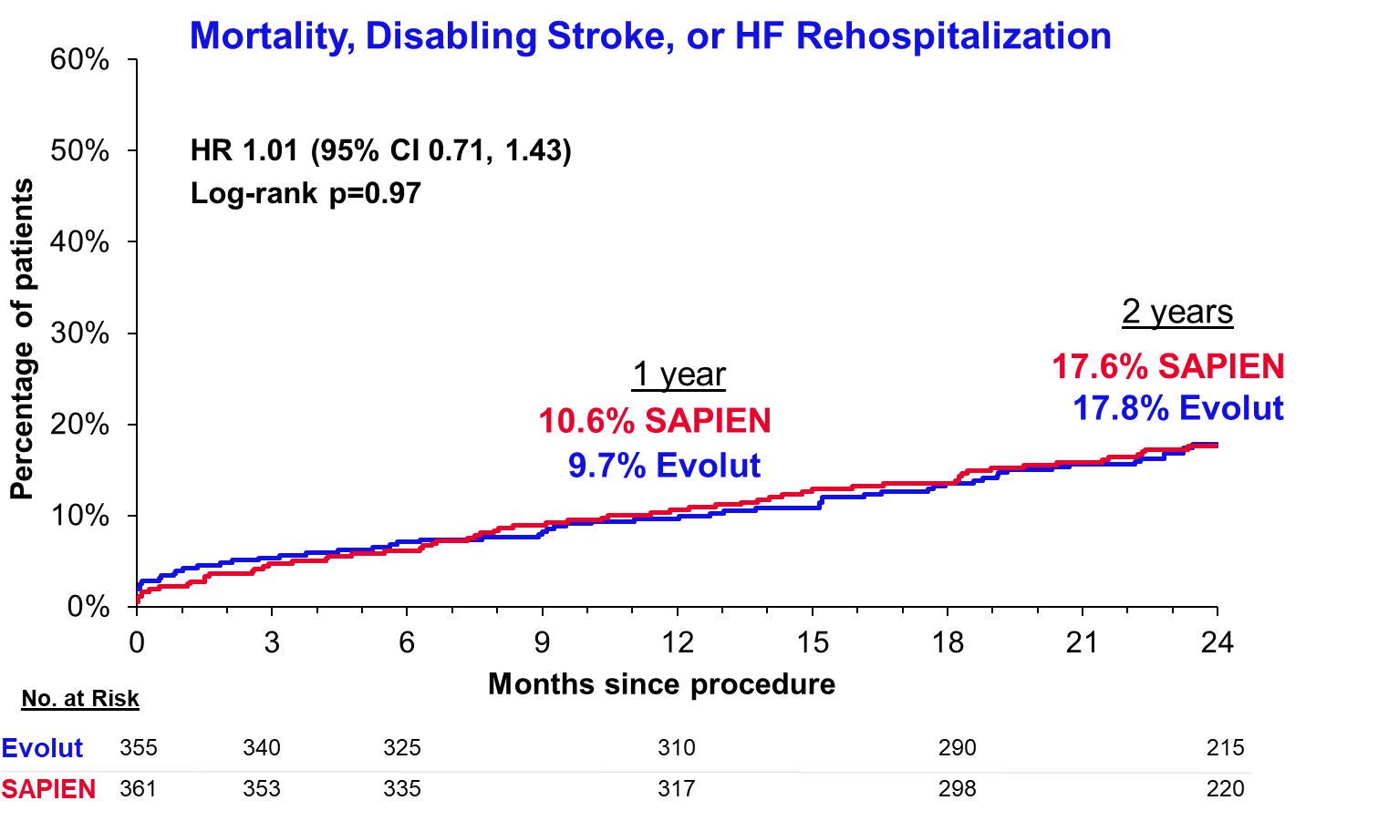
Clinical outcome composite & components through 2 years

Slide 13
Safety events
 | 1 Year |  |  | 2 Years
KM% | Evolut (N=355) | SAPIEN (N=361) | Log-Rank P Value | Evolut (N=355) | SAPIEN (N=361) | Log-Rank P Value
All-cause mortality | 5.1% | 5.9% | 0.676 | 12.7% | 11.4% | 0.657
Cardiovascular mortality | 3.4% | 3.7% | 0.882 | 7.2% | 6.4% | 0.706
Heart failure rehospitalization | 4.1% | 3.5% | 0.661 | 6.1% | 6.0% | 0.951
Aortic valve reintervention | 0.9% | 0.6% | 0.637 | 0.9% | 0.9% | 0.978
New pacemaker implantª | 14.0% | 9.3% | 0.052 | 15.4% | 11.4% | 0.097
Total pacemaker implant^{b} | 12.8% | 8.7% | 0.064 | 14.1% | 10.6% | 0.118
All stroke | 5.4% | 4.2% | 0.439 | 7.3% | 6.2% | 0.487
Disabling stroke | 3.1% | 2.6% | 0.616 | 4.7% | 3.2% | 0.302
Transient ischemic attack | 0.9% | 2.6% | 0.087 | 1.2% | 4.2% | 0.020
Prosthetic valve thrombosis | 0.3% | 2.0% | 0.035 | 1.0% | 4.5% | 0.005
Clinical valve thrombosis | 0.3% | 0.3% | 0.990 | 0.3% | 1.2% | 0.189
Subclinical valve thrombosis | 0.0% | 1.7% | 0.015 | 0.8% | 3.2% | 0.013
ªPatients with pacemaker/ICD at baseline are excluded
^{b}Patients with pacemaker/ICD at baseline are included
Values based on independent Clinical Events Committee adjudication.

Slide 14
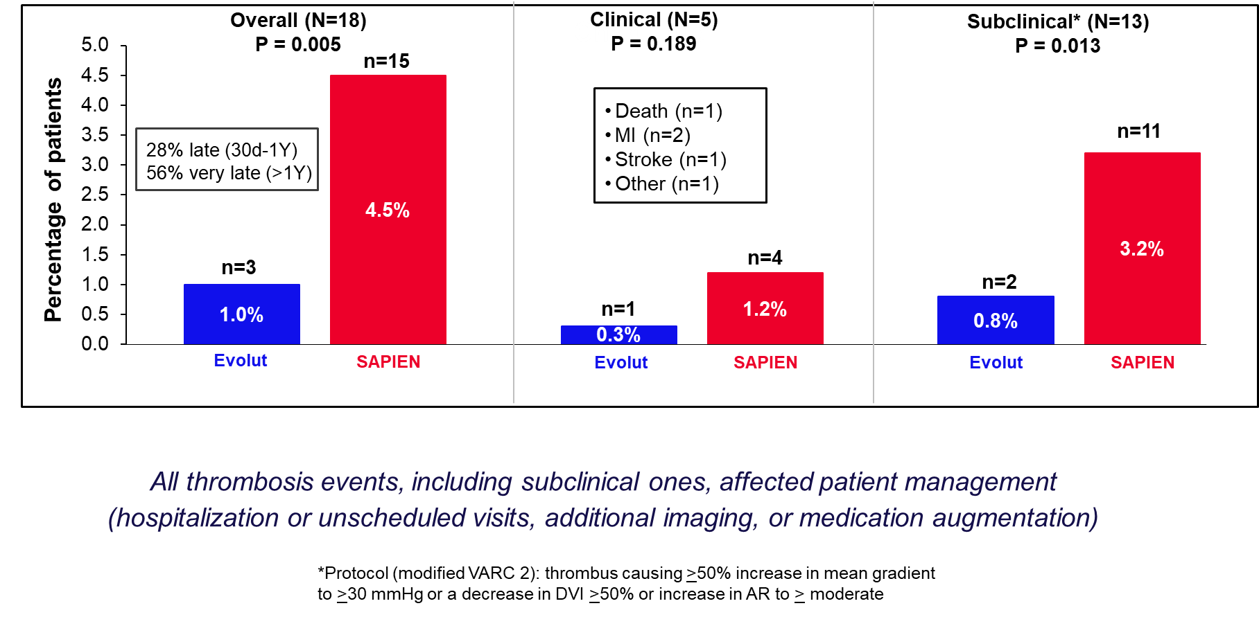
Prosthetic Valve Thrombosis Through 2 Years
(CEC adjudicated)

Slide 15
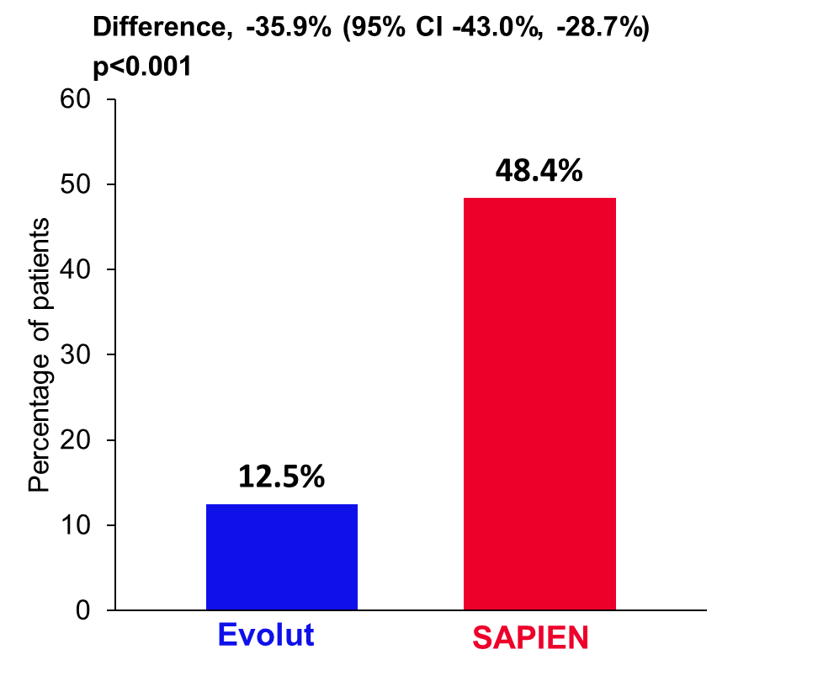

Bioprosthetic valve dysfunction through 2 years
 | Evolut (N=350) | SAPIEN (N=365) | P Value
BVD composite | 12.5% | 48.4% | <0.001
HSVD | 4.7% | 42.4% | <0.001
NSVD | 6.7% | 18.0% | <0.001
Thrombosis (clinical) | 0.3% | 1.2% | 0.17
Endocarditis | 2.2% | 2.6% | 0.76
AV Reintervention | 0.9% | 0.9% | >0.99
HSVD = Mean gradient ≥ 20 mmHg
NSVD = Severe PPM through 1 year per VARC-3 or ≥moderate total AR

Slide 16
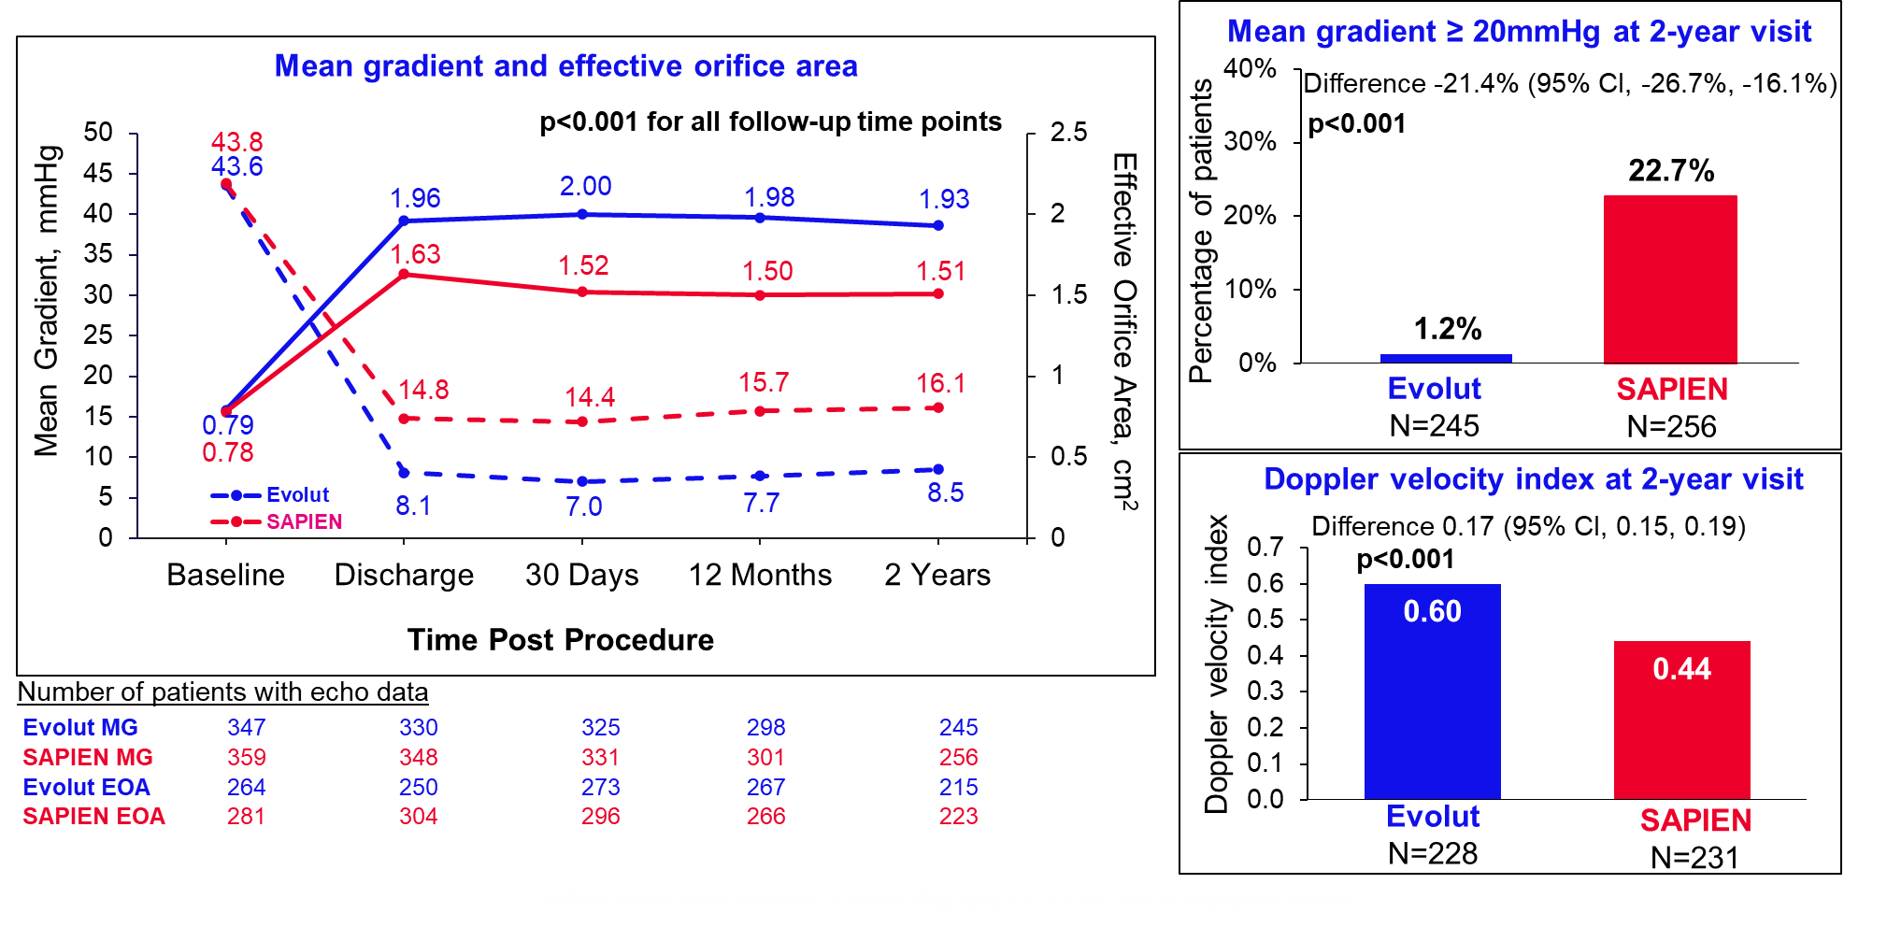
SMART Trial results at 2 years: Hemodynamics
Values based on independent Echocardiography Core Laboratory (Mayo) assessment.

Slide 17
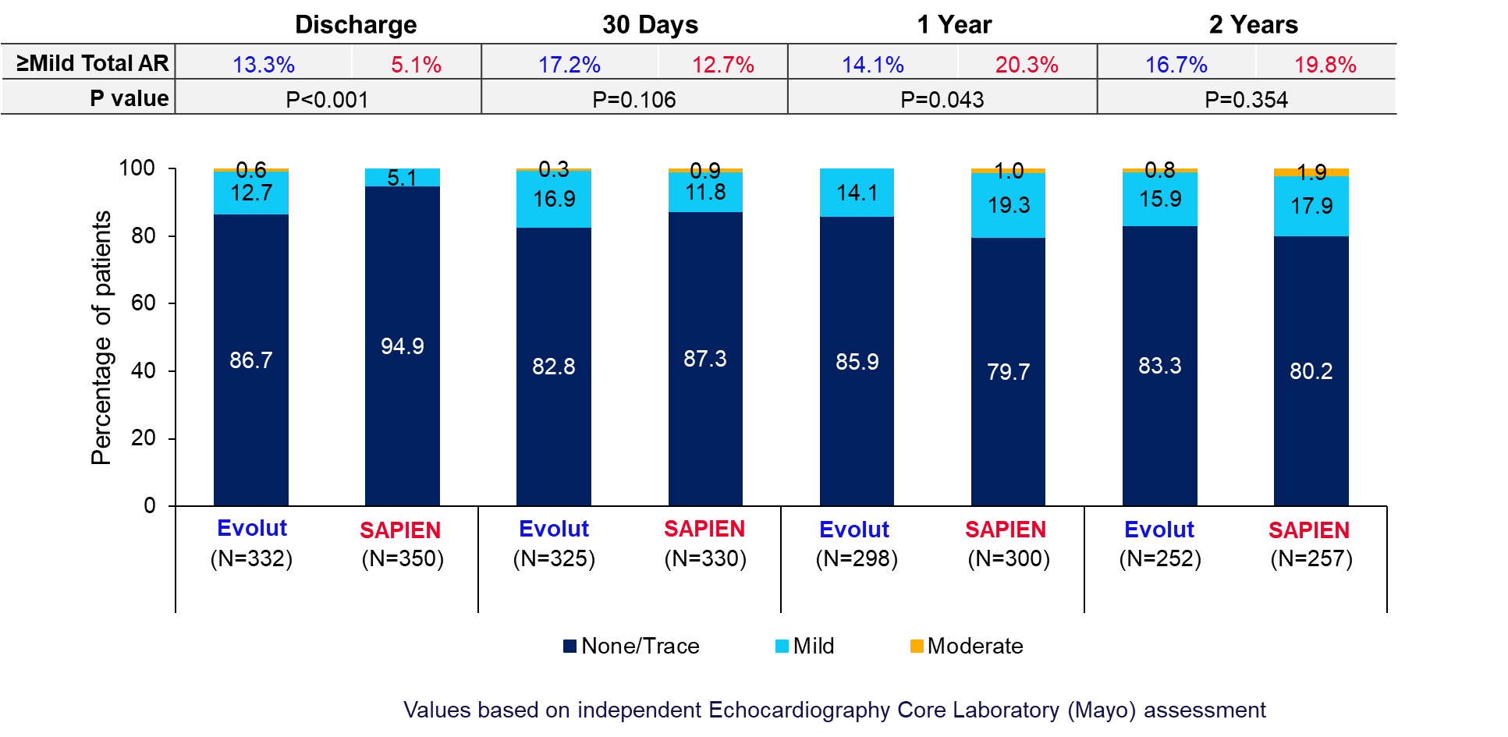
Total aortic regurgitation

Slide 18
Alternative valve dysfunction definitions through 2 years
Alternative definition (Cumulative rates through 2 years) |  | Evolut (N=350) | SAPIEN (N=365) | Difference | P Value (Superiority)
Individual Component Definitions | Mean gradient ≥20 mmHg | 4.7% | 42.4% | -37.7% | <0.001
 | Mean gradient ≥22.5 mmHg¹ | 2.6% | 32.5% | -29.9% | <0.001
 | Mean gradient ≥25 mmHg | 2.4% | 21.7% | -19.2% | <0.001
 | Severe PPM through 1Y (VARC-3)² | 4.9% | 16.7% | -11.8% | <0.001
 | Severe PPM through 1Y (VARC-2)³ | 5.9% | 19.6% | -13.6% | <0.001
Evolut Better
SAPIEN Better
Composite Definitions | SMART BVD⁴ | 12.5% | 48.4% | -35.9% | <0.001
 | EAPCI/ESC/EACTS BVD⁵ | 14.5% | 50.6% | -36.1% | <0.001
 | VARC-3 Mod Hemo² | 10.1% | 24.2% | -14.1% | <0.001
 | Evolut SVD⁶ | 1.3% | 12.9% | -11.7% | <0.001
 | Evolut BVD⁷ | 5.3% | 20.1% | -14.7% | <0.001
Evolut was superior to SAPIEN for all hemodynamic and composite BVD endpoint definitions tested
(Evolut – SAPIEN, % Difference)

Slide 19
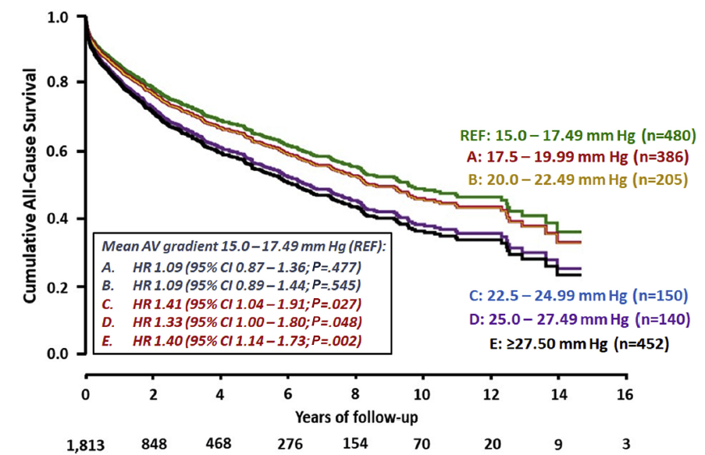
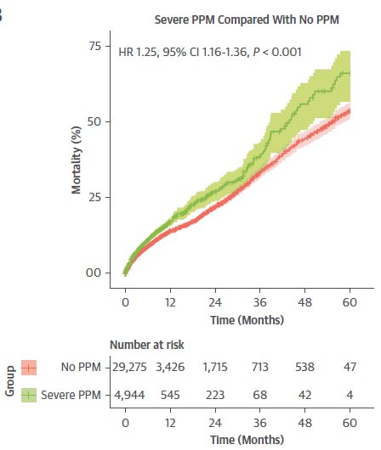
Adverse hemodynamics affect clinical outcomes
Elevated mean gradient after surgical and transcatheter aortic valve replacement reduces survival
Severe prosthesis-patient mismatch after TAVR increases mortality
Australian National Echo Registry
(6,050 patients with prior aortic valve replacement)
Meta-analysis of patient data
(23 studies and 81,969 patients)
Moderate/Severe = 24%
Severe = 11%
Playford et al. J Am Soc Echocardiogr. 2020;33(9):1077-1086.e1.
Sá MP, et al. JACC Cardiovasc Imaging. 2023 Mar;16(3):298-310.

Slide 20


Trial Leadership/Committees: Executive Committee Steering Committee Case Planning Committee Training & Education Committee Publication Committee Independent Safety Committees: Clinical Events Committee Data Safety Monitoring Board Administrator: Baim Institute for Clinical Research Independent Core Laboratories: Echocardiography: Mayo Angiography: Baim Institute for Clinical Research Sponsor: Medtronic (Minneapolis, MN)
Thank You to All of Our Patients, Trial Investigators, Research Coordinators, the 83 Global Sites, Committee Members & Core Laboratories!

Slide 21
Summary
  The randomized SMART trial compared the Evolut and SAPIEN TAVR valves in 716 patients (87% women) with a small aortic annulus.
  After 2 years of follow up, we observed similar rates for the clinical outcome composite of death, disabling stroke, or HF rehospitalization.
  All individual and composite hemodynamic measures continue to demonstrate the superiority of the Evolut platform.
  These findings emphasize the importance of the planned comparison through 5 years of follow-up.

