Slide 1
Post-procedural anticoagulation after primary percutaneous coronary intervention for ST-segment elevation myocardial infarction: a multicentre, randomised, double-blind trial
Shaoping Nie, M.D., Ph.D., FESC, FACC, FSCAI
Beijing Anzhen Hospital, Capital Medical University, Beijing, China National Clinical Research Center of Cardiovascular Diseases, China
On behalf of G Montalescot, Y Li, J Lu, Y Yan and the RIGHT trial investigators

Slide 2
Disclosure Statement of Financial Interest
Dr. Shaoping Nie
Dr. Yan Yan Specific to this topic: None
General (within 12 months): Dr. Nie was funded by National Key Research & Development Program of China (2020YFC2004800), National Natural Science Foundation of China (82270258), Beijing Municipal Science & Technology Commission, China (Z221100003522027) and reports research grants to the Institution from Boston Scientific, Abbott, Jiangsu Hengrui Pharmaceuticals, China Resources Sanjiu Medical & Pharmaceuticals, East China Pharmaceuticals

Slide 3
Background
Empirical prescription of post procedural anticoagulation (PPA) after primary PCI is common worldwide, with various drugs and dosages
CCC-ACS registry (2014–2019)¹
159 tertiary and 82 secondary hospitals in China
34,826 STEMI patients with primary PCI, 75.4% were treated with PPA
HORIZONS-AMI and EUROMAX pooled analysis²
HORIZONS-AMI 123 centres in 11 countries and EUROMAX 65 sites in 9 countries
Among 5239 patients with primary PCI, 41.1% received PPA
Current ESC and AHA/ACC guidelines do not provide recommendations for PPA after primary PCI in patients with STEMI
1. J Am Coll Cardiol Intv. 2022;15(3):251-263; 2. Eur Heart J Acute Cardiovasc Care. 2017;6(7):659-665.

Slide 4
Study Objectives
Primary efficacy objective
To demonstrate superiority of PPA versus placebo to prevent ischemic event through 30 days from randomization
Secondary exploratory objective
To evaluate the consistency of the global primary result across three anticoagulation regimen (enoxaparin, UFH, or bivalirudin)
Safety objective
To evaluate major bleeding (Bleeding Academic Research Consortium [BARC] 3 to 5) at 30 days

Slide 5
Study Design
UFH 10 U/kg/h maintain ACT 150-220 s
Prolonged anticoagulation*
Enoxaparin 40 mg/d s.c.
Primary endpoint at 30 days
Final follow-up for 1 year
Patients with STEMI
undergoing R
primary PCI ^{1:1}
with bivalirudin
Bivalirudin 0.2 mg/kg/h
No anticoagulation
Placebo, according to allocated group
Randomization
< 4 hours
post procedure
N≈2856
Duration: for at least 48h after the procedure or until discharge from CCU if it occurs later
* Each center will use only one anticoagulant in all patients randomized at this center
Yan Y. et al. Am Heart J 2020;227:19-30; RIGHT ClinicalTrials.gov number, NCT 03664180

Slide 6
Inclusion & Key Exclusion Criteria
Inclusion criteria
STEMI with primary PCI of culprit lesion
Undergoing bivalirudin therapy during primary PCI
Age ≥ 18 years
Ability to understand and to comply with the study protocol
Signed informed consent form
Key exclusion criteria
Patients with any indication for anticoagulation
Patients with previous lytic treatment
Patients with previous CABG
Cardiogenic shock, malignant ventricular arrhythmia, or mechanical complications
Estimated body weight of > 120 kg or < 45kg
Any bleeding diathesis or severe hematologic disease or history of intracerebral mass, aneurysm, arteriovenous malformation, recent (<6 months) ischemic stroke or TIA, recent (<6 months) intracranial haemorrhage or, gastrointestinal or genitourinary bleeding within the past 2 weeks
Yan Y. et al. Am Heart J 2020;227:19-30; RIGHT ClinicalTrials.gov number, NCT 03664180

Slide 7
Study Endpoints
Primary efficacy endpoint
Composite of all-cause death, non-fatal myocardial infarction, non-fatal stroke, stent thrombosis (definite) or urgent revascularization (of any vessel) at 30 days
Primary safety endpoint
Major bleeding (BARC definition type 3 to 5) at 30 days

Slide 8
Endpoints
Secondary ischemic endpoints (in hierarchical order)
All-cause death, non-fatal myocardial infarction, non-fatal stroke or urgent revascularization (any vessel) at 30 days
All-cause death, non-fatal myocardial infarction, or non-fatal stroke at 30 days
Cardiovascular death or non-fatal myocardial infarction at 30 days
Definite stent thrombosis (ARC definition) at 30 days
Cardiovascular death at 30 days
All-cause death at 30 days

Slide 9
Sample Size
The sample size calculation was based on a superiority assumption for the primary efficacy endpoint over 30 days of follow-up
Based on similar studies, assuming an event rate of 7% at one month in the control arm, we calculated that a sample size of 2720 would provide 80% power to detect a 35% lower risk of the primary efficacy endpoint in the anticoagulation group with a type I error rate of 0.05
Assuming an expected 5% loss to follow-up, we sought to include 2856 patients

Slide 10
Study Collaborators
The trial was led by the CREATE group (China) and the ACTION group (France)
Funding
Jiangsu Hengrui Pharmaceuticals
Steering Committee
Shaoping Nie, MD, PhD (Study Chair)
Gilles Montalescot, MD, PhD (Scientific Director) Yongjun Li, MD, PhD (Co Chair)
Jiapeng Lu, PhD (Methodology & STAT Representative)
Data Safety and Monitoring Board
Zhenyu Liu, MD, PhD (Chair) Yuqing Zhang, MD, PhD (Member)
Xiaoyan Yan, PhD (Independent Statistician)
Scientific Review Committee
Changsheng Ma, MD, PhD (Chair)
Clinical Events Committee
Jiamin Liu, MD (Chair) Haibo Zhang, MD (Member) Jinhui Song, MD (Member) Yan Li, MD (Member)
Xinli Tian, MD (Member) Yumiao Gong, MD (Member) Yunfeng Han, MD (Member)
Clinical Coordinating Centre
Yan Yan, MD (Study Coordinator) Chen Feng (Project Manager) Yue He (Project Manager) Xiaoyu Ma (Project Manager) Hongwei Tian (Project Manager) Lixiao Chang (Project Manager)
Xin Zhang (DSMB and CEC Coordinator)
Data Management & Analysis
National Clinical Research Center of Cardiovascular Diseases, Fuwai Hospital, Chinese Academy of Medical Sciences, Beijing, China
IWRS & Electronic Data Capture
DAP software (Beijing) Co., Ltd
Study Medication Preparation & Distribution
Changzhou Qianhong Bio-pharma Co., Ltd Jiangsu Hansoh Pharmaceutical Group Co., Ltd
Keyuan Xinhai (Beijing) Medical Products Trade Co., Ltd
ClinsNow Research & Development (Beijing) Co., Ltd

Slide 11
Participating Sites & PIs
Sites | PIs | Sites | PIs
Beijing Anzhen Hospital | Shaoping Nie | The Third Hospital of Shijiazhuang | Lijun Wang
The 7th People's Hospital of Zhengzhou | Jing Li | Wuhan No.1 Hospital | Liqun He
Beijing Haidian Hospital | Fuchun Zhang | Sichuan Provincial People's Hospital | Jianhong Tao
Civil Aviation General Hospital | Zeyuan Fan | Xingtai People's Hospital | Qingmin Wei
Beijing Luhe Hospital, Capital Medical University | Jincheng Guo | Tangshan Gongren Hospital | Xiaokun Liu
The Second Hospital of HeBei Medical University | Suyun Liu | Pizhou People's Hospital | Jianrong Yin
The Second Hospital of HeBei Medical University | Yongjun Li | The First Affiliated Hospital of Henan University of Chinese Medicine | Huaimin Guan
NanYang Central Hospital | Gang Li | Shijiazhuang People's Hospital | Jie Mi
Zhoukou Central Hospital | Huazhong Ran | Renmin Hospital of Wuhan University | Hong Jiang
ZhengZhou Central Hospital | Lin Zhang | Puyang Oilfield General Hospital | Dingran Si
Xinxiang Central Hospital | Zhifang Wang | Cangzhou Central Hospital | Jun Zhang
Yancheng Third People's Hospital | Wanfeng Sun | Linyi People's Hospital | Yanjin Wei
The First People's Hospital of Lianyungang | Delu Yin | Sanmenxia Central Hospital | Huiyu Wang
Zhangjiakou First Hospital | Senlin Li | Tianjin Third Central Hospital | Yingwu Liu
Beijing Friendship Hospital, Capital Medical University | Hui Chen | Handan First Hospital | Shuanli Xin
Cangzhou People's Hospital | Yali Hu | The First Affiliated Hospital of Nanyang Medical College | Ou Zhang
Tianjin 4th Central Hospital | He Feng | Binzhou Central Hospital | Junqiang Cao
Tianjin First Central Hospital | Chengzhi Lu | Xinyang Central Hospital | Junqiang Yuan
The Second Hospital of Tianjin Medical University | Yanmin Xu | The People's Hospital of Yongcheng | Changming Tian
Jiangxi Provincial People's Hospital | Guotai Sheng | Yuancheng District People's Hospital of Heyuan City | Xianrong Gao
The First Hospital of Hebei Medical University | Zhen Wang | Heyuan People's Hospital | Jianhua Le
The First Affiliated Hospital of Anhui Medical University | Xianhe Lin | Beijing Liangxiang Hospital | Xuehua Fang
Beijing Pinggu Hospital | Huiqiang Zhao | The People's Hospital of Pizhou | Chunqiang Yu
Xuchang Central Hospital | Feng Wang | Zhoukou Central Hospital | Haizhu Wang
The First Affiliated Hospital of Nanyang Medical College | Jie Li | Yancheng Third People's Hospital | Ting Cui
Beijing Luhe Hospital, Capital Medical University | Guozhong Wang | Beijing Pinggu Hospital | Hongzhen Jin
Shanxi Bethune Hospital | Xiaolong Mi

Slide 12
Patient Flow
2989 patients were eligible for randomisation
1494 were assigned to PPA group
1495 were assigned to placebo group
1494 in the intention-to-treat population
1495 in the intention-to-treat population
107 were excluded:
42 no respect of inclusion criteria 5 missing data for the primary
efficacy end point
1 no respect of the randomised strategy
59 major protocol deviation
102 were excluded
40 no respect of inclusion criteria 5 missing data for the primary
efficacy end point
3 no respect of the randomised strategy
54 major protocol deviation
1387 in the per-protocol population
1393 in the per-protocol population
Post-procedural anticoagulation (PPA)

Slide 13
Key Baseline Characteristics
Variables | PPA (n=1494) | Placebo (n=1495)
Age, years; mean (SD) | 60.7 (12.4) | 61.1 (12.3)
Male sex | 1195/1494 (80.0) | 1175/1495 (78.6)
Current smoking | 763/1494 (51.1) | 712/1495 (47.6)
Hypertension | 830/1494 (55.6) | 800/1495 (53.5)
Diabetes | 359/1494 (24.0) | 372/1495 (24.9)
Dyslipidaemia | 637/1494 (42.6) | 623/1495 (41.7)
Prior myocardial infarction | 107/1494 (7.2) | 92/1495 (6.2)
Chronic kidney disease | 30/1494 (2.0) | 28/1495 (1.9)
Anterior STEMI | 640/1494 (42.8) | 658/1495 (44.0)
Door-to-balloon time, minutes; median (IQR) | 74 (55, 99) | 75 (53, 103)
Aspirin before angiography | 1467/1494 (98.2) | 1458/1495 (97.5)
P2Y₁₂ inhibitor loading before angiography | 1425/1494 (95.4) | 1407/1495 (94.1)

Slide 14
Angiographic & Procedural Characteristics
Variables | PPA (n=1494) | Placebo (n=1495)
Radial access | 1462/1494 (97.9) | 1454/1495 (97.3)
Infarct related artery
Left main coronary artery | 5/1494 (0.3) | 8/1495 (0.5)
Left anterior descending coronary artery | 698/1494 (46.7) | 714/1495 (47.8)
Left circumflex coronary artery | 204/1494 (13.7) | 199/1495 (13.3)
Right coronary artery | 657/1494 (44.0) | 660/1495 (44.1)
Multi-vessel disease | 941/1494 (63.0) | 981/1495 (65.6)
Thrombus aspiration | 522/1494 (34.9) | 490/1495 (32.8)
Number of stents implanted, median (IQR) | 1 (1, 1) | 1 (1, 2)
Total length of stent, mm; median (IQR) | 29 (22, 38) | 30 (23, 40)
TIMI 3 flow after PCI | 1473/1494 (98.6) | 1464/1495 (97.9)
Glycoprotein IIb/IIIa inhibitor bailout use | 290/1494 (19.4) | 260/1495 (17.4)

Slide 15
Primary Efficacy Endpoint
6.0
PPA
Placebo
Cumulative incidence (%)
5.0
4.0
Hazard ratio, 1.0 (95% CI, 0.63–1.57) p=0.988
3.0
2.0
1.0
0
0
5
10 15 20
Days since randomisation
25
30
No. at risk
Placebo | 1495 | 1475 | 1466 | 1463 | 1461 | 1459 | 1458
PPA | 1494 | 1475 | 1464 | 1461 | 1460 | 1457 | 1457
Primary efficacy endpoint: Death, MI, stroke, stent thrombosis or urgent revascularization at 30 days

Slide 16
Primary Safety Endpoint
6.0
PPA
Placebo
Cumulative incidence (%)
5.0
4.0
3.0
Hazard ratio, 0.74 (95% CI, 0.30-1.83) p=0.511
2.0
1.0
0
0
5
10 15 20
Days since randomisation
25
30
No. at risk
Placebo | 1488 | 1470 | 1462 | 1458 | 1457 | 1456 | 1456
PPA | 1468 | 1448 | 1440 | 1438 | 1437 | 1435 | 1435
Primary safety endpoint: Major bleeding (BARC 3 to 5) at 30 days

Slide 17
Secondary Ischaemic Endpoints
PPA
No. of patients with
Placebo
No. of patients with
Hazard ratio
(95% CI)
Outcomes
event/total no. (%) | event/total no. (%)
All-cause death, non-fatal MI, non-fatal stroke, or _{37/1494 (2.5)} | 37/1495 (2.5) | 1.00 (0.63, 1.57)
All-cause death, non-fatal MI, or non-fatal stroke _{35/1494 (2.3)} | 36/1495 (2.4) | 0.97 (0.61, 1.54)
Cardiovascular death or non-fatal MI _{34/1494 (2.3)} | 29/1495 (1.9) | 1.17 (0.71, 1.92)
Definite stent thrombosis (ARC definition) _{3/1494 (0.2)} | 4/1495 (0.3) | 0.75 (0.17, 3.35)
Cardiovascular death _{27/1494 (1.8)} | 24/1495 (1.6) | 1.12 (0.65, 1.94)
All-cause death _{27/1494 (1.8)} | 24/1495 (1.6) | 1.12 (0.65, 1.94)
Non-fatal MI _{7/1494 (0.5)} | 5/1495 (0.3) | 1.40 (0.44, 4.42)
Non-fatal stroke 2/1494 (0.1) | 7/1495 (0.5) | 0.29 (0.06, 1.37)
urgent revascularisation

Slide 18
Secondary Safety Endpoints
PPA
No. of patients with event/total no. (%)
Placebo
No. of patients with event/total no. (%)
Hazard ratio
(95% CI)
Outcomes
BARC 1, 2, 3, 4, and 5 | 138/1468 (9.4) | 131/1488 (8.8) | 1.07 (0.84, 1.36)
BARC 2, 3 or 5 | 44/1468 (3.0) | 40/1488 (2.7) | 1.11 (0.72, 1.70)
TIMI major, minor, minimal bleeding at 30 days, and their combination | 30/1468 (2.0) | 26/1488 (1.7) | 1.16 (0.69, 1.97)
STEEPLE major bleeding | 7/1468 (0.5) | 11/1488 (0.7) | 0.64 (0.25, 1.66)
GUSTO severe or moderate bleeding | 3/1468 (0.2) | 5/1488 (0.3) | 0.61 (0.14, 2.54)
Thrombocytopenia | 3/1468 (0.2) | 0/1488 (0) | -

Slide 19
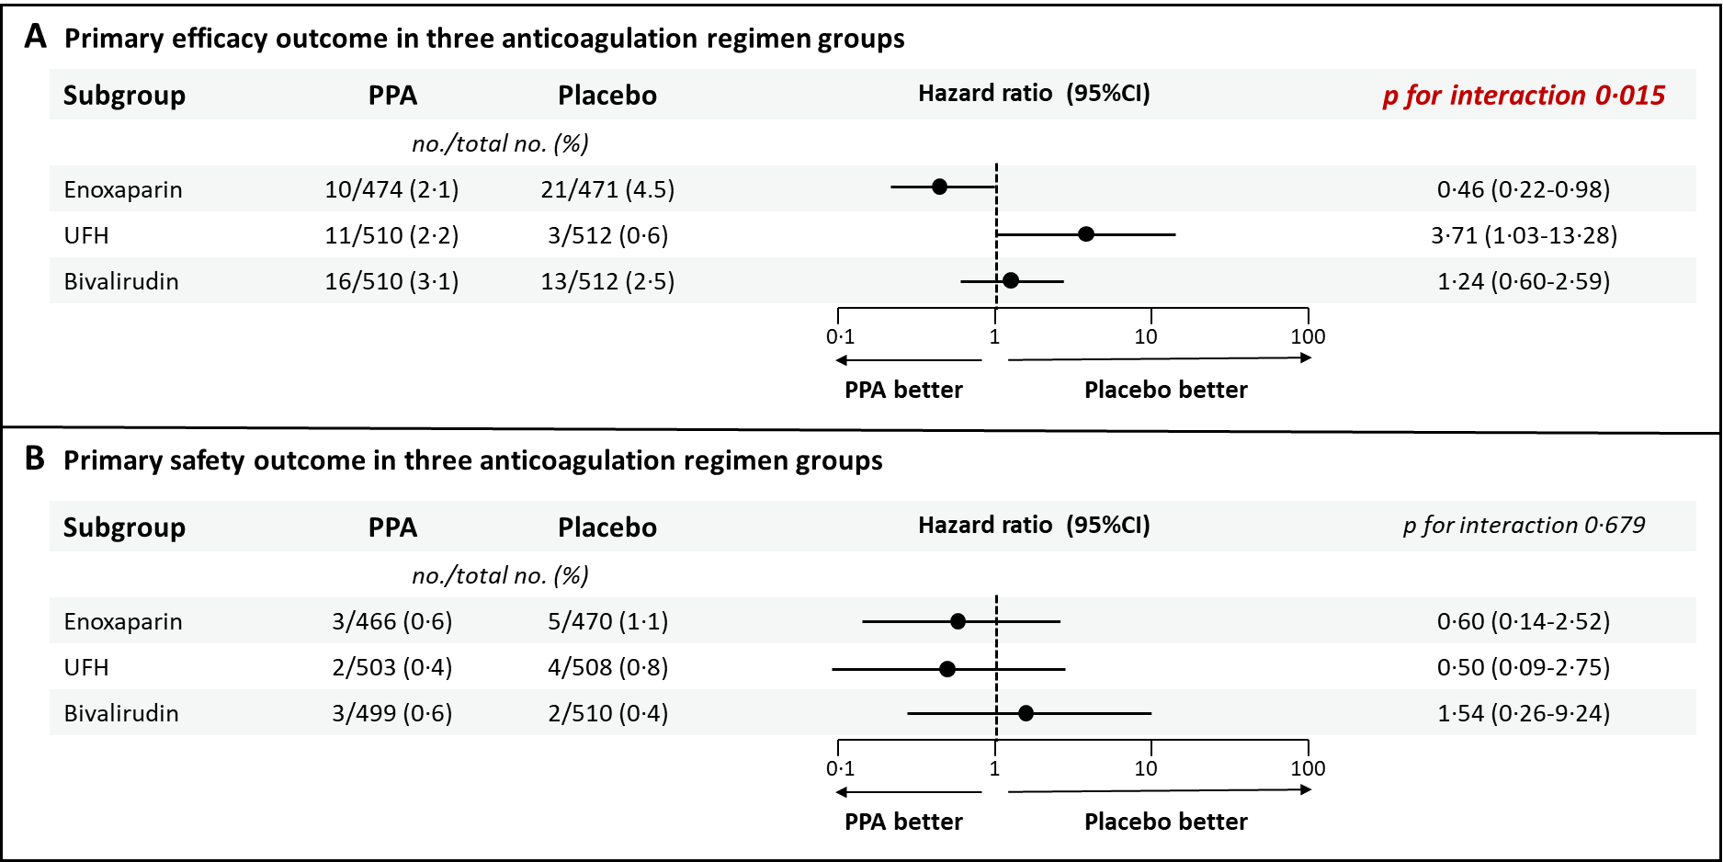
Secondary Exploratory Findings

Slide 20
Study Limitations
The actual event rate was lower than the assumed event rate, an accident not uncommon in recent acute myocardial infarction trials
The type of anticoagulant was not allocated by central randomisation for each patient (for practical reason), but each site preselected a specific anticoagulant. However administration was blinded for each patient with a specific placebo. The cross comparisons of anticoagulants remain exploratory

Slide 21
Conclusion & Clinical Implications
Routine PPA using low-dose anticoagulation after primary PCI is safe but does not improve ischaemic outcome at 30 days
Our data suggest that the three anticoagulants may not be equivalent in the prevention of 30-day ischaemic events but this finding deserves confirmation in future studies

Slide 22
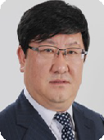
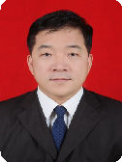
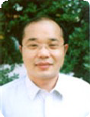
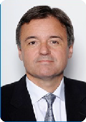
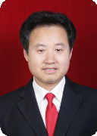
Acknowledgements

