Slide 1
Practice Factors Affecting Cardiologists’ Wellbeing: The American College of Cardiology 2019 Burnout Study
Laxmi S. Mehta, MD; Andrew Miller, MD; B. Hadley Wilson, MD; Anne Rzeszut, MA; Scott Lilly, MD; Daniel Murphy, MD; Dipti Itchhaporia, MD; Akshay Khandelwal, MD; Garima Sharma, MD; Jennifer Mieres, MD; C. Michael Valentine, MD; Stephanie Mitchell, BPh; Pamela Douglas, MD; on behalf of the ACC’s Membership Committee and Workgroup on Wellness

Slide 2
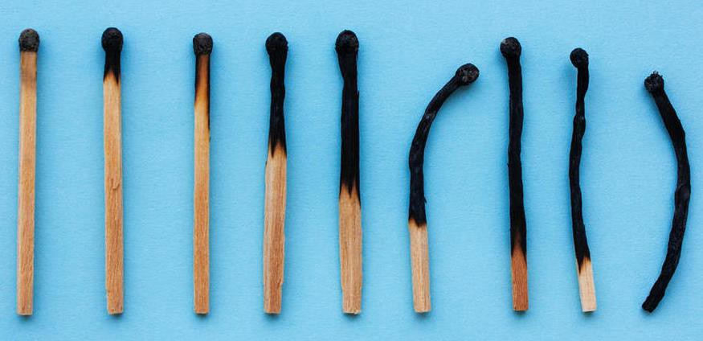
Disclosures
None

Slide 3
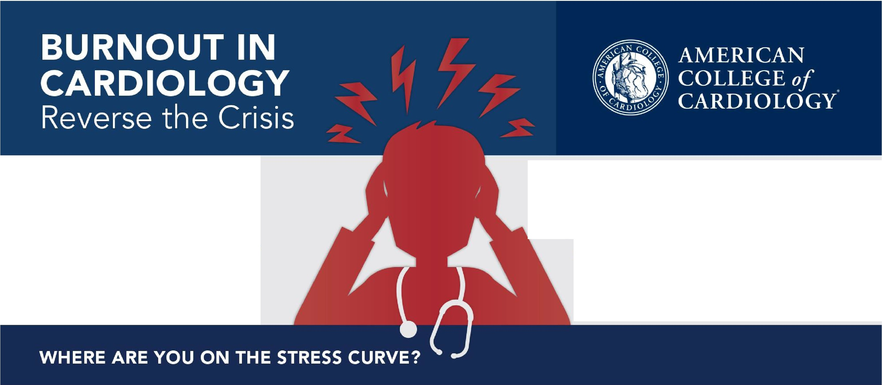
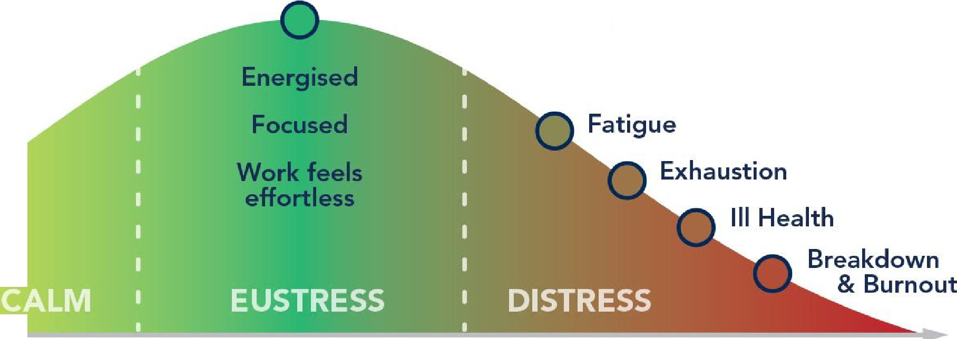
Physical/Emotional Exhaustion
SYMPTOMS OF A BURNOUT
Personal Sense of Lack of Aecom plishment
Cynicism and Detachment
Optimal Performance
Aim to keep employees
-------- a
this performance level
a,
u
C
Seeing Improvement Q
ltl
.^{E}..
...⁰....
aª..,
Bored Q
RICAN
LEGE of
DIOLOGY

Slide 4
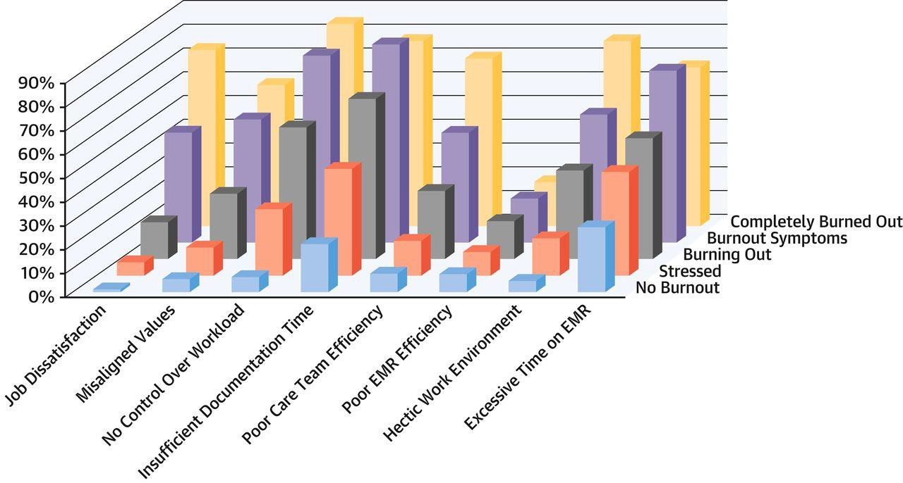

Prevalence of Burnout Amongst Cardiologists
23.7%
Enjoyed Work
26.8%
Burned Out
49.5%
Stressed
Laxmi S. Mehta et al. JACC 2019;73:3345-3348

Slide 5

Methods
Survey sent to 19,348 ACC Members
  September-October 2019
  14,325 cardiologists 2,025 completed survey
Burnout assessed by Mini Z survey
  Also used in 2015 ACC Professional Life Survey
Included novel questions regarding medical errors, desire to change jobs

Slide 6
Mini-Z Burnout Questionnaire
1. Overall, I am satisfied with my current job.
Strongly Disagree | Disagree | Neither | Agree | Strongly Agree
2. I feel a great deal of stress because of my job.
Strongly Disagree | Disagree | Neither | Agree | Strongly Agree
3. My professional values are well aligned with those of my department leaders.
Strongly Disagree | Disagree | Neither | Agree | Strongly Agree
4. Using your own definition of “burnout,” please select one of the answers below.
a. I enjoy my work. I have no symptoms of burnout.
b. I am stressed, but I don’t feel burned out.
c. I am definitely burning out and have symptoms of burnout, e.g., emotional exhaustion.
d. The symptoms of burnout that I am experiencing won’t go away.
e. I feel completely burned out. I am at the point where I may need to seek help.
5. My control over my workload is:
Poor | Marginal | Satisfactory |  | Good |  | Optimal
6. Sufficiency of time for documentation is:
Poor | Marginal |  | Satisfactory |  | Good |  | Optimal
7. The degree to which my care team works efficiently together is:
Poor | Marginal |  | Satisfactory |  | Good |  | Optimal
8. My proficiency with EHR use is:
Poor | Marginal |  | Satisfactory |  | Good |  | Optimal
9. Which number best describes the atmosphere in your primary work area?
1 - Calm | 2 |  | 3 - Busy, but reasonable |  | 4 |  | 5 - Hectic, chaotic
10. The amount of time I spend on the electronic health record (EHR) at home is:
Excessive | Moderately High |  | Satisfactory |  | Modest |  | Minimal/None

Slide 7
Burnout Prevalence
50%
45%
40%
35%
30%
25%
20%
15%
10%
5%
0%
20.7%
No Burnout
Stressed
Burned Out

Slide 8
Burnout Prevalence
50%
45%
40%
35%
30%
25%
20%
15%
10%
5%
0%
43.9%
20.7%
No Burnout
Stressed
Burned Out

Slide 9
Burnout Prevalence
50%
45%
40%
35%
30%
25%
20%
15%
10%
5%
0%
43.9%
35.4%
20.7%
No Burnout
Stressed
Burned Out

Slide 10
Burnout Prevalence
35.4%
50%
45%
40%
35%
30%
25%
20%
15%
10%
5%
0%
23.9%
9.9%
1.6%
One or More Symptoms of Burnout
Chronic Burnout and Work Frustrations
Completely Burned out

Slide 11



Burnout Prevalence 2015 & 2019
60.0%
49.5%
50.0%
43.9%
40.0%
35.4%
30.0%
26.8%
23.7%
20.7%
20.0%
10.0%
0.0%
No Burnout
Stressed
Burned Out
Laxmi S. Mehta et al. JACC 2019;73:3345-3348

Slide 12
Burnout and Gender
p < 0.001
Women
45.3%
Men
33.5%
0%
5%
10%
15%
20%
25%
30%
35%
40%
45%
50%

Slide 13
Burnout and Career Stage
p < 0.001
Early Career
35.4%
Mid Career
45.3%
Late Career
31.5%
0%
5%
10% 15% 20% 25% 30% 35% 40% 45% 50%

Slide 14
Burnout and Work Hours
p < 0.001
<40 hours/week
17.9%
40-59 hours/week
29.5%
>60 hours/week
41.5%
0%
5%
10%
15%
20%
25%
30%
35%
40%
45%

Slide 15
Hectic Work Environment
p < 0.001
70%
59.5%
60%
50%
40%
32.3%
30%
20%
14.6%
10%
0%
No Burnout
Stressed
Burned Out

Slide 16
Major Medical Error
n=175 (8.6%) of total respondents
p < 0.001
70%
58.3%
60%
50%
40%
33.1%
30%
20%
8.6%
10%
0%
No Burnout
Stressed
Burned Out

Slide 17
Plans to Leave Current Practice Setting
n=315 (15.5%) of total respondents
p < 0.001
70%
58.1%
60%
50%
40%
27.9%
30%
20%
14.0%
10%
0%
No Burnout
Stressed
Burned Out

Slide 18
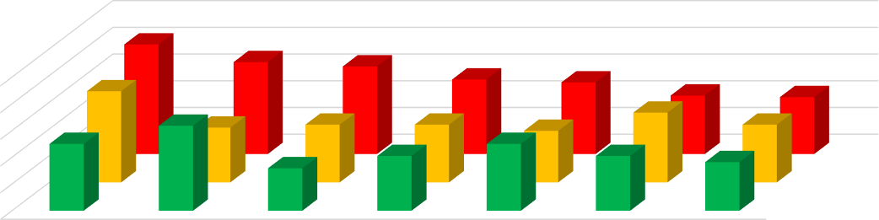
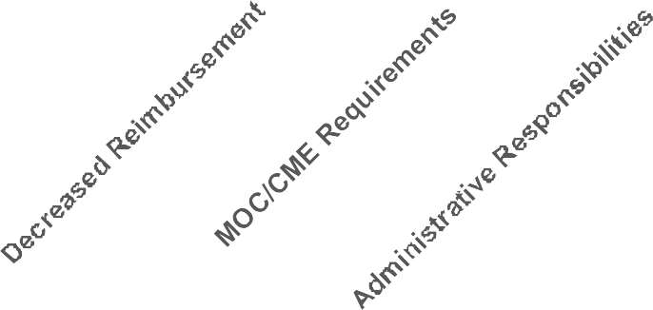

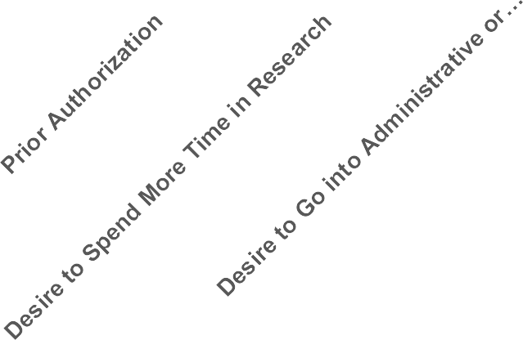
Reasons to Leave Current Practice Setting
No Burnout
Stressed
Burned Out
50.0%
40.0%
30.0%
20.0%
10.0%
0.0%
Burned Out Stressed
No Burnout
p =NS

Slide 19
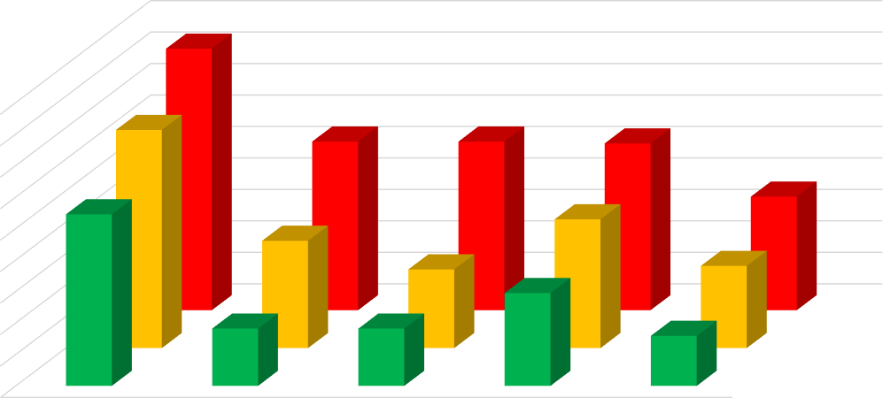
Reasons to Leave Current Practice Setting
90.0%
80.0%
70.0%
60.0%
50.0%
40.0%
30.0%
20.0%
10.0%
0.0%
Burned Out Stressed
No Burnout
Desire to Spend More Time with Family
Call
Excessive RVU
Targets
Electronic Health Records
Pressure to Maintain High Patient Sat. Scores
No Burnout
Stressed
Burned Out

Slide 20
Limitations
The survey response rate was less than ideal (14%).
– However, consistent with other national surveys.
Potential for bias to completing the survey in those who were burned out or stressed versus those who were not.
Burnout was self-reported, and may vary over time.

Slide 21
Conclusions
In 2019, >1/3 of US cardiologists reported being burned out.
  This has increased by 32% since 2015.
  Women and mid career cardiologists are at higher risk of burnout.
Burnout rates are higher in cardiologists who work longer hours or in a hectic work environment, plan to leave current practice and among those reporting medical errors.
Among burned out cardiologists who plan to leave their job, desire to spend more time with family and work related factors (call, RVU, satisfaction scores) are frequently reported.

Slide 22
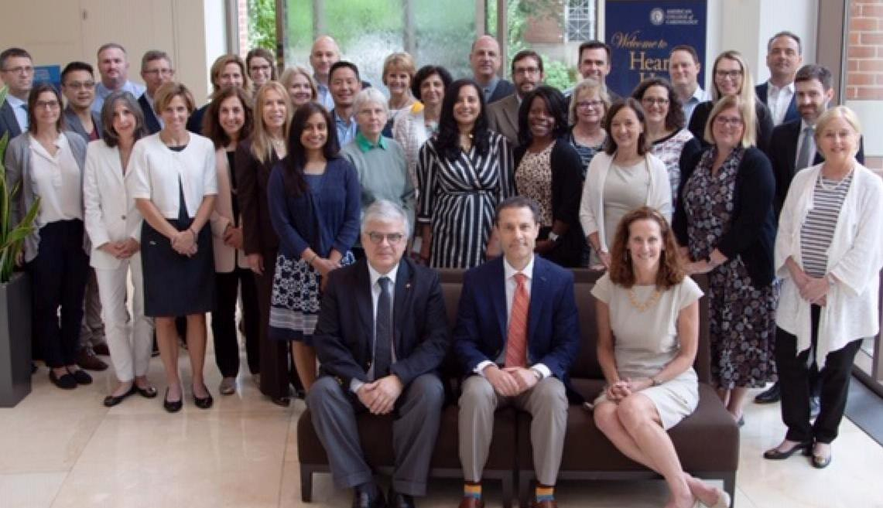
Thank You!
Laxmi S. Mehta, MD, FACC Professor of Medicine Section Director, Preventative
Cardiology & Women’s CV Health
Sarah Ross Soter Endowed Chair in Women’s Cardiovascular Health
Email: Laxmi.Mehta@osumc.edu Twitter: @DrLaxmiMehta

Slide 23
Self-Care Strategies During the Age of COVID-19
Relinquish Control
Revisit History
Establish Realistic Expectations
Give Yourself a Brain Break
Unplug from the Noise
Find a State of Flow
Your Body Matters
Pay it Forward
Find Your Tribe

Slide 24

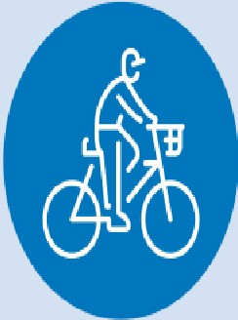



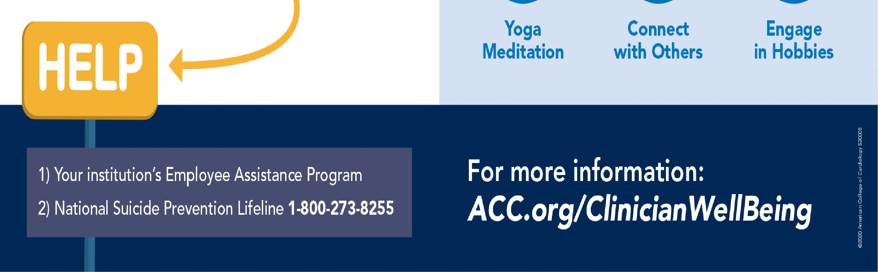

BURNOUT BY THE NUMBERS
WELL-BEING TIPS
/rll,
Exercise
Eat Healthy
Sleep Well
I I I\
35-54°/o
of U.S. physicians
and nurses
45-60°/o
of medical students
and residents
. 1 "\
)
\
41:, A
·
Yoga | Conned | Engage
Meditation | with Others | in Hobbies
AMERICAN COLLEGE of CARDIOLOGY

