Slide 1
The European Bifurcation Club Left Main Coronary Stent study - a randomised comparison of stepwise provisional versus systematic dual stenting strategies (EBC MAIN)
David Hildick-Smith
On behalf of the EBC MAIN Investigators and
the European Bifurcation Club

Slide 2
Potential conflict of interest
Speaker's name: D Hildick-Smith
Study funded from Medtronic
Proctor/Advisory/Lectures: Abbott, Boston, Medtronic, Terumo

Slide 3
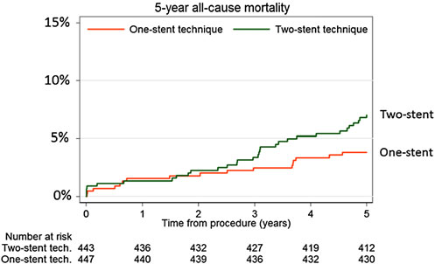
Background
Many trials have shown lack of benefit associated with systematic two-stent strategies for bifurcations
NORDIC, BBC ONE, BBK, CACTUS etc…
Even in patients with larger, true bifurcations
EBC TWO
Outcomes may be worse with systematic dual stenting:
Behan et al EHJ 2016
Long term follow-up of the NORDIC and BBC ONE trials
p=0.04

Slide 4
Left Main Bifurcations
Often described as “a different animal”
Wider angle between vessels
Neither vessel is a branch
More calcification and fibrosis
Greater need for vessel preparation
Two stent techniques may be expected to be worse
Ample evidence from non-randomised trials showing worse outcomes for two-stent techniques
However, randomised data from Dr Shao-Liang Chen et al. support dkcrush in left main bifurcations

Slide 5
Study Hypothesis
EBC MAIN was designed to examine clinical outcomes in patients with true bifurcation left main stem lesions randomised to step-wise layered provisional strategy vs a systematic dual stent strategy
Primary endpoint: death, target lesion revascularisation and myocardial infarction at 1 year
Secondary endpoints:
Death
Myocardial infarction
Target lesion revascularisation
Stent thrombosis

Slide 6
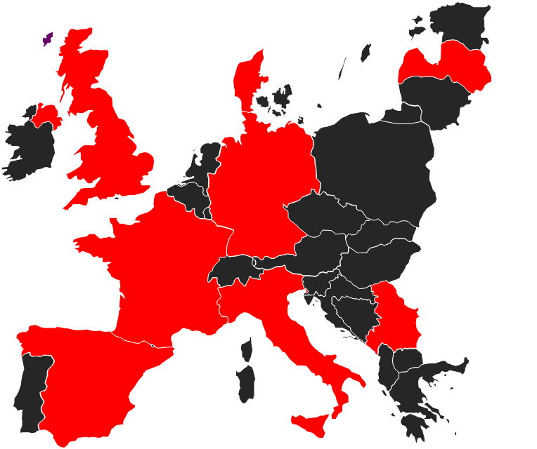
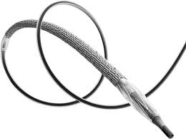
Study Structure
467 patients
31 centres
11 countries
Medtronic Onyx
CEC
DSMB
CRO
CoreLab

Slide 7
Technical details
Provisional approach:
Step-by-step layered technique
according to EBC Consensus (2009-15)
POT mandated
Kiss mandated
Systematic approach:
Operator choice
(T, TAP, Culotte, dkcrush)
Step-by-step approach
according to EBC Consensus (2009-15)
High pressure “ostial” bifurcation dilatations
Kiss mandated +/- final POT

Slide 8
Patient demographics
 | Stepwise provisional (n=230) | Systematic dual (n=237)
Age | 70.8 (10.1) | 71.4 (9.8)
Male | 79% | 74%
Diabetes | 29% | 27%
Acute presentation | 33% | 40%
Syntax score | 22.6 (5.9) | 23.2 (6.0)
Radial approach | 71% | 70%
Sheath 6F | 61% | 59%

Slide 9
Procedural summary characteristics
 | Stepwise provisional (n=230) | Systematic dual (n=237) | p value
No. stents at bifurcation | 1.6 (1.1) | 2.3 (0.8) | <0.001
Stented length (mm) | 25.4 (13) | 31.7 (18) | <0.001
Procedure duration (mins) | 74 (35) | 80 (39) | 0.049
Fluoroscopy time (mins) | 21 (12) | 24 (16) | 0.02
Air kerma (Gy) | 0.7 (1.3) | 0.82 (1.3) | 0.02

Slide 10
Procedural flow
 | Stepwise provisional (n=230) | Systematic dual (n=237)
Main vessel preparation | 199 (88%) | 204 (88%)
Side vessel preparation | 112 (49%) | 190 (83%)
Stent to main vessel | 226 (99%) | 229 (99%)
POT | 194 (85%) | 199 (87%)
Kissing | 202 (89%) | -
Stent to side vessel | 51 (22%) | 217 (94%)
Kissing | 51 (22%) | 217 (94%)
Final POT | 184 (81%) | 192 (84%)

Slide 11
Primary Endpoint
 | Stepwise provisional (n=230) | Systematic dual (n=237) | Hazard ratio
Primary Endpoint
Death, MI, TLR | 34 (14.7%) | 42 (17.7%) | 0.8 (0.5-1.3)
 | Stepwise provisional (n=230) | Systematic dual (n=237) | Hazard ratio
Primary Endpoint
Death, MI, TLR | 34 (14.7%) | 42 (17.7%) | 0.8 (0.5-1.3)
Secondary Endpoints
Death | 7 (3.0%) | 10 (4.2%) | 0.7 (0.3-1.9)
MI | 23 (10.0%) | 24 (10.1%) | 0.9 (0.5-1.7)
Target lesion revascn | 14 (6.1%) | 22 (9.3%) | 0.6 (0.3-1.2)
Stent thrombosis | 4 (1.7%) | 3 (1.3%) | 0.9 (0.4-1.9)

Slide 12
Conclusions
Stent treatment of true bifurcation left main stem coronary disease had generally good outcomes
Numerically fewer serious adverse events with stepwise provisional approach
Procedure time, X-ray dose and consumables were less
Only one-fifth of patients in provisional group required second stent
It is not necessary to “prejudge the issue” and start with a non-provisional two-stent approach
Patients are treated equally well with a stepwise layered provisional approach, starting with a single stent, as with a more complex dual stent implant
The stepwise provisional strategy should remain the approach of choice for the majority of left main bifurcation interventions

