Slide 1
Efficacy and Safety of Indobufen versus Aspirin after Coronary Drug-eluting Stent Implantation (OPTION): a randomized, open-label, non-inferiority trial
Junbo Ge，MD, FACC, FAHA
Department of Cardiology, Zhongshan Hospital
Fudan University
On behalf of the OPTION investigators

Slide 2
Disclosures
Sponsored by Hangzhou Zhongmei Huadong Pharmaceutical Co., Ltd, Hangzhou, Zhejiang, China
Supported by Shanghai Clinical Research Center for Interventional Medicine (19MC1910300) and Clinical Research Special Fund of Zhongshan Hospital Fudan University (2020ZSLC57)

Slide 3
Background
Dual antiplatelet therapy (DAPT) with aspirin as a background therapy has become the standard care following PCI.
Several unfavorable non-cardiac effects, such as allergy and intolerance, limit the use or adherence of aspirin in clinical practice.
Indobufen is associated with a better platelet selectivity, tolerability and benefit/risk profile.
Exploration of pharmacological alternatives to aspirin on top of a P2Y12 inhibitor is of great interest and clinical relevance.

Slide 4
Objective
The OPTION trial was conducted to establish whether indobufen-based DAPT (indobufen 100mg twice a day plus clopidogrel 75mg/d for 12 months) is non-inferior to conventional DAPT (aspirin 100mg/d plus clopidogrel 75mg/d for 12 months) in patients with negative cardiac troponin undergoing coronary DES implantation.

Slide 5
Study design
a randomized, open-labeled, prospective, non-inferiority, multi-center study in 103 cardiovascular centers in China
CV death, non-fatal MI, stroke, definite or probable ST, and BARC bleeding (type 2,3,or 5)
300-600mg Clo loading
Indo 100mg bid
Clo 75mg qd
18 to 75 yrs
CAD patients with negative cTnT or I
Successful PCI with DES
Within 24h
1 month post-PCI
3 months post-PCI
6 months post-PCI
12 months post-PCI
R
ASA 100mg qd
Clo 75mg qd
CAD= coronary artery disease, PCI= percutaneous coronary intervention, DES= drug-eluting stent, Clo= clopidogrel, Indo= indobufen, ASA=aspirin, CV= cardiovascular, MI= myocardial infarction, ST= stent thrombosis

Slide 6
Baseline characteristics of the ITT population
 | Indobufen N= 2258 | Aspirin N= 2293
Age, years | 61.0±8.3 | 61.2±8.4
Male | 1521 (67.4%) | 1447 (63.1%)
BMI, kg/m² | 25.0±3.3 | 25.0±3.2
Hypertension | 1517 (67.2%) | 1542 (67.2%)
Diabetes mellitus | 802 (35.5%) | 768 (33.5%)
Hyperlipidemia | 744 (33.0%) | 734 (32.0%)
Current smoking | 584 (25.9%) | 541 (23.6%)
Previous myocardial infarction | 137 (6.1%) | 137 (6.0%)
Previous heart failure | 128 (5.7%) | 142 (6.2%)
Previous stroke | 146 (6.5%) | 108 (4.7%)
Previous gastrointestinal bleeding | 13 (0.6%) | 15 (0.6%)
ARC high bleeding risk | 145 (6.4%) | 137 (6.0%)
Creatinine clearance <60ml/min | 294 (13.0%) | 286 (12.5%)
 | Indobufen N= 2258 | Aspirin N= 2293
Clinical presentation
Stable CAD | 993 (44.0%) | 990 (43.2%)
Unstable angina | 1265 (56.0%) | 1303 (56.8%)
PCI procedure
Multivessel disease | 1264 (56.0%) | 1280 (55.8%)
No. of stents | 1.51±0.77 | 1.53±0.79
Length of stents (mm) | 37.8±23.1 | 38.5±24.7
Bifurcation target lesion | 215 (9.5%) | 210 (9.2%)
Complex-PCI | 541 (24.0%) | 583 (25.4%)
Medication
Statin | 2087 (92.4%) | 2134 (93.1%)
β-blocker | 1537 (68.1%) | 1609 (70.2%)
ACEI or ARB | 1303 (57.7%) | 1347 (58.7%)
PPIs | 1085 (48.0%) | 1138 (49.6%)

Slide 7
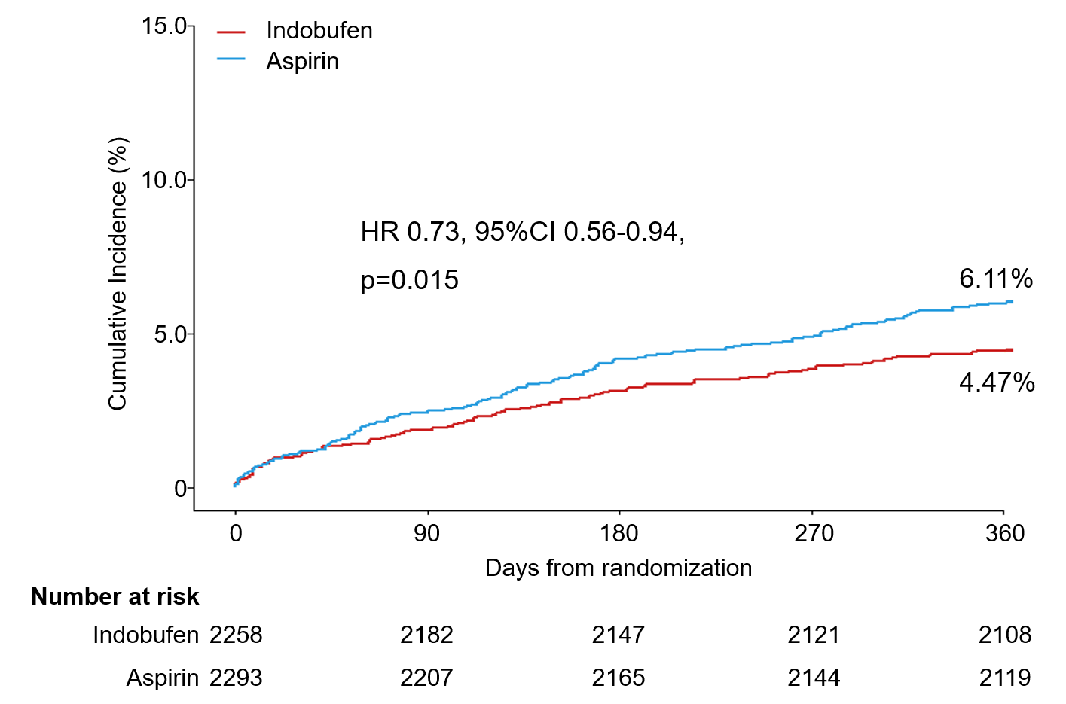
The primary endpoint
a composite of CV death, nonfatal MI, ischemic stroke, definite or probable stent thrombosis, or BARC type 2, 3 or 5 bleeding at 1-year
occurred in 101 (4.47%) patients in the indobufen-based DAPT group and 140 (6.11%) patients in the conventional DAPT group (p_{noninferiority}<0.001)

Slide 8
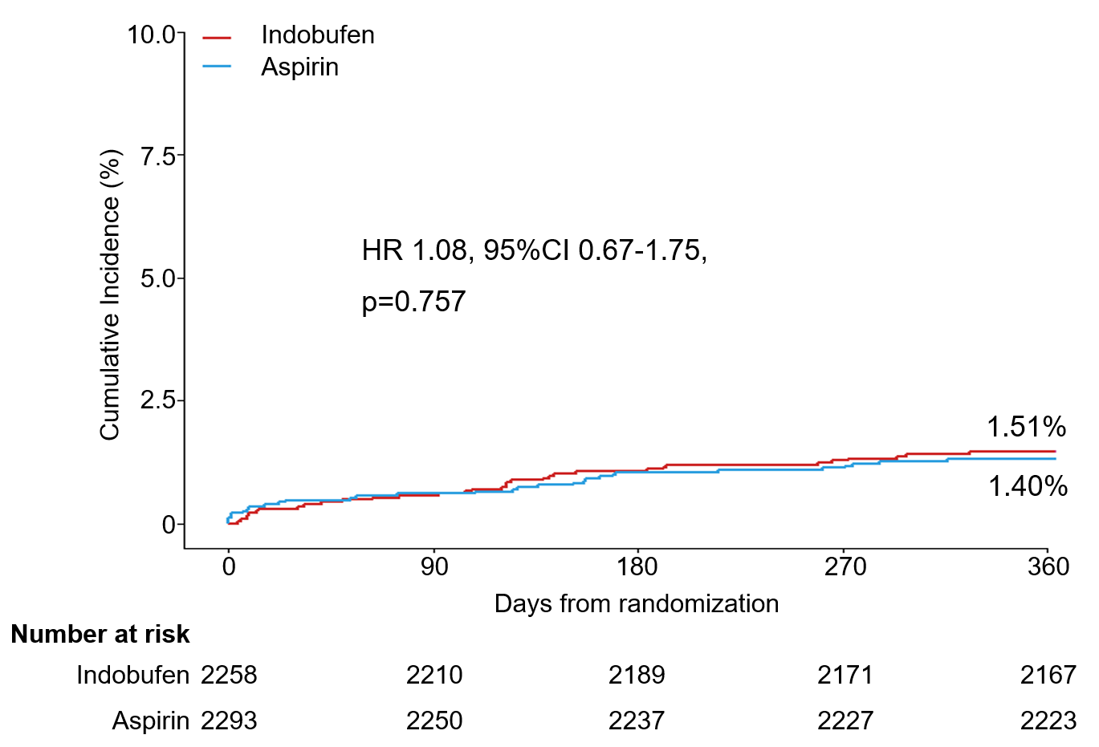
The secondary efficacy endpoint
 | Indobufen N= 2258 | Aspirin N= 2293
CV death, nonfatal MI, ischemic stroke, ST | 34 (1.51%) | 32 (1.40%)
CV death | 3 (0.13%) | 4 (0.17%)
Nonfatal MI | 9 (0.40%) | 10 (0.44%)
Ischemic stroke | 18 (0.80%) | 19 (0.83%)
Definite or probable ST | 5 (0.22%) | 4 (0.17%)

Slide 9
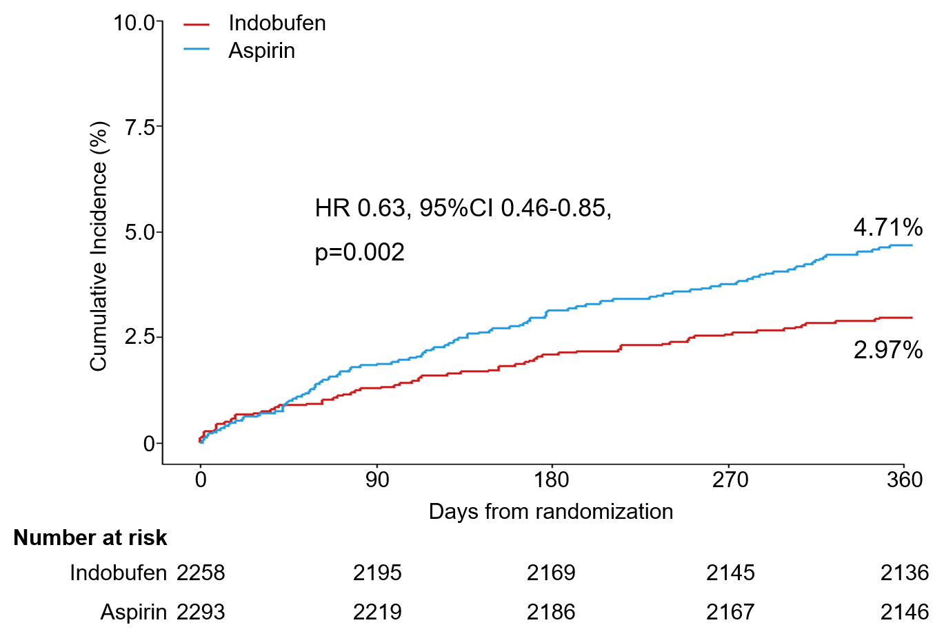
The secondary safety endpoint
 | Indobufen N= 2258 | Aspirin N= 2293 | P value
BARC type 2, 3, 5 bleeding | 67 (2.97%) | 108 (4.71%) | 0.002
BARC type 3, 5 bleeding | 29 (1.28%) | 28 (1.22%) | 0.84
BARC type 2 bleeding | 38 (1.68%) | 80 (3.49%) | <0.001
BARC type 3 bleeding | 24 (1.06%) | 24 (1.05%) | 0.95
BARC type 5 bleeding | 5 (0.22%) | 4 (0.17%) | 0.72

Slide 10
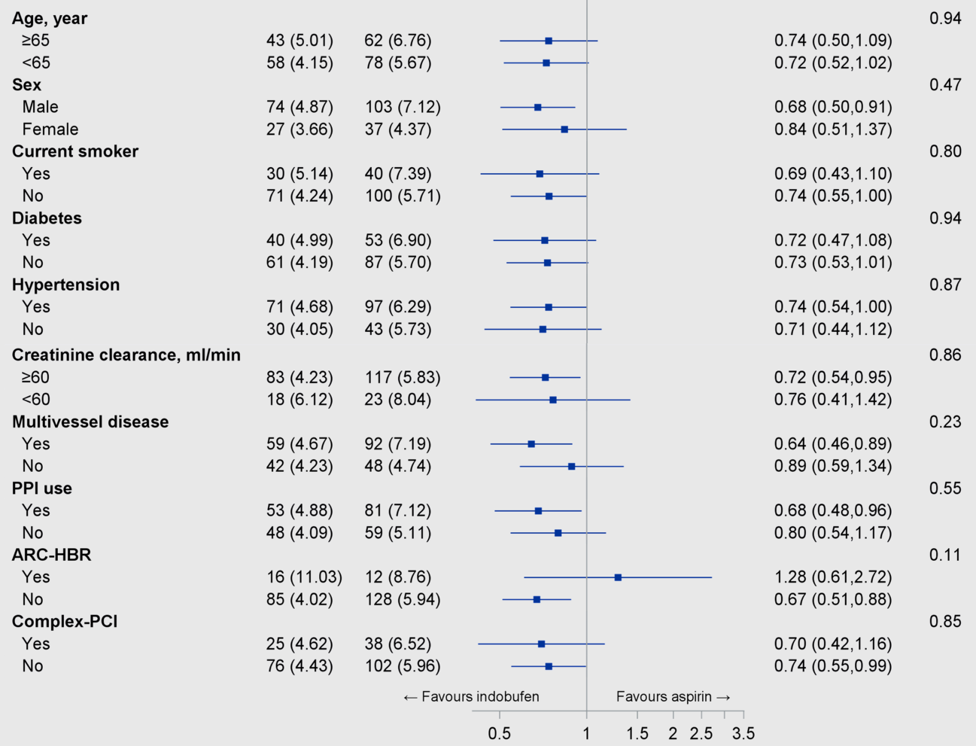
Subgroup analysis
Indobufen
Aspirin
HR (95% CI)
P value for interaction
The beneficial effect of indobufen-based DAPT was consistent across all subgroups with no significant interaction.

Slide 11
Conclusions
Indobufen plus clopidogrel DAPT for 12 months is non-inferior in the 1-year composite of efficacy and safety outcomes compared to aspirin plus clopidogrel DAPT.
There is no statistical difference regarding the 1-year efficacy composite (CV death, nonfatal MI, ischemic stroke, and definite or probable ST) between indobufen plus clopidogrel DAPT and conventional DAPT. The decreased BARC bleeding in indobufen group is mostly driven by a reduction of minor bleeding events.

Slide 12
Circulation. 2022; [published online ahead of print]. DOI: 10.1161/CIRCULATIONAHA.122.062762
Indobufen or Aspirin on Top of Clopidogrel after Coronary Drug-eluting Stent Implantation (OPTION): a Randomized, Open-label, Endpoint-blinded, Non-inferiority Trial
Hongyi Wu, MD; Lili Xu, MD; Xin Zhao, MD; Huanyi Zhang, MB; Kang Cheng, MD; Xiaoyan Wang, MD; Manhua Chen, MB; Guangping Li, MD; Jiangnan Huang, MD; Jun Lan, MM; Guanghe Wei, MM; Chi Zhang, MD; Yinman Wang, MD; Juying Qian, MD; Junbo Ge, MD; on behalf of the OPTION investigators
Circulation
https://www.ahajournals.org/doi/10.1161/CIRCULATIONAHA.122.062762

Slide 13
THANK YOU

