Slide 1
Angiography-based radial wall strain and lesion vulnerability
Shengxian Tu, PhD, FACC, FESC Professor of Biomedical Engineering Shanghai Jiao Tong University

Slide 2
Potential conflicts of interest
Speaker‘s name : Shengxian Tu
☑ I have the following potential conflicts of interest to declare: Co-founder: Pulse Medical
Receipt of grants / research support: Pulse Medical
Consultancy: Pulse Medical
EuroPCR.com

Slide 3
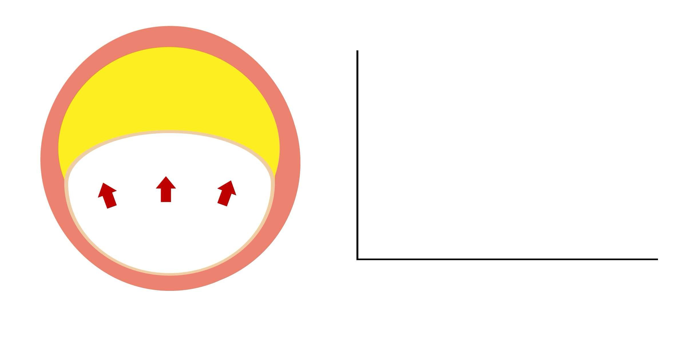
Mechanism for plaque rupture
Material strength of fibrous cap
Plaque
Wall stress
Wall stress or plaque stress
EuroPCR.com

Slide 4
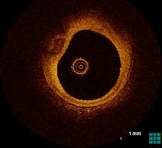
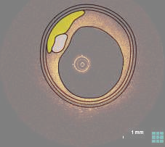
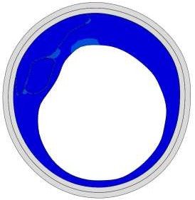
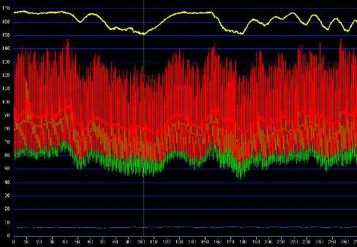
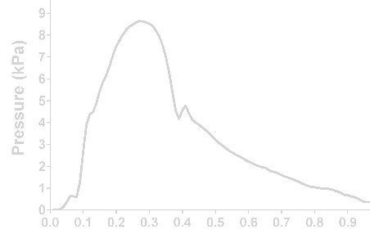
Computation of plaque stress from OCT by finite element analysis
Lipidic plaque
Calcific plaque
Material properties
OCT Image
geometric model
pressure Load
Boundary condition
…
Δstress
pressure tracing
Huang, …, Wijns, Tu. Front Cardiovasc Med 2021.8:715995
EuroPCR.com

Slide 5
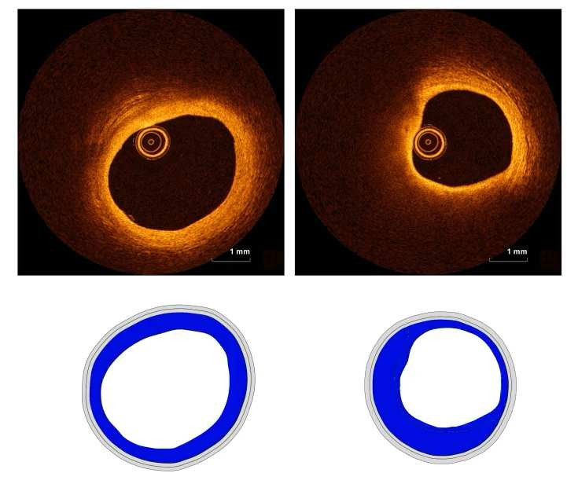
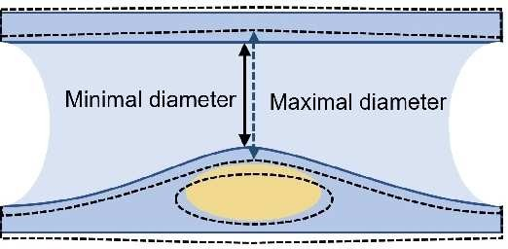
Concept of Radial Wall Strain (RWS)
Normal
Vulnerable: High LCR
5.4 %
13.6%
Dynamic Angiogram
Luminal deformation
Huang, …, Wijns, Tu. Front Cardiovasc Med 2021.8:715995 Hong,…Wijns,Tu. EuroIntervention 2022; 18:1001-1010.
EuroPCR.com

Slide 6
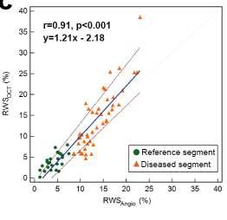
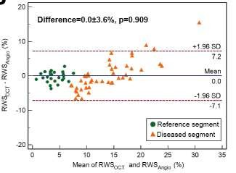
Correlation between OCT-derived and angio-derived RWS
578 OCT cross-sections stemming from 45 lesions
0.9 ± 0.1 min
vs
95.0 ± 41.1 min
Huang, Tu, …, Wijns. JSCAI 2023; 2: 100570
EuroPCR.com

Slide 7
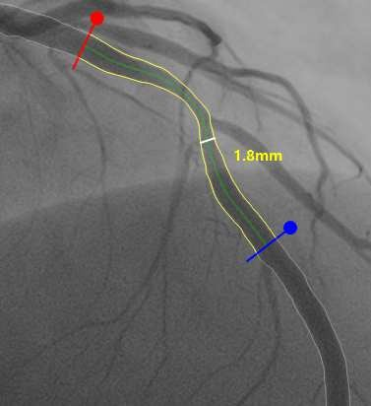
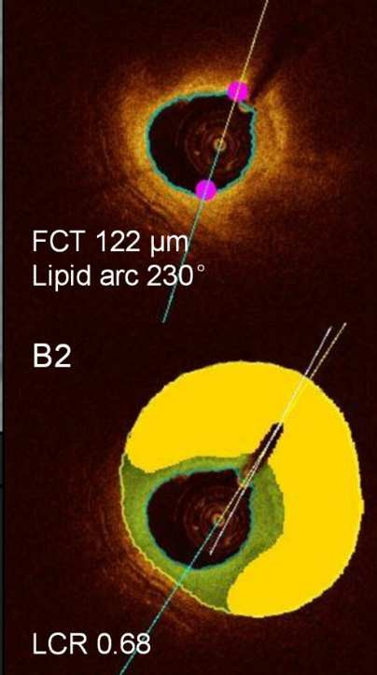
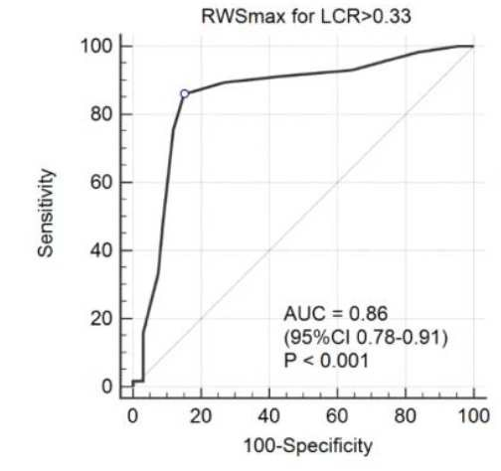
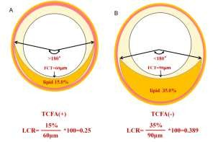
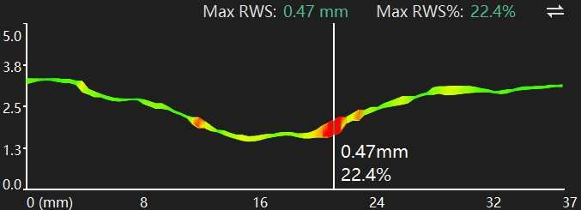
RWS identifies vulnerable plaques defined by OCT
RWS in identifying vulnerable plaques defined by LCR* and TCFA from OCT in 124 vessels
*
*LCR= lipid-to-cap ratio，JACC: Asia 2022; 4:460-72
High RWS is associated with presence of TCFA and high lipid-to-cap ratio
Hong,…Wijns,Tu. Eurosntervention 2022; 18:1001-1010.
EuroPCR.com

Slide 8
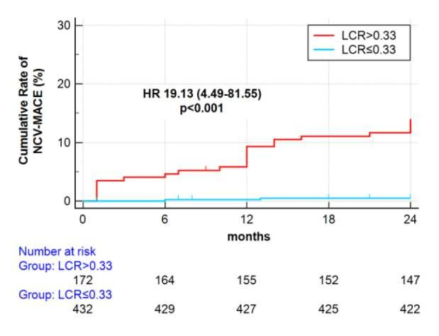
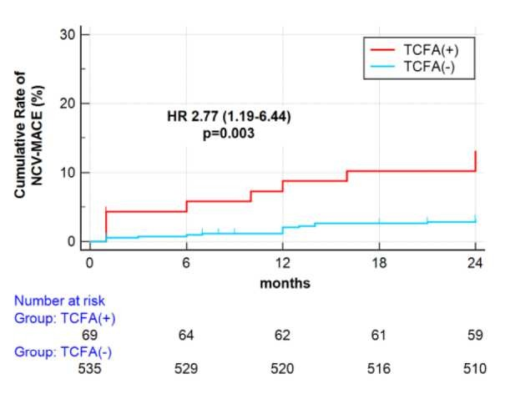
Lipid-to-cap ratio (LCR): a new plaque vulnerability index
LCR = lipid-to-cap ratio
(lipid plaque burden / fibrous cap thickness)
TCFA= thin-capped fibroatheroma
(thinnest fibrous cap<65um & lipid
º )
arc>180
High LCR is associated with non-culprit vessel-related MACE at 2-year follow-up
Hong, …, Wijns, Tu. JACC: Asia 2022; 4:460-72
EuroPCR.com

Slide 9
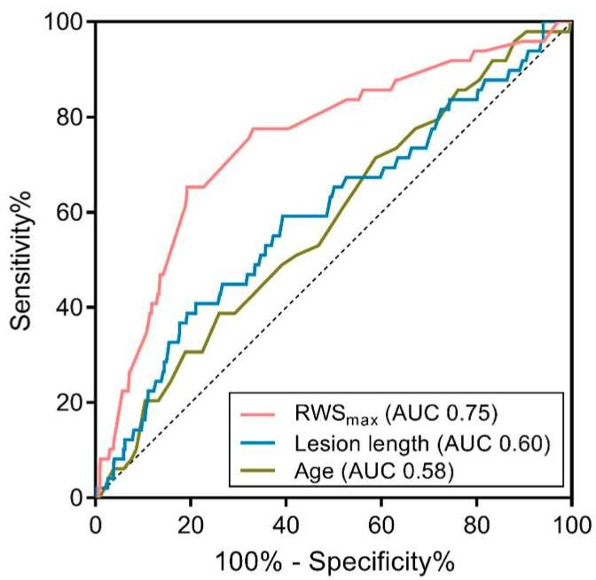
RWS predicts intermediate lesion progression
603 patients with 808 intermediate lesions
 | Variables | Univariate |  | Multivariate
 |  | HR (95% CI) | P value | HR (95% CI) | P value
 | RWS_{max} >12% | 7.65 (4.18-13.98) | < 0.001 | 7.12 (3.83-13.22) | <0.001
 | Age <52 years | 2.03 (1.14-3.61) | 0.016 | 2.22 (1.23-4.01) | 0.008
 | Blood glucose >5.17 mmol/L | 1.80 (0.92-3.53) | 0.086 | 1.72 (0.82-3.60) | 0.151
 | Glycated hemoglobin >6.2% | 1.62 (0.92-2.86) | 0.093 | 1.10 (0.58-2.11) | 0.771
 | hs-CRP >2.01 mg/L | 1.98 (1.08-3.64) | 0.028 | 1.87 (0.99-3.54) | 0.056
 | PCI performed (including other vessels) | 0.60 (0.34-1.06) | 0.078 | 0.58 (0.33-1.03) | 0.061
 | Lesion length >18.6 mm | 2.04 (1.15-3.61) | 0.014 | 1.76 (0.97-3.19) | 0.061
RWS was independently associated with intermediate lesion progression in 2 years
Wang, Xu,…, Tu. J Geriatr Cardiol 2022; 19:937-948.
EuroPCR.com

Slide 10
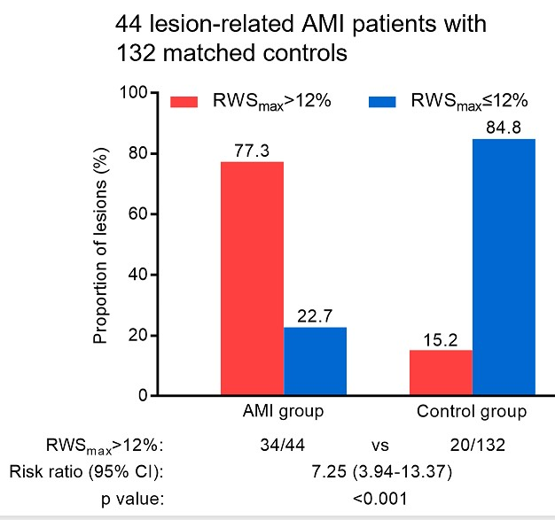
RWS predicts AMI for untreated lesions
 | All patients (n = 176) | AMI group (n = 44) | Control group (n = 132) | p value
Coronary artery location |  |  |  | 1.000
LAD | 52 (29.5) | 13 (29.5) | 39 (29.5)
LCx | 16 (9.1) | 4 (9.1) | 12 (9.1)
RCA | 108 (61.4) | 27 (61.4) | 81 (61.4)
Coronary segment location |  |  |  | 1.000
Proximal | 60 (34.1) | 15 (34.1) | 45 (34.1)
Middle | 88 (50.0) | 22 (50.0) | 66 (50.0)
Distal | 28 (15.9) | 7 (15.9) | 21 (15.9)
QCA-derived parameters
MLD, mm | 2.0 (1.7, 2.4) | 1.9 (1.6, 2.4) | 2.0 (1.7, 2.4) | 0.409
DS%, % | 34.0 (30.0, 40.0) | 33.0 (29.0, 40.0) | 34.5 (30.3, 40.0) | 0.359
RVD, mm | 3.0 (2.6, 3.6) | 2.9 (2.5, 3.6) | 3.1 (2.7, 3.6) | 0.283
Lesion length, mm | 13.0 (9.4, 16.9) | 15.2 (10.4, 18.3) | 11.9 (9.2, 16.5) | 0.040
Vessel-level μQFR | 0.91 (0.88, 0.94) | 0.92 (0.88, 0.95) | 0.91 (0.88, 0.94) | 0.640
Lesion-level ΔμQFR | 0.04 (0.02, 0.07) | 0.04 (0.02, 0.07) | 0.04 (0.02, 0.07) | 0.725
RWSmax, % | 10 (9, 13) | 13 (13, 14) | 10 (9, 11) | <0.001
Li, …, Tu, Ge. JACC Cardiovasc Interv 2023; 16:1039-1049
EuroPCR.com

Slide 11
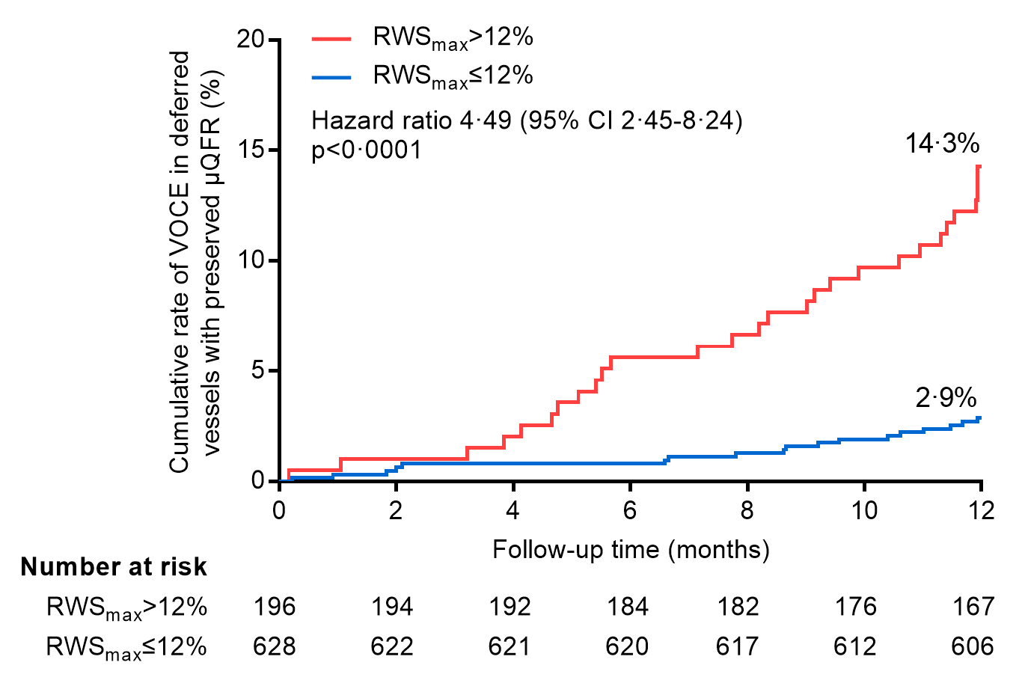
Higher RWS is associated with worse outcome
FAVOR III China RWS Substudy
Hazard ratio: 4.49 (2.45-8.24) P<0.001
Tu, Xu,…, Wijns. JACC 2023; 81:756–767
EuroPCR.com

Slide 12
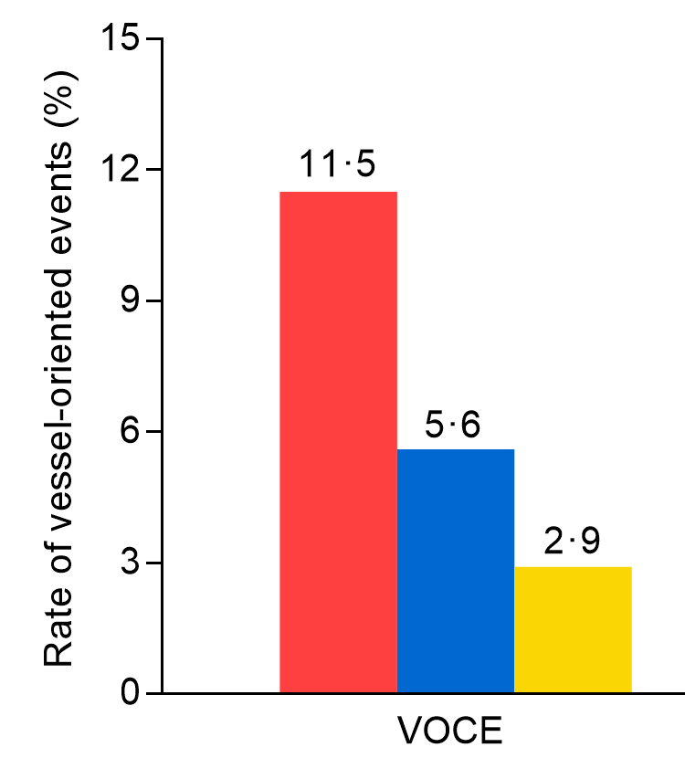
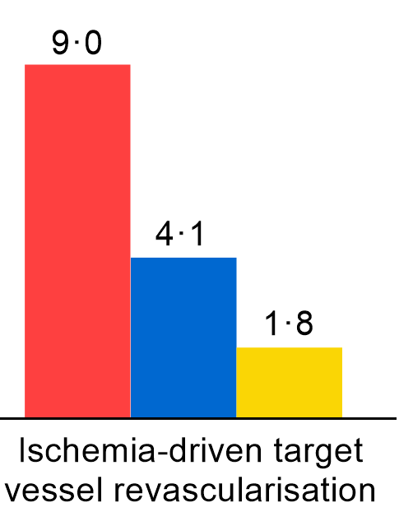
Lower RWS is associated with better outcome
FAVOR III China RWS Substudy
Comparison of safety of deferred revascularisation
guided by angiography, μQFR and combined μQFR-RWS
At 1 year follow-up
Tu, Xu,…, Wijns. JACC 2023; 81:756–767
EuroPCR.com

Slide 13
The essentials to remember
RWS could be rapidly and easily computed solely from angiography
High RWS identifies vulnerable plaques defined by OCT
High RWS is independently associated with plaque progression, AMI, and non flow-limiting vessels related MACE
Low RWS in non-flow limiting stenosis is associated with good clinical outcome
Shengxian Tu, e-mail: sxtu@sjtu.edu.cn
EuroPCR.com

Slide 14
Acknowledgements
Funding
National Science Foundation of China
National Science Technology Foundation of China
Ministry of Education of China
Colleagues and collaborators
Shanghai Jiao Tong University: Wei Yu, Chunming Li , Miao Chu
University of Galway: William Wijns, Daixin Ding, Jiayue Huang, Simone Fezzi
Fujian Medical University : Lianglong Chen, Zhiqing Wang, Huihong Hong
Fuwai Hospital: Bo Xu; PLA General Hospital: Yundai Chen
Zhongshan Hospital: Junbo Ge, Chenguang Li
Bundeswehrzentralkrankenhaus: Juan Luis Gutiérrez-Chico
Harbin Medical University: Haibo Jia; Guangdong General Hospital: Junqing Yang
Shengxian Tu, e-mail: sxtu@sjtu.edu.cn
EuroPCR.com

Slide 15
PCRonline.com

