Slide 1
Biolimus Coated Versus Paclitaxel Coated Balloons for Coronary In-Stent Restenosis (BIO ASCEND ISR): a Randomized, Non-inferiority Trial
Lei Song MD, Fu Wai Hospital National Center for Cardiovascular Diseases On behalf of Yundai Chen and BIO ASCEND ISR Study investigators

Slide 2
Potential conflicts of interest
Speaker's name : Lei Song
☑ I do not have any potential conflict of interest to declare

Slide 3
Why this study?
In-stent restenosis (ISR), particularly with the use of drug-eluting stents (DES), poses a significant clinical challenge.
Biolimus A9 (BA9, Biosensor International), a sirolimus derivative, has tenfold lipophilicity in comparison to sirolimus and other limus compounds, while retaining its rapamycin inhibition properties.
The study was conducted to investigate a novel biolimus-coated balloon (BCB) for the treatment of coronary DES-ISR compared with the best investigated paclitaxel-coated balloon (PCB).

Slide 4
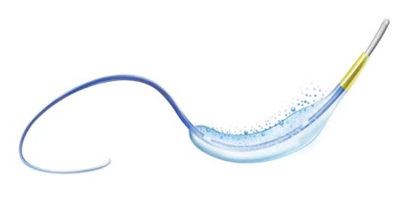
Description of Biolimus A9 Coated Balloon: BioAscendTM
Test device: Biolimus A9 Coated Balloon (BioAscendTM)
Drug: BA9, proven higher (10X) lipophilicity in limus drug
Coating：Newly improved drug formulation and Coating technology. It minimized drug loss and enhanced rapid absorption by tissue during delivery
Excipient: Polyethylene oxide (PEO)
Dose: Microcrystalline BA9 @3 µg/mm²
Published Clinical result in Small Vessels: BIO-RISE CHINA study

Slide 5
BIO ASCEND ISR: Study sites and investigators
Sites | Investigators
Department of Cardiology, the First Medical Center of Chinese PLA General Hospital, Beijing, China | Yundai Chen, Lian Chen, Zhijun Sun, Yu Wang
Senior Department of Cardiology, the Sixth Medical Center of Chinese PLA General Hospital, Beijing, China | Lei Gao
Beijing AnZhen Hospital Capital Medical University, Beijing, China | Liu Jinghua, Peng Hongyu, Li Wenzheng, Wu Zheng
Beijing Friendship Hospital Capital Medical University, Beijing, China | Chen Hui, Li Dongbao, Wang Dongxing, Ding Xiaosong
The first hospital of Jilin university, Changchun, China | Tong Qian, Gao Xiaodong, Liu Quan, Zhao Xuezhong
Tianjin Chest Hospital, Tianjin, China | Qin Qin, Yang Ning, Yang Jingyu, Li Yang
Cangzhou Central Hospital, Cangzhou, China | Zhang Jun, Niu Heping, Fu Jinguo, Wan yanfang
First affiliated hospital of Zhengzhou university, Zhengzhou, China | Qiu Chunguang, Wang Xi, Wang Xule, Lu Wenjie
The Ninth People's Hospital Affiliated to Shanghai Jiaotong University School of Medicine, Shanghai, China | Wang Changqian, Zhang Junfeng, Fan Yuqi
Sir Run Run Shaw Hospital, Zhejiang University School of Medicine，Hangzhou, China | Fu guosheng, Qiu Fuyu, Zhu Jun, Kong Xugang
Zhongda Hospital Southeast University, Nanjing, China | Magenshan, Wei Qin, Chen Lijuan, Tong Jiayi
Nanjing Drum Tower Hospital The Affiliated Hospital of Nanjing University Medical School, Nanjing, China | Xu Biao, Wang Kun, Wang Yi, Song Jie
Xiangya Hospital Central South University, Changsha, China | Yu zaixin, Xie Wei, Long Tianyi
The Third Xiangya Hospital of Central South University, Changsha, China | Cao Yu, Huang Wei, Sheng Zhe, Zhou Li
Xiangtan Central Hospital, Xiangtan, China | Wu mingxing, Wang Lei, Huang Haobo, Hu Hailong
Shanxi Provincial Cardiovascular Hospital, Taiyuan, China | An Jian, Dong Jin, Wang Zhongchao, Zhang Zhulin
General Hospital of Ningxia Medical University, Yinchuan, | Jia Shaobin, Zhang Guoshan, Wei Ning, Chen Dapeng
West China Hospital of Sichuan University, Chengdu, China | He Yong, He Sen, Yang Xuemei, Huang Baotao

Slide 6
How was the study executed?
Multicentre, randomised controlled (1:1), single-blinded, non- inferiority study conducted at 17 hospitals in China
The primary endpoint: in-segment late lumen loss (LLL) at 9 months
after the procedure
The major secondary endpoint: neointima area at 9 months (for the OCT subgroup only)
Powered for non-inferiority against SeQuent Please NEO [B. Braun Melsungen AG]) DCB
Assuming LLL at 9 months of 0.46 mm in both groups
Non-inferiority margin of 0.195 mm
1:1 randomization
Sample size 280
Sponsor: Shandong JW Medical Systems Ltd, China

Slide 7
How was the study executed?
The key inclusion criteria were patients with DES-ISR Mehran type I, II, and III with stable angina, acute coronary syndrome, or asymptomatic myocardial ischemia.
The key exclusion criteria included acute myocardial infarction within one week prior to intervention or without recovery of cardiac enzymes, previously treated ISR, left main lesions, and patients with total occlusion.

Slide 8
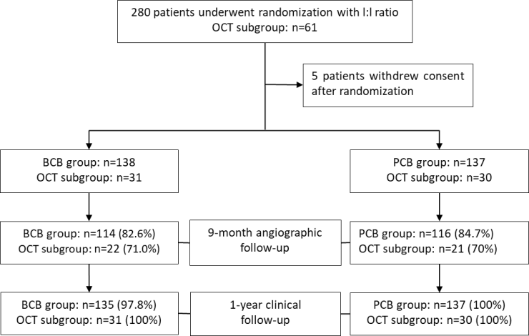
How was the study executed?

Slide 9
Baseline Characteristics
 | BCB group (Patients, n=138; Lesions, n=152) | PCB group (Patients, n=137; Lesions, n=153) | p value
Age, years | 63.64±8.90 | 64.24±8.84 | 0.576
Male | 103 (74.6) | 101 (73.7) | 0.862
Body mass index, kg/m² | 25.96±3.59 | 25.91±3.31 | 0.887
Diabetes mellitus | 51 (37.0) | 59 (43.1) | 0.301
Insulin-treated diabetes | 23 (46.0) | 29 (50.9) | 0.614
Hypertension | 86 (62.3) | 98 (71.5) | 0.104
Hyperlipidemia | 61 (44.2) | 53 (38.7) | 0.353
Previous MI | 22 (15.9) | 33 (24.1) | 0.091
Previous CABG | 0 (0) | 0 (0) | -
Unstable angina | 111 (94.1) | 108 (93.1) | 0.763
Left ventricular EF | 61.02±8.01 | 60.87±8.96 | 0.883
Multivessel disease | 0.30±0.49 | 0.29±0.50 | 0.837
Target vessel location | 152 (100) | 153 (100) | 0.346

Slide 10
Baseline Characteristics
 | BCB group (Patients, n=138; Lesions, n=152) | PCB group (Patients, n=137; Lesions, n=153) | p value
Left anterior descending | 71 (46.7) | 78 (51.0)
Left circumflex | 23 (15.1) | 13 (8.5)
Right coronary artery | 54 (35.5) | 58 (37.9)
Others | 4 (2.6) | 4 (2.6)
Number of non-target lesions | 138 (100) | 137 (100) | 0.799
0 | 98 (71.0) | 100 (73.0)
1 | 38 (27.5) | 34 (24.8)
2 | 2 (1.4) | 3 (2.2)
Mehran type | 152 (100) | 153 (100) | 0.617
I | 25 (16.4) | 31 (20.3)
II | 88 (57.9) | 81 (52.9)
III | 39 (25.7) | 41 (26.8)
IV | 0 (0) | 0 (0)

Slide 11
Procedural Characteristics and Results
 | BCB group (Patients, n=138; Lesions, n=152) | PCB group (Patients, n=137; Lesions, n=153) | p value
Transradial approach | 146 (96.1) | 141 (92.2) | 0.372
Pre-dilation | 152 (100) | 153 (100) | 0.728
Plain balloon | 217 (63.6) | 218 (66.7)
Scoring balloon | 54 (15.8) | 49 (14.9)
Cutting balloon | 52 (15.3) | 42 (12.8)
Number of DCB | 152 (100) | 153 (100) | -
1 | 152 (100) | 153 (100)
2 | 0 (0) | 0 (0)
Mean diameter of DCB, mm | 3.04±0.41 | 3.01±0.35 | 0.525
Total length of DCB, mm | 25.13±6.63 | 24.38±6.82 | 0.328
Maximal inflation pressure with DCB, atm | 9.20±2.33 | 9.27±2.52 | 0.782

Slide 12
Procedural Characteristics and Results
 | BCB group (Patients, n=138; Lesions, n=152) | PCB group (Patients, n=137; Lesions, n=153) | p value
Duration of inflation with DCB, sec | 59.38±8.16 | 60.56±11.49 | 0.302
Bail-out strategy | 4 (2.6) | 2 (1.3) | 0.448
Post-procedure TIMI flow | 152 (100) | 153 (100) | -
I | 0 (0) | 0 (0)
II | 0 (0) | 0 (0)
III | 152 (100) | 153 (100)
Successful outcomes*
Device success | 152 (100) | 153 (100) | -
Lesion success | 152(100) | 153 (100) | -
Procedural success | 138 (100) | 136 (99.3) | 0.498

Slide 13
BIO ASCEND ISR Trial: Primary Results

Slide 14
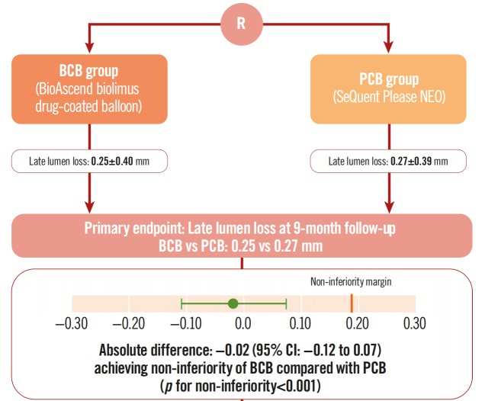
Primary Endpoint: in-segment late lumen loss at 9 months

Slide 15
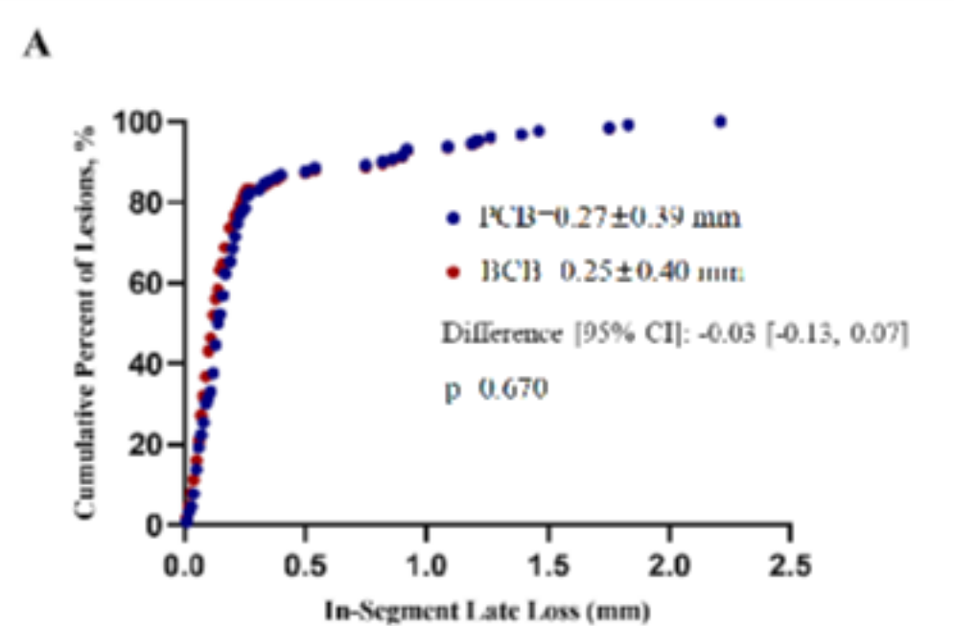
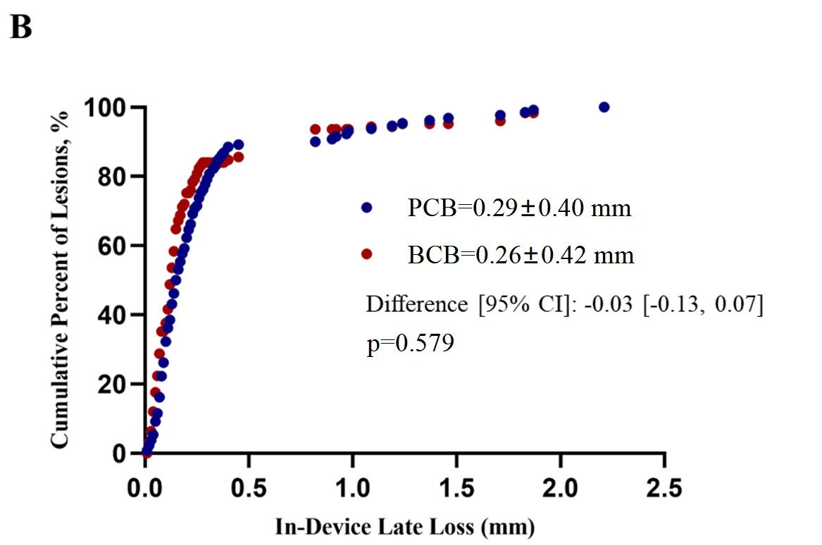
9-month In-Segment and In-Device Late Loss Distribution
There were no differences in the cumulative percentage of lesions of LLL between the 2 groups.

Slide 16
The major secondary endpoint:
Neointima area at 9 months (OCT subgroup only)
 | Preoperative |  |  | Immediately after PCI |  |  | 9 months follow-up
 | BCB group (n=21) | PCB group (n=21) | p value | BCB group (n=27) | PCB group (n=27) | p value | BCB group (n=23) | PCB group (n=20) | p value
Mean luminal area | 5.02±1.46 | 4.88±1.89 | 0.849 | 6.23±1.57 | 5.58±1.82 | 0.163 | 5.71±1.44 | 5.13±1.64 | 0.226
Minimal luminal area | 2.28±0.96 | 2.04±1.37 | 0.611 | 4.56±1.35 | 3.97±1.46 | 0.134 | 3.55±1.04 | 3.43±1.16 | 0.717
Mean stent area | 7.45±2.26 | 7.64 ±2.37 | 0.850 | 8.16 ±2.17 | 7.63 ±2.17 | 0.371 | 8.03±2.15 | 7.50±2.26 | 0.436
Minimal stent area | 5.70±1.76 | 6.15±2.17 | 0.578 | 6.49±1.73 | 6.08±2.02 | 0.429 | 6.25±1.76 | 5.98±2.02 | 0.635
Average neointimal cross-sectional area | 2.44±1.40 | 2.75±1.16 | 0.562 | 1.93±1.01 | 2.05±0.88 | 0.640 | 2.32±1.04 | 2.37±0.93 | 0.882
Change of average neointimal cross- sectional area | - | - | - | - | - | - | 0.29±0.35 | 0.28±0.43 | 0.913
Average neointimal volume | 65.87±47.41 | 69.30±30.68 | 0.839 | 49.20±30.37 | 51.7±27.3 | 0.751 | 57.89±36.96 | 58.35±24.84 | 0.962
Change of average neointimal volume | - | - | - | - | - | - | 7.58±9.98 | 7.90±10.83 | 0.921

Slide 17
Quantitative Coronary Angiographic Results
 | BCB group | PCB group | p value
Pre-procedure | n=150 | n=151
Reference vessel diameter, mm | 2.79±0.40 | 2.80±0.39 | 0.779
Minimal lumen diameter, mm | 0.84±0.35 | 0.87±0.36 | 0.544
Diameter stenosis, % | 69.91±11.05 | 69.11±11.56 | 0.540
Lesion length, mm | 16.26±7.21 | 15.97±6.85 | 0.718
Post-procedure | n=150 | n=151
Minimal lumen diameter, mm
In-device | 2.24±0.37 | 2.27±0.35 | 0.375
In-segment | 2.14±0.37 | 2.17±0.34 | 0.557
Diameter stenosis, %
In-device | 21.94±7.52 | 20.15±7.06 | 0.034
In-segment | 23.24±7.34 | 21.69±6.84 | 0.059

Slide 18
Quantitative Coronary Angiographic Results
 | BCB group | PCB group | p value
Acute lumen gain, mm
In-device | 1.39±0.41 | 1.40±0.39 | 0.803
In-segment | 1.30±0.40 | 1.30±0.40 | 0.988
9-month follow-up | n=125 | n=130
Minimal lumen diameter, mm
In-device | 1.96±0.62 | 1.98±0.56 | 0.832
In-segment | 1.87±0.60 | 1.88±0.54 | 0.868
Diameter stenosis, %
In-device | 31.25±19.31 | 29.54±17.30 | 0.456
In-segment | 32.59±18.78 | 31.61±16.99 | 0.662

Slide 19
Quantitative Coronary Angiographic Results
 | BCB group | PCB group | p value
Late lumen loss, mm
In-device | 0.26±0.42 | 0.29±0.40 | 0.579
In-segment | 0.25±0.40 | 0.27±0.39 | 0.670
Net lumen gain†, mm
In-device | 1.13±0.62 | 1.11±0.55 | 0.772
In-segment | 1.04±0.59 | 1.02±0.54 | 0.720
Binary restenosis, %
In-device | 17 (11.3) | 20 (13.1) | 0.806
In-segment | 17 (11.3) | 20 (13.1) | 0.806

Slide 20
Clinical Outcomes
 | BCB group | PCB group | p value
At 1 month | n=138 | n=137
Target lesion failure | 0(0) | 1(0.7) | 0.498
Patient-oriented composite endpoint | 1(0.7) | 1(0.7) | 1.000
All-cause death | 0(0) | 0(0) | -
Myocardial infarction | 0(0) | 1(0.7) | 0.498
Target lesion revascularization | 0(0) | 0(0) | -
At 1 year | n=135 | n=137
Target lesion failure | 18(13.3) | 13(9.5) | 0.318
Patient-oriented composite endpoint | 32(23.4) | 20 (14.6) | 0.064
All-cause death | 2(1.5) | 1(0.7) | 1.000
Myocardial infarction | 0(0) | 1(0.7) | 1.000
Target lesion revascularization | 18(13.3) | 11(8.1) | 0.161
Target vessel revascularization | 23(17.0) | 13(9.6) | 0.068

Slide 21
Why is this important?
This clinical trial reveals that for patients dealing with coronary DES- ISR, the use of BCB was noninferior in terms of angiographic outcomes at 9 months compared to a well-established PCB
A higher number of revascularization events were seen in the BCB group at 1-year
Due to the unique pharmacokinetic profile of -limus analogues, long term follow-up is needed to establish the clinical efficacy of these technologies

Slide 22
Simultaneous Publication
Biolimus-Coated versus Paclitaxel- Coated Balloons for Coronary In-stent Restenosis (BIO ASCEND ISR): A Randomised, Non-Inferiority Trial
Yundai Chen; Lei Gao; Qin Qin; Jun Zhang; Shaobin Jia; Mingxing Wu; Yong He; Guosheng Fu; Jinghua Liu; Hui Chen; Qian Tong; Zaixin Yu; Jian An; Chunguang Qiu; Biao Xu; Yu Cao; Changqian Wang; Genshan Ma

Slide 23
The essentials to remember
Why?
The safety and efficacy of BCB for coronary artery disease is uncertain.
What?
To evaluate the safety and efficacy of BCB for the treatment of coronary DES-ISR.
How?
Multicentre, single-blinded non-inferiority randomised (1:1) trial.
What are the results?
BCB shows non-inferiority in 9-month LLL and neointimal area in comparison with PCB.
Why is this important?
These results suggest the potential of BCB to improve clinical outcomes in coronary ISR treatment.
EuroPCR.com

Slide 24
PCRonline.com

