Slide 1

Debris heterogeneity across different valve types captured by a cerebral protection system during TAVR
Tobias Schmidt, MD
Leon, M.,MD; Mehran, R., MD; Kuck, K.-H., MD; Fields, T.; Alu, M.; Molinari, L.; Kodali, S., MD; Kapadi, S., MD; Linke, A., MD; Naber, C., MD; Romero, M., MD; Virmani, R., MD; Frerker, C., MD

Slide 2
Background
Cerebral injury after transcatheter aortic valve replacement (TAVR) has an impact on clinical outcome
Potential differences between transcatheter heart valve (THV) types and cerebral injury are not well understood
Notes:
2

Slide 3
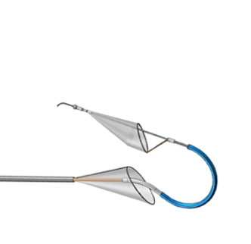
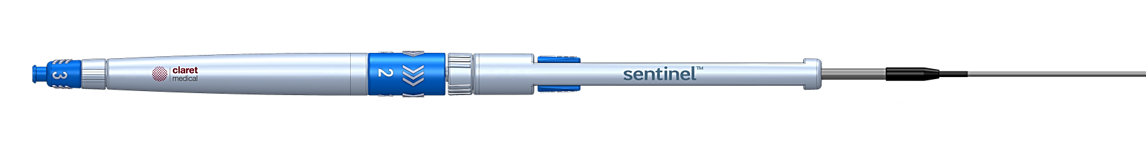
Aim
The aim of this study was to investigate differences between THV types and debris captured by a transcatheter cerebral embolic protection system (Claret Medical, Santa Rosa, CA).
Notes:
3

Slide 4
Study flow chart
SENTINEL IDE study n=363
SENTINEL-H study n=163
Patients receiving Sentinel and planned for histopathologic assessment, n=121
Patient samples received by CVPath for analysis, n= 109
Both filters deployed during TAVR, n=103
THV type commercially available
(at time of this study), n=100
THV type commercially available
(at time of this study), n=146
246 patients with 492 filters for
histopathologic and morphometric analysis
Notes:
Erklären die Zahlen

Slide 5
Debris analyses
Analyses of debris were performed for:
Histopathology
Histomorphometry:
  Automated measured:
    Particle Size (≥150µm, ≥500µm, ≥1000µm)
    Particle Count
    Total Particle Area
  Manually measured:
    Maximum Dimension

Slide 6
Baseline characteristics and THV type
Characteristic | n (%) or Median [Q1, Q3]
Age – years | 82 [78, 87]
Female | 133 (54.1)
History of Stroke | 22 (8.9)
History of AF | 89 (36.2)
History of PAD | 44 (17.9)
Pre-dilatation | 88 (35.8)
Post-dilatation | 28 (11.4)
Valve Type | n (%)
EvolutR | 40 (16.3)
Lotus | 36 (14.6)
SAPIEN XT | 25 (10.2)
SAPIEN 3 | 145 (59.3)

Slide 7
Correlation
of THV type, patient demographics and captured debris
Valve type
Debris
Patient demographics

Slide 8
Histopathology

Slide 9
Particle size
(automated Histomorphometry)
Percent of patients with particles by particle size
Notes:
Number of patients with particles greater than 500 and 1000 microns are higher for EvR than S3 or XT

Slide 10
Particle size
(automated Histomorphometry)
Percent of patients with particles by particle size
53%
Notes:
Number of patients with particles greater than 500 and 1000 microns are higher for EvR than S3 or XT

Slide 11
Median particle count
(automated Histomorphometry)
Lotus > EvR p=0.004
Lotus > S3 p<0.001
Lotus > XT p=0.020
Lotus > S3 p=0.001
EvR > S3 p=0.001
Notes:
Looking at particle count, the number of particles that were collected.
We have found a higher number of particles for Lotus compared to EvR, S3 and XT

Slide 12
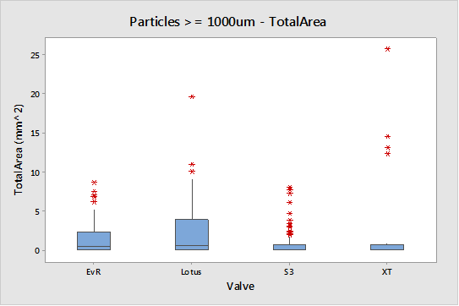
Median total particle area
(automated Histomorphometry)
EvR > S3 p=0.0003
EvR > XT p=0.0475
Lotus > S3 p<0.001
Lotus > XT p=0.0179
EvR > S3 p=0.0009
Lotus > S3 p=0.0007
Notes:
Look on the total particle area, which describes the amount of debris captured by the CPS
EvR and Lotus had a greater total area than S3 and XT

Slide 13
Large particle outliers
Patients with large total particle area are found with all valve types.

Slide 14
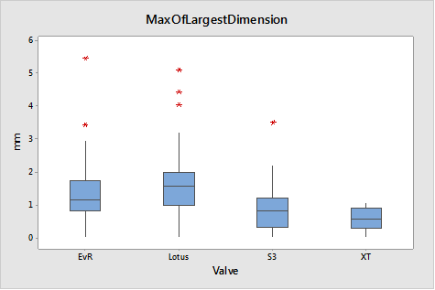
Maximum dimension
(manual Histomorphometry)
the largest particle per patient
EvR > S3 p=0.003
EvR > XT p<0.0001
Lotus > S3 p<0.0001
Lotus > XT p<0.0001
Notes:
Larger particles for EvR and Lotus than for S3 and XT

Slide 15
Correlation
of THV type, patient demographics and captured debris
THV type
Debris
Patient demographic

Slide 16
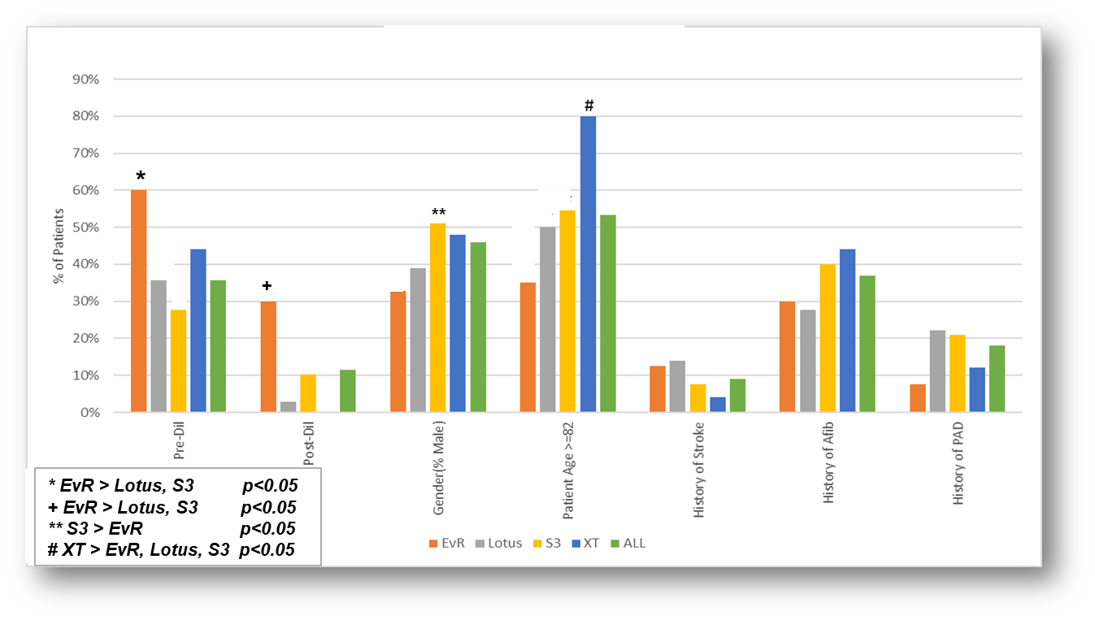
Patient demographics and valve type
Notes:
Pre and post-dilation were more frequently performed in EvR patients than in Lotus or S3 patients

Slide 17
Correlation
of THV type, patient demographics and captured debris
THV type
Debris
Patient demographic
Multivariate analysis

Slide 18
Multivariate analysis
Since patient and procedural characteristics differed significantly between THV types, multivariate analysis was performed to test for interaction with the amount of debris captured.
This analysis showed that
THV type was the only significant predictor for the
morphometric findings (p<0.003)
Notes:
Which morphometric result? Auf alle?

Slide 19
Conclusion
Debris was captured in 99% of patients
Independent of the valve type, 53% of all patients had particles of debris larger than 1mm
Quantity of debris (measured by different methods and techniques) revealed more debris in patients receiving an EvR or Lotus THV, than in patients receiving a Sapien 3 or Sapien XT prosthesis
Capture of embolic debris is universal across different THV types and supports the benefit of using CEP in all TAVR procedures
Notes:
19

Slide 20
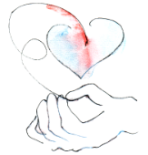
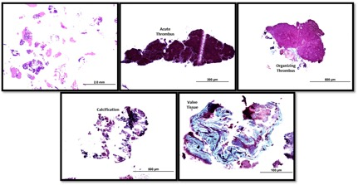
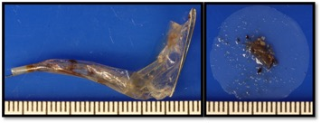
Thank you!
Notes:
20

