Slide 1
International experience of 10 zig Covered CP stent correction of Sinus Venosus ASD
Eric Rosenthal MD FRCP Evelina London Children’s Hospital

Slide 2
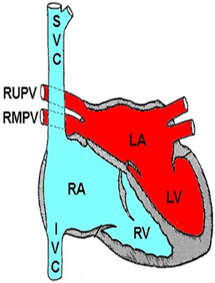
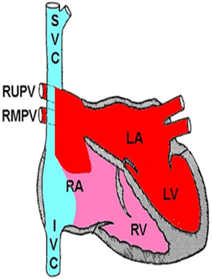
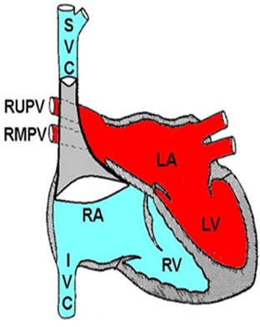
Covered stent correction of SVASD
Normal
SVASD
CCP stent
10 zig Covered CP stent
Kabir … Rosenthal. JACC Cardiovasc Imaging 2021
10.1016/j.jcmg.2020.11.010.

Slide 3
75 patients (2 grown children & 73 adults)
12 centres
72 successful implants – defect correction without any surgery
2 stents embolised requiring surgery
1 pulmonary vein occlusion requiring surgery
Focus of this study is benefit of using longer non FDA approved (non CE marked) stents
International study

Slide 4
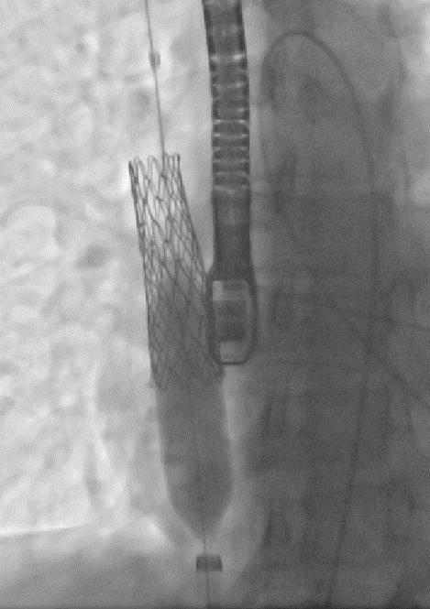
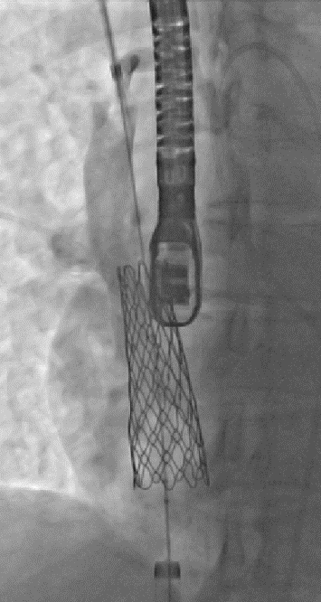
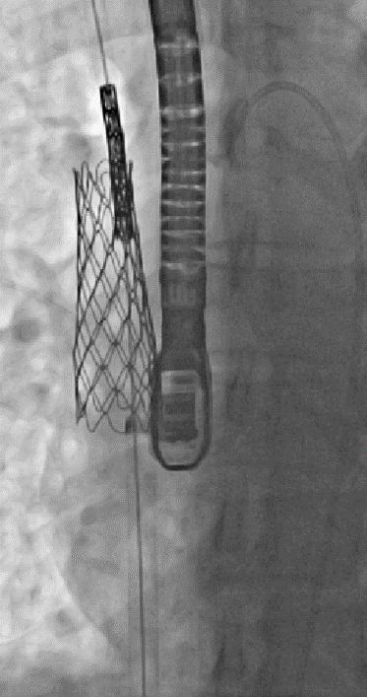
Need for a 2nd stent

Slide 5
Benefit of longer stents
Length | n | 2nd stent | %
5 – 5.5 cm | 5 | 4 | 80%
6 cm | 29 | 18 | 62% *
7 cm | 18 | 5 | 28% *
7.5 - 8 cm | 22 | 5 | 23%
11 cm | 1 | 0 | 0%
* 1 x 6 cm & 1 x 7 cm
stent embolised

Slide 6
Covered stent closure of Sinus Venosus ASD is now an alternative to surgery in carefully selected adults
Avoids the morbidity of sternotomy & bypass surgery
Stent migration remains a concern but should be avoidable with the longer stents used in this study
Pulmonary vein patency is paramount – careful testing & meticulous attention to detail are needed
The longer 10 zig CCP stent is a major advance
Conclusions

