Slide 1
RED-CVD
Reviving Early Diagnosis of CardioVascular Disease: A cluster-randomized diagnostic trial
Amy Groenewegen, MD, epidemiologist, on behalf of the RED-CVD investigators 28 August 2023

Slide 2
Declaration of interest
- I have nothing to declare
• •
ESC Congress 2023
Amsterdam & Online

Slide 3
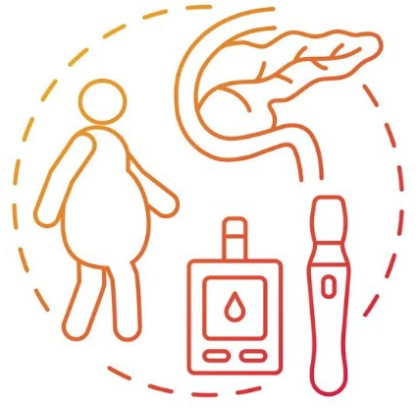
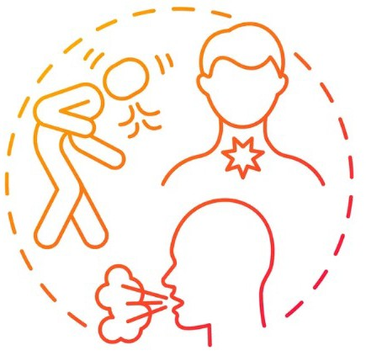
Background
Type 2 diabetes
20 – 41% have unknown but treatable cardiovascular disease*
COPD
* Based on opportunistic screening studies (Rutten 2005, Muhlestein 2014, Rasmussen 2013, Boonman-de Winter 2015)

Slide 4
Background
Type 2 diabetes
– 41% coronary artery stenosis of
≥50%
– 28% heart failure
COPD
Most of these patients experience symptoms
Rutten 2005, Muhlestein 2014, Rasmussen 2013, Boonman-de Winter 2015

Slide 5
RED-CVD
Reviving Early Diagnosis of CardioVascular Disease
Aim
to uncover cardiovascular disease at an early stage
with an easy-to-use diagnostic strategy
in primary care patients with COPD and/or T2DM
R E D - C V D

Slide 6
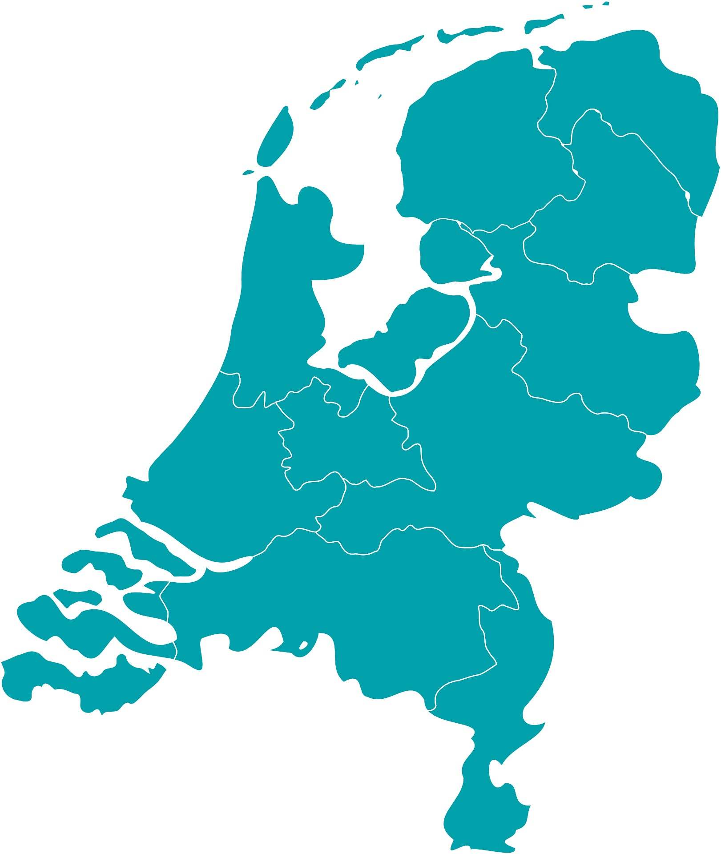
Design
Design
Cluster-randomized: randomization of practices
Main inclusion criterium
Participation in a primary care disease management program for COPD and/or T2DM
Primary endpoint
Newly detected CVD (AF, HF, and CAD) in 1 year
Secondary endpoint(s)
Subsequent treatment

Slide 7
Statistics
Sample size: 1170
1300, including 10% drop-out
Primary and secondary outcome:
generalized mixed linear models
Random intercept for clusters
Fixed effects for potential confounders
Intention-to-treat

Slide 8
Design of the trial
Randomisation of primary care practices

Slide 9
Structure of the trial
Randomisation of primary care practices
Inclusion of 650 patients with COPD or
T2DM per arm

Slide 10
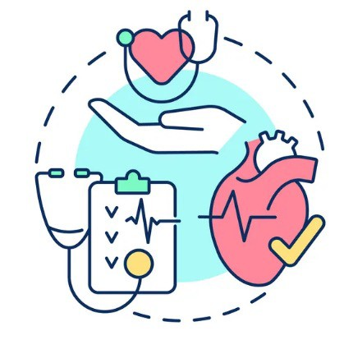
Structure of the trial
Usual Care
Randomisation of primary care practices
Inclusion of 650 patients with COPD or
Performance of diagnostic intervention
T2DM per arm
OR usual care

Slide 11
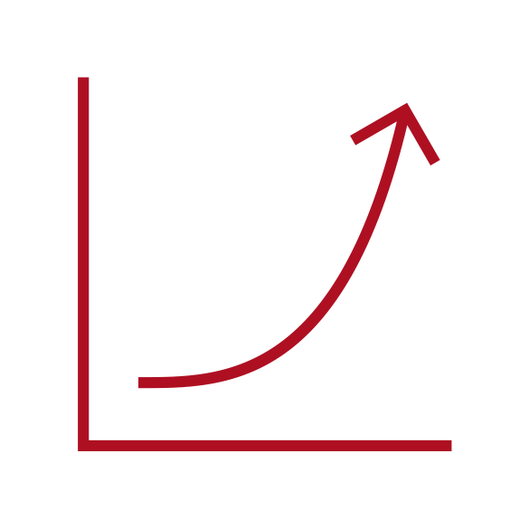
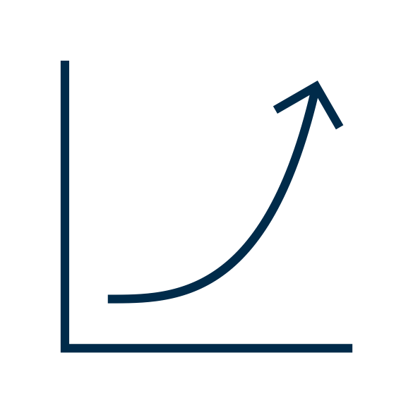
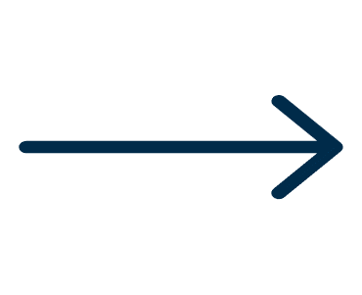
Structure of the trial
Usual Care
Randomisation of primary care practices
Inclusion of 650 patients with COPD or
Performance of diagnostic intervention
Numbers of new
CAD, AF, HF diagnoses after 1 year
T2DM per arm
OR usual care

Slide 12
The diagnostic intervention
STEP I
Age, sex BMI
Smoking
Palpitations
Chest pain during exercise Shortness of breath during exercise Reduced exercise tolerance Claudication
Health-related stress Expected health worsening
Symptom Questionnaire
Proceed to step II if score above threshold

Slide 13
The diagnostic intervention
STEP I
STEP II
Physical Exam
NT-proBNP ECG
STEP III
Symptom Questionnaire
Referral
Proceed to step II if score above threshold
Proceed to step III in case of abnormalities
At the GPs discretion

Slide 14
Flowchart
Primary care practices randomized:
25
Control practices:
11
Eligible patients invited:
2382
Received additional information:
919
Signed informed consent:
628
Inclusion criteria not met: 30
Withdrew, moved or died before baseline visit: 5
Intervention practices:
14
Eligible patients invited:
2653
Received additional information:
951
Signed informed consent:
650
Inclusion criteria not met: 10
Withdrew, moved or died before baseline visit: 16
Early diagnosis strategy:
624
Usual care:
592

Slide 15
Study Sample Characteristics
 | Baseline characteristics of 1,216 patients with COPD or T2DM, subdivided in intervention and usual care groups
 | Variable | Intervention | Usual care
 | N | 624 | 592
 | Age in years (SD) | 67.9 (9.8) | 68.8 (8.9)
 | Female sex | 253 (41) | 229 (39)
 | Comorbidities at baseline
 | Hypertension | 426 (68) | 438 (74)
 | Hypercholesterolaemia | 489 (78) | 442 (75)
 | Diabetes | 541 (87) | 511 (86)
 | COPD | 122 (20) | 123 (21)
 | Peripheral artery disease | 34 (5) | 32 (5)
 | Stroke | 24 (4) | 28 (5)
 | TIA | 34 (5) | 29 (5)
 | Current smoking | 83 (13) | 78 (13)*
 | * Information on smoking status was missing in 15 cases (2.4%) in the usual care arm; percentages were calculated over 577 cases.

Slide 16
Study Sample Characteristics - continued
Baseline characteristics of 1,216 patients with COPD or T2DM, subdivided in intervention and usual care groups
Variable | Intervention | Usual care | P-value
Target diagnoses at baseline
Heart failure | 13 (2) | 17 (3) | 0.38
Atrial fibrillation / atrial flutter | 59 (10) | 68 (12) | 0.25
Coronary artery disease (angina pectoris, prior myocardial infarction, CABG, PCI) | 105 (17) | 101 (17) | 0.91
Prior myocardial infarction | 59 (9) | 44 (7) | 0.21
Any target diagnosis (atrial fibrillation, any coronary artery disease, heart failure) at baseline | 154 (25) | 159 (27) | 0.39

Slide 17
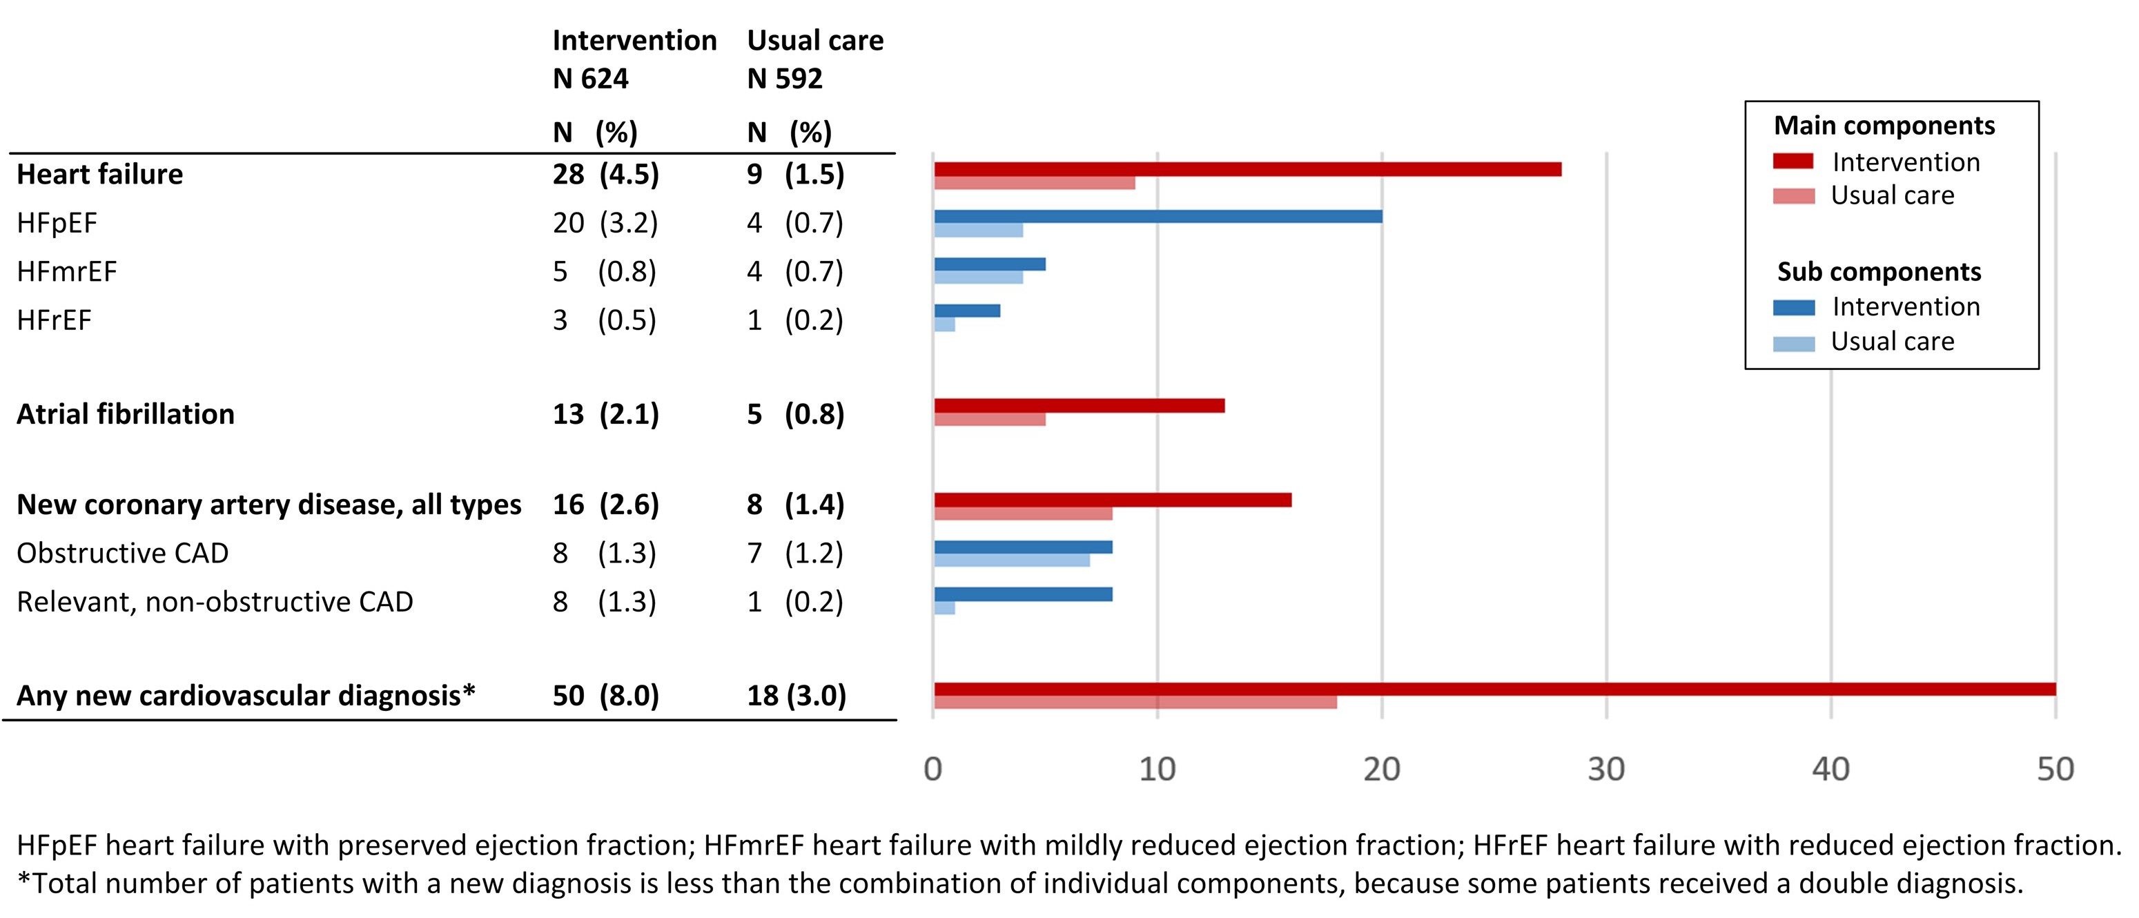
Results: Numbers of new diagnoses

Slide 18
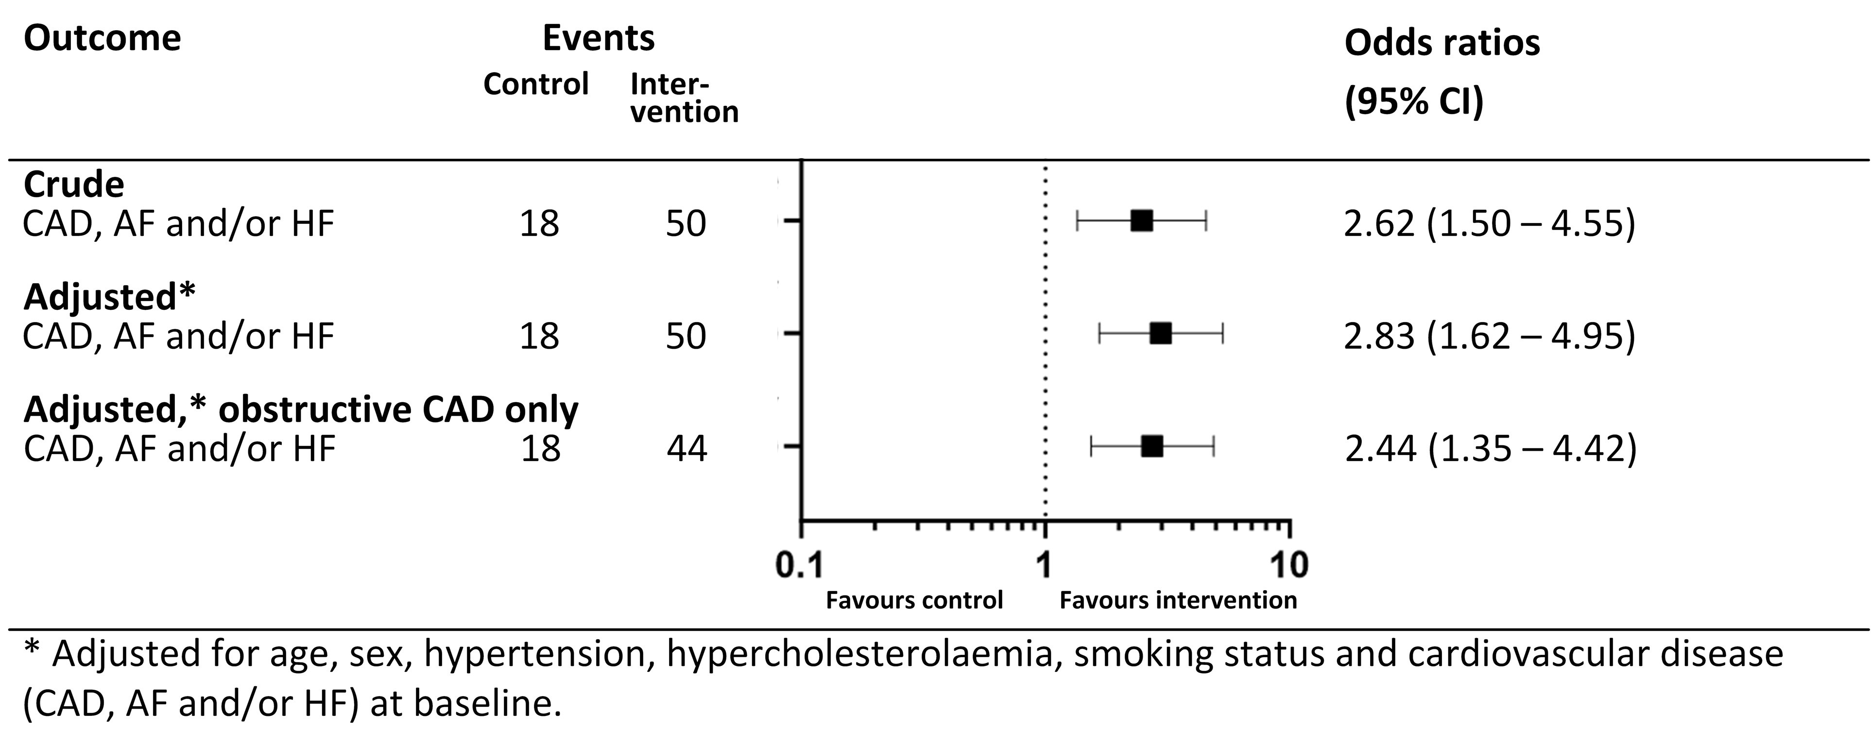
Results: Odds ratios

Slide 19
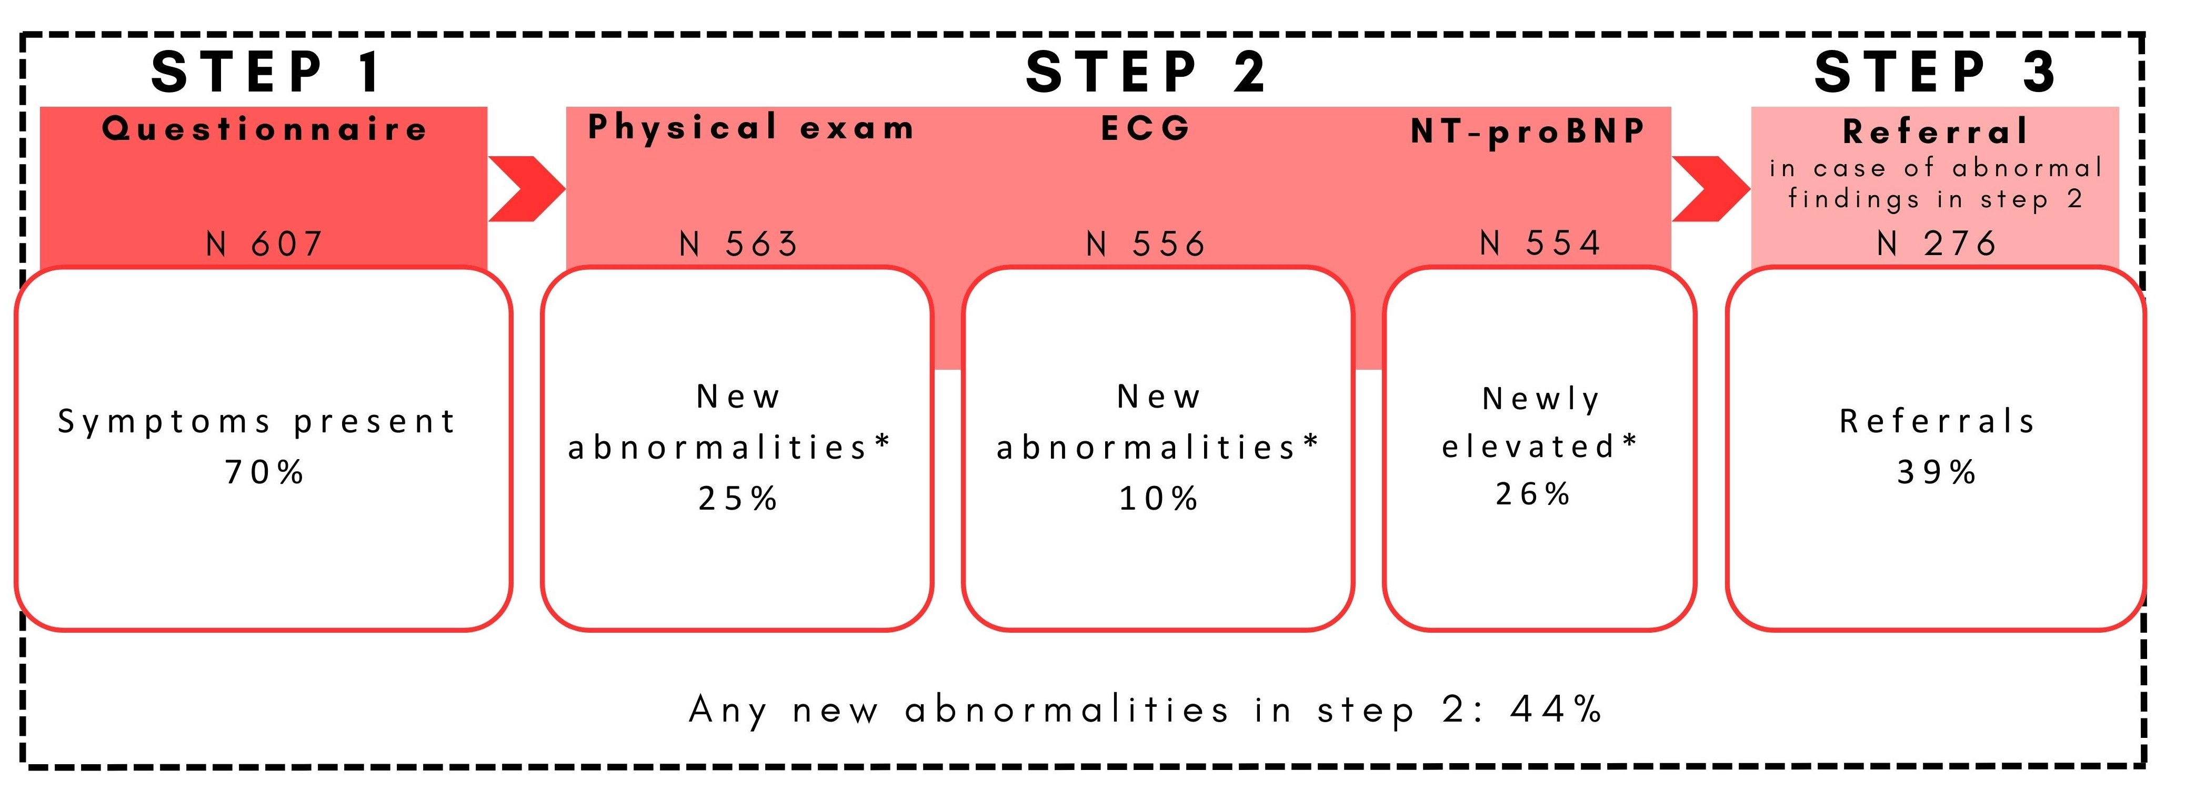
Results: components of the strategy
Shortness of breath
44%
32%
26%
4%
23%
6%
20%
ST-T abnormalities
4%
Health-related stress Claudication Palpitations
Exercise tolerance ↓ Chest pain
Expected health worsening
Peripheral oedema
15%
7%
6%
3%
2%
1%
3%
2%
1%
1%
0.4%
0.4%
0.2%
Abnormal heart sounds ^{Pathological Q waves}
LVH
Tachycardia (≥100bpm)
Complete LBBB Trifascicular block Atrial fibrillation Third degree AV block
Crepitations
² Irregular pulse
Tachycardia (≥100bpm)
¹ Abnormal apical beat

Slide 20
Results: medication use
All patients:
No difference in use of evidence-based medication at follow-up between the arms.
Patients with a new diagnosis:
No difference in use of evidence-based medication at follow-up between the arms.

Slide 21
Conclusion
The diagnostic strategy more than doubled the number of new diagnoses of heart failure, atrial fibrillation and coronary artery disease
Easy-to-use
Tools available in primary care
Implemented in existing disease management programs for T2DM and COPD

Slide 22
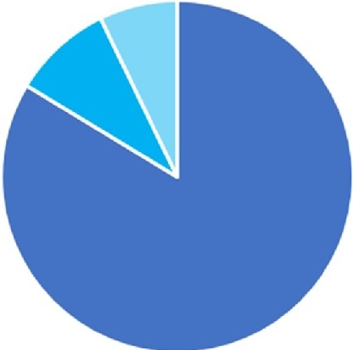
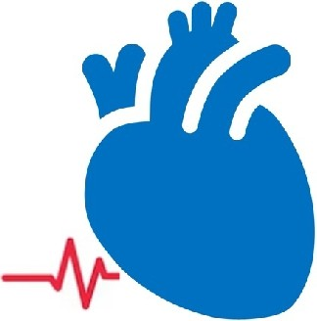
A Bigger Picture
In the Netherlands, 858.651 patients with COPD and/or T2DM participate in a primary care disease management program
Applying the screening strategy in all participants of T2DM and COPD disease management programs would result in 47.224 additional CVD diagnoses
718.366 T2DM
78.284 COPD
61.661 Both
CAD
10.303 cases
AF
11.162 cases
HF
25.759 cases

Slide 23
Acknowledgements
Many thanks to…
Prof. Frans Rutten, GP, UMC Utrecht
Prof. Rudolf de Boer, cardiologist, Erasmus MC
Prof. Michiel Rienstra, cardiologist UMC Groningen
Prof. Yvonne van der Schouw, epidemiologist, UMC Utrecht
Assoc. Prof. Maarten-Jan Cramer, cardiologist, UMC Utrecht
Assoc. Prof. Erik Koffijberg, HTA expert, University Twente
Prof. Arno Hoes, klinisch epidemiologist, UMC Utrecht
Assist. Prof. Monika Hollander, GPSI-CVD, UMC Utrecht
Victor Zwartkruis, PhD student, UMC Groningen
Martijn Oude Wolcherink, PhD student, University Twente
Dr Nicolaas Zuithoff, biostatistics, UMC Utrecht
R E D - C V D

Slide 24
Acknowledgements
Many thanks to…
ALL PARTICIPATING GENERAL PRACTITIONERS AND PRACTICE NURSES
R E D - C V D

