Slide 1


ACC.20/WCC:
A Composite Metric For Benchmarking Site Performance In Transcatheter Aortic Valve Replacement: Results From The STS/ACC TVT Registry
Nimesh D. Desai MD PhD
On behalf of the STS/ACC TVT Registry Risk Modeling Subcommittee

Slide 2

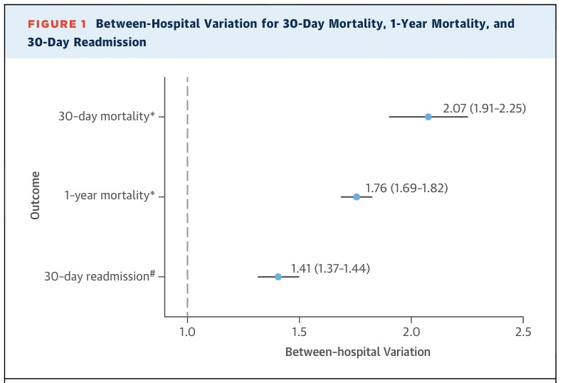
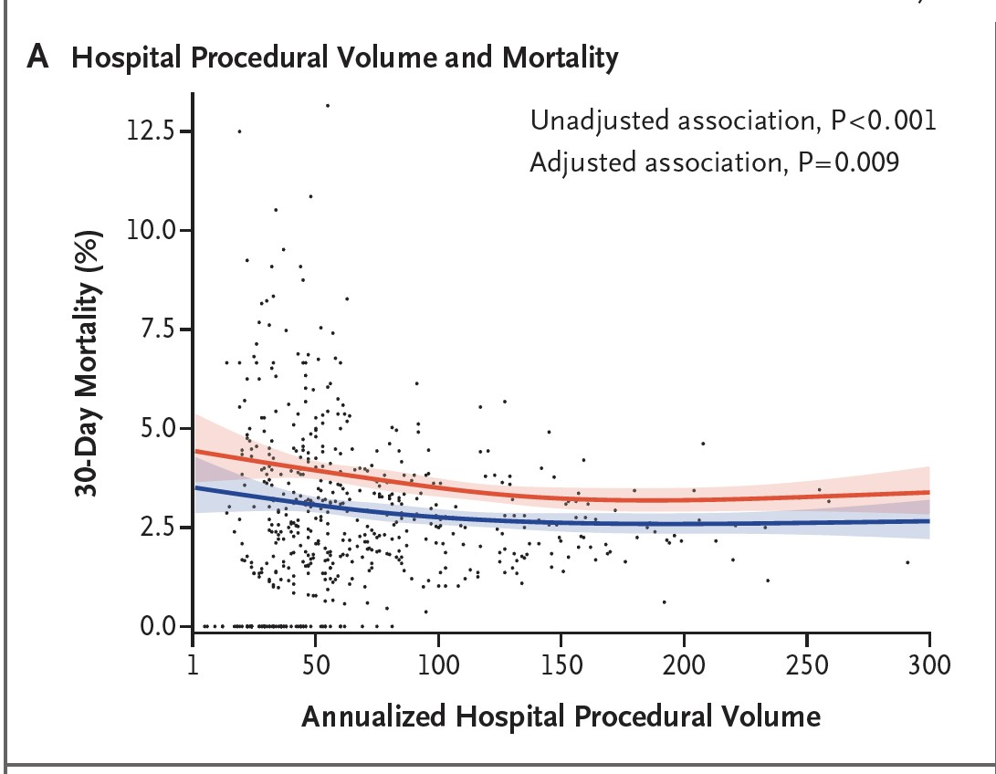
TAVR Outcomes in the United States
Wide variation in TAVR mortality is occurring at the SITE level
Murugiah et al JACC 2015
Vemulapalli et al NEJM 2019

Slide 3
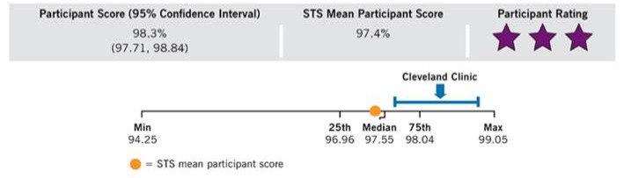
Patients care about outcomes beyond peri-
procedural mortality
  Alive and Well with improved functional status and quality of life
Composite measures can summarize all available information about the quality of care
delivered using high quality, validated clinical data
Move away from surrogate measures of quality
such as volume towards real clinical outcomes
Concept is well established in CABG, Valve Surgery
Going Beyond Mortality
Outcomes:
Why Develop a Composite Morbidity and
Mortality Measure for
TAVR?
Participant

Slide 4
Study Purpose
The purpose of this study was to determine if there is site-level variation in quality of care in TAVR in the United States using a novel patient- centric 30-day composite outcome measure.
Key Features:
  Fatal and Non-Fatal Outcomes
  Robust, non-parsimonious
  Incorporating novel data elements such as gait speed and KCCQ
    functional status, patient reported health status
  Highly patient-centric, meaningful endpoints
  Responsive to changes in patient populations and technologies

Slide 5


Methods: Patient Cohort
Derivation cohort of Composite Mortality and Morbidity Risk Model
All patients undergoing TRANSFEMORAL TAVR in the United States for symptomatic aortic stenosis between Jan 1, 2015 – Dec 31, 2017 were included from the STS/ACC TVT Registry
Based on conventions established for the TVT 30- day mortality model, data from hospitals with >10% missing data for the outcome variable and other key study variables were excluded.
Inclusion-Exclusion | Sites | Records
Inclusion: Index TAVRs procedures in patients discharged from 01JAN2015-31DEC2017 | 556 | 114121
Inclusion: Sites with >=90% completeness data for Ranked Endpoint, KCCQ-baseline and 5 m walk | 301 | 54217
Inclusion: Ranked Endpoint status available | 301 | 52561

Slide 6
Methods: Development of Ranked Composite Outcome
Understanding what Matters to Patients
 | 1-yr Mortality |  | 1-yr KCCQ-OS
30-day Non-fatal complications after TAVR | Adjusted Hazard Ratio | P-value | Adjusted Estimate | P-value
Any stroke | 2.2(1.7,2.9) | <.001 | -5.8 (-9.2,-2.4) | <.001
Major or Life- threatening/Disabling Bleed | 1.9(1.4,2.6) | <.001 | -.41 (-2.0,1.19) | 0.619
Acute kidney injury (Stage III) | 1.8(1.4,2.4) | <.001 | -3.3 (-6.8,0.28) | 0.071
Paravalvular Leak (Moderate/Severe) | 1.5(1.2],1.8) | <.001 | -2.0 (-3.8,-.30) | 0.021
The selection and rank order of the periprocedural complications for the composite was determined by their adjusted association with 1-year mortality and patient quality of life(KCCQ)
  Not Expert Opinion, Delphi Process
Any outcome with significant HR was maintained
(New Pacemaker and Major Vascular
complications were not significant)

Slide 7









TVT Risk Model Composite: Global Ranking of Endpoints
In-Hospital or 30-day mortality
Death
If a patient experienced multiple outcomes captured in the global rank composite measure, the outcome with the highest rank was assigned.
In-Hospital or 30-day stroke
Stroke
In-hospital or 30-day VARC major/life threatening/disabling bleed
Bleed
In-hospital of 30-day creatinine increase or 30 day new dialysis (AKI III)
AKI
In-hospital or 30-day moderate/severe peri-valvular leak (PVL)
PVL
None of the above
None

Slide 8
Results:
Morbidity and Mortality Composite Components
Frequency of Global Ranking Categories in Study Cohort
Endpoint Category | Number (N = 52,561) | Percent
1 = In-hospital/30-day death | 1671 | 3.2%
2 = In-hospital/30-day stroke | 1077 | 2.0%
3 = In-hospital/30-day VARC major/life threatening/disabling bleed | 3024 | 5.8%
4 = AKI: In-hospital/30-day sig creatinine increase or new dialysis | 336 | 0.6%
5 = In-hospital/30-day moderate/severe peri-valvular leak (PVL) | 1304 | 2.5%
6 = None of the above | 45149 | 85.9%

Slide 9

















Primary End-point Assessment:
TAVR Patients at Site of Interest
Mortality
Stroke
Average Site
Average Site
No Winner?
Overall Model:
Hierarchical multi-category logistic regression model which estimates a set of hospital-specific odds ratios
Site of Interest
Site of Interest
Random Patient from Site of Interest
Simplification for Illustrative Purposes only
SI TE DI FFERENCE =
p Random Pat i ent does Wo r se at Av g Hospi t al -
p Random Pat i ent does Bet t er at Av g Hospi t al
Positive Site Difference is good, Negative Site Difference is bad.
Site Difference
Novel metric incorporating elements similar to ‘Win Ratio’
Sites whose outcomes were outside 95% confidence intervals of the average sites were considered to be performing worse or better than expected. No prespecified outlier proportions.
Risk Adjusted with 46 Covariates incl. Baseline
KCCQ and Gait Speed

Slide 10
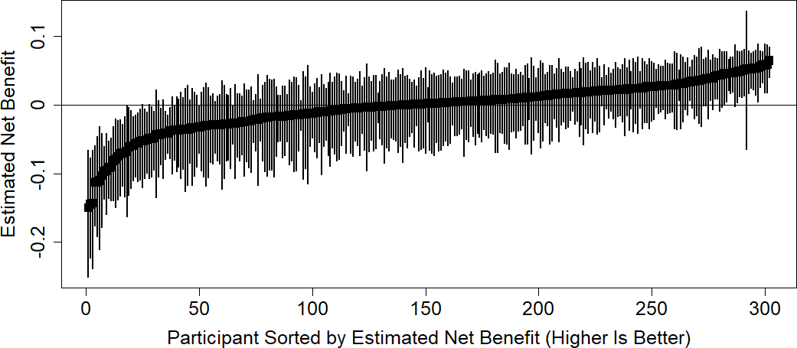
Results: TVT Risk Model – Site Difference Morbidity and Mortality Composite (3 yr)
Estimated Site Difference
Participant Sorted by Site Difference (Higher is Better)

Slide 11
Validity: Risk Adjusted Outcomes by Site Status
2.5
Worse than Expected As Expected
Adjusted Observed/Expected Ratio
2.13
Better than Expected
2
2
1.5
1.25
1.29
1.17
1.12
1.19
1
1.01
1.03
1.02
0.71
0.73
0.77
0.67
0.5
0.45
0
Death
Stroke
Major/LT/DA Bleed
AKI: Stage III
Mod/Sev PVL

Slide 12
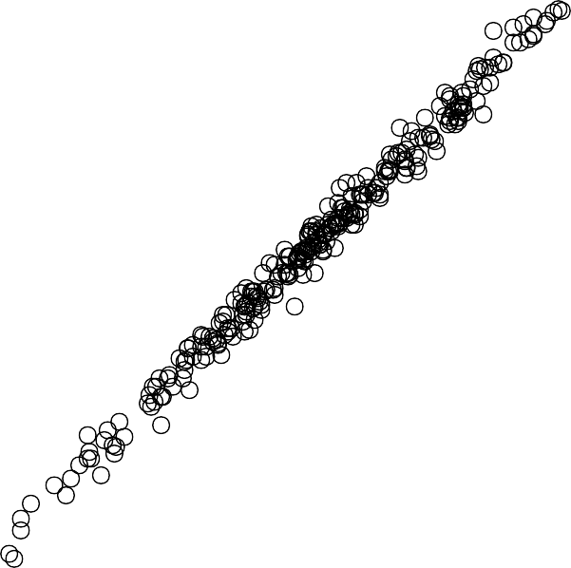
Sensitivity Analyses: Remove KCCQ and Gait Speed
1.0
Correlation = 0.996
0.5
Modified
0.0
Eligible Centers in cohort: 301 to 447
-0.5
1 of 301 Original Sites Change Star Category
-0.5
0.0
Original
0.5
1.0

Slide 13

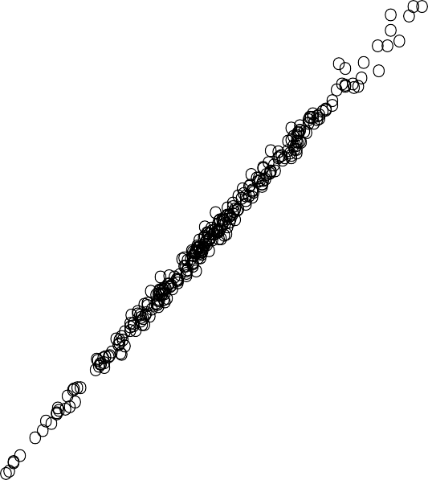


Sensitivity Analyses: 3 State instead of 6 State model
In-Hospital or 30-day mortality
Death
Correlation = 0.998
0.5
In-Hospital or 30-day major complication
Major Comp
Modified
0.0
None of the above
None
-0.5
2 of 301 Sites Change Star Category
-0.5
0.0
Original
0.5
1.0

Slide 14

Reliability Testing
Value below
0.5 indicates poor reliability
Value above
0.5 indicates acceptable reliability
Values above 0.7-0.8 are desirable
Reliability: A measure of how well one can confidently distinguish the performance of one site
from another (Signal to Noise)
There are three main drivers of reliability: sample size, differences between sites, and measurement error.
Potential Causes of Poor Reliability:
Low Event Rates
Short Periods of Observation(1-3 years of data)
Programs with Small Sample Size
Limited Variation in Outcomes b/w Programs

Slide 15
Hospital TAVR Volume | Outcome Measure
 | 30-Day Mortality | 30-Day Mortality and Morbidity Ranked Composite
Hospitals with at least 10 cases | 0.14 | 0.58
Hospitals with at least 25 cases | 0.17 | 0.62
Hospitals with at least 50 cases | 0.19 | 0.67
Hospitals with at least 75 cases | 0.22 | 0.71
Hospitals with at least 100 cases | 0.26 | 0.74
Hospitals with at least 200 cases | 0.34 | 0.82
Hospitals with at least 500 cases | 0.50 | 0.89
Estimated reliability as a function of volume threshold for reporting
Derived from Monte Carlo Simulation

Slide 16
How does the model perform with contemporary data?
Jan 1, 2015 to Dec 31, 2017 Jan 1, 2018 to Jun 30, 2019
Endpoint Category | Number | Percent
Death | 1671 | 3.2%
Stroke | 1077 | 2.0%
VARC Major or LT/Disabling Bleed | 3024 | 5.8%
AKI (Stage III) | 336 | 0.6%
Moderate/Severe peri-valvular leak | 1304 | 2.5%
None of the above | 45149 | 85.9%
Endpoint Category | Number | Percent
Death | 1307 | 2.6%
Stroke | 1009 | 2.0%
VARC Major or LT/Disabling Bleed | 2513 | 5.0%
AKI (Stage III) | 250 | 0.5%
Moderate/Severe peri-valvular leak | 625 | 1.2%
None of the above | 45037 | 88.8%
Worse Than Expected | As Expected | Better Than Expected
34 / 301 (11%) | 242 / 301 (80%) | 25 / 301 (8%)
Worse Than Expected | As Expected | Better Than Expected
34/373 (9%) | 328/373 (88%) | 11/373 (3%)

Slide 17
Limitations
This analysis does not examine quality of care in patients who underwent TAVR using non-femoral access
Missing baseline KCCQ-12 and gait speed data limited the number of sites included in this analysis.
  Sensitivity analyses showed that exclusion of these variables did not meaningfully change the categorization of sites
  significant educational efforts are being made to improve compliance and the inclusion of these variables within the TVT registry remains mandated by CMS.
  2019: 92% completeness for KCCQ

Slide 18
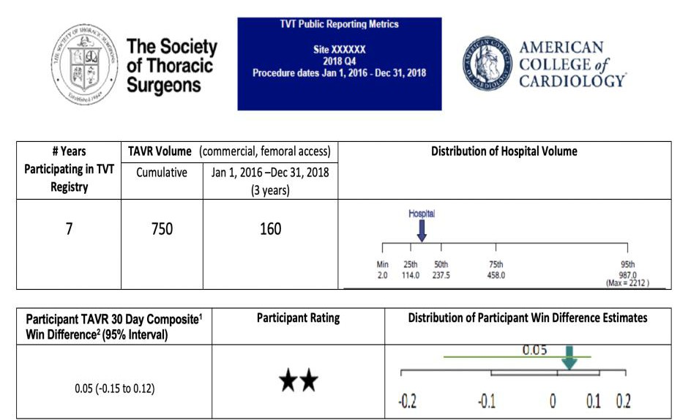
Conclusions
We developed a novel patient-centric composite outcome for TAVR based on 30-day outcomes and their ranked association with both 1-year mortality and quality of life.
We have identified significant site-level variation in mortality and major complications after TAVR procedures in the United States.
The model demonstrated excellent performance including internal validity and moderate to high reliability even when including lower-volume programs
This 30-day composite metric is appropriate for high-stakes applications such as public reporting.
Draft of Potential
Means of Publicly
Reporting Site
Performance
STS/ACC Registry Risk Modeling Subcommittee: Chairs: Nimesh D. Desai MD PhD, David J Cohen MD MSc Members: John Carroll MD, Sreekanth Vemulapalli MD, Sean O’Brien PhD, John Forrest MD, Vinod Thourani MD,
Ajay Kirtane MD, Brian O’Neil MD, Pratik Manandhar MD, David Shahian MD, Vinay Badhwar MD, Suzanne V Arnold MD MHA, Joseph E Bavaria MD
ACC/STS Staff: Carole Crohn, Joan Michaels, Susan
Fitzgerald, Donna Macdonald

