Slide 1
The STOP-CA Trial
Co-PI: Tomas G. Neilan, MD, MPH
Director, Cardio-Oncology Program, Massachusetts General Hospital, @TomasNeilan
Co-PI: Marielle Scherrer-Crosbie, MD, PhD
Director, Echocardiography Laboratory,
Hospital of the University of Pennsylvania, @Mariellesc1

Slide 2
The STOP-CA Trial
Statins TO Prevent the Cardiotoxicity associated with Anthracyclines
A double-blind, placebo-controlled, multicenter randomized trial testing the effect of atorvastatin, compared to placebo, on the occurrence of cardiac dysfunction among patients with lymphoma being treated with anthracyclines.

Slide 3
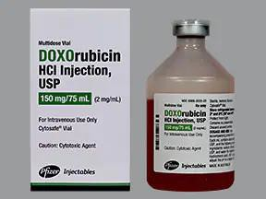
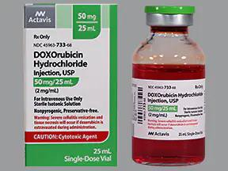
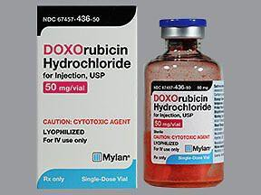
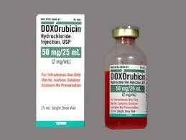
Background – Why Anthracyclines?
Anthracyclines (e.g., doxorubicin, epirubicin, idarubicin) are a standard chemotherapy used in several cancers including breast cancer, lymphoma, leukemia, and sarcoma.
Each year, > 1 million patients worldwide are treated with anthracyclines.

Slide 4
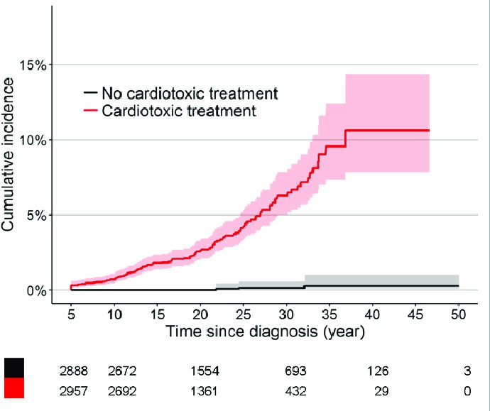
Anthracyclines – Cardiac Toxicity
Cardiac injury with anthracyclines begins with the 1st cycle
of chemotherapy.¹
Depending on the population, time from therapy, and the diagnostic criteria, there is an up to ~10-15-fold increased risk of heart failure with anthracyclines.^{2, 3}
Ewer MS, Journal of Clinical Oncology, 1984;¹ Lieke Feijen EAM, Journal of the American Heart Association, 2019;² Larsen CM, JAMA Network Open, 2023;³

Slide 5
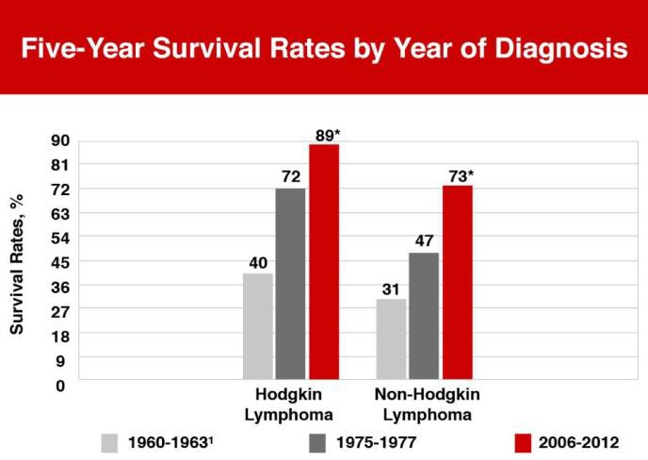
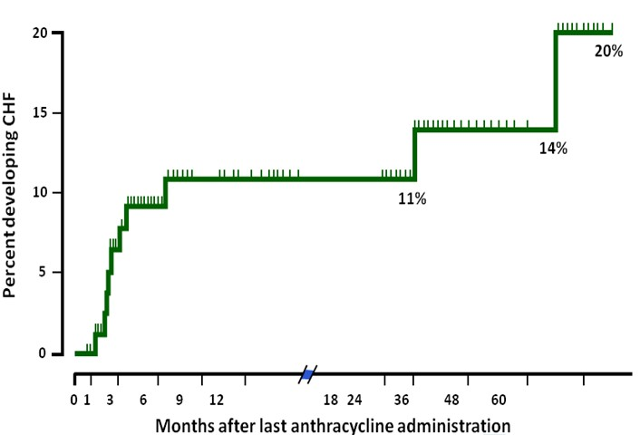
Why Lymphoma?
Common cancer (~90,000 in the US per year), high survival rate.^{1,2}
High rate of cardiac dysfunction and clinical heart failure (> breast cancer).^{3,4}
Lancet Hematology, Xu, 2019;¹ SEER Cancer Statistics, 2021;² European Journal of Cancer, Elvira C, 2006;³ Annals of Oncology, Jensen BV, 2002;⁴

Slide 6
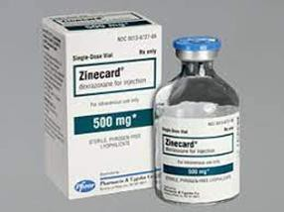
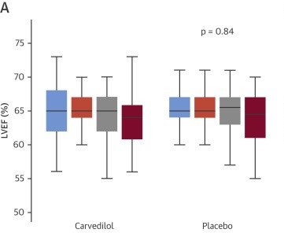
What Primary Prevention Strategies have been Tested?
There is one cardioprotectant (dexrazoxane, Zinecard) approved by the FDA to reduce anthracycline-associated cardiotoxicity with limited widespread use due to potential secondary effects.
Other therapies, principally neurohormonal blockade, have been tested with modest effects or have been limited by hemodynamic factors.^{1, 2, 3, 4, 5}
Bosch X, Journal of the American College of Cardiology, 2013;¹ Gulati G, European Heart Journal, 2016;² Avila MS, Journal of the American College of Cardiology, 2018;³ Pituskin, E, Journal of Clinical Oncology, 2016;⁴ Guglin M, Journal of the American College of Cardiology, 2019;⁵

Slide 7
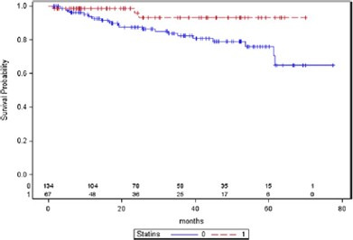
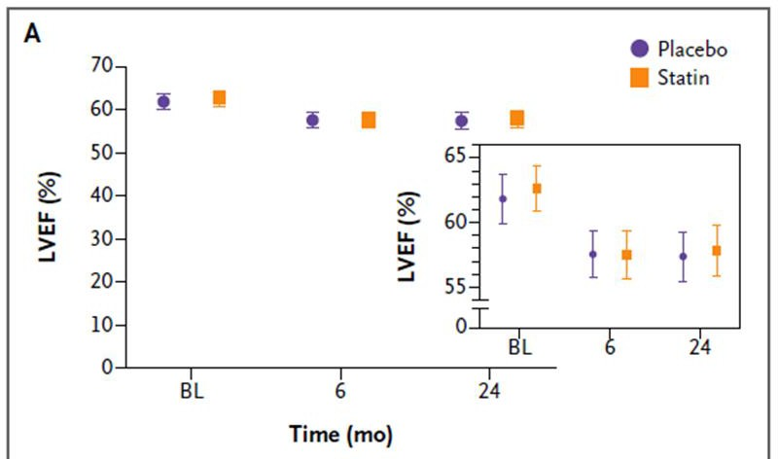
Why Statins/Atorvastatin?
Experimental data,^{1,2} retrospective studies,^{3,4} and a small randomized trial ⁵ have reported either attenuation of anthracycline-associated LV dysfunction or a lower rate of heart failure.
HOWEVER
A recent multicenter randomized trial of atorvastatin vs placebo did not show preservation of the LVEF at 24 months.⁶ The 24-month LVEF was 58% in both the atorvastatin and placebo group.
Riad, A, Cancer Research, 2009;¹ Ramanjaneyulu SV, Journal of Physiology and Biochemistry, 2013;² Seicean S, Journal of the American College of Cardiology, 2013;³ Abdel-Qadir H, Journal of the American Heart Assoc, 2021;⁴, Acar Z, Journal of the American College of Cardiology, 2011;⁵ Hundley WG, New England Journal of Medicine Evidence, 2022;⁶

Slide 8
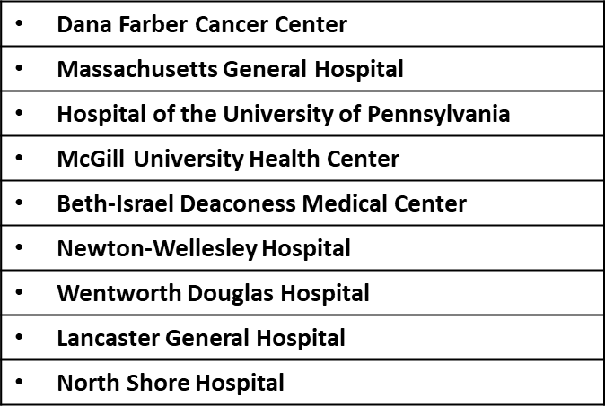
STOP-CA Study Design
Multicenter, randomized, double-blind placebo-controlled trial (NCT02943590).
9 centers, US and Canada.
Funded by the National Institutes for Health/National Heart and Lung Blood
Institute (R01HL130539).

Slide 9
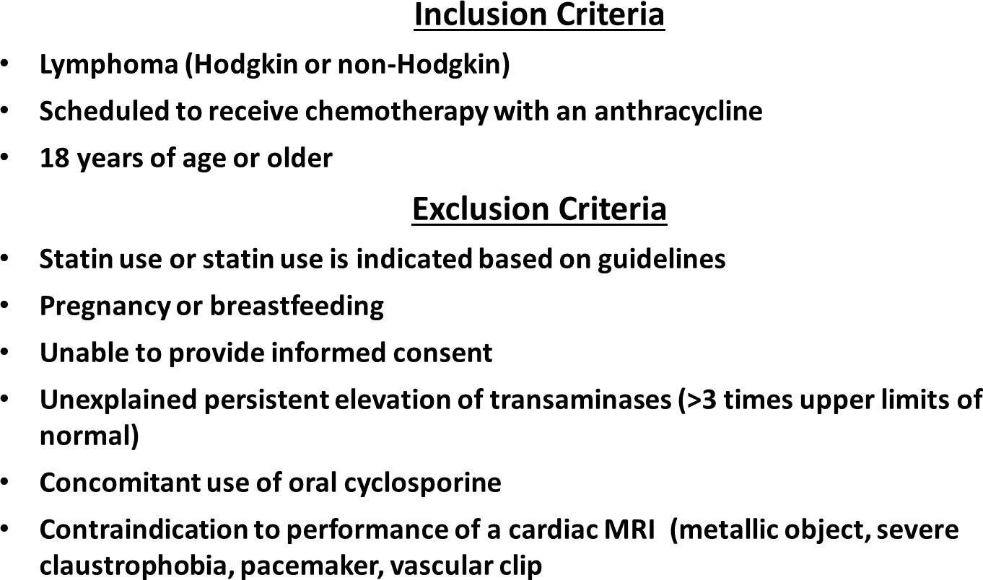
STOP-CA Participants

Slide 10
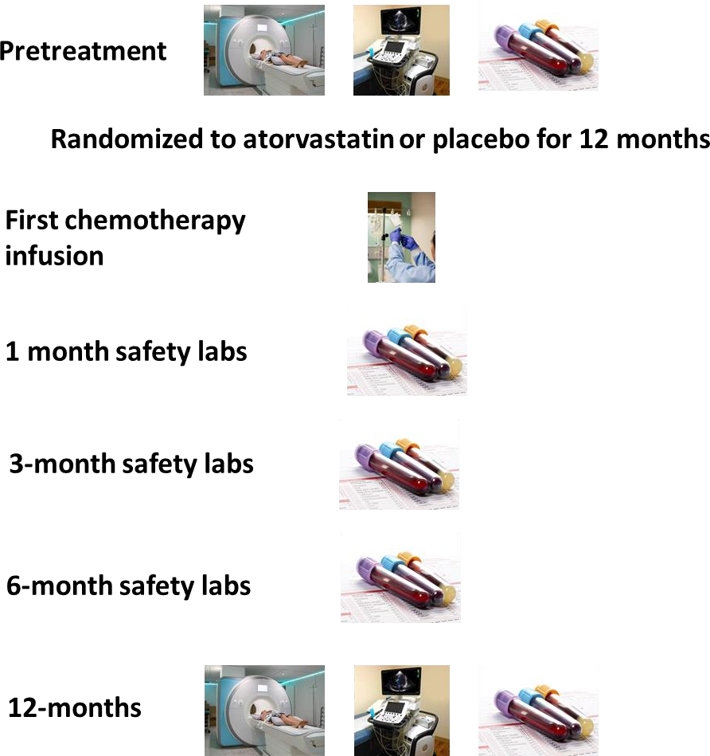
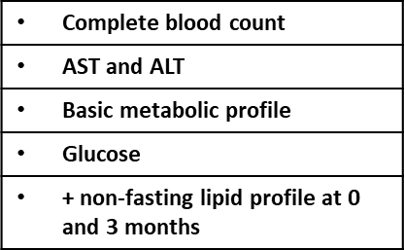
STOP-CA Primary Study Procedures and Intervention

Slide 11
STOP-CA Study Endpoints
Primary outcome: Proportion who had a decline in the LVEF of ≥ 10% to less than 55%.
Secondary outcome: Proportion who had a decline in the LVEF of ≥ 5% to less than 55%.
Exploratory outcomes:
Absolute reduction in the LVEF by group.
Pre-specified subgroup analyses based on the absolute LVEF change.
Rates of incident heart failure.
Safety: Adverse events of special interest.

Slide 12
STOP-CA Results

Slide 13
STOP-CA Results
Table 1. Patient Demographics, Cancer Characteristics, Drug Exposure, Radiation and Compliance
Characteristics | Full Cohort (n=300) | Atorvastatin (n=150) | Placebo (n=150) | P value
Age — years
Mean (±SD) | 50 (17) | 50 (17) | 49 (16)
Median (minimum, maximum) | 52 (20 - 91) | 51 (20 - 91) | 52 (20 - 83) | 0.76†
Sex — no. of patients (%)
Female | 142 (47) | 68 (45) | 74 (49) | 0.56‡
Males | 158 (53) | 82 (55) | 76 (51)
Table 1. Patient Demographics, Cancer Characteristics, Drug Exposure, Radiation and Compliance
Characteristics |  | Full Cohort (n=300) | Atorvastatin (n=150) | Placebo (n=150) | P value
 | Age — years
 | Mean (±SD) | 50 (17) | 50 (17) | 49 (16)
 | Median (minimum, maximum) | 52 (20 - 91) | 51 (20 - 91) | 52 (20 - 83) | 0.76†
Race — no. of patients (%)
Asian | 11 (4) | 4 (3) | 7 (5) | 0.77‡
Black | 9 (3) | 5 (3) | 4 (3)
Unknown | 14 (5) | 6 (4) | 8 (5)
White | 266 (89) | 135 (90) | 131 (87)
Ethnicity — no. of patients (%)
Hispanic/Latino | 19 (6) | 11 (7) | 8 (5) | 0.68‡
Non-Hispanic/Latino | 271 (90) | 135 (90) | 136 (91)
Unknown | 10 (3) | 4 (3) | 6 (4)
Body-mass index†
Mean (±SD) | 28 (6.1) | 28 (6.2) | 28 (6.1)
Median (minimum, maximum) | 27 (14 - 52) | 27 (14 - 52) | 27 (17 - 50) | 0.65†
Body mass index, (kg/m²) WHO criteria
Female | 142 (47) | 68 (45) | 74 (49) | 0.56‡
Males | 158 (53) | 82 (55) | 76 (51)
Underweight, < 18.5 8 (3) | 2 (1) | 6 (4) 0.60‡
Normal weight, ≥ 18.5 99 (33) | 48 (32) | 51 (34)
Overweight, ≥ 25 107 (36) | 56 (37) | 51 (34)
Race — no. of patients (%)
Obese, ≥ 30 52 (17) 25 (17) 27 (18)
Asian 11 (4) 4 (3) 7 (5) 0.77‡
Severely Obese, ≥ 35 34 (11) 19 (13) 15 (10)
Type of lymphoma — no. of patients (%)
Black 9 (3) 5 (3) 4 (3)
Unknown 14 (5) 6 (4) 8 (5)
White 266 (89) 135 (90) 131 (87)
T-cell 14 (5) 9 (6) 5 (3) 0.45‡
B-cell 206 (69) 104 (69) 102 (68)
Hodgkin’s 80 (27) 37 (25) 43 (29)
ECOG Performance Status Scale
Grade 0 | 216 (72) | 112 (75) | 104 (69) | 0.61‡
Grade 1 | 65 (22) | 29 (19) | 36 (24)
Grade 2 | 11 (4) | 4 (3) | 7 (5)
Grade 3 | 2 (1) | 1 (1) | 1 (1)
Unknown | 6 (2) | 4 (3) | 2 (1)
Ethnicity — no. of patients (%)
Hispanic/Latino | 19 (6) | 11 (7) | 8 (5) | 0.68‡
Non-Hispanic/Latino | 271 (90) | 135 (90) | 136 (91)
Unknown | 10 (3) | 4 (3) | 6 (4)
Body-mass index†
Cardiac medications — no. of patients (%)
ARB, or ACE inhibitor | 17 (6) | 7 (5) | 10 (7) | 0.47‡
Beta-blocker | 10 (3) | 7 (5) | 3 (2) | 0.22‡
Aspirin | 16 (5) | 10 (7) | 6 (4) | 0.44‡
Calcium channel blocker | 8 (3) | 4 (3) | 4 (3) | > 0.99‡
Other (e.g., diuretic, aldosterone antagonist) | 6 (2) | 3 (2) | 3 (2) | > 0.99‡
Cardiac Risk Factors — no. of patients (%)
Mean (±SD) 28 (6.1) 28 (6.2) 28 (6.1)
Hypertension | 34 (11) | 14 (9) | 20 (13) | 0.36‡
Smoking history | 61 (20) | 29 (19) | 32 (21) | 0.77‡
Current | 14 (5) | 6 (4) | 8 (5)
Sleep apnea | 11 (4) | 4 (3) | 7 (5) | 0.54‡
Cancer treatment
Median (minimum, maximum) 27 (14 - 52) 27 (14 - 52) 27 (17 - 50) 0.65†
Cumulative anthracycline dose (mg/m²)
Body mass index, (kg/m²) WHO criteria
Mean (±SD) | 264 (60) | 268 (58) | 260 (62)
Median (minimum, maximum) | 300 (50 - 312) | 300 (100 -308) | 300 (50 – 312) | 0.76†
Radiation treatment* — no. of patients (%) | 33 (11) | 12 (8) | 21 (14) | 0.14‡
Study drug compliant — no. of patients (%) | 273 (91) | 138 (92) | 135 (90) | 0.69‡
‡Fisher's exact test, †Wilcoxon rank-sum test, ECOG = Eastern Cooperative Oncology Group, ARB = angiotensin receptor blocker, ACE = angiotensin converting enzyme, * 4 participants had radiation treatment that involved the cardiac silhouette.
Underweight, < 18.5 | 8 (3) | 2 (1) | 6 (4) | 0.60‡
Normal weight, ≥ 18.5 | 99 (33) | 48 (32) | 51 (34)
Overweight, ≥ 25 | 107 (36) | 56 (37) | 51 (34)
Obese, ≥ 30 | 52 (17) | 25 (17) | 27 (18)
Severely Obese, ≥ 35 | 34 (11) | 19 (13) | 15 (10)

Slide 14
STOP-CA Results
Table 1. Patient Demographics, Cancer Characteristics, Drug Exposure, Radiation and Compliance
Table 1. Patient Demographics, Cancer Characteristics, Drug Exposure, Radiation and Compliance
Characteristics
Full Cohort (n=300)
Atorvastatin Placebo (n=150) P value (n=150)
Characteristics
Full Cohort (n=300)
Atorvastatin (n=150)
Placebo P value (n=150)
Age — years
Mean (±SD)
50 (17)
50 (17) 49 (16)
51 (20 - 91) 52 (20 - 83)
Type of lymphoma — no. of patients (%)
Median (minimum, maximum)
52 (20 - 91)
0.76
†
Sex — no. of patients (%) Female | 142 (47) | 68 (45) | 74 (49) | 0.56 | ‡ |  |  | T-cell | 14 (5) | 9 (6) | 5 (3) 0.45‡
Males Race — no. of patients (%) | 158 (53) | 82 (55) | 76 (51) |  |  |  |  | B-cell | 206 (69) | 104 (69) | 102 (68)
Asian | 11 (4) | 4 (3) | 7 (5) | 0.77‡
Black | 9 (3) | 5 (3) | 4 (3)
Unknown | 14 (5) | 6 (4) | 8 (5)
White | 266 (89) | 135 (90) | 131 (87)
Ethnicity — no. of patients (%) Hispanic/Latino | 19 (6) | 11 (7) | 8 (5) | 0.68‡
Non-Hispanic/Latino | 271 (90) | 135 (90) | 136 (91)
Unknown | 10 (3) | 4 (3) | 6 (4)
Body-mass index†
Hodgkin’s 80 (27) 37 (25) 43 (29)
ECOG Performance Status Scale
Grade 0 | 216 (72) | 112 (75) | 104 (69) | 0.61‡
Grade 1 | 65 (22) | 29 (19) | 36 (24)
Grade 2 | 11 (4) | 4 (3) | 7 (5)
Grade 3 | 2 (1) | 1 (1) | 1 (1)
Unknown | 6 (2) | 4 (3) | 2 (1)
Mean (±SD) 28 (6.1) 28 (6.2) 28 (6.1)
Median (minimum, maximum) 27 (14 - 52) 27 (14 - 52) 27 (17 - 50) 0.65†
Body mass index, (kg/m²) WHO criteria
Cardiac medications — no. of patients (%)
ARB, or ACE inhibitor
Underweight, < 18.5 | 8 (3) | 2 (1) | 6 (4) | 0.60‡
Normal weight, ≥ 18.5 | 99 (33) | 48 (32) | 51 (34)
Overweight, ≥ 25 | 107 (36) | 56 (37) | 51 (34)
Obese, ≥ 30 | 52 (17) | 25 (17) | 27 (18)
Severely Obese, ≥ 35 | 34 (11) | 19 (13) | 15 (10)
17 (6)
7 (5)
10 (7)
0.47‡
 |  |  |  |  |  | Beta-blocker | 10 (3) | 7 (5) | 3 (2) 0.22‡
Type of lymphoma — no. of patients (%) T-cell 14 (5) | 9 (6) | 5 (3) | 0.45‡ |  |  | Aspirin | 16 (5) | 10 (7) | 6 (4) 0.44‡
B-cell 206 (69) 104 (69) 102 (68)
Calcium channel blocker
8 (3)
4 (3)
4 (3)
> 0.99‡
Hodgkin’s 80 (27) 37 (25) 43 (29)
Other (e.g., diuretic, aldosterone antagonist)
6 (2)
3 (2)
3 (2)
> 0.99‡
ECOG Performance Status Scale
Grade 0 216 (72) 112 (75) 104 (69) 0.61‡
Grade 1 65 (22) 29 (19) 36 (24)
Grade 2 11 (4) 4 (3) 7 (5)
Cardiac Risk Factors — no. of patients (%)
Grade 3 2 (1) 1 (1) 1 (1)
Unknown 6 (2) 4 (3) 2 (1)
Hypertension | 34 (11) | 14 (9) | 20 (13) 0.36‡
Smoking history | 61 (20) | 29 (19) | 32 (21) 0.77‡
Current | 14 (5) | 6 (4) | 8 (5)
Cardiac medications — no. of patients (%)
ARB, or ACE inhibitor | 17 (6) | 7 (5) | 10 (7) | 0.47‡
Beta-blocker | 10 (3) | 7 (5) | 3 (2) | 0.22‡
Aspirin | 16 (5) | 10 (7) | 6 (4) | 0.44‡
Calcium channel blocker | 8 (3) | 4 (3) | 4 (3) | > 0.99‡
Other (e.g., diuretic, aldosterone antago | nist) 6 (2) | 3 (2) | 3 (2) | > 0.99‡
Cardiac Risk Factors — no. of patients (%)
Sleep apnea
11 (4)
4 (3)
7 (5)
0.54‡
Hypertension
34 (11)
14 (9)
20 (13)
0.36‡
Cancer treatment
 | Cumulative anthracycline dose (mg/m²)
 | Mean (±SD) | 264 (60) | 268 (58) | 260 (62)
 | Median (minimum, maximum) | 300 (50 - 312) | 300 (100 -308) | 300 (50 – 312) | 0.76†
 | Radiation treatment* — no. of patients (%) | 33 (11) | 12 (8) | 21 (14) | 0.14‡
Smoking history
61 (20)
29 (19)
32 (21)
0.77‡
Current
14 (5)
6 (4)
8 (5)
Sleep apnea
11 (4)
4 (3)
7 (5)
0.54‡
Cancer treatment
Cumulative anthracycline dose (mg/m²)
Mean (±SD) Median (minimum, maximum) | 264 (60) 300 (50 - 312) | 268 (58) 300 (100 -308) | 260 (62) 300 (50 – 312) | 0.76†
Radiation treatment* — no. of patients (%) | 33 (11) | 12 (8) | 21 (14) | 0.14‡
Study drug compliant — no. of patients (%) | 273 (91) | 138 (92) | 135 (90) | 0.69‡
‡Fisher's exact test, †Wilcoxon rank-sum test, ECOG = Eastern Cooperative Oncology Group, ARB = angiotensin receptor blocker, ACE = angiotensin converting enzyme, * 4 participants had radiation treatment that involved the cardiac silhouette.
Study drug compliant — no. of patients (%)
273 (91)
138 (92)
135 (90)
0.69‡

Slide 15
STOP-CA RESULTS
At baseline, among the entire cohort, the LVEF was 63±4.6%.
In total, 286 participants (95%) completed the trial.
At 12 months, among the entire cohort, the LVEF was 59±5.9%.
At 12 months, among the entire cohort, 46 participants (15%) had a decline in the LVEF of ≥ 10% from prior to chemotherapy to a final value of < 55%.
Adherence with study drug was documented in > 90%.

Slide 16
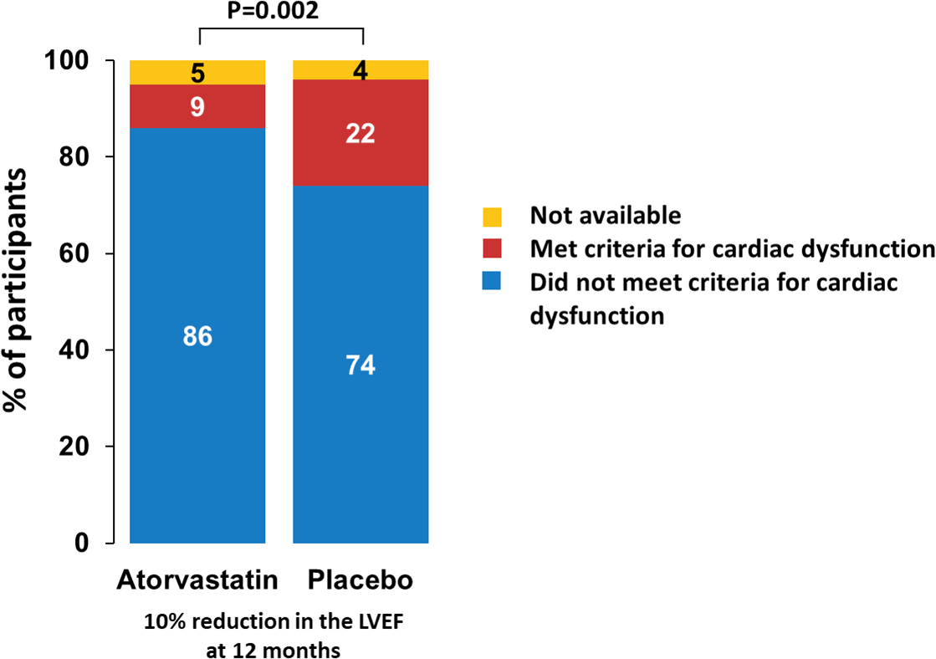
STOP-CA Primary Endpoint Results
The incidence of the primary endpoint at 12 months was 9% in the atorvastatin group and 22% in the placebo group (P=0.002).
The odds of a ≥ 10% decline in the LVEF to final value of < 55% after anthracyclines was almost 3 times greater for participants randomized to placebo (OR 2.9, 95% CI 1.4 - 6.4).

Slide 17
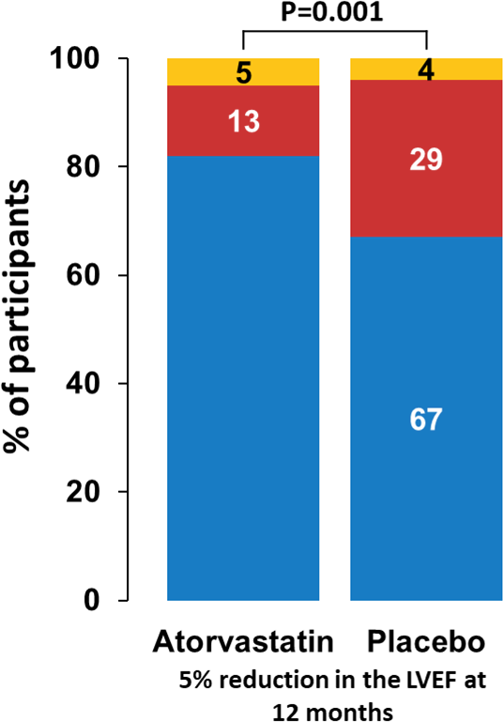
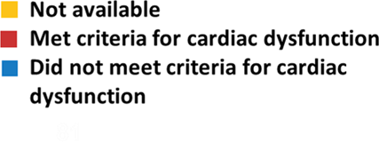
STOP-CA Secondary Endpoint Results
At 12 months, 64 participants (21%) in the entire cohort had a decline in the LVEF of ≥ 5% from prior to chemotherapy to a final value of < 55%.
The incidence of this secondary endpoint was 13% in the atorvastatin group and 29% in the placebo group (P=0.001).

Slide 18
STOP-CA Exploratory Endpoints
In the atorvastatin group, the average pretreatment LVEF was 63% and
the LVEF at 12 months was 59%, a mean decrease of 4%.
In the placebo group, the average pretreatment LVEF was 63% and the average LVEF at 12 months was 57%, a mean decrease of 5%.
Thus, overall, there was only a minor difference of 1% in the change in LVEF at 12 months between those randomized to atorvastatin and placebo (P=0.029).
There were 11 heart failure events with no difference in the incidence of heart failure between study groups (P=0.77).

Slide 19
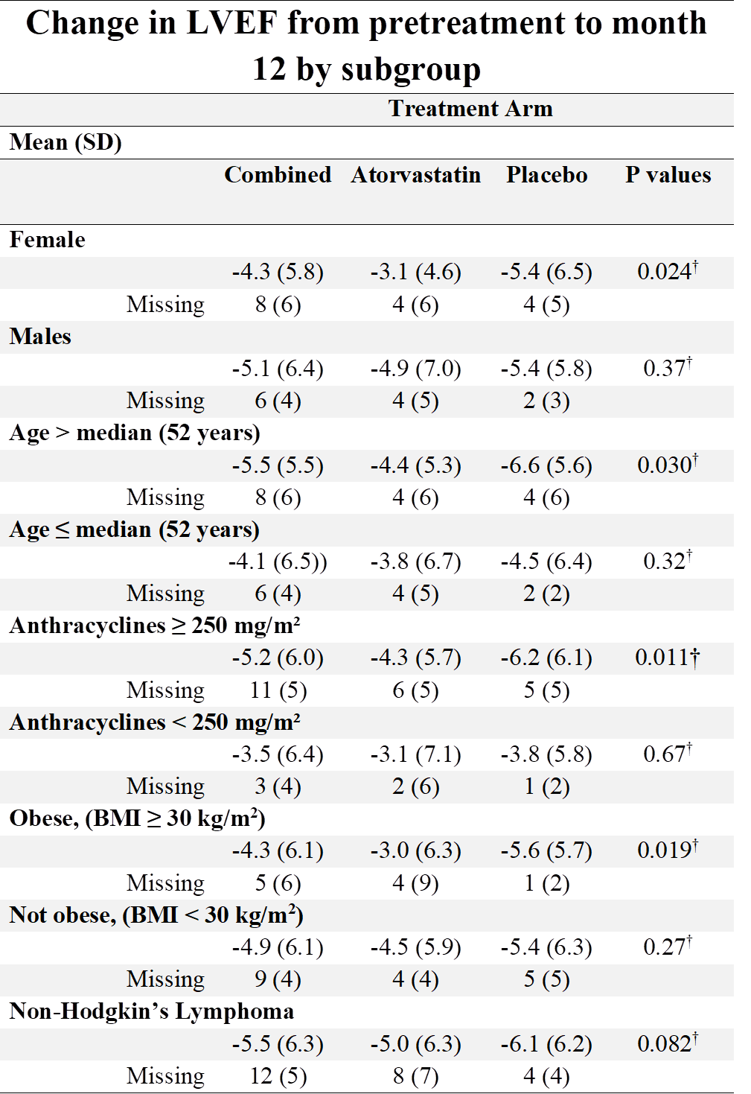
STOP-CA Exploratory Subgroup Analyses
†Wilcoxon rank-sum test, between treatment group comparison.

Slide 20
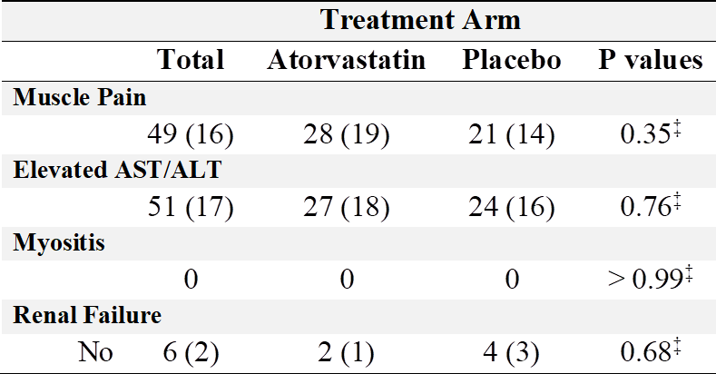
STOP-CA Adverse Events of Interest
‡Fisher’s exact test.

Slide 21
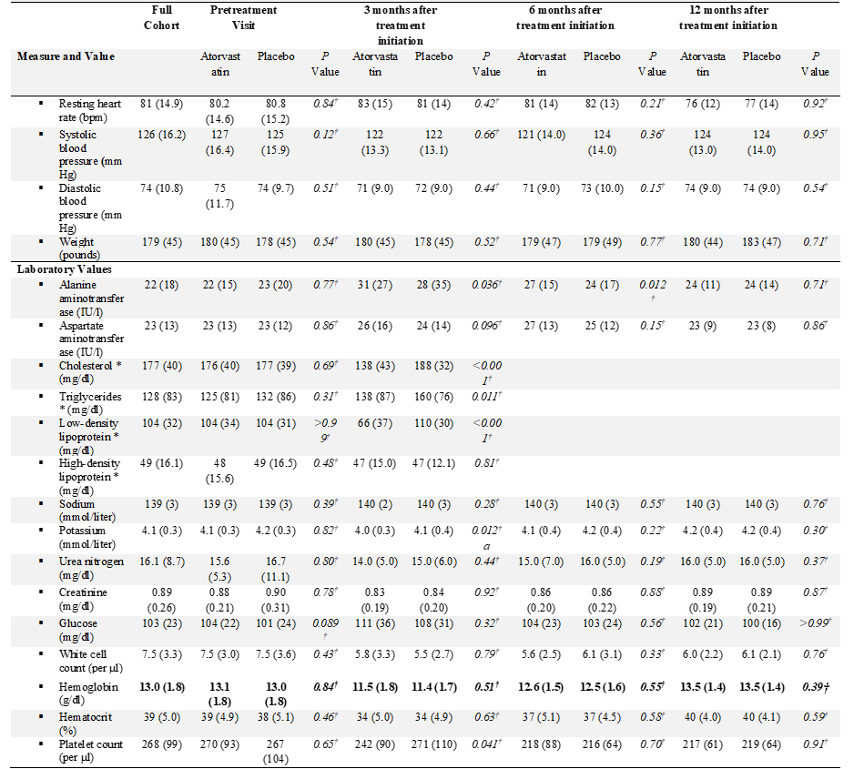
STOP-CA Laboratory Parameters
At pretreatment, there were no differences in the total cholesterol and the low-density lipoprotein between the study groups.
Participants in the atorvastatin group
experienced an expected decline of
~37% in LDL levels.
There were no marked or unexpected changes in other tested laboratory parameters.
‡Fisher’s exact test.

Slide 22
STOP-CA - Strengths
Double-blind, randomized, placebo-controlled trial with enrolling sites in 9 US and Canadian centers, thus representing a highly relevant study population.
Despite the challenges of performing an outpatient cardiac study among cancer patients on active chemotherapy and, in a major part, during a COVID-19 pandemic:
STOP-CA had 100% enrollment.
100% of study participants had a baseline measure of LVEF.
Follow-up was available in 95%.
Study drug adherence was > 90%.
The intervention, atorvastatin, was safe with no effect on heart rate, blood pressure, blood parameters (other than lipid parameters) and no serious study related side effects.

Slide 23
STOP-CA - Limitations
LVEF was applied as surrogate for the development of heart failure as the study was not powered to test an effect of atorvastatin on heart failure. However, the study endpoint was a large change in the LVEF.
Second, although STOP-CA enrolled nearly 50% women, the study did not
enroll a racially or ethnically diverse population.
STOP-CA examined the LVEF to 12 months, and it is unclear if the 12-month beneficial effect would have been noted had the LVEF been checked at a later timepoint.

Slide 24
STOP-CA Summary
In a randomized clinical trial, funded by the National Heart and Lung Blood Institute, among study participants with lymphoma being treated with anthracyclines, the prophylactic use of atorvastatin over 12 months was associated with a lower rate of cardiac systolic dysfunction.
These data support the use of atorvastatin among patients with lymphoma being treated with anthracyclines where prevention of cardiac systolic dysfunction is important.

Slide 25
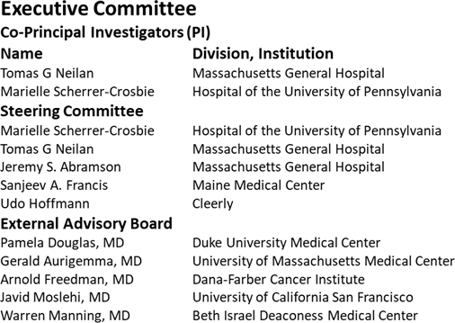
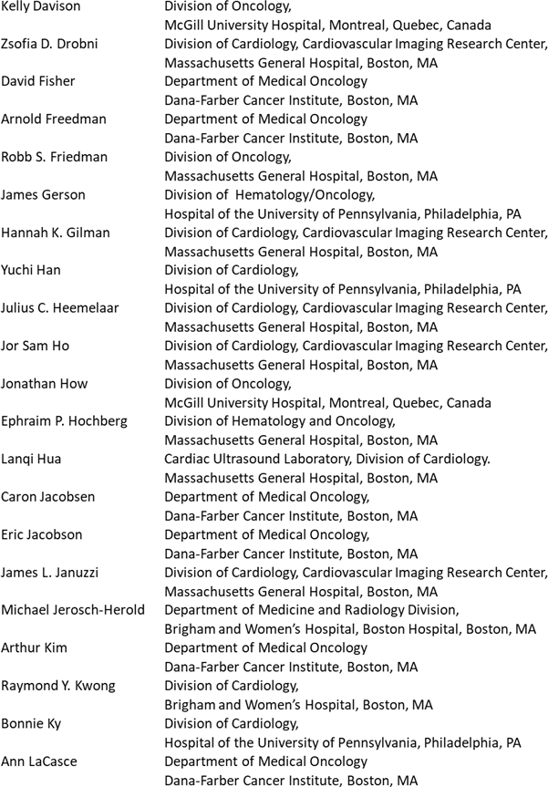
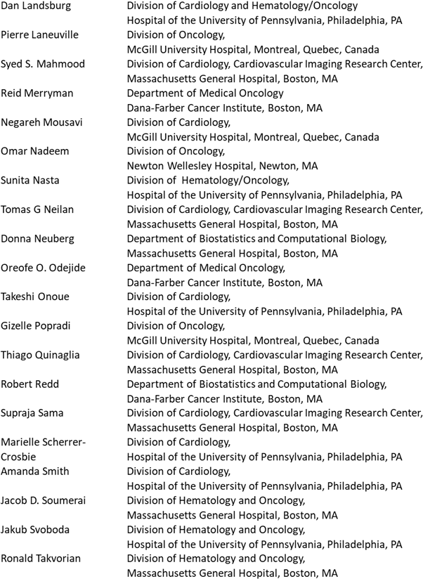
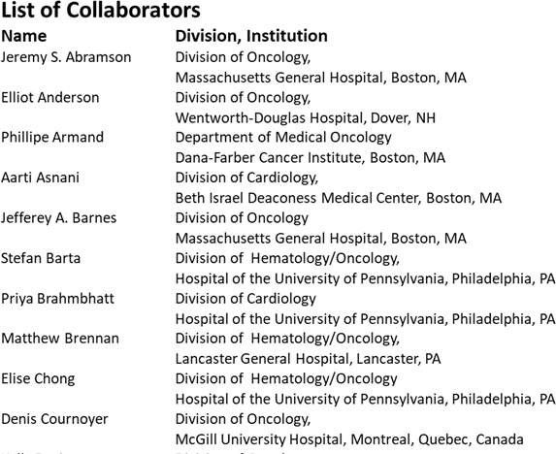
STOP-CA Team

Slide 26
Supplemental Data

Slide 27
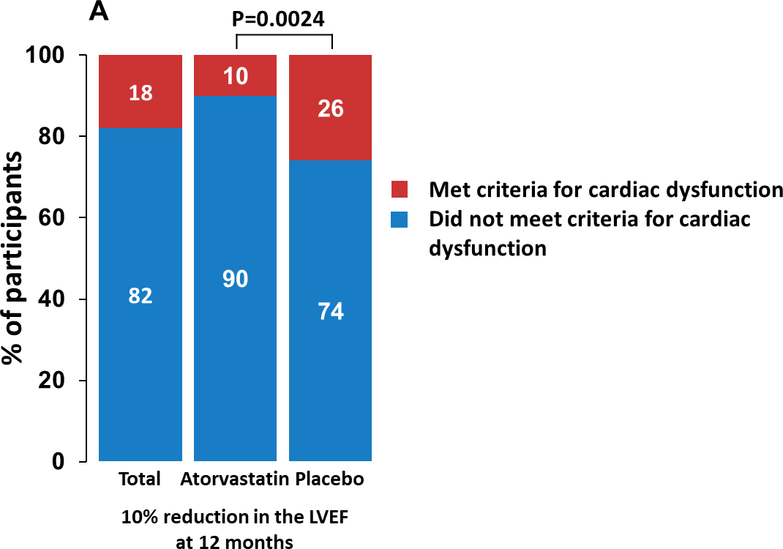
STOP-CA Primary Endpoint Results – MRI only
77% had their follow-up LVEF measured with cardiac MRI.
There was no difference in the proportion in each study group who had their follow-up LVEF measured by cardiac MRI.
In an analysis restricted to those with MRI follow-up, the beneficial effect of atorvastatin on the primary outcome was unchanged.

Slide 28
STOP-CA - Other MRI Parameters
†Wilcoxon rank-sum test, between treatment group comparison.

