Slide 1
Effect of Myocardial Viability, Functional Recovery and PCI on Clinical Outcomes in the REVIVED-BCIS2 Trial
Prof Divaka Perera MD FRCP King’s College London, UK
On behalf of the REVIVED Investigators
@divaka_perera | @REVIVED_BCIS2

Slide 2
Binary Viability Classification
SPECT/PET/DSE
Observational Meta-analysis
Allman, Shaw, Hachamovitch, Udelson. JACC 2002

Slide 3
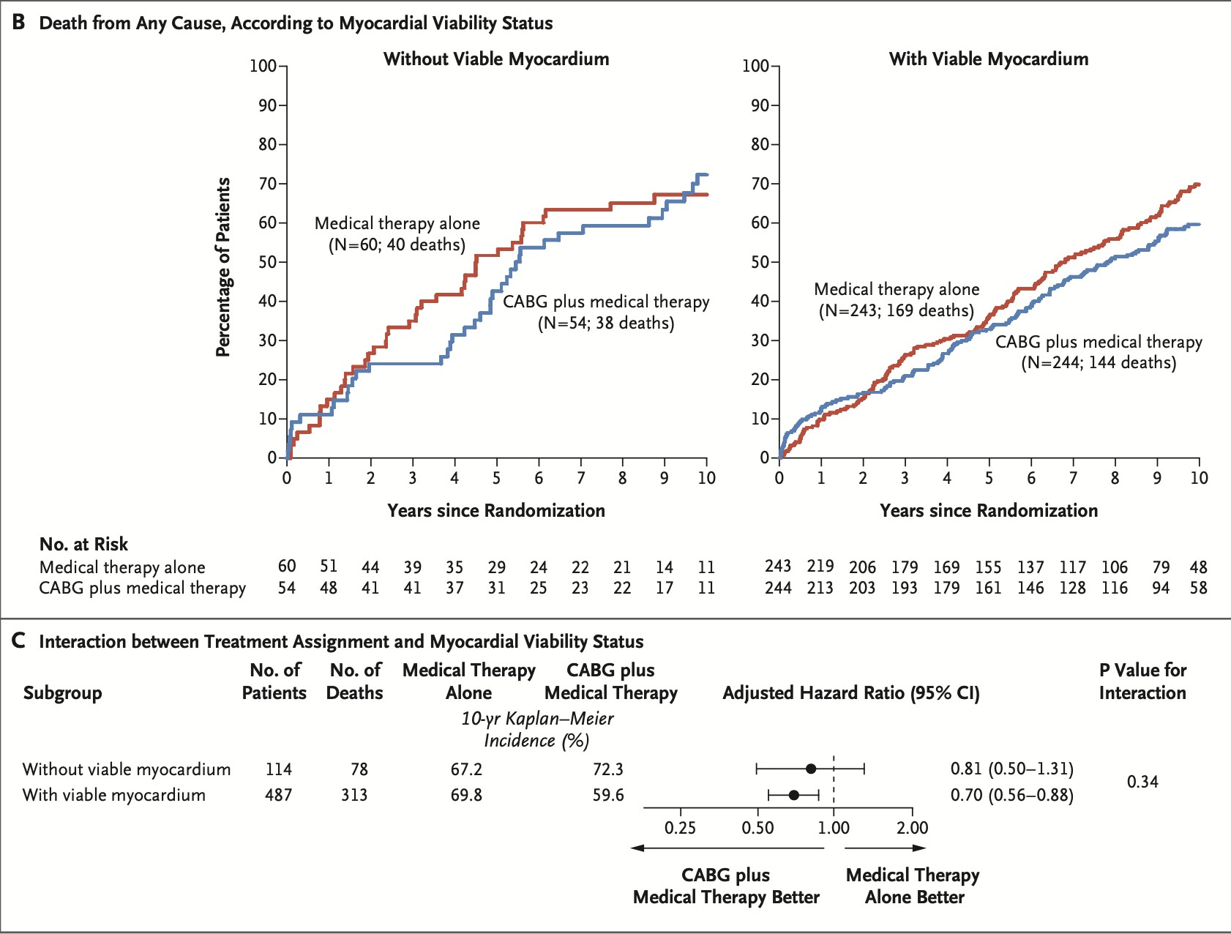
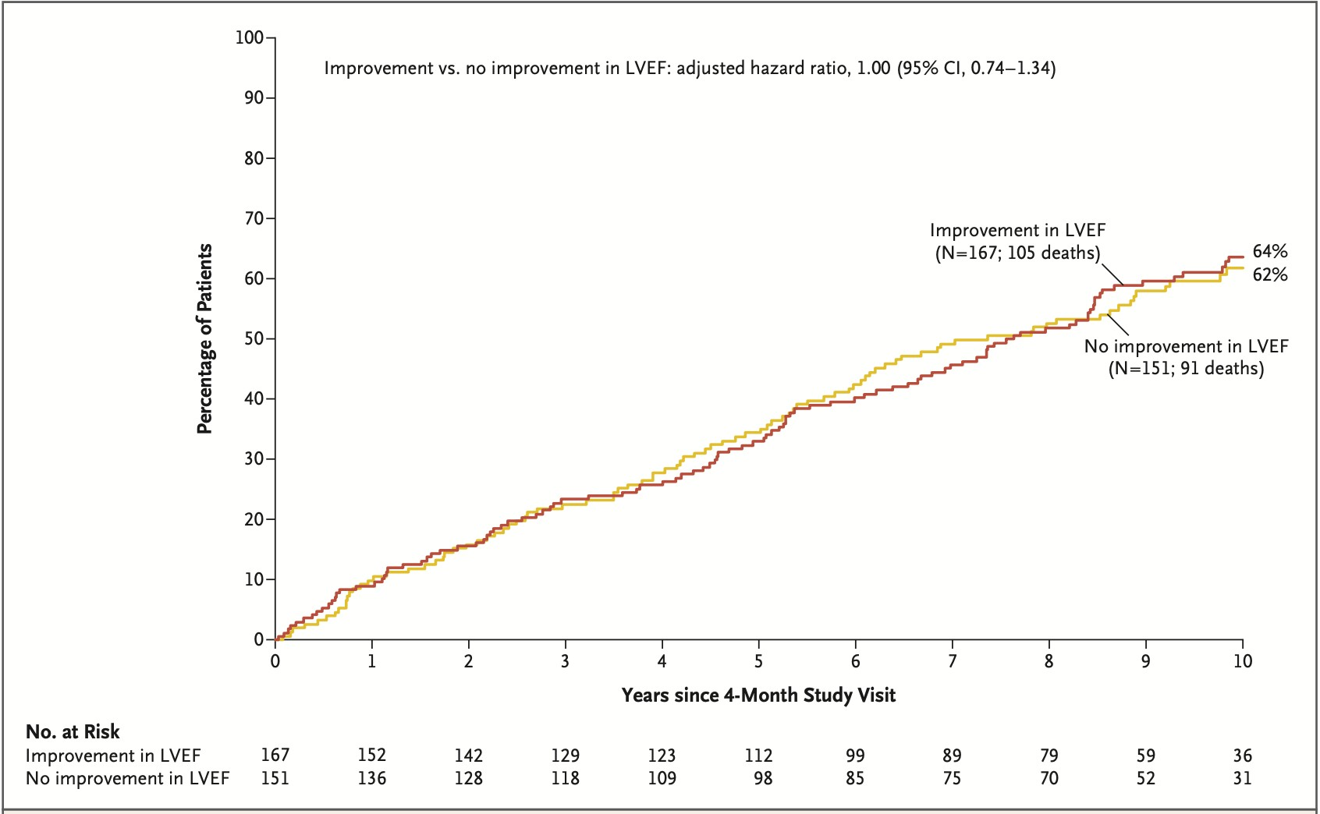
STICH(ES) Viability Study
Binary Viability Classification
SPECT/DSE
Discretionary Testing
Bonow et al NEJM 2011; Panza et al NEJM 2019

Slide 4
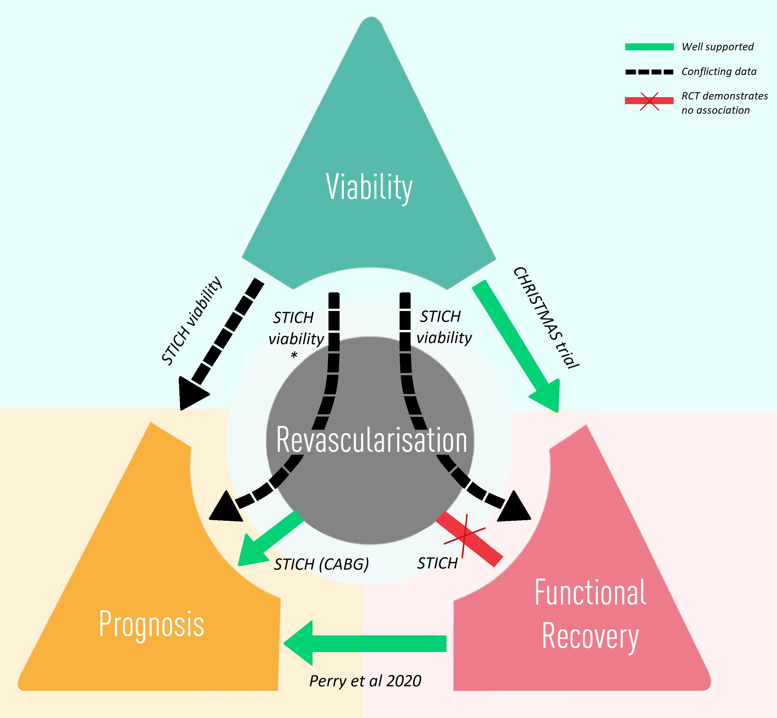
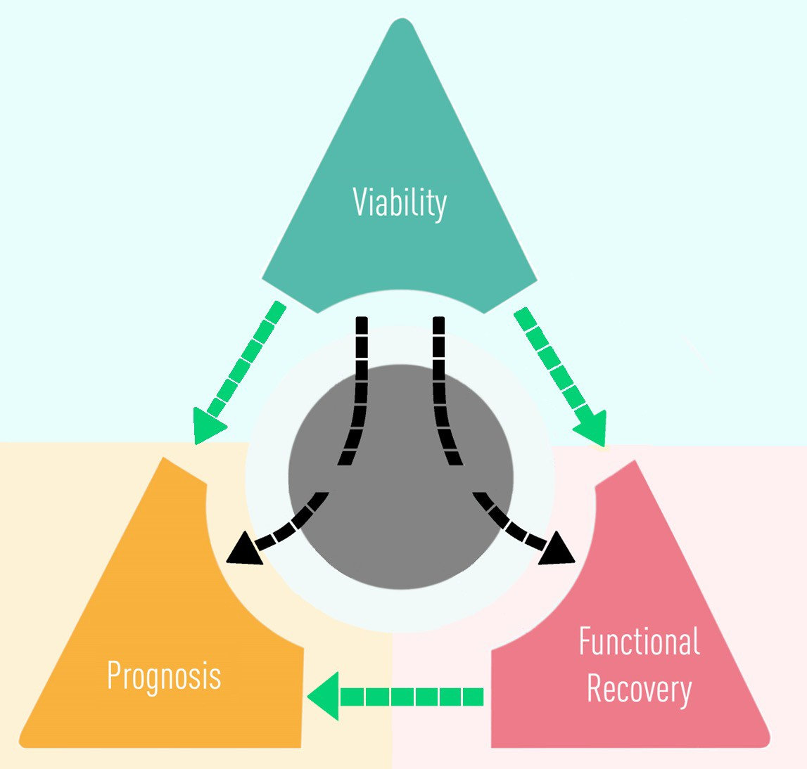
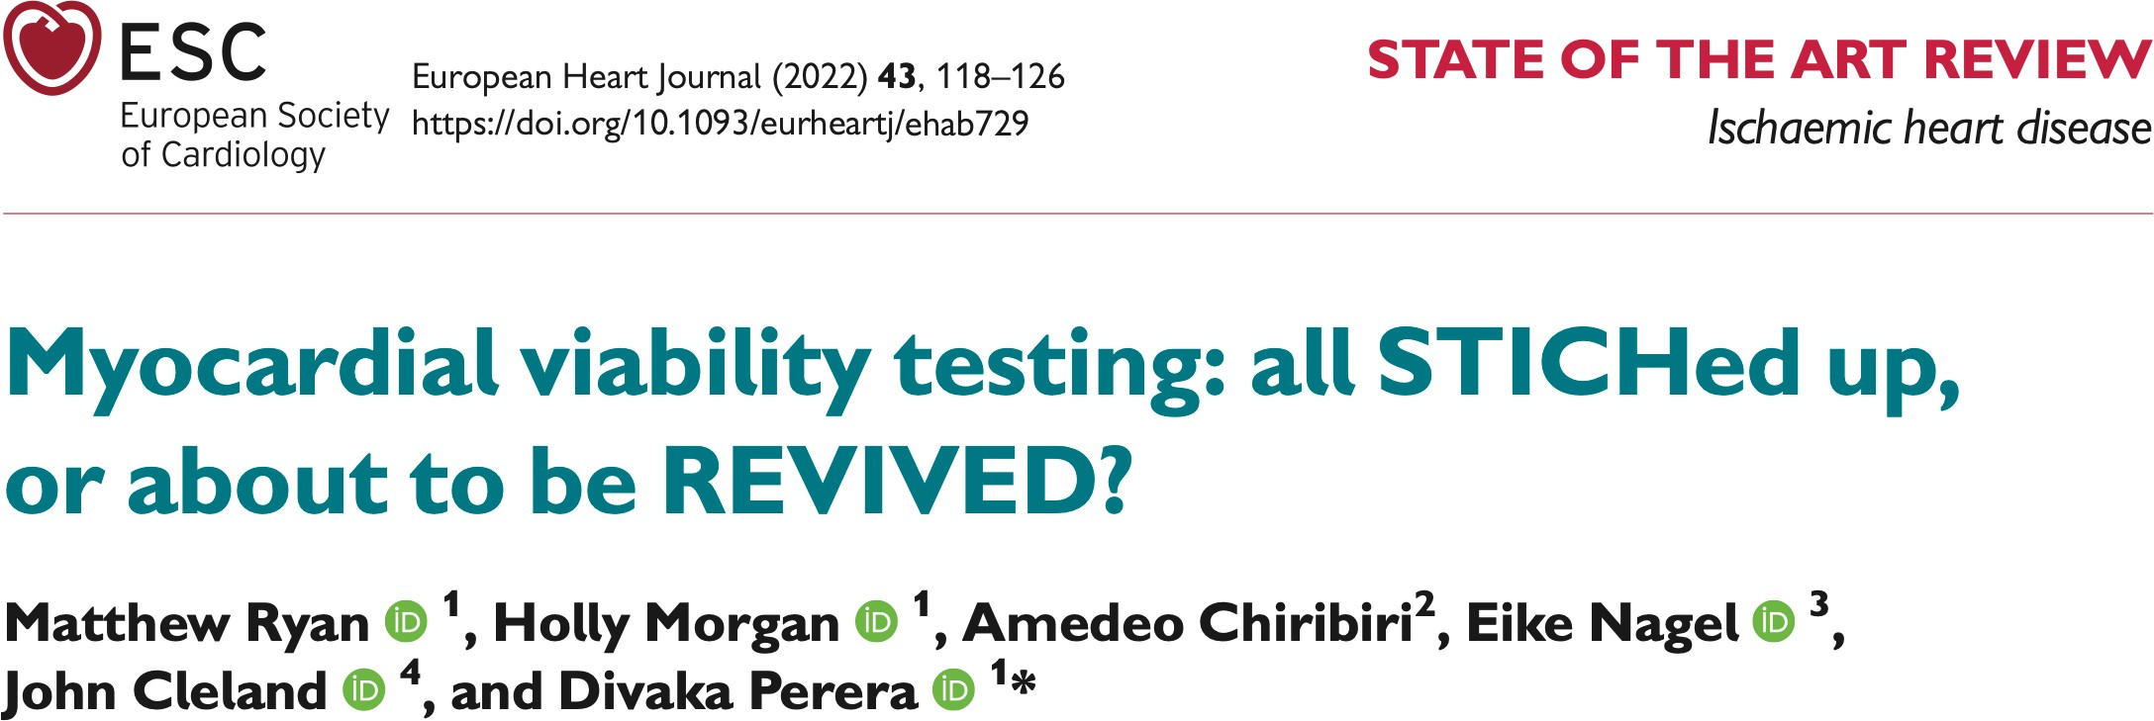
PCI
Death or HHF
Improved LVEF

Slide 5
Hypothesis 1
H1
Viability characterization predicts
event-free survival
PCI
Death or HHF
Improved LVEF

Slide 6
Hypothesis 2
H1
H2
Viability characterization predicts
left ventricular recovery
PCI
Death or HHF
Improved LVEF

Slide 7
Hypothesis 3
H1
H2
Viability characterization predicts response to
PCI vs OMT
PHC3 I
Death or HHF
Improved LVEF

Slide 8
Hypothesis 4
H1
H2
Left ventricular recovery predicts
event-free survival
PHC3 I
Death or HHF
Improved LVEF
H4

Slide 9
Scar
Potential for recovery
Viability characterized by continuous variables
PCI
Death or HHF
Improved LVEF

Slide 10
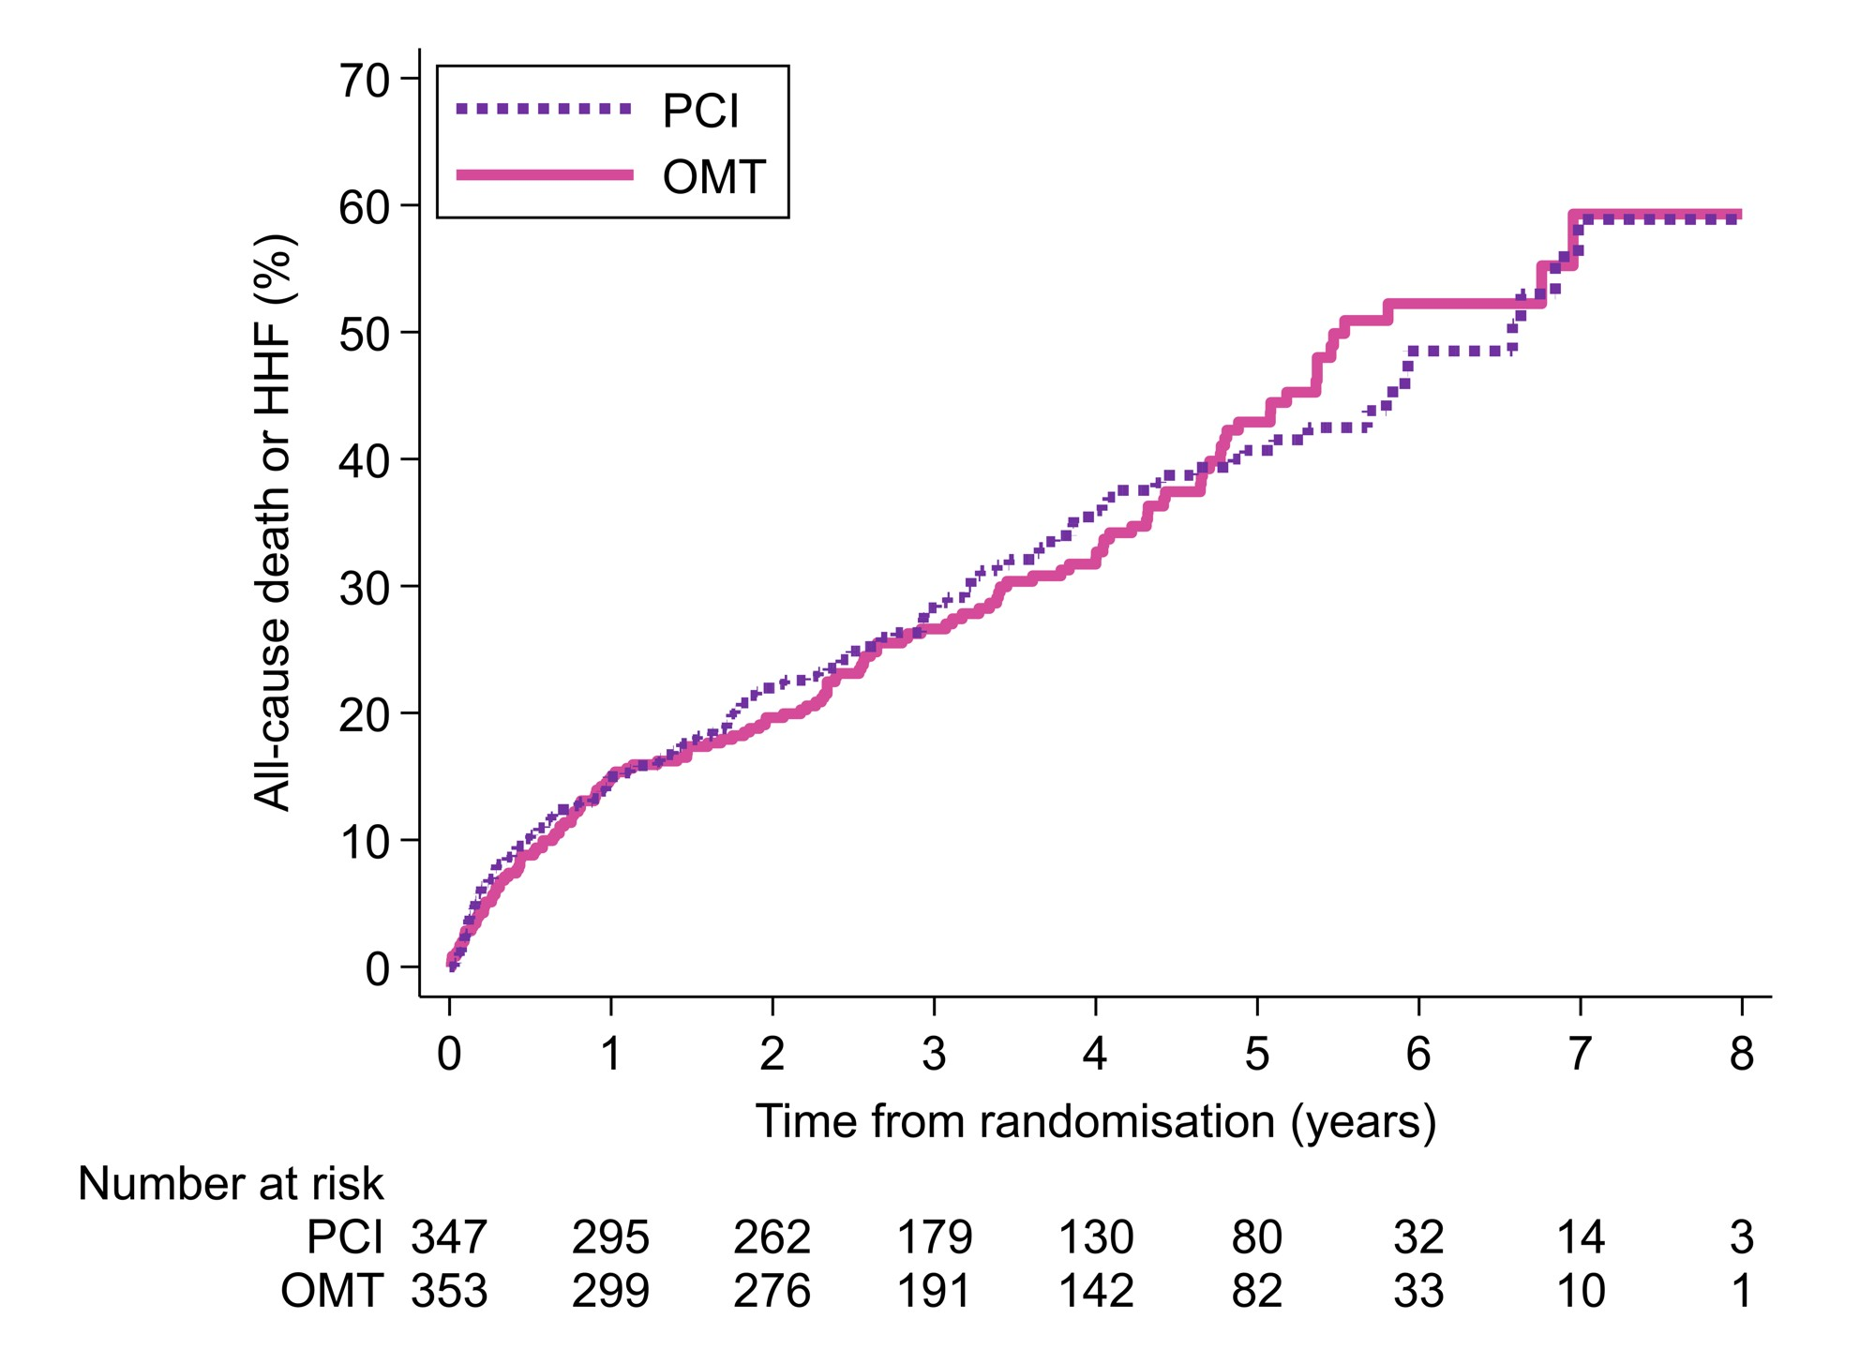
LV Ejection Fraction ≤ 35% Extensive Coronary Disease (BCIS-JS ≥6)
Primary Outcome
All-cause death or hospitalisation for heart failure
Major Secondary Outcome
Left ventricular ejection fraction at 6- and 12-months
Viable Myocardium
on CMR, DSE, SPECT or PET
PCI feasible to lesions subtending ≥4 dysfunctional but viable segments
129 events (37.2%)
134 events (38.0%)
Hazard Ratio 0.99
95% CI 0.78 to 1.27 p=0.96
RANDOMISE
PCI
Optimal Medical Therapy
Echocardiography at 6m, 12m
Clinical, ICD, biochemical follow up at 6m, 12m, 24m+
Perera et al, NEJM 2022: 1351-1360

Slide 11
Viability Characterization
Blinded CMR Core Laboratory
Blinded Stress Echo Core Laboratory
Director:
Prof Amedeo Chiribiri
Director: Prof Roxy Senior

Slide 12
Viability Characterization: Potential for Recovery
610
patients
Wall motion Potential for recovery
Normokinetic
Dysfunctional- Viable
DSE (CR) CMR LGE ≤25%
Dysfunctional yet viable myocardium
(% of LV)
All segments
Dysfunctional
Non-Viable
DSE (no CR) CMR LGE >25%

Slide 13
Viability Characterization: Potential for Recovery
Wall motion Potential for recovery
All Viable Myocardium
Normokinetic
Normal
+
Dysfunctional- Viable
DSE (CR) CMR LGE ≤25%
All segments
Dysfunctional-Viable
Dysfunctional
(% of LV)
Non-Viable
DSE (no CR) CMR LGE >25%

Slide 14
Viability Characterization: Scar Burden
Segmental scar
478
patients
0
1 - 25
Scar Burden
(% of LV)
All segments
26 - 50
51 - 75
76 - 100
14

Slide 15
Statistical considerations
PCI
Death or HHF
Improved LVEF
Outcome measures
All-cause death or hospitalization for heart failure
Change in LV EF at 6 months
Binary (≥ median change)
Cox Proportional Hazards
adjusted for
age sex
diabetes previous HFH
chronic renal failure extent of CAD (BCIS-JS)
modality of viability testing baseline LV ejection fraction

Slide 16
700 underwent randomisation
Randomisation
347 assigned to PCI + OMT
353 assigned to OMT only
Viability testing
CMR n = 246
DSE n = 91
Other n = 14
CMR n = 247
DSE n = 93
Other n = 17
Core labs
6 unavailable
4 insufficient quality
24 unavailable
4 had CMR
4 insufficient quality
4 insufficient quality
16 unavailable
3 had CMR
2 insufficient quality
CMR n = 236
DSE n = 59
CMR n = 243
DSE n = 72
Follow up
Primary
Primary
Primary
Primary
outcome in 98.7%
outcome in 100%
outcome in 99.2%
outcome in 100%

Slide 17
Baseline characteristics
 | PCI n=295 | OMT n=315 | All n=610
Age (yrs) | 69.8 (9.1) | 68.8 (8.9) | 69.3 (9.0)
Female sex | 37 (12.5) | 38 (12.1) | 75 (12.3)
Diabetes | 116 (39.3) | 134 (42.5) | 250 (41.0)
BCIS jeopardy score | 10 [8, 12] | 10 [8, 12] | 10 [8, 12]
Left ventricular ejection fraction (%) | 32.0 (9.9) | 32.0 (9.7) | 32.0 (9.8)
Viability test CMR DSE | 236 (80.0) 59 (20.0) | 243 (77.1) 72 (22.9) | 479 (78.5) 131 (21.5)
Normal segments | 6 [4, 9] | 6 [4, 9] | 6 [4, 9]
Dysfunctional-Viable segments | 5 [3, 9] | 5 [2, 8] | 5 [2, 8]
Non-viable segments | 5 [2, 7] | 5 [2, 7] | 5 [2, 7]
17

Slide 18
Death or HHF by viability characterization
H1
PCI
Death or HHF
Improved LVEF
All-Viable Myocardium HR 0.93 (CI 0.87 to 1.00)*
p=0.048 (adjusted)
Dysfunctional-Viable Myocardium HR 0.98 (CI 0.93 to 1.04)*
p=0.56 (adjusted)
*per 10% increase in volume

Slide 19
Death or HHF by scar burden
H1
PCI
Death or HHF
Improved LVEF
Scar burden
HR 1.18 (CI 1.04 to 1.33)
p=0.009 (adjusted)
per 10% increase in scar volume

Slide 20
Treatment effect by viability characterization
HPC3I
Death or HHF
Improved LVEF
Death or HHF
All viable (% LV)
(tertiles)
p=0.14
Dysfunctional-viable (% LV)
(tertiles)
Low abundance of
dysfunctional-viable segments
≤18% LV
High abundance of
dysfunctional-viable segments
≥42% LV
Medium abundance of
dysfunctional-viable segments
19 to 41% LV
p=0.43
Scar burden (% LV)
(tertiles)
p=0.71
0.1
1
10
PCI better
OMT better

Slide 21
Treatment effect by viability characterization
HPC3I
Death or HHF
Improved LVEF
Low abundance of dysfunctional-viable segments
≤18% LV
Medium abundance of dysfunctional-viable segments
19 to 41% LV
High abundance of dysfunctional-viable segments
≥42% LV
Adjusted hazard ratio 0.98 (0.61 to 1.59)
Adjusted hazard ratio 0.83 (0.54 to 1.28)
Adjusted hazard ratio 1.28 (0.79 to 2.10)
p for interaction = 0.43

Slide 22
Left ventricular recovery by viability characterization
H2
PCI
Death or HHF
Improved LVEF
All Viable (% LV)
1.22 [1.08 to 1.37]
Dysfunctional-Viable (% LV)
1.01 [0.93 to 1.11]
Scar burden (% LV)
0.69 [0.56 to 0.84]
0.33
1.00
Odds Ratio (log scale)
3.00
Binary LV recovery: ≥ median change (4.7% EF)

Slide 23
Treatment effect by viability characterization
HPC3I
LV Recovery at 6 months (≥ EF 4.7%)
Death or HHF
Improved LVEF
All viable (% LV)
(tertiles)
p=0.35
Dysfunctional-viable (% LV)
(tertiles)
p=0.84
Scar burden (% LV)
(tertiles)
p=0.54
0.1
1
10
PCI better
OMT better

Slide 24
Death or HHF by LV recovery
PCI
Death or HHF
H4
Improved LVEF
HR 0.62 (0.41 to 0.95)
p=0.029 (adjusted)
Graph only includes patients with paired baseline and 6-month corelab-analyzed echocardiograms (without imputation)

Slide 25
Conclusions
PCI does not improve prognosis or LV recovery in ischemic cardiomyopathy, compared to OMT alone, regardless of viability characteristics at baseline
Scar burden predicts prognosis and likelihood of LV recovery in ischemic cardiomyopathy independent of baseline LVEF or extent of CAD
PCI
The abundance of dysfunctional-yet-viable segments was not associated with
prognosis or likelihood of LV recovery
Death or HHF
Improved LVEF
@divaka_perera | @REVIVED_BCIS2

Slide 26
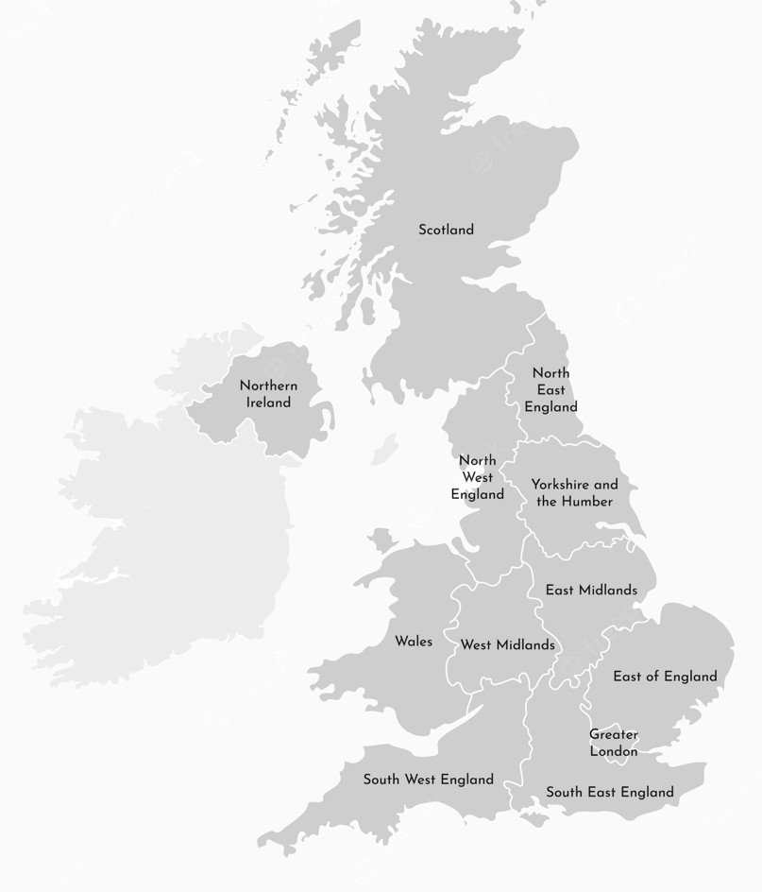
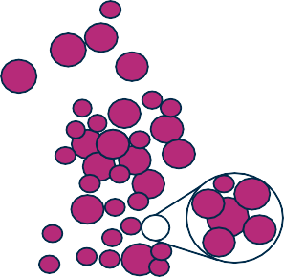
CORE LABS
CMR DSE
Echo
Funder
National Institute for Health Research
Trial Steering Committee
Sponsor
King’s College London
2
10
83
Data Safety Monitoring Committee
LSHTM Clinical Trials Unit,
Chief Investigator, Statisticians
32
26
3
2
54
6 ₁
16
9
2
10 1¹2
1
2
₁₅ 18
2
10
5
8
13
13
6
63
18 2
124
8
1
3
³ 9 56 ²
25
17
5
5
Clinical Events Committee
Recruiting Centers
@divaka_perera | @REVIVED_BCIS2

