Slide 1




A Randomized Trial Evaluating Clinically Significant Bleeding with Low-Dose Rivaroxaban vs Aspirin, in Addition to P2Y12 inhibition, in ACS
Magnus Ohman MB, on behalf of the GEMINI-ACS-1 Investigators

Slide 2
Committees and Disclosures
Academic Executive Committee
E. Magnus Ohman, MB—Co-chair
C. Michael Gibson, MS, MD—Co-chair
Matthew T. Roe, MD, MHS
P. Gabriel Steg, MD
Stefan James, MD
Christoph Bode, MD
Robert Welsh, MD
Steering Committee
21 representatives from the
participating countries
Data Monitoring Board: Stanford
Robert A. Harrington, MD—Chair
Bernard Gersh, MD
David Faxon, MD
Christian Hamm, MD
David Moliterno, MD
Douglas Weaver, MD
Janet Wittes, PhD
Conflict of Interest Disclosure
Disclosures for Dr Ohman listed on www.dcri.org and for all authors within the manuscript

Slide 3
Trial Conduct
Academic Coordinating Centers: Duke Clinical Research Institute and Perfuse Study Group, Beth Israel Deaconess, Harvard Medical School
  Independently performed statistical analysis (Frank Rockhold, PhD and Jennifer
White, MS)
  Event adjudication (Dr Thomas J. Povsic, DCRI—Chair)
Sponsors: Janssen Research & Development (Dr Alexei Plotnikov) and Bayer
AG (Dr Hardi Mundi)
  Global trial management
Protocol adherence
  Total of 1 patient lost to follow-up (0.03% of overall)
  Median study follow-up: 326 days (25th, 75th%: 284, 383 days)

Slide 4
Background
Aspirin and dual antiplatelet therapy (aspirin + a P2Y12 inhibitor [DAPT]) have become foundational therapy in ACS, while nearly 10% of patients still suffer a major cardiovascular event during follow-up
Triple antithrombotic therapy with DAPT + rivaroxaban, a Xa inhibitor, has been shown to reduce cardiovascular events, but with a significantly higher rate of major bleeding complications
In-vivo thrombosis and bleeding studies have suggested that rivaroxaban with a P2Y12 inhibitor had similar efficacy to DAPT, but with lower risk of bleeding
These findings, in concert with studies in post-PCI patients with atrial fibrillation (where aspirin was dropped), suggest that dual-pathway therapy with Rivaroxaban and a P2Y12 agent may be a way to enhance overall outcomes in ACS

Slide 5
Inclusion Criteria
Randomization within 10 days of an ACS event
  STEMI and Non-STEMI patients required positive biomarkers (troponin or CK-MB) with either ECG changes or thrombotic culprit lesion at cath
  Unstable angina patients required at least ECG changes, TIMI risk score >4, or revascularization for ACS
Patient age >18 years
Patients age <55 years required 1 of 2 enrichment criteria
  History of diabetes
  Prior MI

Slide 6
Exclusion Criteria
History of active bleeding, intracranial bleeding, or significant GI bleeding with
12 months
Estimated creatinine clearance <20 mL/min
Use of omeprazole
– In clopidogrel strata only
Need for chronic full-dose anticoagulation
All patients were tested for P2Y12 metabolite status and results were provided to caring physician within 2 weeks of randomization to allow poor clopidogrel metabolizer patients to be switched

Slide 7
Statistical Considerations
Designed as a phase 2 trial to estimate TIMI non-CABG clinically significant bleeding risk of rivaroxaban compared with aspirin with either clopidogrel or ticagrelor
Sample size of approximately 3,000 patients
  Based on estimated bleeding rate of 6.5% at 360 days
  An estimated upper bound of 95% CI of 2.0 = 170 events
Intention-to-treat to first event using Cox proportional hazards model
Exploratory analysis of other bleeding definitions
Exploratory analysis of composite ischemic endpoint of CV death, MI, stroke, or
definitive stent thrombosis

Slide 8
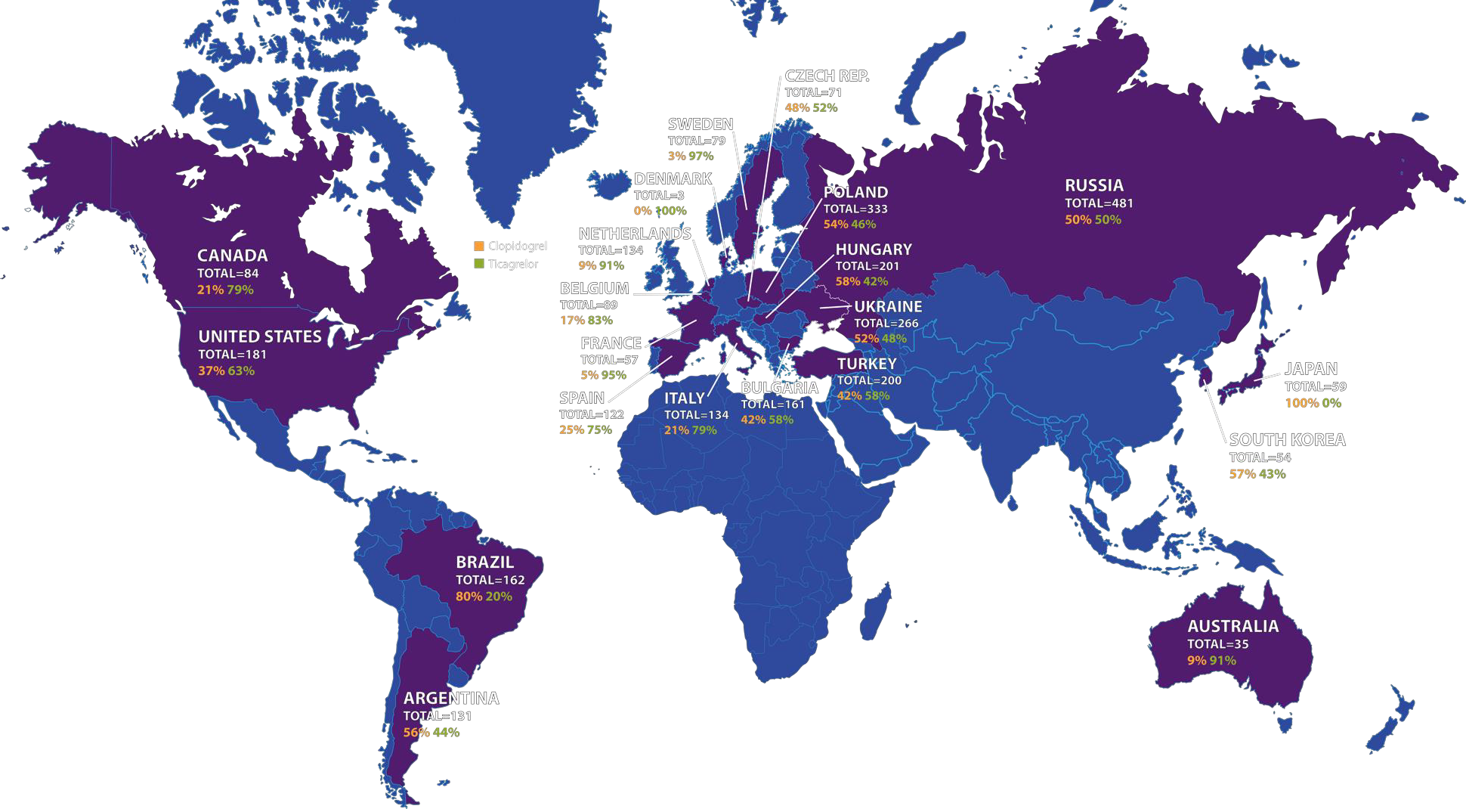
Enrollment
3037 patients from 371 sites in 21 countries between April 2015 and October 2016
Ticagrelor=1704; Clopidogrel=1333

Slide 9












Recent ACS
Stabilized, randomized between 24 hours – 10 days post-event
Exclusions: Bleeding risk, anticoagulant use, prior stroke/TIA
ASA 100 mg qd
Screening Phase
> 24 hrs
< 10 days
Stratify by MD decision to use either Clopidogrel or Ticagrelor
Clopidogrel 75 mg qd (n=1500)
Ticagrelor 90 mg bid (n=1500)
R
R
Clopidogrel
75 mg qd
+ ASA
100 mg qd
Clopidogrel
75 mg qd
+
Rivaroxaban
2.5 mg bid
Ticagrelor
90 mg bid
+ ASA
100 mg qd
Ticagrelor
90 mg bid
+
Rivaroxaban
2.5 mg bid
Minimum 180 days Maximum 360 days
PRIMARY SAFETY ENDPOINT: TIMI non-CABG clinically significant bleeding EXPLORATORY EFFICACY ENDPOINT: Composite of CV death, MI, ischemic stroke, or stent thrombosis

Slide 10
Protocol Outline
3037 patients; Ticagrelor 1704 patients and Clopidogrel 1333 patients
Adherence to P2Y12 therapy 95% during study period, 6.5% switched P2Y12 therapy
At least 48 hours^
Up to 10 days
Rivaroxaban 2.5mg bid
with Clopidogrel 75mg or
Ticagrelor 90mg bid
ACS Event
R
STEMI* Non-STEMI UA
ASA+Clopidgrel or ASA+Ticagrelor
ASA 100mg
with Clopidogrel 75mg or
Ticagrelor 90mg bid
5.5 days (3.4,7.6)
*capped at 50%
^24 hours if no PCI
291 days (284,354)

Slide 11
Baseline Characteristics: Aspirin vs
R
ivaroxaban | Aspirin (N=1518) | Rivaroxaban (N=1519) | Total (N=3037)
Age, median (25th, 75th), yrs | 63.0 (57.0, 69.0) | 62.0 (57.0, 69.0) | 62.0 (57.0, 69.0)
Male sex, no. (%) | 1141 (75%) | 1134 (75%) | 2275 (75%)
White race, no. (%) | 1407 (93%) | 1417 (93%) | 2824 (93%)
Presentation characteristics
Disease classification, no. (%)
STEMI | 741 (49%) | 743 (49%) | 1484 (49%)
NSTEMI | 612 (40%) | 611 (40%) | 1223 (40%)
Unstable Angina | 165 (11%) | 165 (11%) | 330 (11%)
Time from hospitalization to randomization, median (25th, 75th), days | 5.1 (3.0, 7.3) | 5.1 (3.1, 7.2) | 5.1 (3.1, 7.2)
Cardiovascular disease history
Prior MI | 345 (23%) | 314 (21%) | 659 (22%)
Prior PCI | 315 (21%) | 286 (19%) | 601 (20%)
Prior CABG | 68 (4%) | 58 (4%) | 126 (4%)
Prior PAD | 74 (5%) | 66 (4%) | 140 (5%)
Prior heart failure | 153 (10%) | 157 (10%) | 310 (10%)

Slide 12
Baseline Characteristics: Aspirin vs
R
ivaroxaban | Aspirin (N=1518) | Rivaroxaban (N=1519) | Total (N=3037)
Baseline risk assessment, median (25th, 75th)
GRACE risk score | 97.0 (83.0, 112.0) | 96.0 (83.0, 112.0) | 96.0 (83.0, 112.0)
Hemoglobin, g/dL | 14.1 (13.1, 15.1) | 14.2 (13.2, 15.1) | 14.1 (13.1, 15.1)
Creatinine clearance, mL/min | 87.0 (70.2, 106.2) | 87.0 (69.0, 106.8) | 87.0 (69.6, 106.8)
Geographic region, no. (%)
North America | 135 (9%) | 130 (9%) | 265 (9%)
South America | 150 (10%) | 143 (9%) | 293 (10%)
Western Europe | 292 (19%) | 326 (21%) | 618 (20%)
Eastern Europe | 373 (25%) | 374 (25%) | 747 (25%)
Central Europe | 488 (32%) | 478 (31%) | 966 (32%)
Asia & Pacific | 80 (5%) | 68 (4%) | 148 (5%)

Slide 13
Baseline Characteristics: Aspirin vs
R
ivaroxaban | Aspirin (N=1518) | Rivaroxaban (N=1519) | Total (N=3037)
Cardiac procedures for index event
Catheterization performed | 1430 (94%) | 1425 (94%) | 2855 (94%)
PCI performed | 1320 (87%) | 1325 (87%) | 2645 (87%)
Stent placed | 1286 (84.7%) | 1295 (85.3%) | 2581 (85.0%)
DES | 870 (68.0%) | 859 (66.5%) | 1729 (67.3%)
BMS | 423 (33.1%) | 438 (33.9%) | 861 (33.5%)
Bioabsorbable stent | 8 (0.6%) | 16 (1.2%) | 24 (0.9%)
CABG performed | 4 (<0.5%) | 5 (<0.5%) | 9 (<0.5%)
Concomitant medication at randomization, no. (%)
Beta-blocker | 984 (65%) | 970 (64%) | 1954 (64%)
ACE inhibitors/ARB | 960 (63%) | 947 (62%) | 1907 (63%)
Statins | 1065 (70%) | 1038 (68%) | 2103 (69%)

Slide 14
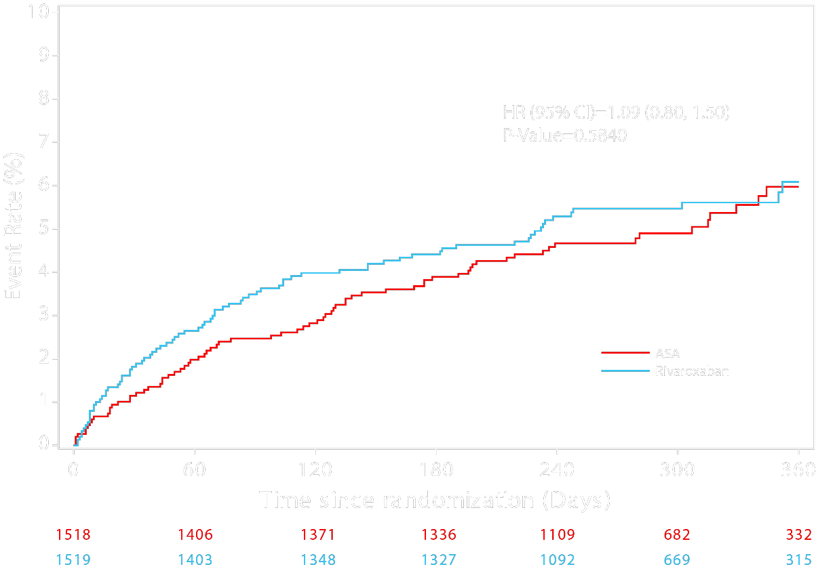
TIMI Non-CABG Clinically Significant Bleeding

Slide 15
Bleeding Endpoints
 | Aspirin (N=1518) | Rivaroxaban (N=1519) | HR (95% CI) | P Value
TIMI Bleeding Categories
TIMI non-CABG clinically significant bleeding | 74 (4.9%) | 80 (5.3%) | 1.09 (0.80–1.50) | 0.5840
TIMI major bleeding† | 8 (0.5%) | 10 (0.7%) | 1.25 (0.49–3.17) | 0.6341
TIMI minor bleeding | 4 (0.3%) | 9 (0.6%) | 2.25 (0.69–7.29) | 0.1664
GUSTO Bleeding Categories
GUSTO life threatening or severe bleeding | 2 (0.1%) | 3 (0.2%) | 1.50 (0.25–8.95) | 0.6571
GUSTO life threatening, severe, or moderate bleeding | 7 (0.5%) | 11 (0.7%) | 1.58 (0.61–4.08) | 0.3395
ISTH Bleeding Categories
ISTH major bleeding | 17 (1.1%) | 31 (2.0%) | 1.83 (1.01–3.31) | 0.0420
BARC Bleeding Categories
BARC 3a and higher bleeding | 13 (0.9%) | 22 (1.4%) | 1.70 (0.85–3.37) | 0.1263
Data presented as no. (%), unless otherwise indicated.
All bleeding events are non-CABG related with the exception of TIMI major. This category includes both non-CABG and CABG related TIMI major bleeding.
†TIMI major bleeding is the only endpoint that includes CABG related bleeding.
BARC indicates Bleeding Academic Research Consortium; CI, confidence interval; GUSTO, Global Use of Strategies to Open Occluded Coronary Arteries; HR, hazard ratio; ISTH, International Society on Thrombosis and Haemostasis; TIMI, Thrombolysis in Myocardial Infarction.

Slide 16
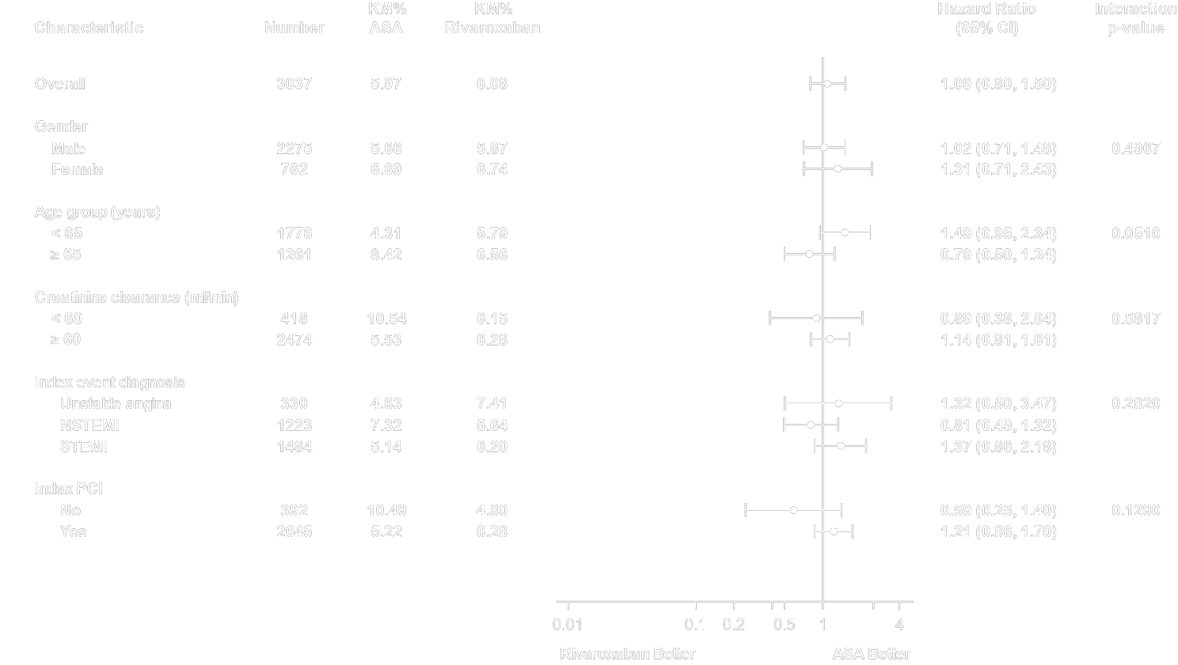
TIMI Non-CABG Clinically Significant Bleeding Subgroups

Slide 17
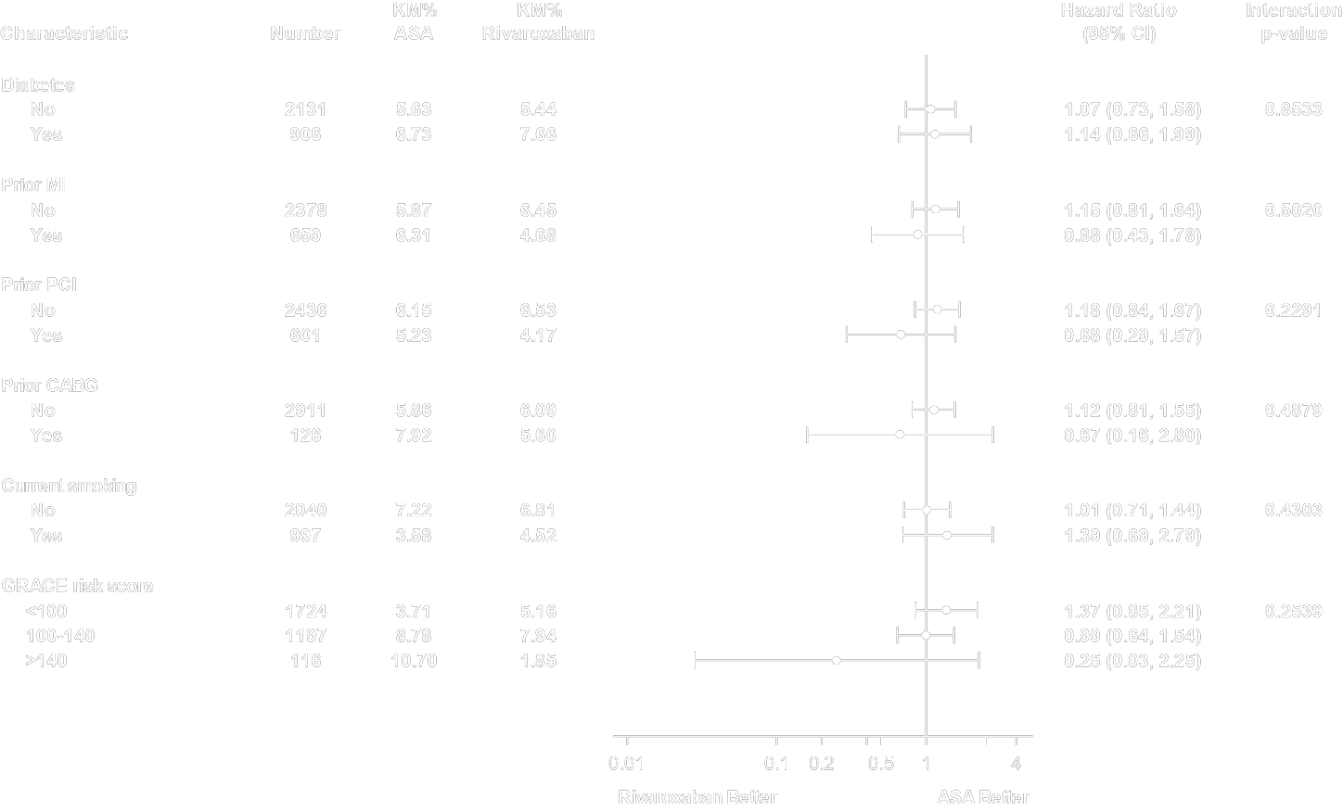
TIMI Non-CABG Clinically Significant Bleeding Subgroups

Slide 18
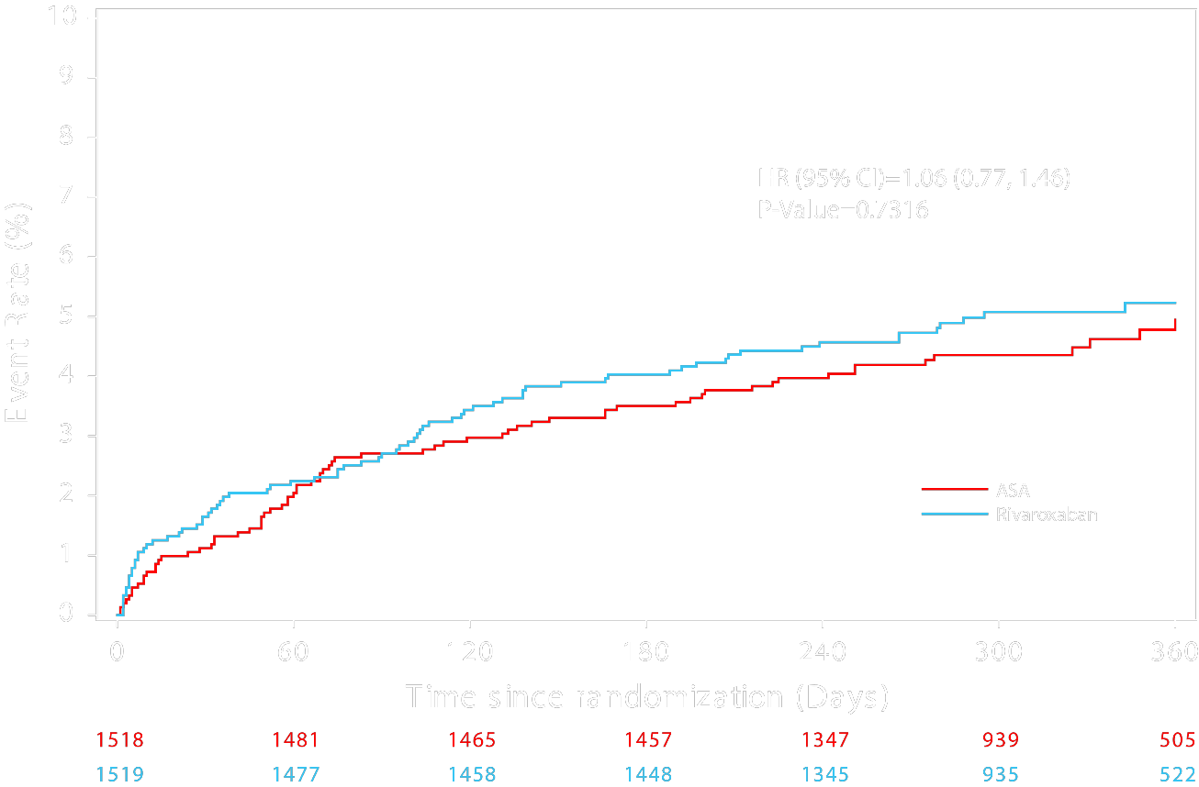
Ischemic Composite Endpoint
CV death,
MI, stroke, or definite stent thrombosis

Slide 19
Ischemic Composite Endpoints
 | Aspirin (N=1518) | Rivaroxaban (N=1519) | HR (95% CI) | P Value
CV death, MI, stroke, or definite stent thrombosis | 72 (4.7%) | 76 (5.0%) | 1.06 (0.77–1.46) | 0.7316
All-cause death | 23 (1.5%) | 22 (1.4%) | 0.95 (0.53–1.71) | 0.8771
CV death | 17 (1.1%) | 19 (1.3%) | 1.12 (0.58–2.15) | 0.7401
MI | 49 (3.2%) | 56 (3.7%) | 1.15 (0.78–1.68) | 0.4872
Stroke | 12 (0.8%) | 7 (0.5%) | 0.58 (0.23–1.48) | 0.2506
All stent thrombosis | 16 (1.1%) | 17 (1.1%) | 1.06 (0.54–2.11) | 0.8583
Definite stent thrombosis | 8 (0.5%) | 11 (0.7%) | 1.37 (0.55–3.42) | 0.4917
Data presented as no. (%), unless otherwise indicated.
CI indicates confidence interval; CV, cardiovascular; HR, hazard ratio; MI, myocardial infarction.

Slide 20
Clopidogrel and Ticagrelor Strata
Baseline characteristics varied significantly with the choice of P2Y12 inhibitor
  More Non-STEMI, more cath, PCI, and use in Europe and North America for patients treated with ticagrelor
The choice of P2Y12 inhibitor was analyzed as a subgroup
  No significant treatment interaction and P2Y12 inhibitor use for primary bleeding endpoint (p=0.5889) or ischemic endpoints (p=0.3889)
A limited post-hoc multivariate model for the primary bleeding endpoint noted a higher association with bleeding and ticagrelor use (p=0.0006), but was also associated with region (p=0.02)

Slide 21
Limitations
This is a phase-2 trial and therefore the results are hypotheses generating
The patients randomized were on stable DAPT at the time of randomization on average 5 days after their ACS event
The study population is relative homogenous and treated with high rates of
cardiac catheterization and PCI
Prasugrel was not studied in the trial as this P2Y12 inhibitor is not approved across the full spectrum of ACS

Slide 22
Conclusion
In this phase-2 trial we observed similar risk of TIMI non-CABG clinically significant bleeding with the combination of rivaroxaban and a P2Y12 inhibitor compared with DAPT
The ischemic composite outcomes were also similar, but the trial was not
powered for assessing this endpoint
There was no treatment interaction between the choice of P2Y12 inhibitor and randomized treatment of rivaroxaban or ASA on either the primary bleeding or the exploratory ischemic endpoint
Defining the best intensity of antithrombotic therapy while patients transition
from the acute thrombotic setting to chronic prevention deserves more research

