Slide 1
A Randomized Trial of Sirolimus-coated Versus Paclitaxel-coated Balloons in
De Novo Coronary Lesions
Wan Azman Wan Ahmad¹,
Amin Ariff Nuruddin², Muhamad Ali SK Abdul Kader³, Tiong Kiam Ong⁴, Houng Bang Liew⁵, Rosli Mohd Ali⁶, Ahmad Syadi Mahmood Zuhdi¹, Muhammad Dzafir Ismail¹, Ahmad K M Yusof², Carsten Schwenke⁷, Maren Kutschera⁸, Bruno Scheller⁹, MD
¹Department of Medicine, University Malaya Medical Center, Kuala Lumpur, Malaysia. ²Cardiology Department, National Heart Institute Malaysia, Kuala Lumpur, Malaysia. ³Cardiology Department, Hospital Pulau Pinang, George Town, Malaysia. ⁴Cardiology Department, Sarawak Heart Centre, Kota Samarahan, Malaysia. ⁵Cardiology Department and Clinical Research Center, Queen Elizabeth Hospital II, Kota Kinabalu, Malaysia. ⁶Cardiac Vascular Sentral Kuala Lumpur, Kuala Lumpur, Malaysia. ⁷SCO:SSiS, Berlin, Germany. ⁸Experimental Radiology, Charité Universitätsmedizin, Berlin, Germany. ⁹Clinical and Experimental Interventional Cardiology, University of Saarland, Germany.

Slide 2
Disclosure Statement of Financial Interest
I, Wan Azman Wan Ahmad DO NOT have a financial interest/arrangement or affiliation with one or more organizations that could be perceived as a real or apparent conflict of interest in the context of the subject of this presentation.
Faculty disclosure information can be found on the app
Faculty disclosure information can be found on the app

Slide 3
Background
ESC guidelines: IA recommendation for paclitaxel coated balloons (PCB) in the treatment of coronary in-stent restenosis (ISR)
Increasing clinical evidence for PCB in coronary de-novo lesions
Role of alternative drugs such as sirolimus unclear
FIM trial in patients with with ISR comparing a novel SCB (SeQuent SCB, 4 μg/mm²) with a PCB (SeQuent Please Neo, 3 μg/mm²) showed similar angiographic outcomes at 6 months
A Randomized Trial of Sirolimus-coated Versus Paclitaxel-coated Balloons in De Novo Coronary Lesions
Notes:
Paclitaxel coated balloons are standard of care for the therapy of coronary in-stent restenosis. With comparable clinical results, they do not require the implantation of an additional metal layer and may lead to better long-term results.
There is increasing clinical evidence for the treatment of coronary de-novo disease with drug coated balloons (DCB). However, it is unclear whether paclitaxel remains the drug of choice or whether sirolimus represents an alternative in analogy to drug eluting stents.
Drug eluting stents (DES) dominate catheter-based coronary intervention (PCI) ¹. In recent years, sirolimus and its analogues established as the drug of choice for stent-based local drug delivery. In contrast, clinical evidence from randomized trials (RCT) for drug coated balloons (DCB), except for a single study ², exists only for paclitaxel-coated balloons (PCB).

Slide 4
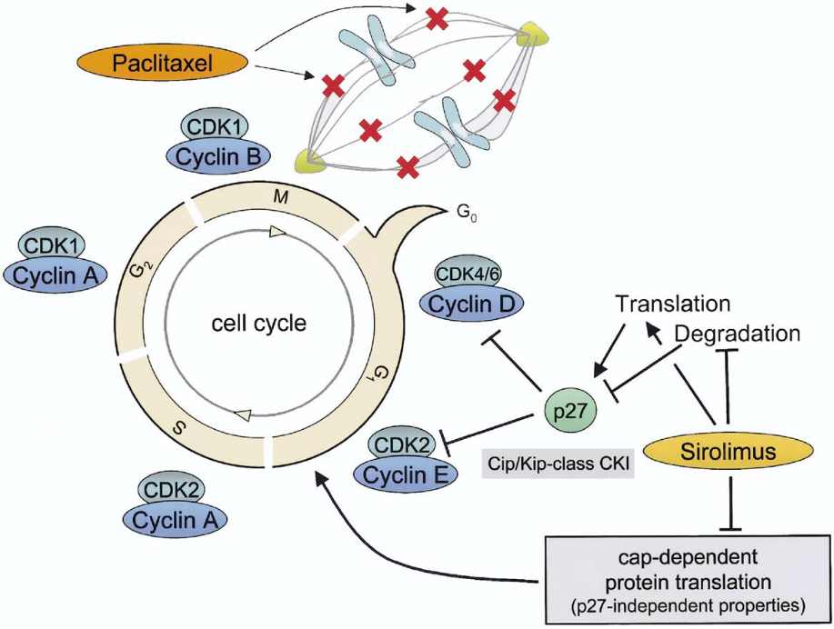
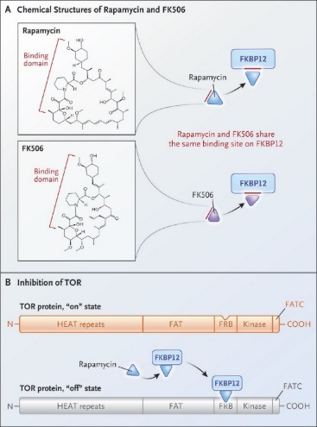
Sirolimus vs Paclitaxel
Blockade of cell-cycle progression during mitosis by binding to and stabilizing microtubules
Snyder, PNAS 2001; 98: 5312-6
N Engl J Med 2017; 377:1297-1299
Wessely, J Am Coll Cardiol 2006; 47: 708-14
Notes:
Paclitaxel binds irreversibly to the microtubes ³, resulting in excellent persistence in vascular cells ^{4,5} and has beneficial cell-specific effects ⁶. In contrast, sirolimus and its analogues bind only reversibly to FKBP 12 and form a complex with the Mammalian Target of Rapamycin (mTOR), blocking cell cycle progression at the interface of G1 and S phases ⁷. Therefore, according to previous theory, sirolimus must be released in a controlled manner over a longer period of time for effective inhibition of neointimal proliferation ⁸.

Slide 5
Table 1. Sirolimus Coatings Studied in the Different Experiments
Circ Cardiovasc Interv. 2016;9:e003543. DOI: 10.1161/CIRCINTERVENTIONS.115.003543
Notes:
In contrast, the crystalline sirolimus coating with BHT (butylated hydroxy toluene) as excipient investigated in the present clinical study was associated with persistent vessel concentrations of up to 50% of the initial concentration at one month ¹².

Slide 6
Circ Cardiovasc Interv. 2016;9:e003543. DOI: 10.1161/CIRCINTERVENTIONS.115.003543
Notes:
In contrast, the crystalline sirolimus coating with BHT (butylated hydroxy toluene) as excipient investigated in the present clinical study was associated with persistent vessel concentrations of up to 50% of the initial concentration at one month ¹².

Slide 7
PCB POST PCI
SCB POST PCI
SCB Follow-Up
PCB Follow-Up
SCB PRE PCI
PCB PRE PCI
JACC Cardiovasc Interv. 2019; 12: 558-566
Notes:
In a first-in-human randomized trial in 50 patients with DES in-stent restenosis (ISR), there was no significant angiographic difference between a novel sirolimus coated balloon (SeQuent SCB, 4 μg/mm²; SCB) with a clinically proven PCB (SeQuent Please, 3 μg/mm²; PCB) at 6 months. Randomized data for coronary de-novo lesions have not been published to date.

Slide 8
Study Objective
The aim of this randomized controlled multicentre clinical trial was to investigate the SeQuent SCB using a crystalline sirolimus coating with a dose of 4 μg/mm² compared to the clinically proven SeQuent Please in the treatment of coronary de-novo lesions

Slide 9
Study Design
Multicenter, randomized, controlled, non-inferiority trial (6 centers in Malaysia)
Patients undergoing PCI in native coronary arteries with DCB only strategy
Randomization after lesion preparation
Comparison of SeQuent SCB (sirolimus 4 μg/mm²) with SeQuent Please Neo (paclitaxel 3 μg/mm²)
Primary Endpoint: Non-inferiority for angiographic late lumen loss @ 6 months
Non-inferiority margin of δ = 0.35 mm to test the difference in SCB and PCB
Sample size calculation: 2 x 35 patients
A Randomized Trial of Sirolimus-coated Versus Paclitaxel-coated Balloons in De Novo Coronary Lesions
Notes:
The Randomized Trial of Sirolimus-coated Versus Paclitaxel-coated Balloons in De Novo Coronary Lesions is a multicenter, randomized controlled non-inferiority trial that was performed in 6 centers in Malaysia. Inclusion criterion was a PCI in a native coronary artery with intended DCBonly strategy.
The trial compared the SeQuent SCB (sirolimus 4 μg/mm²) with SeQuent Please Neo (paclitaxel 3 μg/mm²).
The primary endpoint was angiographic late lumen loss at 6 months.
The primary aim of the analysis was non-inferiority of the SCB vs PCB with non-inferiority being established if the upper limit of the two-sided 95% confidence interval of the absolute late lumen loss difference was less than 0.35 mm.

Slide 10
Major In/Exclusion Criteria
Exclusion Criteria
  myocardial infarction within the past 72 hours
  intolerance and/or allergy to sirolimus, paclitaxel and/or the delivery matrix,
  LV ejection fraction of < 30 %
  reference vessel diameter (RVD) < 2.5 mm
  contraindication for whichever necessary accompanying medication
Inclusion Criteria
  >18 years of age
  clinical evidence of stable or unstable angina or a positive functional study
  significant coronary de-novo stenosis (≥ 70% diameter stenosis or intermediate ≥ 50% to <70% diameter stenosis with positive functional test or symptom of ischemia)
A Randomized Trial of Sirolimus-coated Versus Paclitaxel-coated Balloons in De Novo Coronary Lesions
Notes:
Patients at least 18 years of age with clinical evidence of stable or unstable angina or a positive functional study, a significant coronary de-novo stenosis (≥ 70% diameter stenosis or intermediate ≥ 50% to <70% diameter stenosis with positive functional test or symptom of ischemia) were considered for enrollment. Major clinical exclusion criteria were myocardial infarction within the past 72 hours, intolerance and/or allergy to sirolimus, paclitaxel and/or the delivery matrix, patients with an ejection fraction of < 30 %, reference vessel diameter (RVD) < 2.5 mm, or a contraindication for whichever necessary accompanying medication. Cardiac catheterization and intervention were carried out according to hospital practice.
After assessment for angiographic and clinical inclusion and exclusion criteria, patients were randomly assigned on a centre-by-centre basis by closed envelops to undergo balloon angioplasty of the target lesion with either a paclitaxel coated or a sirolimus coated balloon catheter.
Seventy patients with coronary de-novo lesions were enrolled in this randomized study. Thirty-five patients were randomly assigned to the SCB group and 35 to the PCB group.

Slide 11
Study Flow Chart
70 randomly allocated to treatment and included in full analysis set
70 patients with coronary de-novo lesions
35 assigned to receive PCB
35 assigned to receive SCB
Clinical follow-up 30 days (n=35)
Clinical follow-up 30 days (n=35)
Follow-up at 6 months
Clinical (n=35), angiographic (n=33)
Clinical follow-up at 12 months (n=33)
Angiographic follow-up: Intention-to-treat 36 lesions
Follow-up at 6 months
Clinical (n=35), angiographic (n=35)
Angiographic follow-up: Intention-to-treat 37 lesions
Clinical follow-up at 12 months (n=35)
A Randomized Trial of Sirolimus-coated Versus Paclitaxel-coated Balloons in De Novo Coronary Lesions
Notes:
Patients at least 18 years of age with clinical evidence of stable or unstable angina or a positive functional study, a significant coronary de-novo stenosis (≥ 70% diameter stenosis or intermediate ≥ 50% to <70% diameter stenosis with positive functional test or symptom of ischemia) were considered for enrollment. Major clinical exclusion criteria were myocardial infarction within the past 72 hours, intolerance and/or allergy to sirolimus, paclitaxel and/or the delivery matrix, patients with an ejection fraction of < 30 %, reference vessel diameter (RVD) < 2.5 mm, or a contraindication for whichever necessary accompanying medication. Cardiac catheterization and intervention were carried out according to hospital practice.
After assessment for angiographic and clinical inclusion and exclusion criteria, patients were randomly assigned on a centre-by-centre basis by closed envelops to undergo balloon angioplasty of the target lesion with either a paclitaxel coated or a sirolimus coated balloon catheter.
Seventy patients with coronary de-novo lesions were enrolled in this randomized study. Thirty-five patients were randomly assigned to the SCB group and 35 to the PCB group.

Slide 12


Study Organization
Pinang General Hospital, Penang
Dr. Muhamad Ali bin Sheik Abdul Kader
Queen Elizabeth Hospital II, Kota Kinabalu, Sabah
Dr Liew Houng Bang
National Heart Institute, Kuala Lumpur
Dr. Amin Ariff Nuruddin
University Malaya Medical Centre, Kuala Lumpur
Dr. Wan Azman Wan Ahmad
Cardio Vascular Sentral Kuala Lumpur:
Dr Rosli Mohd Ali
Sarawak Heart Centre, Kota Samarahan, Sarawak
Dr. Ong Tiong Kiam
Co-Ordinating PI, Corelab: Bruno Scheller, Saarland University, Germany
Statistician: Carsten Schwenke, SCO:SSiS, Berlin, Germany
Study coordination: InnoRa GmbH, Berlin, Germany; Beatrix Schnorr, Maren Kutschera
Study devices: B.Braun Melsungen AG, Berlin, Germany
A Randomized Trial of Sirolimus-coated Versus Paclitaxel-coated Balloons in De Novo Coronary Lesions
Notes:
The study was conducted at six departments of cardiology in Malaysia (National Heart Institute, Kuala Lumpur; University Malaya Medical Centre, Kuala Lumpur; Queen Elizabeth Hospital II, Kota Kinabalu, Sabah; Sarawak Heart Centre, Kota Samarahan, Sarawak; Penang General Hospital, Penang, Cardio Vascular Sentral Kuala Lumpur). Study coordination, data management, on-site monitoring, and financial support were provided by InnoRa GmbH, Berlin, Germany. Study devices were provided by B.Braun Melsungen AG, Berlin, Germany.

Slide 13
Baseline patients characteritics
Baseline | PCB | SCB | P
Number of patients (n, %) | 35 (100) | 35 (100)
Age (y, mean±SD) | 59±12 | 60±11 | 0.607
Gender (Male) (n, %) | 30 (86) | 26 (74) | 0.371
Acute coronary syndrome (n, %) | 18 (51) | 20 (57) | 0.811
Prior PCI (n, %) | 11 (31) | 13 (37) | 0.802
History of any Myocardial infarction (n, %) | 16 (46) | 12 (34) | 0.332
Hypertension (n, %) | 23 (66) | 24 (69) | 1.000
Diabetes (n, %) | 17 (49) | 19 (54) | 0.811
Hyperlipidemia (n, %) | 20 (57) | 18 (51) | 0.451
Smoking (n, %) | 6 (17) | 7 (20) | 0.766
A Randomized Trial of Sirolimus-coated Versus Paclitaxel-coated Balloons in De Novo Coronary Lesions
Notes:
Baseline characteristics of the patients were similar in the two groups. Mean age was 60 years, 80% of patients were men. More than half of the patients were diabetics (63%) and had multi-vessel coronary artery disease (77 %).

Slide 14
Procedural Data
Procedural data | PCB | SCB | p
number of patients (n,%) | 35 (100) | 35 (100)
number of lesions (n) | 38 | 37
Multivessel disease (n,%) | 28 (80) | 23 (66) | 0.392
Left ventricular ejection fraction % (n) | 52±11(16) | 57±16 (17) | 0.296
Lesion preparation; yes (n,%) | 35 (100) | 35 (100)
number of used balloons | 1.5±0.6 | 1.6±0.9 | 0.541
Scoring | 18 | 20 | 0.116
POBA | 27 | 34
Other | 8 | 2
Number of inflations (n) | 4.9±3.6 | 4.5±2.9 | 0.267
Highest pressure used (bar) | 13.8±2.8 | 13.5±3.1 | 0.852
total duration of inflation (sec) | 110.6±127.4 | 104.2±84.1 | 0.568
Number of study balloons (n) | 40 | 39
Balloon pressure (bar) | 8±2 | 7±2 | 0.185
Balloon inflation time (sec) | 58±11 | 57±8 | 0.603
Bail out stenting (n,%) | 1 (3) | 1 (3) | 1.000
TIMI III flow at end of procedure (n,%) | 34 (97) | 35 (100) | 1.000
Final diameter stenosis (%) | 10±8 | 9±8 | 0.906
Final dissection Type A | 5 (14) | 3 (9) | 1.000
Type B | 2 (6) | 1 (3)
Type D | 1 (3) | 0
A Randomized Trial of Sirolimus-coated Versus Paclitaxel-coated Balloons in De Novo Coronary Lesions
Notes:
In the PCB group 38 study lesions were treated, 37 in the SCB group. On average, 1.1 study balloons per patient were used. Mean study balloon inflation pressure was 8 atm, inflation time 58 seconds. One lesion per group underwent bailout limus eluting stent implantation after the study balloon due to dissection.

Slide 15
Quantitative Coronary Angiography
QCA | PCB |  |  | SCB | SCB |  | p
n (lesions) | 36 |  |  | 37
lesion length [mm] | 26.67 | ± | 8.04 | 23.82 | ± | 7.32 | 0.117
Reference diameter [mm] | 2.81 | ± | 0.59 | 2.72 | ± | 0.40 | 0.494
Minimal lumen diameter initial in-lesion [mm] | 0.89 | ± | 0.38 | 0.97 | ± | 0.44 | 0.453
Minimal lumen diameter initial in-segment [mm] | 0.90 | ± | 0.38 | 0.96 | ± | 0.43 | 0.533
Minimal lumen diameter final in-lesion [mm] | 2.11 | ± | 0.52 | 2.11 | ± | 0.40 | 0.976
Minimal lumen diameter final in-segment [mm] | 2.02 | ± | 0.55 | 2.03 | ± | 0.39 | 0.909
Minimal lumen diameter follow-up in-lesion [mm] | 2.08 | ± | 0.56 | 1.99 | ± | 0.49 | 0.473
Minimal lumen diameter follow-up in-segment [mm] | 2.01 | ± | 0.57 | 1.92 | ± | 0.47 | 0.463
A Randomized Trial of Sirolimus-coated Versus Paclitaxel-coated Balloons in De Novo Coronary Lesions
Notes:
Quantitative coronary angiography revealed no differences in baseline parameters. Mean vessel size was similar. Mean Difference between SCB and PCB was 0.08 (95% KI [-0.07; 0.24]). Non-inferiority at a predefined margin of 0.35 was shown .

Slide 16
Primary Endpoint
(Non-Inferiority Late Lumen Loss @ 6 months)
Set
Le
vel
Late Lumen Loss
Diff
erence
CI
Threshold
LLL
In-lesion
SCB
0.11 mm [-0.01; 0.23]
PCB
0.05 mm [-0.08; 0.17]
0.06
[-0.11; 0.24]
<0.35
LLL
In-segment
SCB
0.10 mm [-0.01; 0.21]
PCB
0.01 mm [-0.10; 0.13]
0.08
[-0.07; 0.24]
<0.35
-0.6
-0.4
-0.2
0
0.2
0.4
0.6
F
a
v
ors PCB
mm
F
a
v
ors SCB
A Randomized Trial of Sirolimus-coated Versus Paclitaxel-coated Balloons in De Novo Coronary Lesions
Notes:
Mean Difference between SCB and PCB was 0.08 (95% KI [-0.07; 0.24]). Non-inferiority at a predefined margin of 0.35 was shown .

Slide 17
Late Lumen Loss
PCB
SCB
A Randomized Trial of Sirolimus-coated Versus Paclitaxel-coated Balloons in De Novo Coronary Lesions
Notes:
After six months in-segment LLL was 0.01 ± 0.33 mm in the PCB group versus 0.10 ± 0.32 mm in the SCB group.

Slide 18
Minimal lumen diameter distribution in-segment
Negative LLL: PCB 58% of lesions vs SCB 32% of lesions (p=0.019)
Notes:
Negative LLL was significantly more frequent in the PCB group with 58% of lesions vs 32% in the SCB group (p=0.019)

Slide 19
Clinical Outcome
12 months clinical follow-up | PCB | SCB | p
n | 35 | 35
TLR | 0 | 0 | 1.000
stent thrombosis | 0 | 0 | 1.000
death | 2 (6) | 0 | 0.493
TV MI | 0 | 0 | 1.000
unscheduled angio | 2 (6) | 3 (9) | 1.000
MACE | 2 (6) | 0 | 0.493
A Randomized Trial of Sirolimus-coated Versus Paclitaxel-coated Balloons in De Novo Coronary Lesions
Notes:
Clinical events during 12 months of follow-up also did not differ between the groups

Slide 20
SCB vs PCB in de novo - Conclusions
Coronary de novo lesions: novel SCB with crystalline coating (SeQuent SCB, 4 μg/mm²) is non-inferior to best-in class PCB (SeQuent Please Neo)
in-segment late lumen loss for SCB 0.10 ± 0.32 mm vs 0.01 ± 0.33 mm for PCB
However, late lumen enlargement is more frequent with PCB (58% of lesions) vs SCB 32% (p=0.019)
Longer follow-up and confirmatory trials is needed.
A Randomized Trial of Sirolimus-coated Versus Paclitaxel-coated Balloons in De Novo Coronary Lesions
Notes:
In the current study of coronary de-novo disease, there was also no significant difference in angiographic outcomes at six months with an in-segment late lumen loss of 0.01 ± 0.33 mm in the PCB group versus 0.10 ± 0.32 mm in the SCB group. Furthermore, there was no difference in clinical event rates at one year.
However, lumen enlargement at follow-up was detected in almost 2/3 of lesions in the PCB group, which is in line with observations from other studies ^{28,29}. In contrast, in lesions treated with SCB, this effect was found in only about 1/3 of all cases, which is similar to the frequency reported for simple angioplasty.
It is, of course, not possible from this first small RCT to make a conclusive statement as to whether paclitaxel is the better drug for de-novo lesions in the absence of a stent cage and whether this will ultimately have an impact on the longer-term clinical course. However, further studies should investigate this important aspect.

Slide 21

THANK YOU: WISH YOU ALL A GREAT MEETING

